Slide 1
MTH-471
Integral Equations
Sheikh Irfan Ullah Khan
Assistant Professor
Department of Mathematics
COMSTAS Institute of Information Technology

Slide 2
Recall Lecture 2
Solution of an Integral Equation
Some important identities and Theorems
Proof of Theorems
Examples

Slide 3
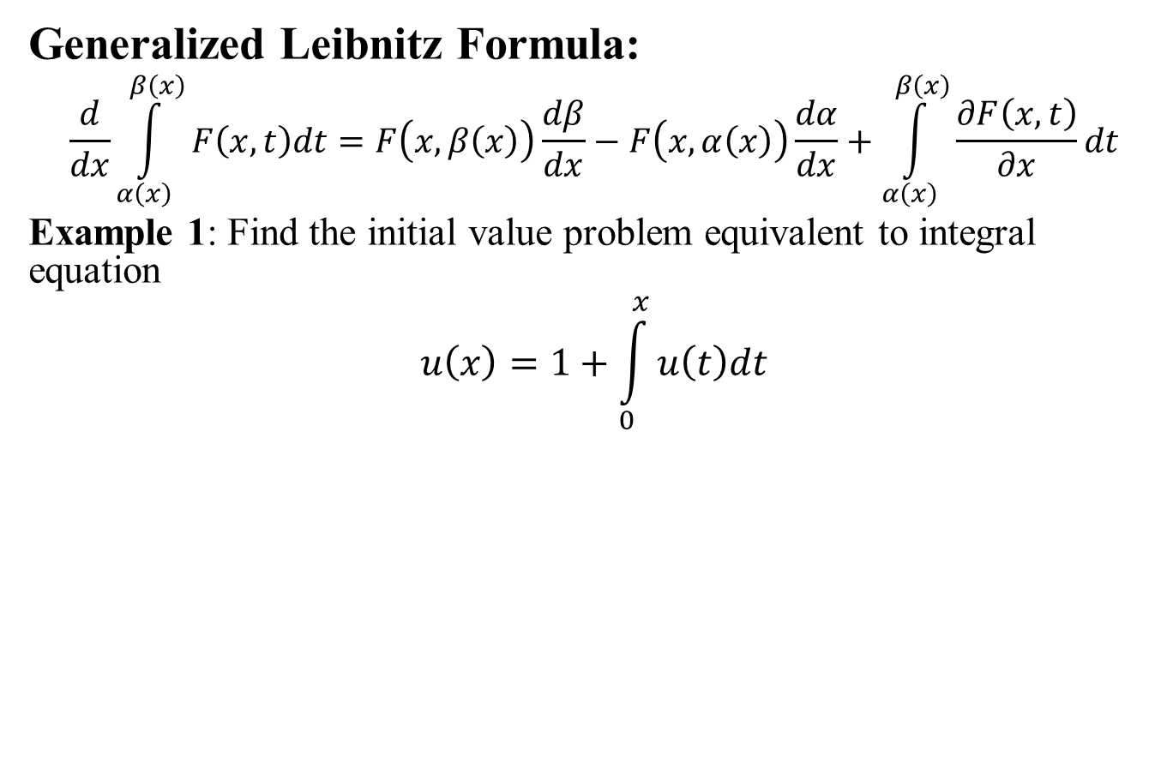

Slide 4
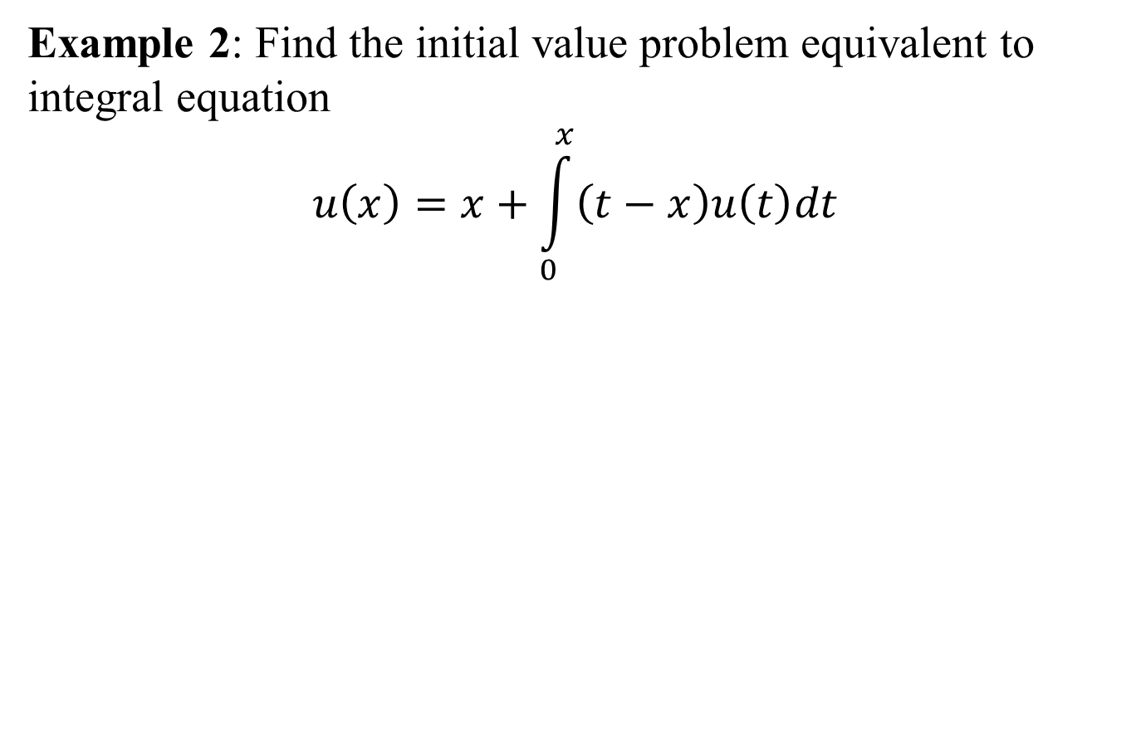
S

Slide 5
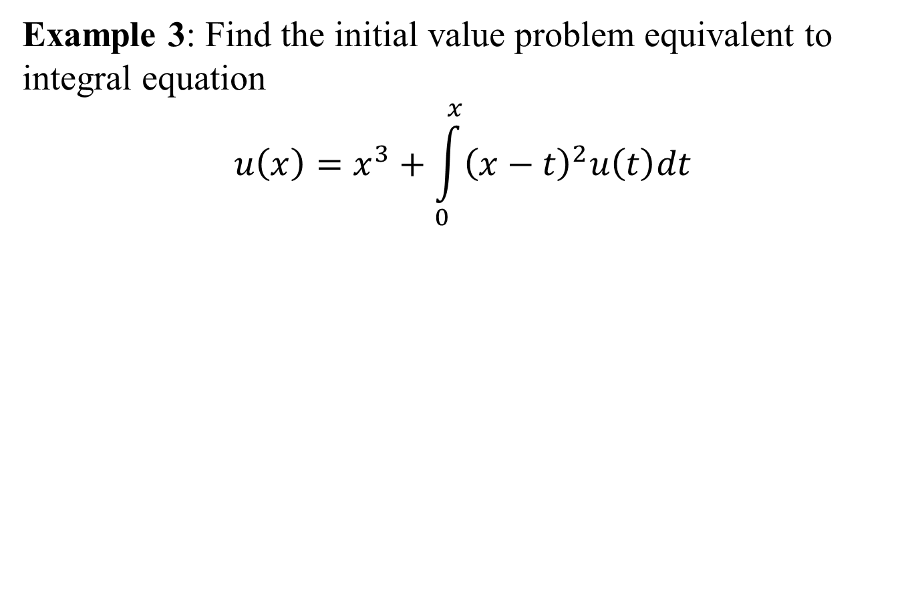

Slide 6
Origins of an Integral equations:
As we know integral equations arise in many scientific and engineering applications. Voltera integral equations can be obtained from converting initial value problems with prescribed initial values. However, Fredholm integral equation cab be derived from boundary value problems with given boundary conditions.
It is important to point out that converting Voltera integral equations to initial value problems and initial value problems to Voltera integral equations are commonly used in literature. However, converting Fredholm integral equations to boundary value problem and boundary value problems to Fredholm integral equations are rarely used.

Slide 7
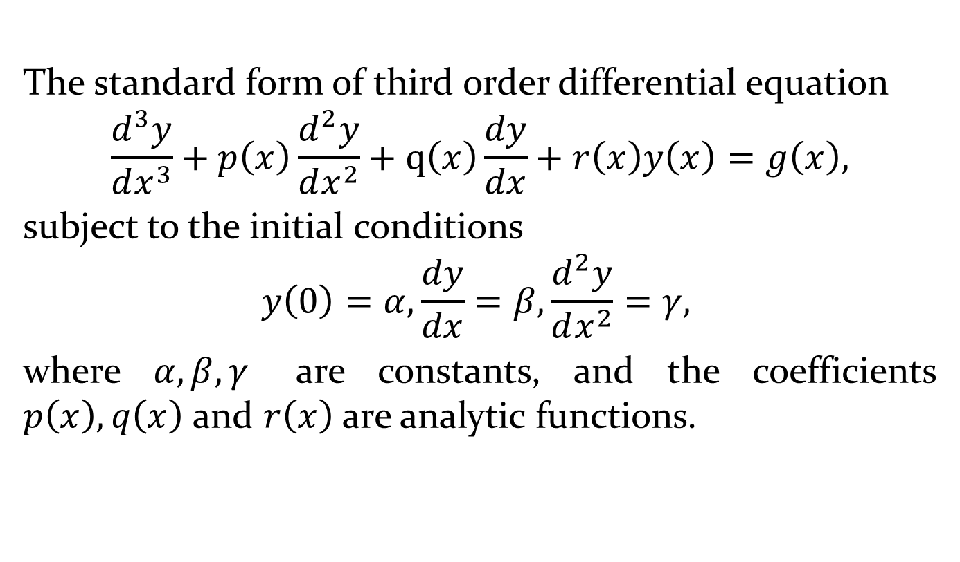
Converting IVP to Voltera Integral Equation

