Slide 1
MTH-471
Integral Equations
Sheikh Irfan Ullah Khan
Assistant Professor
Department of Mathematics
COMSTAS Institute of Information Technology

Slide 2
MTH-471
Lecture # 01
Integral Equations

Slide 3

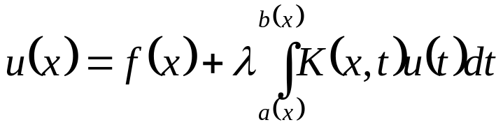


Definition
An integral equation is an equation in which the unknown function to be determined appears under the integral sign. A typical form of an integral equation in is of the form
(1)
where K is a function of two variables called the kernel of the integral equation and and are the limits of integration.
In equation (1), it is easily observed that the unknown function appears under the integral sign as stated above, and outside of the integral sign in most other cases.

Slide 4


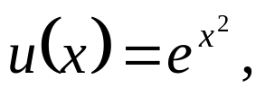
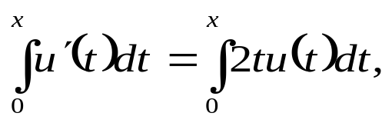
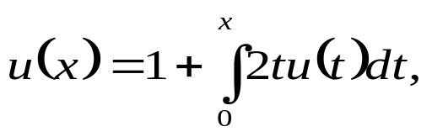
Example 1: Consider the initial value problem
(2)
Subject to the boundary condition (3)
Solution: The equation (2) can be easily solved by using separation of variables, the solution
(4)
is easily obtained.
However, integrating both sides of (2) with respect to x, from 0 to x and using the initial condition (3) yield the following
(5)
or equivalently
(6)

Slide 6
Classification of Linear Integral Equations:
The most frequently used linear integral equations fall under the two main classes namely Fredholm and Voltera integral equations. However, in this text we will distinguish four types of linear integral equations; in which two are of from main classes and two related types of integral equations. In particular, the four types are given by:
Fredholm integral equations
Voltera integral equations
Integro-Differential equations
Singular integral equations.

Slide 7
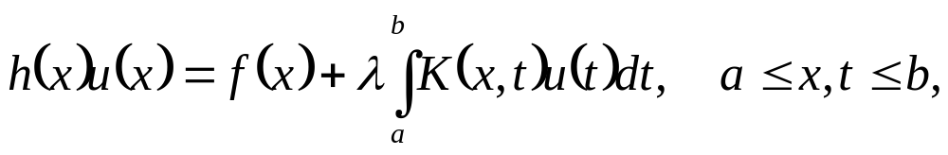
Fredholm Linear Integral Equations:
The standard form of Fredholm linear integral equations, where the limits of integration a and b are constants, are given by
(7)

Slide 8
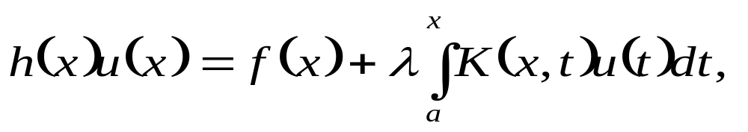
Voltera Linear Integral Equations:
The standard form of Voltera linear integral equations, where the limit of integration are function of x rather than constants, are given by
(10)

Slide 9
Examining the equations (7) – (12) carefully, the following remarks can be concluded:
Structure of Fredholm and Voltera equations:
The unknown function appears linearly only under the integral sign in linear Fredholm and Voltera integral equations of the first kind. However, the unknown function appears linearly under the integral sign and outside the integral sign as well in the second kind of these linear integral equations.
Limits of integration:
In Fredholm integral equations, the integral is taken over a finite interval with fixed limit of integration. However, in Voltera integral equations, at least one limit of the range of integration is a variable.

Slide 10
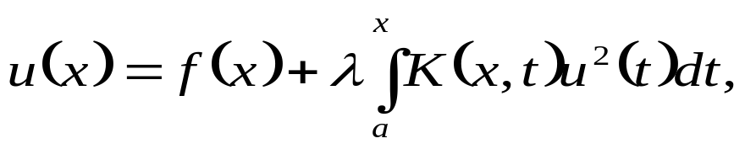
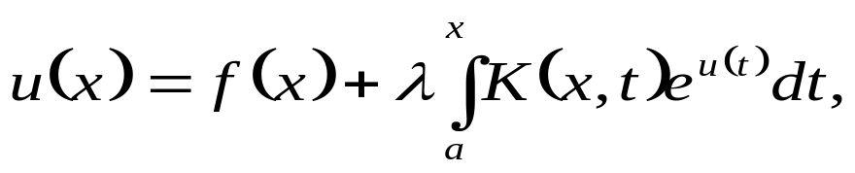
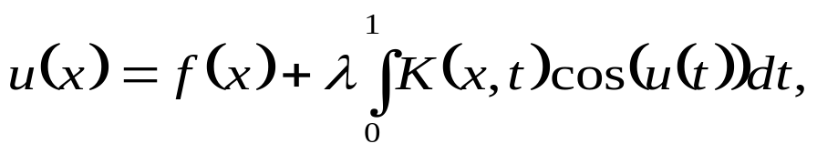
Linearity property:
If the exponent of the unknown function inside the integral sign is one, the integral equation is called linear integral equation. If the unknown function has exponent other than one, or if the equation contains nonlinear function of , such as and etc., the integral equation is known as nonlinear integral equation. The following are examples of nonlinear integral equations:
(13)
(14)
(15)

Slide 11

Homogeneity property:
If we set in Fredholm or Voltera integral equation of the second kind given by (9) and (12), the resulting equation is known as homogeneous integral equation, otherwise it is called nonhomogeneous integral equation, i.e.

Slide 12
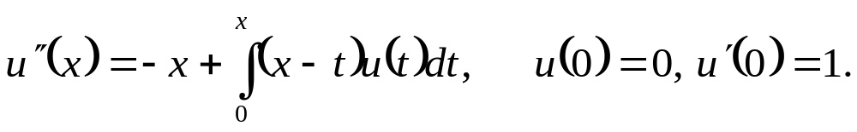
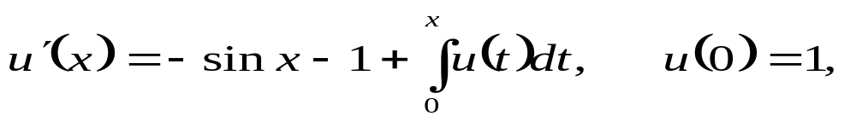
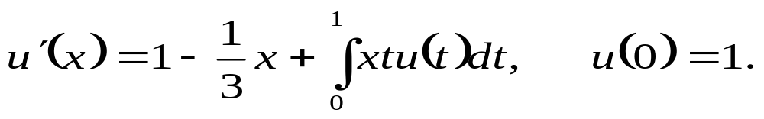
Integro-Differential Equations:
Voltera, in the early 1900, studied the population growth, where new types of equations have been developed and was termed as Integro-differential equations. In this type of equations, the unknown function occurs in one side as an ordinary derivative, and appears on the other side under the integral sign. The following are examples of Integro-differential equations:
(16)
(17)
(18)

Slide 13
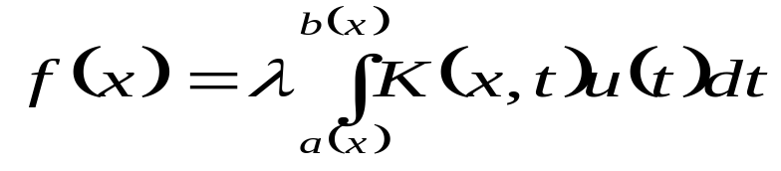

Singular integral Equations:
The integral equation of the first kind
(19)
or the integral equation of the second kind
(20)
is called singular if the lower limit, the upper limit or both limits of integration are infinite. In addition, the equation (19) or (20) is also called a singular integral equation if the kernel becomes infinite at one or more point in the domain of integration.

Slide 14
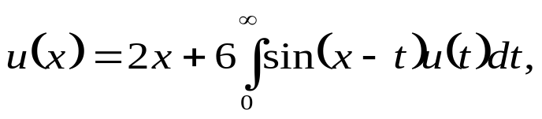
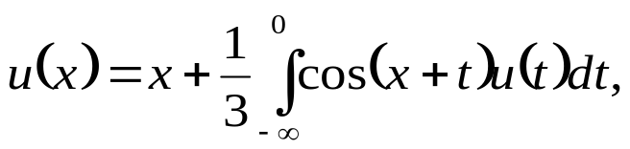
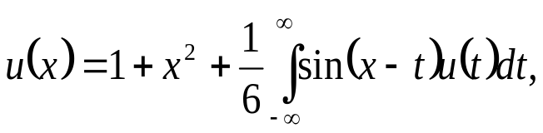
Some examples of first kind are listed below:
where the singular behavior in these examples has resulted from the range of the integration becoming infinite.

Slide 15
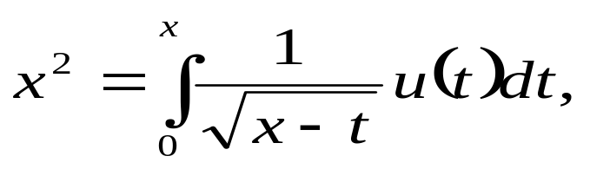
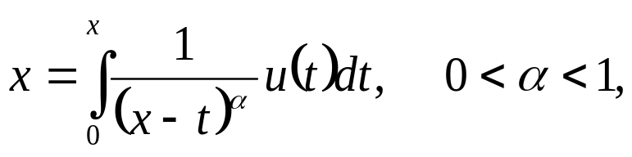
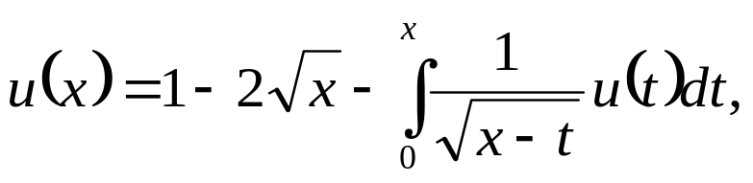

Examples of the second kind of singular integral equation are given by.
where the singular behavior in this kind of equations has resulted from the kernel becoming infinite as .

Slide 16
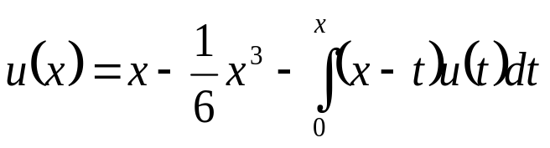
Example 2: Classify the following integral equation
as Fredholm or Voltera integral equation, linear or nonlinear, and homogeneous or nonhomogeneous.

Slide 17
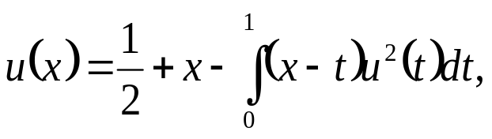
Example 3: Classify the following integral equation
as Fredholm or Voltera integral equation, linear or nonlinear, and homogeneous or nonhomogeneous.

Slide 18
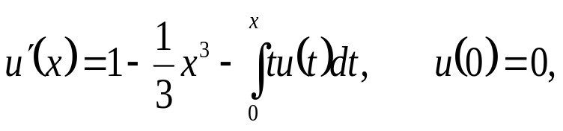
Example 4: Classify the following integral equation
as Fredholm or Voltera integral equation, linear or nonlinear, and homogeneous or nonhomogeneous.

Slide 19
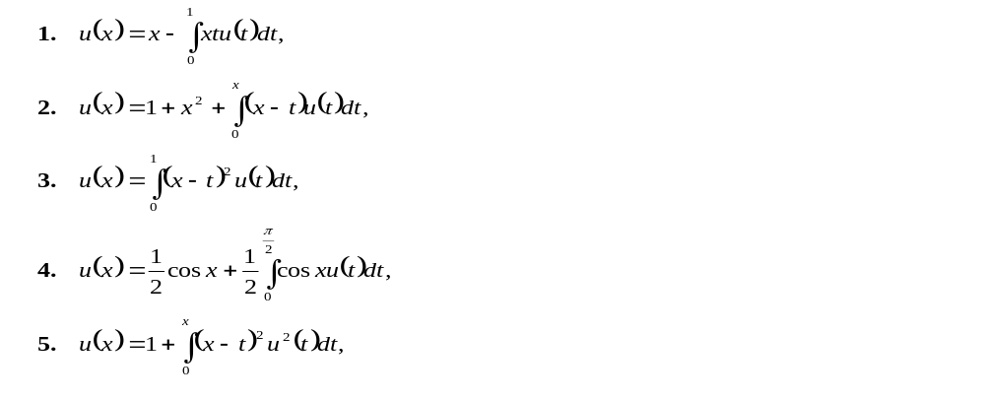
Exercise
In exercise 1-5, classify the following integral equation as Fredholm or Voltera integral equation, linear or nonlinear, and homogeneous or nonhomogeneous:

Slide 20
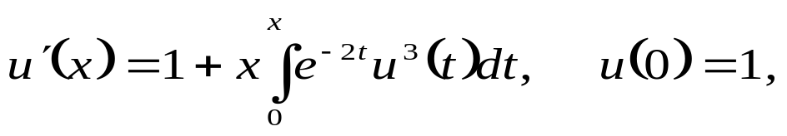
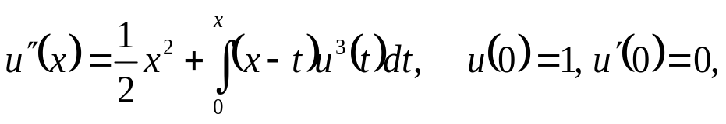
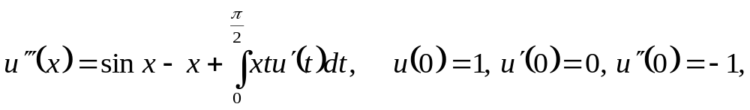
In exercise 6-8, classify each of the following Integro-differential equation as Fredholm integro-differential equation or Voltera Integro-differential equation. Also determine whether the equation is linear or nonlinear:
6.
7.
8.

Slide 21
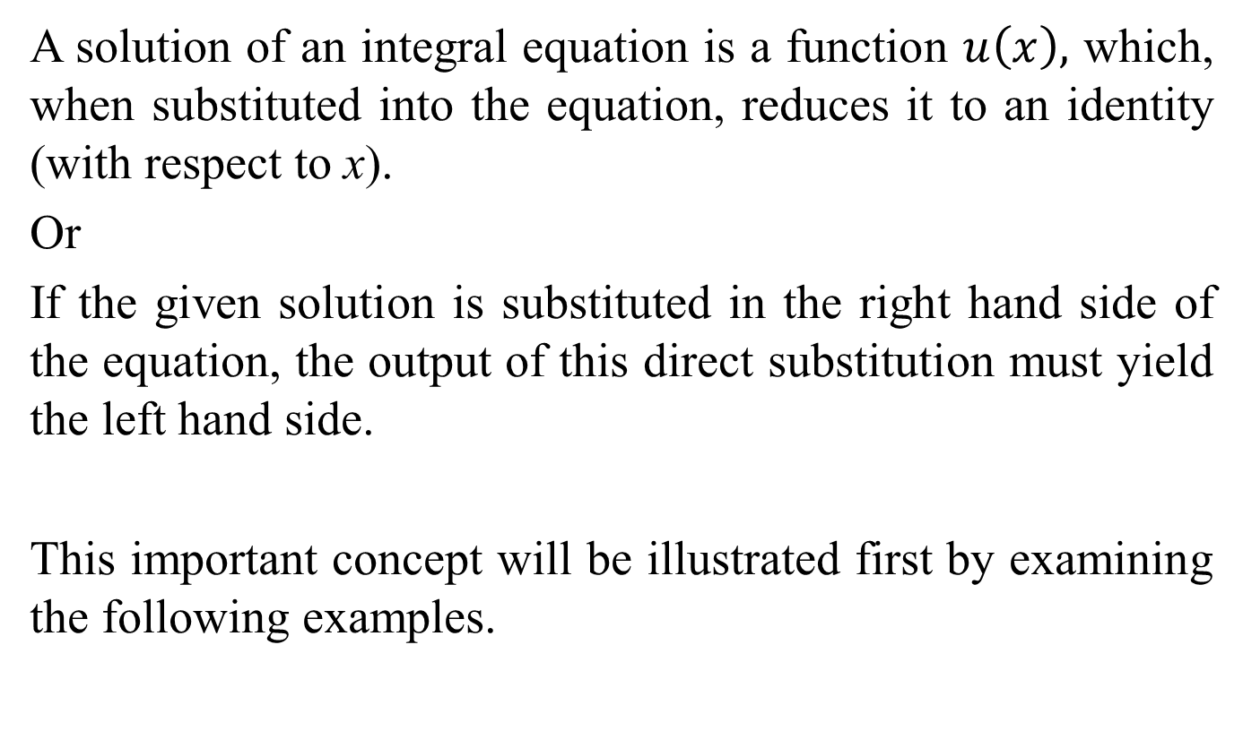
Solution of an Integral Equation:
A solution of an integral equation is a function $u\left(x\right),$ which, when substituted into the equation, reduces it to an identity (with respect to x).
Or
If the given solution is substituted in the right hand side of the equation, the output of this direct substitution must yield the left hand side.
This important concept will be illustrated first by examining the following examples.

Slide 22
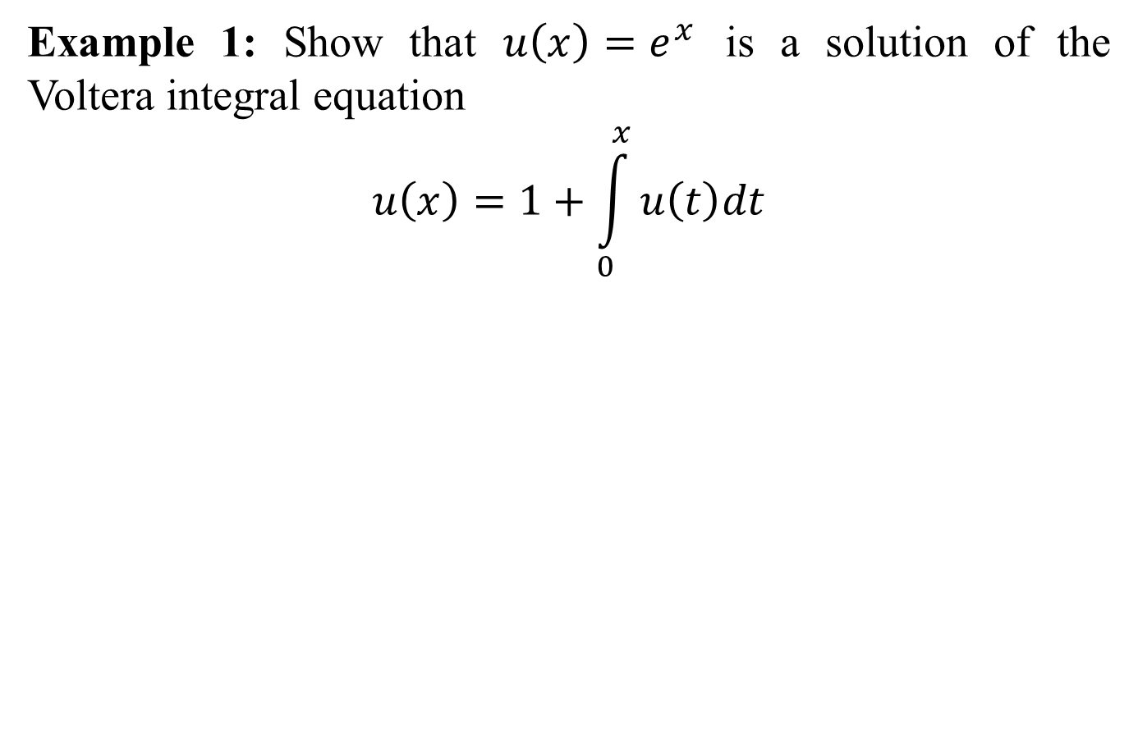
Example 1: Show that $u\left(x\right)=e^{x}$ is a solution of the Voltera integral equation
$$u\left(x\right)=1+\int_{0}^{x}{u\left(t\right)dt}$$

Slide 23
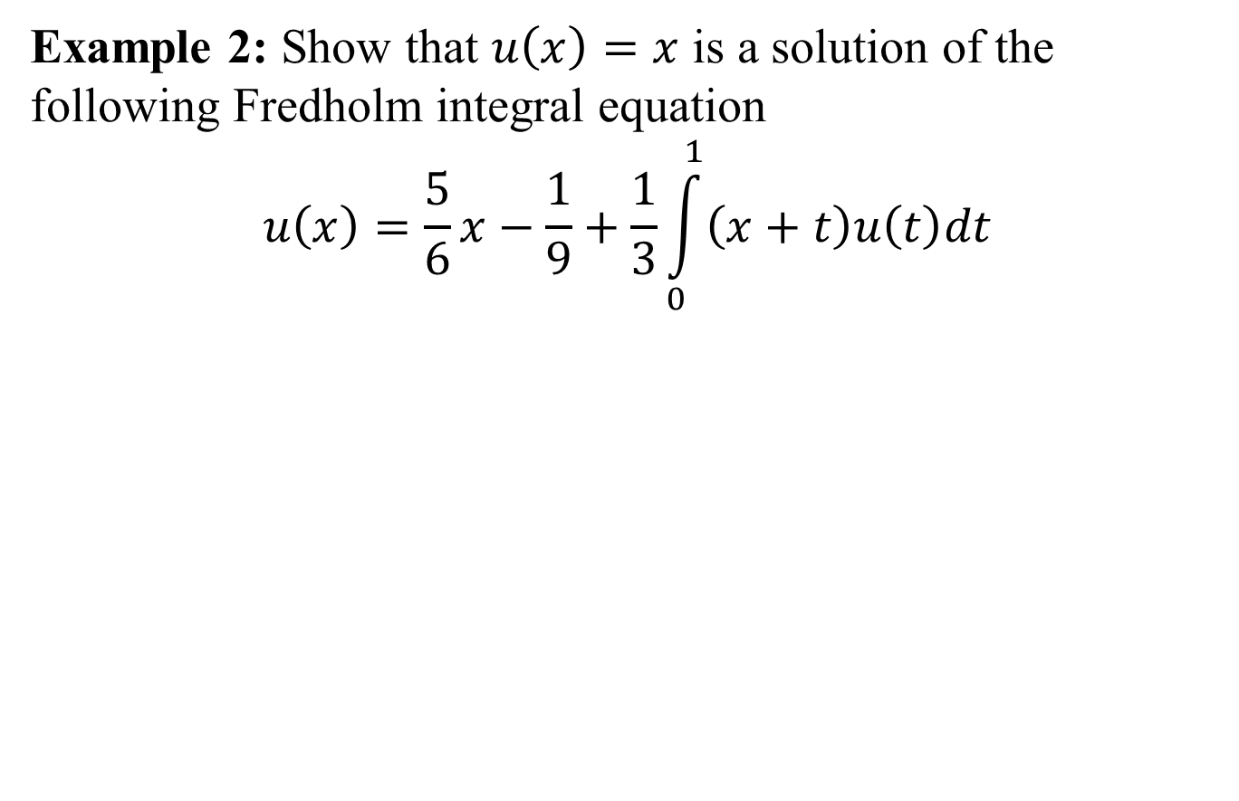
Example 2: Show that $u\left(x\right)=x$ is a solution of the following Fredholm integral equation
$$u\left(x\right)=\frac{5}{6}x−\frac{1}{9}+\frac{1}{3}\int_{0}^{1}{\left(x+t\right)u\left(t\right)dt}$$

Slide 24
Here some valuable remarks can be made with respect to the concept of the solution of an integral equation.
Existence and uniqueness of a solution.
If solution exists for an integral equation, then this solution may be given in a closed form expressed in terms of elementary functions, such as a polynomial, exponential, trigonometric or hyperbolic function, similar to the solutions given in example 1-2. However, it is not always possible to obtain the solution in a closed form, but instead the solution obtained may be expressible in a series form. The solution obtained in series form is usually used for numerical approximations.

Slide 25
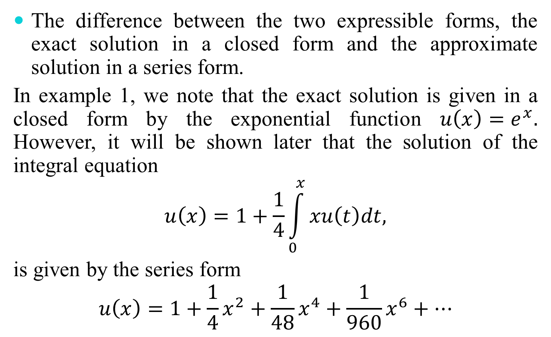
The difference between the two expressible forms, the exact solution in a closed form and the approximate solution in a series form.
In example 1, we note that the exact solution is given in a closed form by the exponential function $u\left(x\right)=e^{x}.$ However, it will be shown later that the solution of the integral equation
$$u\left(x\right)=1+\frac{1}{4}\int_{0}^{x}{xu\left(t\right)dt,}$$
is given by the series form
$$u\left(x\right)=1+\frac{1}{4}x^{2}+\frac{1}{48}x^{4}+\frac{1}{960}x^{6}+…$$

Slide 26
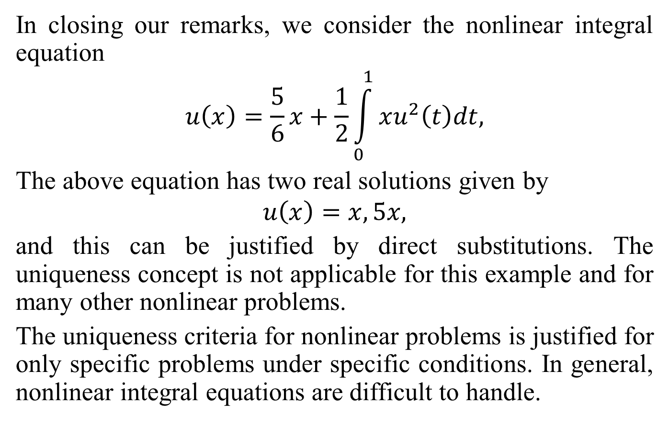
In closing our remarks, we consider the nonlinear integral equation
$$u\left(x\right)=\frac{5}{6}x+\frac{1}{2}\int_{0}^{1}{xu^{2}\left(t\right)dt,}$$
The above equation has two real solutions given by
$$u\left(x\right)=x,5x,$$
and this can be justified by direct substitutions. The uniqueness concept is not applicable for this example and for many other nonlinear problems.
The uniqueness criteria for nonlinear problems is justified for only specific problems under specific conditions. In general, nonlinear integral equations are difficult to handle.

Slide 27
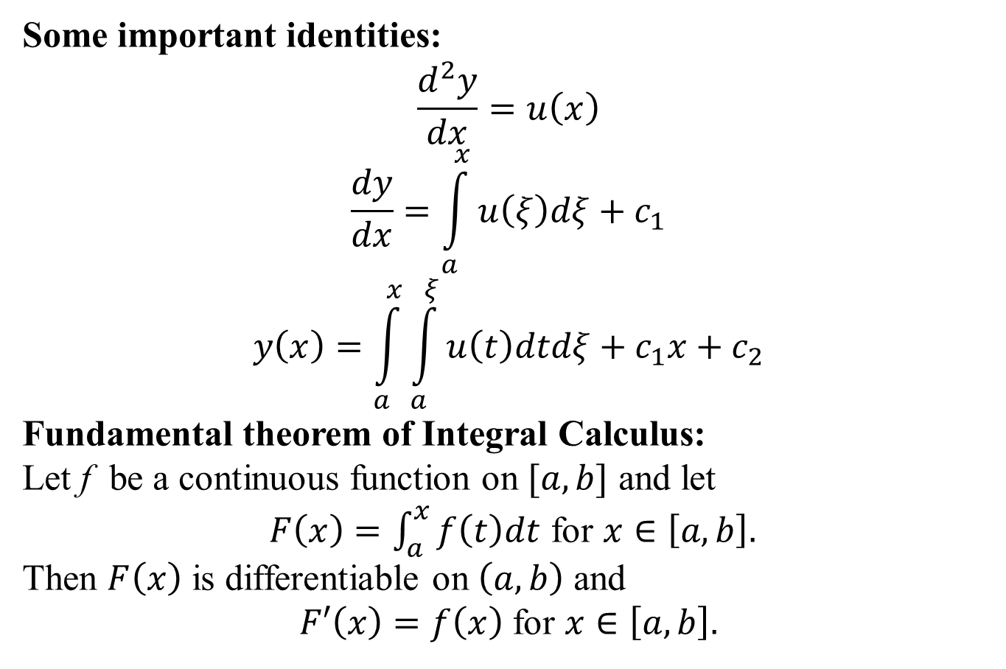
Some important identities:
$$\frac{d^{2}y}{dx}=u\left(x\right)$$
$$\frac{dy}{dx}=\int_{a}^{x}{u\left(ξ\right)dξ+c_{1}}$$
$$y\left(x\right)=\int_{a}^{x}{\int_{a}^{ξ}{u\left(t\right)dtdξ+c_{1}x+c_{2}}}$$
Fundamental theorem of Integral Calculus:
Let f be a continuous function on $[a,b]$ and let
$F\left(x\right)=\int_{a}^{x}{f\left(t\right)dt}$ for $x∈\left[a,b\right].$
Then $F\left(x\right)$ is differentiable on $\left(a,b\right)$ and
$F′\left(x\right)=f\left(x\right)$ for $x∈\left[a,b\right].$

Slide 28
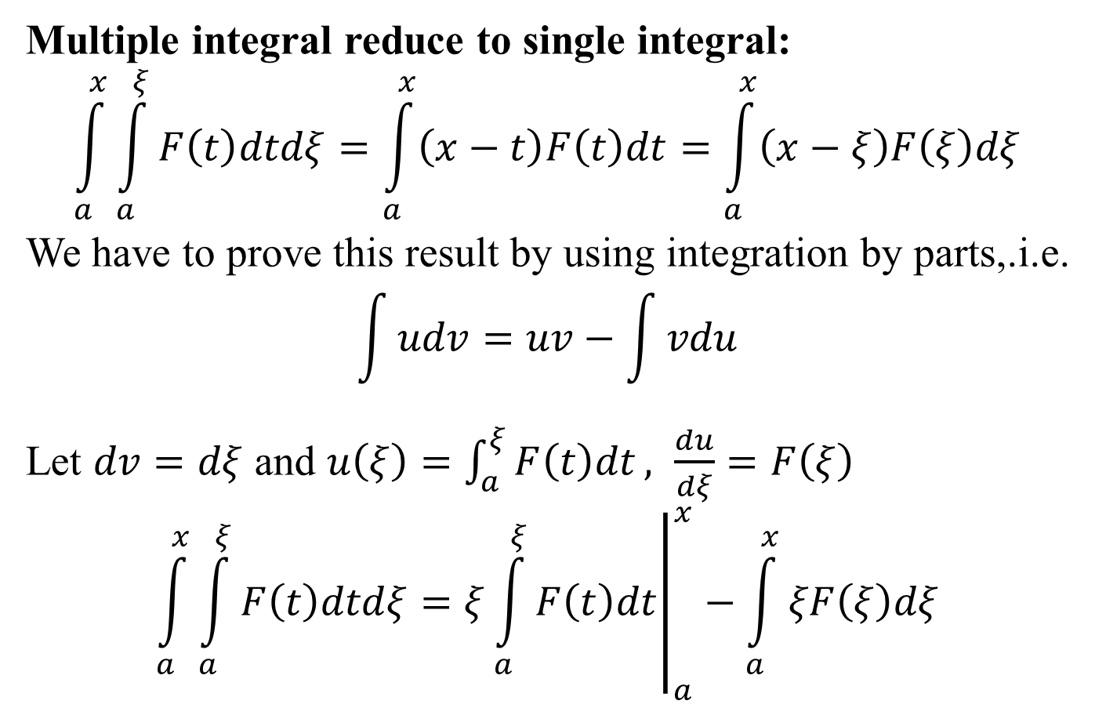
Multiple integral reduce to single integral:
$$\int_{a}^{x}{\int_{a}^{ξ}{F\left(t\right)dtdξ=\int_{a}^{x}{\left(x−t\right)F\left(t\right)dt}}=\int_{a}^{x}{\left(x−ξ\right)F\left(ξ\right)dξ}}$$
We have to prove this result by using integration by parts,.i.e.
$$\int{udv=uv−\int{vdu}}$$
Let $dv=dξ$ and $u\left(ξ\right)=\int_{a}^{ξ}{F\left(t\right)dt}, \frac{du}{dξ}=F\left(ξ\right)$
$$\int_{a}^{x}{\int_{a}^{ξ}{F\left(t\right)dtdξ=ξ{\left.\int_{a}^{ξ}{F\left(t\right)dt}\right|}_{a}^{x}}−\int_{a}^{x}{ξF\left(ξ\right)dξ}}$$

Slide 29
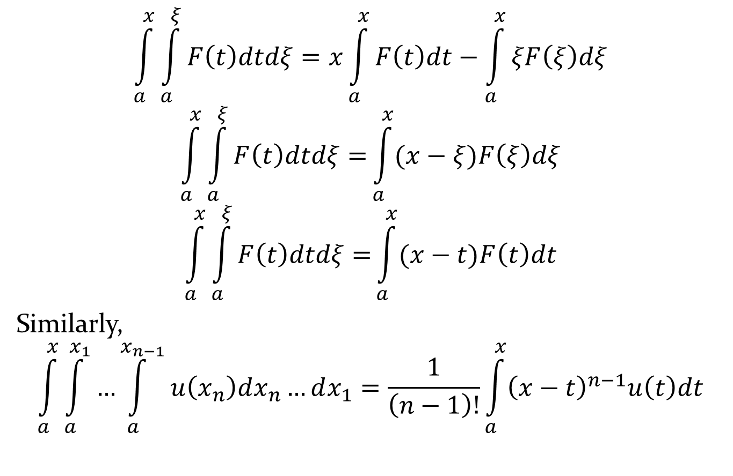
$$\int_{a}^{x}{\int_{a}^{ξ}{F\left(t\right)dtdξ=x\int_{a}^{x}{F\left(t\right)dt}}−\int_{a}^{x}{ξF\left(ξ\right)dξ}}$$
$$\int_{a}^{x}{\int_{a}^{ξ}{F\left(t\right)dtdξ=}\int_{a}^{x}{(x−ξ)F\left(ξ\right)dξ}}$$
$$\int_{a}^{x}{\int_{a}^{ξ}{F\left(t\right)dtdξ=}\int_{a}^{x}{(x−t)F\left(t\right)dt}}$$
Similarly,
$$\int_{a}^{x}{\int_{a}^{x_{1}}{…\int_{a}^{x_{n−1}}{u\left(x_{n}\right)dx_{n}…dx_{1}=\frac{1}{\left(n−1\right)!}}}}\int_{a}^{x}{{\left(x−t\right)}^{n−1}u\left(t\right)dt}$$

Slide 30
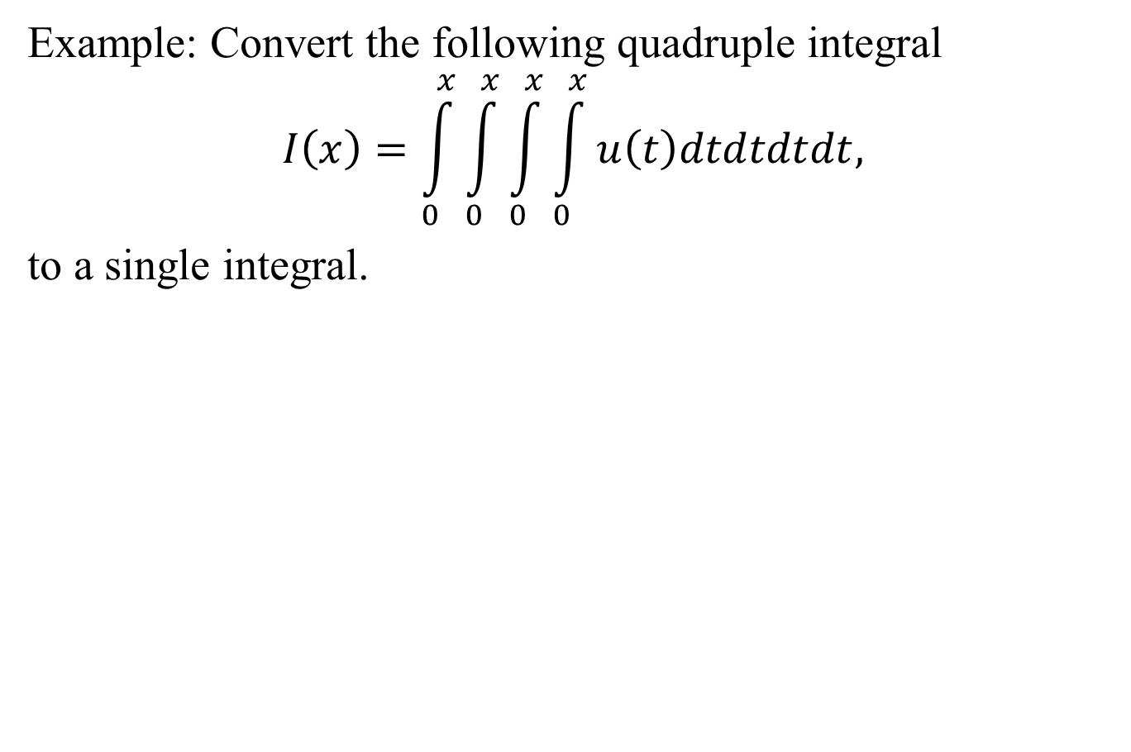
Example: Convert the following quadruple integral
$$I\left(x\right)=\int_{0}^{x}{\int_{0}^{x}{\int_{0}^{x}{\int_{0}^{x}{u\left(t\right)dtdtdtdt,}}}}$$
to a single integral.

Slide 31
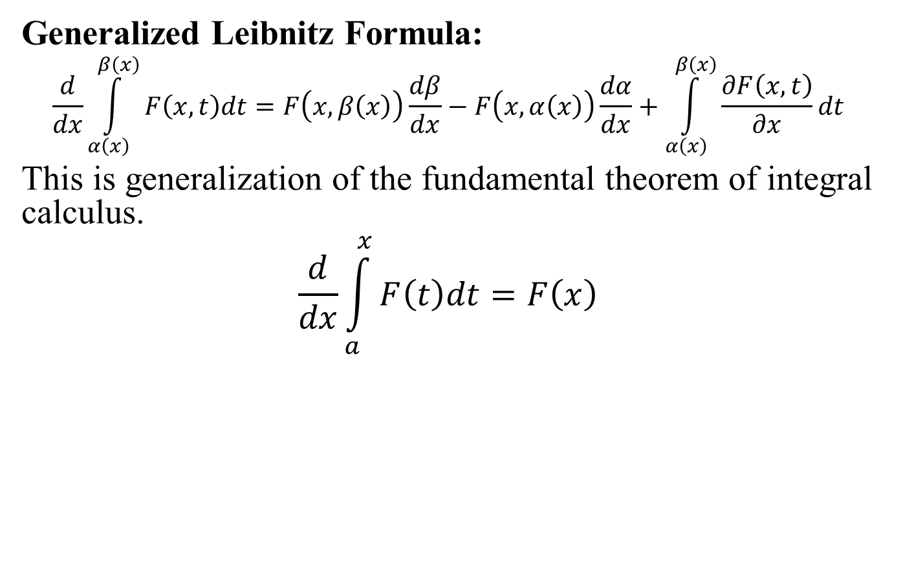
Generalized Leibnitz Formula:
$$\frac{d}{dx}\int_{α\left(x\right)}^{β\left(x\right)}{F\left(x,t\right)dt=F\left(x,β\left(x\right)\right)\frac{dβ}{dx}−F\left(x,α\left(x\right)\right)\frac{dα}{dx}+\int_{α\left(x\right)}^{β\left(x\right)}{\frac{∂F\left(x,t\right)}{∂x}dt}}$$
This is generalization of the fundamental theorem of integral calculus.
$$\frac{d}{dx}\int_{a}^{x}{F\left(t\right)dt}=F\left(x\right)$$

Slide 33
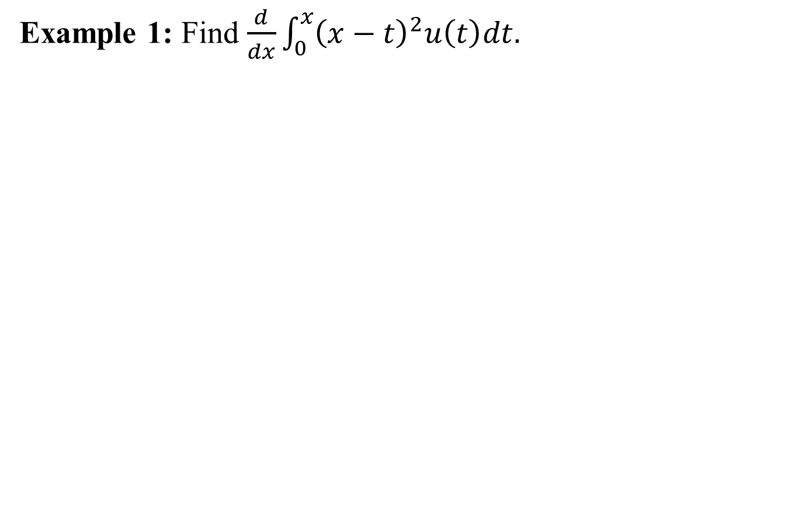
Example 1: Find $\frac{d}{dx}\int_{0}^{x}{{\left(x−t\right)}^{2}u\left(t\right)dt.}$

Slide 34
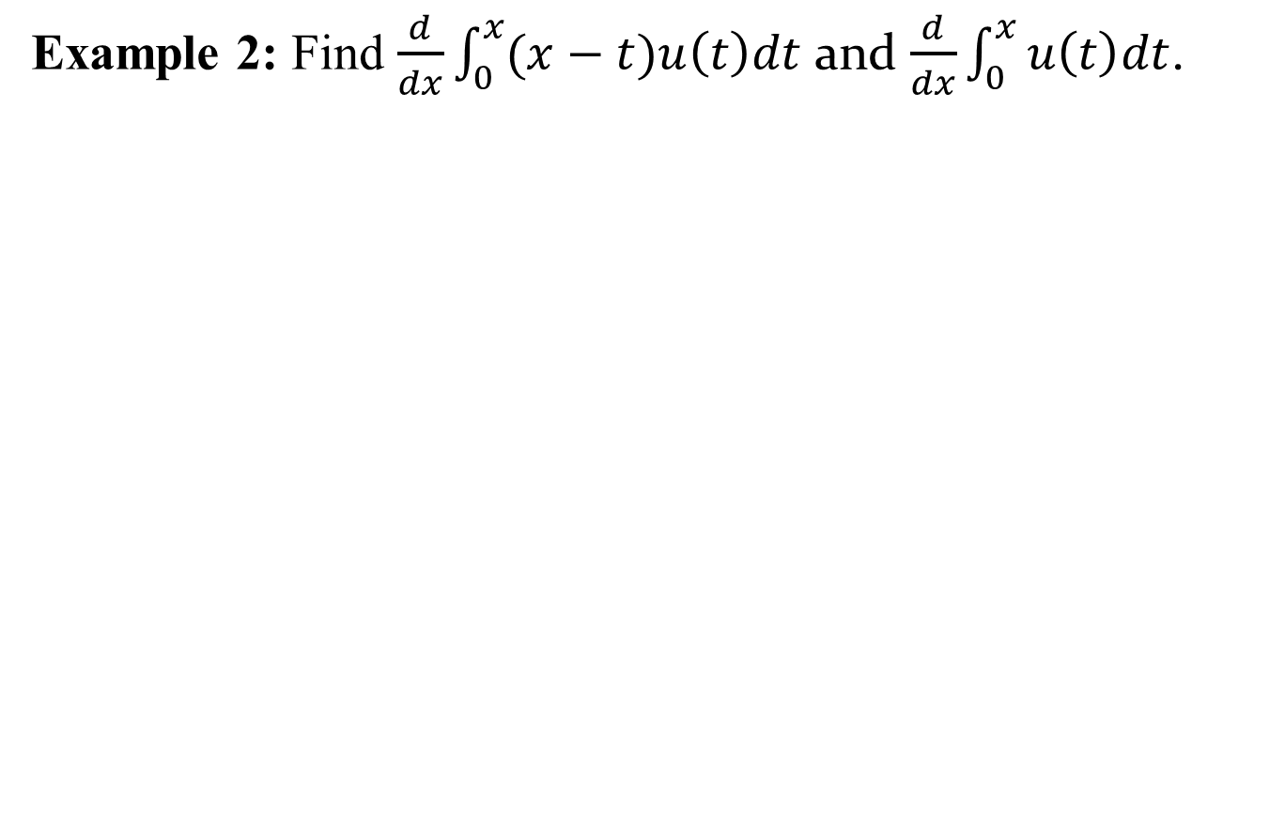
Example 2: Find $\frac{d}{dx}\int_{0}^{x}{(x−t)u\left(t\right)dt}$ and $\frac{d}{dx}\int_{0}^{x}{u\left(t\right)dt}$.

Slide 35
MTH-471
Lecture # 03

Slide 36
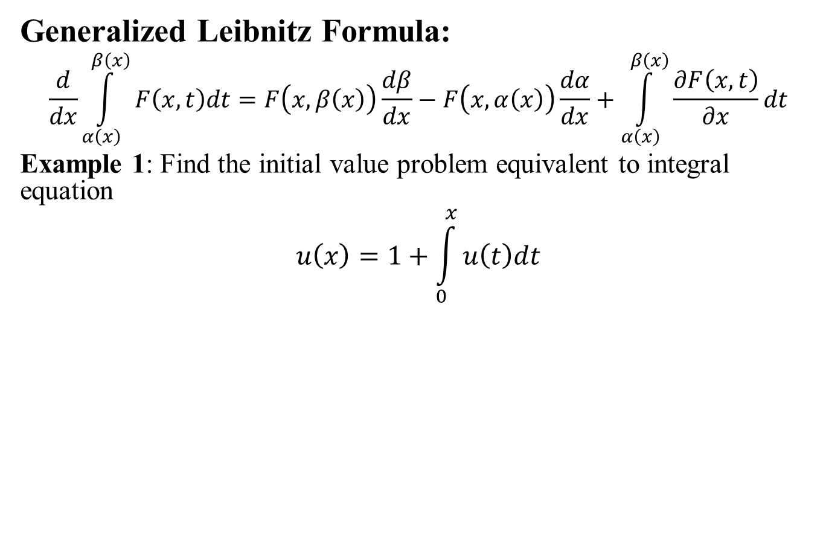
Generalized Leibnitz Formula:
$$\frac{d}{dx}\int_{α\left(x\right)}^{β\left(x\right)}{F\left(x,t\right)dt=F\left(x,β\left(x\right)\right)\frac{dβ}{dx}−F\left(x,α\left(x\right)\right)\frac{dα}{dx}+\int_{α\left(x\right)}^{β\left(x\right)}{\frac{∂F\left(x,t\right)}{∂x}dt}}$$
Example 1: Find the initial value problem equivalent to integral equation
$$u\left(x\right)=1+\int_{0}^{x}{u\left(t\right)dt}$$

Slide 37
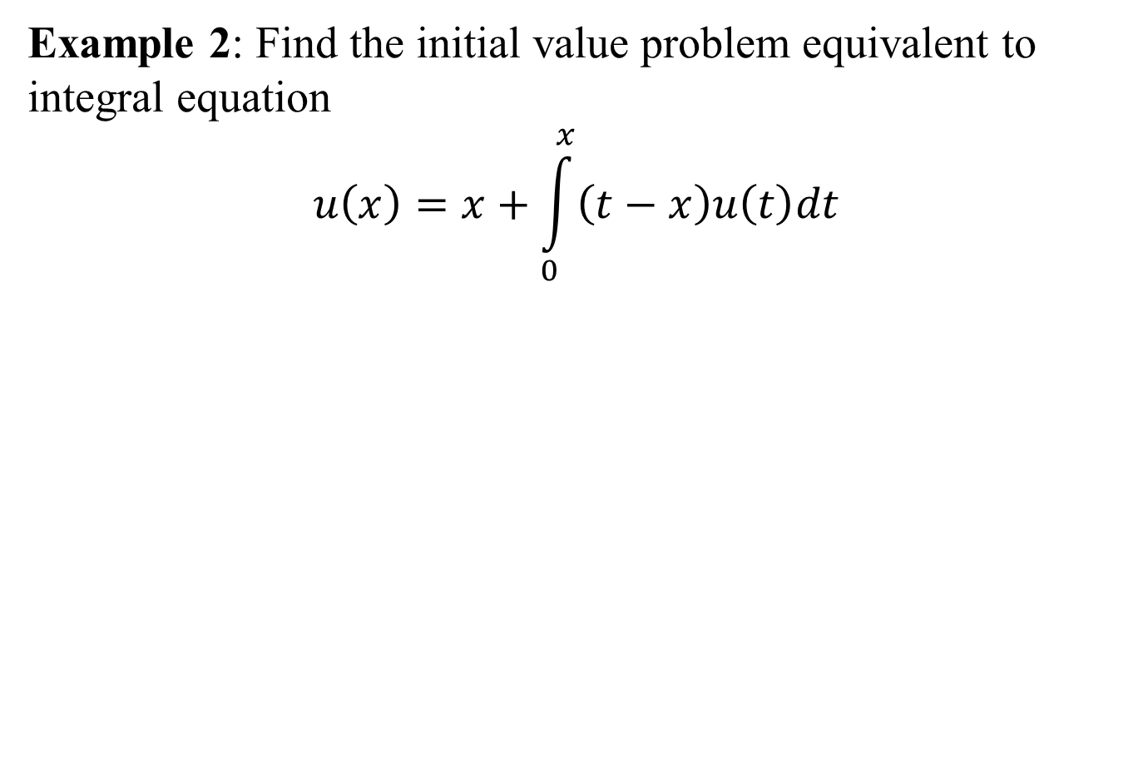
Example 2: Find the initial value problem equivalent to integral equation
$$u\left(x\right)=x+\int_{0}^{x}{\left(t−x\right)u\left(t\right)dt}$$

Slide 38
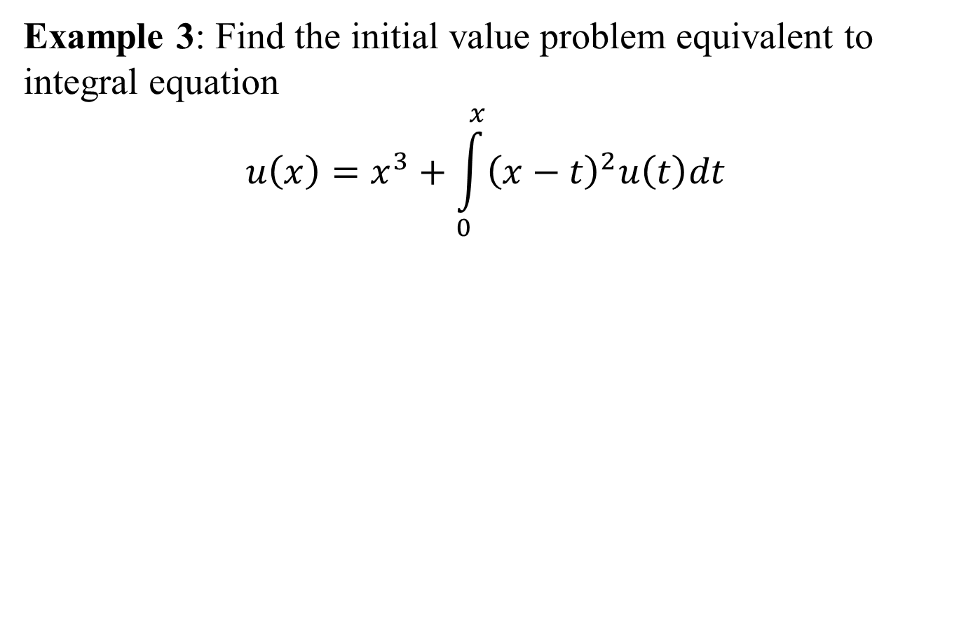
Example 3: Find the initial value problem equivalent to integral equation
$$u\left(x\right)=x^{3}+\int_{0}^{x}{{\left(x−t\right)}^{2}u\left(t\right)dt}$$

Slide 39
Origins of an Integral equations:
As we know integral equations arise in many scientific and engineering applications. Voltera integral equations can be obtained from converting initial value problems with prescribed initial values. However, Fredholm integral equation cab be derived from boundary value problems with given boundary conditions.
It is important to point out that converting Voltera integral equations to initial value problems and initial value problems to Voltera integral equations are commonly used in literature. However, converting Fredholm integral equations to boundary value problem and boundary value problems to Fredholm integral equations are rarely used.

Slide 40
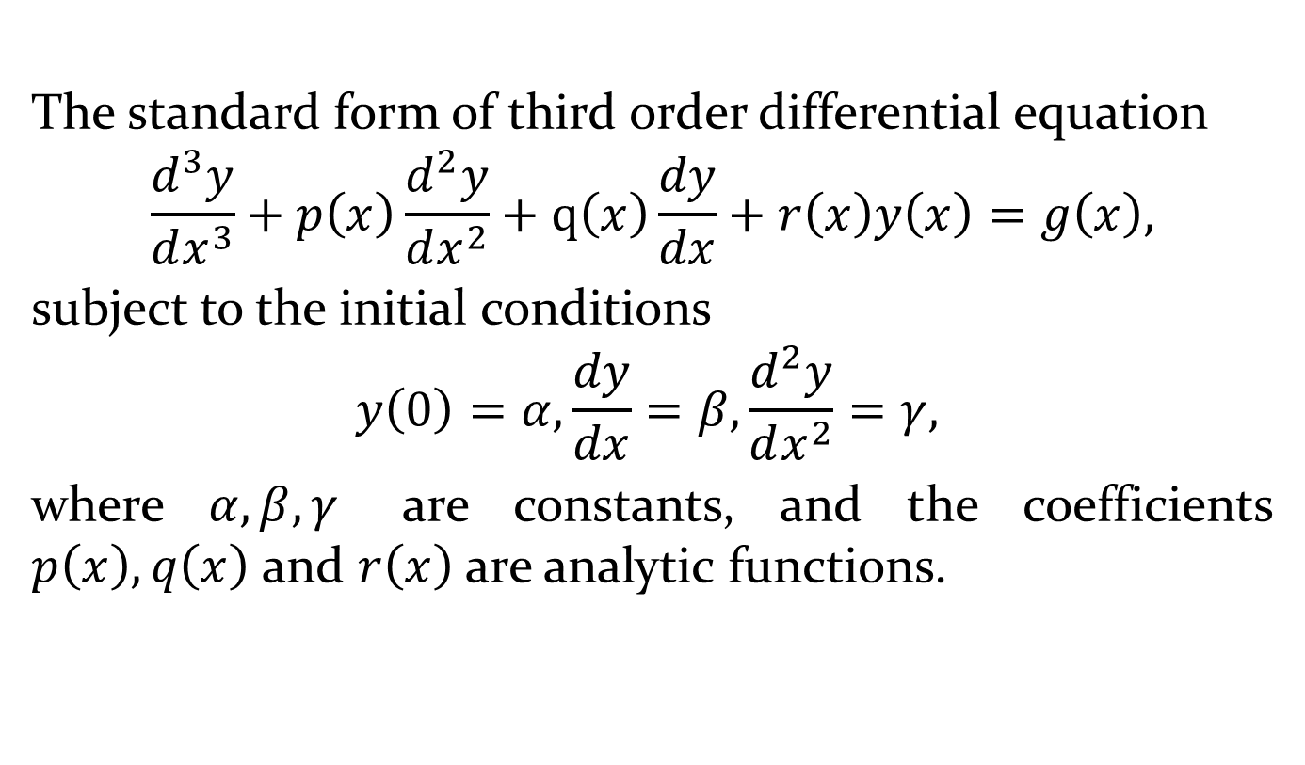
Converting IVP to Voltera Integral Equation
The standard form of third order differential equation
$$\frac{d^{3}y}{dx^{3}}+p\left(x\right)\frac{d^{2}y}{dx^{2}}+q\left(x\right)\frac{dy}{dx}+r\left(x\right)y\left(x\right)=g\left(x\right),$$
subject to the initial conditions
$$y\left(0\right)=α, \frac{dy}{dx}=β,\frac{d^{2}y}{dx^{2}}=γ,$$
where $α, β, γ$ are constants, and the coefficients $p\left(x\right), q\left(x\right)$ and $r\left(x\right)$ are analytic functions.

Slide 45
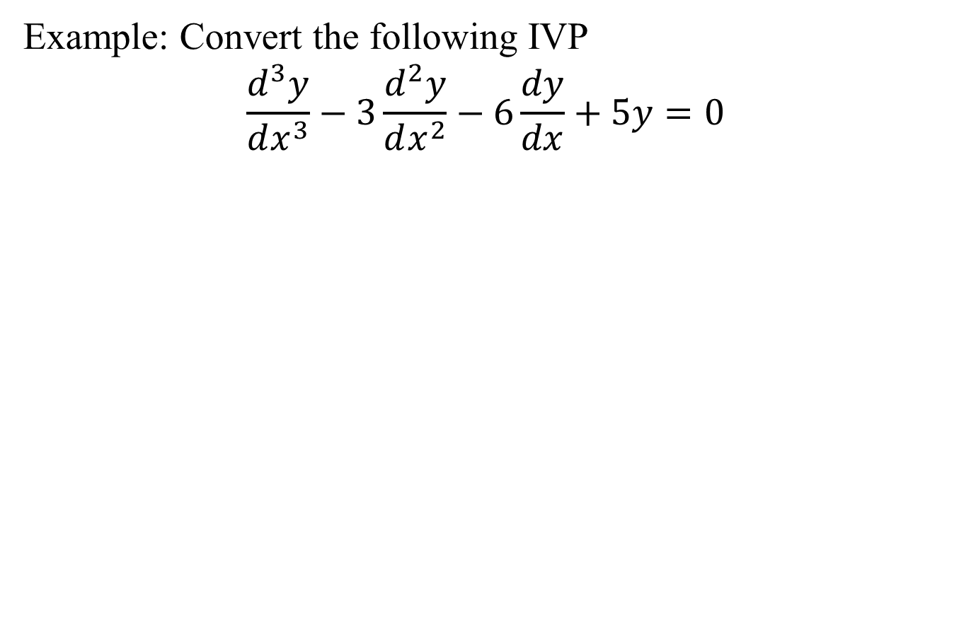
Example: Convert the following IVP
$$\frac{d^{3}y}{dx^{3}}−3\frac{d^{2}y}{dx^{2}}−6\frac{dy}{dx}+5y=0$$

Slide 49
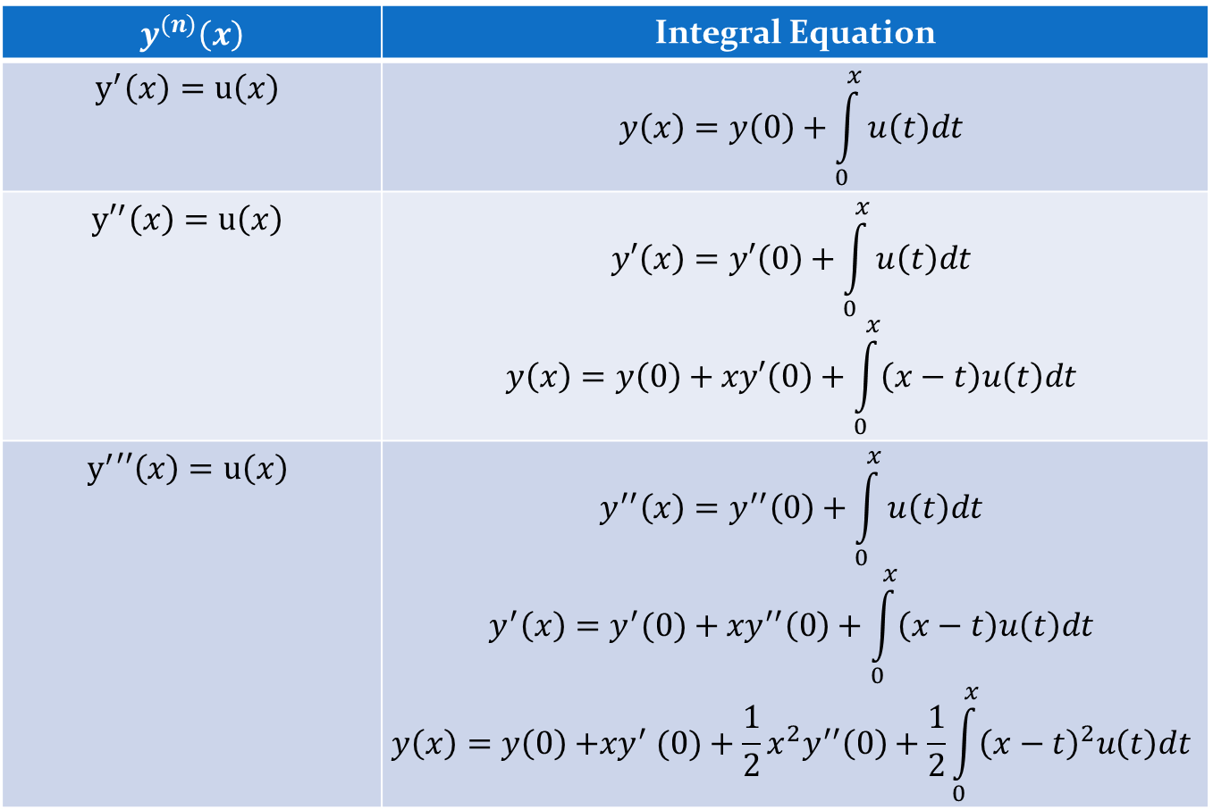
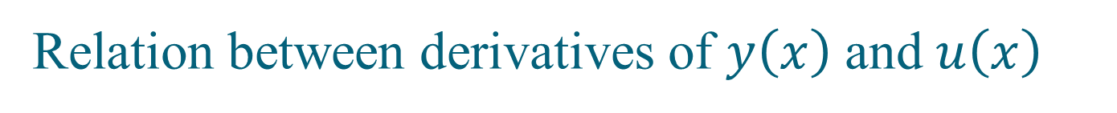
Relation between derivatives of $y\left(x\right)$ and $u\left(x\right)$
$$y^{(n)}\left(x\right)$$ | Integral Equation
$$y^{′}\left(x\right)=u\left(x\right)$$ | $$y\left(x\right)=y\left(0\right)+\int_{0}^{x}{u\left(t\right)dt}$$
$${y′}^{′}\left(x\right)=u\left(x\right)$$ | $$y′\left(x\right)=y′\left(0\right)+\int_{0}^{x}{u\left(t\right)dt}$$ $$y\left(x\right)=y\left(0\right)+xy′\left(0\right)+\int_{0}^{x}{\left(x−t\right)u\left(t\right)dt}$$
$$y^{′}′′\left(x\right)=u\left(x\right)$$ | $$y^{′′}\left(x\right)=y^{′′}\left(0\right)+\int_{0}^{x}{u\left(t\right)dt}$$ $$y^{′}\left(x\right)={y^{′}(0)+xy}^{′′}\left(0\right)+\int_{0}^{x}{\left(x−t\right)u\left(t\right)dt}$$ $$y\left(x\right)={y\left(0\right){+xy}^{′}(0)+\frac{1}{2}x^{2}y}^{′′}\left(0\right)+\frac{1}{2}\int_{0}^{x}{{\left(x−t\right)}^{2}u\left(t\right)dt}$$

Slide 50
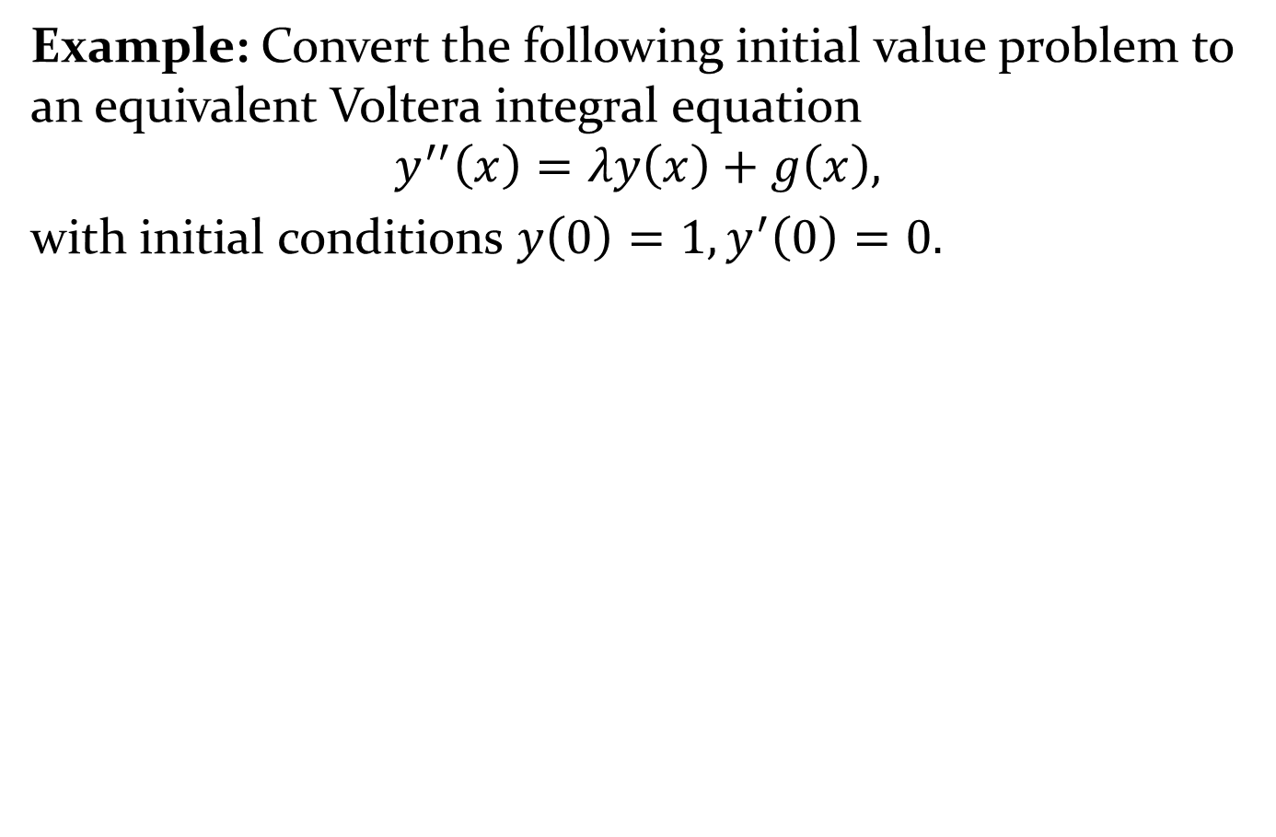
Example: Convert the following initial value problem to an equivalent Voltera integral equation
$$y^{′′}\left(x\right)=λy\left(x\right)+g\left(x\right),$$
with initial conditions $y\left(0\right)=1, y^{′}\left(0\right)=0.$

Slide 52
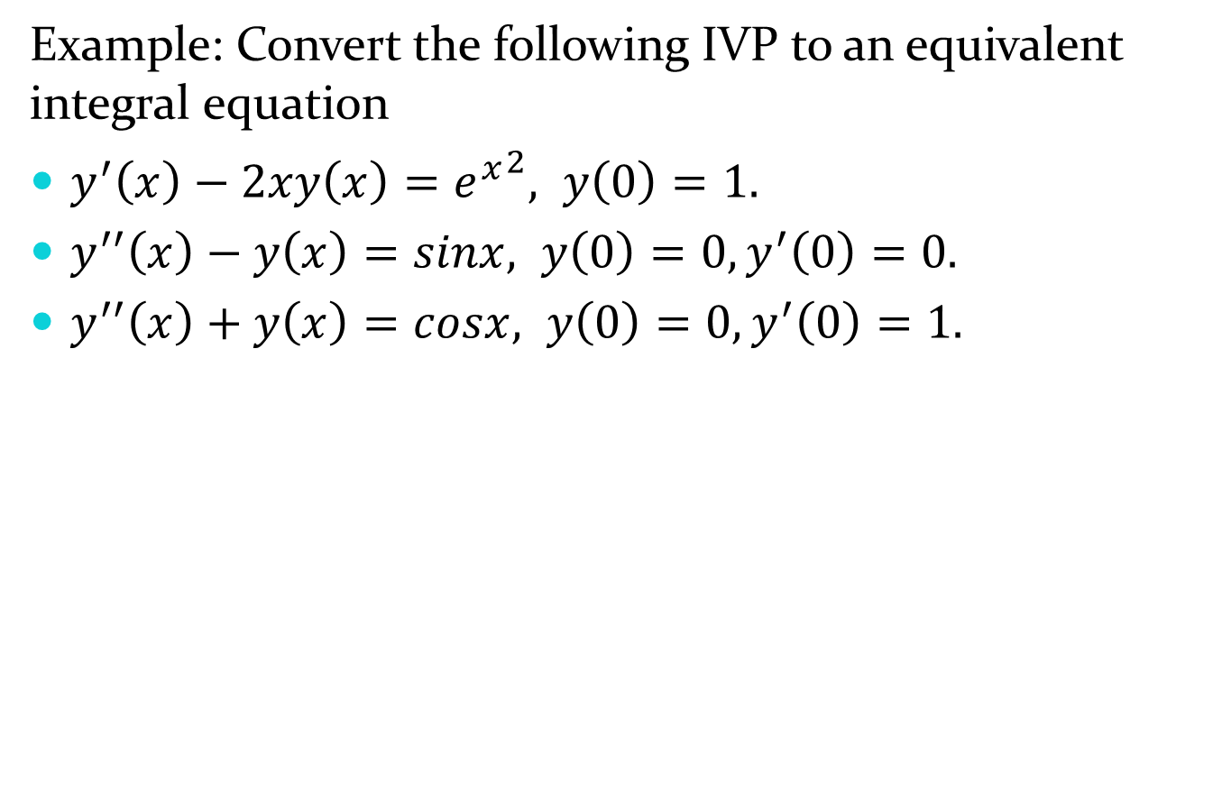
Example: Convert the following IVP to an equivalent integral equation
$y^{′}\left(x\right)−2xy\left(x\right)={e^{x}}^{2}, y\left(0\right)=1.$
$y^{′′}\left(x\right)−y\left(x\right)=sinx, y\left(0\right)=0, y^{′}\left(0\right)=0.$
$y^{′′}\left(x\right)+y\left(x\right)=cosx, y\left(0\right)=0, y^{′}\left(0\right)=1.$

Slide 56
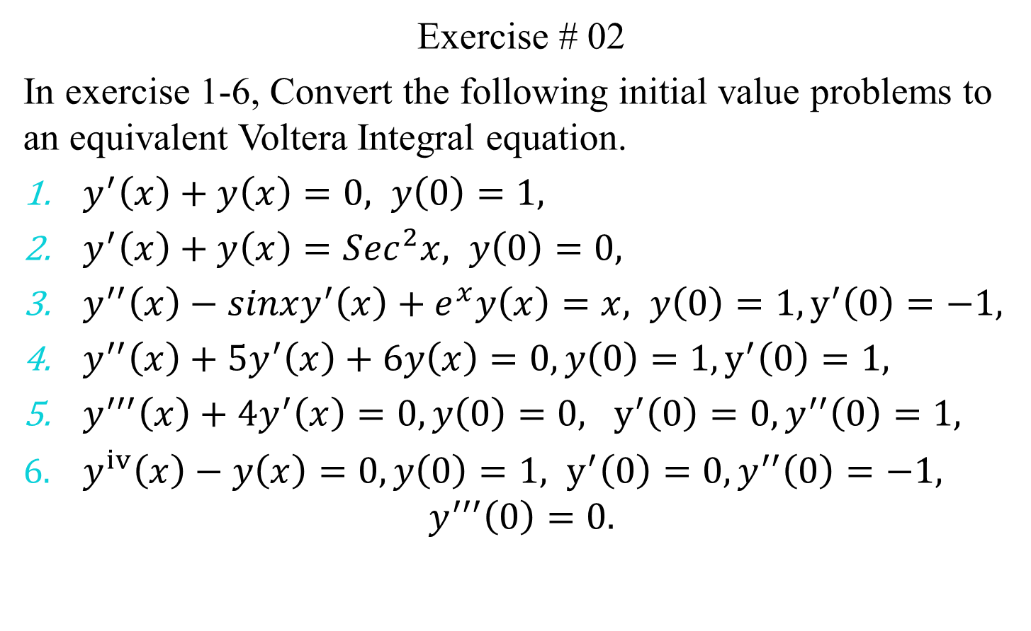
Exercise # 02
In exercise 1-6, Convert the following initial value problems to an equivalent Voltera Integral equation.
$y^{′}\left(x\right)+y\left(x\right)=0, y\left(0\right)=1,$
$y^{′}\left(x\right)+y\left(x\right)=Sec^{2}x, y\left(0\right)=0,$
$y^{′′}\left(x\right)−sinxy^{′}\left(x\right)+e^{x}y\left(x\right)=x, y\left(0\right)=1, y^{′}\left(0\right)=−1,$
$y^{′′}\left(x\right)+5y^{′}\left(x\right)+6y\left(x\right)=0,y\left(0\right)=1, y^{′}\left(0\right)=1,$
$y^{′′′}\left(x\right)+4y^{′}\left(x\right)=0,y\left(0\right)=0, y^{′}\left(0\right)=0, y^{′′}\left(0\right)=1,$
$y^{iv}\left(x\right)−y\left(x\right)=0,y\left(0\right)=1, y^{′}\left(0\right)=0, y^{′′}\left(0\right)=−1,$
$$y^{′′′}\left(0\right)=0.$$

