Slide 1
MTH-471
Integral Equations
Sheikh Irfan Ullah Khan
Assistant Professor
Department of Mathematics
COMSTAS Institute of Information Technology

Slide 2
Recall Lecture 1
How to define an Integral Equation
Classification of an Integral Equation
Solution of an Integral Equation
Examples and Exercise

Slide 4
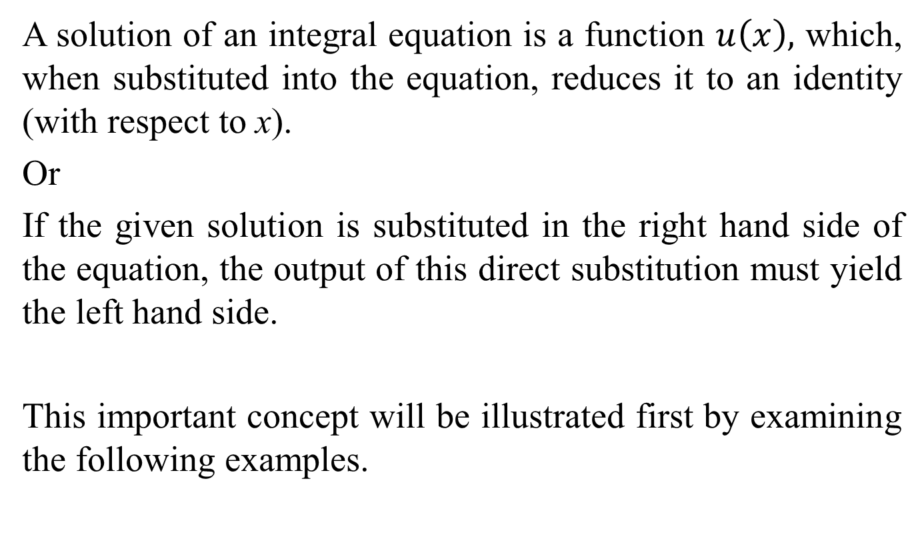
Solution of an Integral Equation:
A solution of an integral equation is a function $u\left(x\right),$ which, when substituted into the equation, reduces it to an identity (with respect to x).
Or
If the given solution is substituted in the right hand side of the equation, the output of this direct substitution must yield the left hand side.
This important concept will be illustrated first by examining the following examples.

Slide 5
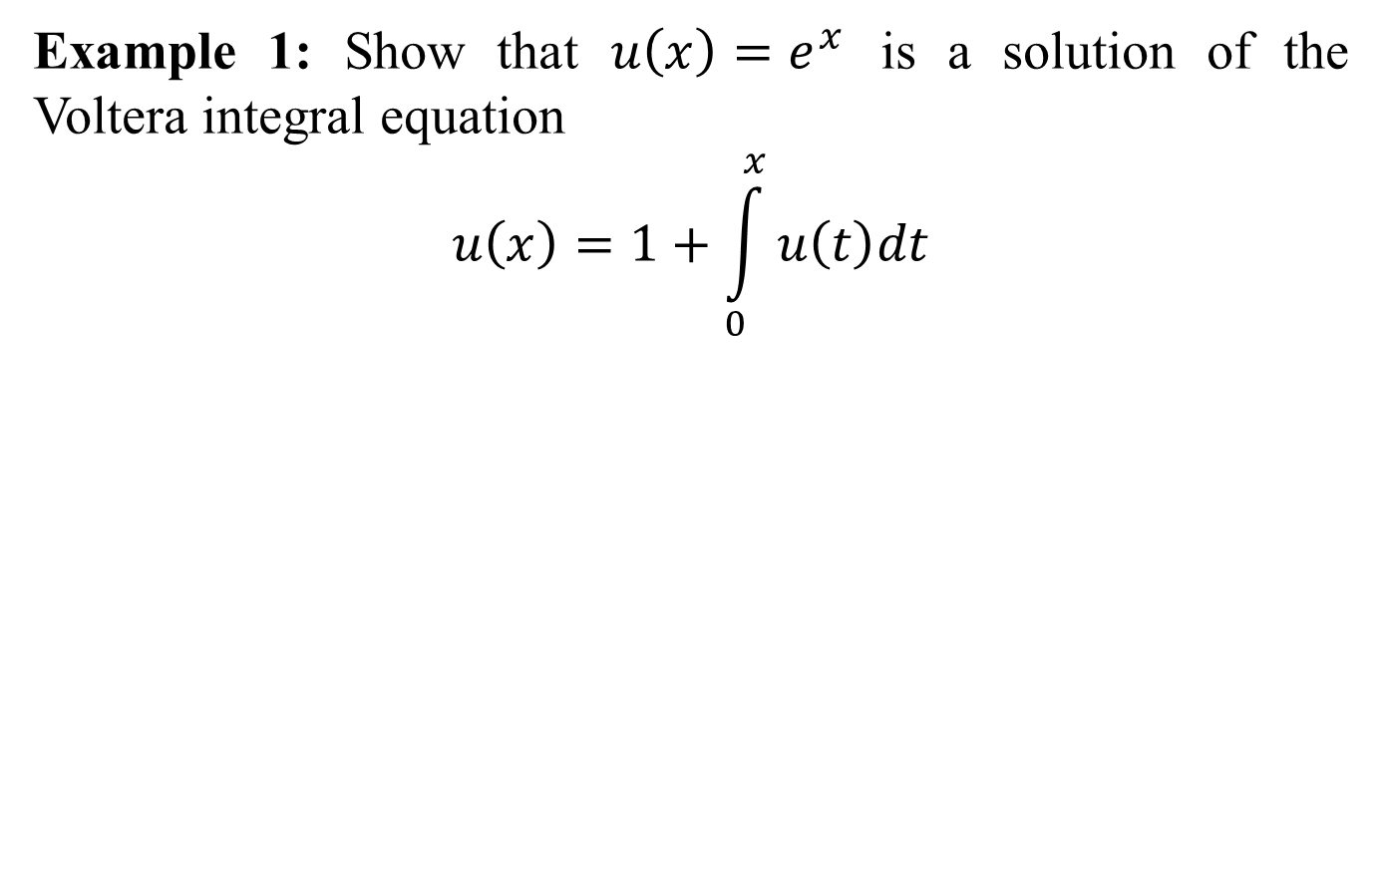
Example 1: Show that $u\left(x\right)=e^{x}$is a solution of the Voltera integral equation
$$u\left(x\right)=1+\int_{0}^{x}{u\left(t\right)dt}$$

Slide 6
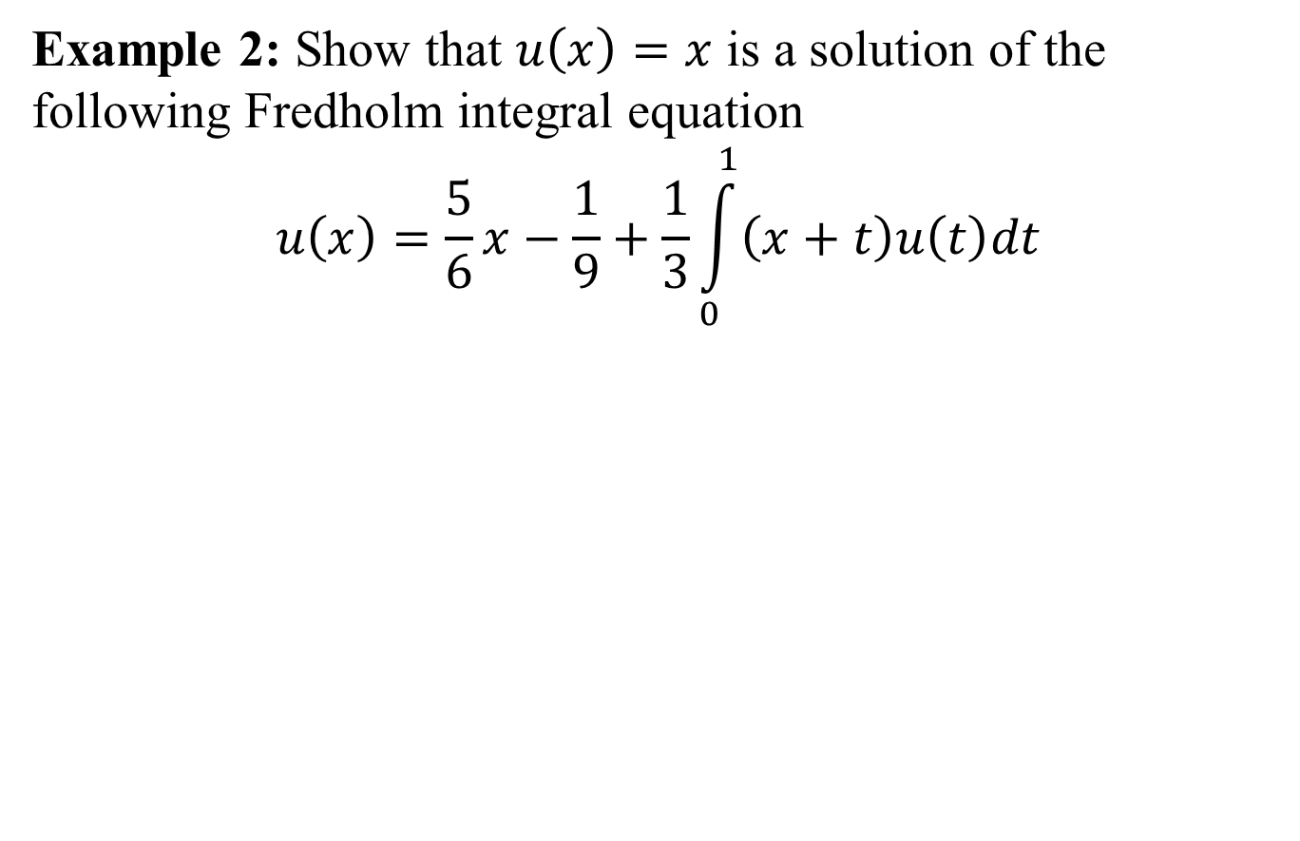
Example 2: Show that $u\left(x\right)=x$is a solution of the following Fredholm integral equation
$$u\left(x\right)=\frac{5}{6}x−\frac{1}{9}+\frac{1}{3}\int_{0}^{1}{\left(x+t\right)u\left(t\right)dt}$$

Slide 7
Here some valuable remarks can be made with respect to the concept of the solution of an integral equation.
Existence and uniqueness of a solution.
If solution exists for an integral equation, then this solution may be given in a closed form expressed in terms of elementary functions, such as a polynomial, exponential, trigonometric or hyperbolic function, similar to the solutions given in example 1-2. However, it is not always possible to obtain the solution in a closed form, but instead the solution obtained may be expressible in a series form. The solution obtained in series form is usually used for numerical approximations.

Slide 8
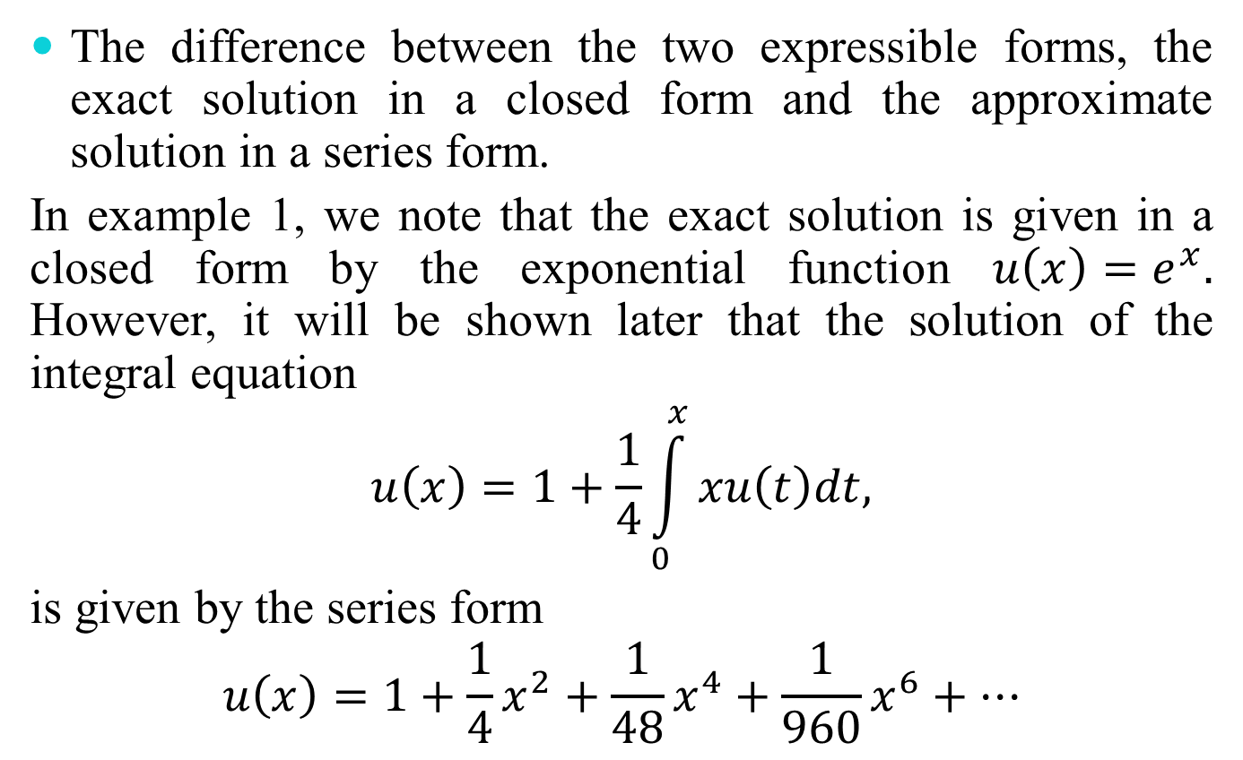
The difference between the two expressible forms, the exact solution in a closed form and the approximate solution in a series form.
In example 1, we note that the exact solution is given in a closed form by the exponential function $u\left(x\right)=e^{x}.$ However, it will be shown later that the solution of the integral equation
$$u\left(x\right)=1+\frac{1}{4}\int_{0}^{x}{xu\left(t\right)dt,}$$
is given by the series form
$$u\left(x\right)=1+\frac{1}{4}x^{2}+\frac{1}{48}x^{4}+\frac{1}{960}x^{6}+…$$

Slide 9
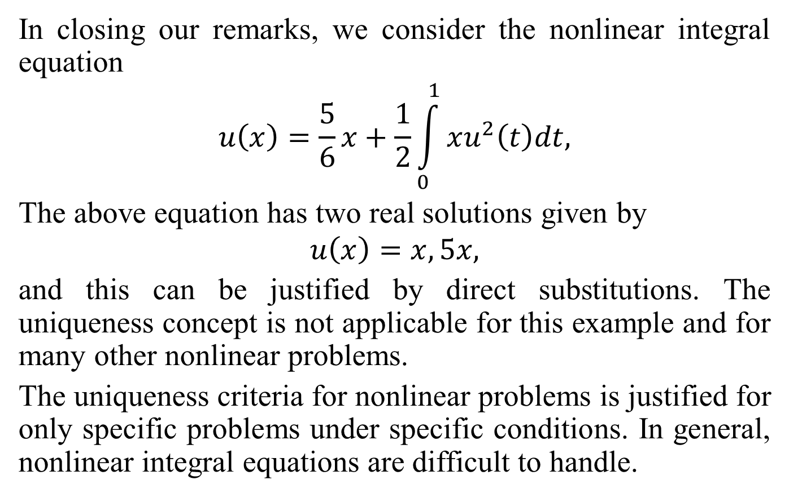
In closing our remarks, we consider the nonlinear integral equation
$$u\left(x\right)=\frac{5}{6}x+\frac{1}{2}\int_{0}^{1}{xu^{2}\left(t\right)dt,}$$
The above equation has two real solutions given by
$$u\left(x\right)=x,5x,$$
and this can be justified by direct substitutions. The uniqueness concept is not applicable for this example and for many other nonlinear problems.
The uniqueness criteria for nonlinear problems is justified for only specific problems under specific conditions. In general, nonlinear integral equations are difficult to handle.

Slide 10
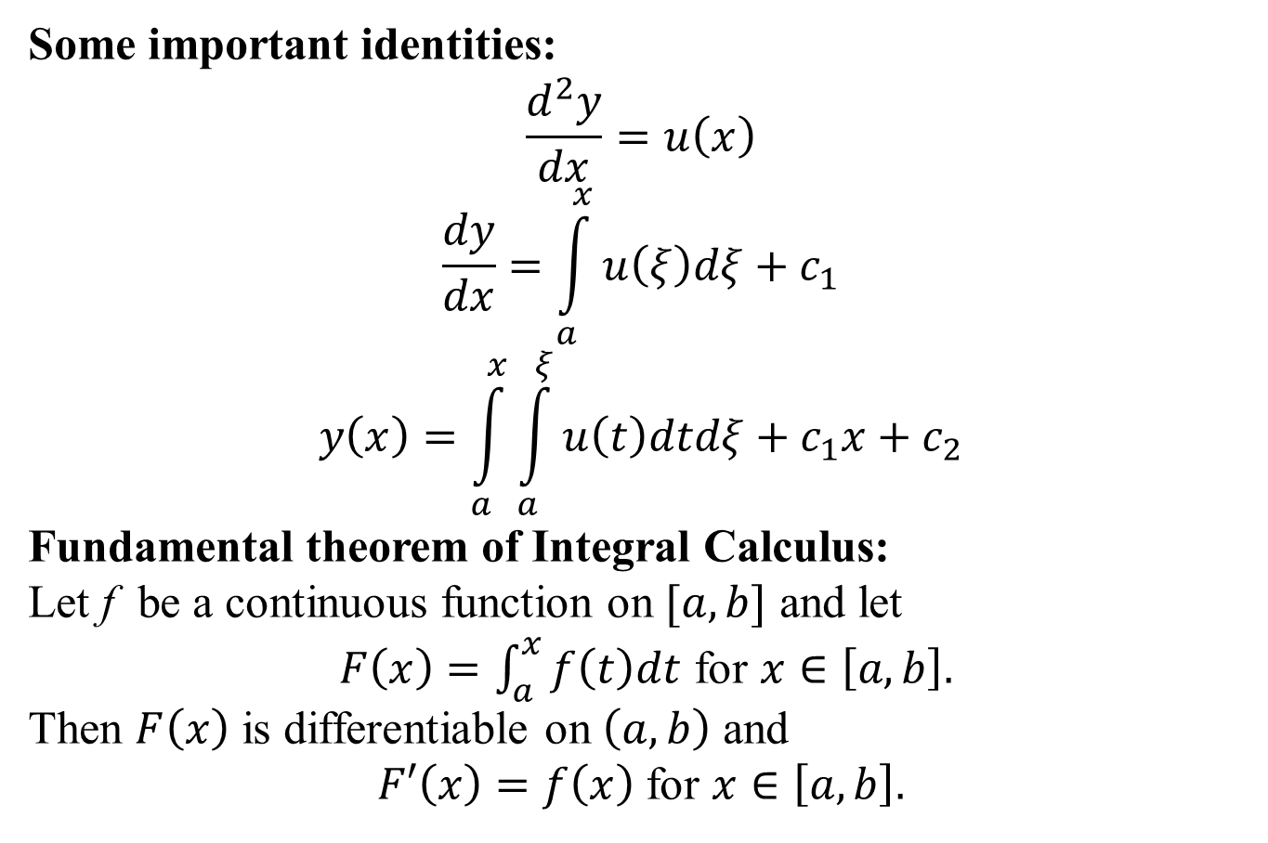
Some important identities:
$$\frac{d^{2}y}{dx}=u\left(x\right)$$
$$\frac{dy}{dx}=\int_{a}^{x}{u\left(ξ\right)dξ+c_{1}}$$
$$y\left(x\right)=\int_{a}^{x}{\int_{a}^{ξ}{u\left(t\right)dtdξ+c_{1}x+c_{2}}}$$
Fundamental theorem of Integral Calculus:
Let f be a continuous function on $[a,b]$and let
$F\left(x\right)=\int_{a}^{x}{f\left(t\right)dt}$for $x∈\left[a,b\right].$
Then $F\left(x\right)$is differentiable on $\left(a,b\right)$and
$F′\left(x\right)=f\left(x\right)$for $x∈\left[a,b\right].$

Slide 11
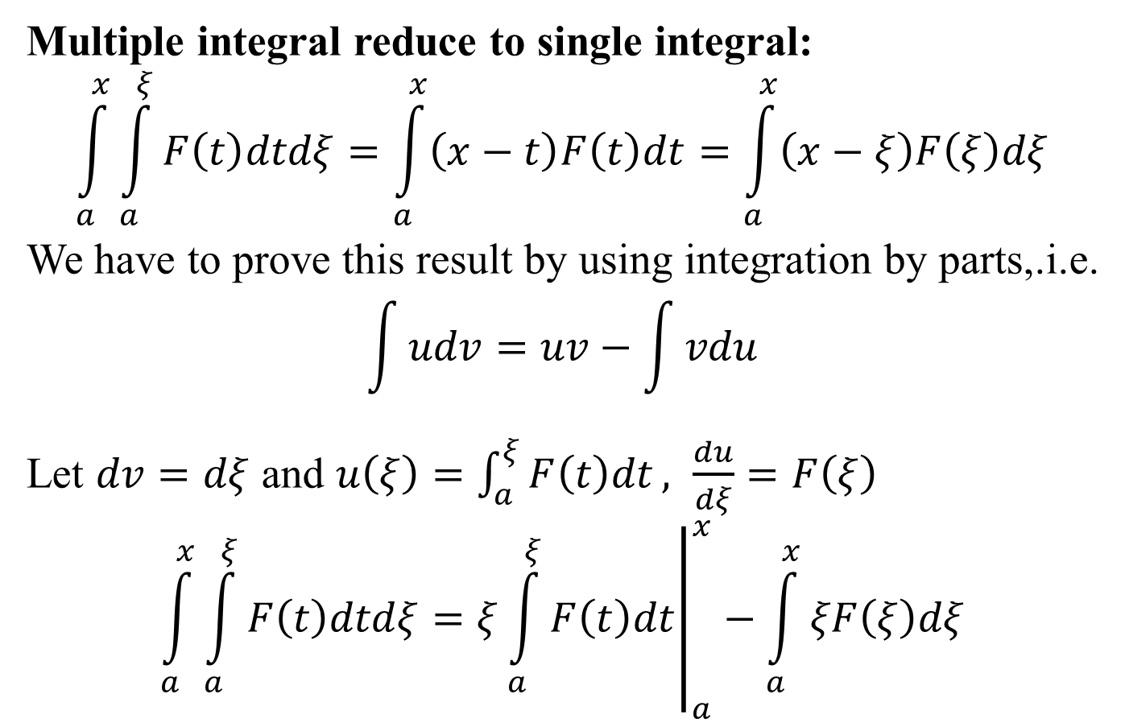
Multiple integral reduce to single integral:
$$\int_{a}^{x}{\int_{a}^{ξ}{F\left(t\right)dtdξ=\int_{a}^{x}{\left(x−t\right)F\left(t\right)dt}}=\int_{a}^{x}{\left(x−ξ\right)F\left(ξ\right)dξ}}$$
We have to prove this result by using integration by parts,.i.e.
$$\int{udv=uv−\int{vdu}}$$
Let $dv=dξ$ and $u\left(ξ\right)=\int_{a}^{ξ}{F\left(t\right)dt}, \frac{du}{dξ}=F\left(ξ\right)$
$$\int_{a}^{x}{\int_{a}^{ξ}{F\left(t\right)dtdξ=ξ{\left.\int_{a}^{ξ}{F\left(t\right)dt}\right|}_{a}^{x}}−\int_{a}^{x}{ξF\left(ξ\right)dξ}}$$

Slide 12
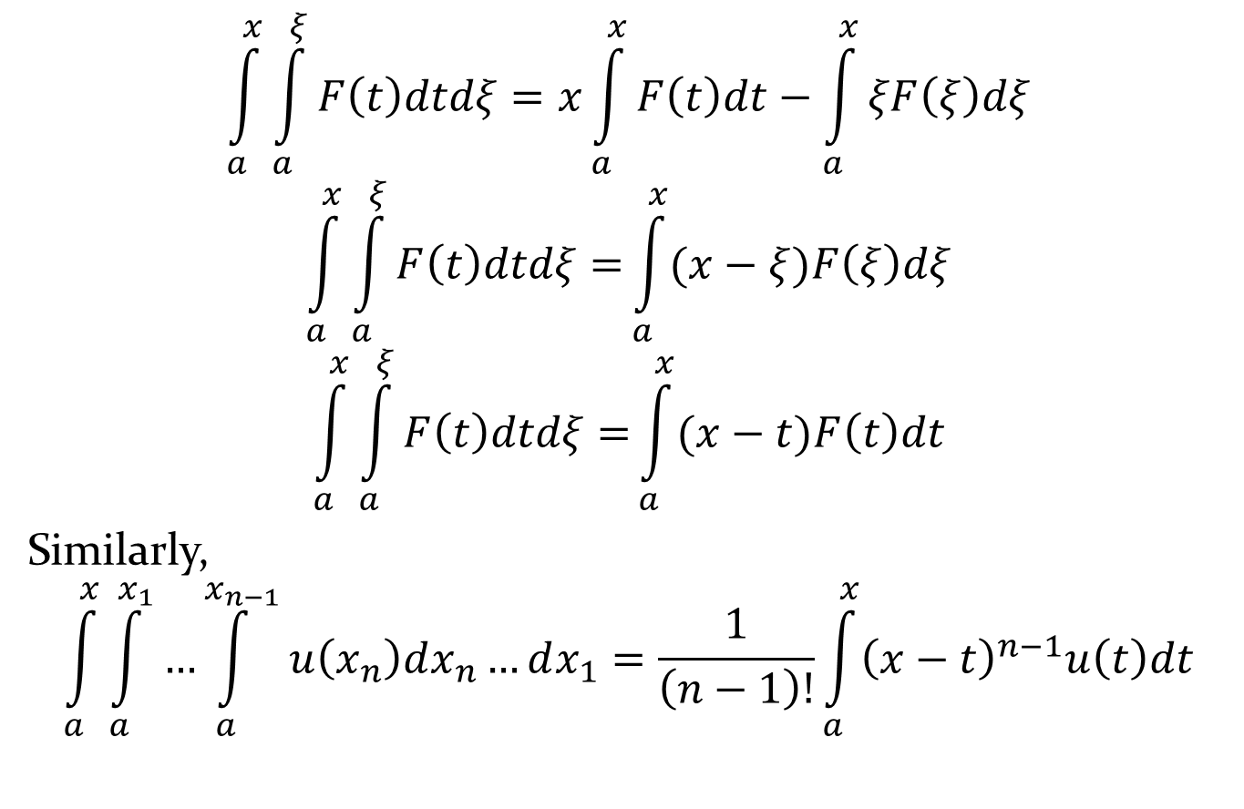
$$\int_{a}^{x}{\int_{a}^{ξ}{F\left(t\right)dtdξ=x\int_{a}^{x}{F\left(t\right)dt}}−\int_{a}^{x}{ξF\left(ξ\right)dξ}}$$
$$\int_{a}^{x}{\int_{a}^{ξ}{F\left(t\right)dtdξ=}\int_{a}^{x}{(x−ξ)F\left(ξ\right)dξ}}$$
$$\int_{a}^{x}{\int_{a}^{ξ}{F\left(t\right)dtdξ=}\int_{a}^{x}{(x−t)F\left(t\right)dt}}$$
Similarly,
$$\int_{a}^{x}{\int_{a}^{x_{1}}{…\int_{a}^{x_{n−1}}{u\left(x_{n}\right)dx_{n}…dx_{1}=\frac{1}{\left(n−1\right)!}}}}\int_{a}^{x}{{\left(x−t\right)}^{n−1}u\left(t\right)dt}$$

Slide 13
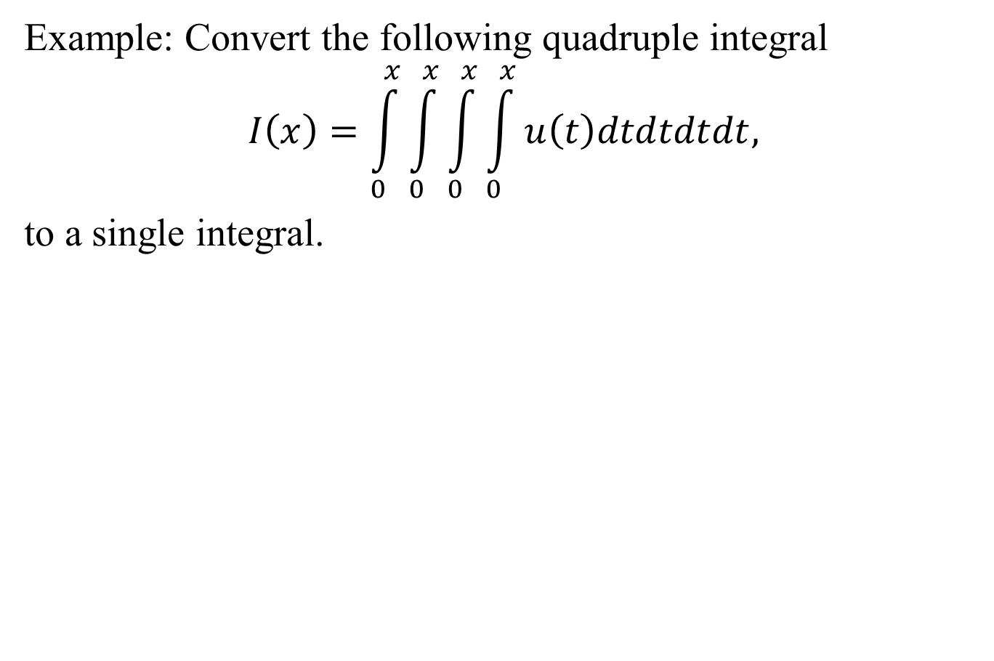
Example: Convert the following quadruple integral
$$I\left(x\right)=\int_{0}^{x}{\int_{0}^{x}{\int_{0}^{x}{\int_{0}^{x}{u\left(t\right)dtdtdtdt,}}}}$$
to a single integral.

Slide 14
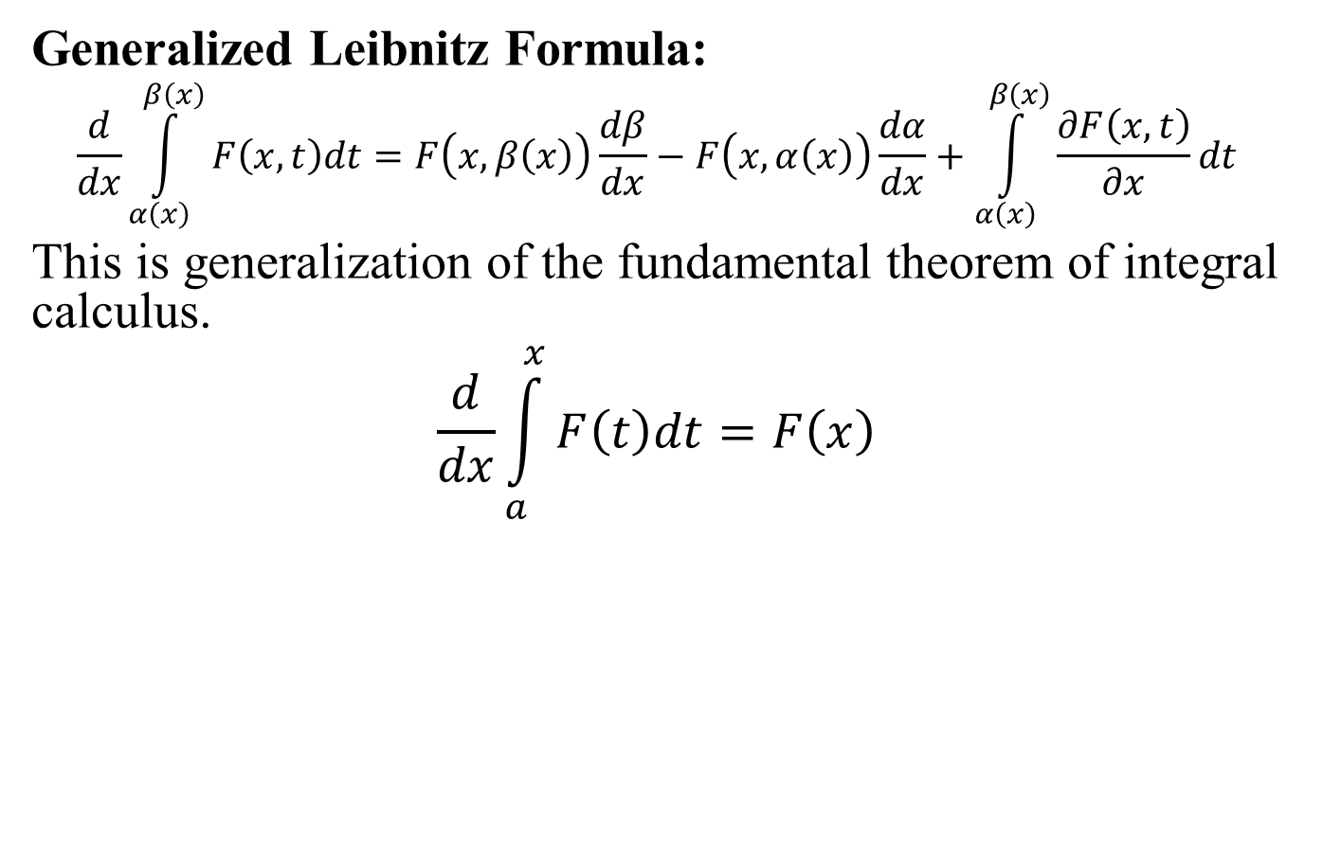
Generalized Leibnitz Formula:
$$\frac{d}{dx}\int_{α\left(x\right)}^{β\left(x\right)}{F\left(x,t\right)dt=F\left(x,β\left(x\right)\right)\frac{dβ}{dx}−F\left(x,α\left(x\right)\right)\frac{dα}{dx}+\int_{α\left(x\right)}^{β\left(x\right)}{\frac{∂F\left(x,t\right)}{∂x}dt}}$$
This is generalization of the fundamental theorem of integral calculus.
$$\frac{d}{dx}\int_{a}^{x}{F\left(t\right)dt}=F\left(x\right)$$

Slide 16
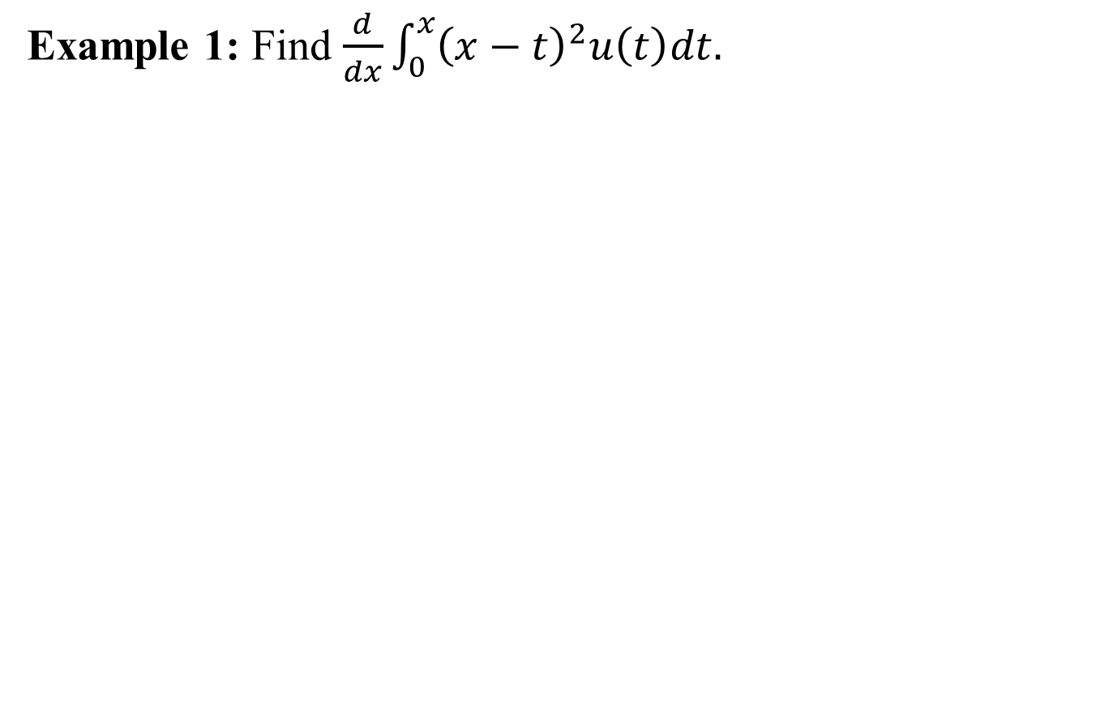
Example 1: Find $\frac{d}{dx}\int_{0}^{x}{{\left(x−t\right)}^{2}u\left(t\right)dt.}$

Slide 17
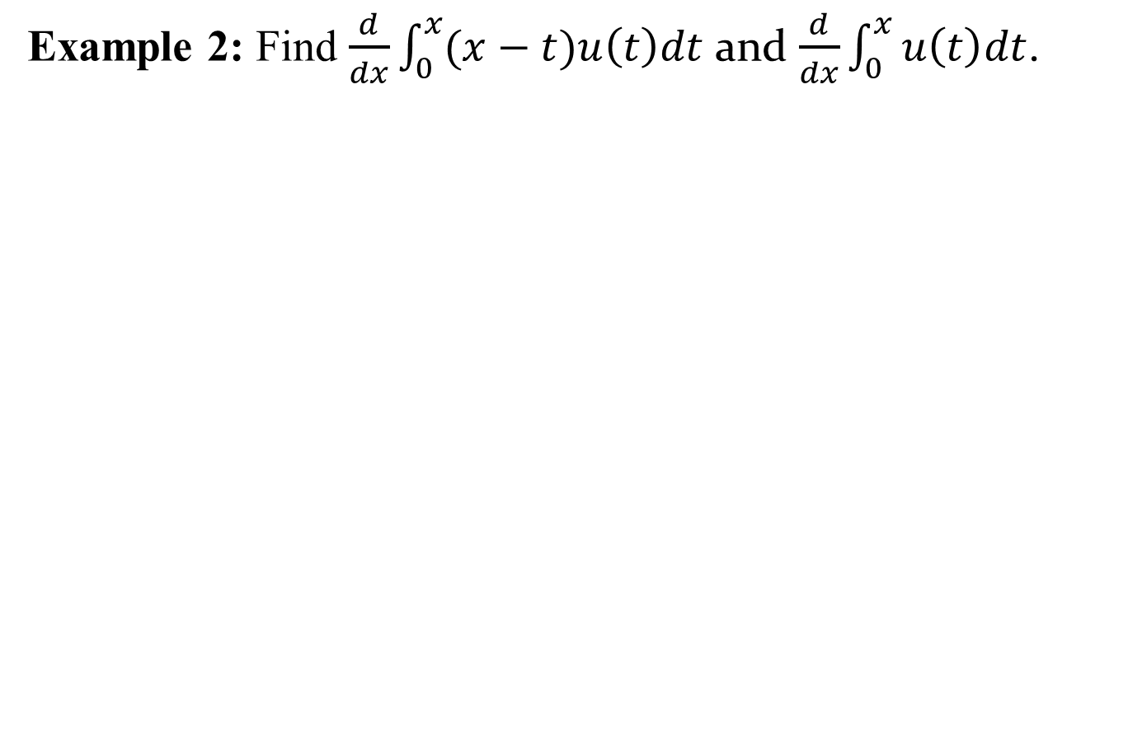
Example 2:Find $\frac{d}{dx}\int_{0}^{x}{(x−t)u\left(t\right)dt}$ and $\frac{d}{dx}\int_{0}^{x}{u\left(t\right)dt}$.

Slide 18
Origins of an Integral equations:
As we know integral equations arise in many scientific and engineering applications. Voltera integral equations can be obtained from converting initial value problems with prescribed initial values. However, Fredholm integral equation cab be derived from boundary value problems with given boundary conditions.
It is important to point out that converting Voltera integral equations to initial value problems and initial value problems to Voltera integral equations are commonly used in literature. However, converting Fredholm integral equations to boundary value problem and boundary value problems to Fredholm integral equations are rarely used.

Slide 19
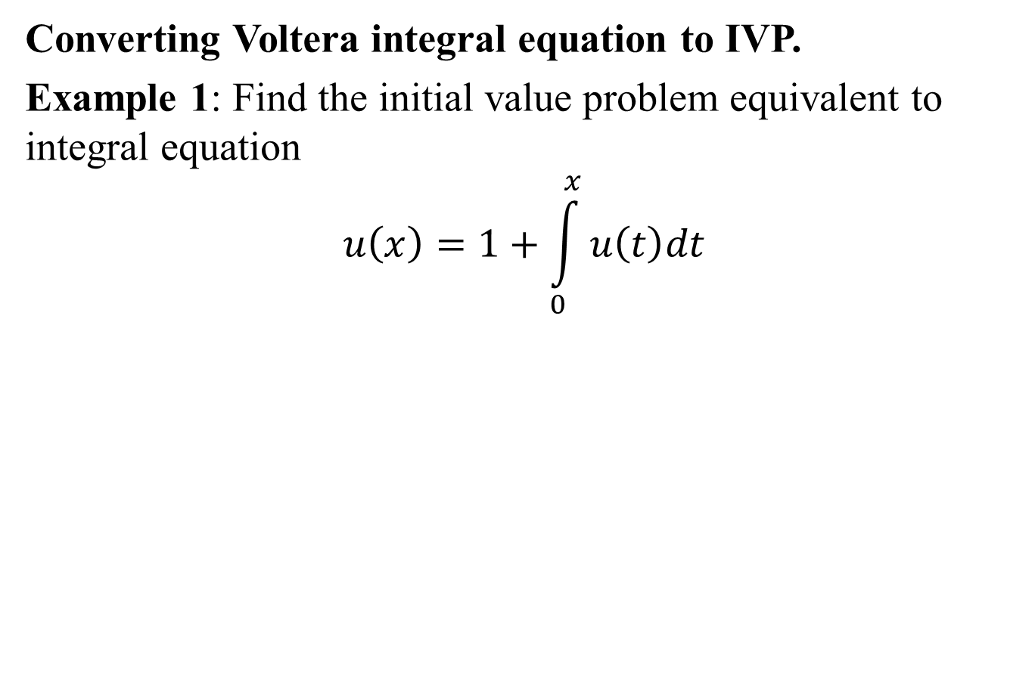
Converting Voltera integral equation to IVP.
Example 1: Find the initial value problem equivalent to integral equation
$$u\left(x\right)=1+\int_{0}^{x}{u\left(t\right)dt}$$

Slide 20
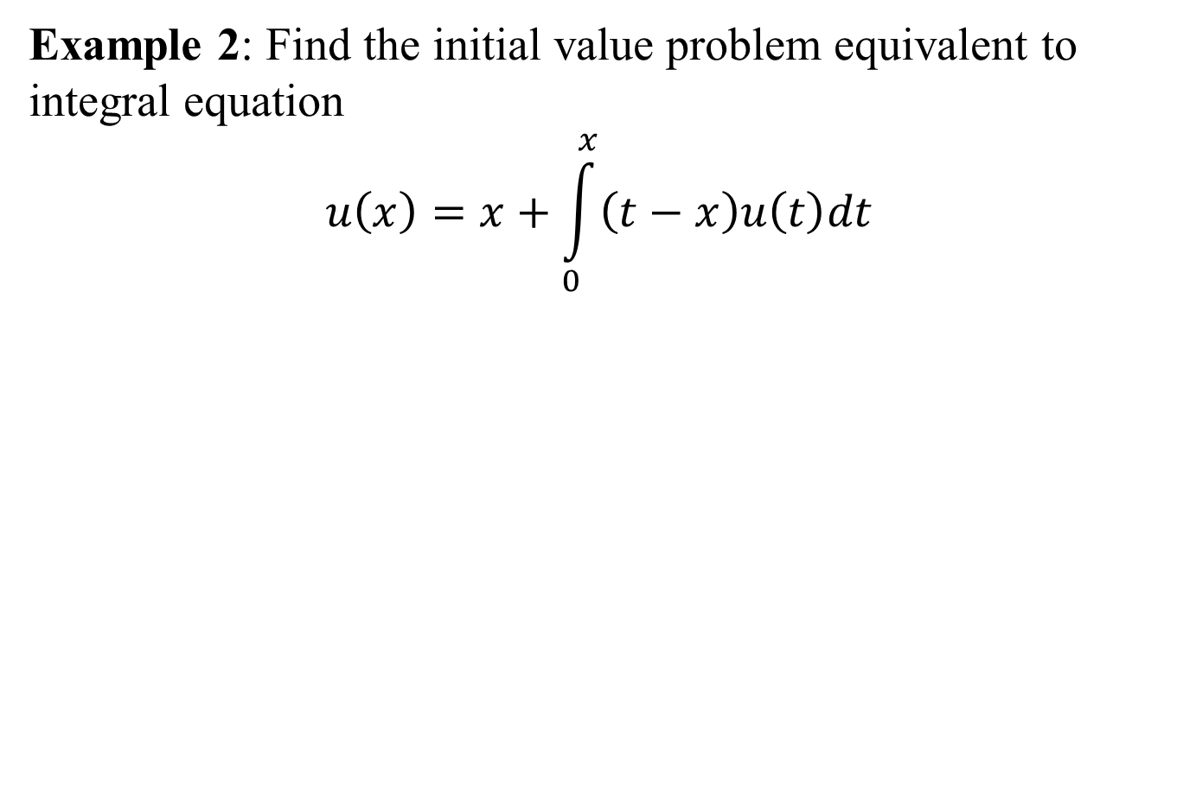
Example 2: Find the initial value problem equivalent to integral equation
$$u\left(x\right)=x+\int_{0}^{x}{\left(t−x\right)u\left(t\right)dt}$$

Slide 21
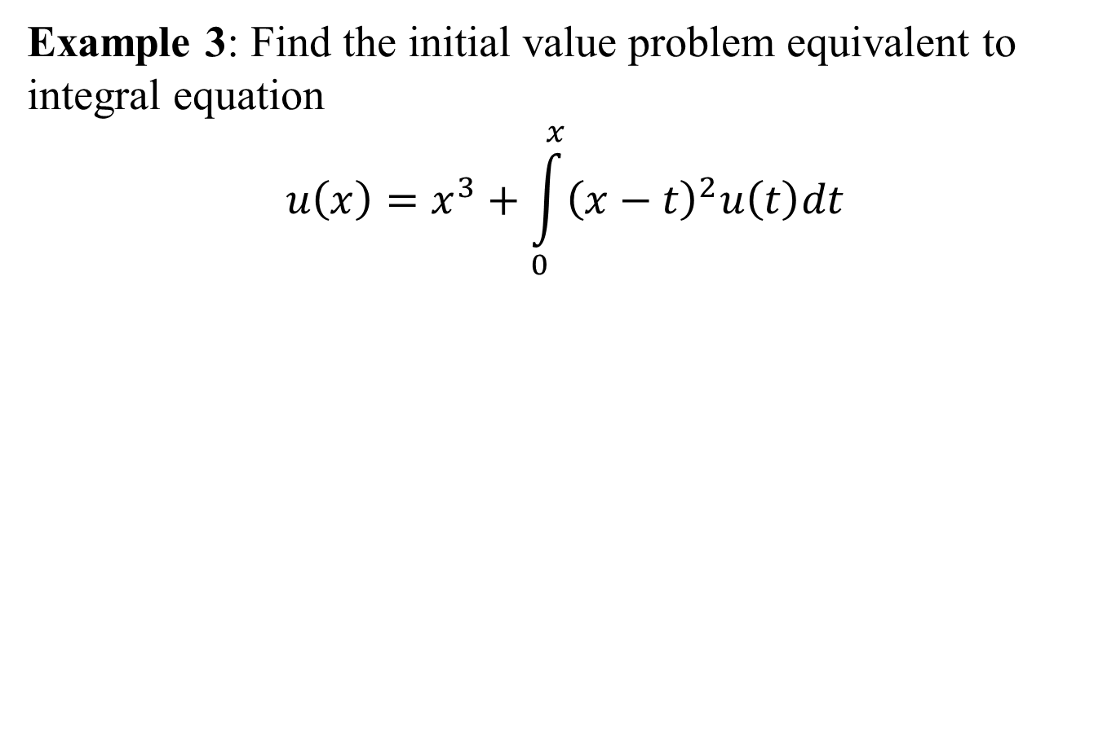
Example 3: Find the initial value problem equivalent to integral equation
$$u\left(x\right)=x^{3}+\int_{0}^{x}{{\left(x−t\right)}^{2}u\left(t\right)dt}$$

Slide 22
Summary:
Solution of an Integral Equation
Some important identities and Theorems
Proofs
Examples related Theorems
Conversion of Voltera integral equation to initial value problems (with examples)

