Slide 1
MTH-471
Integral Equations
Sheikh Irfan Ullah Khan
Assistant Professor
Department of Mathematics
COMSTAS Institute of Information Technology

Slide 2
Recall

Slide 5
Integral Transform Methods:
The integral transform methods are very convenient in solving integral equations of some special forms.
Laplace Transform:
The Laplace transform method is a powerful tool used for solving differential and integral equations. The Laplace transform changes differential equations and integral equations to polynomial equations that can be easily solved, and hence by using the inverse Laplace transform gives the solution of the examined equation.

Slide 6
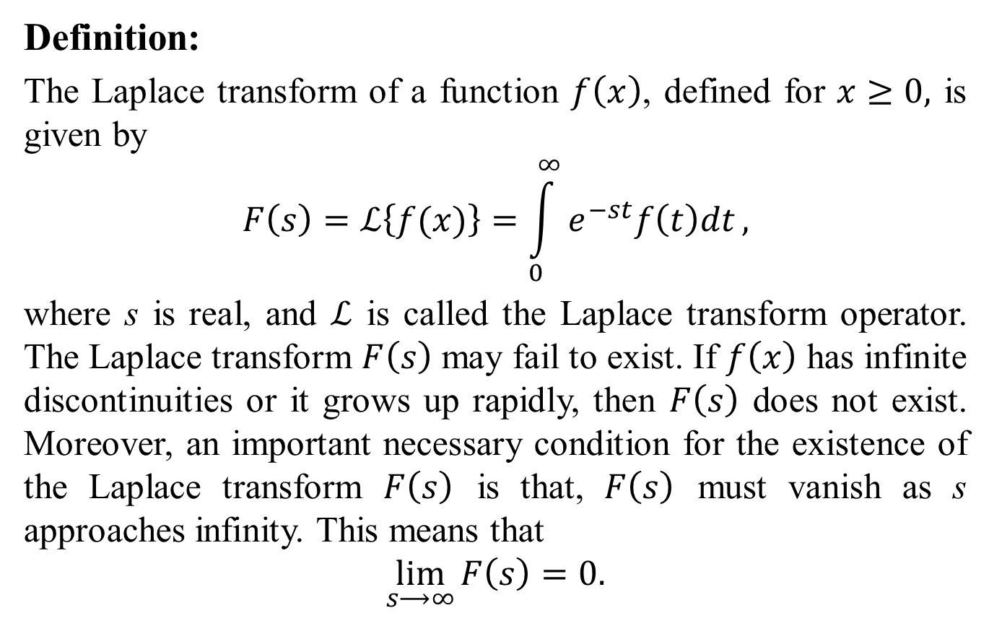

Slide 7
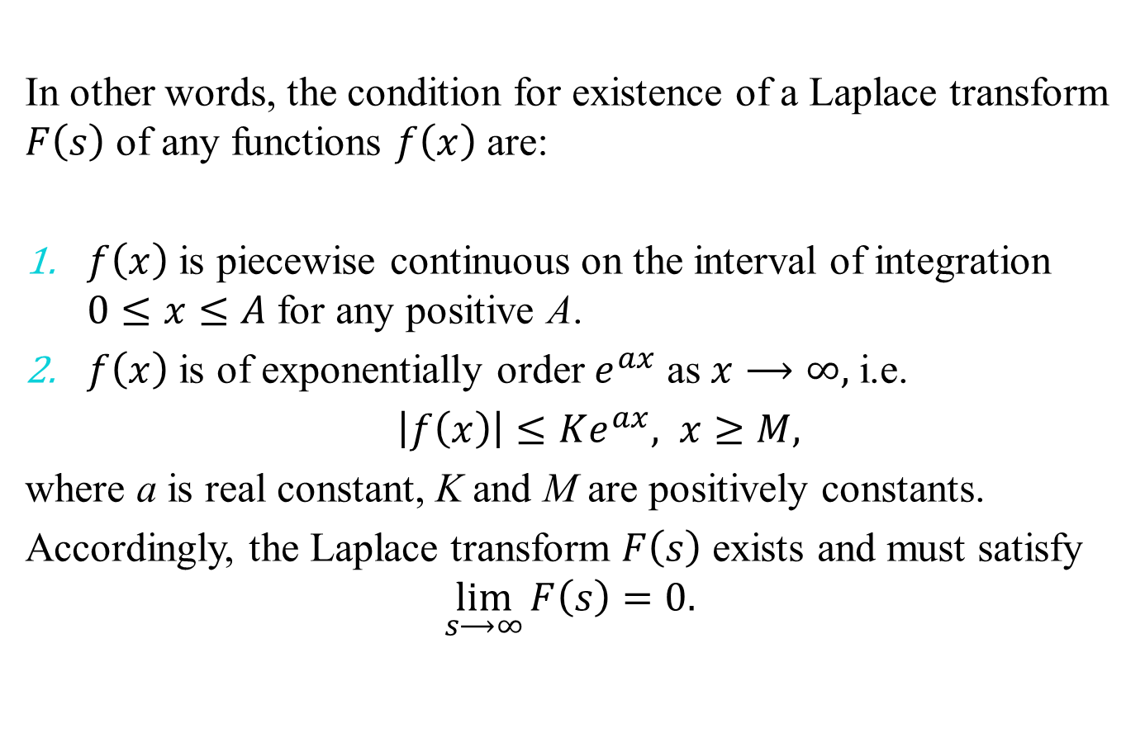

Slide 11
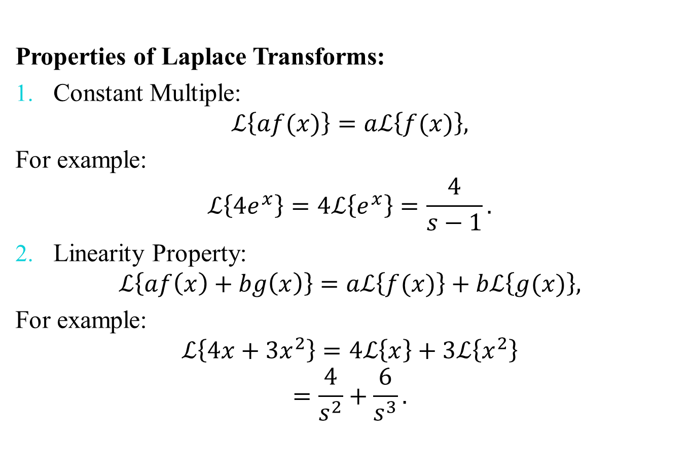

Slide 12
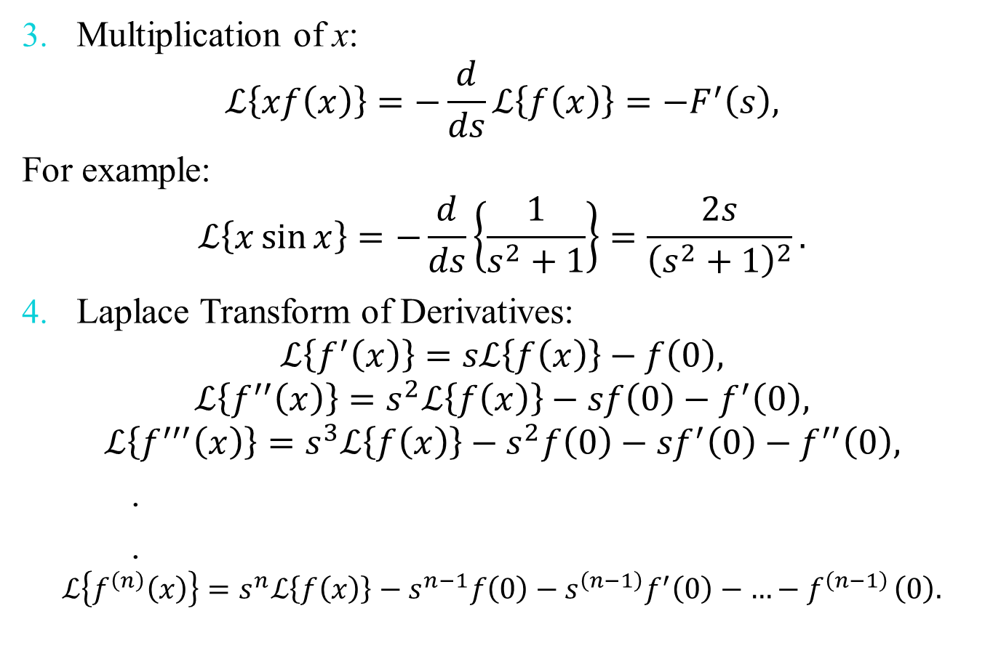

Slide 13
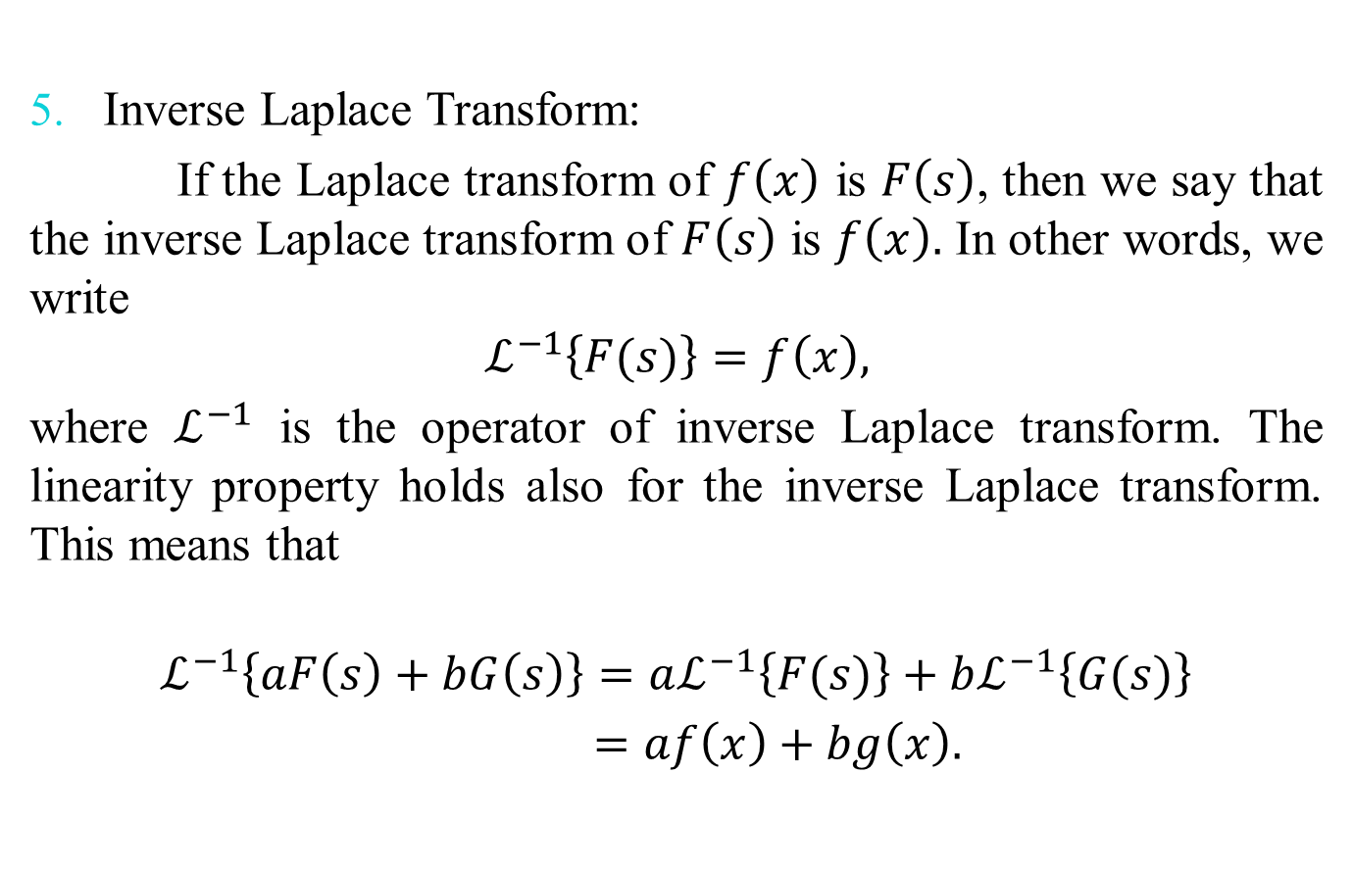

Slide 14
