Slide 1
MTH-471
Integral Equations
Sheikh Irfan Ullah Khan
Assistant Professor
Department of Mathematics
COMSTAS Institute of Information Technology

Slide 2
Definition
An integral equation is an equation in which the unknown function to be determined appears under the integral sign. A typical form of an integral equation in is of the form
(1)
where K is a function of two variables called the kernel of the integral equation and and are the limits of integration.
In equation (1), it is easily observed that the unknown function appears under the integral sign as stated above, and outside of the integral sign in most other cases.

Slide 3
Example 1: Consider the initial value problem
(2)
Subject to the boundary condition (3)
Solution: The equation (2) can be easily solved by using separation of variables, the solution
(4)
is easily obtained.
However, integrating both sides of (2) with respect to x, from 0 to x and using the initial condition (3) yield the following
(5)
or equivalently
(6)

Slide 5
Classification of Linear Integral Equations:
The most frequently used linear integral equations fall under the two main classes namely Fredholm and Voltera integral equations. However, in this text we will distinguish four types of linear integral equations; in which two are of from main classes and two related types of integral equations. In particular, the four types are given by:
Fredholm integral equations
Voltera integral equations
Integro-Differential equations
Singular integral equations.

Slide 6
Fredholm Linear Integral Equations:
The standard form of Fredholm linear integral equations, where the limits of integration a and b are constants, are given by
(7)

Slide 7
Voltera Linear Integral Equations:
The standard form of Voltera linear integral equations, where the limit of integration are function of x rather than constants, are given by
(10)

Slide 8
Examining the equations (7) – (12) carefully, the following remarks can be concluded:
Structure of Fredholm and Voltera equations:
The unknown function appears linearly only under the integral sign in linear Fredholm and Voltera integral equations of the first kind. However, the unknown function appears linearly under the integral sign and outside the integral sign as well in the second kind of these linear integral equations.
Limits of integration:
In Fredholm integral equations, the integral is taken over a finite interval with fixed limit of integration. However, in Voltera integral equations, at least one limit of the range of integration is a variable.

Slide 9
Linearity property:
If the exponent of the unknown function inside the integral sign is one, the integral equation is called linear integral equation. If the unknown function has exponent other than one, or if the equation contains nonlinear function of , such as and etc., the integral equation is known as nonlinear integral equation. The following are examples of nonlinear integral equations:
(13)
(14)
(15)

Slide 10
Homogeneity property:
If we set in Fredholm or Voltera integral equation of the second kind given by (9) and (12), the resulting equation is known as homogeneous integral equation, otherwise it is called nonhomogeneous integral equation, i.e.

Slide 11
Integro-Differential Equations:
Voltera, in the early 1900, studied the population growth, where new types of equations have been developed and was termed as Integro-differential equations. In this type of equations, the unknown function occurs in one side as an ordinary derivative, and appears on the other side under the integral sign. The following are examples of Integro-differential equations:
(16)
(17)
(18)

Slide 12
Singular integral Equations:
The integral equation of the first kind
(19)
or the integral equation of the second kind
(20)
is called singular if the lower limit, the upper limit or both limits of integration are infinite. In addition, the equation (19) or (20) is also called a singular integral equation if the kernel becomes infinite at one or more point in the domain of integration.

Slide 13
Some examples of first kind are listed below:
where the singular behavior in these examples has resulted from the range of the integration becoming infinite.

Slide 14
Examples of the second kind of singular integral equation are given by.
where the singular behavior in this kind of equations has resulted from the kernel becoming infinite as .

Slide 15
Example 2: Classify the following integral equation
as Fredholm or Voltera integral equation, linear or nonlinear, and homogeneous or nonhomogeneous.

Slide 16
Example 3: Classify the following integral equation
as Fredholm or Voltera integral equation, linear or nonlinear, and homogeneous or nonhomogeneous.

Slide 17
Example 4: Classify the following integral equation
as Fredholm or Voltera integral equation, linear or nonlinear, and homogeneous or nonhomogeneous.

Slide 18
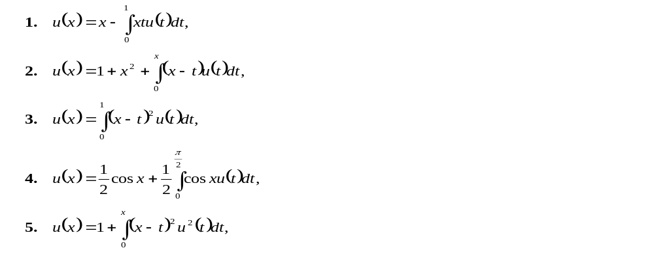
Exercise
In exercise 1-5, classify the following integral equation as Fredholm or Voltera integral equation, linear or nonlinear, and homogeneous or nonhomogeneous:

Slide 19
In exercise 6-8, classify each of the following Integro-differential equation as Fredholm integro-differential equation or Voltera Integro-differential equation. Also determine whether the equation is linear or nonlinear:
6.
7.
8.

Slide 20
Summary
How to define an integral equation
Classification of integral equation
Linear, Nonlinear, Homogeneous, Nonhomogeneous
Example and Exercise

