Slide 1
Analytic Number Theory
MTH 435
Dr Mohib Ali

Slide 2
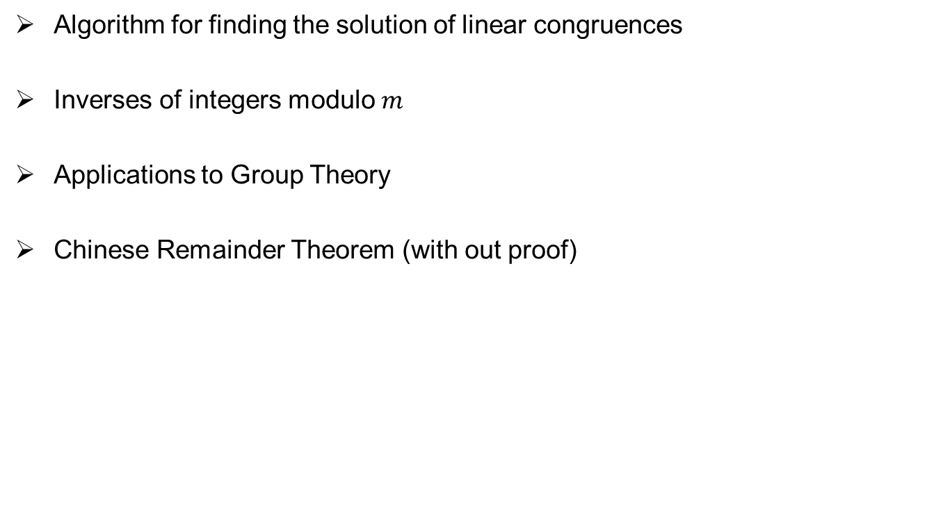
Review of Lecture 8
Algorithm for finding the solution of linear congruences
Inverses of integers modulo $m$
Applications to Group Theory
Chinese Remainder Theorem (with out proof)

Slide 4
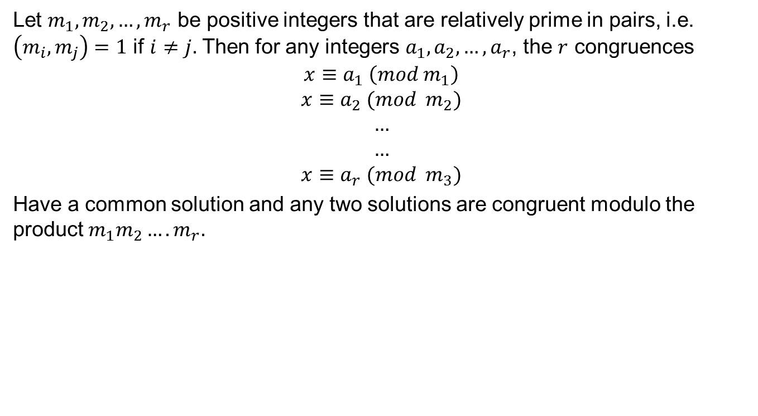
Chinese Remainder Theorem
Let $m_{1},m_{2},…,m_{r}$ be positive integers that are relatively prime in pairs, i.e. $\left(m_{i},m_{j}\right)=1$ if $i≠j.$ Then for any integers $a_{1},a_{2},…,a_{r}$, the $r$ congruences
$$x≡a_{1} \left(mod m_{1}\right)$$
$$x≡a_{2} (mod m_{2})$$
$$…$$
$$…$$
$$x≡a_{r} (mod m_{3})$$
Have a common solution and any two solutions are congruent modulo the product $m_{1}m_{2}….m_{r}.$

Slide 8
Examples

Slide 9
Examples

Slide 10
Examples

Slide 11
Examples

Slide 12
Examples

Slide 13
Indirect application of CRT

Slide 14
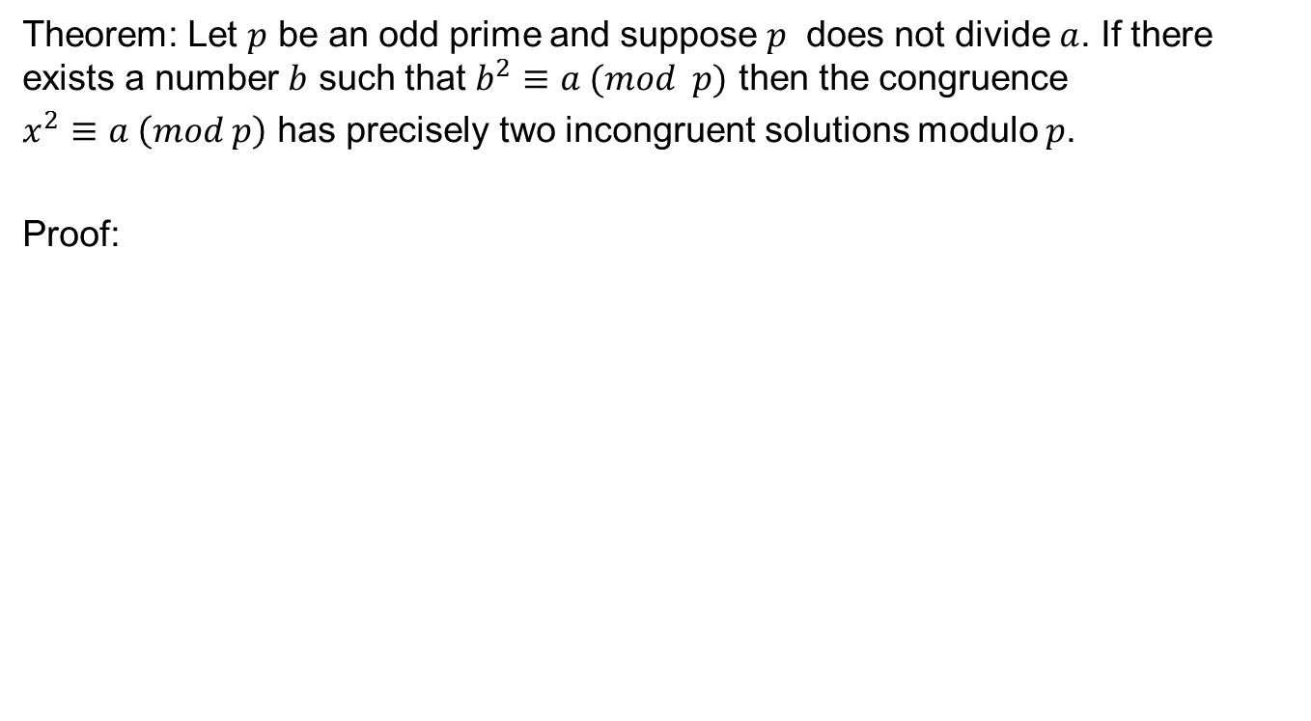
Prime Numbers
Theorem: Let $p$ be an odd prime and suppose $p$ does not divide $a$. If there exists a number $b$ such that $b^{2}≡a (mod p)$ then the congruence
$x^{2}≡a \left(mod p\right)$ has precisely two incongruent solutions modulo $p$.
Proof:

Slide 15
Behavior as FTA
Two solutions as of the quadratic equation.

Slide 16
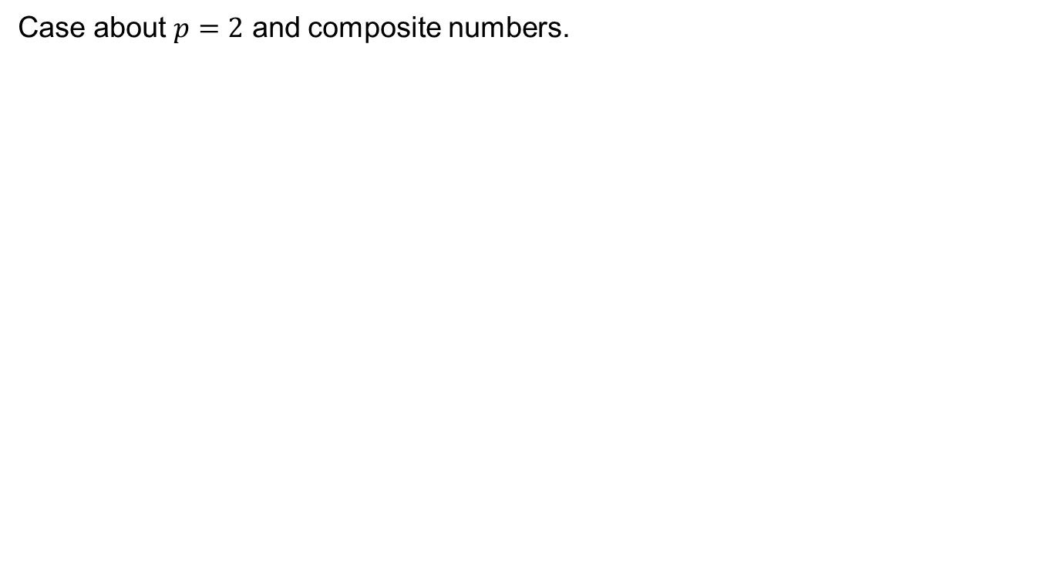
Remarks
Case about $p=2$ and composite numbers.

Slide 17
Review of Lecture 9
Chinese Remainder Theorem (Proof)
Examples of CRT
Indirect Examples where CRT can be applied

