Slide 1
Analytic Number Theory
MTH 435
Dr Mohib Ali

Slide 2
Review of Lecture 7
Linear congruences
Solution of Linear congruences
Criteria for the existence of solution and their count
Algorithm for finding the solutions

Slide 3
Algorithm for finding the solution

Slide 4
Algorithm…

Slide 7

Inverses of Integers modulo $m$
Defintion:

Slide 8
Examples

Slide 9
Application to Group Theory

Slide 10
Examples

Slide 11
Examples

Slide 12
System of Linear congruences

Slide 13
Solution of the system

Slide 14
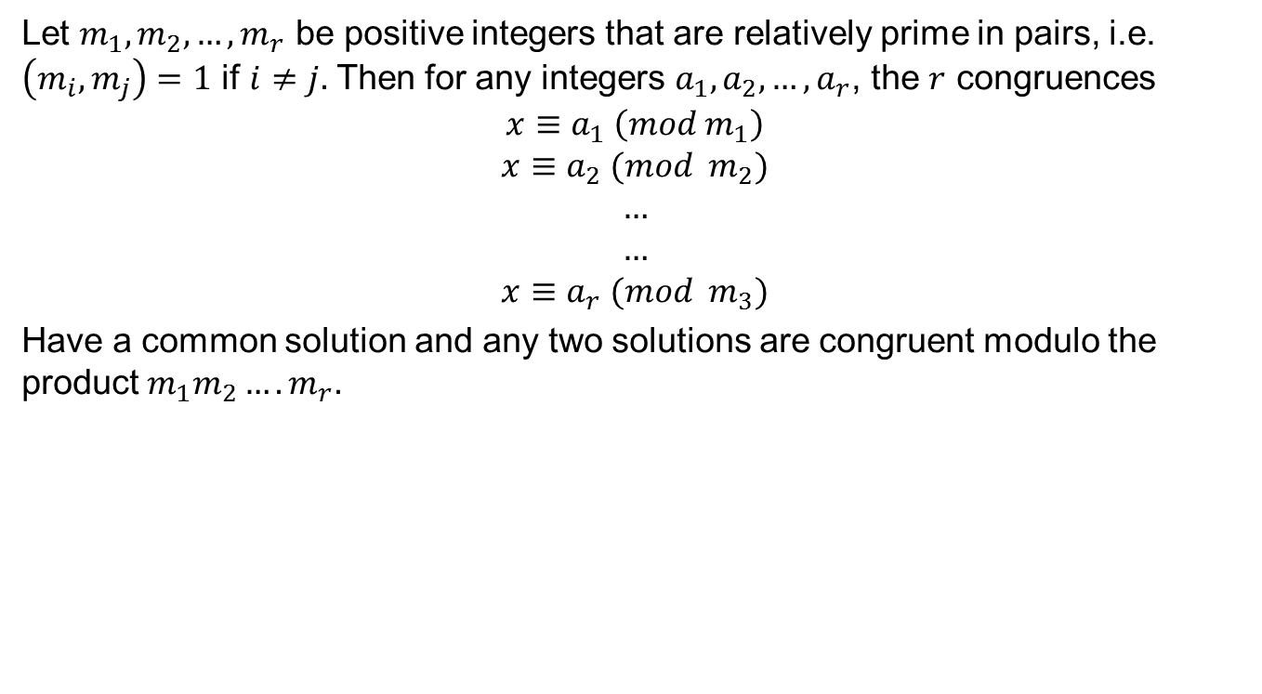
Chinese Remainder Theorem
Let $m_{1},m_{2},…,m_{r}$ be positive integers that are relatively prime in pairs, i.e. $\left(m_{i},m_{j}\right)=1$ if $i≠j.$ Then for any integers $a_{1},a_{2},…,a_{r}$, the $r$ congruences
$$x≡a_{1} \left(mod m_{1}\right)$$
$$x≡a_{2} (mod m_{2})$$
$$…$$
$$…$$
$$x≡a_{r} (mod m_{3})$$
Have a common solution and any two solutions are congruent modulo the product $m_{1}m_{2}….m_{r}.$

Slide 15
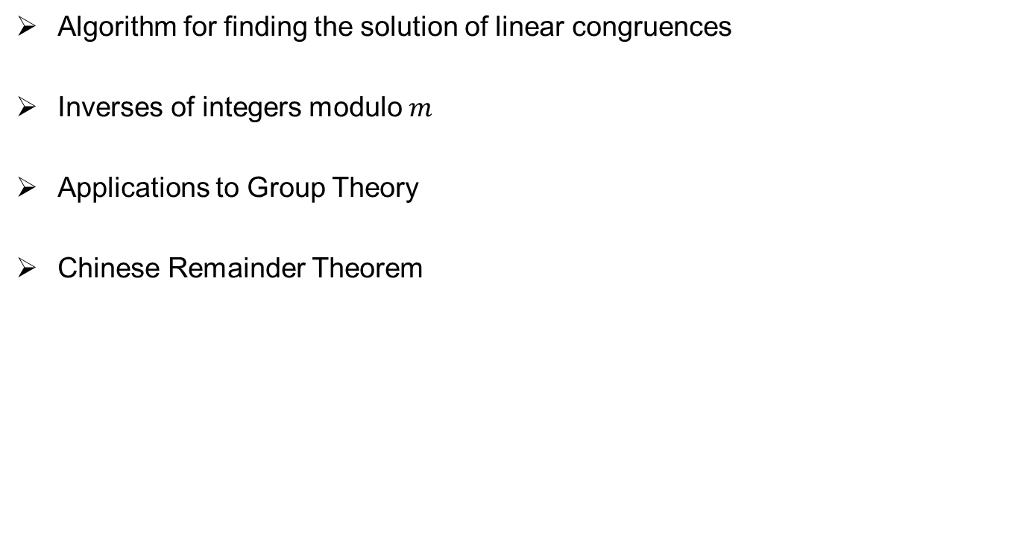
Review of Lecture 8
Algorithm for finding the solution of linear congruences
Inverses of integers modulo $m$
Applications to Group Theory
Chinese Remainder Theorem

