Slide 1
Analytic Number Theory
MTH 435
Dr Mohib Ali

Slide 2
Review of Lecture 6
Multiplication of Congruences
Congruences with polynomials
Congruences with divisors and least common multiples
Divisibility Test

Slide 3
Linear Congruences
Definition:

Slide 4
Linear Congruences
Solution of Linear Congruence:

Slide 5
How to Solve the Linear Congruences
Example:

Slide 6
How to Solve the Linear Congruences

Slide 8
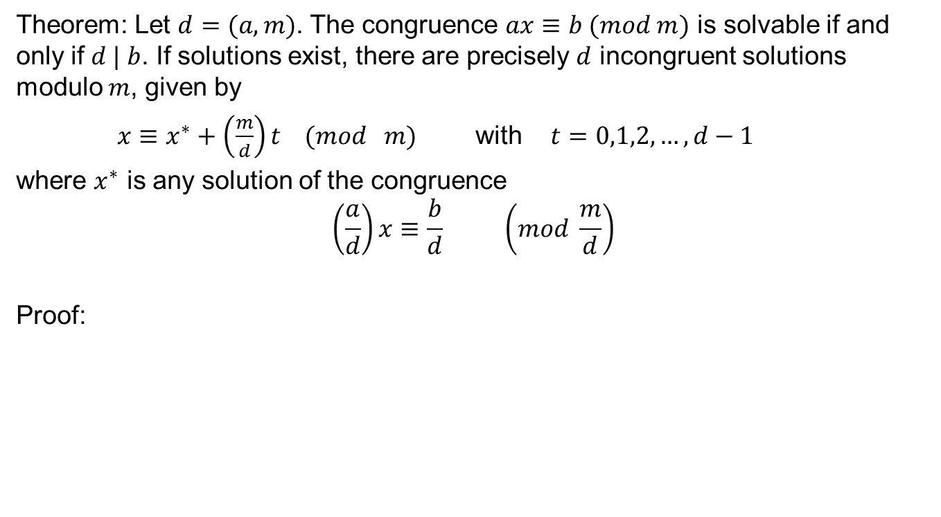
Linear Congruence
Theorem: Let $d=(a,m)$. The congruence $ax≡b (mod m)$ is solvable if and only if $d | b$. If solutions exist, there are precisely $d$ incongruent solutions modulo $m$, given by
$x≡x^{∗}+\left(\frac{m}{d}\right)t (mod m)$ with $t=0,1,2,…,d−1$
where $x^{∗}$ is any solution of the congruence
$$\left(\frac{a}{d}\right)x≡\frac{b}{d} \left(mod \frac{m}{d}\right)$$
Proof:

Slide 9
Linear Congruence

Slide 10
Linear Congruence

Slide 13
Algorithm for finding the solution

Slide 14
Review of Lecture 7
Linear congruences
Solution of Linear congruences
Criteria for the existence of solution and their count
Algorithm for finding the solution

