Slide 1
Analytic Number Theory
MTH 435
Dr Mohib Ali

Slide 2
Review of Lecture 5
Positive solutions of Diophantine equation
Definition of Congruences
Divisibility and Congruences
Multiples, addition and multiplication of congruences

Slide 3
Review of Elementary Properties

Slide 4
Review

Slide 5
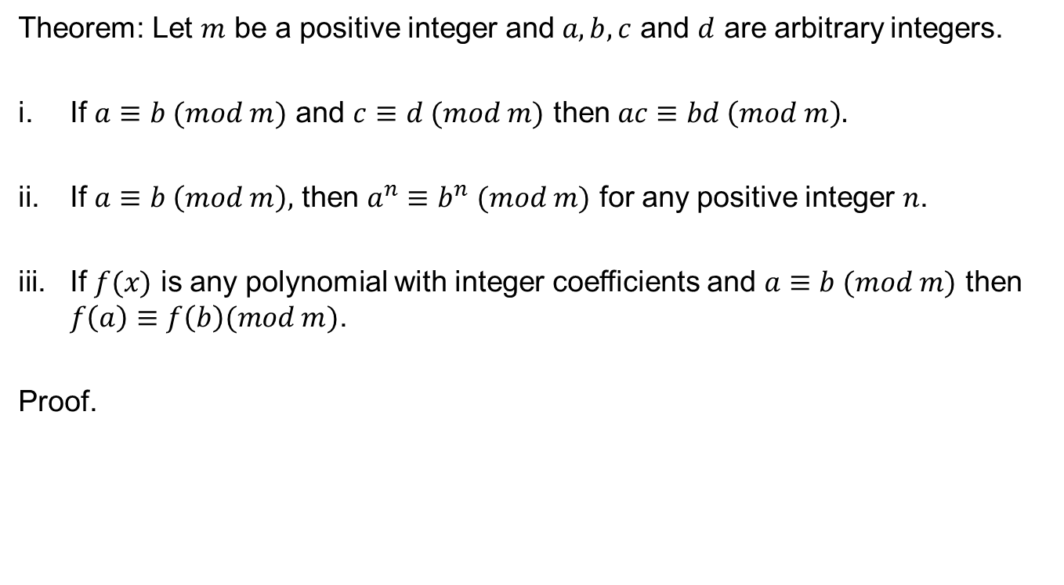
Elementary Properties
Theorem: Let $m$ be a positive integer and $a,b,c$ and $d$ are arbitrary integers.
If $a≡b (mod m)$ and $c≡d (mod m)$ then $ac≡bd \left(mod m\right).$
If $a≡b \left(mod m\right),$ then $a^{n}≡b^{n} (mod m)$ for any positive integer $n$.
If $f(x)$ is any polynomial with integer coefficients and $a≡b (mod m)$ then $f\left(a\right)≡f\left(b\right)(mod m)$.
Proof.

Slide 9
Elementary properties
Before going to the further properties of congruences we revisit one important property of l.c.m.
Theorem: The least common multiple of two integers divide any other common multiple of two integers.
Proof:

Slide 11
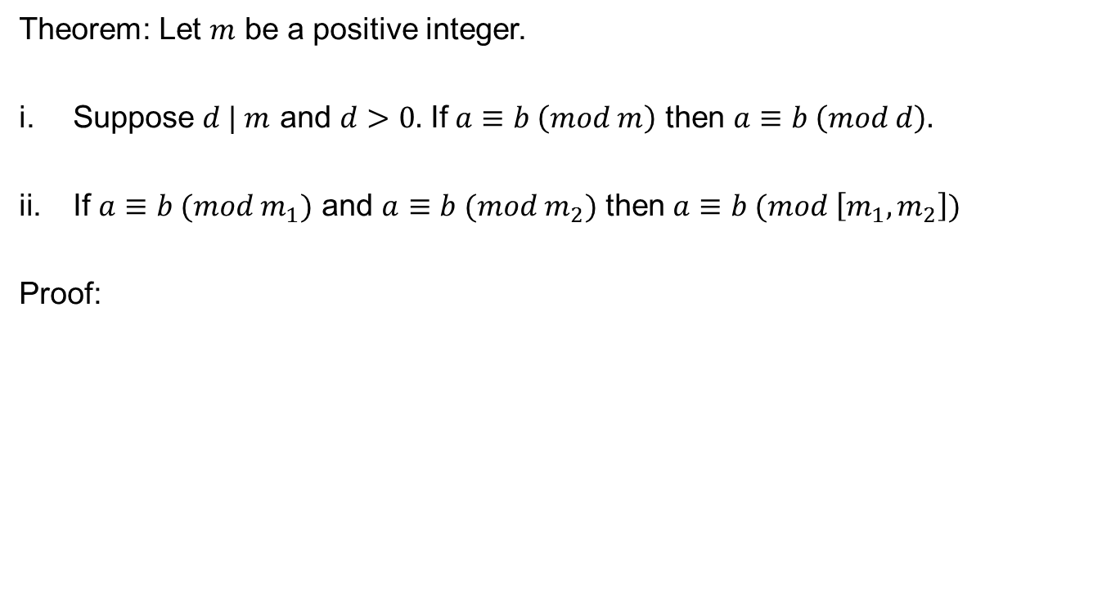
Elementary properties
Theorem: Let $m$ be a positive integer.
Suppose $d | m$ and $d>0.$ If $a≡b \left(mod m\right)$ then $a≡b \left(mod d\right).$
If $a≡b (mod m_{1})$ and $a≡b (mod m_{2})$ then $a≡b (mod \left[m_{1},m_{2}\right])$
Proof:

Slide 13
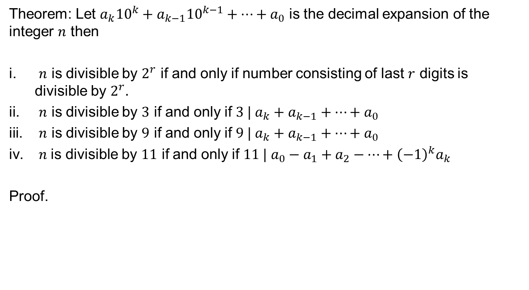
Divisibility Test
Theorem: Let $a_{k}{10}^{k}+a_{k−1}{10}^{k−1}+…+a_{0}$ is the decimal expansion of the integer $n$ then
$n$ is divisible by $2^{r}$ if and only if number consisting of last $r$ digits is divisible by $2^{r}.$
$n$ is divisible by $3$ if and only if $3 | a_{k}+a_{k−1}+…+a_{0}$
$n$ is divisible by $9$ if and only if $9 | a_{k}+a_{k−1}+…+a_{0}$
$n$is divisible by $11$ if and only if $11 | a_{0}−a_{1}+a_{2}−…+{\left(−1\right)}^{k}a_{k}$
Proof.

Slide 18
Linear Congruences
Defintion:

Slide 19
Linear Congruences

Slide 20
Review of Lecture 6
Multiplication of Congruences
Congruences with polynomials
Congruences with divisors and least common multiples
Divisibility Test

