Slide 1
Analytic Number Theory
MTH 435
Dr Mohib Ali

Slide 2
Review of Lecture 4
Diophantine equations and their solutions
Construction of solutions using extended Euclidean algorithm
Diophantine equations and their solutions in positive integers.(without proof)

Slide 3
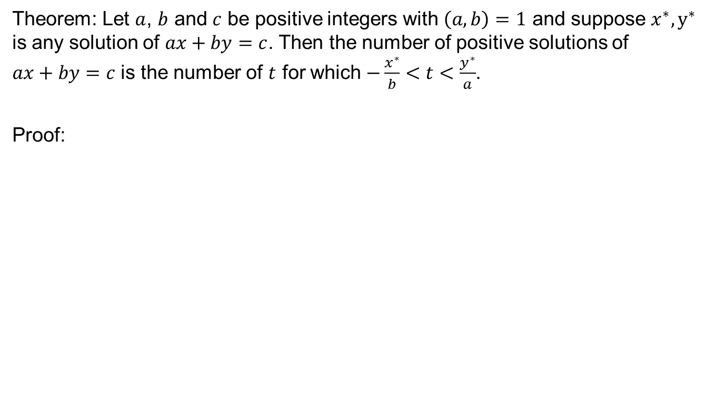
Positive Solutions for Diophantine Equation
Theorem: Let $a$, $b$ and $c$ be positive integers with $\left(a,b\right)=1$ and suppose $x^{∗}, y^{∗}$ is any solution of $ax+by=c$. Then the number of positive solutions of $ax+by=c$ is the number of $t$ for which $−\frac{x^{∗}}{b}<t<\frac{y^{∗}}{a}$.
Proof:

Slide 4
Positive Solutions for Diophantine Equation
Proof Continued…

Slide 5
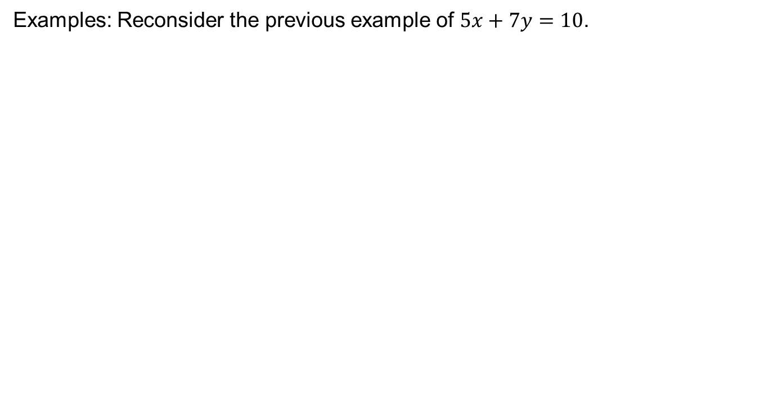
Positive Solutions for Diophantine Equation
Examples: Reconsider the previous example of $5x+7y=10$.

Slide 6
Examples

Slide 7
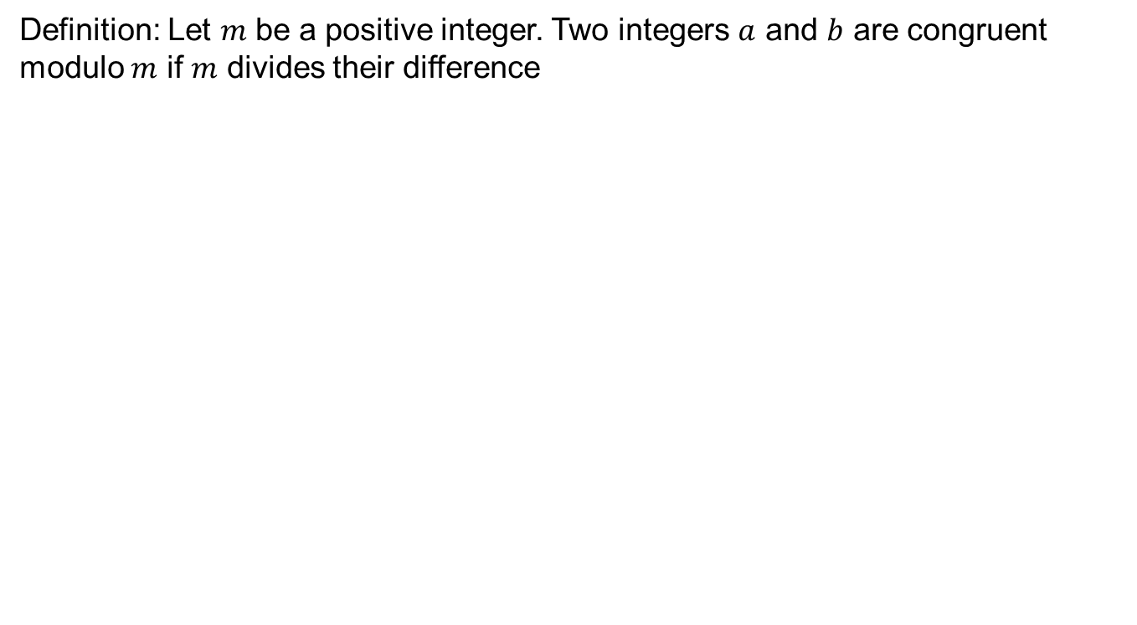
Congruences
Definition: Let $m$ be a positive integer. Two integers $a$ and $b$ are congruent modulo $m$ if $m$ divides their difference

Slide 8
Congruences
Least positive residues:

Slide 9
Congruences

Slide 10
Congruences
Complete Residue System:

Slide 11
Congruences

Slide 12
Congruences

Slide 13
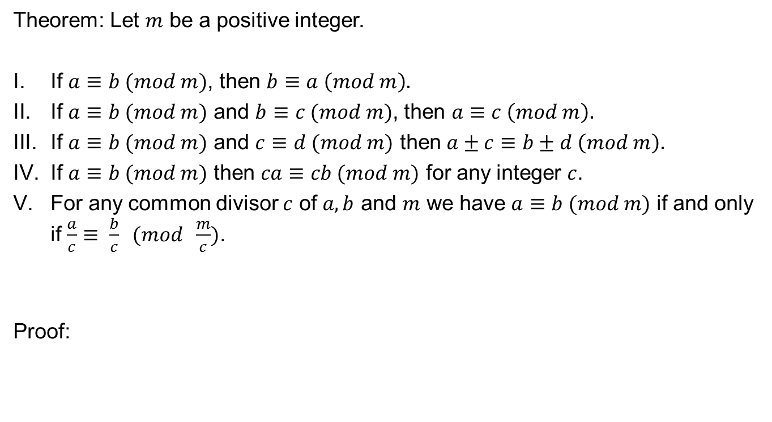
Elementary properties
Theorem: Let $m$ be a positive integer.
If $a≡b (mod m)$, then $b≡a \left(mod m\right).$
If $a≡b (mod m)$ and $b≡c (mod m)$, then $a≡c \left(mod m\right).$
If $a≡b (mod m)$ and $c≡d (mod m)$ then $a±c≡b±d \left(mod m\right).$
If $a≡b (mod m)$ then $ca≡cb (mod m)$ for any integer $c$.
For any common divisor $c$ of $a,b$ and $m$ we have $a≡b (mod m)$ if and only if $\frac{a}{c}≡ \frac{b}{c} (mod \frac{m}{c})$.
Proof:

Slide 17
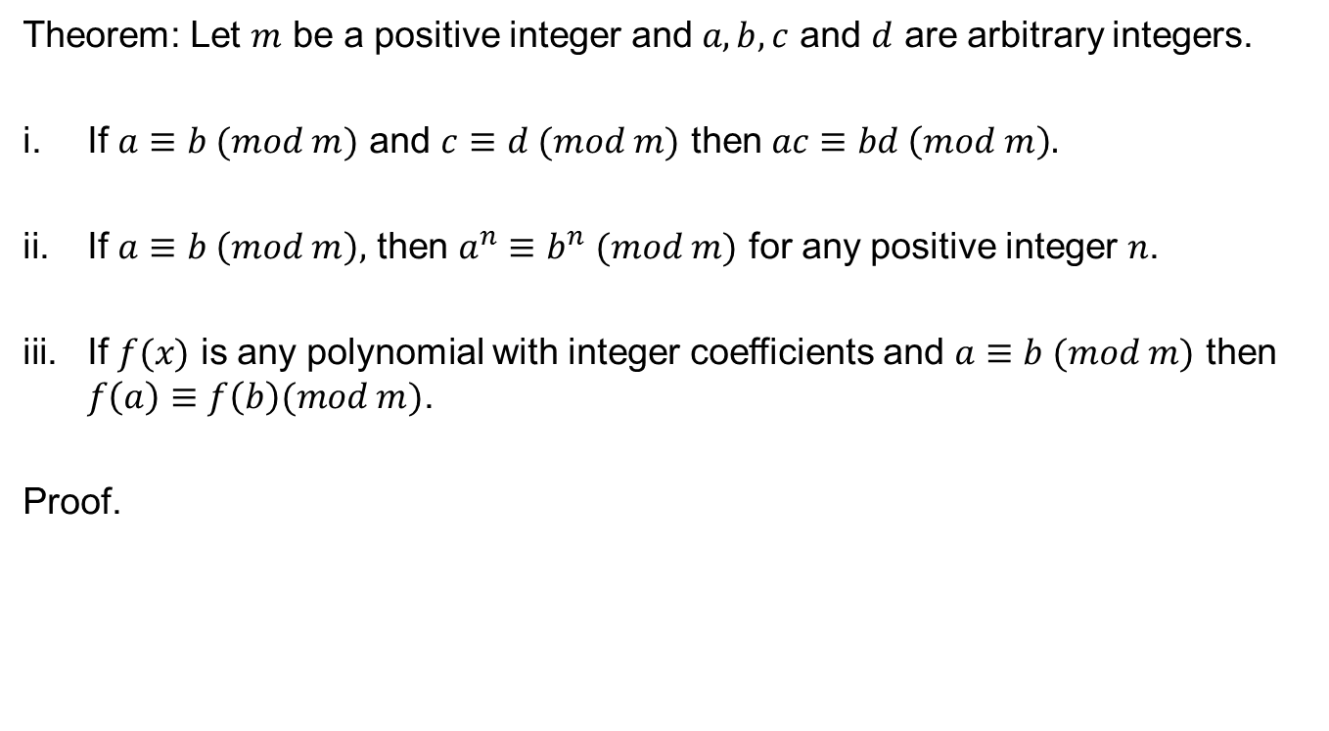
Elementary Properties
Theorem: Let $m$ be a positive integer and $a,b,c$ and $d$ are arbitrary integers.
If $a≡b (mod m)$ and $c≡d (mod m)$ then $ac≡bd \left(mod m\right).$
If $a≡b \left(mod m\right),$ then $a^{n}≡b^{n} (mod m)$ for any positive integer $n$.
If $f(x)$ is any polynomial with integer coefficients and $a≡b (mod m)$ then $f\left(a\right)≡f\left(b\right)(mod m)$.
Proof.

Slide 20
Elementary properties
Before going to the further properties of congruences we revisit one important property of l.c.m.
Theorem: The least common multiple of two integers divide any other common multiple of two integers.
Proof:

Slide 22
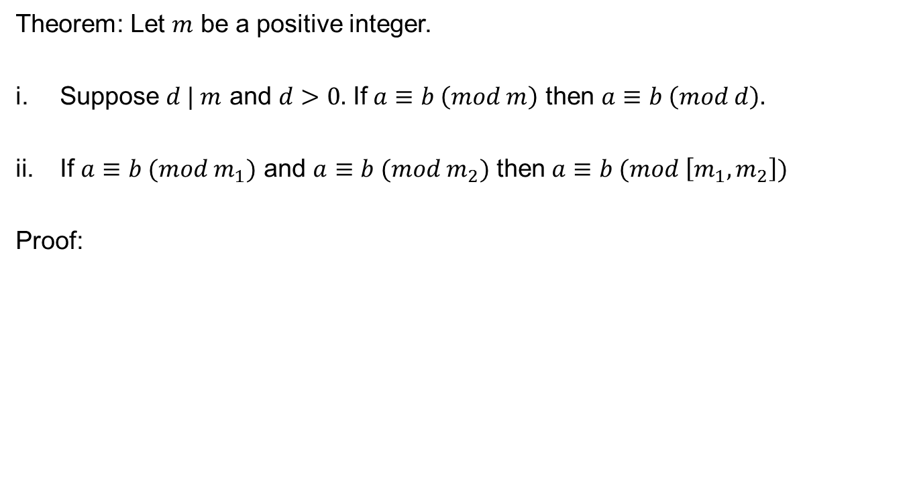
Elementary properties
Theorem: Let $m$ be a positive integer.
Suppose $d | m$ and $d>0.$ If $a≡b \left(mod m\right)$ then $a≡b \left(mod d\right).$
If $a≡b (mod m_{1})$ and $a≡b (mod m_{2})$ then $a≡b (mod \left[m_{1},m_{2}\right])$
Proof:

Slide 24
Review of Lecture 5
Definition of Congruences
Divisibility and Congruences
Multiples, addition and multiplication of congruences

