Slide 1
Analytic Number Theory
MTH 435
Dr Mohib Ali

Slide 2
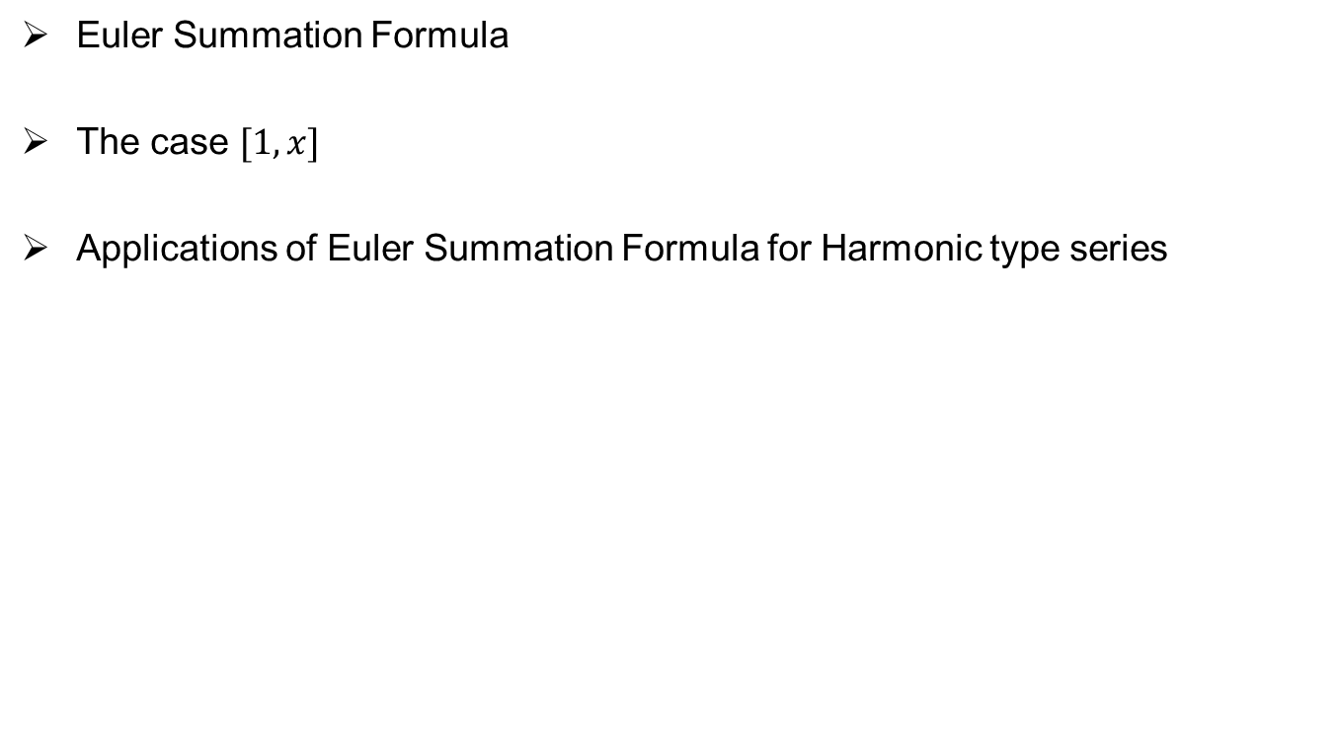
Review of Lecture 31
Euler Summation Formula
The case $[1,x]$
Applications of Euler Summation Formula for Harmonic type series

Slide 4
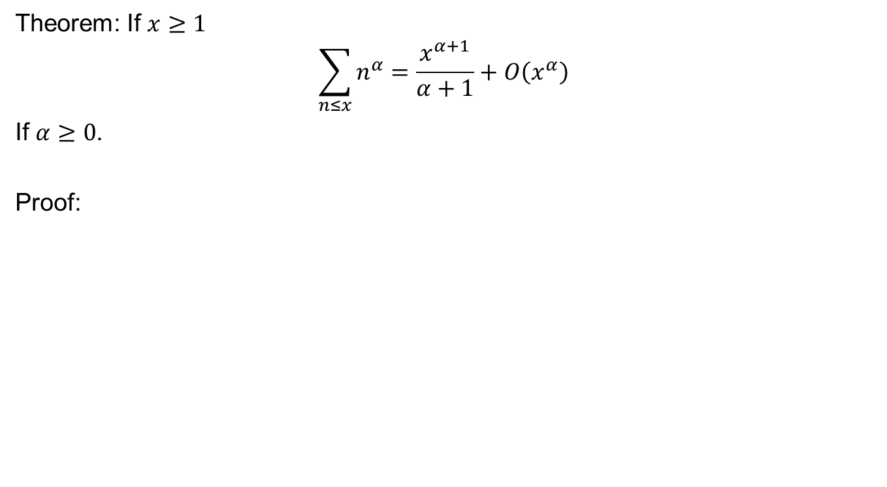
Theorem: If $x≥1$
$$\sum_{n≤x}{n^{α}=\frac{x^{α+1}}{α+1}}+O\left(x^{α}\right)$$
If $α≥0$.
Proof:

Slide 6

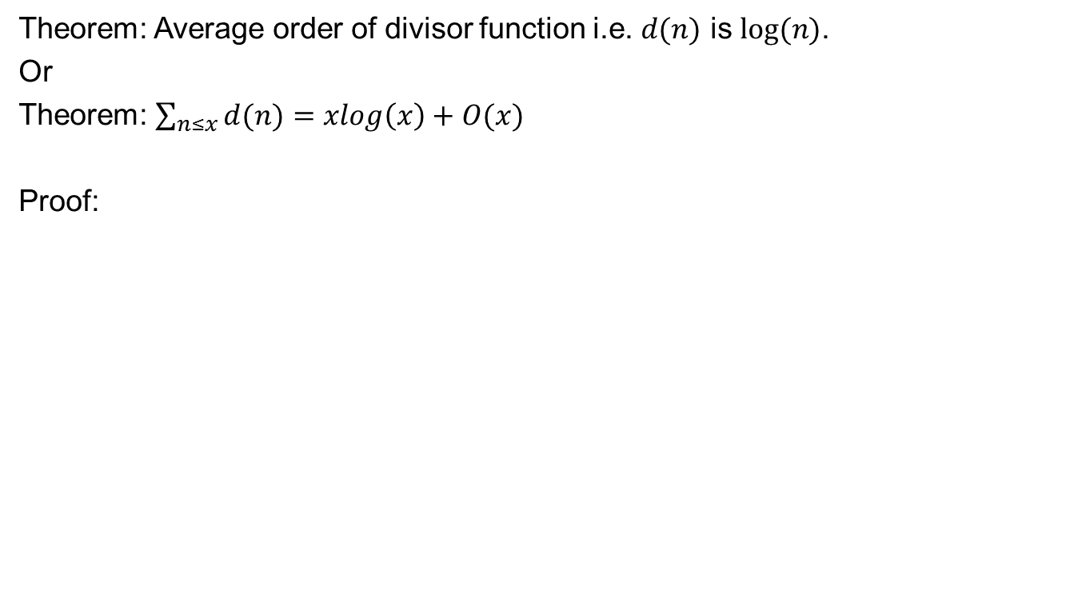
Average Order of $d\left(n\right)=σ_{0}(n)$
Theorem: Average order of divisor function i.e. $d(n)$ is $log⁡(n)$.
Or
Theorem: $\sum_{n≤x}{d(n)}=xlog\left(x\right)+O(x)$
Proof:

Slide 9
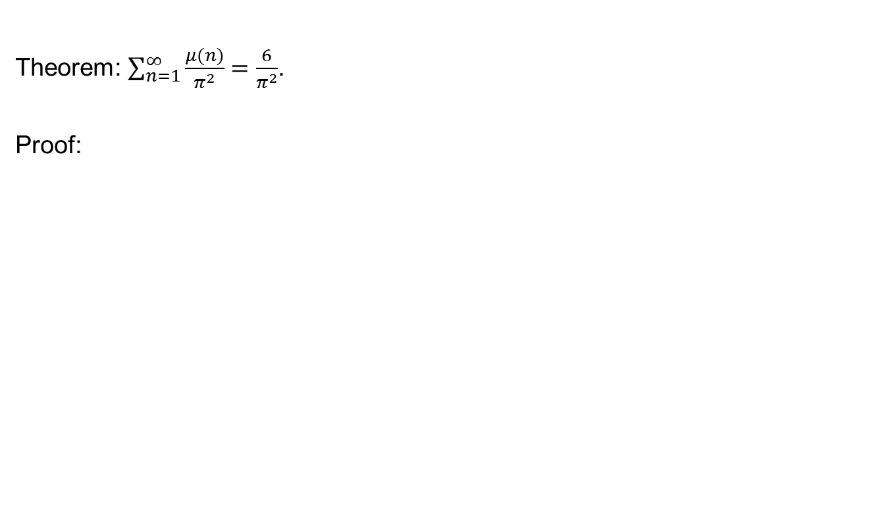
Theorem: $\sum_{n=1}^{∞}{\frac{μ(n)}{π^{2}}}=\frac{6}{π^{2}}$.
Proof:

Slide 11

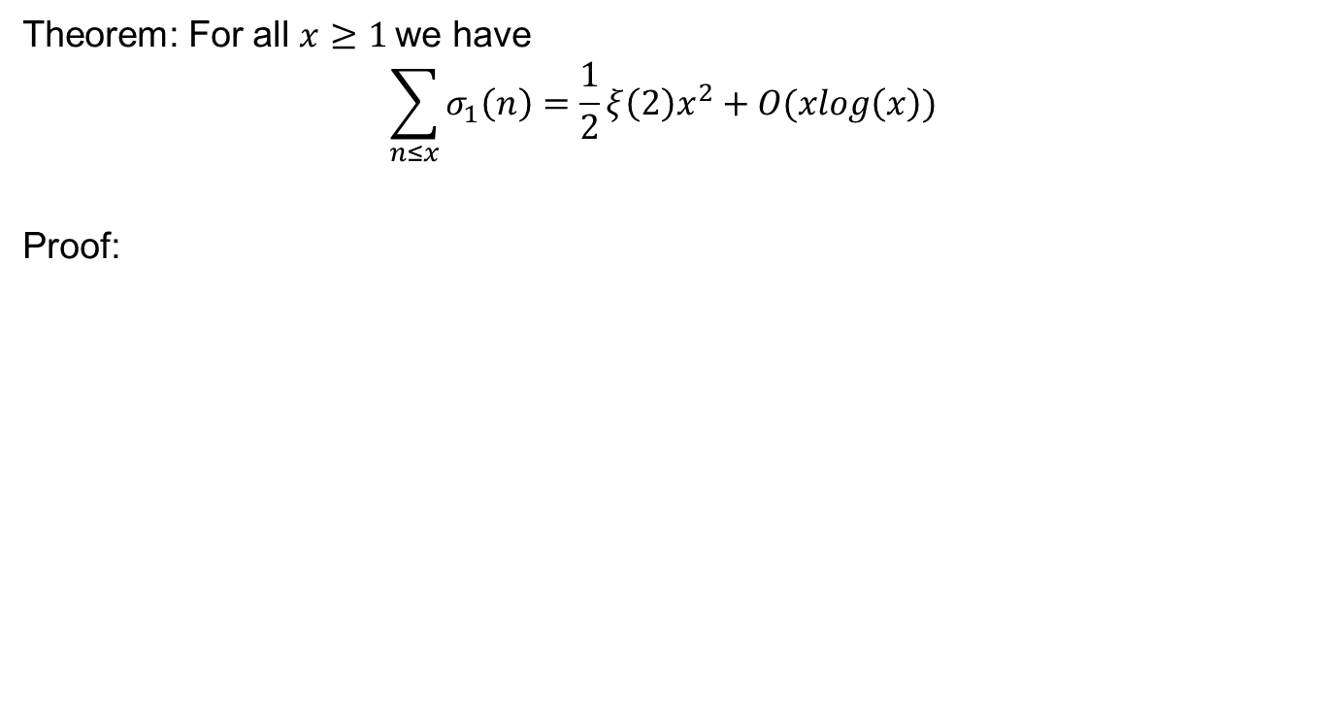
Average order of $σ_{1}(n)$
Theorem: For all $x≥1$we have
$$\sum_{n≤x}{σ_{1}\left(n\right)=\frac{1}{2}ξ\left(2\right)x^{2}+O(xlog\left(x\right))}$$
Proof:

Slide 13

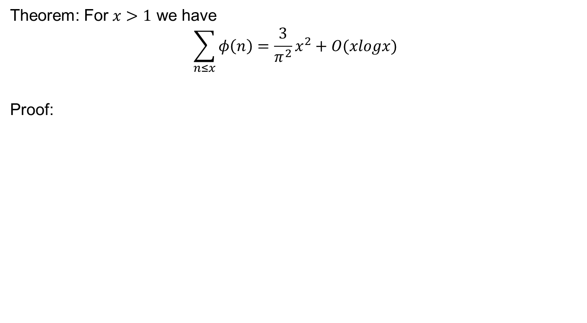
Average order of Euler $φ−$ function
Theorem: For $x>1$ we have
$$\sum_{n≤x}{φ\left(n\right)=\frac{3}{π^{2}}x^{2}+O(xlogx)}$$
Proof:

Slide 17
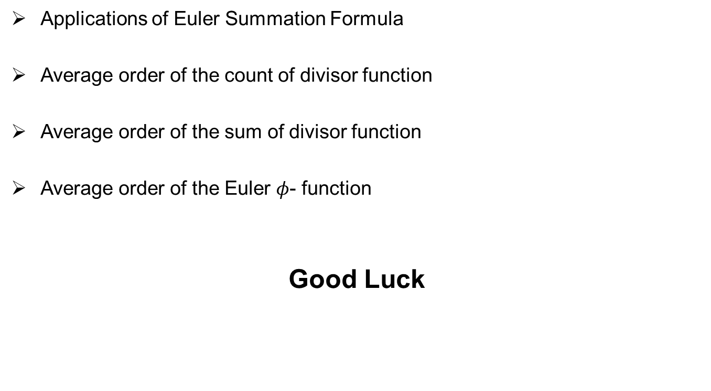
Review of Lecture 32
Applications of Euler Summation Formula
Average order of the count of divisor function
Average order of the sum of divisor function
Average order of the Euler $φ$- function
Good Luck

