Slide 1
Analytic Number Theory
MTH 435
Dr Mohib Ali

Slide 2
Review of Lecture 30
Big “O” and small “o” notations
Asymptotic functions
Prime Number Theorem (Statement only as example)
Euler Summation Formula

Slide 3
Euler Summation Formula

Slide 4

Interval $[1,x]$

Slide 7
Reimann Zeta Function

Slide 8
Euler Constant

Slide 9
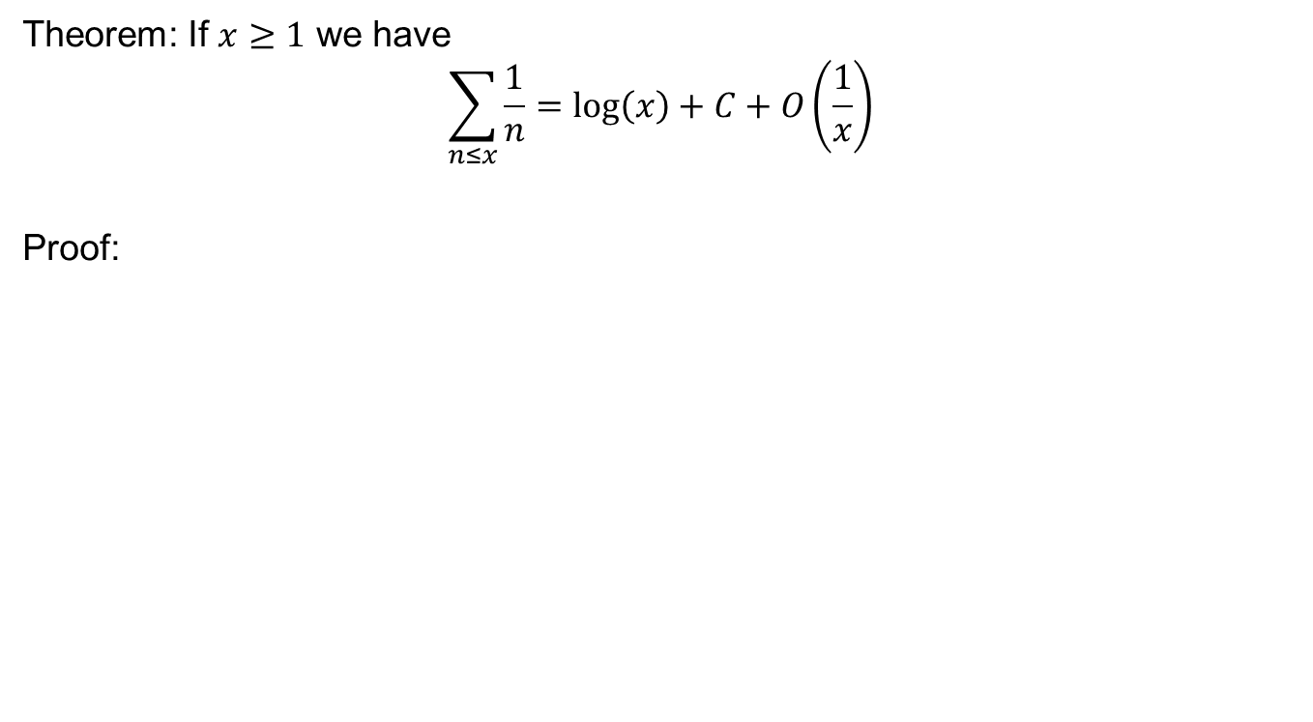
Application of Summation Formula
Theorem: If $x≥1$ we have
$$\sum_{n≤x}{\frac{1}{n}=\log\left(x\right)+C+O\left(\frac{1}{x}\right)}$$
Proof:

Slide 13
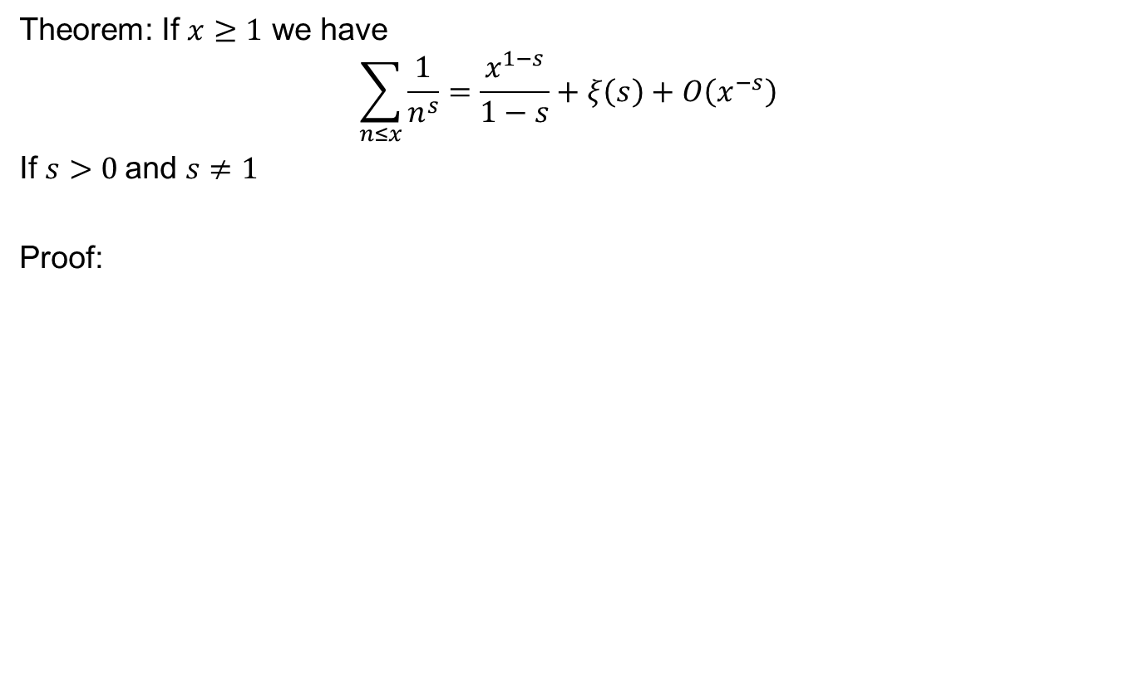
Theorem: If $x≥1$ we have
$$\sum_{n≤x}{\frac{1}{n^{s}}=\frac{x^{1−s}}{1−s}}+ξ\left(s\right)+O\left(x^{−s}\right)$$
If $s>0$and $s≠1$
Proof:

Slide 16
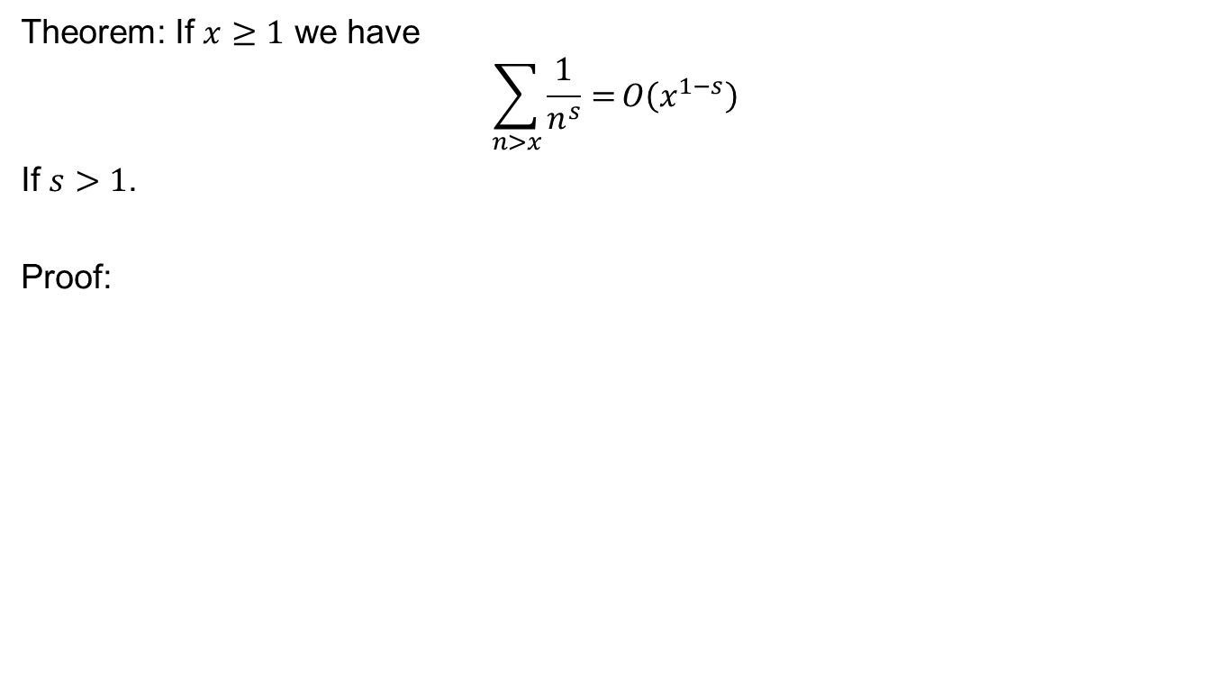
Theorem: If $x≥1$ we have
$$\sum_{n>x}{\frac{1}{n^{s}}=}O\left(x^{1−s}\right)$$
If $s>1$.
Proof:

Slide 18
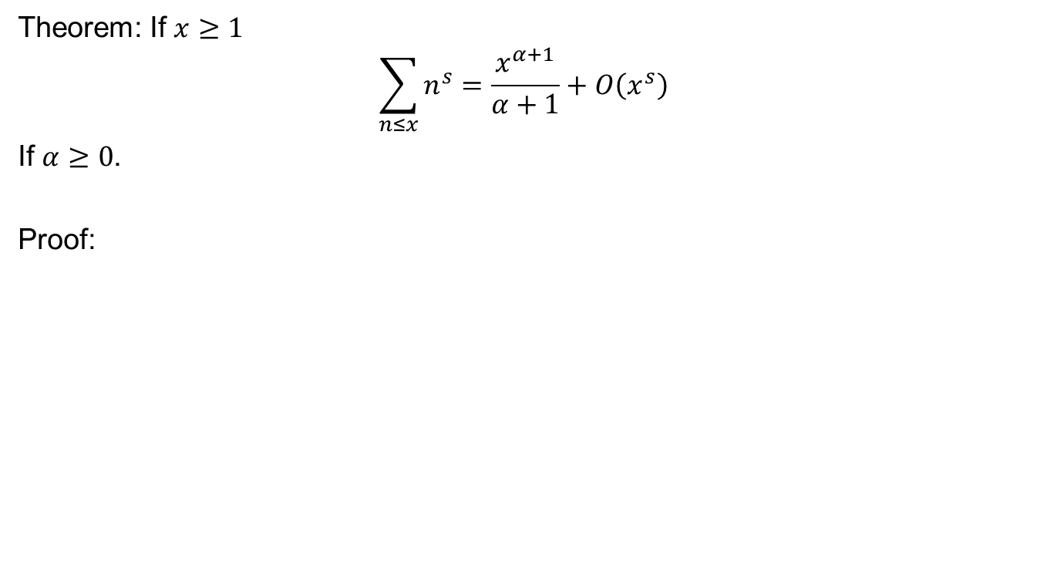
Theorem: If $x≥1$
$$\sum_{n≤x}{n^{s}=\frac{x^{α+1}}{α+1}}+O\left(x^{s}\right)$$
If $α≥0$.
Proof:

Slide 20

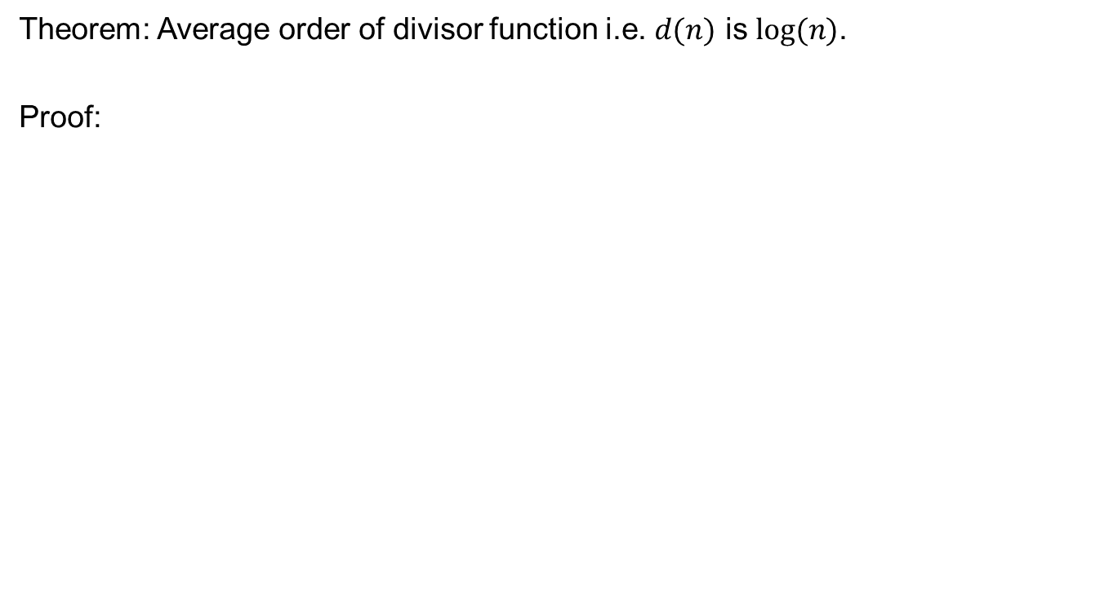
Average Order of $d(n)$
Theorem: Average order of divisor function i.e. $d(n)$ is $log⁡(n)$.
Proof:

Slide 24
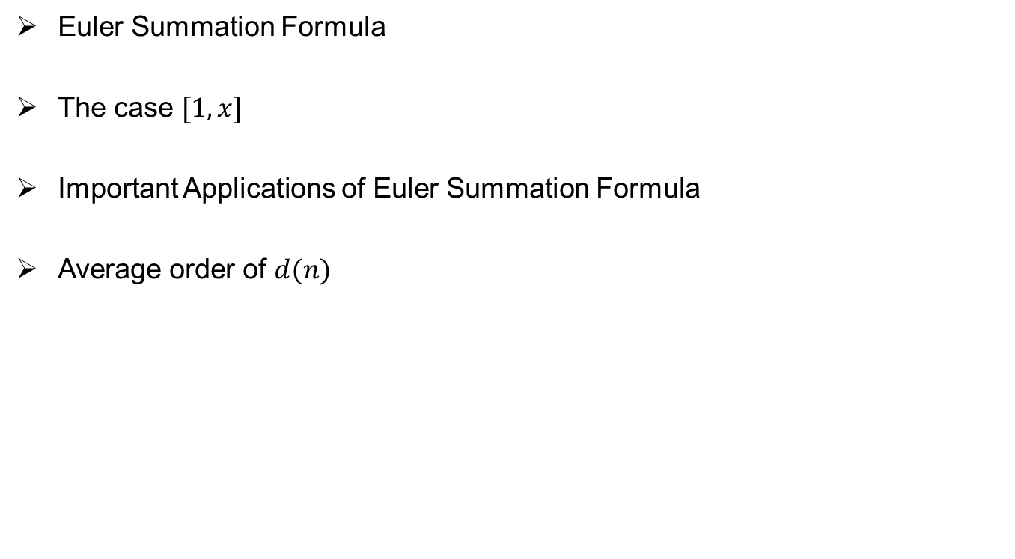
Review of Lecture 31
Euler Summation Formula
The case $[1,x]$
Important Applications of Euler Summation Formula
Average order of $d(n)$

