Slide 1
Analytic Number Theory
MTH 435
Dr Mohib Ali

Slide 2
Review of Lecture 2
L.C.M and G.C.D relation
Prime Numbers
Fundamental Theorem of Arithmetic
Infinite many primes

Slide 3
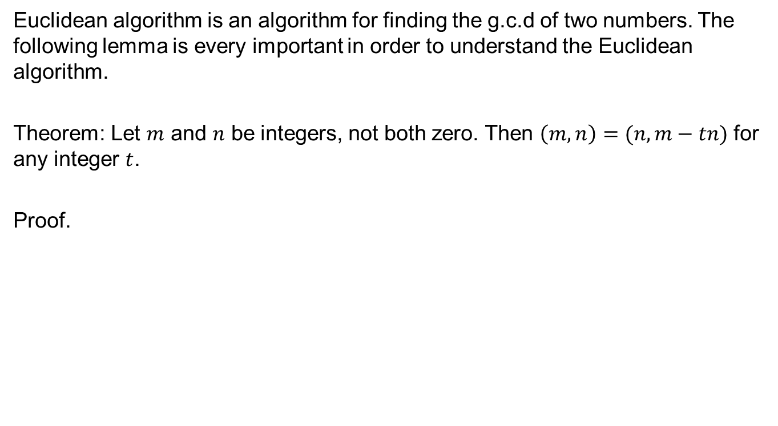
Euclidean Algorithm
Euclidean algorithm is an algorithm for finding the g.c.d of two numbers. The following lemma is every important in order to understand the Euclidean algorithm.
Theorem: Let $m$ and $n$ be integers, not both zero. Then $\left(m,n\right)=(n,m−tn)$ for any integer $t$.
Proof.

Slide 4
Continued….

Slide 5
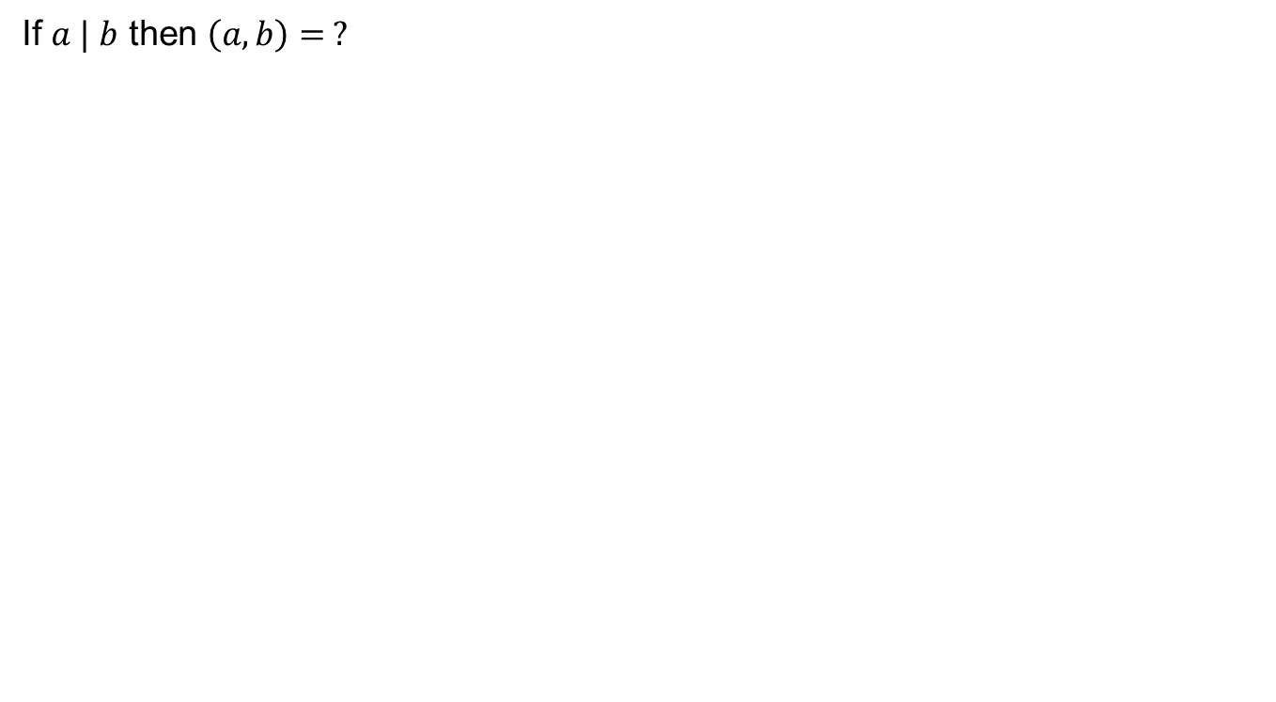
Remark
If $a | b$ then $\left(a,b\right)= ?$

Slide 6
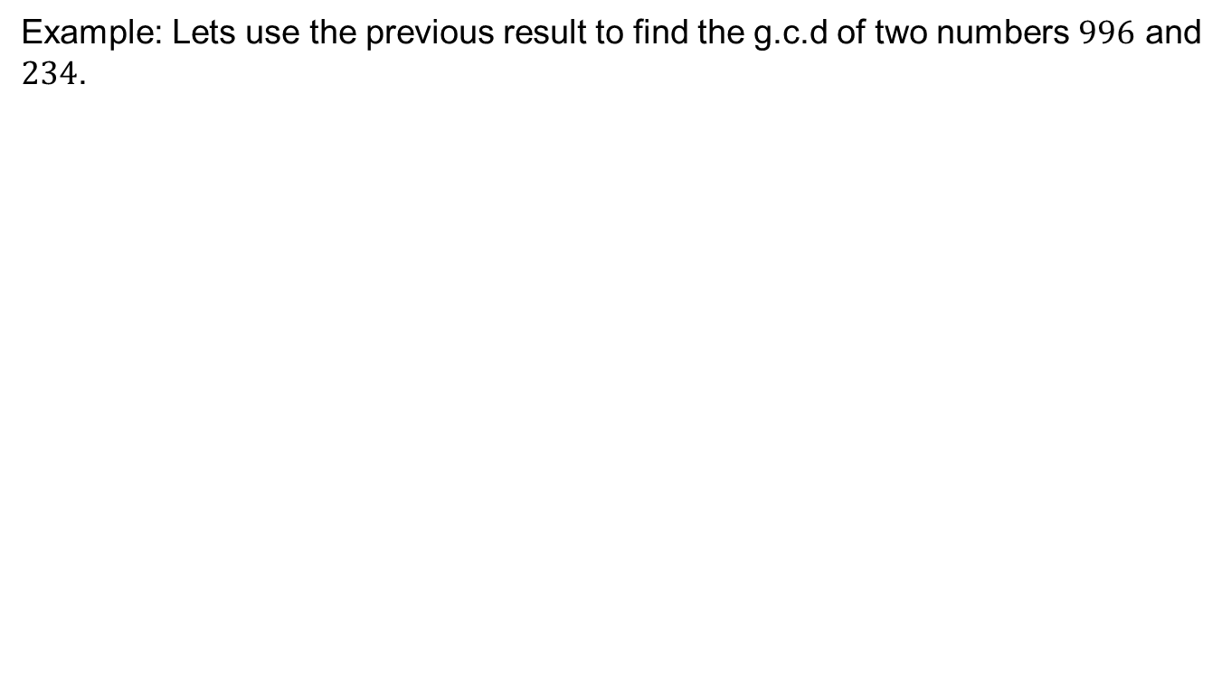
Euclidean Algorithm
Example: Lets use the previous result to find the g.c.d of two numbers $996$ and $234$.

Slide 7
Euclidean Algorithm

Slide 8
Euclidean Algorithm

Slide 9
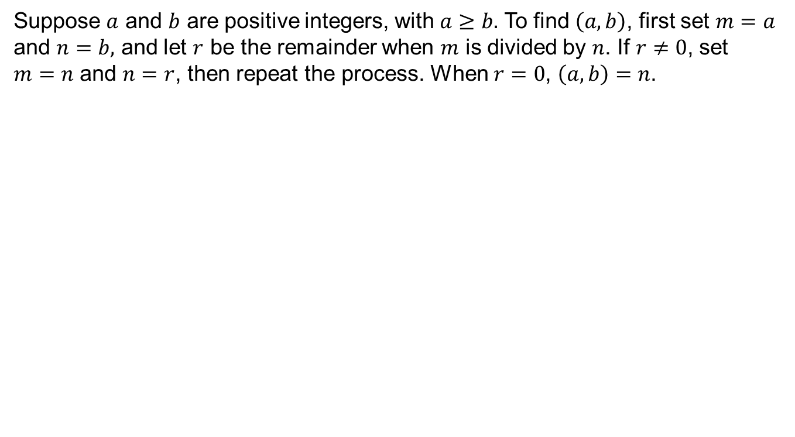
Euclidean Algorithm
Suppose $a$ and $b$ are positive integers, with $a≥b.$ To find $\left(a,b\right)$, first set $m=a$ and $n=b,$ and let $r$ be the remainder when $m$ is divided by $n$. If $r≠0$, set $m=n$ and $n=r$, then repeat the process. When $r=0$, $\left(a,b\right)=n$.

Slide 10
Euclidean Algorithm
Example by Algorithm.

Slide 11
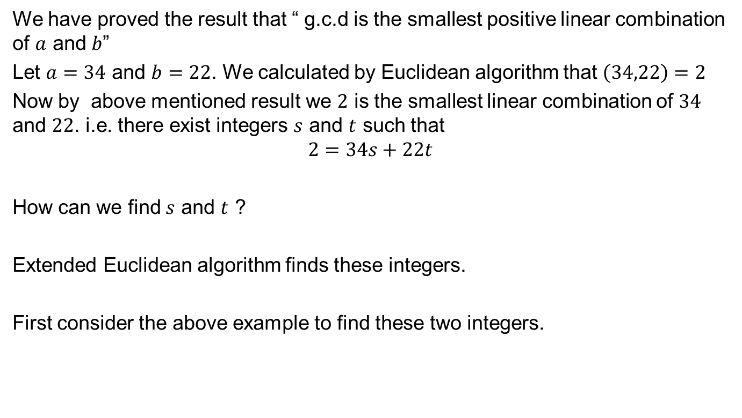
Extended Euclidean Algorithm
We have proved the result that “ g.c.d is the smallest positive linear combination of $a$ and $b$”
Let $a=34$ and $b=22$. We calculated by Euclidean algorithm that $\left(34,22\right)=2$
Now by above mentioned result we $2$ is the smallest linear combination of $34$ and $22$. i.e. there exist integers $s$ and $t$ such that
$$2=34s+22t$$
How can we find $s$ and $t$ ?
Extended Euclidean algorithm finds these integers.
First consider the above example to find these two integers.

Slide 12
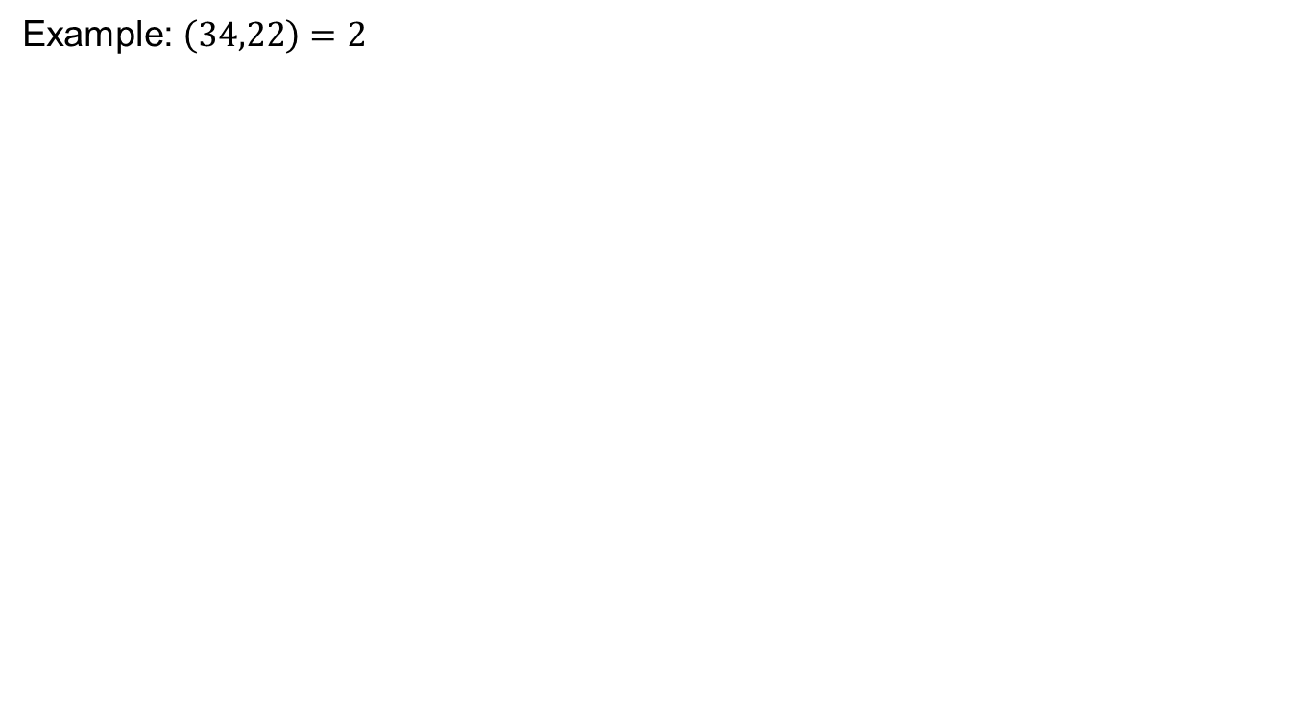
Extended Euclidean Algorithm
Example: $\left(34,22\right)=2$

Slide 13
Extended Euclidean Algorithm
Example:

Slide 14
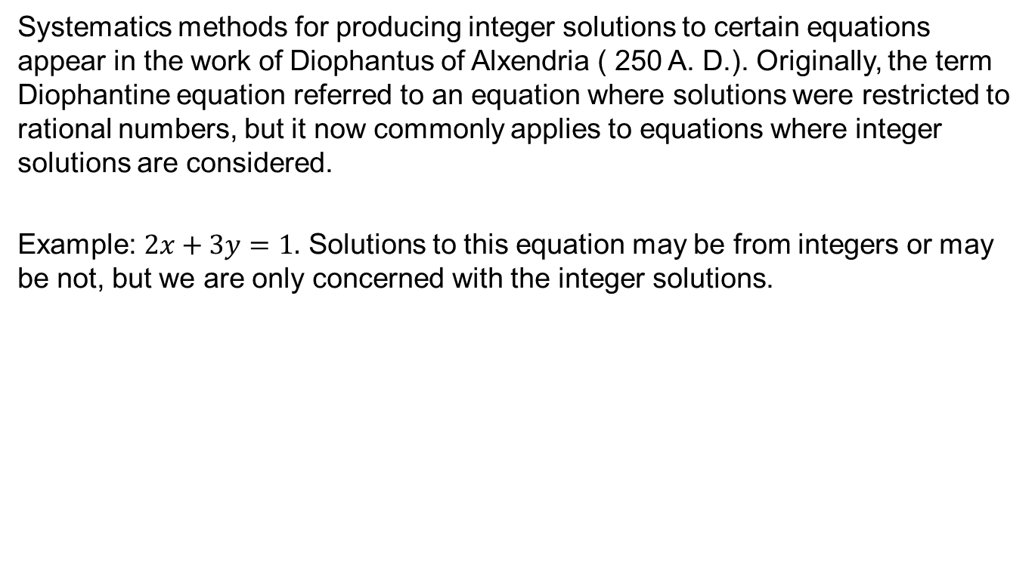
Diophantine Equations
Systematics methods for producing integer solutions to certain equations appear in the work of Diophantus of Alxendria ( 250 A. D.). Originally, the term Diophantine equation referred to an equation where solutions were restricted to rational numbers, but it now commonly applies to equations where integer solutions are considered.
Example: $2x+3y=1.$ Solutions to this equation may be from integers or may be not, but we are only concerned with the integer solutions.

Slide 15
Diophantine Equations

Slide 16
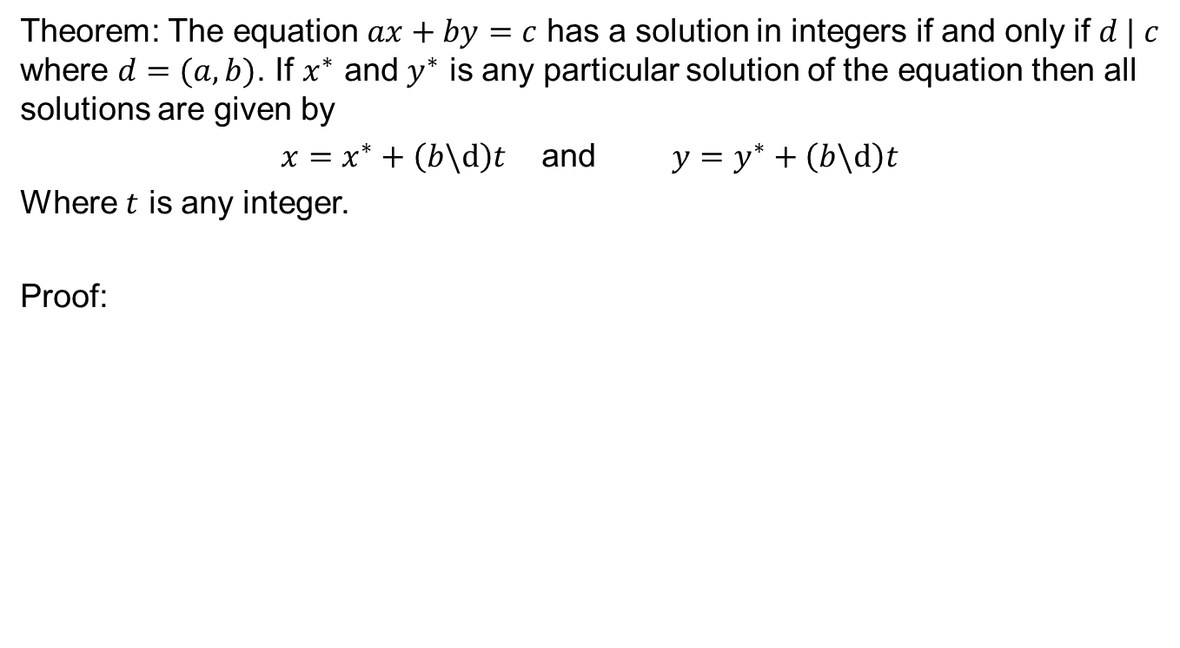
Diophantine Equations
Theorem: The equation $ax+by=c$ has a solution in integers if and only if $d | c$ where $d=(a,b)$. If $x^{∗}$ and $y^{∗}$ is any particular solution of the equation then all solutions are given by
$x=x^{∗}+\left(b\backslash d\right)t$ and $y=y^{∗}+\left(b\backslash d\right)t$
Where $t$ is any integer.
Proof:

Slide 17
Examples

Slide 18
Review of Lecture 3
Euclidean Algorithm
Extended Euclidean Algorithm
Diophantine Equations and their solutions

