Slide 1
Analytic Number Theory
MTH 435
Dr Mohib Ali

Slide 2
Review of Lecture 27
Review of lecture 26
Multiplicative functions, Completely multiplicative functions
Inverse functions
Abelian groups and their subgroups

Slide 3
Power Series

Slide 4
Formal Power Series

Slide 9
Bell Series of Arithmetical functions

Slide 11
Examples

Slide 13
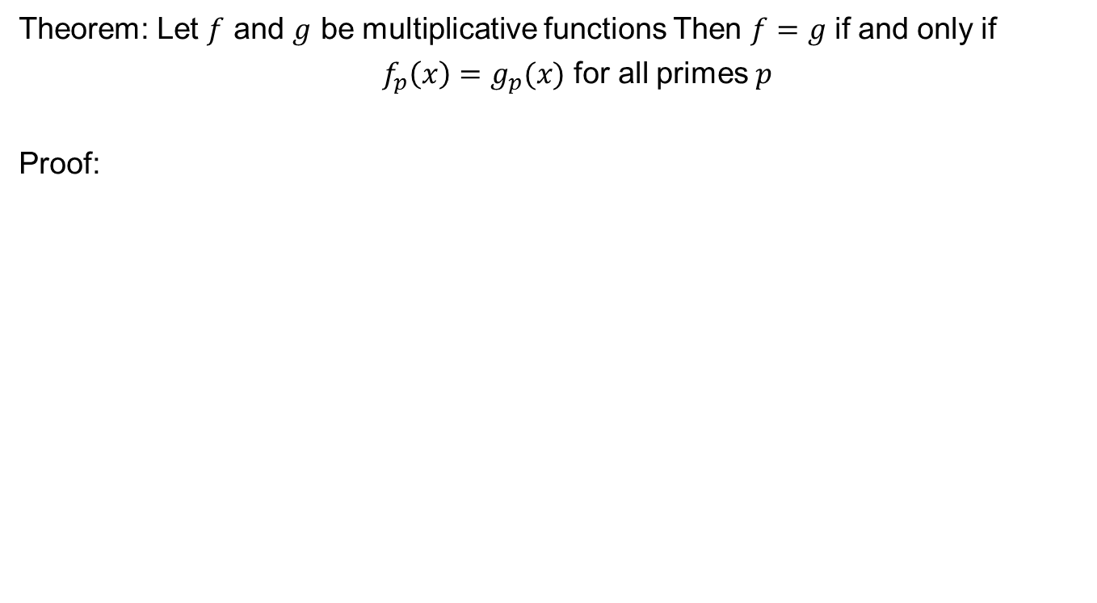
Uniqueness Theorem
Theorem: Let $f$ and $g$ be multiplicative functions Then $f=g$ if and only if
$f_{p}\left(x\right)=g_{p}(x)$ for all primes $p$
Proof:

Slide 15
Remark for Completely multiplicative functions

Slide 16
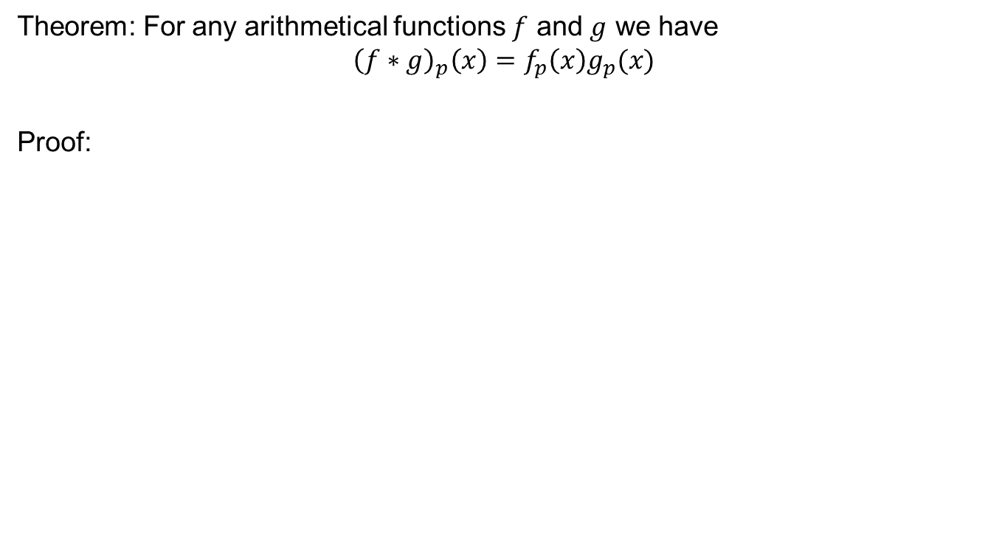
Bell Series and Dirichlet Product
Theorem: For any arithmetical functions $f$ and $g$ we have
$${\left(f∗g\right)}_{p}\left(x\right)=f_{p}\left(x\right)g_{p}(x)$$
Proof:

Slide 18
Application of Bell Series

Slide 20
Derivative of Arithmetical functions
Defintion:

Slide 21
Examples

Slide 22
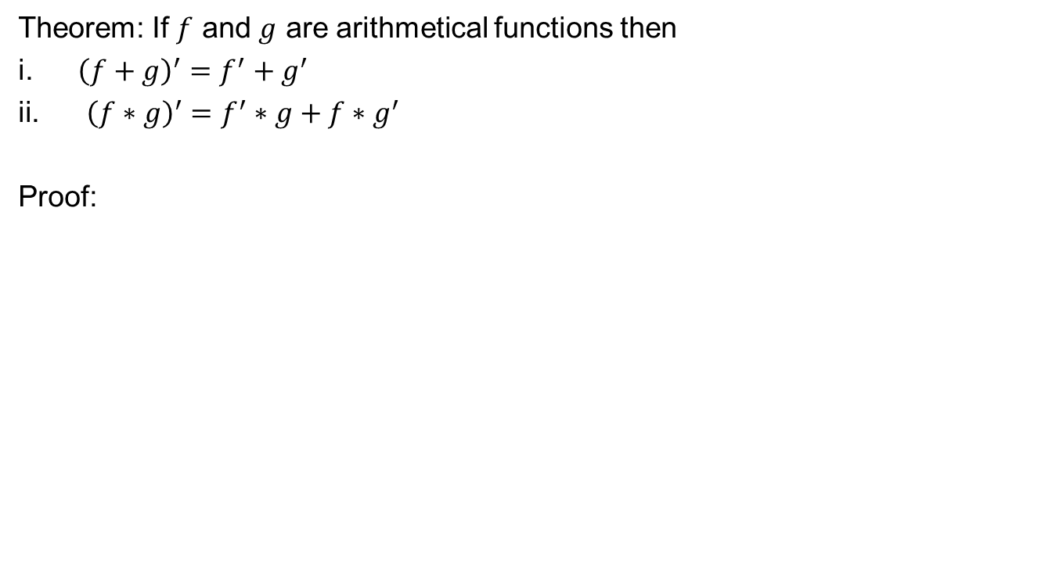
Derivative like properties
Theorem: If $f$ and $g$ are arithmetical functions then
${\left(f+g\right)}^{′}=f^{′}+g^{′}$
${\left(f∗g\right)}^{′}=f^{′}∗g+f∗g^{′}$
Proof:

Slide 24
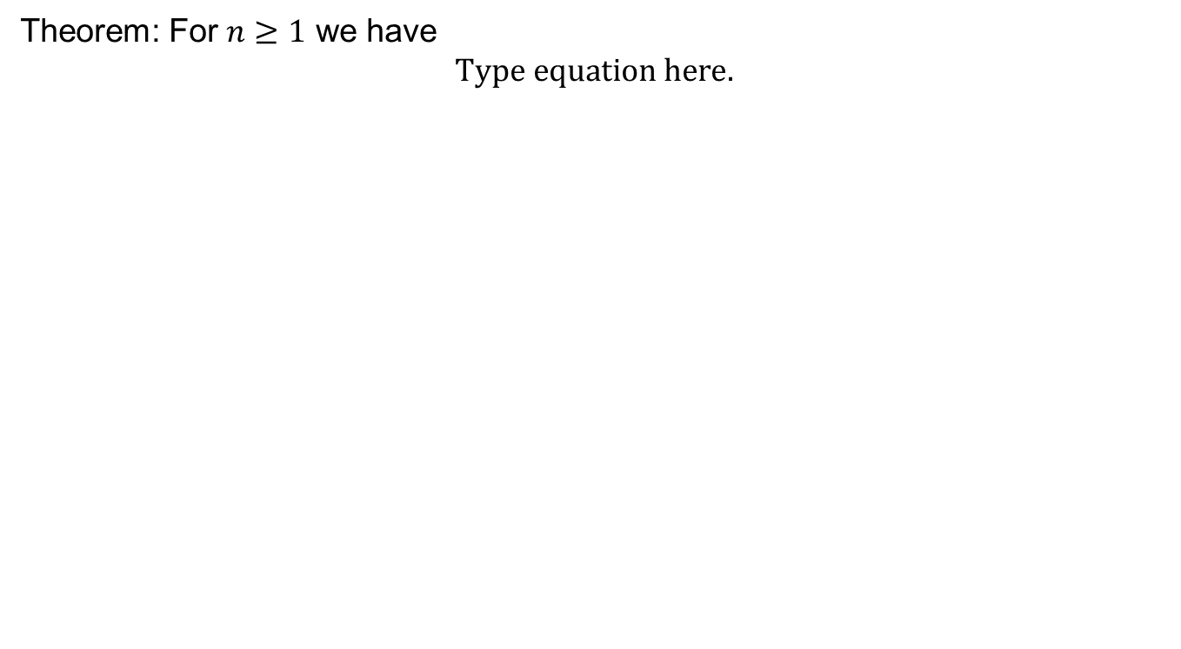
Selberg Identity
Theorem: For $n≥1$ we have

Slide 30
Review of Lecture 28
Formal Power Series
Bell series of arithmetical functions
Bell series and Dirichlet product
Applications of Bell series
Derivative of arithmetical function
Selberg identity

