Slide 1
Analytic Number Theory
MTH 435
Dr Mohib Ali

Slide 2
Review of Lecture 26
Mobius and Euler functions
Some results about Euler function
Arithmetical Functions
Mobius Inversion Formula
Mangoldt function by MIF

Slide 3
Some Review of previous lecture

Slide 5
Multiplicative Functions

Slide 7
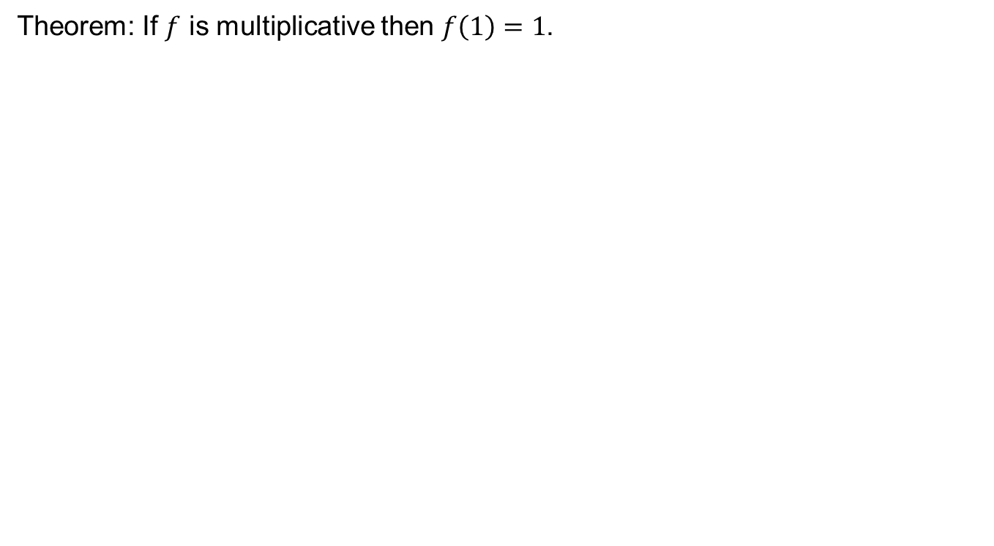
Theorem: If $f$ is multiplicative then $f\left(1\right)=1$.

Slide 10
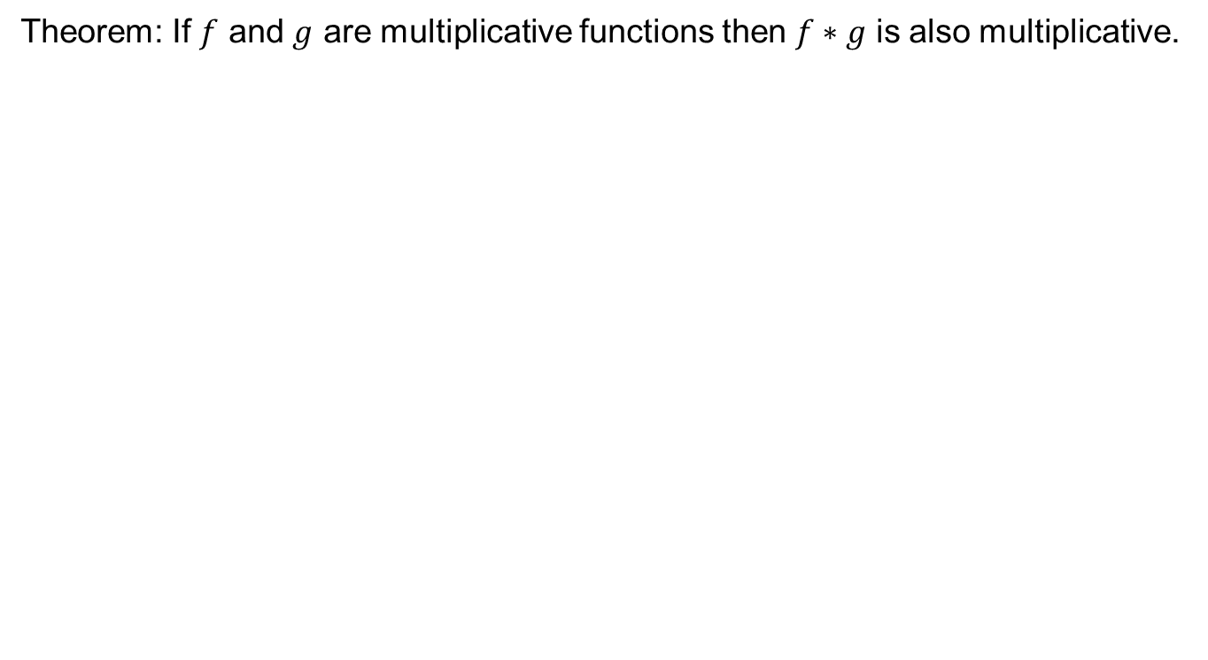
Multiplicative functions and Dirichlet product
Theorem: If $f$ and $g$ are multiplicative functions then $f∗g$ is also multiplicative.

Slide 12
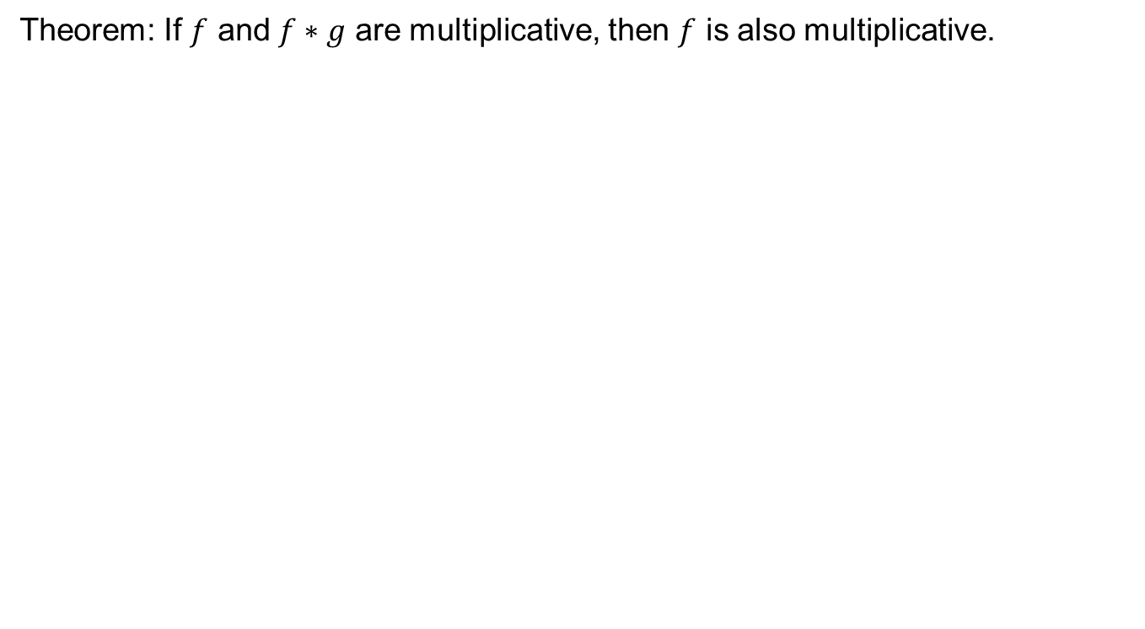
Theorem: If $f$ and $f∗g$ are multiplicative, then $f$ is also multiplicative.

Slide 15
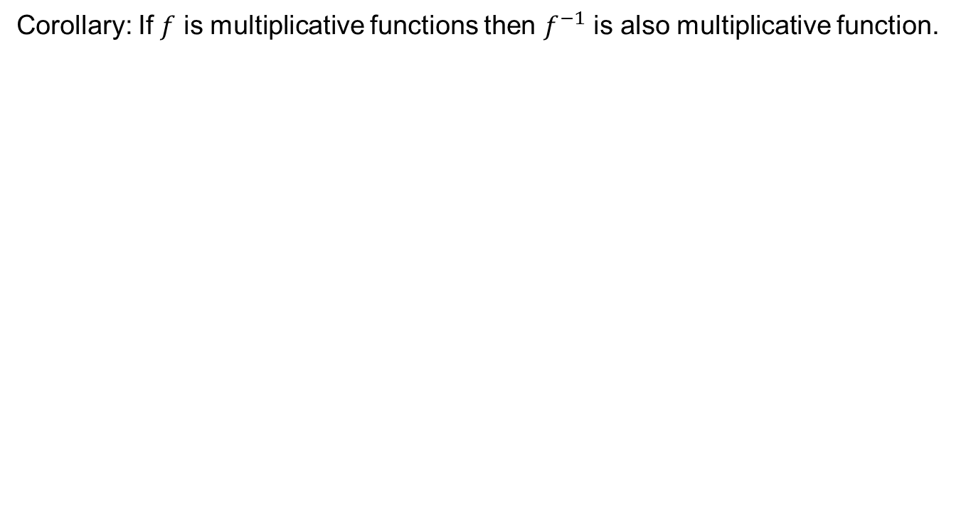
Inverse of multiplicative function
Corollary: If $f$ is multiplicative functions then $f^{−1}$ is also multiplicative function.

Slide 16
Algebraic Point of View
Dirichlet product is Commutative and associative.

Slide 18
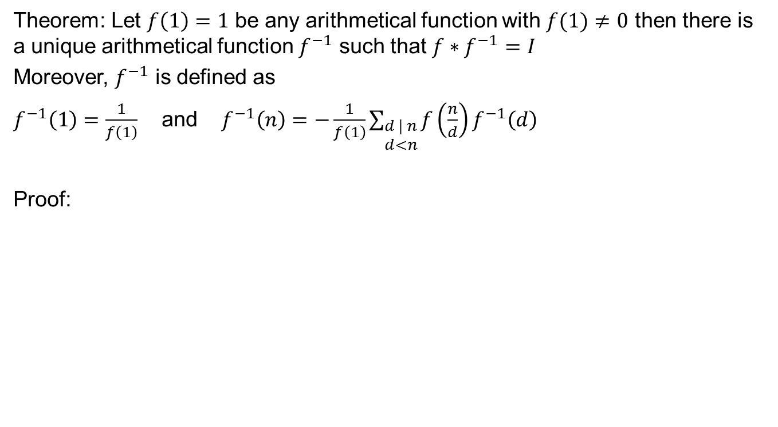
Inverse of a function
Theorem: Let $f\left(1\right)=1$ be any arithmetical function with $f(1)≠0$ then there is a unique arithmetical function $f^{−1}$ such that $f∗f^{−1}=I$
Moreover, $f^{−1}$ is defined as
$f^{−1}\left(1\right)=\frac{1}{f\left(1\right)}$ and $f^{−1}\left(n\right)=−\frac{1}{f\left(1\right)}\sum_{\begin{aligned}d | n \\ d<n\end{aligned}}{f\left(\frac{n}{d}\right)f^{−1}\left(d\right)}$
Proof:

Slide 21
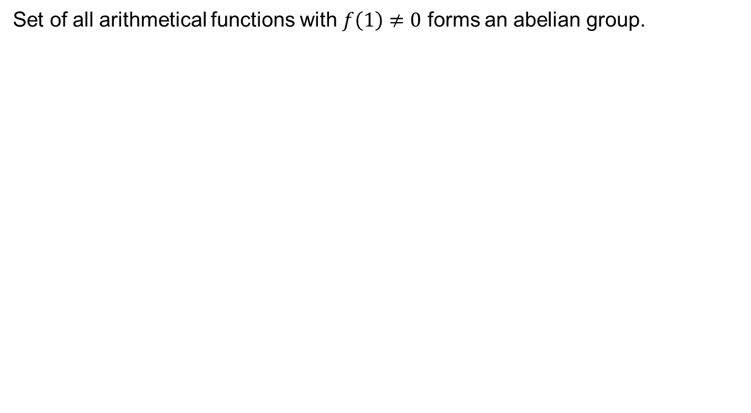
Abelian group of Arithmetical functions
Set of all arithmetical functions with $f\left(1\right)≠0$ forms an abelian group.

Slide 23
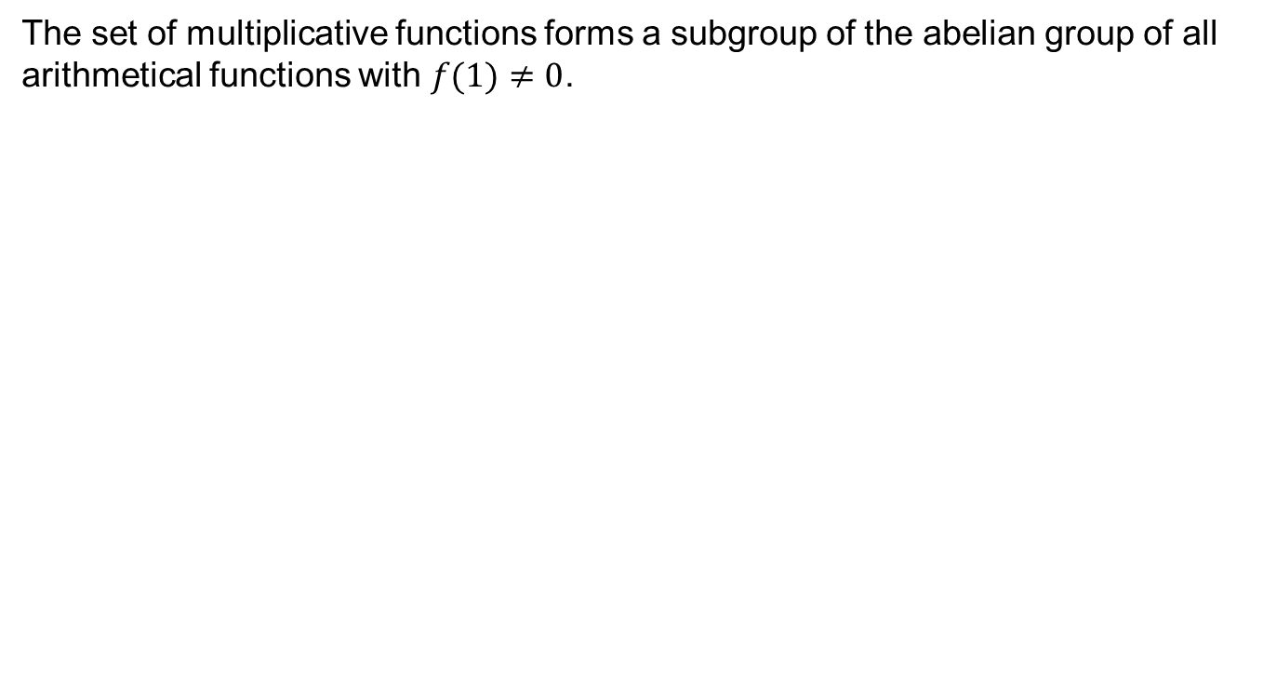
Subgroup of Abelian group
The set of multiplicative functions forms a subgroup of the abelian group of all arithmetical functions with $f(1)≠0$.

Slide 24
Review of Lecture 27
Review of lecture 26
Multiplicative functions, Completely multiplicative functions
Inverse functions
Algebraic point of view

