Slide 1
Analytic Number Theory
MTH 435
Dr Mohib Ali

Slide 2
Review of Lecture 25
Arithmetical functions
Divisor functions
Relation of Perfect numbers with Mersenne primes
Mobius Function
Divisor sums of Mobius and Euler Functions

Slide 3

Review of Euler $φ$ function

Slide 4
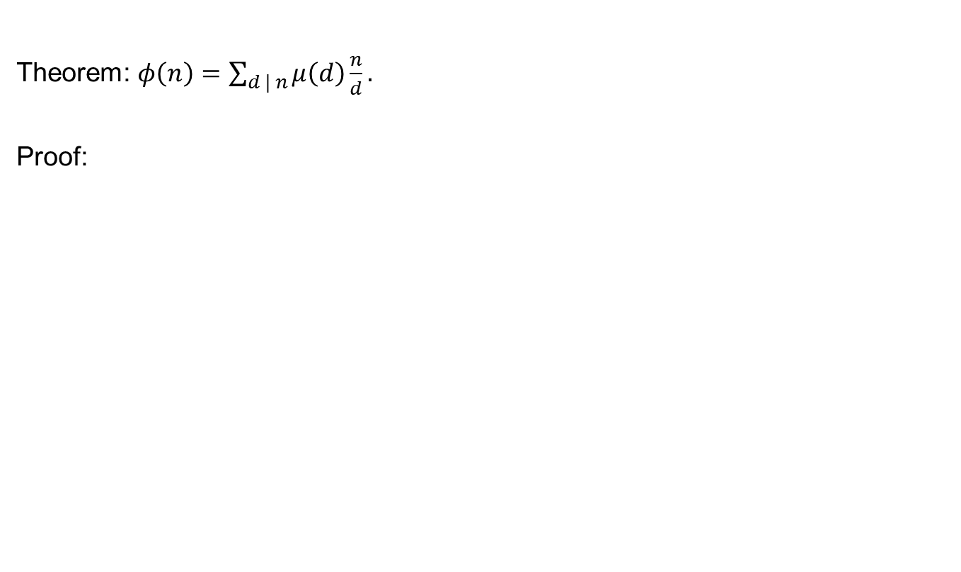
Relation of Mobius and Euler Funciton
Theorem: $φ\left(n\right)=\sum_{d | n}{μ\left(d\right)\frac{n}{d}}.$
Proof:

Slide 7
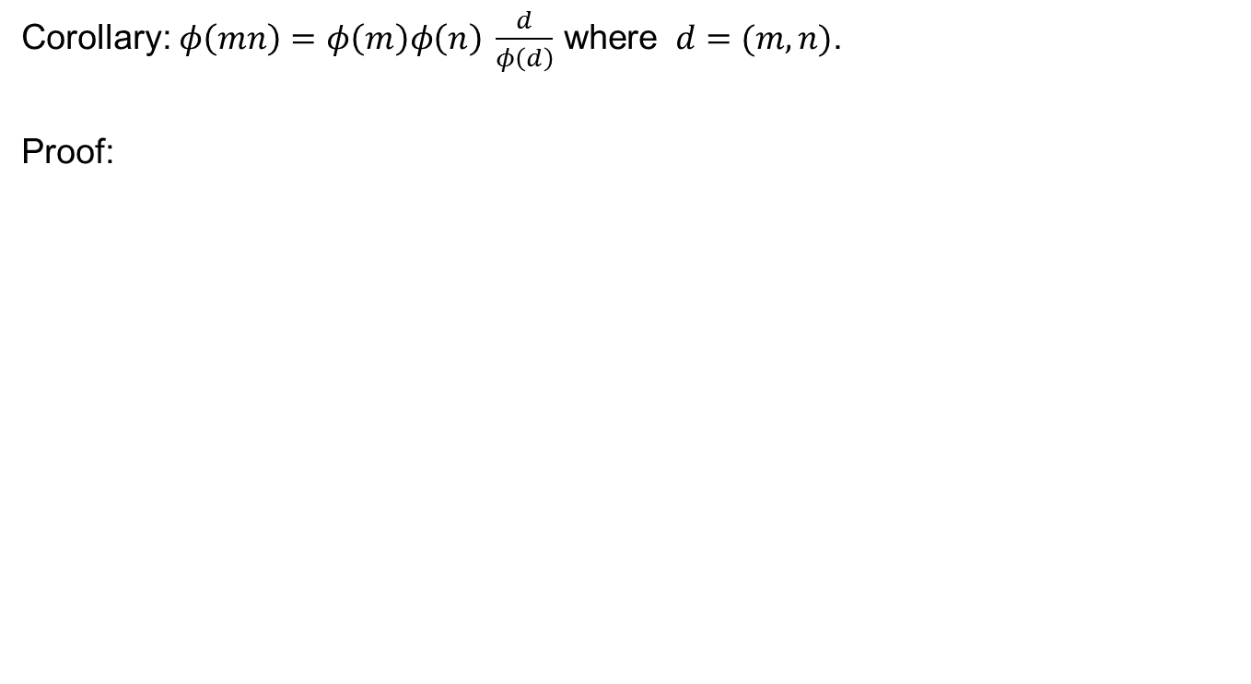
Corollary: $φ\left(mn\right)=φ\left(m\right)φ\left(n\right) \frac{d}{φ\left(d\right)}$ where $d=(m,n)$.
Proof:

Slide 10
More Arithmetical Functions
Mangoldt Function

Slide 12
Dirichlet Product (Convolution)

Slide 14
Identity Function

Slide 15
Inverse of a function

Slide 16
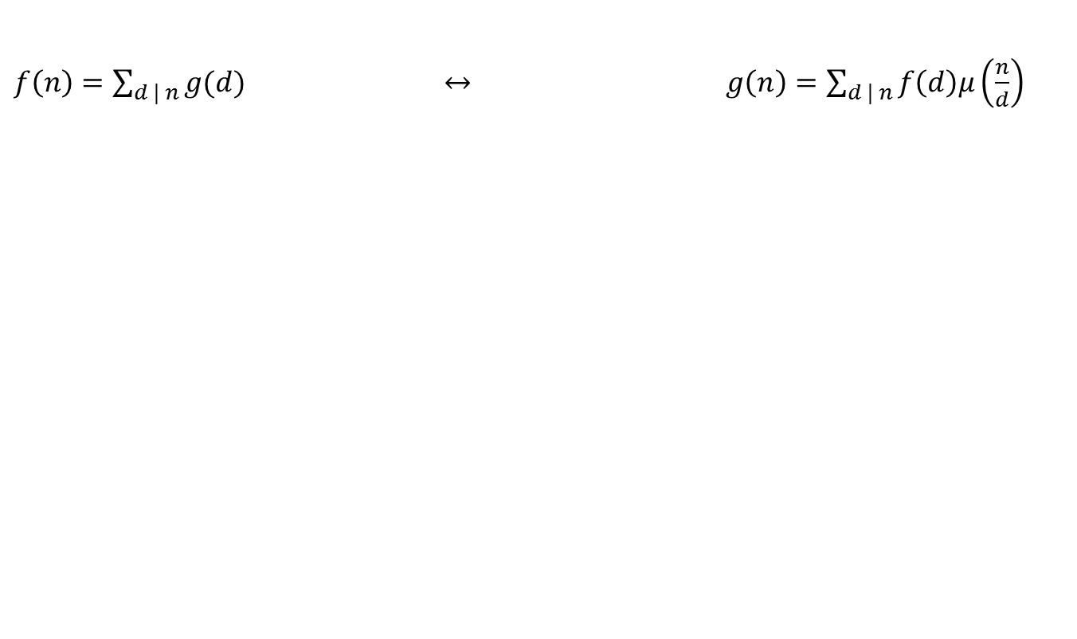
Mobius Inversion Formula
$f\left(n\right)=\sum_{d | n}{g(d)}$ $↔ g\left(n\right)=\sum_{d | n}{f\left(d\right)μ\left(\frac{n}{d}\right)}$

Slide 19
Divisor Sum of Mangoldt Functon

Slide 21
Application of Mobius Inversion Formula

Slide 24
Review of Lecture 26
Mobius and Euler functions
Some results about Euler function
Arithmetical Functions
Mobius Inversion Formula
Mangoldt function by MIF
Multiplicative functions

