Slide 1
Analytic Number Theory
MTH 435
Dr Mohib Ali

Slide 2
Review of Lecture 24
Primes, Fermats Numbers, Mersenne Primes
Sieve of Eratosthenes
Distribution of Primes, Bertrand’s Postulate
Goldbach Conjecture

Slide 3
Arithmetical Functions

Slide 4
Divisor Function

Slide 7
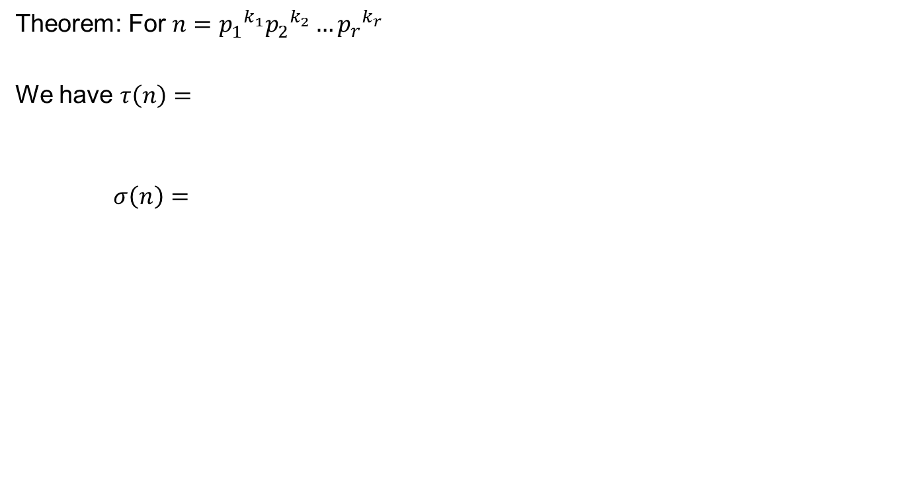
Formulas for Divisor Functions
Theorem: For $n={p_{1}^{}}^{k_{1}}{p_{2}^{}}^{k_{2}}…{p_{r}^{}}^{k_{r}}$
We have $τ\left(n\right)=$
$$σ\left(n\right)=$$

Slide 10
Perfect Numbers

Slide 11
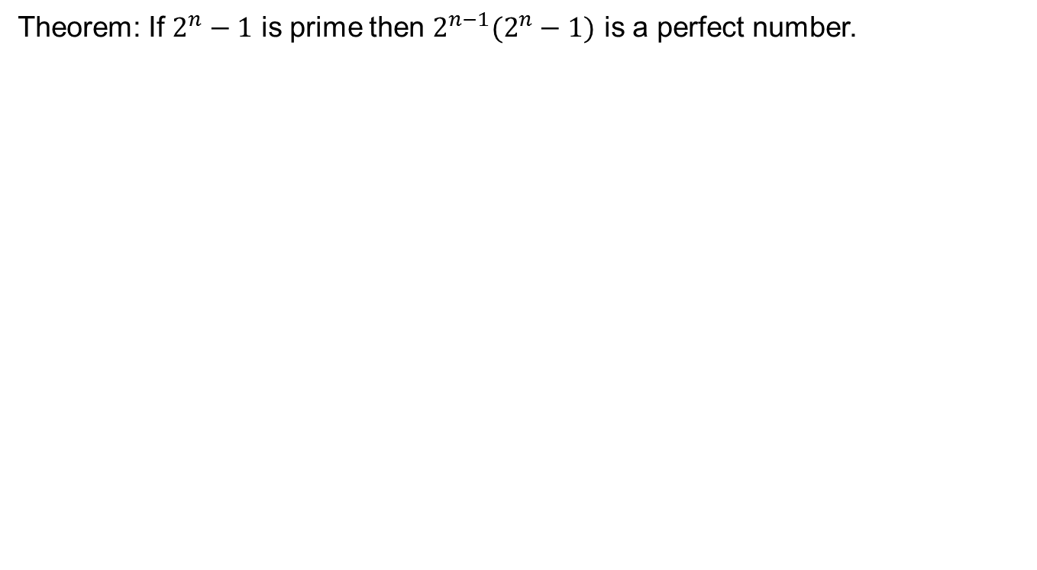
Perfect Numbers and Mersenne primes
Theorem: If $2^{n}−1$ is prime then $2^{n−1}(2^{n}−1)$ is a perfect number.

Slide 13
Corollary: If Mersenne primes are infinite then the previous result implies that perfect numbers are infinite.

Slide 14
Mobius Function

Slide 15
Divisor Sums

Slide 17
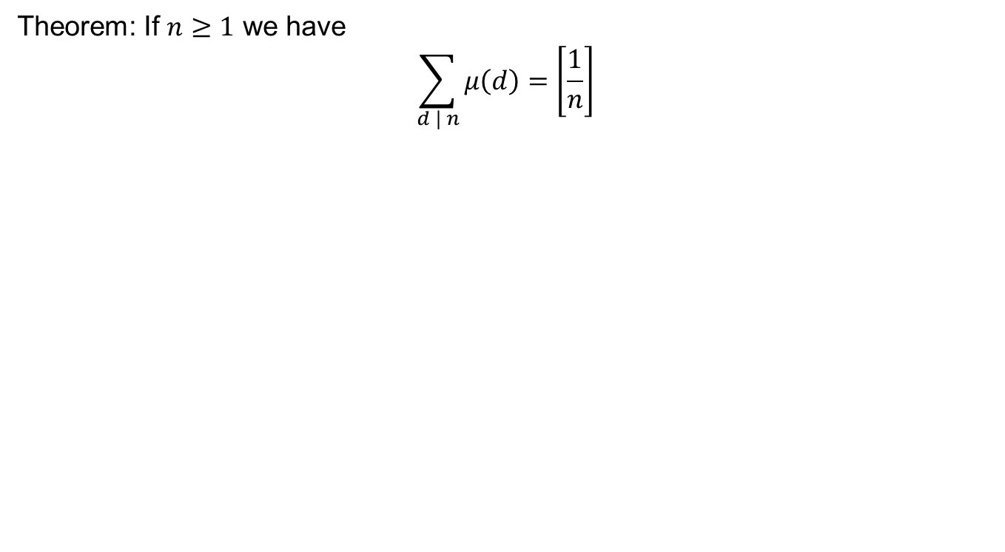
Theorem: If $n≥1$ we have
$$\sum_{d | n}{μ\left(d\right)=\left[\frac{1}{n}\right]}$$

Slide 19

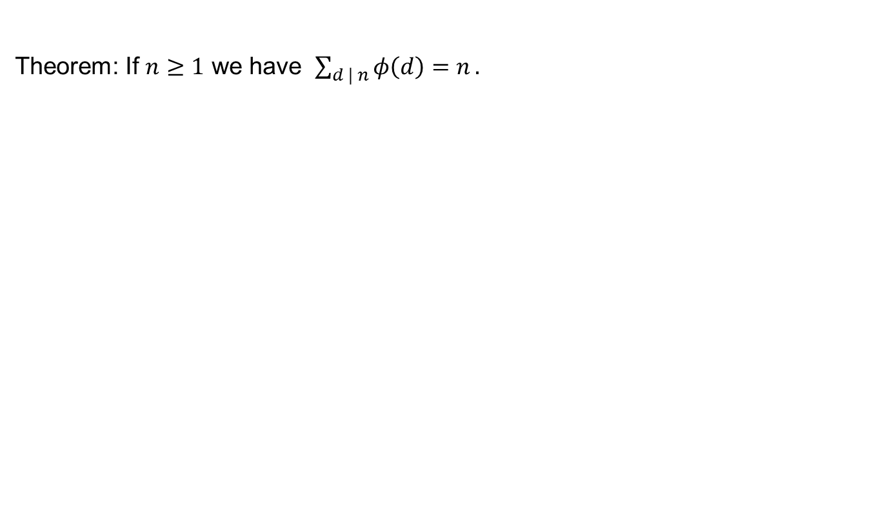
Divisor Sum for Euler $φ$ function
Theorem: If $n≥1$ we have $\sum_{d | n}{φ\left(d\right)=n}.$

Slide 22
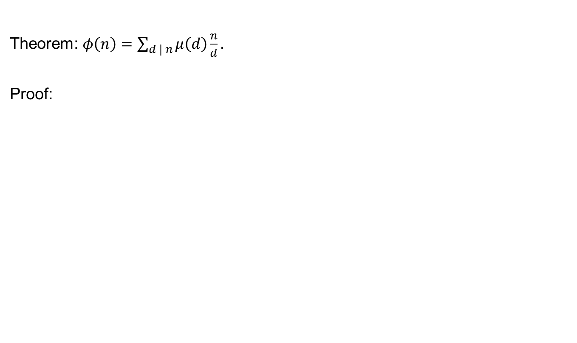
Relation of Mobius and Euler Funciton
Theorem: $φ\left(n\right)=\sum_{d | n}{μ\left(d\right)\frac{n}{d}}.$
Proof:

Slide 25
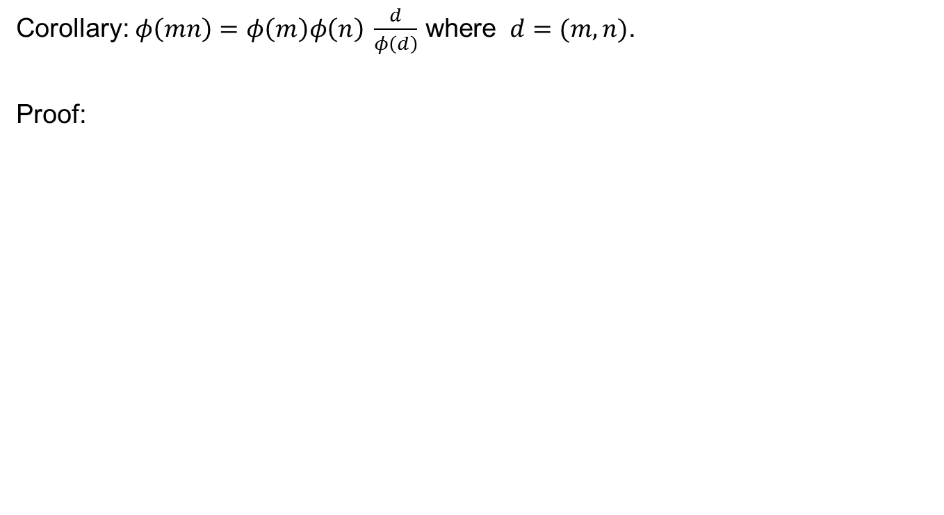
Corollary: $φ\left(mn\right)=φ\left(m\right)φ\left(n\right) \frac{d}{φ\left(d\right)}$ where $d=(m,n)$.
Proof:

Slide 27
Review of Lecture 25
Arithmetical functions
Divisor functions
Mobius Function
Divisor sums
Mobius and Euler Functions

