Slide 1
Analytic Number Theory
MTH 435
Dr Mohib Ali

Slide 2
Review of Lecture 23
Review of Quadratic residues
Exercises
Quadratic Residues
Quadratic Reciprocity Law

Slide 3
Review of Some results about primes

Slide 5
Fermat Primes, Mersennse Primes

Slide 7
Sieve of Eratosthenes

Slide 10
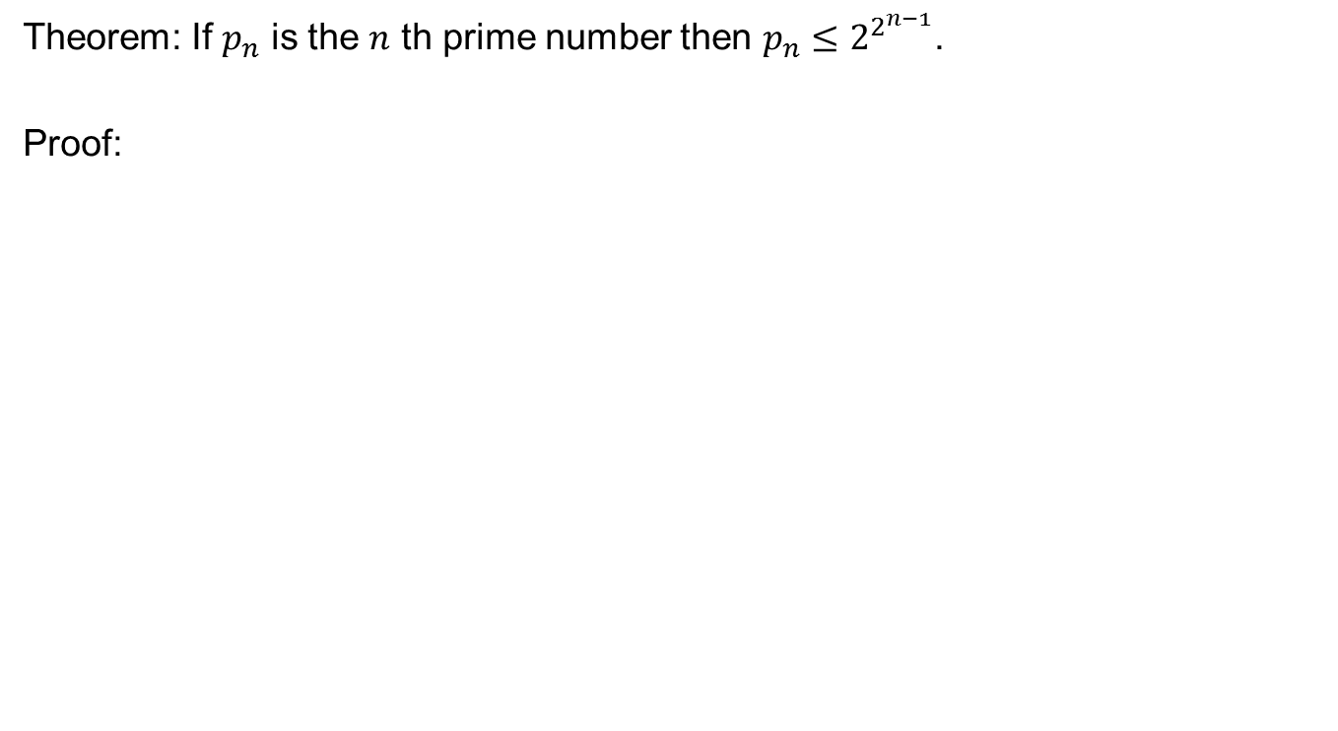
Bound of Primes
Theorem: If $p_{n}$ is the $n$ th prime number then $p_{n}≤2^{2^{n−1}}$.
Proof:

Slide 12
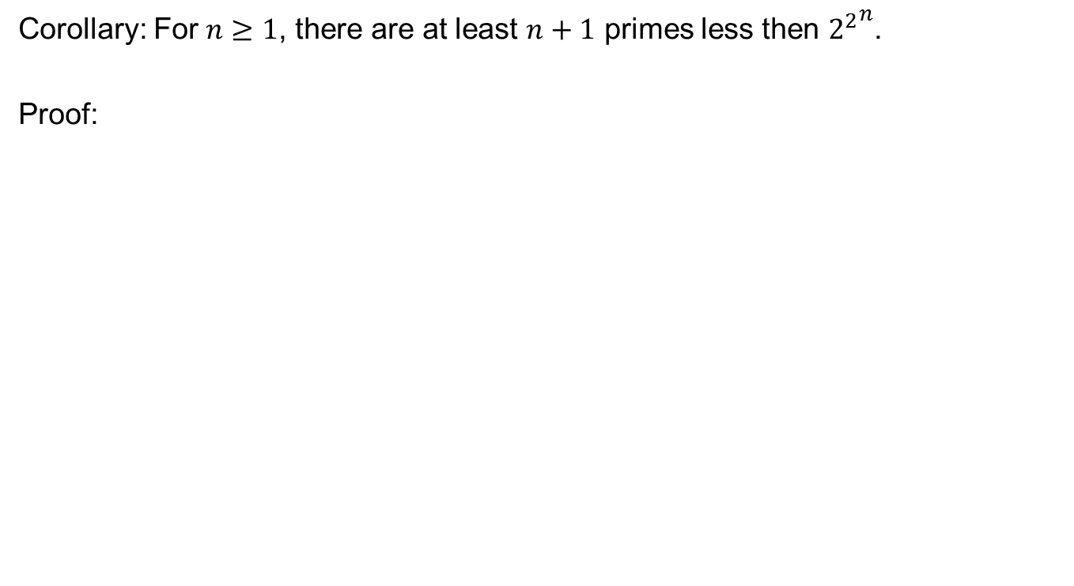
Corollary: For $n≥1$, there are at least $n+1$ primes less then ${2^{2}}^{n}$.
Proof:

Slide 13
Bertrand’s Postulate

Slide 14
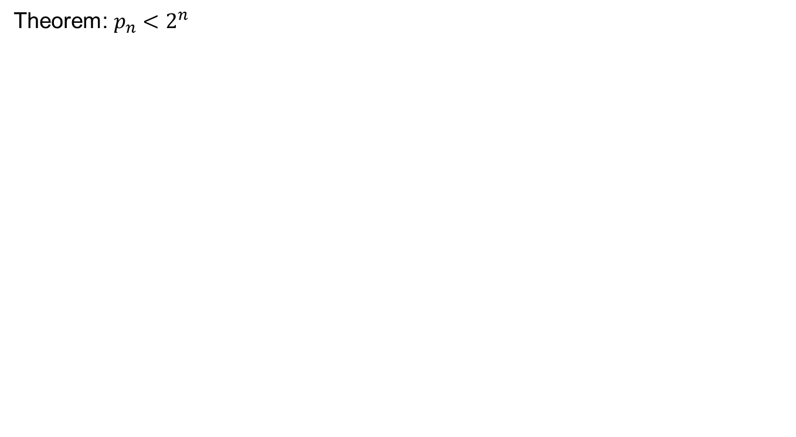
Improvement in the bound
Theorem: $p_{n}<2^{n}$

Slide 16
Goldbach Conjecture

Slide 17
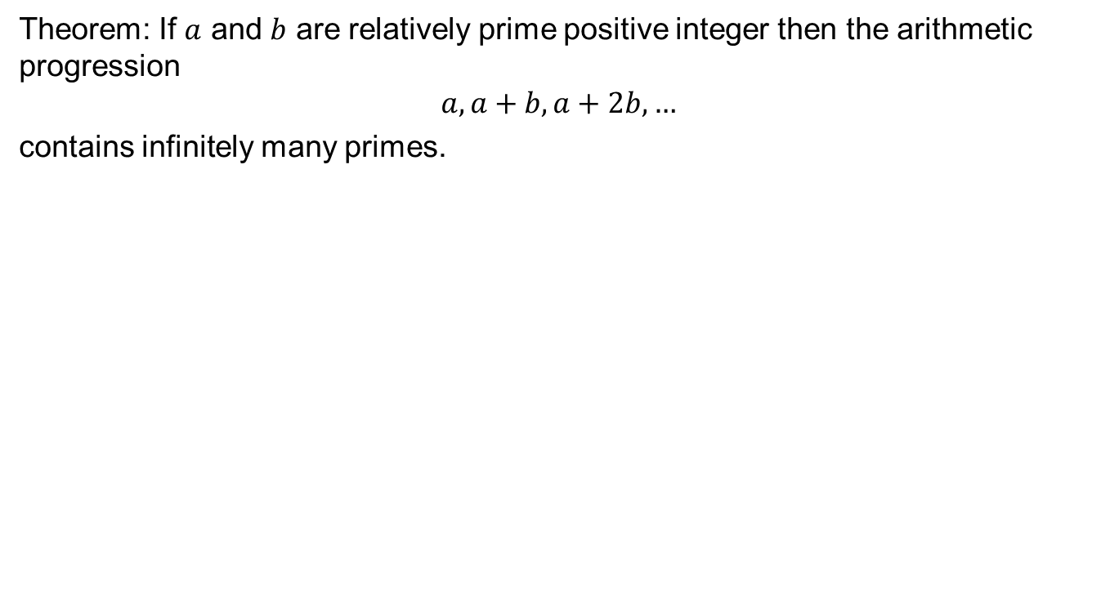
Dirichlet Theorem
Theorem: If $a$ and $b$ are relatively prime positive integer then the arithmetic progression
$$a,a+b,a+2b,…$$
contains infinitely many primes.

Slide 18
Review of Lecture 24
Primes, Fermats Numbers, Mersenne Primes
Sieve of Eratosthenes
Distribution of Primes, Beratnd’s Postulate
Goldbach Conjecture

