Slide 1
Analytic Number Theory
MTH 435
Dr Mohib Ali

Slide 2
Review of Lecture 21
Applications of quadratic residues
Advance result for Calculation of quadratic residues
Jacobi Symbol
Computations

Slide 4
What is Quadratic Reciprocity

Slide 6
Some preparation for theorem

Slide 7
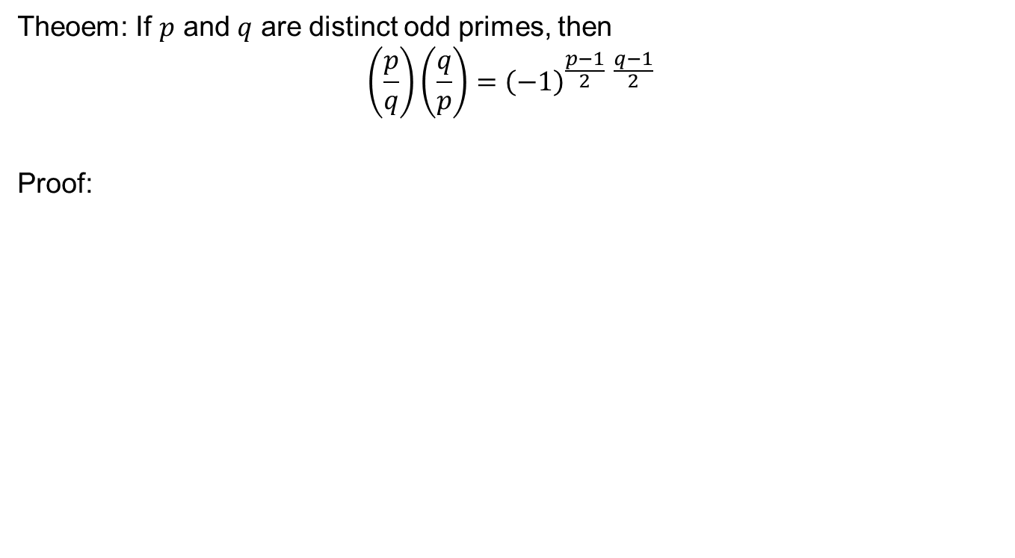
Quadratic Reciprocity Law
Theoem: If $p$ and $q$ are distinct odd primes, then
$$\left(\frac{p}{q}\right)\left(\frac{q}{p}\right)={\left(−1\right)}^{\frac{p−1}{2} \frac{q−1}{2}}$$
Proof:

Slide 14
Computations

Slide 15
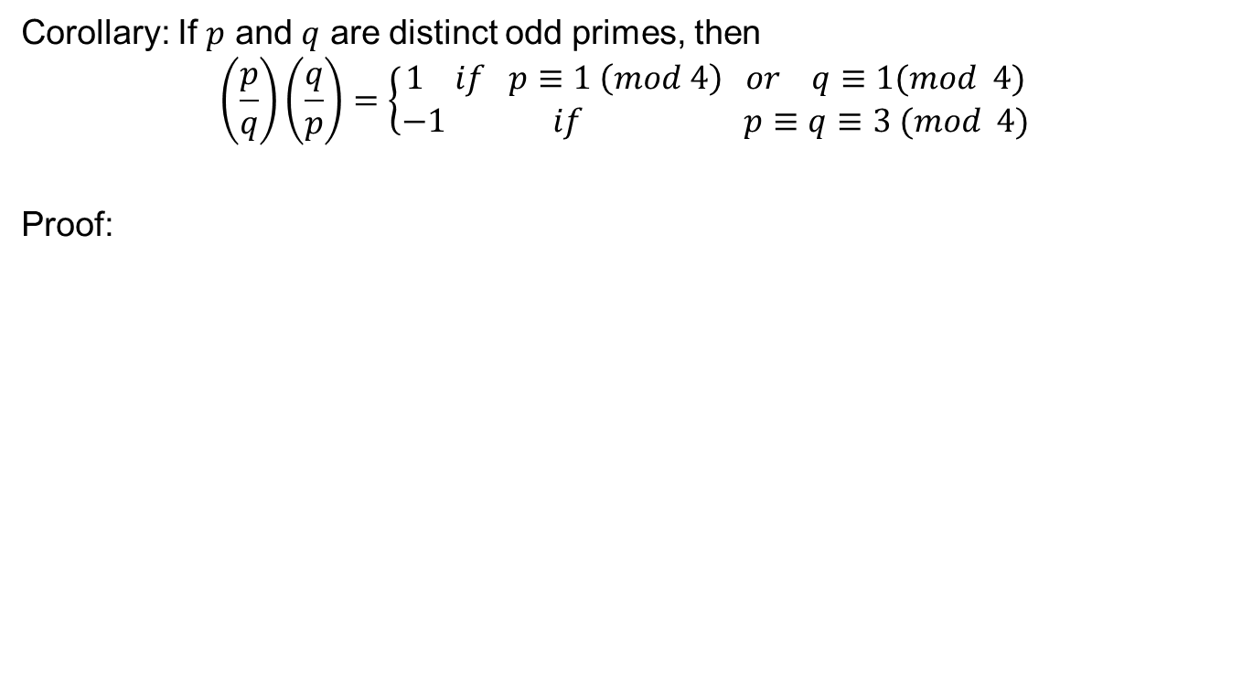
Results
Corollary: If $p$ and $q$ are distinct odd primes, then
$$\left(\frac{p}{q}\right)\left(\frac{q}{p}\right)=\left\{\begin{aligned}1 if p≡1 \left(mod 4\right) or q≡1(mod 4) \\ −1 if p≡q≡3 (mod 4)\end{aligned}\right.$$
Proof:

Slide 17
Review of Lecture 22
Motivation
Quadratic Reciprocity Law
Computations using Quadratic reciprocity law

