Slide 1
Analytic Number Theory
MTH 435
Dr Mohib Ali

Slide 2
Review of Lecture 20
An application of quadratic residues
Guass Lemma
Computations using Guass Lemma

Slide 3
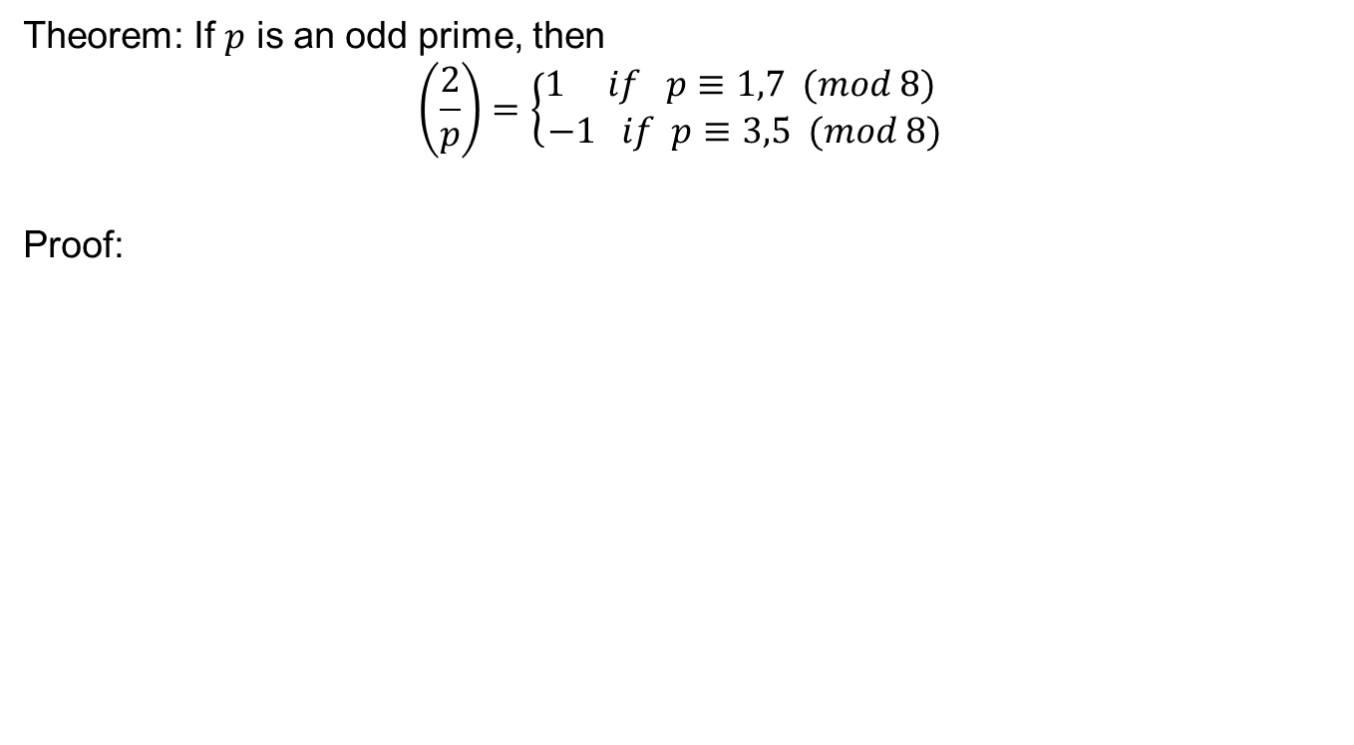
Revisiting the result by using Guass Lemma
Theorem: If $p$ is an odd prime, then
$$\left(\frac{2}{p}\right)=\left\{\begin{aligned}1 if p≡1,7 (mod 8) \\ −1 if p≡3,5 (mod 8)\end{aligned}\right.$$
Proof:

Slide 6
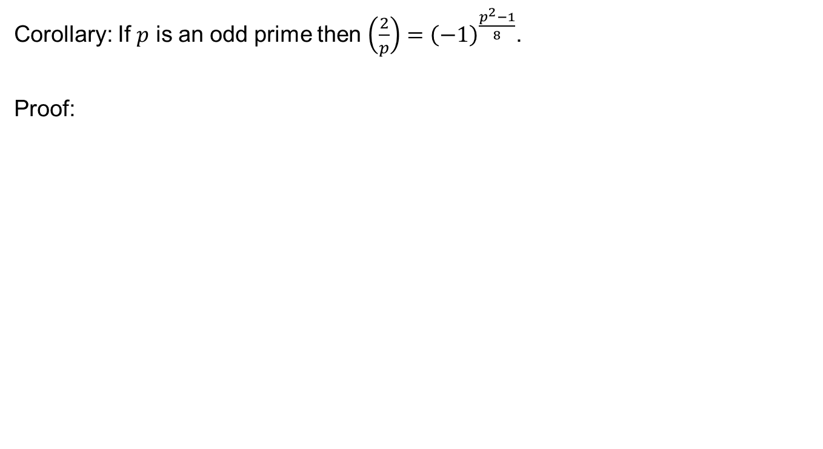
Corollary: If $p$ is an odd prime then $\left(\frac{2}{p}\right)={\left(−1\right)}^{\frac{p^{2}−1}{8}}$.
Proof:

Slide 7
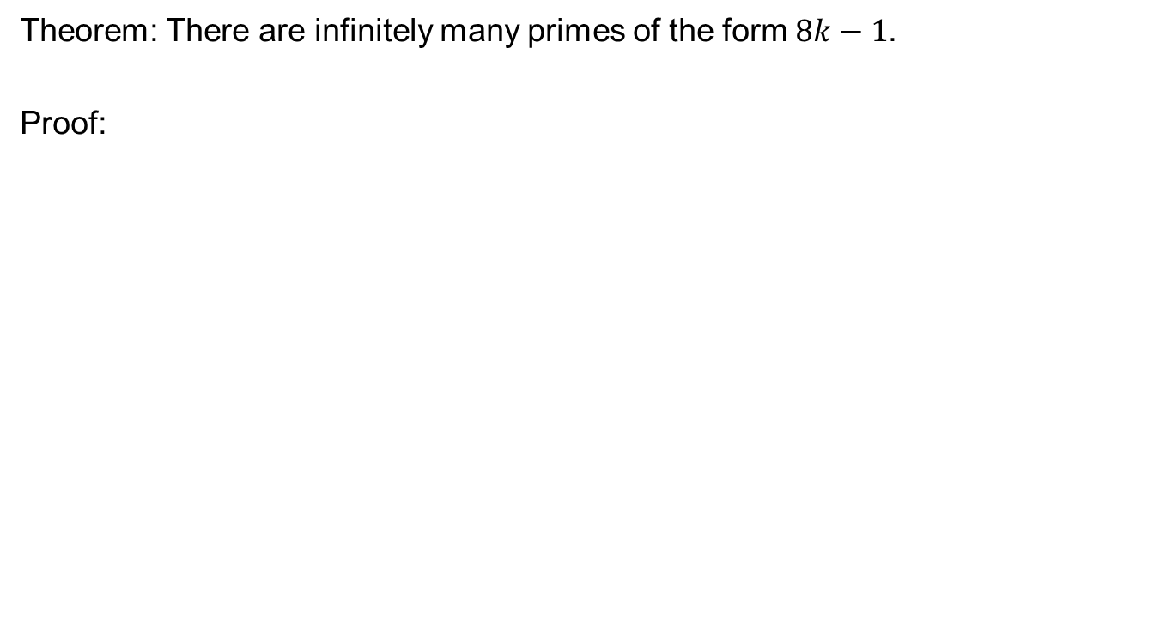
Application of quadratic residues
Theorem: There are infinitely many primes of the form $8k−1$.
Proof:

Slide 10
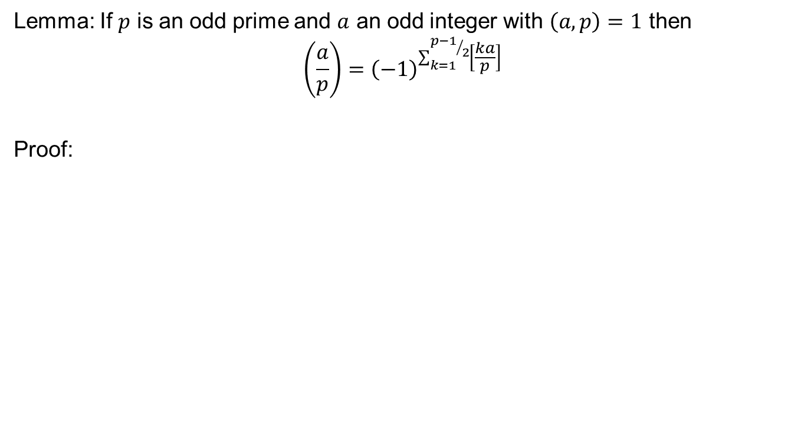
Important Result
Lemma: If $p$ is an odd prime and $a$ an odd integer with $\left(a,p\right)=1$ then
$$\left(\frac{a}{p}\right)={\left(−1\right)}^{\sum_{k=1}^{{p−1}/2}{\left[\frac{ka}{p}\right]}}$$
Proof:

Slide 16
Jacobi Symbol

Slide 17
Review of Lecture 21
Computations using Guass Lemma
Applications of quadratic residues
Advance result for Calculation of quadratic residues
Jacobi Symbol
Computations

