Slide 1
Analytic Number Theory
MTH 435
Dr Mohib Ali

Slide 2
Review of Lecture 19
Quadratic residues
Legender Symbol
Euler criteria and Legender Symbol
Properties of Legender Symbol

Slide 3
Legender Symbol

Slide 4
Computations

Slide 5
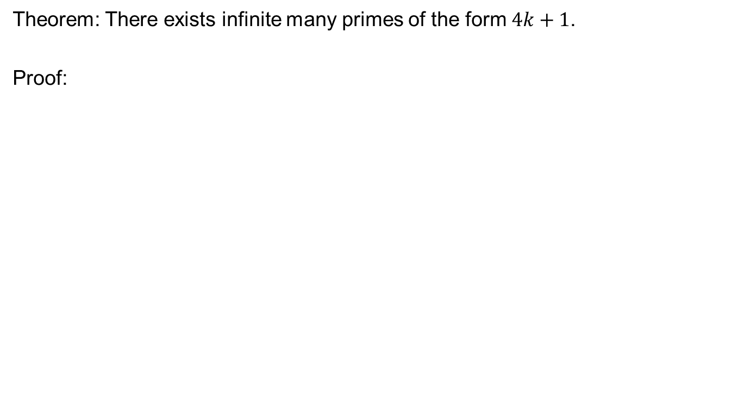
Application (Infinite primes)
Theorem: There exists infinite many primes of the form $4k+1$.
Proof:

Slide 8
Introduction to Guass Lemma

Slide 9
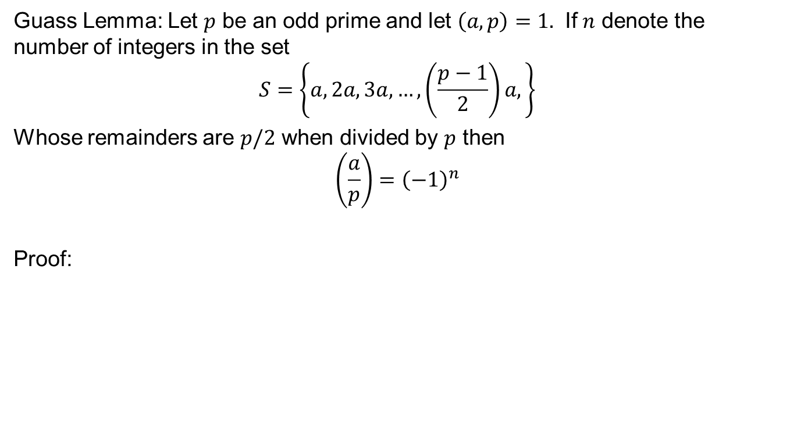
Guass Lemma
Guass Lemma: Let $p$ be an odd prime and let $\left(a,p\right)=1.$ If $n$ denote the number of integers in the set
$$S=\left\{a,2a,3a,…,\left(\frac{p−1}{2}\right)a,\right\}$$
Whose remainders are $p/2$ when divided by $p$ then
$$\left(\frac{a}{p}\right)={\left(−1\right)}^{n}$$
Proof:

Slide 17
Review of Lecture 20
An application of quadratic residues
Guass Lemma
Computations using Guass Lemma
Some results following from Guass Lemma

