Slide 1
Analytic Number Theory
MTH 435
Dr Mohib Ali

Slide 2
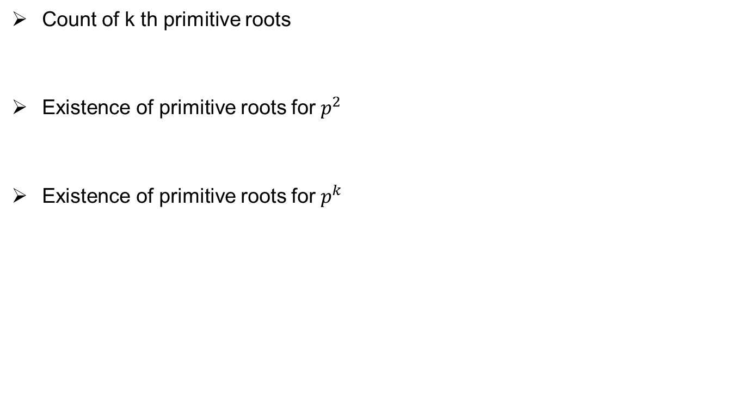
Review of Lecture 18
Count of k th primitive roots
Existence of primitive roots for $p^{2}$
Existence of primitive roots for $p^{k}$

Slide 3
Quadratic Residues
Definition:

Slide 5
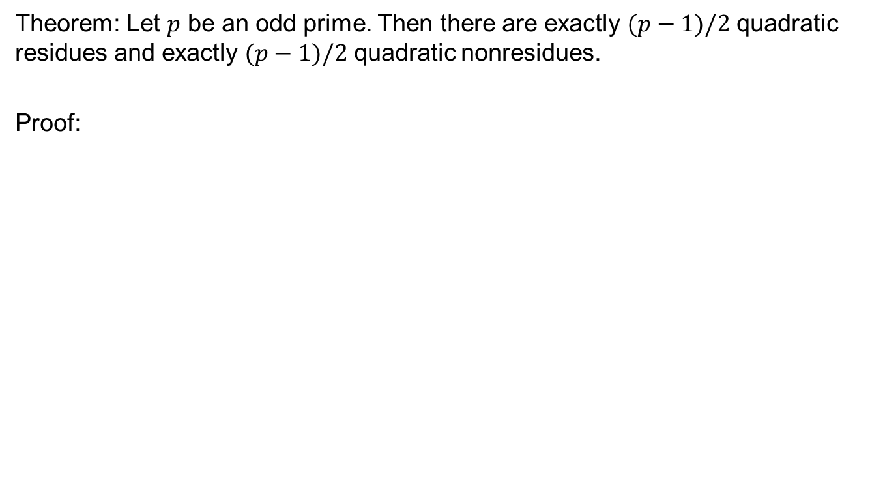
Theorem: Let $p$ be an odd prime. Then there are exactly $(p−1)/2$ quadratic residues and exactly $(p−1)/2$ quadratic nonresidues.
Proof:

Slide 7
Legender Symbol
Definition:

Slide 9
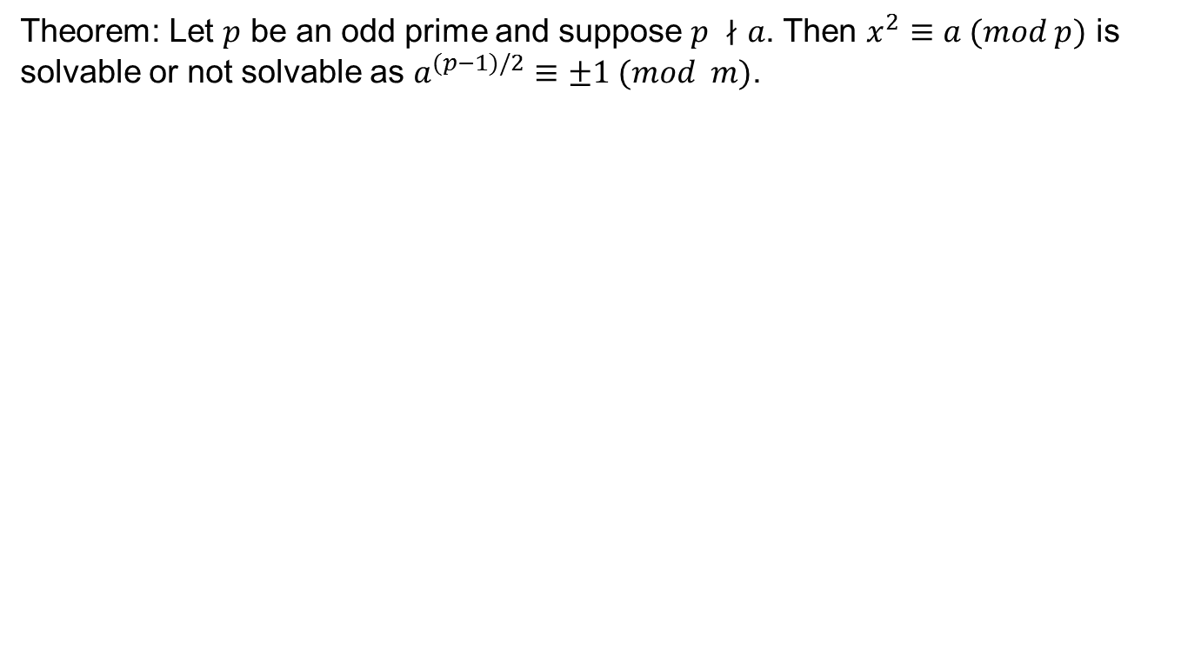
Revisit the Euler criteria
Theorem: Let $p$ be an odd prime and suppose $p ∤a$. Then $x^{2}≡a (mod p)$ is solvable or not solvable as $a^{(p−1)/2}≡±1 (mod m)$.

Slide 10
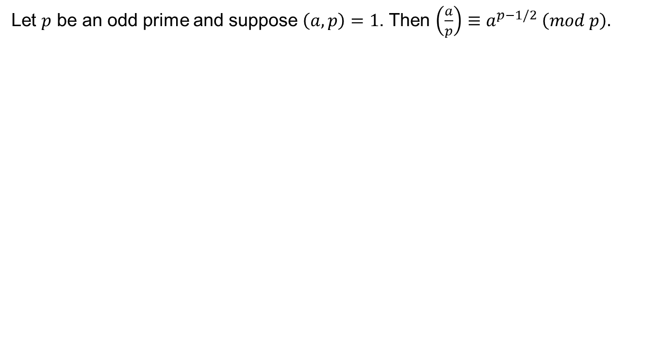
Legender Symbol and Euler Criteria
Let $p$ be an odd prime and suppose $\left(a,p\right)=1$. Then $\left(\frac{a}{p}\right)≡a^{p−1/2} \left(mod p\right).$

Slide 11
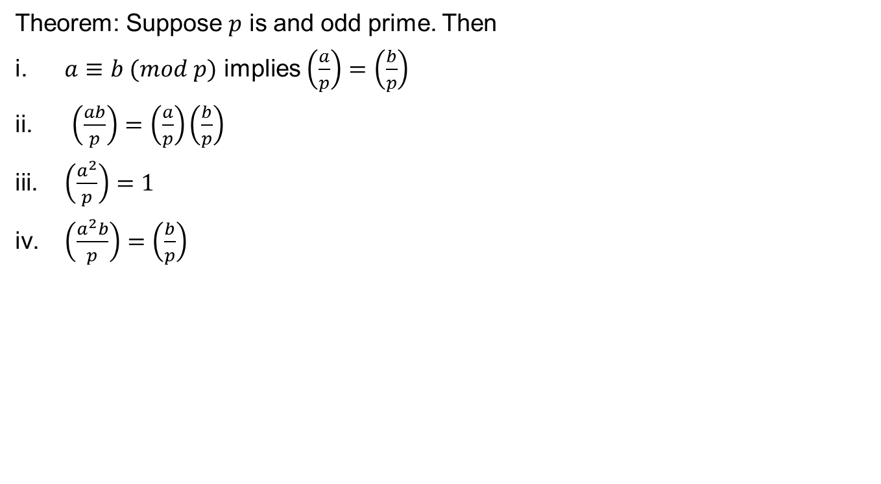
Properties of Legender Symbol
Theorem: Suppose $p$ is and odd prime. Then
$a≡b (mod p)$ implies $\left(\frac{a}{p}\right)=\left(\frac{b}{p}\right)$
$\left(\frac{ab}{p}\right)=\left(\frac{a}{p}\right)\left(\frac{b}{p}\right)$
$\left(\frac{a^{2}}{p}\right)=1$
$\left(\frac{a^{2}b}{p}\right)=\left(\frac{b}{p}\right)$

Slide 13
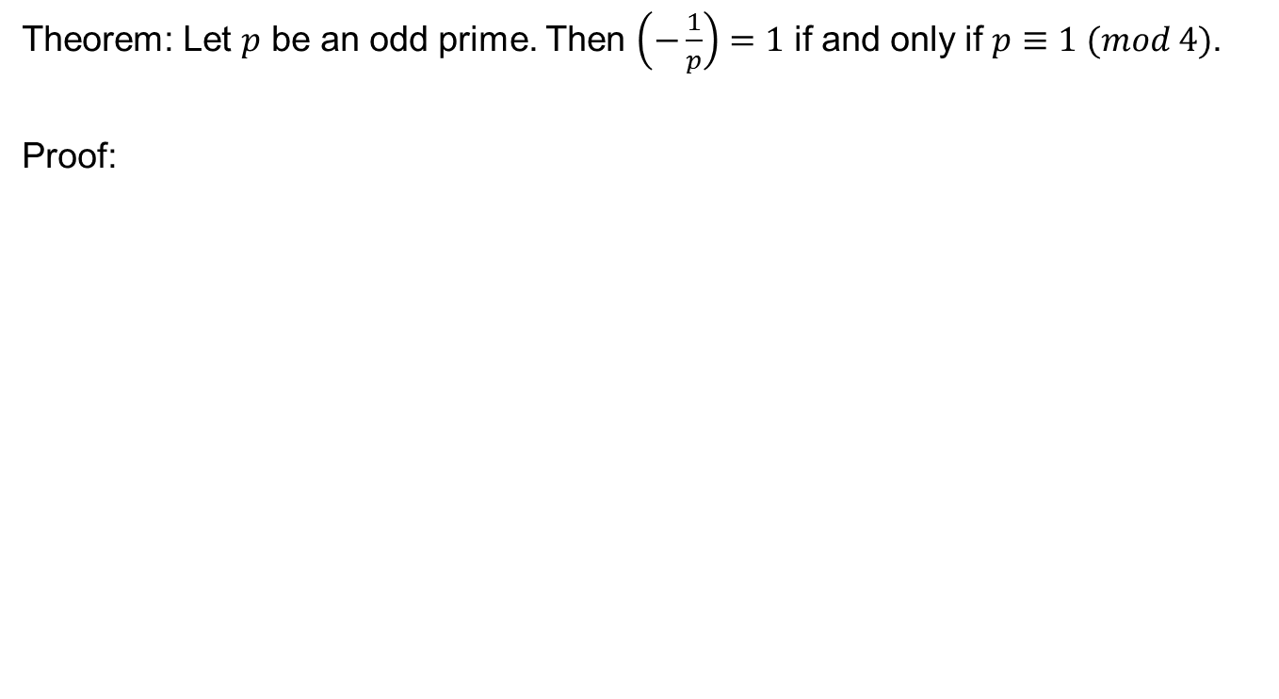
Theorem: Let $p$ be an odd prime. Then $\left(−\frac{1}{p}\right)=1$ if and only if $p≡1 (mod 4)$.
Proof:

Slide 19
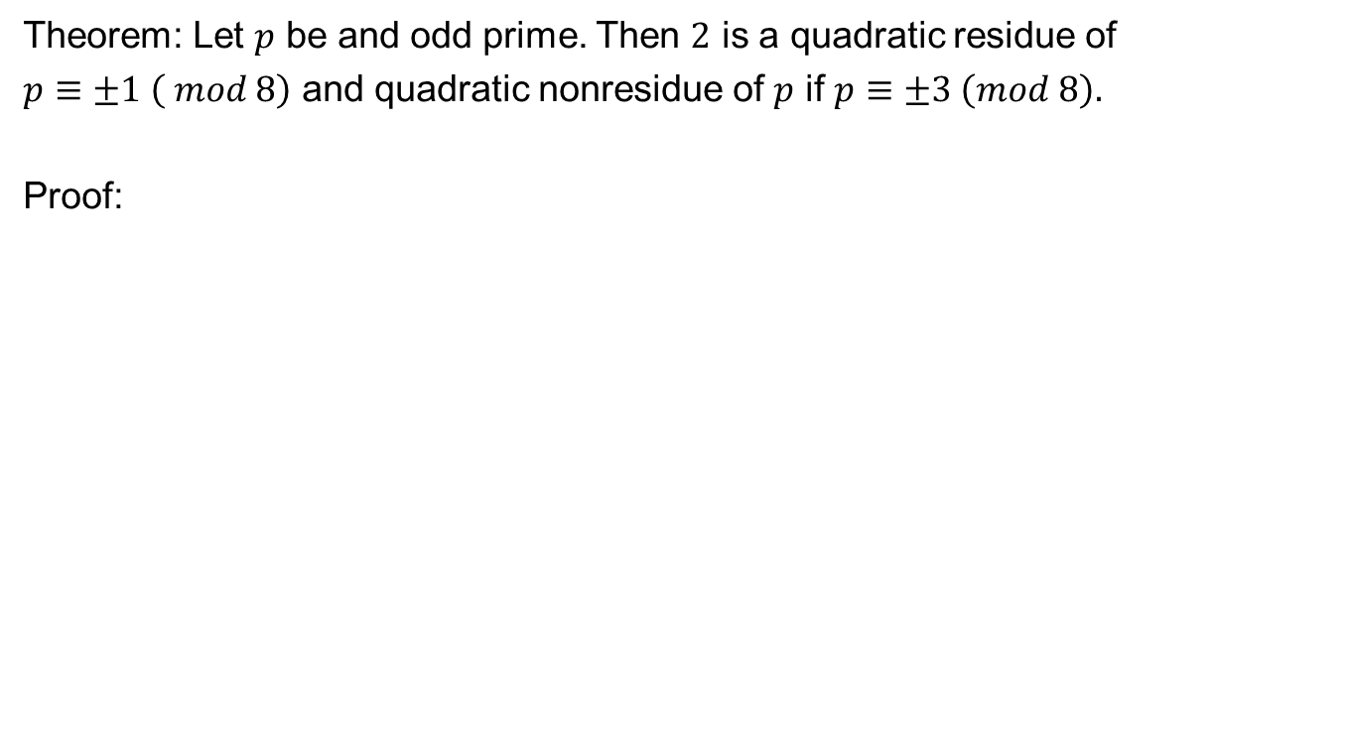
Theorem: Let $p$ be and odd prime. Then $2$ is a quadratic residue of
$p≡±1 \left( mod 8\right)$ and quadratic nonresidue of $p$ if $p≡±3 \left(mod 8\right).$
Proof:

Slide 22
Review of Lecture 19
Quadratic residues
Legender Symbol
Euler criteria and Legender Symbol
Properties of Legender Symbol
Computational results

