Slide 1
Analytic Number Theory
MTH 435
Dr Mohib Ali

Slide 2
Review of Lecture 17
Power indices
Properties
Power residues
Criteria for power residues
Computational note
Count of residues

Slide 3
Count of solutions and residues

Slide 4
Count…

Slide 5
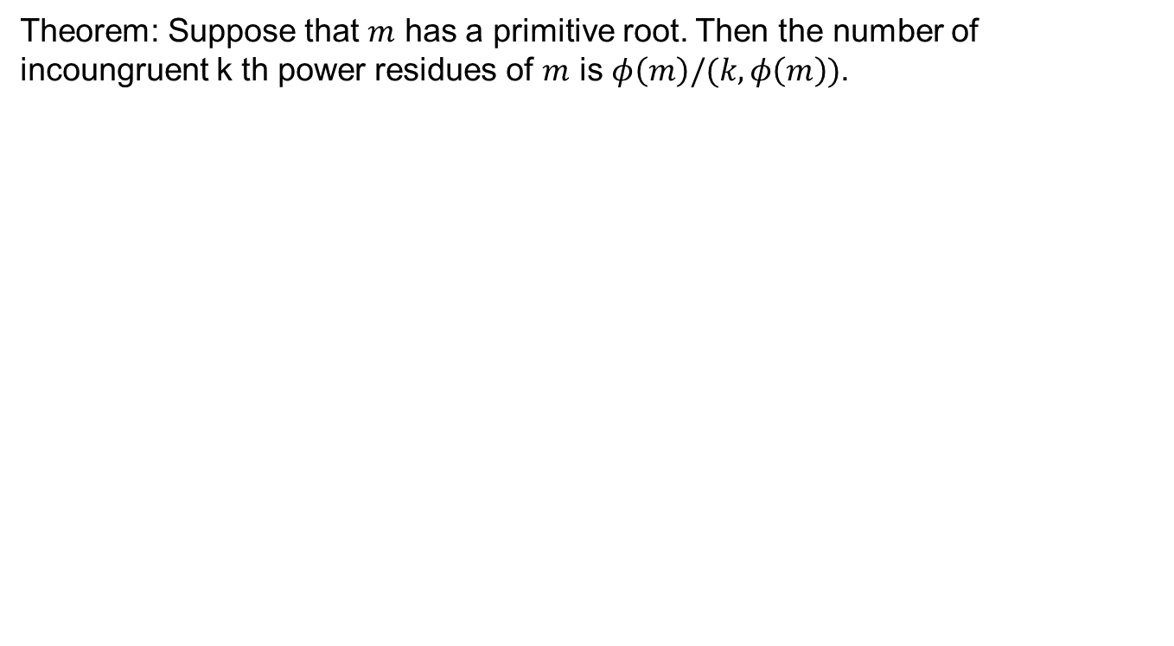
Theorem: Suppose that $m$ has a primitive root. Then the number of incoungruent k th power residues of $m$ is $φ\left(m\right)/(k,φ\left(m\right))$.

Slide 6
Count….

Slide 10

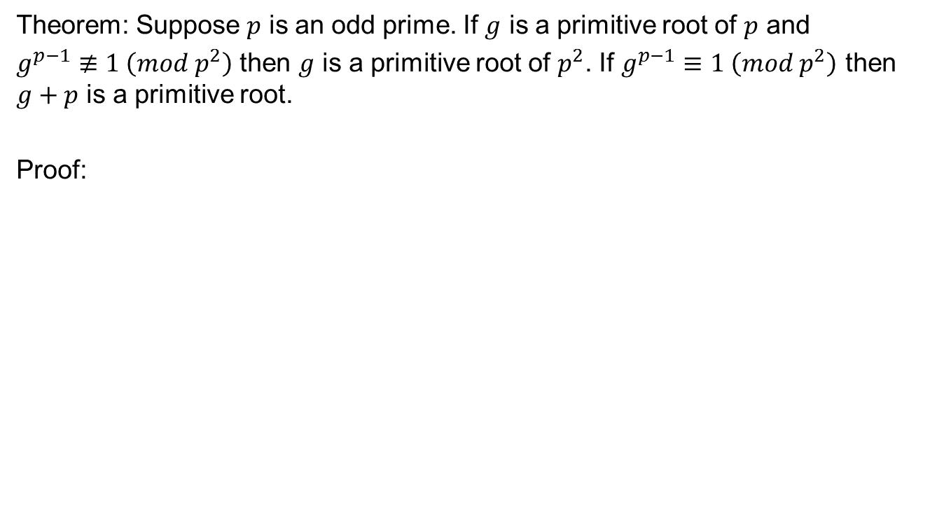
Existence of primitive roots for $p^{k}$
Theorem: Suppose $p$ is an odd prime. If $g$ is a primitive root of $p$ and
$g^{p−1}≢1 \left(mod p^{2}\right)$ then $g$ is a primitive root of $p^{2}$. If $g^{p−1}≡1 \left(mod p^{2}\right)$ then $g+p$ is a primitive root.
Proof:

Slide 16

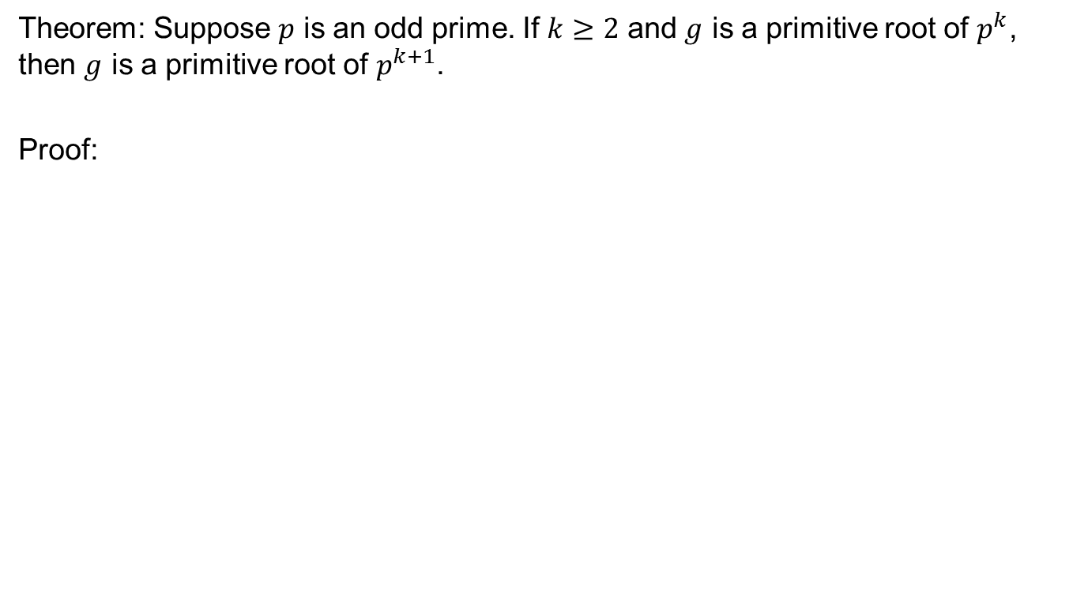
Primitive roots for $p^{k}$
Theorem: Suppose $p$ is an odd prime. If $k≥2$ and $g$ is a primitive root of $p^{k}$, then $g$ is a primitive root of $p^{k+1}$.
Proof:

Slide 22
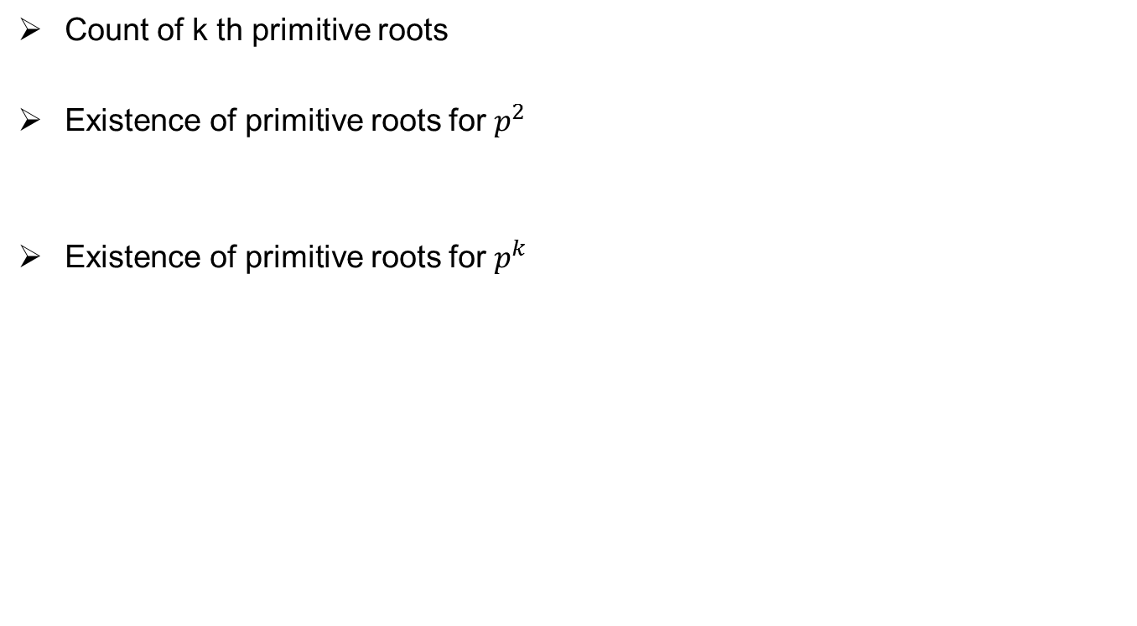
Review of Lecture 18
Count of k th primitive roots
Existence of primitive roots for $p^{2}$
Existence of primitive roots for $p^{k}$

