Slide 1
Analytic Number Theory
MTH 435
Dr Mohib Ali

Slide 2
Review of Lecture 16
Powers of primitive root
Reduced residue system and primitive roots
Count of primitive roots
Count of elements with given order

Slide 3

Index of an integer modulo $m$
Definition:

Slide 4
Examples

Slide 5
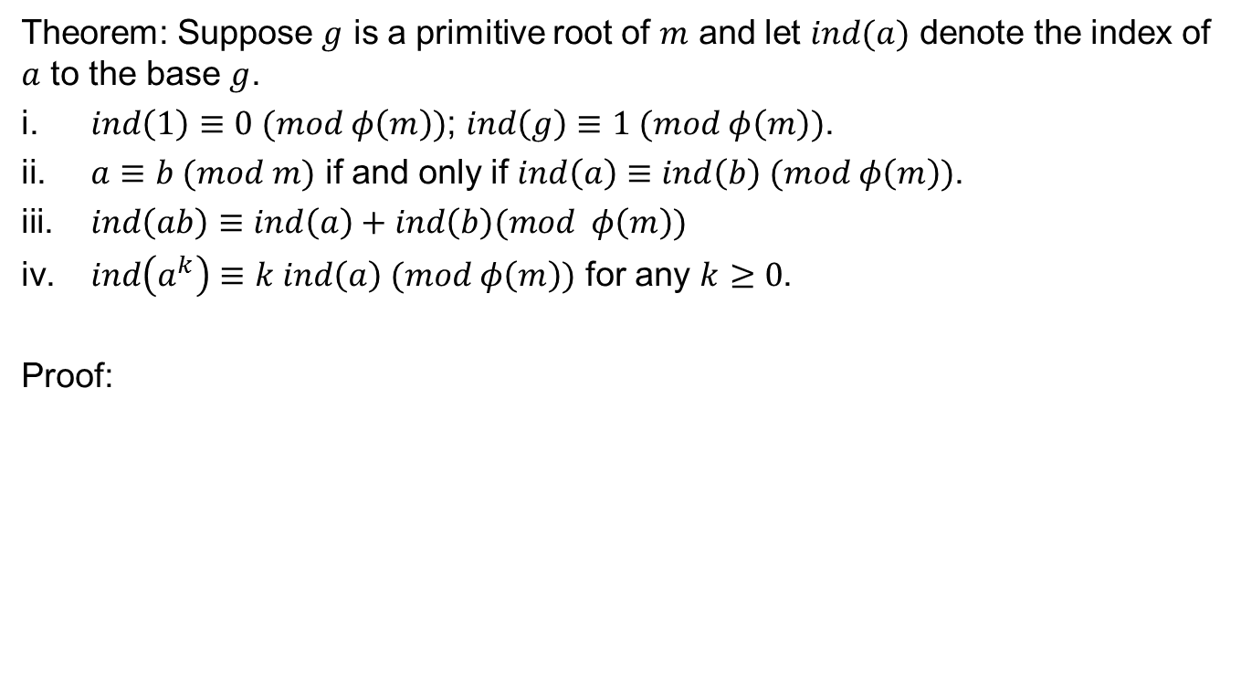
Properties of index
Theorem: Suppose $g$ is a primitive root of $m$ and let $ind(a)$ denote the index of $a$ to the base $g$.
$ind\left(1\right)≡0 (mod φ\left(m\right))$; $ind\left(g\right)≡1 (mod φ\left(m\right))$.
$a≡b (mod m)$ if and only if $ind\left(a\right)≡ind\left(b\right) (mod φ\left(m\right))$.
$ind\left(ab\right)≡ind\left(a\right)+ind\left(b\right)(mod φ\left(m\right))$
$ind\left(a^{k}\right)≡k ind\left(a\right) (mod φ\left(m\right))$ for any $k≥0$.
Proof:

Slide 9

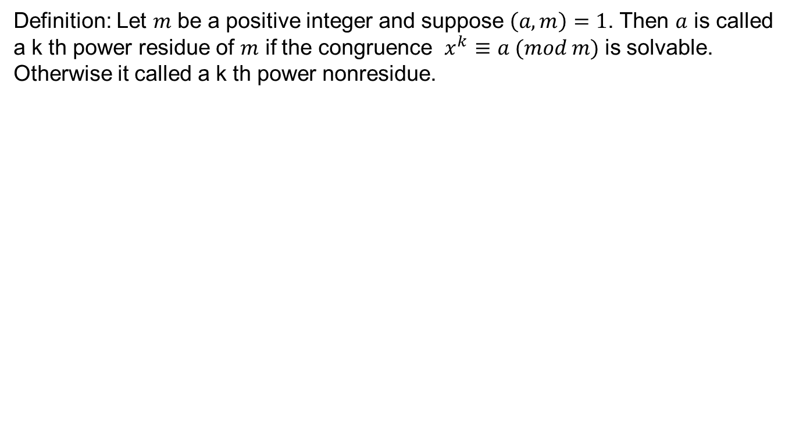
$K^{th}$ power residue
Definition: Let $m$ be a positive integer and suppose $\left(a,m\right)=1$. Then $a$ is called a k th power residue of $m$ if the congruence $x^{k}≡a (mod m)$ is solvable. Otherwise it called a k th power nonresidue.

Slide 10
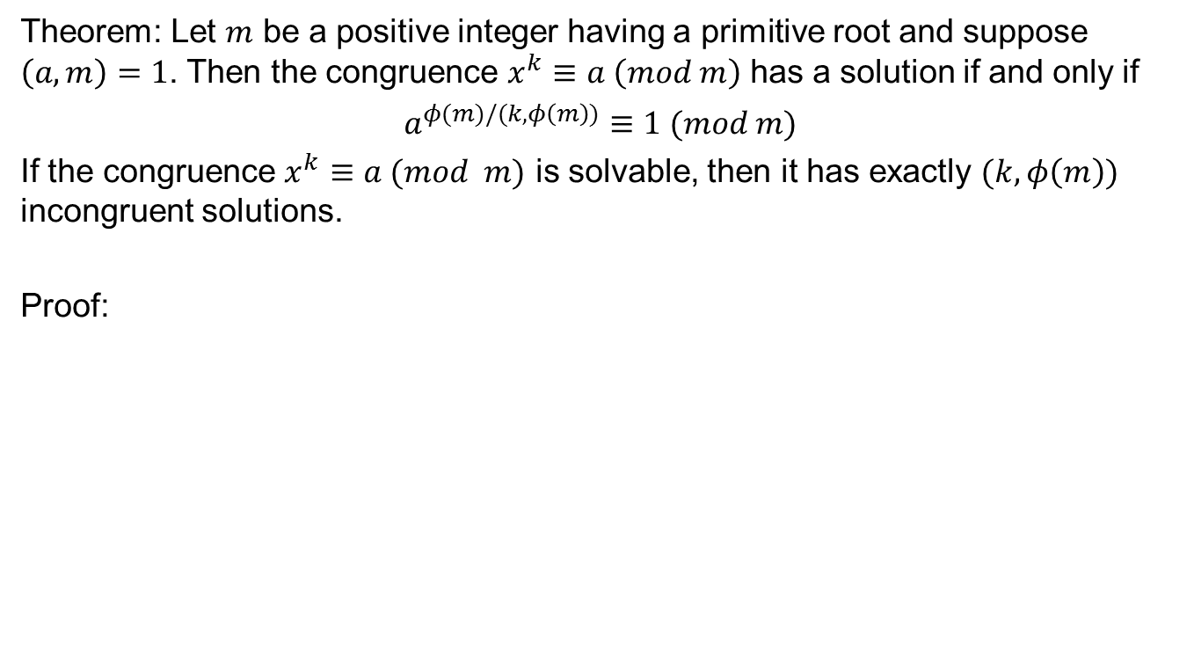
Residues
Theorem: Let $m$ be a positive integer having a primitive root and suppose $\left(a,m\right)=1$. Then the congruence $x^{k}≡a \left(mod m\right)$ has a solution if and only if
$a^{φ(m)/(k,φ\left(m\right))}≡1 (mod m)$
If the congruence $x^{k}≡a (mod m)$ is solvable, then it has exactly $(k,φ\left(m\right))$ incongruent solutions.
Proof:

Slide 14
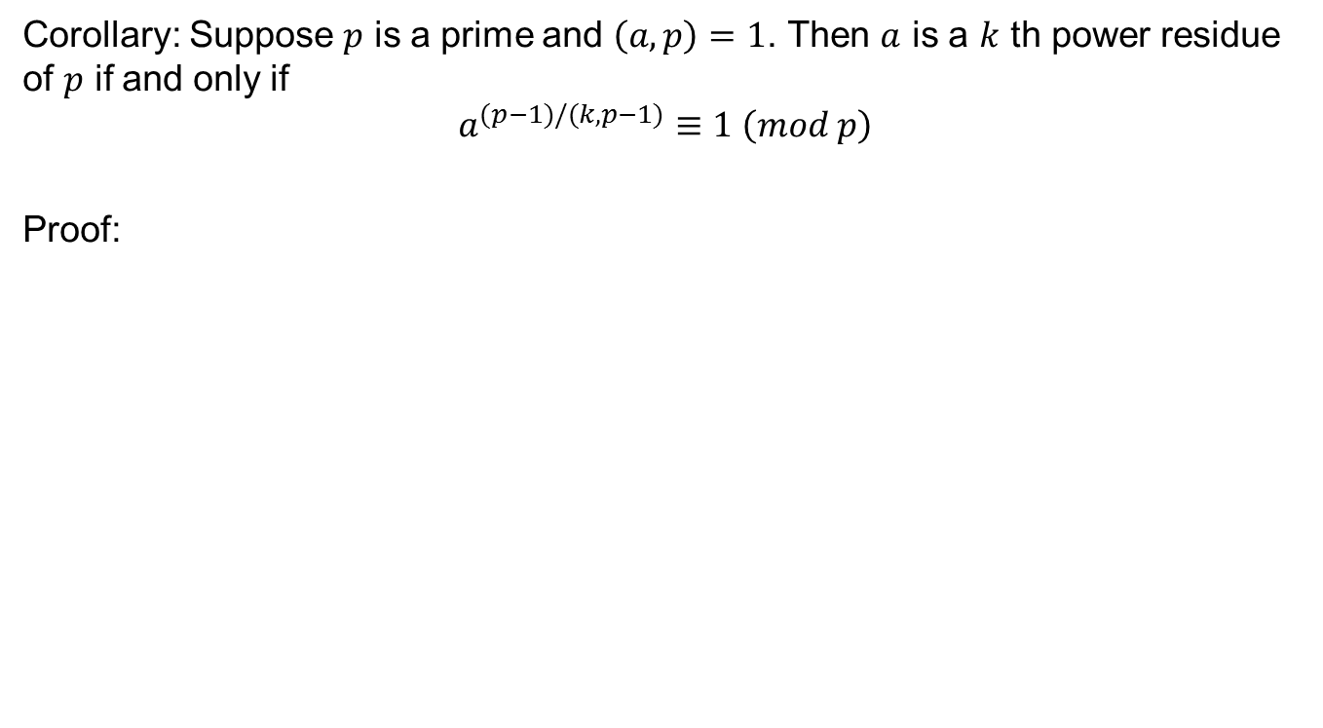
Results
Corollary: Suppose $p$ is a prime and $\left(a,p\right)=1$. Then $a$ is a $k$ th power residue of $p$ if and only if
$$a^{(p−1)/(k,p−1)}≡1 \left(mod p\right)$$
Proof:

Slide 15
Computations

Slide 16
Computations

Slide 17
Computations

Slide 18
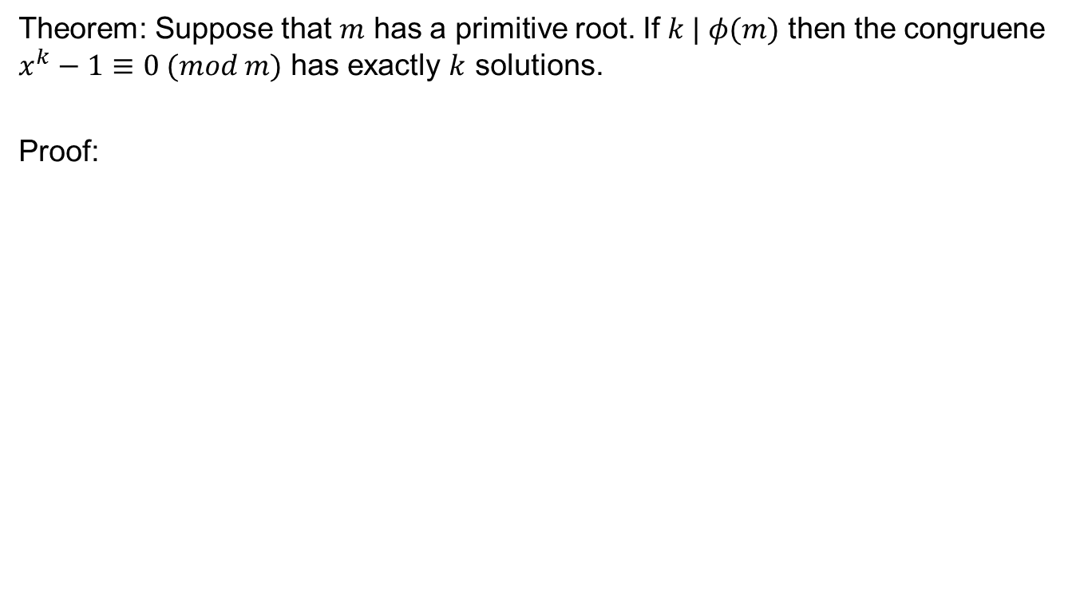
Count of residues
Theorem: Suppose that $m$ has a primitive root. If $k | φ(m)$ then the congruene $x^{k}−1≡0 (mod m)$ has exactly $k$ solutions.
Proof:

Slide 19
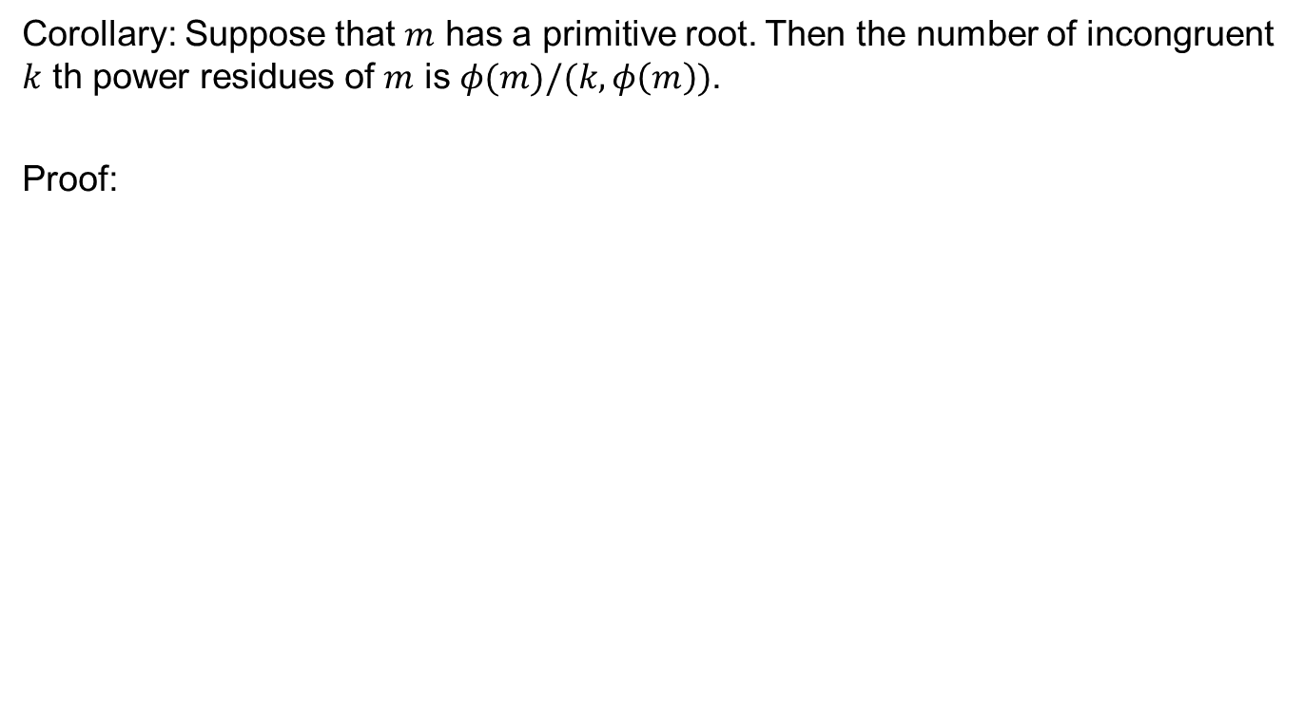
Count….
Corollary: Suppose that $m$ has a primitive root. Then the number of incongruent $k$ th power residues of $m$ is $φ(m)/(k,φ\left(m\right))$.
Proof:

Slide 22
Review of Lecture 17
Power indices
Properties
Power residues
Criteria for power residues
Computational note
Count of residues

