Slide 1
Analytic Number Theory
MTH 435
Dr Mohib Ali

Slide 2
Review of Lecture 15
Primitive roots
Primitive roots for primes
Computations of primitive roots
Partial converse of Fermat’s Theorem

Slide 3

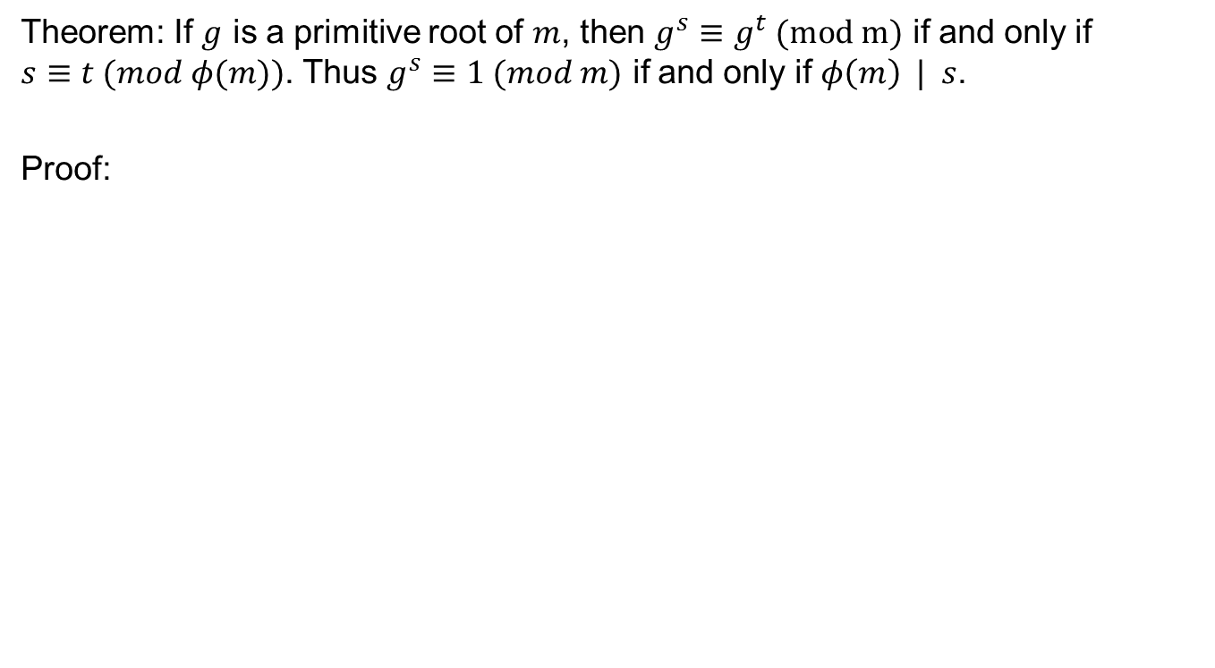
Power of primitive root and $φ(m)$
Theorem: If $g$ is a primitive root of $m$, then $g^{s}≡g^{t} (mod m)$ if and only if $s≡t (mod φ(m))$. Thus $g^{s}≡1 (mod m)$ if and only if $φ\left(m\right) | s$.
Proof:

Slide 5
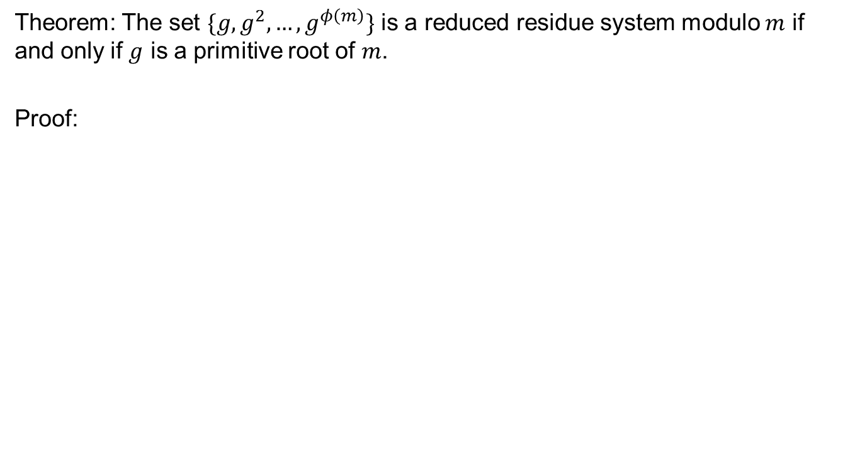
Reduced residue system and primitive roots
Theorem: The set $\{g,g^{2},…, g^{φ\left(m\right)}\}$ is a reduced residue system modulo $m$ if and only if $g$ is a primitive root of $m$.
Proof:

Slide 9
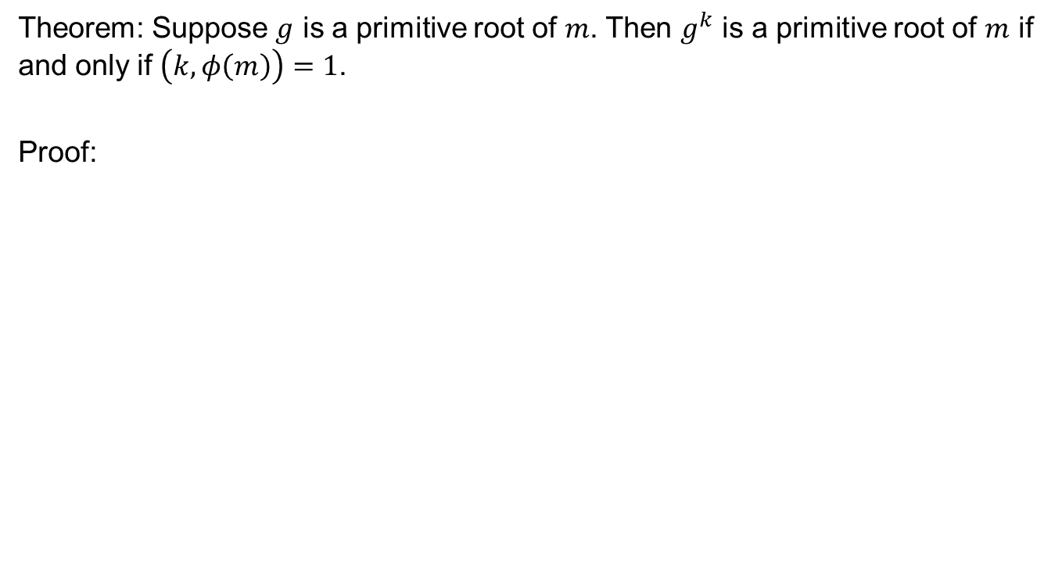
Powers of Primitive roots
Theorem: Suppose $g$ is a primitive root of $m$. Then $g^{k}$ is a primitive root of $m$ if and only if $\left(k,φ\left(m\right)\right)=1$.
Proof:

Slide 11
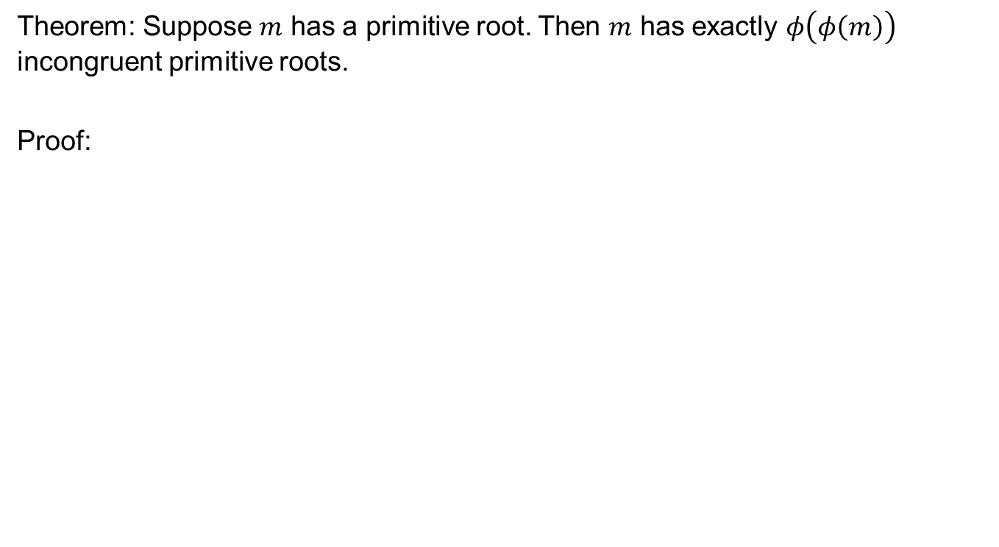
How many primitive roots?
Theorem: Suppose $m$ has a primitive root. Then $m$ has exactly $φ\left(φ\left(m\right)\right)$ incongruent primitive roots.
Proof:

Slide 12
Examples

Slide 15
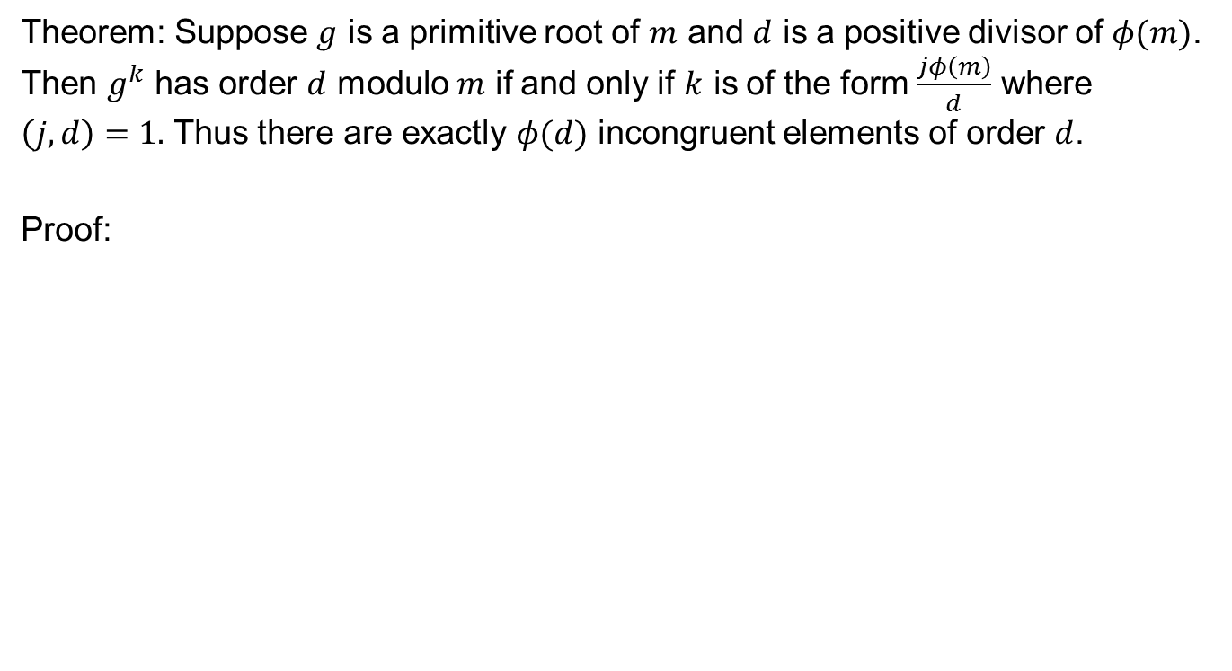
How many elements of a particular order
Theorem: Suppose $g$ is a primitive root of $m$ and $d$ is a positive divisor of $φ(m)$. Then $g^{k}$ has order $d$ modulo $m$ if and only if $k$ is of the form $\frac{jφ\left(m\right)}{d}$ where $\left(j,d\right)=1.$ Thus there are exactly $φ(d)$ incongruent elements of order $d$.
Proof:

Slide 19
Review of Lecture 16
Powers of primitive root
Reduced residue system and primitive roots
Count of primitive roots
Count of elements with given order

