Slide 1
Analytic Number Theory
MTH 435
Dr Mohib Ali

Slide 2
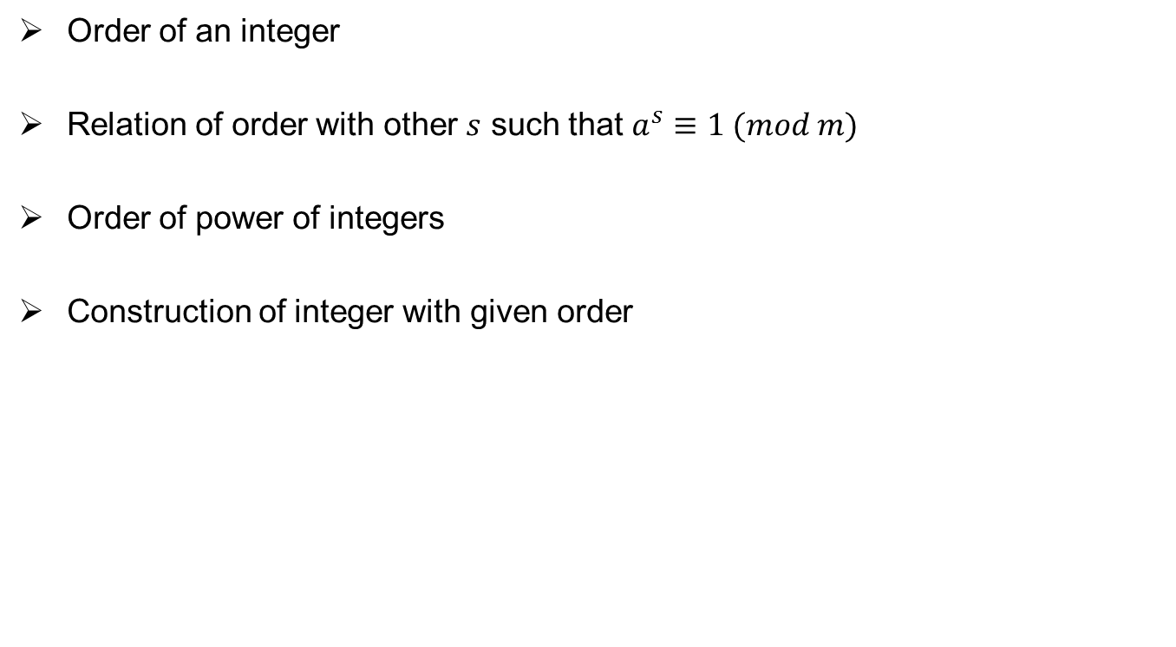
Review of Lecture 14
Order of an integer
Relation of order with other $s$ such that $a^{s}≡1 (mod m)$
Order of power of integers
Construction of integer with given order

Slide 4
Primitive roots
Definition:

Slide 6
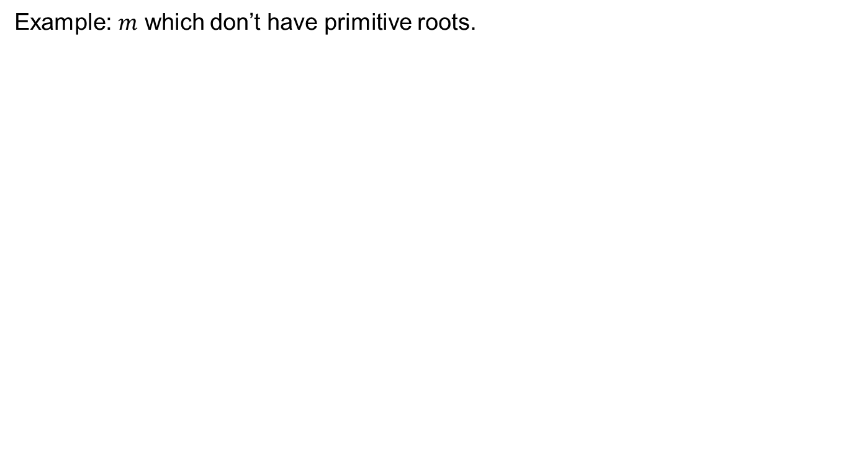
Primitive roots
Example: $m$ which don’t have primitive roots.

Slide 7
Primitive root of a prime number
1773, Euler
1785, Legender
Guass

Slide 8
Least universal exponent
Definition:

Slide 9
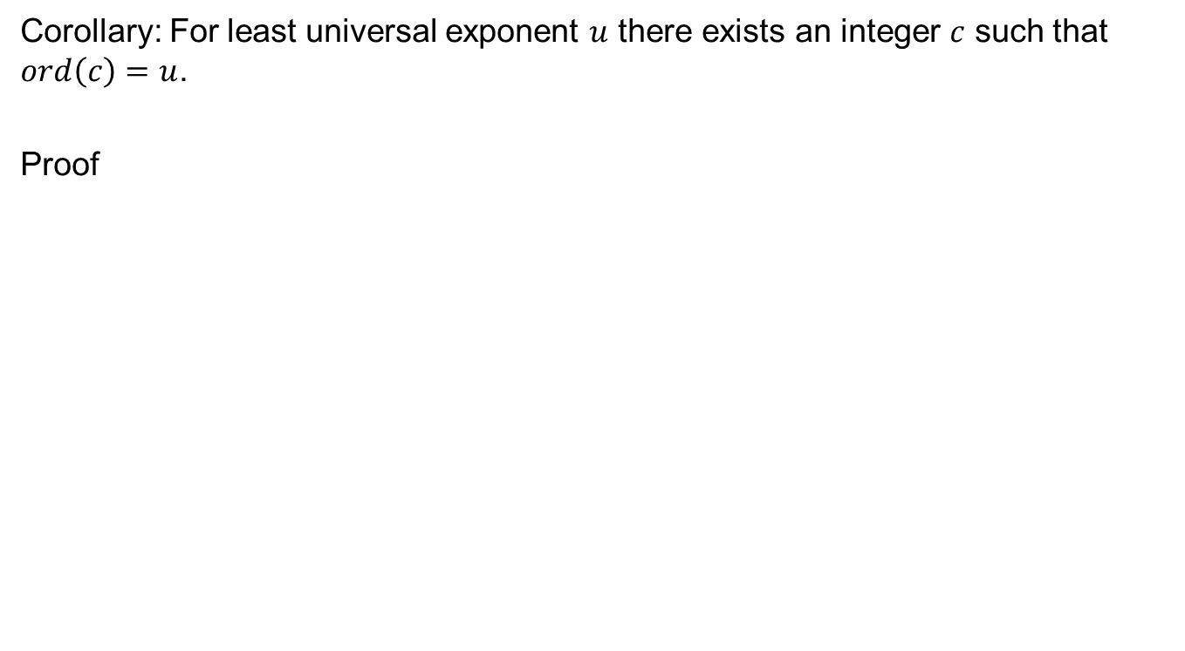
Construction of element for particular order
Corollary: For least universal exponent $u$ there exists an integer $c$ such that $ord\left(c\right)=u$.
Proof

Slide 10
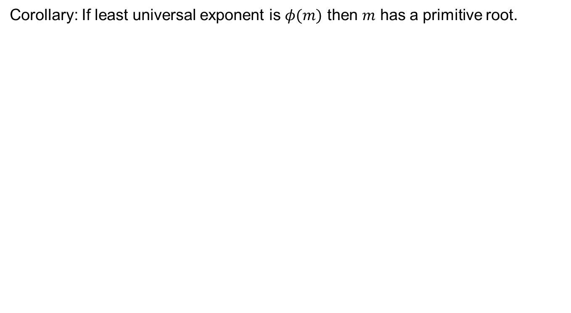
Corollary: If least universal exponent is $φ(m)$ then $m$ has a primitive root.

Slide 11
Primitive root for prime
Theorem (Legender): Every prime has a primitive root.
Proof:

Slide 13
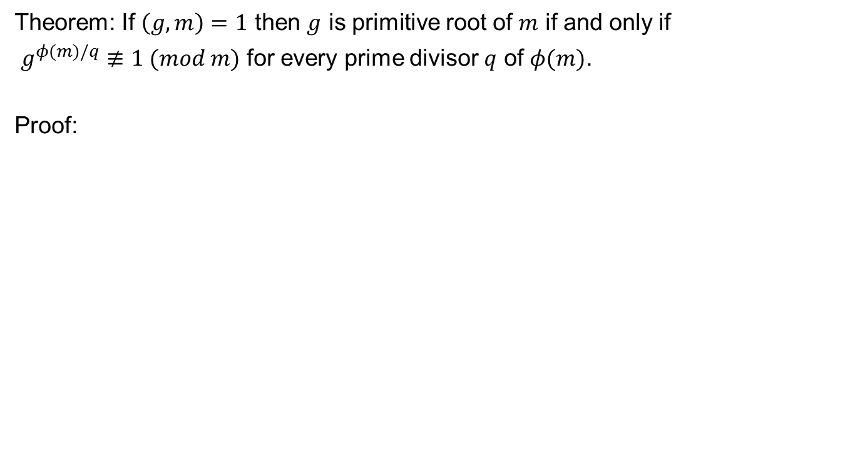
Characterization of primitive roots
Theorem: If $\left(g,m\right)=1$ then $g$ is primitive root of $m$ if and only if
$g^{φ(m)/q}≢1 (mod m)$ for every prime divisor $q$ of $φ(m)$.
Proof:

Slide 17
Examples

Slide 18
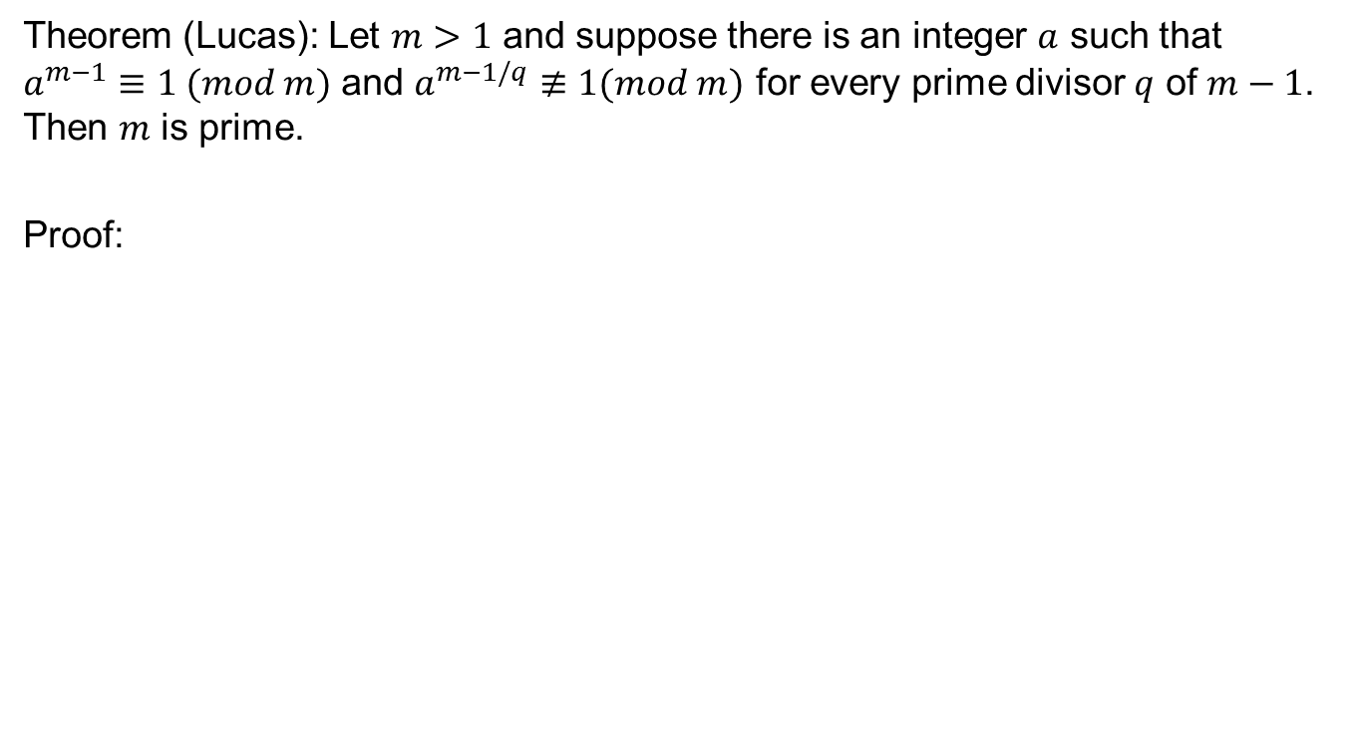
Converse of Fermat’s Theorem
Theorem (Lucas): Let $m>1$ and suppose there is an integer $a$ such that $a^{m−1}≡1 (mod m)$ and $a^{m−1/q}≢1(mod m)$ for every prime divisor $q$ of $m−1$. Then $m$ is prime.
Proof:

Slide 21
Review of Lecture 15
Primitive roots
Primitive roots for primes
Computations of primitive roots
Partial converse of Fermat’s Theorem

