Slide 1
Analytic Number Theory
MTH 435
Dr Mohib Ali

Slide 2
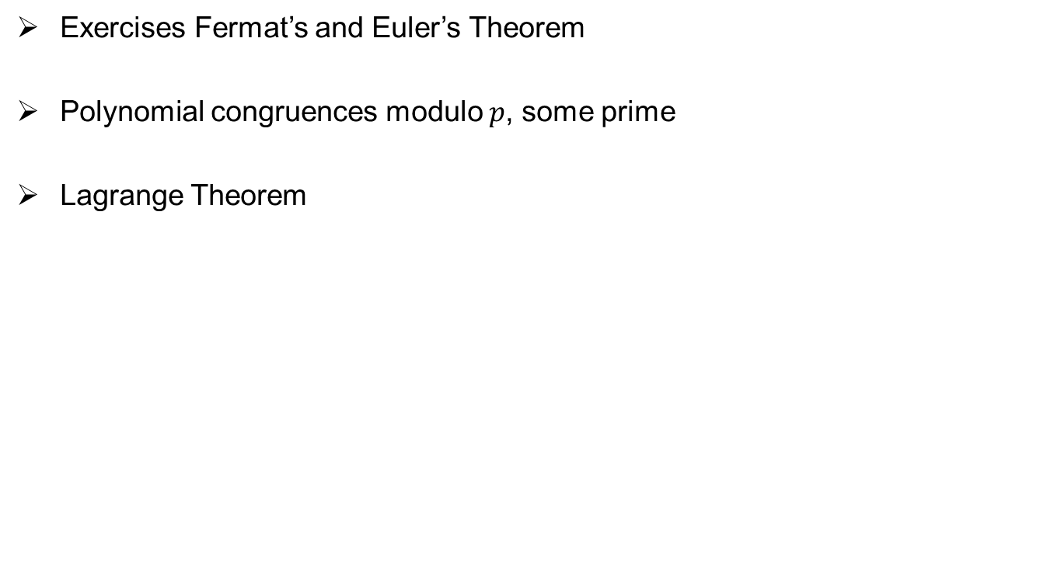
Review of Lecture 13
Exercises Fermat’s and Euler’s Theorem
Polynomial congruences modulo $p$, some prime
Lagrange Theorem

Slide 3
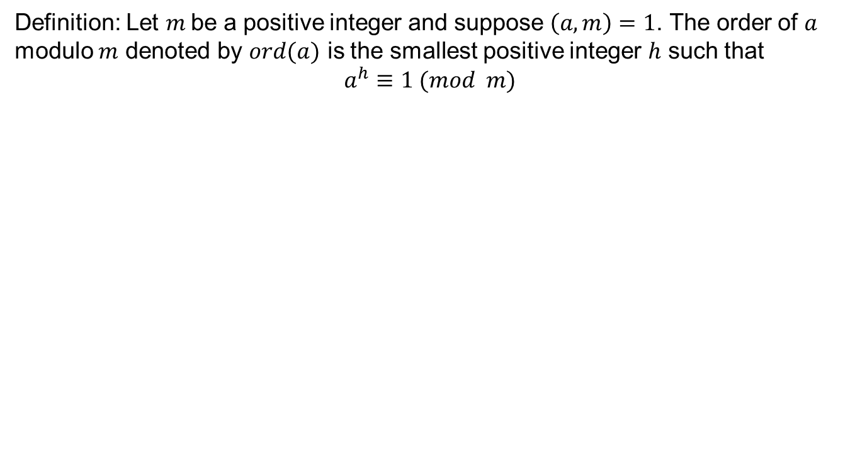
Order of an integer
Definition: Let $m$be a positive integer and suppose $\left(a,m\right)=1$. The order of $a$ modulo $m$ denoted by $ord(a)$ is the smallest positive integer $h$ such that
$$a^{h}≡1 (mod m)$$

Slide 5
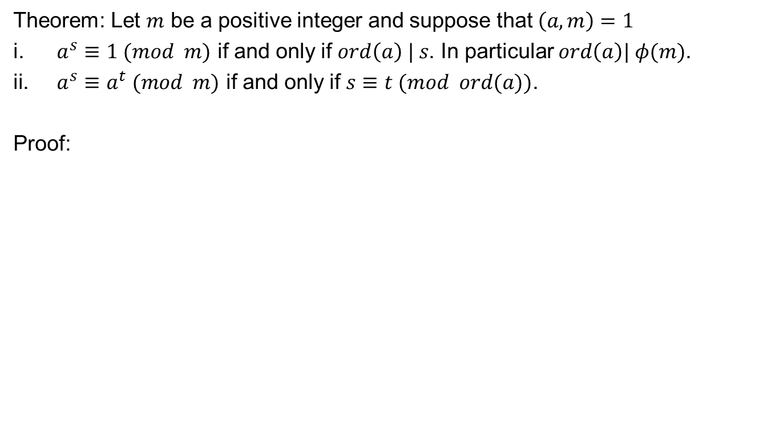
Order of integer
Theorem: Let $m$ be a positive integer and suppose that $\left(a,m\right)=1$
$a^{s}≡1 (mod m)$ if and only if $ord\left(a\right) | s$. In particular $ord\left(a\right)| φ(m)$.
$a^{s}≡a^{t} (mod m)$ if and only if $s≡t (mod ord(a))$.
Proof:

Slide 10
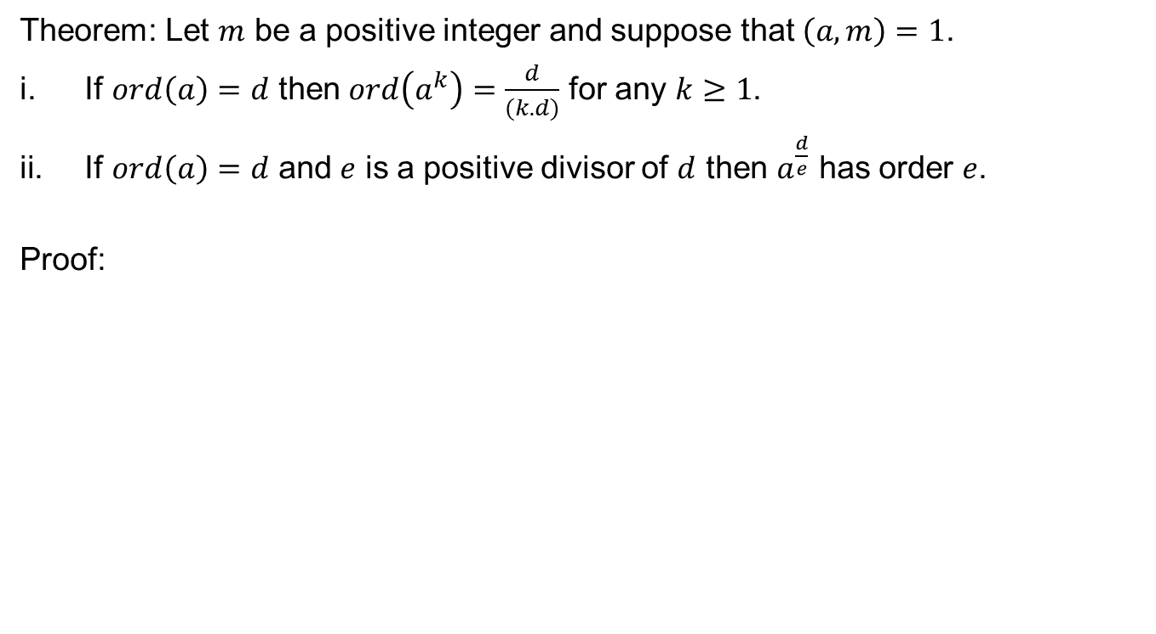
Order of power of integer
Theorem: Let $m$ be a positive integer and suppose that $\left(a,m\right)=1$.
If $ord\left(a\right)=d$ then $ord\left(a^{k}\right)=\frac{d}{(k.d)}$ for any $k≥1$.
If $ord\left(a\right)=d$ and $e$ is a positive divisor of $d$ then $a^{\frac{d}{e}}$ has order $e$.
Proof:

Slide 12
Examples

Slide 13
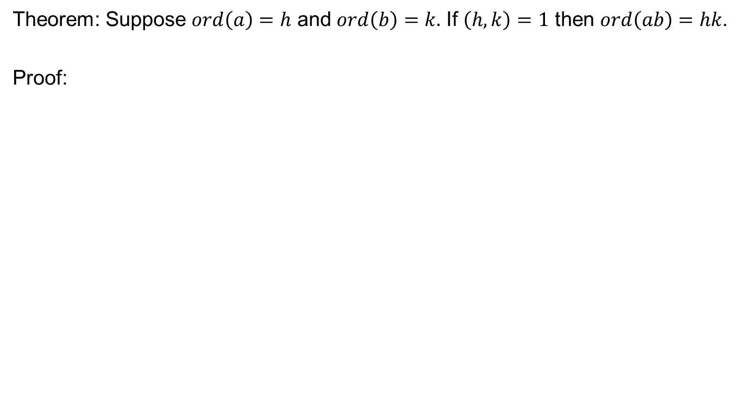
Order of the product
Theorem: Suppose $ord\left(a\right)=h$ and $ord\left(b\right)=k.$ If $\left(h,k\right)=1$ then $ord\left(ab\right)=hk$.
Proof:

Slide 15
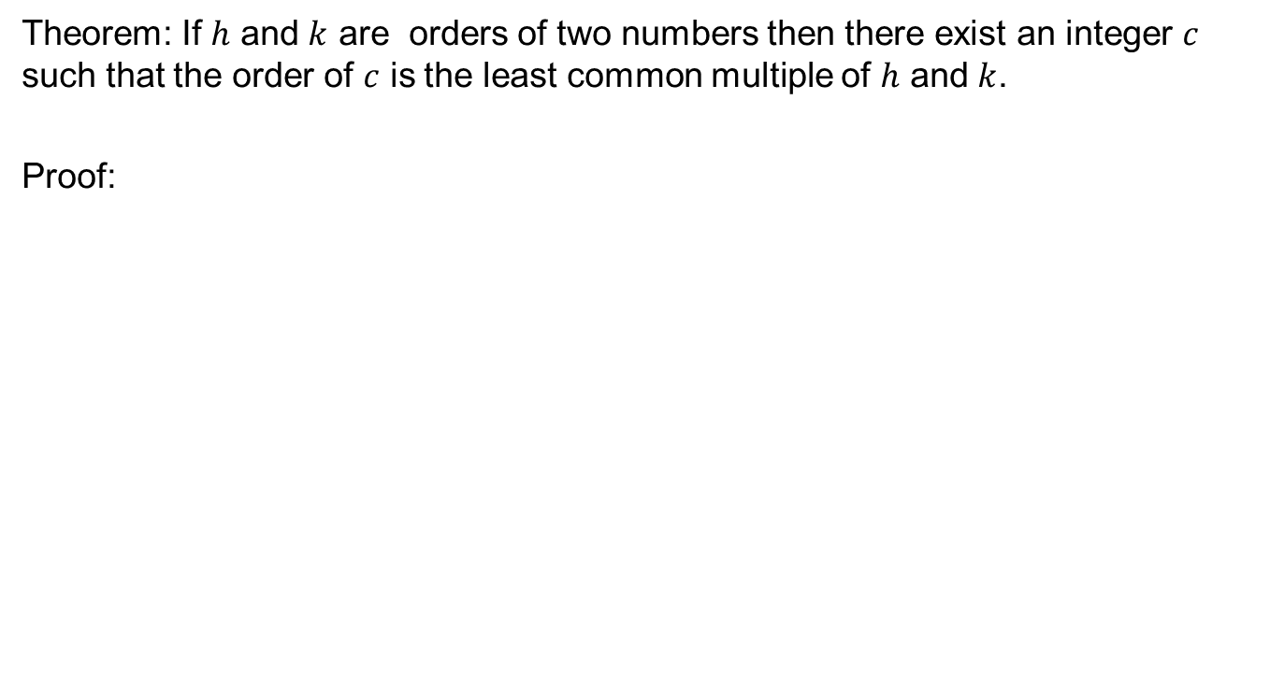
Construction of an integer with given order
Theorem: If $h$ and $k$ are orders of two numbers then there exist an integer $c$ such that the order of $c$ is the least common multiple of $h$ and $k$.
Proof:

Slide 17
Review of Lecture 14
Order of an integer
Relation of order with other numbers
Order of power of integers
Construction of integer with given order

