Slide 1
Analytic Number Theory
MTH 435
Dr Mohib Ali

Slide 2
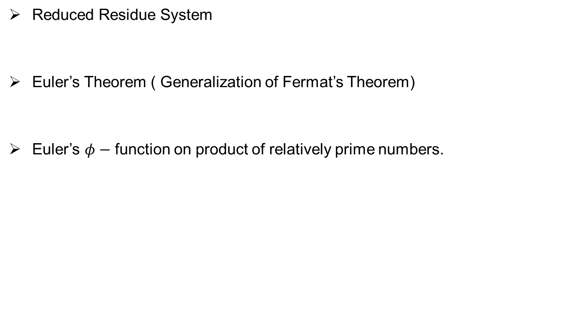
Review of Lecture 12
Reduced Residue System
Euler’s Theorem ( Generalization of Fermat’s Theorem)
Euler’s $φ−$ function on product of relatively prime numbers.

Slide 3

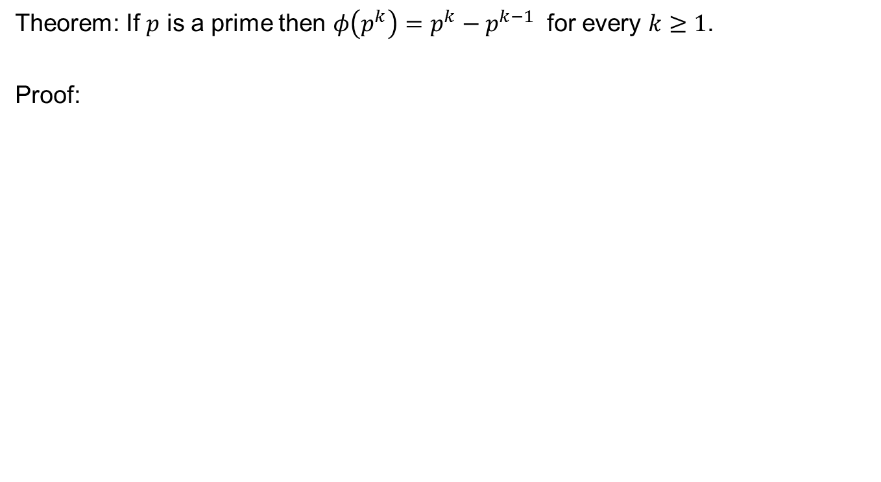
Euler $φ$-function on prime powers
Theorem: If $p$ is a prime then $φ\left(p^{k}\right)=p^{k}−p^{k−1}$ for every $k≥1$.
Proof:

Slide 6
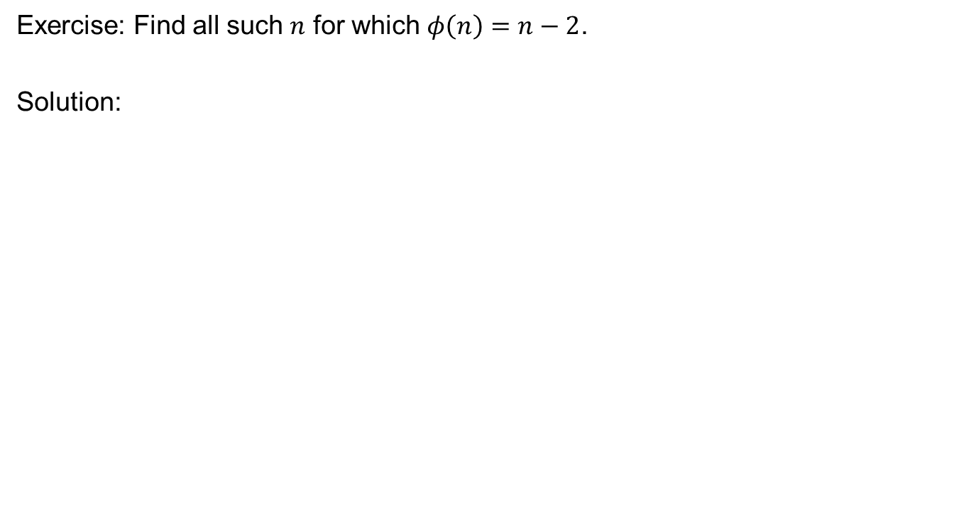
Exercises
Exercise: Find all such $n$ for which $φ\left(n\right)=n−2$.
Solution:

Slide 8
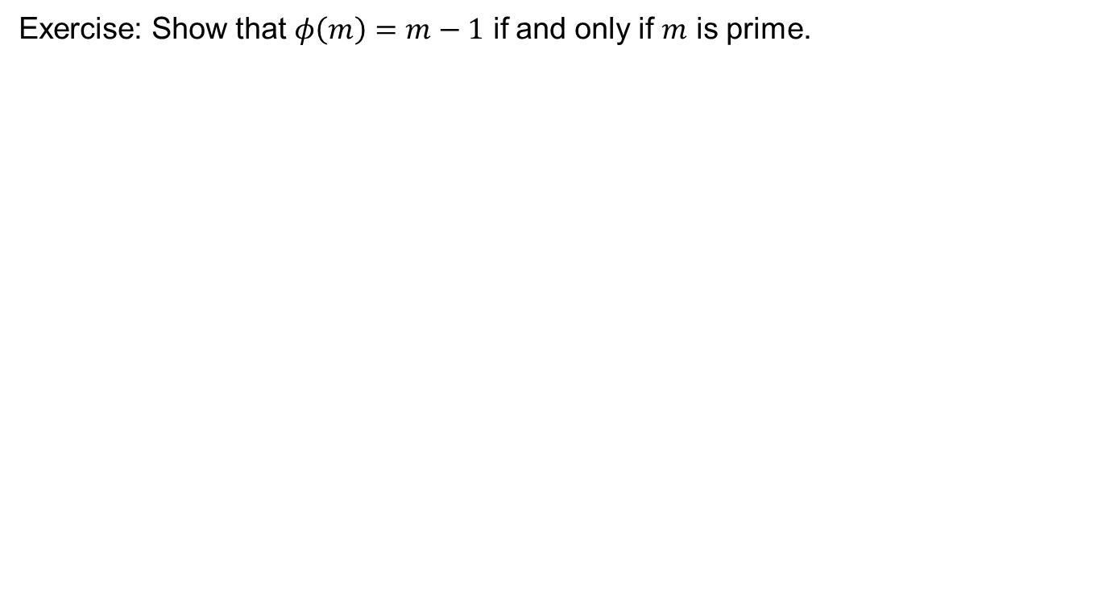
Exercise: Show that $φ\left(m\right)=m−1$ if and only if $m$ is prime.

Slide 9
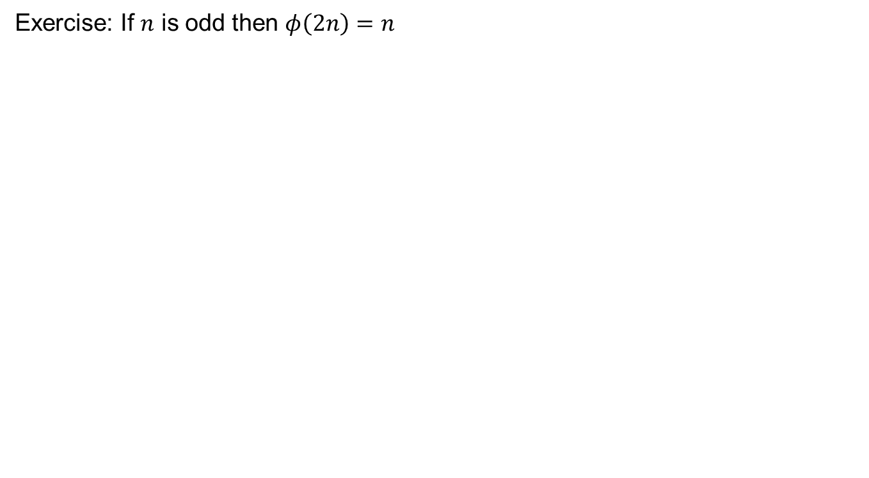
Exercise: If $n$ is odd then $φ\left(2n\right)=n$

Slide 10
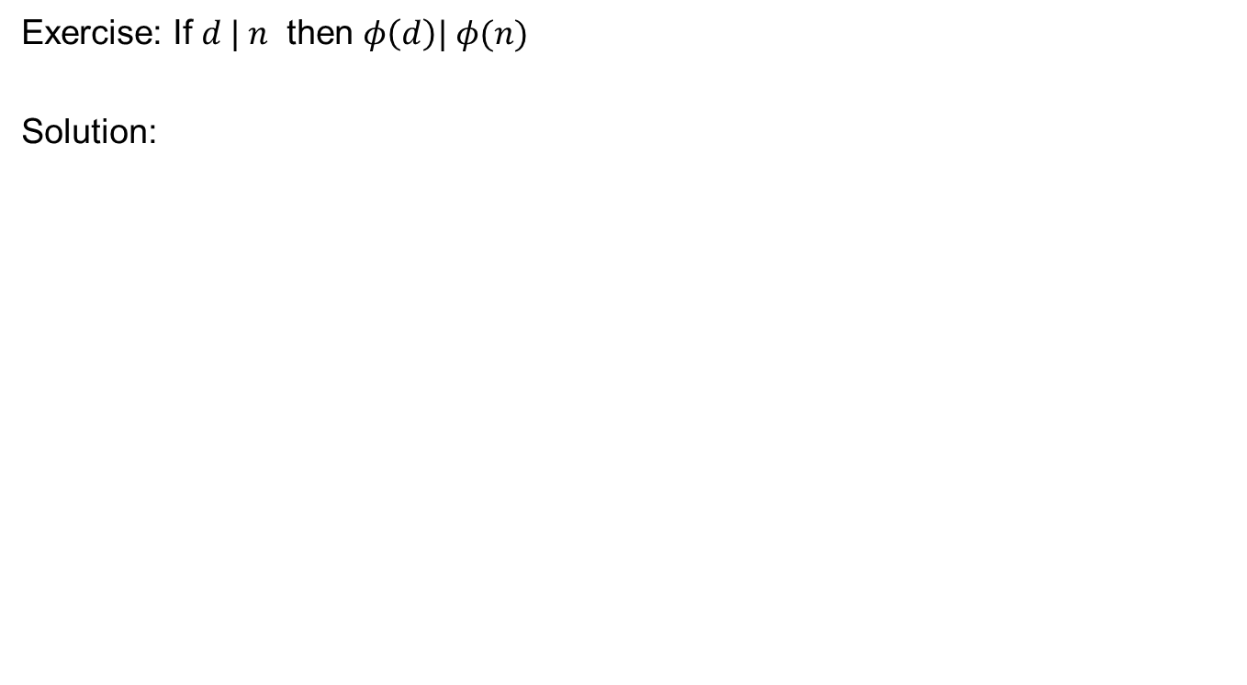
Exercise: If $d | n$ then $φ\left(d\right)| φ(n)$
Solution:

Slide 11
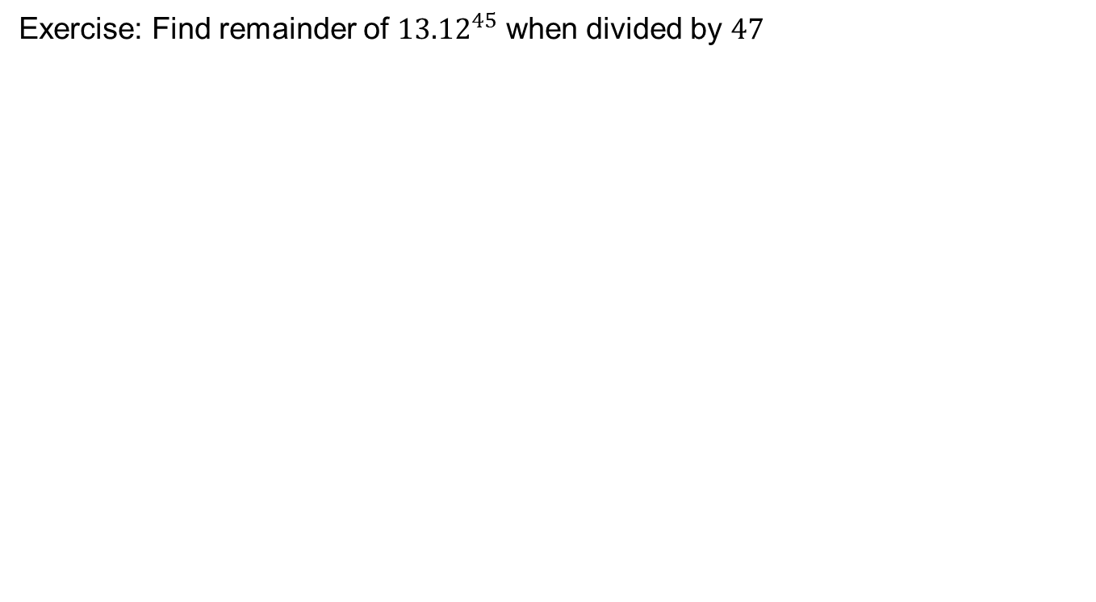
Exercises for Fermat’s Theorem
Exercise: Find remainder of ${13.12}^{45}$ when divided by $47$

Slide 12
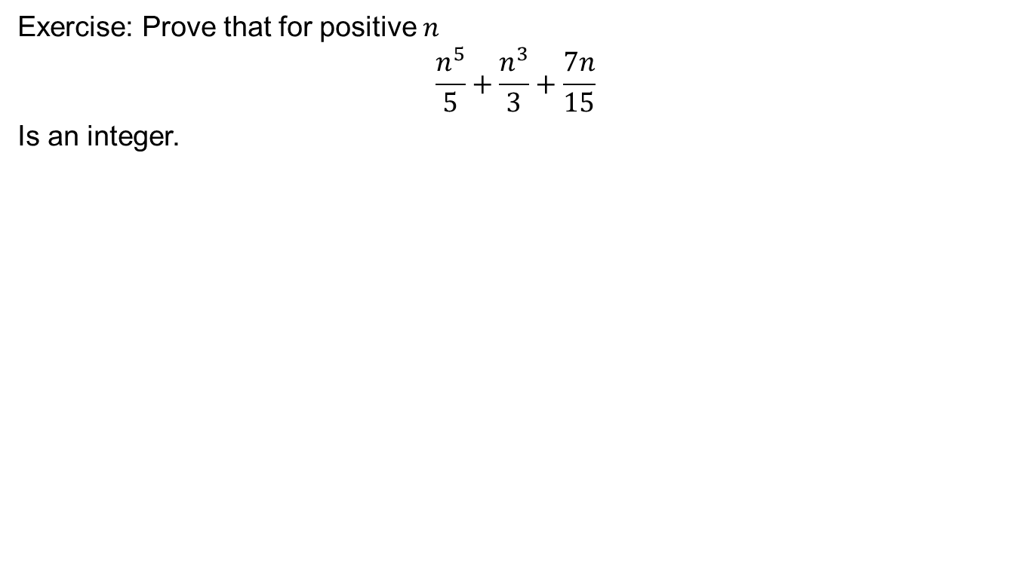
Exercise: Prove that for positive $n$
$$\frac{n^{5}}{5}+\frac{n^{3}}{3}+\frac{7n}{15}$$
Is an integer.

Slide 14
Polynomial congruences and solutions

Slide 16
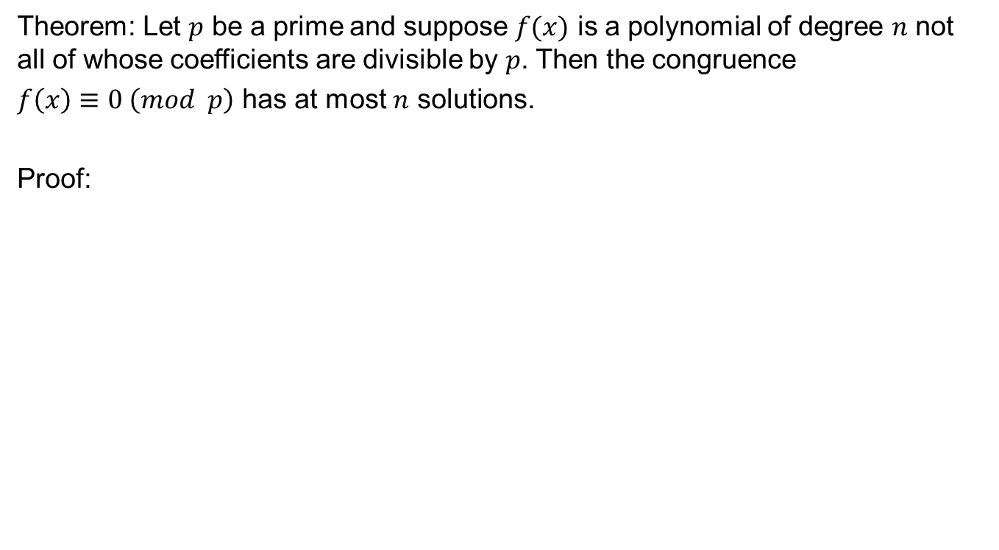
Lagrange’s Theorem
Theorem: Let $p$ be a prime and suppose $f(x)$ is a polynomial of degree $n$ not all of whose coefficients are divisible by $p$. Then the congruence
$f\left(x\right)≡0 \left(mod p\right)$ has at most $n$ solutions.
Proof:

Slide 18
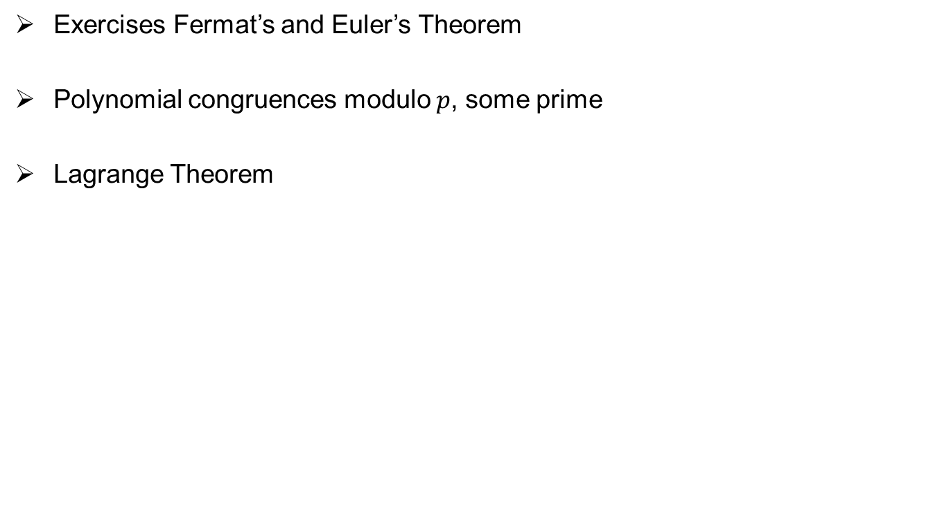
Review of Lecture 13
Exercises Fermat’s and Euler’s Theorem
Polynomial congruences modulo $p$, some prime
Lagrange Theorem

