Slide 1
Analytic Number Theory
MTH 435
Dr Mohib Ali

Slide 2
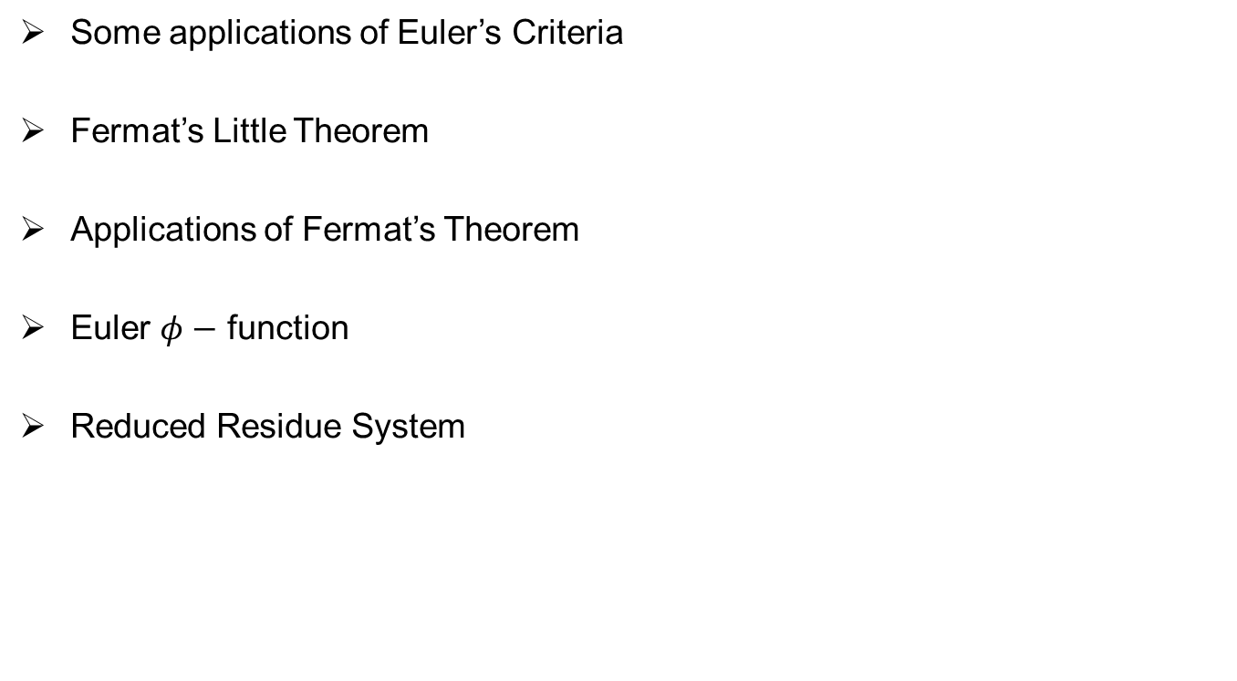
Review of Lecture 11
Some applications of Euler’s Criteria
Fermat’s Little Theorem
Applications of Fermat’s Theorem
Euler $φ−$ function
Reduced Residue System

Slide 3
Application of Fermat’s Theorem

Slide 5
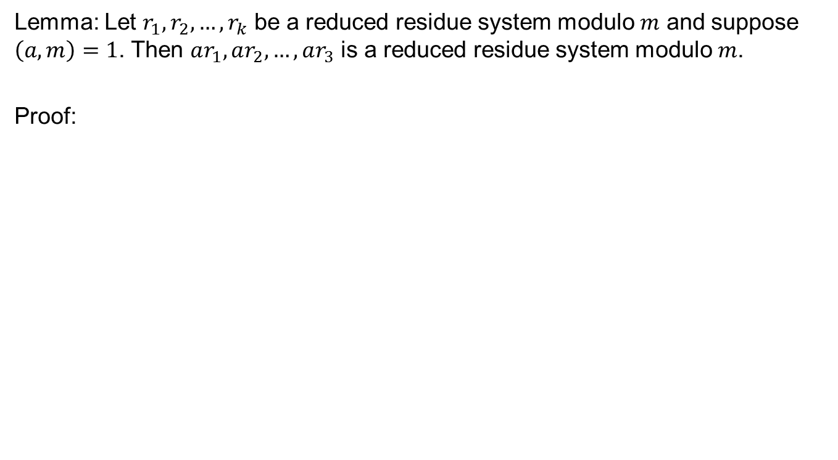
Reduced Residue System
Lemma: Let $r_{1},r_{2},…,r_{k}$ be a reduced residue system modulo $m$ and suppose $\left(a,m\right)=1$. Then $ar_{1},ar_{2},…,ar_{3}$ is a reduced residue system modulo $m$.
Proof:

Slide 6
Reduced Residue System

Slide 7
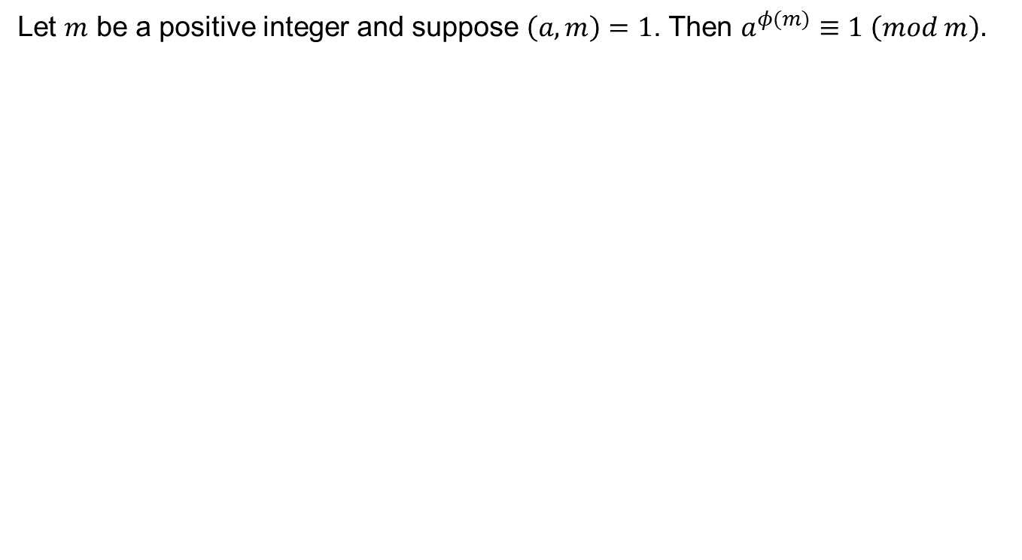
Euler’s Theorem
Let $m$ be a positive integer and suppose $\left(a,m\right)=1$. Then $a^{φ(m)}≡1 \left(mod m\right).$

Slide 10
Remainder Excercises

Slide 11

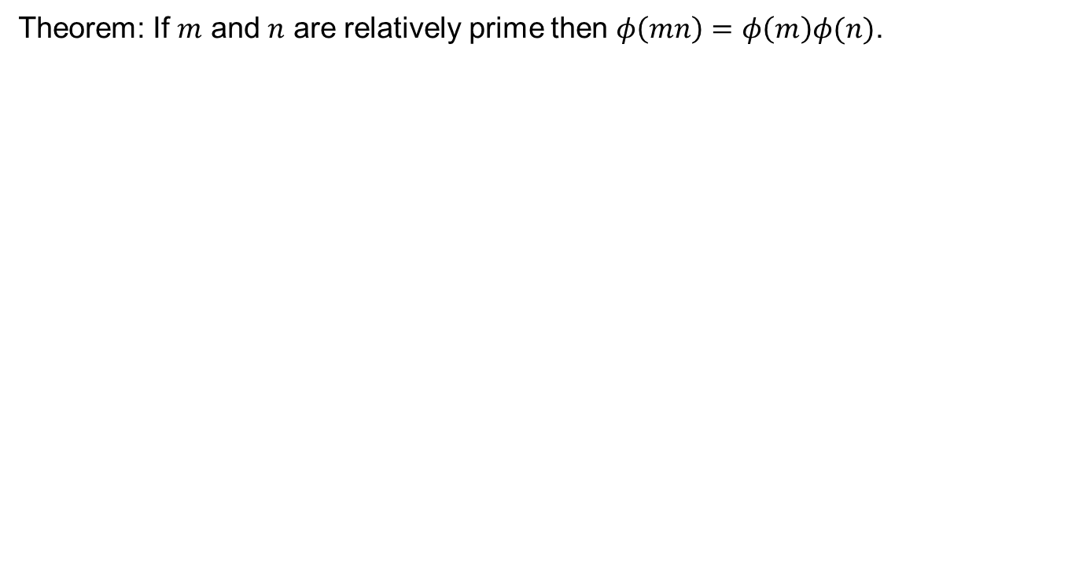
$φ$ as multiplicative function
Theorem: If $m$ and $n$ are relatively prime then $φ\left(mn\right)=φ\left(m\right)φ(n)$.

Slide 14
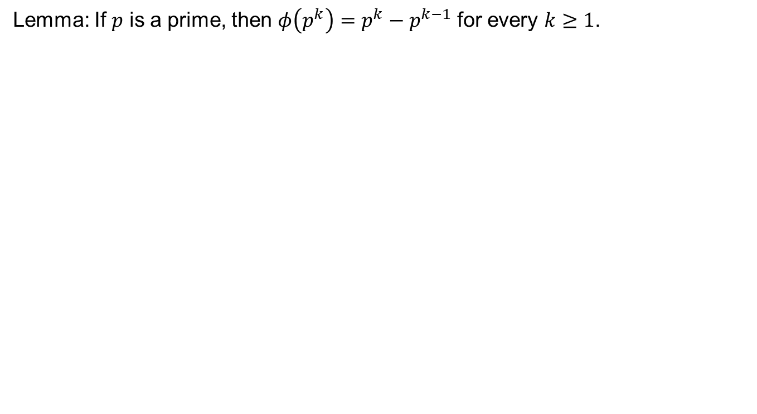

$φ$- function on prime powers
Lemma: If $p$ is a prime, then $φ\left(p^{k}\right)=p^{k}−p^{k−1}$ for every $k≥1$.

Slide 16
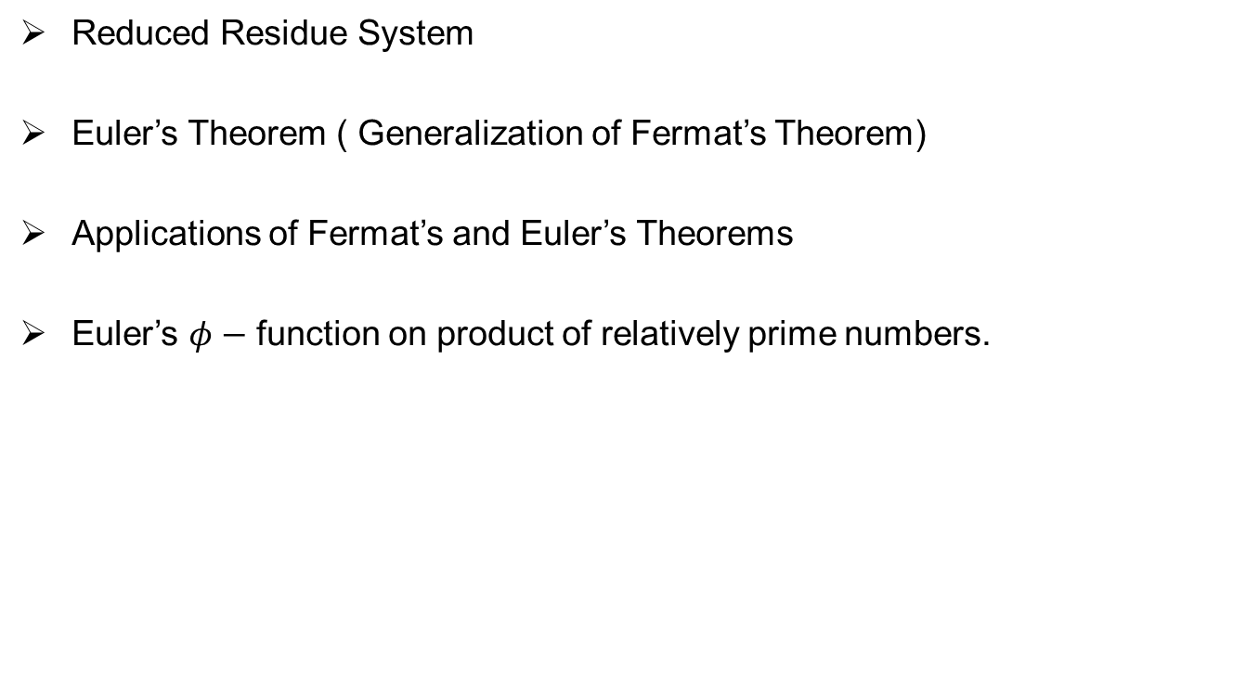
Review of Lecture 12
Reduced Residue System
Euler’s Theorem ( Generalization of Fermat’s Theorem)
Applications of Fermat’s and Euler’s Theorems
Euler’s $φ−$ function on product of relatively prime numbers.

