Slide 1
Analytic Number Theory
MTH 435
Dr Mohib Ali

Slide 2
Review of Lecture 9
Chinese Remainder Theorem (Proof)
Examples of CRT
Indirect Examples where CRT can be applied

Slide 3
Prime Numbers

Slide 4
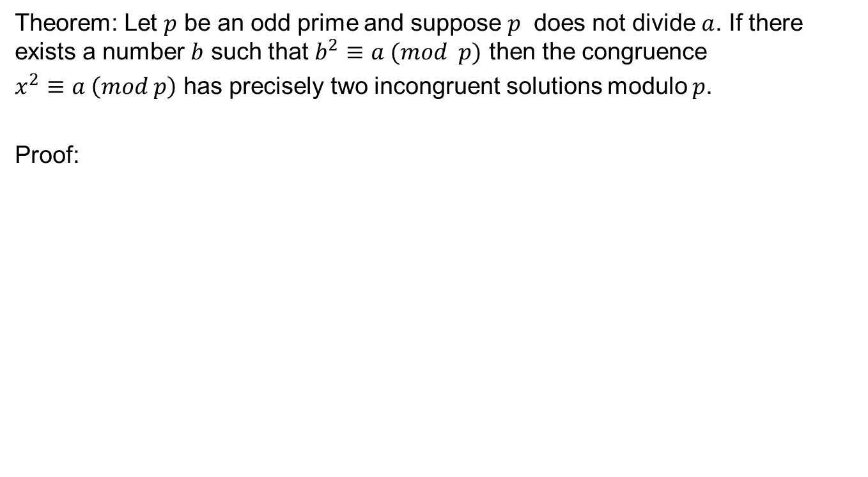
Congruences with primes
Theorem: Let $p$ be an odd prime and suppose $p$ does not divide $a$. If there exists a number $b$ such that $b^{2}≡a (mod p)$ then the congruence
$x^{2}≡a \left(mod p\right)$ has precisely two incongruent solutions modulo $p$.
Proof:

Slide 6
Behavior as FTA
Two solutions as of the quadratic equation.

Slide 7
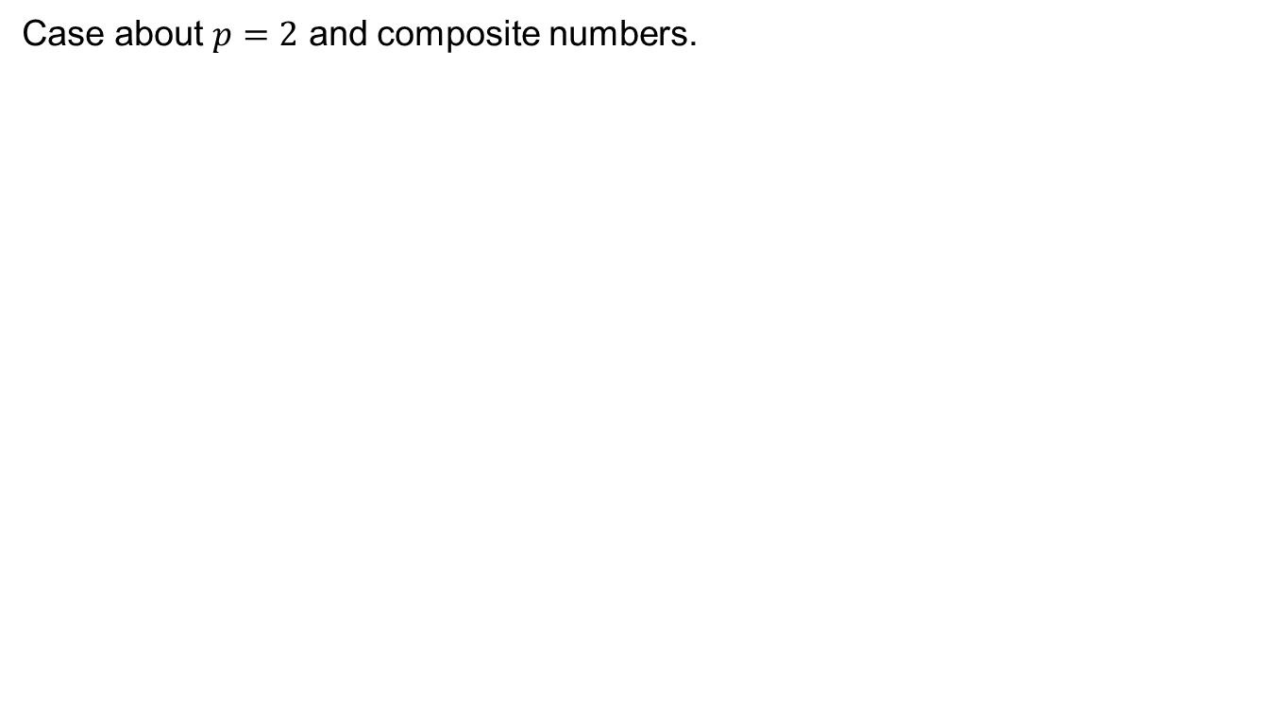
Remarks
Case about $p=2$ and composite numbers.

Slide 8
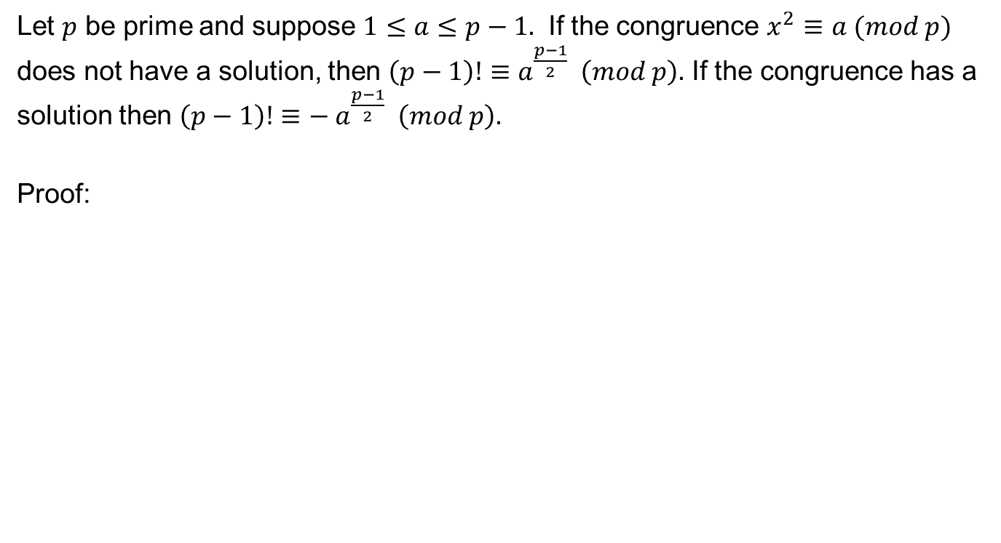
Dirichlet Theorem
Let $p$ be prime and suppose $1≤a≤p−1.$ If the congruence $x^{2}≡a (mod p)$ does not have a solution, then $\left(p−1\right)!≡a^{\frac{p−1}{2}} \left(mod p\right).$ If the congruence has a solution then $\left(p−1\right)!≡− a^{\frac{p−1}{2}} \left(mod p\right).$
Proof:

Slide 11
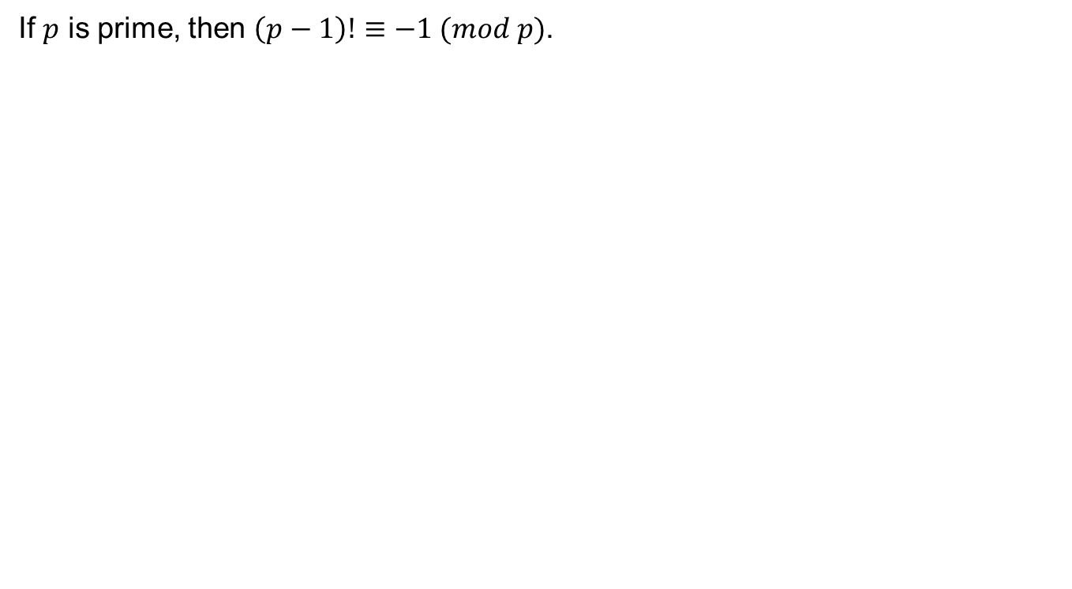
Wilson’s Theorem
If $p$ is prime, then $\left(p−1\right)!≡−1 (mod p)$.

Slide 12
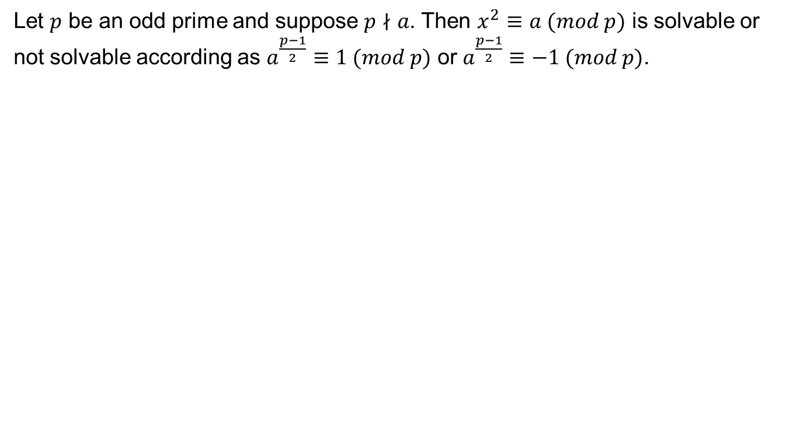
Euler’s Criterian
Let $p$ be an odd prime and suppose $p∤a$. Then $x^{2}≡a (mod p)$ is solvable or not solvable according as $a^{\frac{p−1}{2}}≡1 (mod p)$ or $a^{\frac{p−1}{2}}≡−1 (mod p)$.

Slide 14
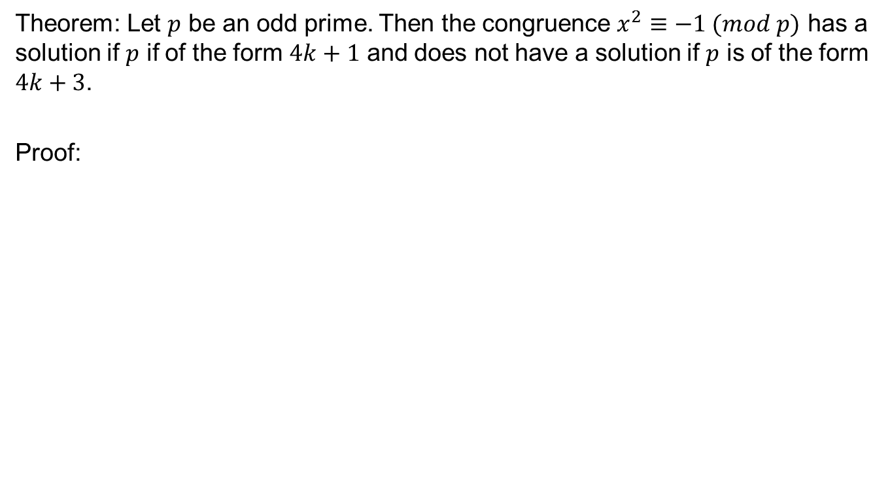
Application
Theorem: Let $p$ be an odd prime. Then the congruence $x^{2}≡−1 (mod p)$ has a solution if $p$ if of the form $4k+1$ and does not have a solution if $p$ is of the form $4k+3$.
Proof:

Slide 16
Review of Lecture 10
Quadratic congruences with prime modulo
Dirichlet Theorem
Wilson’s Theorem
Euler’s Criteria

