Slide 1
Analytic Number Theory
MTH 435
Dr Mohib Ali

Slide 2
My Introduction
Assistant Professor, Department of Mathematics, COMSATS IIT, Islamabad
PhD from Abdus Salam School of Mathematical Sciences, GC University, Lahore
Post Doctorate from Abdus Salam School of Mathematical Sciences, GC University, Lahore
Area of research, Algebra & Number Theory

Slide 3
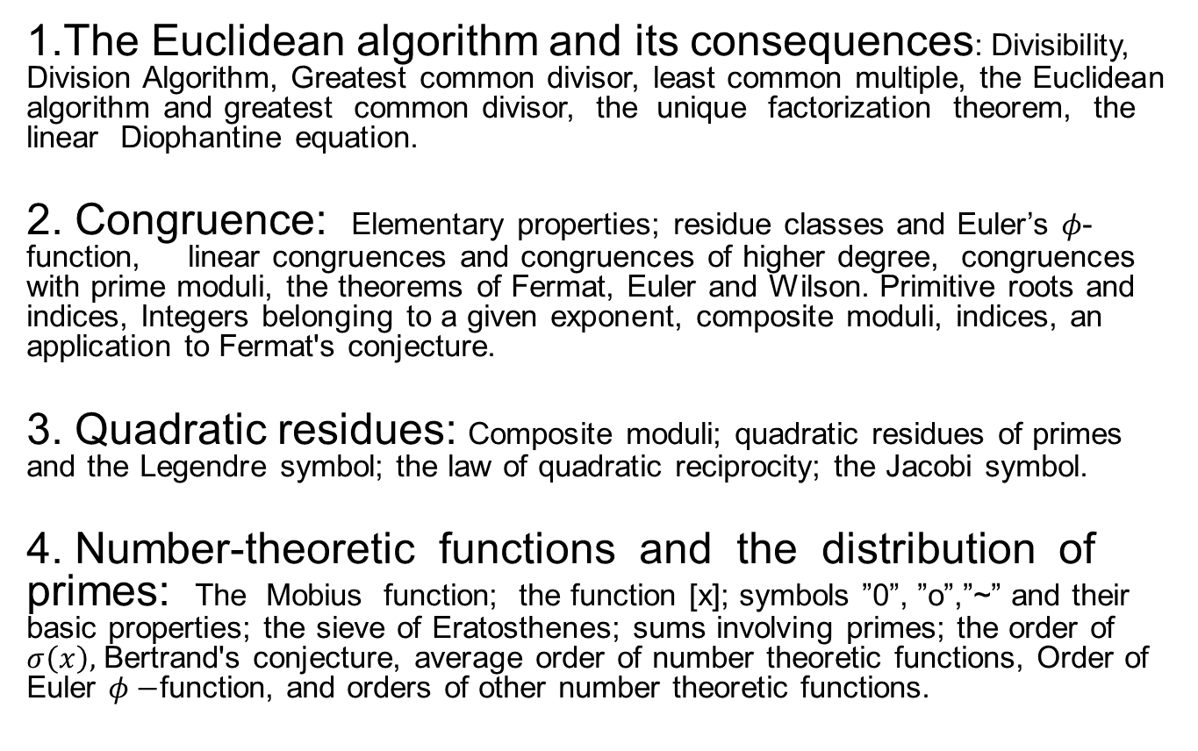
Course Outline
1.The Euclidean algorithm and its consequences: Divisibility, Division Algorithm, Greatest common divisor, least common multiple, the Euclidean algorithm and greatest common divisor, the unique factorization theorem, the linear Diophantine equation.
2. Congruence: Elementary properties; residue classes and Euler’s $φ$-function, linear congruences and congruences of higher degree, congruences with prime moduli, the theorems of Fermat, Euler and Wilson. Primitive roots and indices, Integers belonging to a given exponent, composite moduli, indices, an application to Fermat's conjecture.
3. Quadratic residues: Composite moduli; quadratic residues of primes and the Legendre symbol; the law of quadratic reciprocity; the Jacobi symbol.
4. Number-theoretic functions and the distribution of primes: The Mobius function; the function [x]; symbols ”0”, ”o”,”~” and their basic properties; the sieve of Eratosthenes; sums involving primes; the order of $σ\left(x\right),$ Bertrand's conjecture, average order of number theoretic functions, Order of Euler $φ−$function, and orders of other number theoretic functions.

Slide 4
Text for the course
Readings
[1] Andrew Adler and John E. Coury, THE THEORY OF NUMBERS, Jones and Bartlett Publishers, 1995
[2] Tom M. Apostol, INTRODUCTION TO ANALYTIC NUMBER THEORY, Springer & Verlag, 1998
[1] is the main text book for this course. We will consult [2] for the last section of our course which is about the number theoretic functions and their average orders and distribution of primes.

Slide 5
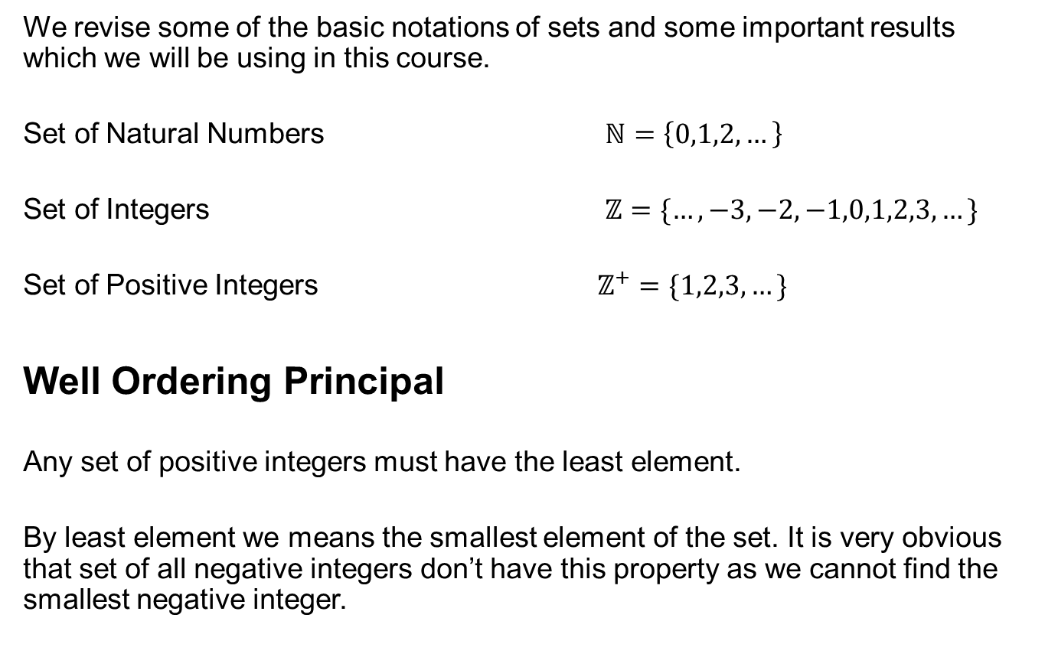
Preliminaries
We revise some of the basic notations of sets and some important results which we will be using in this course.
Set of Natural Numbers $ℕ=\left\{0,1,2,…\right\}$
Set of Integers $ℤ=\{…,−3,−2,−1,0,1,2,3, …\}$
Set of Positive Integers $ℤ^{+}=\{1,2,3,…\}$
Well Ordering Principal
Any set of positive integers must have the least element.
By least element we means the smallest element of the set. It is very obvious that set of all negative integers don’t have this property as we cannot find the smallest negative integer.

Slide 6
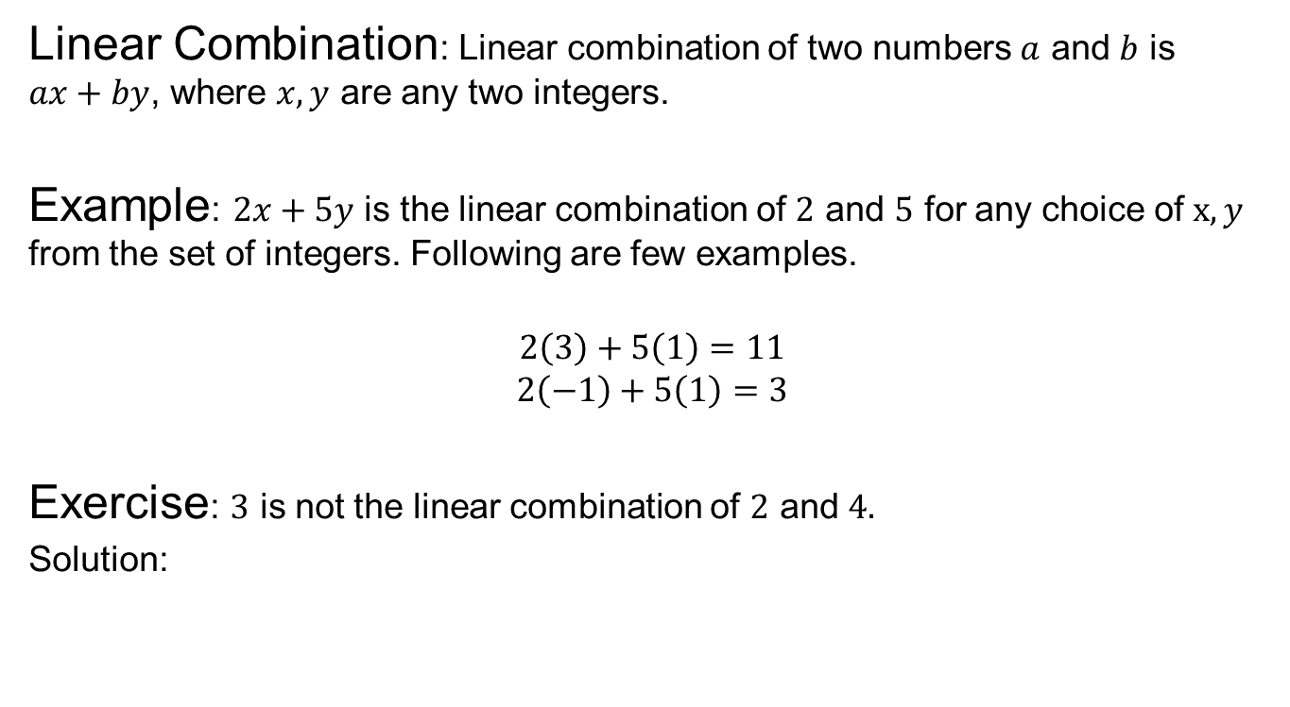
Preliminaries
Linear Combination: Linear combination of two numbers $a$ and $b$ is $ax+by$, where $x,y$ are any two integers.
Example: $2x+5y$ is the linear combination of $2$ and $5$ for any choice of $x,y$ from the set of integers. Following are few examples.
$$2\left(3\right)+5\left(1\right)=11$$
$$2\left(−1\right)+5\left(1\right)=3$$
Exercise: $3$ is not the linear combination of $2$ and $4.$
Solution:

Slide 7
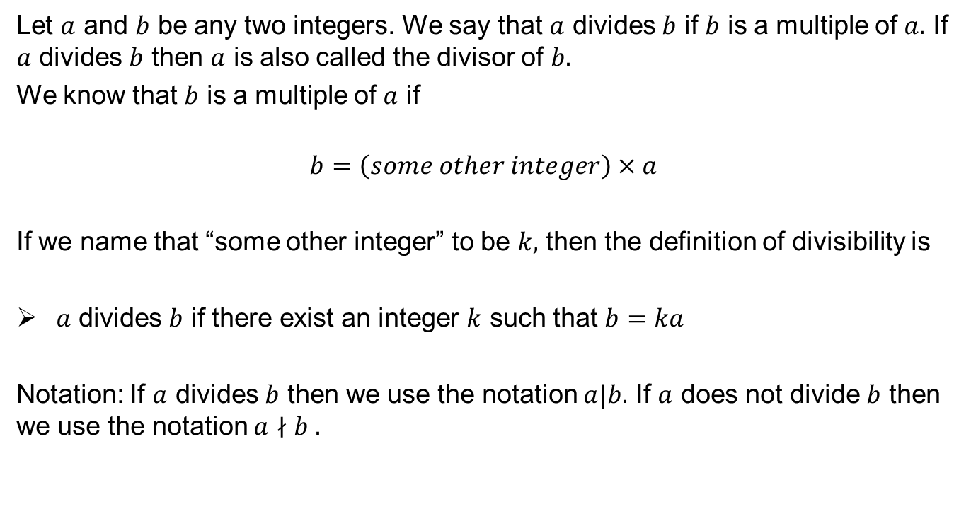
Divisibility
Let $a$ and $b$ be any two integers. We say that $a$ divides $b$ if $b$ is a multiple of $a.$ If $a$ divides $b$ then $a$ is also called the divisor of $b.$
We know that $b$ is a multiple of $a$ if
$$b=\left(some other integer\right)×a$$
If we name that “some other integer” to be $k,$ then the definition of divisibility is
$a$ divides $b$ if there exist an integer $k$ such that $b=ka$
Notation: If $a$ divides $b$ then we use the notation $a|b.$ If $a$ does not divide $b$ then we use the notation $a∤b .$

Slide 8
Some Examples of Divisibility
Example:

Slide 9
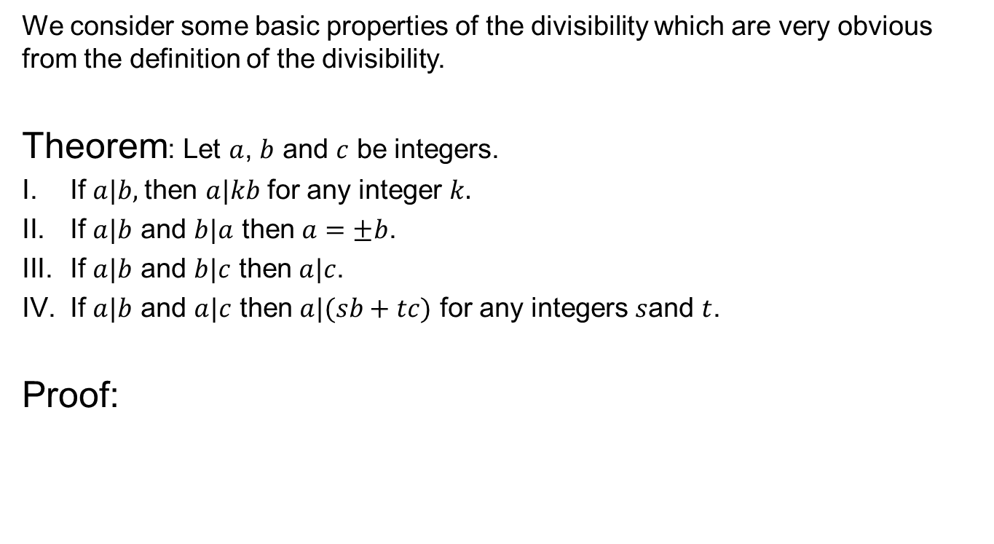
Some properties of Divisibility
We consider some basic properties of the divisibility which are very obvious from the definition of the divisibility.
Theorem: Let $a$, $b$ and $c$ be integers.
If$a|b,$ then $a|kb$ for any integer $k.$
If $a|b$ and $b|a$ then $a=±b$.
If $a|b$ and $b|c$ then $a|c$.
If $a|b$ and $a|c$ then $a|(sb+tc)$ for any integers $s$and $t$.
Proof:

Slide 10
Basic properties of Divisibility
Proof Continued with examples.

Slide 11
Basic Properties

Slide 12
Basic Properties

Slide 13
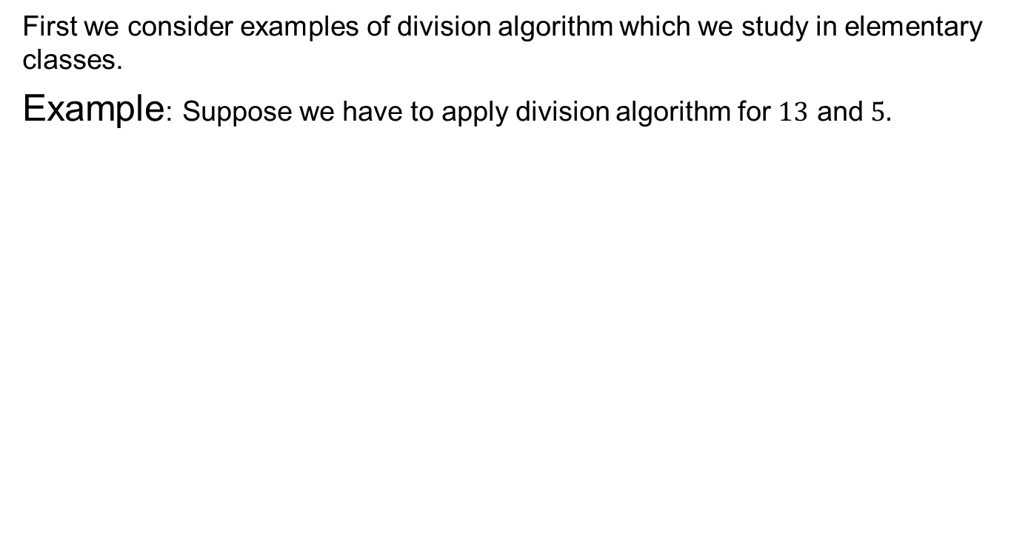
Division Algorithm
First we consider examples of division algorithm which we study in elementary classes.
Example: Suppose we have to apply division algorithm for $13$ and $5.$

Slide 14
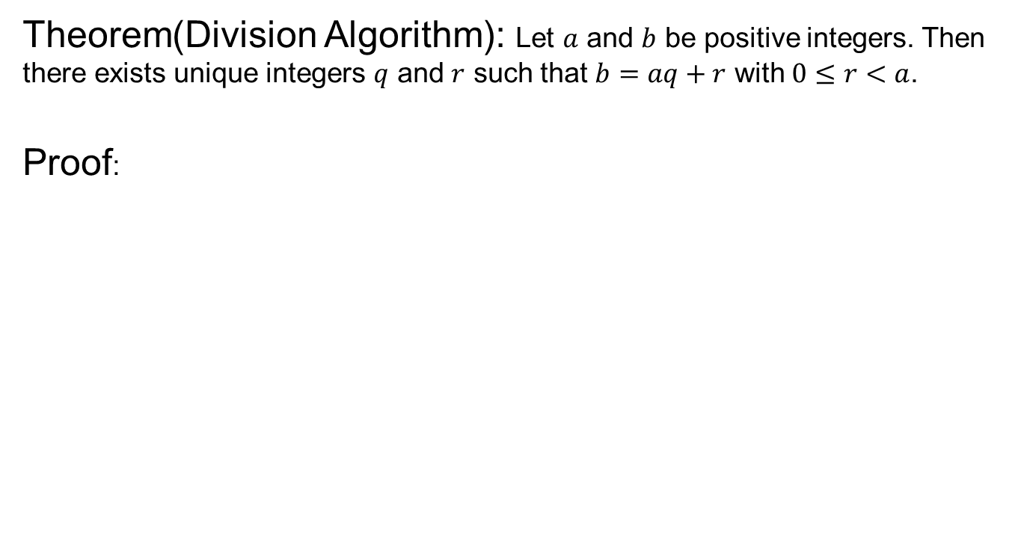
Division Algorithm
Theorem(Division Algorithm): Let $a$ and $b$ be positive integers. Then there exists unique integers $q$ and $r$ such that $b=aq+r$ with $0≤r<a$.
Proof:

Slide 15
Proof Continued

Slide 16
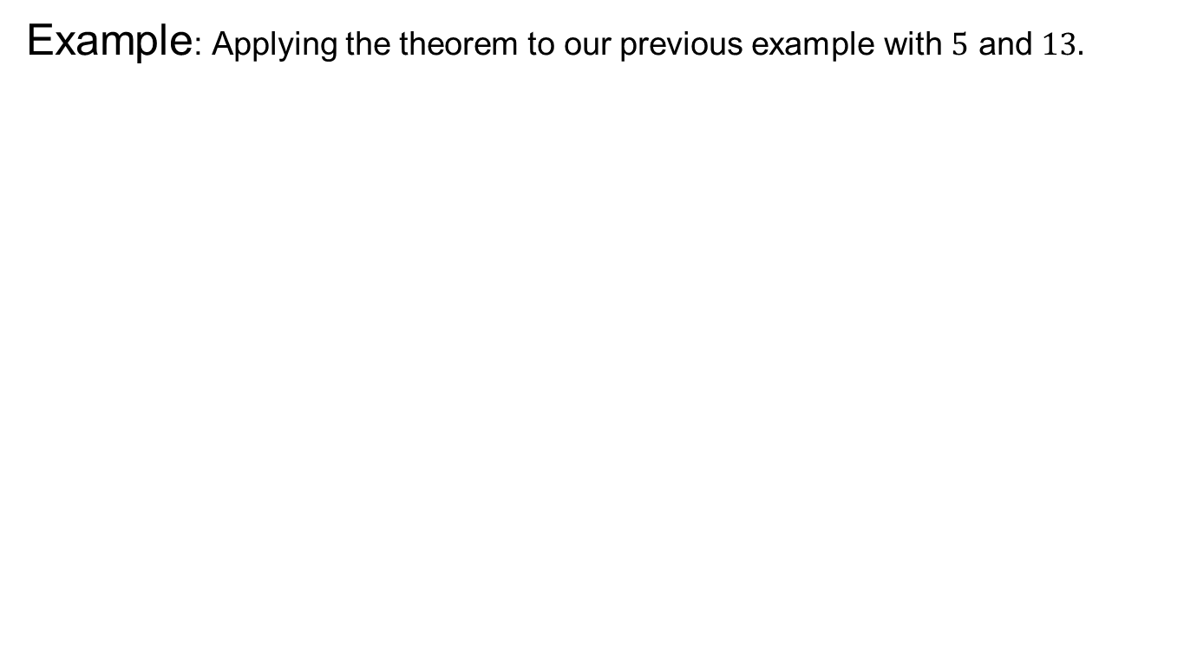
Division Algorithm
Example: Applying the theorem to our previous example with $5$ and $13.$

Slide 17
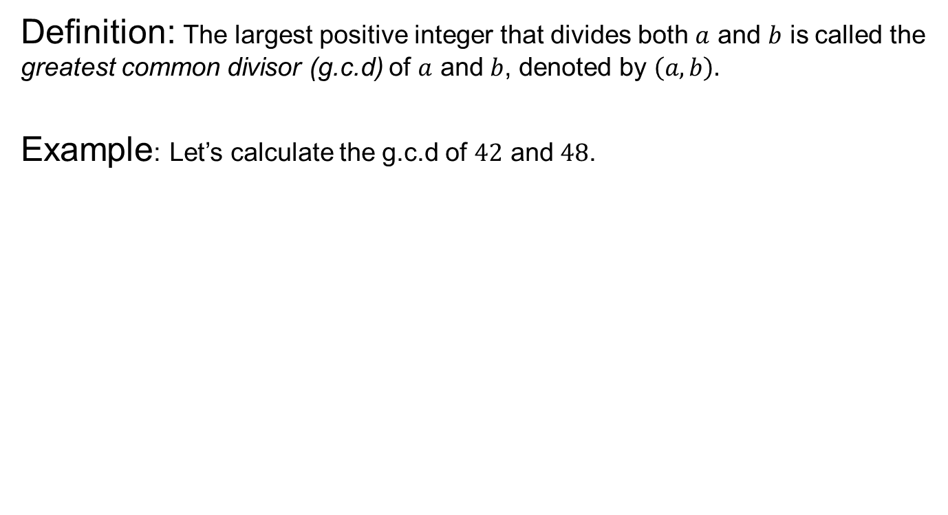
Greatest Common Divisor
Definition: The largest positive integer that divides both $a$ and $b$ is called the greatest common divisor (g.c.d) of $a$ and $b$, denoted by $\left(a,b\right).$
Example: Let’s calculate the g.c.d of $42$ and $48$.

Slide 18
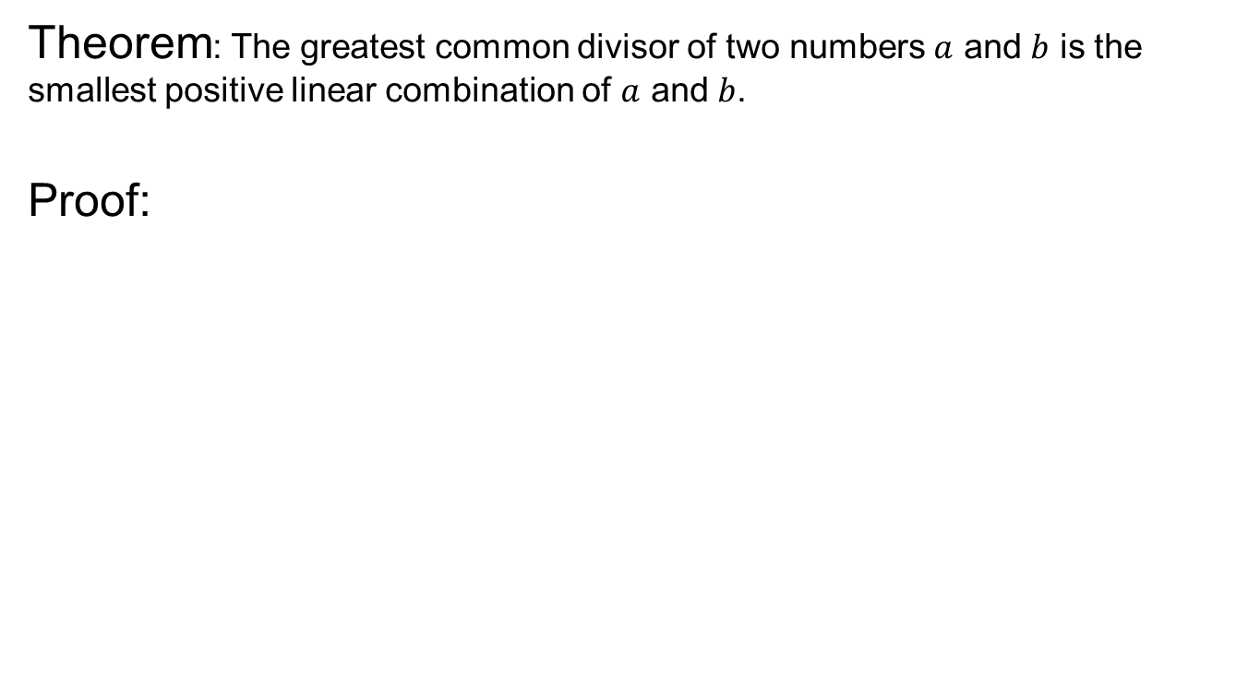
G.C.D and Linear Combination
Theorem: The greatest common divisor of two numbers $a$ and $b$ is the smallest positive linear combination of $a$ and $b$.
Proof:

Slide 19
G.C.D and Linear Combination

Slide 20
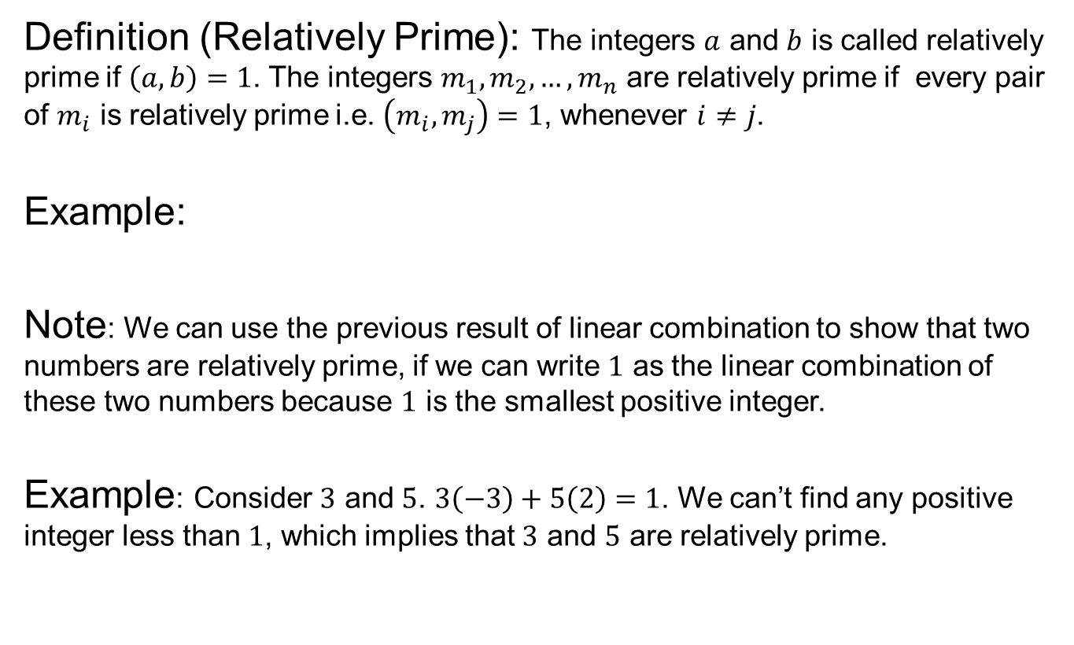
Relatively Prime
Definition (Relatively Prime): The integers $a$ and $b$ is called relatively prime if $\left(a,b\right)=1$. The integers $m_{1},m_{2},…,m_{n}$ are relatively prime if every pair of $m_{i}$ is relatively prime i.e. $\left(m_{i},m_{j}\right)=1$, whenever $i≠j$.
Example:
Note: We can use the previous result of linear combination to show that two numbers are relatively prime, if we can write $1$ as the linear combination of these two numbers because $1$ is the smallest positive integer.
Example: Consider $3$ and $5$. $3\left(−3\right)+5\left(2\right)=1$. We can’t find any positive integer less than $1$, which implies that $3$ and $5$ are relatively prime.

Slide 21
Relatively Prime
Exercise: Any two consecutive numbers are relatively prime

Slide 22
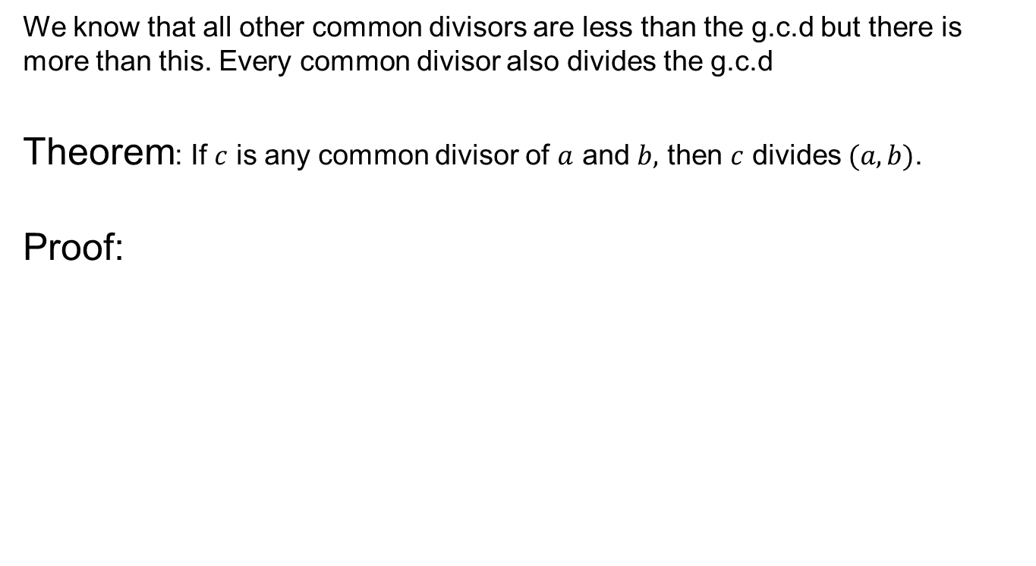
Common Divisor and G.C.D
We know that all other common divisors are less than the g.c.d but there is more than this. Every common divisor also divides the g.c.d
Theorem: If $c$ is any common divisor of $a$ and $b,$ then $c$ divides $(a,b)$.
Proof:

Slide 23
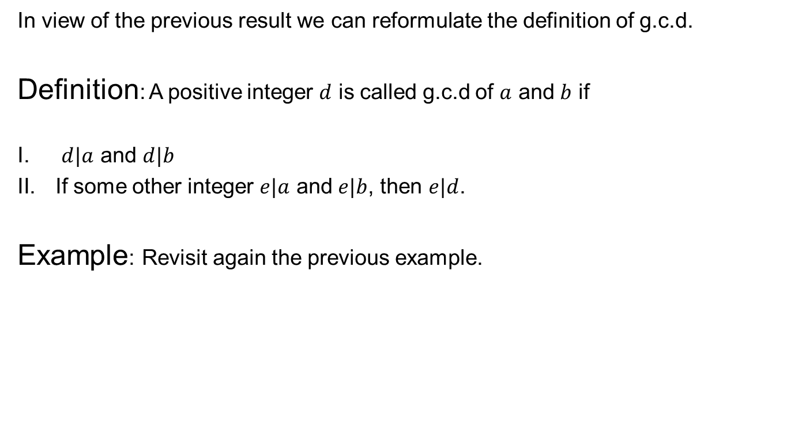
Alternative Definition of G.C.D
In view of the previous result we can reformulate the definition of g.c.d.
Definition: A positive integer $d$ is called g.c.d of $a$ and $b$ if
$d|a$ and $d|b$
If some other integer $e|a$ and $e|b$, then $e|d$.
Example: Revisit again the previous example.

Slide 24
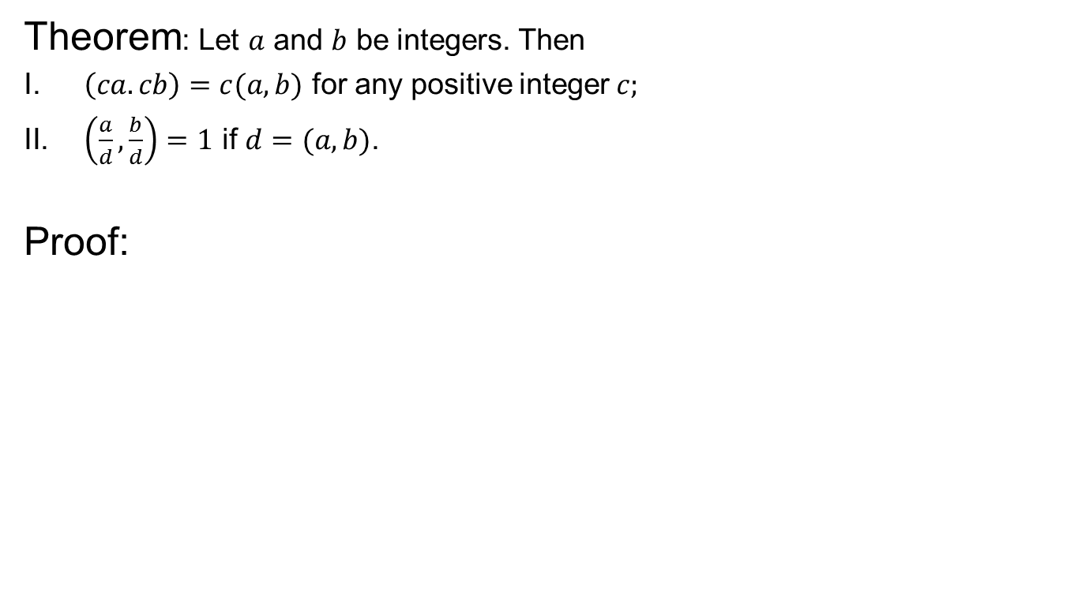
G.C.D and mulitples
Theorem: Let $a$ and $b$ be integers. Then
$\left(ca.cb\right)=c(a,b)$ for any positive integer$c;$
$\left(\frac{a}{d},\frac{b}{d}\right)=1$ if $d=(a,b)$.
Proof:

Slide 25
G.C.D and Multiples
Examples

Slide 26
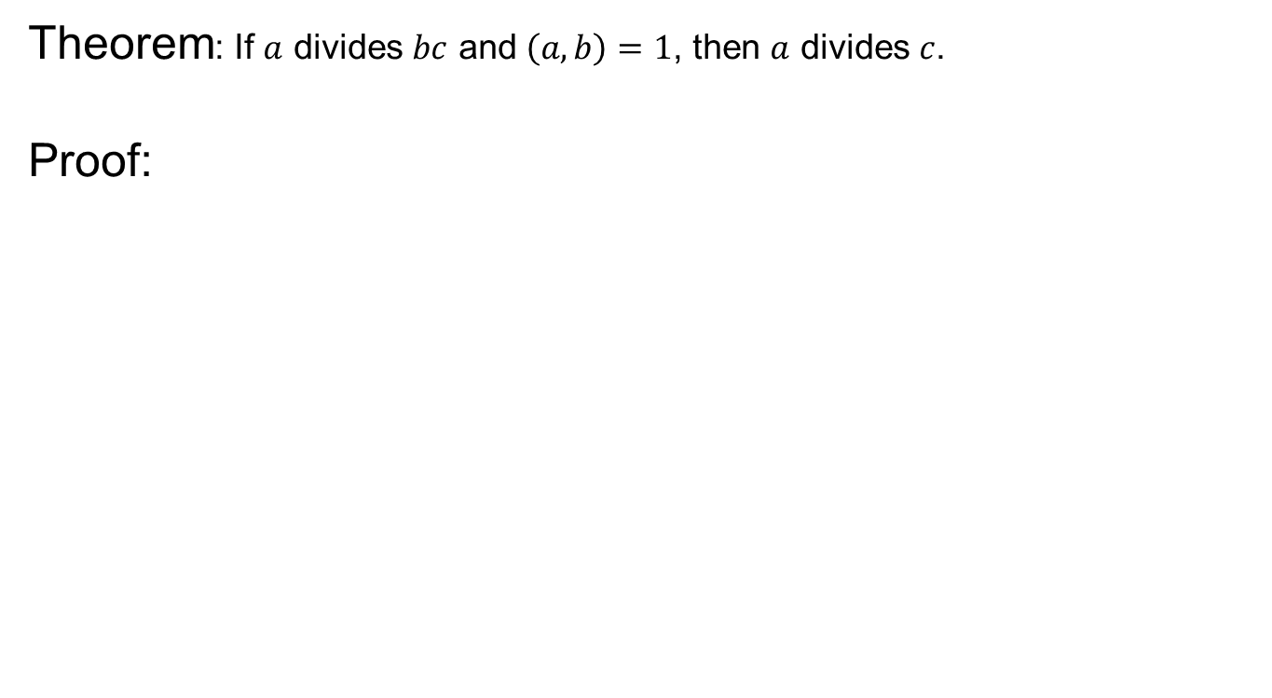
G.C.D & Mulitples
Theorem: If $a$ divides $bc$ and $\left(a,b\right)=1$, then $a$ divides $c$.
Proof:

Slide 27
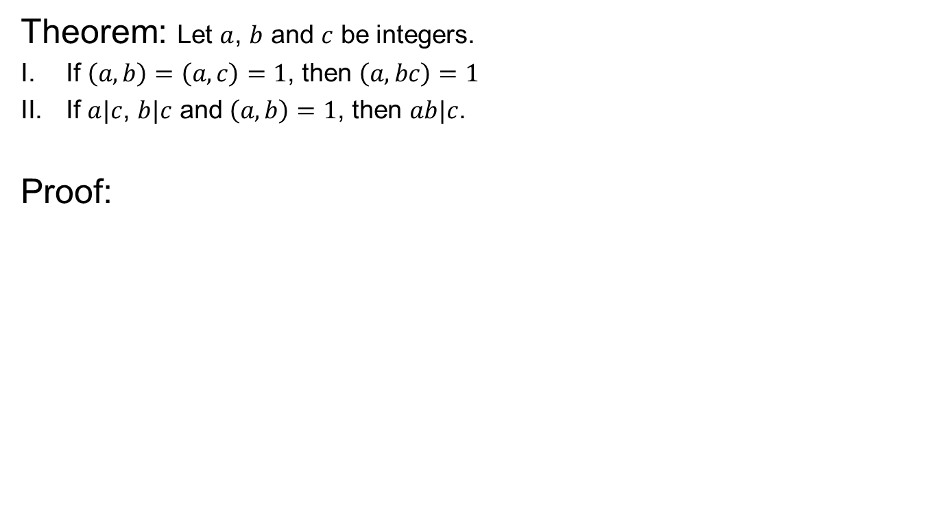
G.C.D & Multiples
Theorem: Let $a$, $b$ and $c$ be integers.
If $\left(a,b\right)=\left(a,c\right)=1$, then $\left(a,bc\right)=1$
If $a|c$, $b|c$ and $\left(a,b\right)=1$, then $ab|c$.
Proof:

Slide 28
G.C.D & Multiples

Slide 29
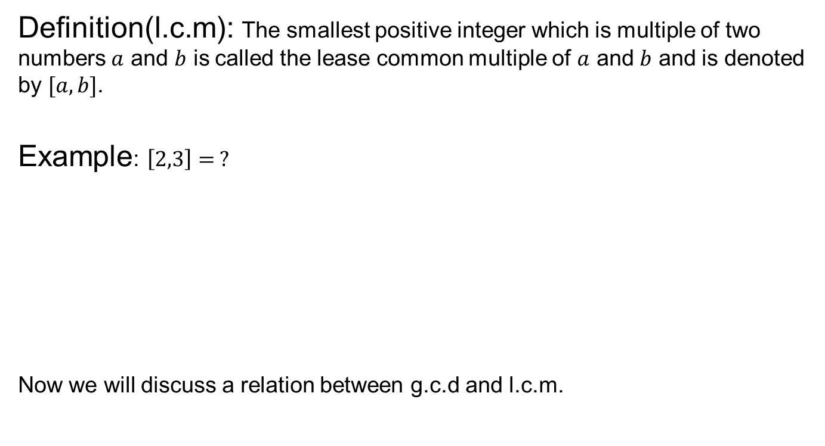
Least Common Multiple
Definition(l.c.m): The smallest positive integer which is multiple of two numbers $a$ and $b$ is called the lease common multiple of $a$ and $b$ and is denoted by $[a,b]$.
Example: $\left[2,3\right]= ?$
Now we will discuss a relation between g.c.d and l.c.m.

Slide 30
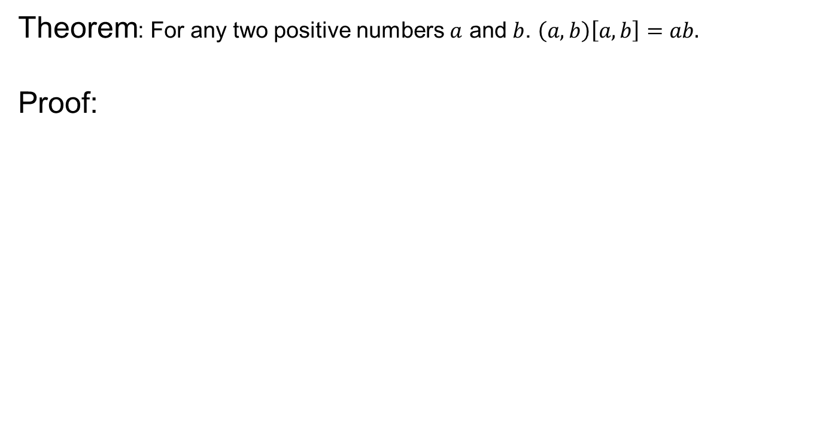
G.C.D and L.C.M
Theorem: For any two positive numbers $a$ and $b$. $\left(a,b\right)\left[a,b\right]=ab.$
Proof:

Slide 31
G.C.D and L.C.M

Slide 32
G.C.D and L.C.M
With the help of the equation in previous result we can find l.cm if we can calculate the g.c.d of two given numbers.
Example:

Slide 33
Review of the Lecture 1
Divisibility
Properties of Divisibility
Division Algorithm
G.C.D and its properties
G.C.D and Linear Combination

