Slide 1
Introduction To Hilbert Spaces
Lokenath Debnath and Piotr Mikusinski
Course Teacher: Dr. Amjad Hussain

Slide 2
Summary of the Last Lecture
In our last lecture, we studied the convergence almost everywhere and fundamental convergence theorems like monotone convergence theorem, Lebesgue dominated convergence theorem, and Fatou’s lemma.

Slide 3
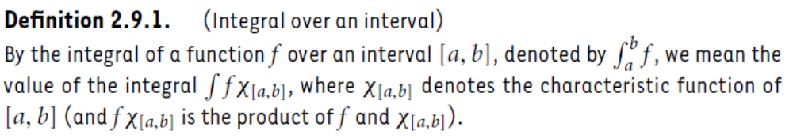
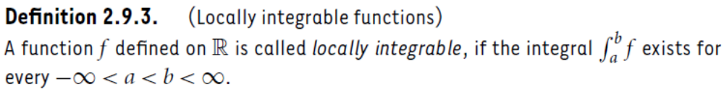
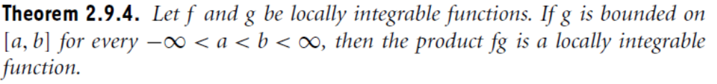
Locally integrable function
Definition
Definition
Theorem 1

Slide 4
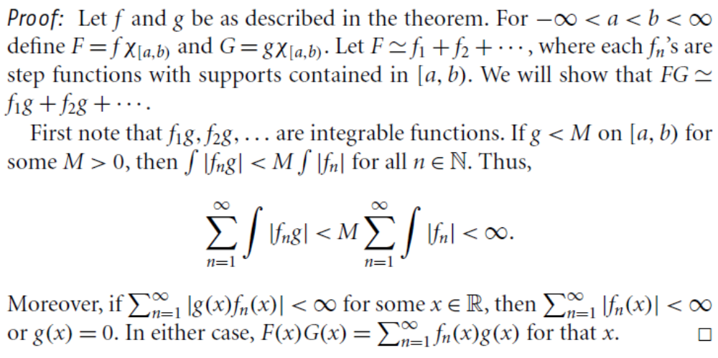

Slide 5
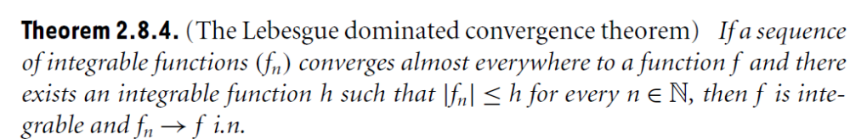
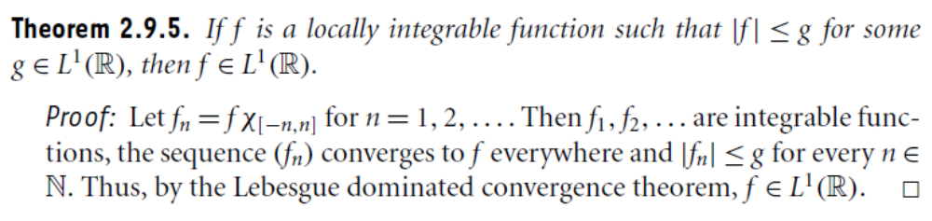
Theorem A
Theorem 2

Slide 6
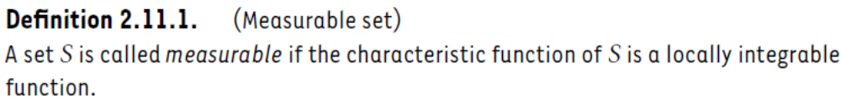
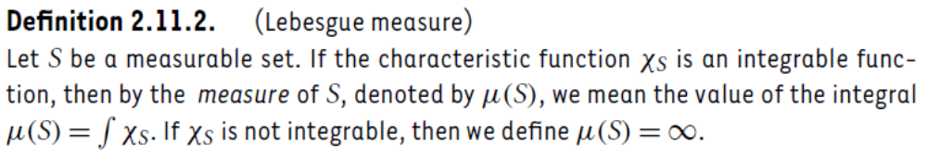
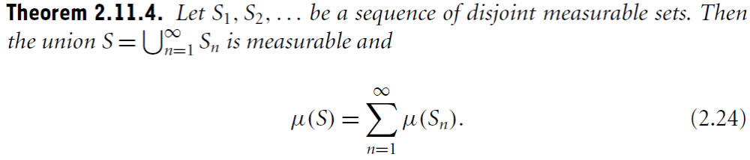
Measureable Set
Definition
Definition
Theorem 3
(1)

Slide 7
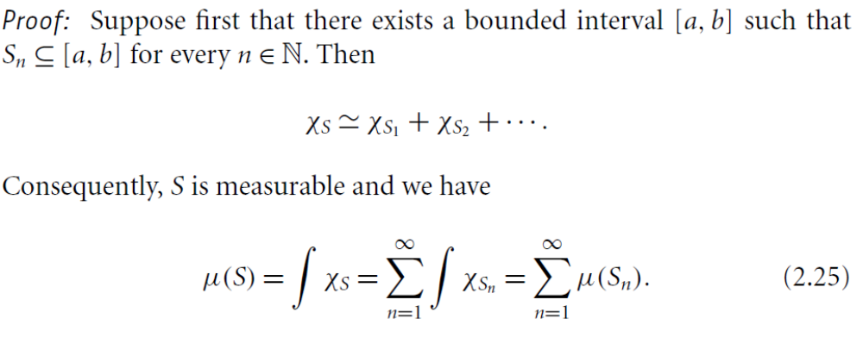
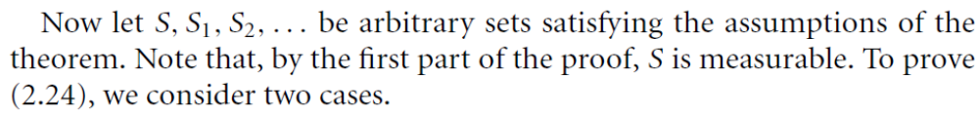
(2)
(1),

Slide 8
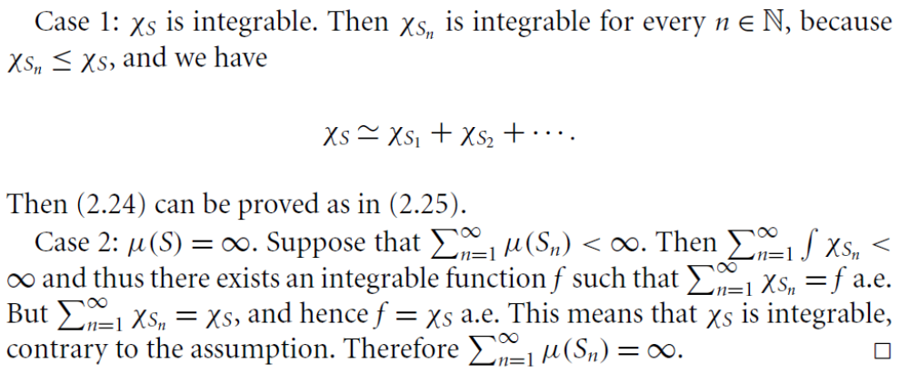
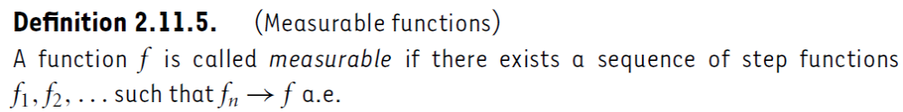
(1)
(2)
Definition

Slide 9
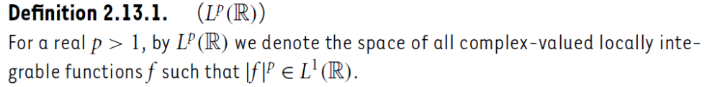
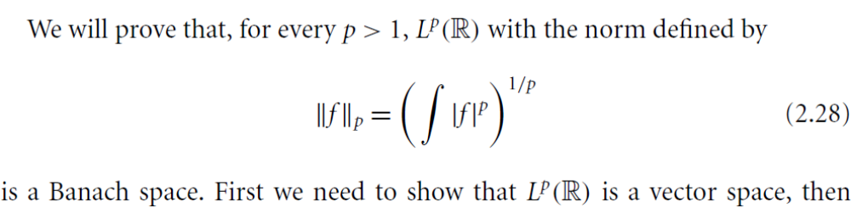
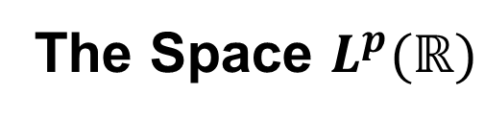
The Space $L^{p}(ℝ)$
Definition
(3)
(3)

Slide 10
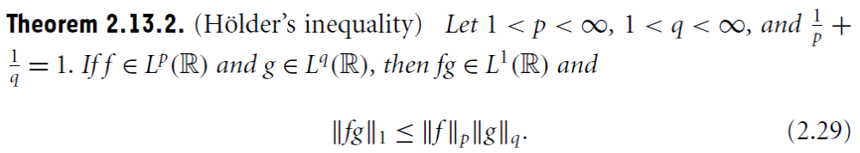
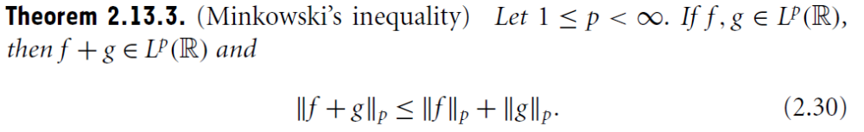
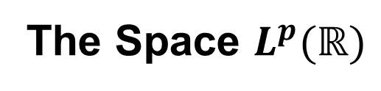
The Space $L^{p}(ℝ)$
Theorem 4
(4)
Theorem 5
(5)

Slide 15
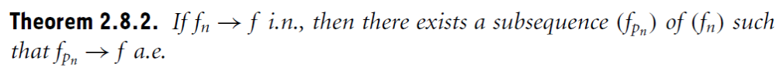
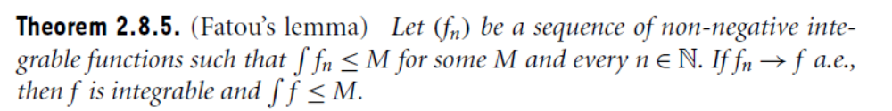
Some Theorems from Lecture 8

Slide 16
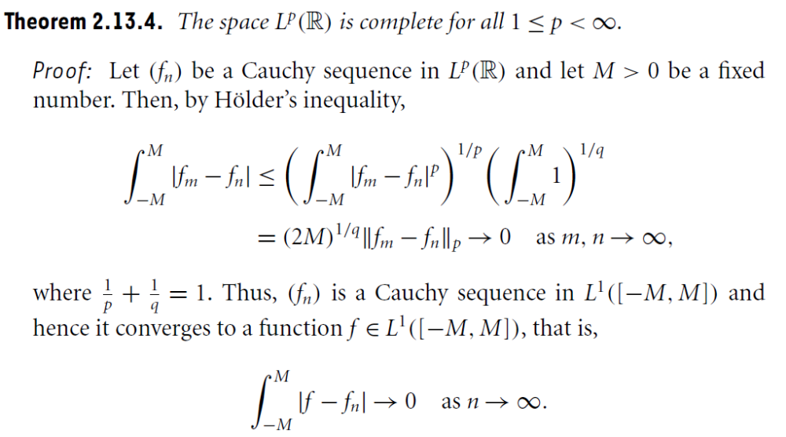

Slide 17
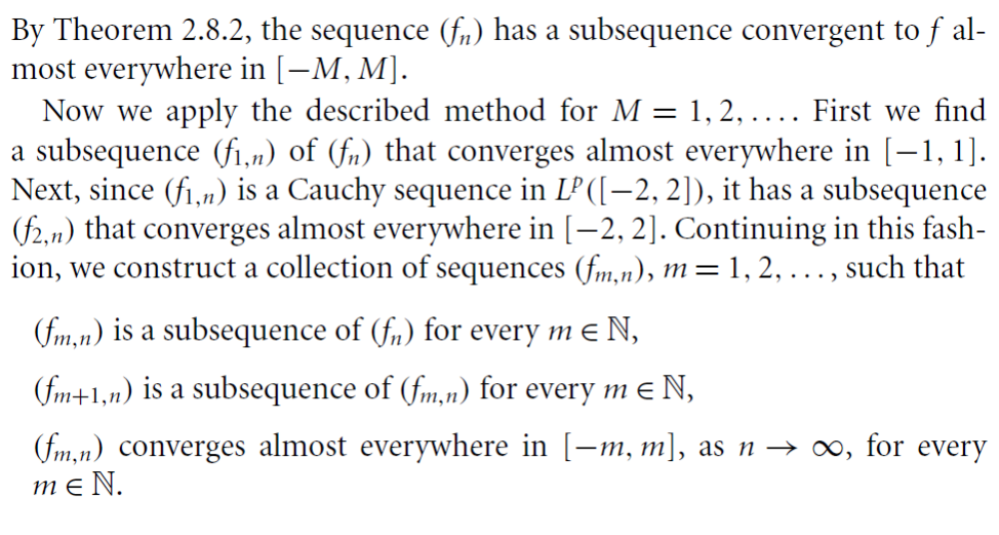

Slide 18
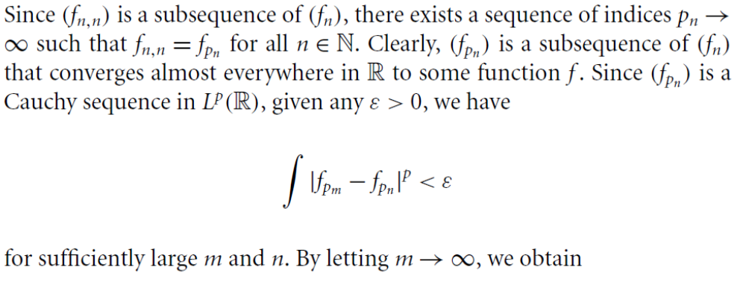

Slide 19
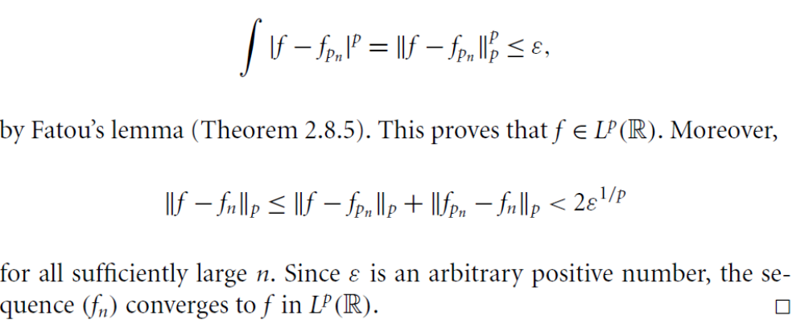

Slide 20
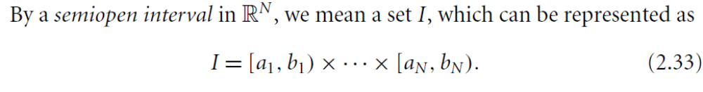
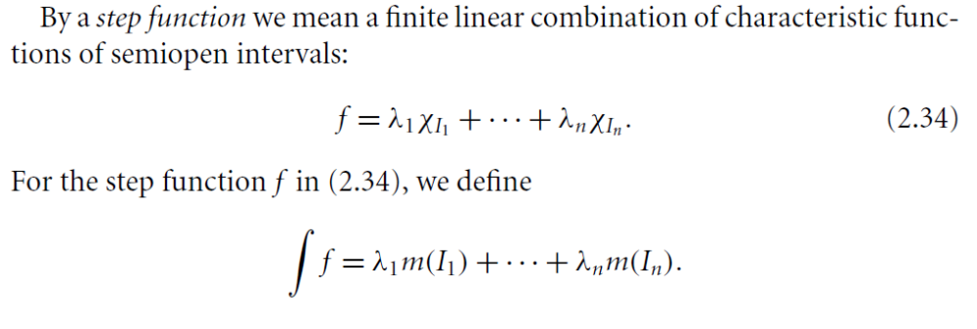
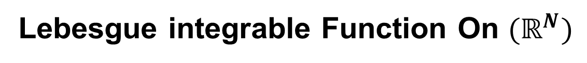
Lebesgue integrable Function On $(ℝ^{N})$
(4)
(5)

Slide 21
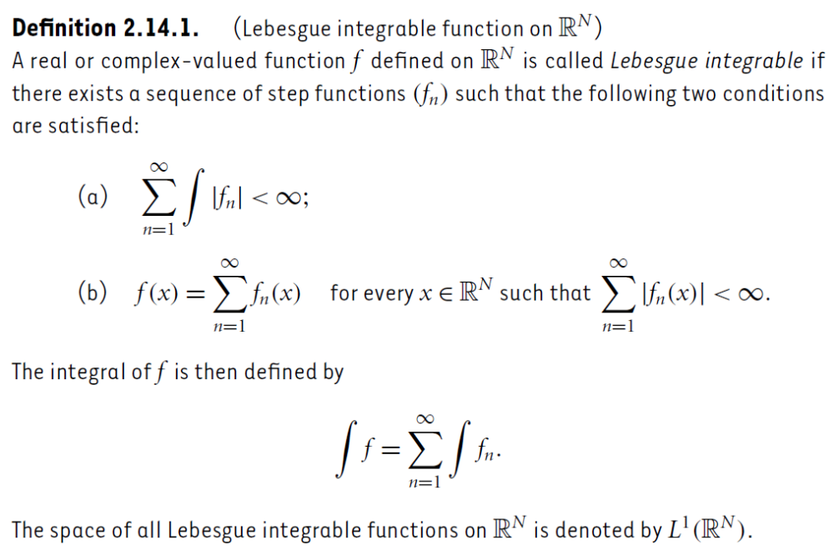
Definition

Slide 22
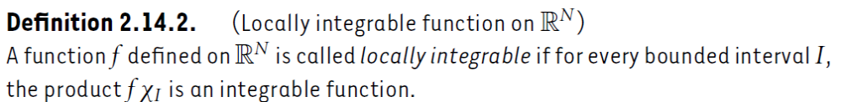
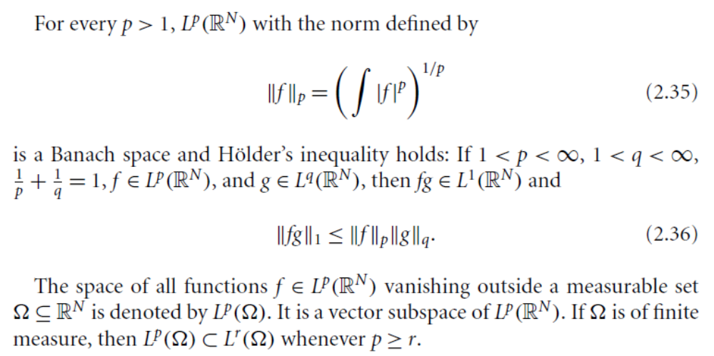
Definition
(6)
(7)

Slide 23
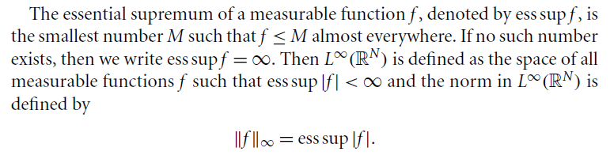

Slide 24
Summary of the today’s Lecture
In our today’s lecture, we discussed measurable sets and Lebesgue measure the proved Holder’s and Minkowski’s inequalities in Lp(R) space. Also define Lebesgue mearable function on R^N.

