Slide 1
Introduction To Hilbert Spaces
Lokenath Debnath and Piotr Mikusinski
Course Teacher: Dr. Amjad Hussain

Slide 2
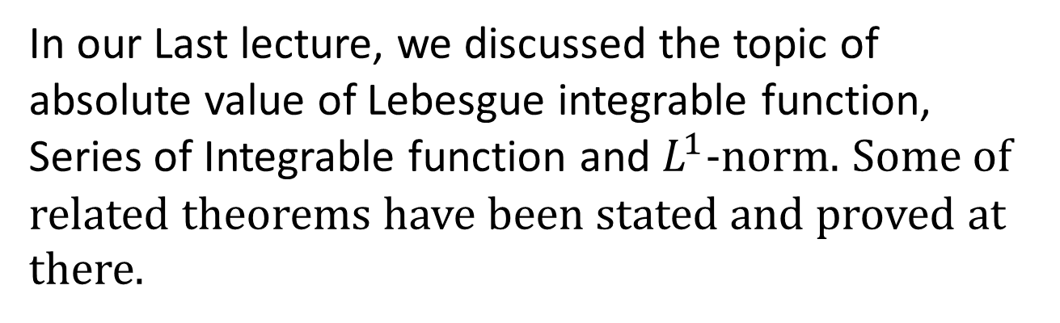
Summary of the Last Lecture
In our Last lecture, we discussed the topic of absolute value of Lebesgue integrable function, Series of Integrable function and $L^{1}$-norm. Some of related theorems have been stated and proved at
there.

Slide 3
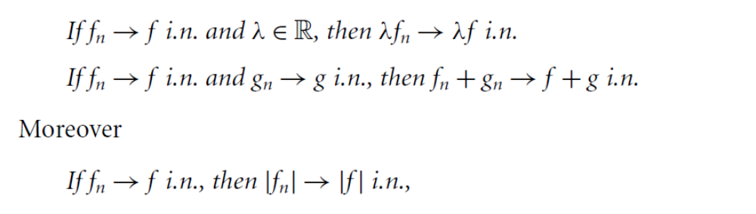
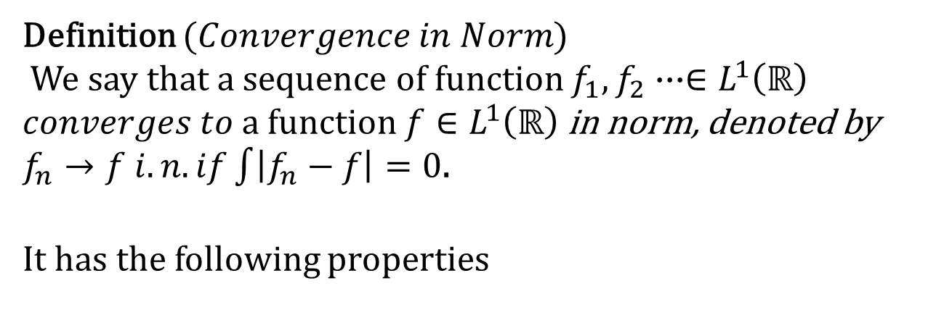
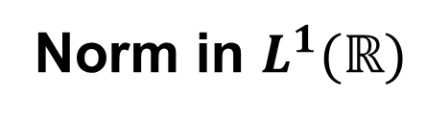
Norm in $L^{1}(ℝ)$
Definition ($Convergence in Norm$)
We say that a sequence of function $f_{1},f_{2}∙∙∙∈L^{1}\left(ℝ\right)$
$converges to$a function $f∈L^{1}\left(ℝ\right)$ in norm, denoted by
$f_{n}→f i.n. if\int{\left|f_{n}−f\right|}=0$.
It has the following properties

Slide 4
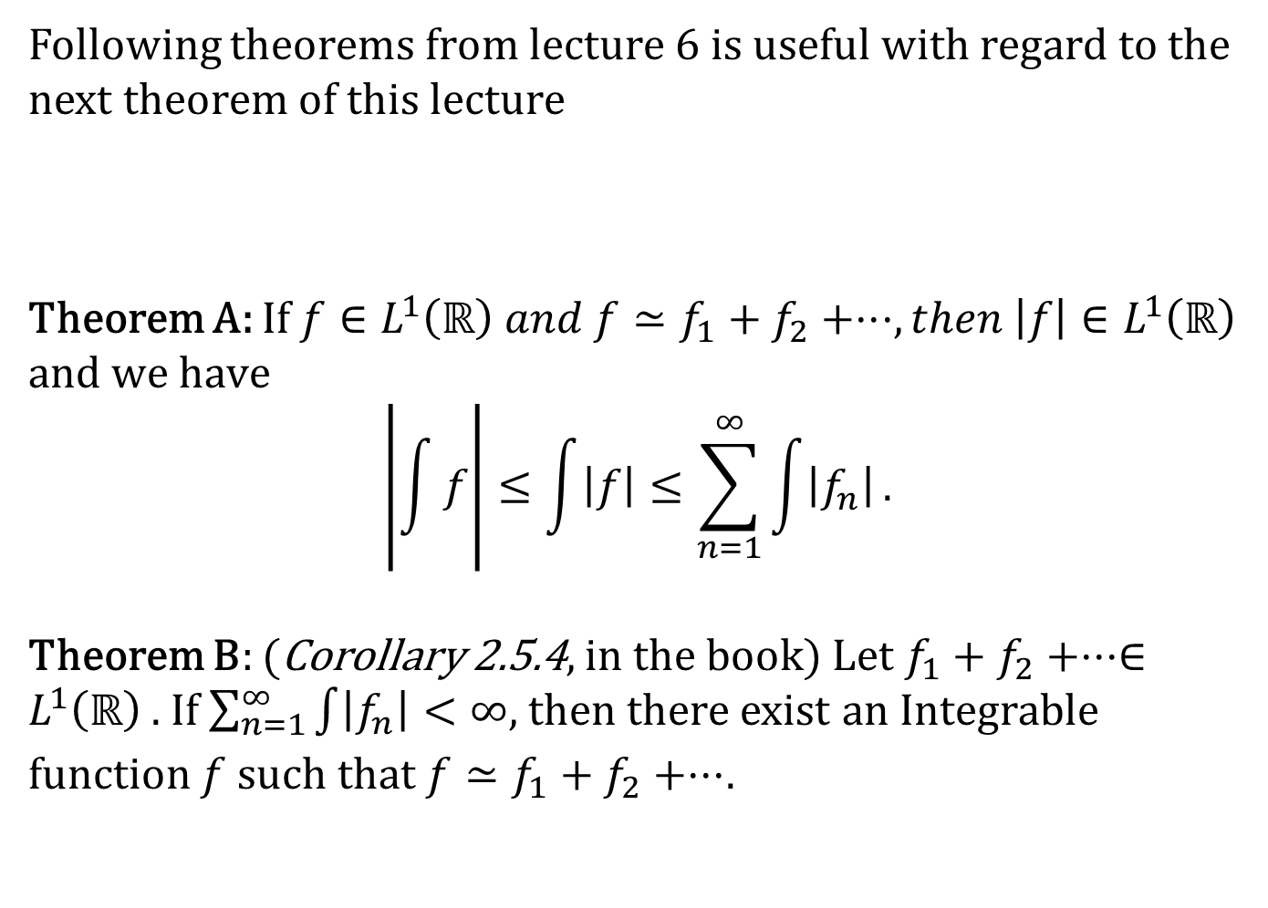
Following theorems from lecture 6 is useful with regard to the next theorem of this lecture
Theorem A: If $f∈L^{1}\left(ℝ\right) and f≃f_{1}+f_{2}+⋅⋅⋅, then \left|f\right|∈L^{1}\left(ℝ\right)$
$$and we have$$
$$\left|\int{f}\right|≤\int{\left|f\right|}≤\sum_{n=1}^{∞}{\int{\left|f_{n}\right|}}.$$
Theorem B: (Corollary 2.5.4, in the book) Let $f_{1}+f_{2}+⋅⋅⋅∈L^{1}\left(ℝ\right)$. If $\sum_{n=1}^{∞}{\int{\left|f_{n}\right|}}<∞$, then there exist an Integrable function $f$ such that $f≃f_{1}+f_{2}+⋅⋅⋅$.

Slide 5
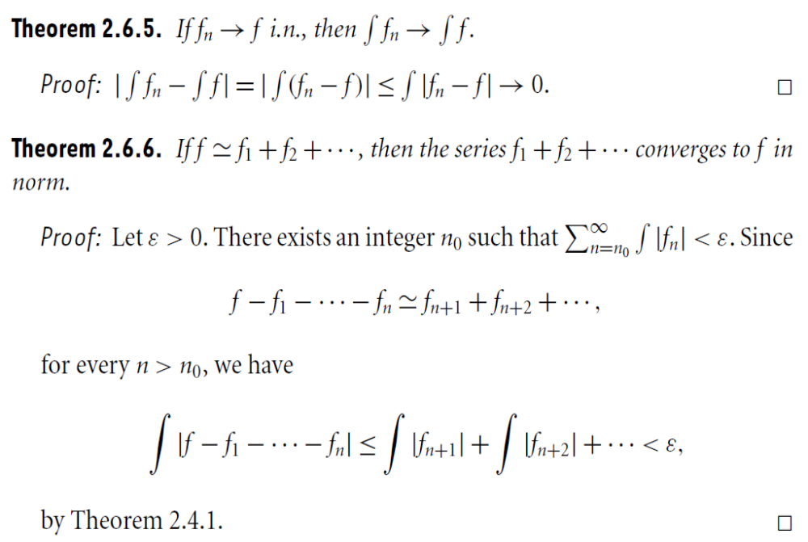
Theorem 1
Theorem 2
By Theorem A

Slide 6
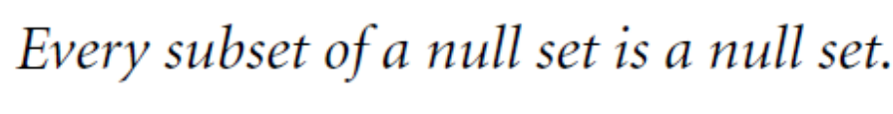
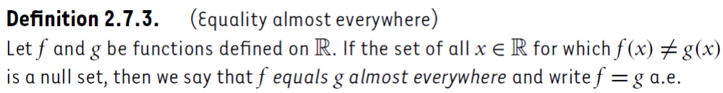

Convergence Almost Everywhere
Definition
($Null set$)
Theorem 3
Definition
$$(Equality almost everwhere)$$

Slide 7
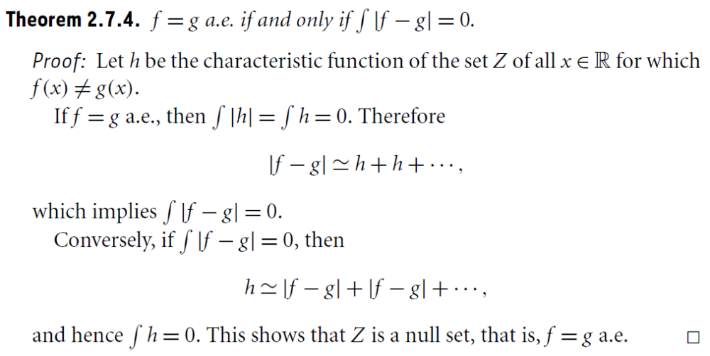
Theorem 4

Slide 8
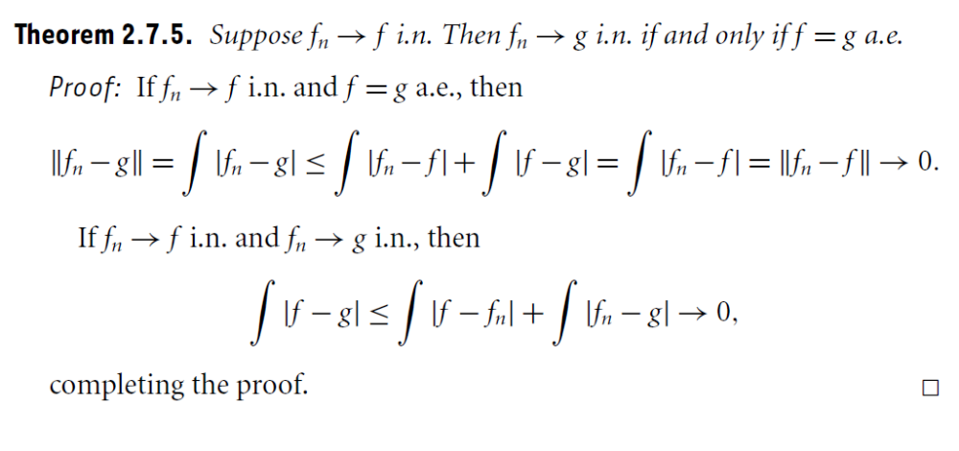
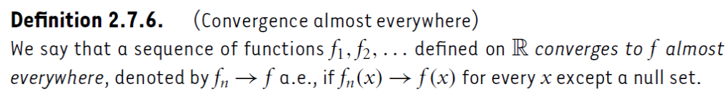
Theorem 5
Definition
$$(Convergence almost everwhere)$$
$$Note:Convergence almosteverywher has properties$$
similar to convergence in norm

Slide 9
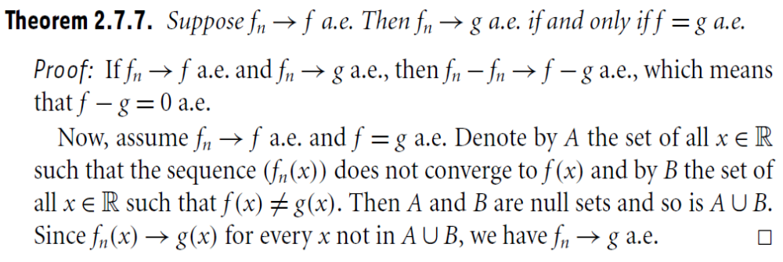
Theorem 6

Slide 10
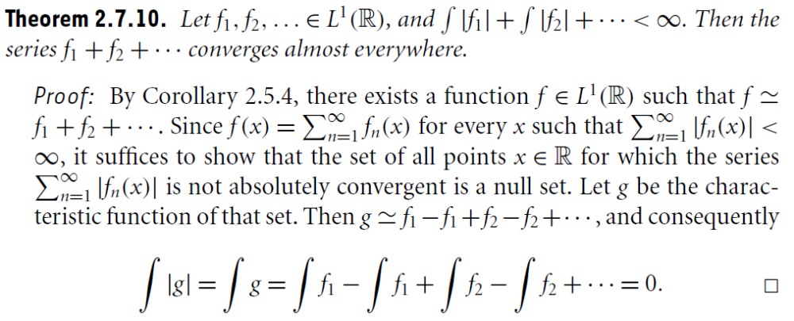
Theorem 7
Corollary 1
Theorem 8

Slide 11
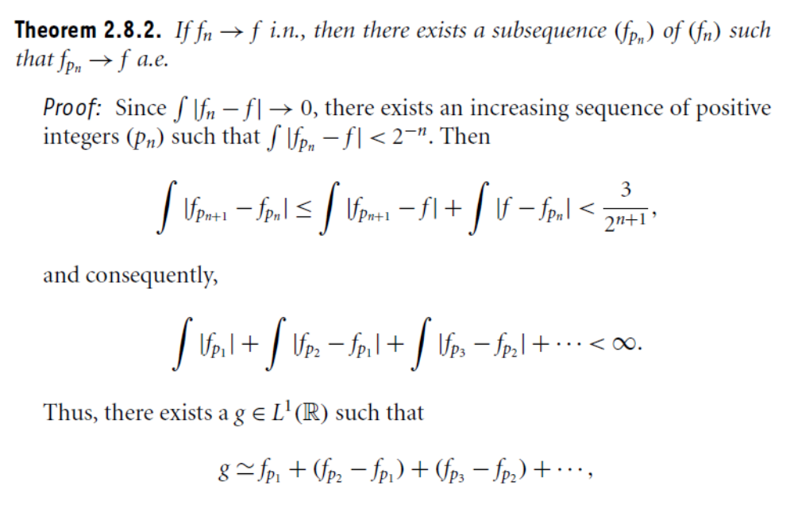
Fundamental Convergence Theorem
Theorem 9
Theorem 10

Slide 12
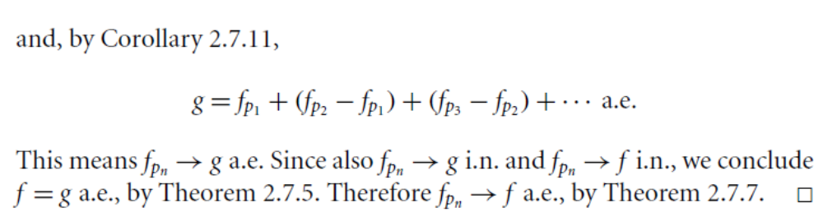
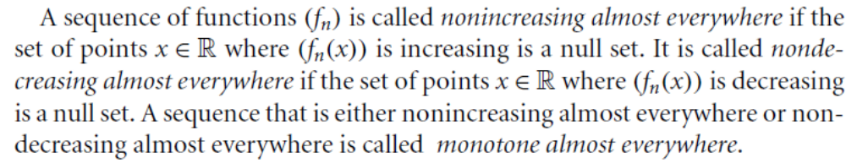
A,
5.
6.
Definition
$$(monotone almost everwhere)$$

Slide 13
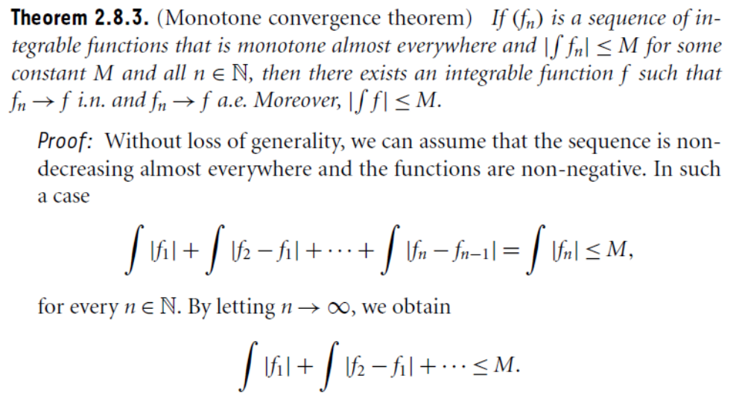
Theorem 11

Slide 14
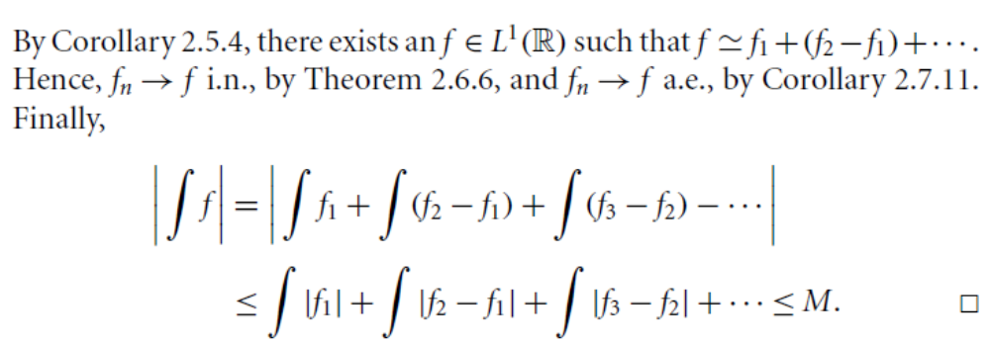
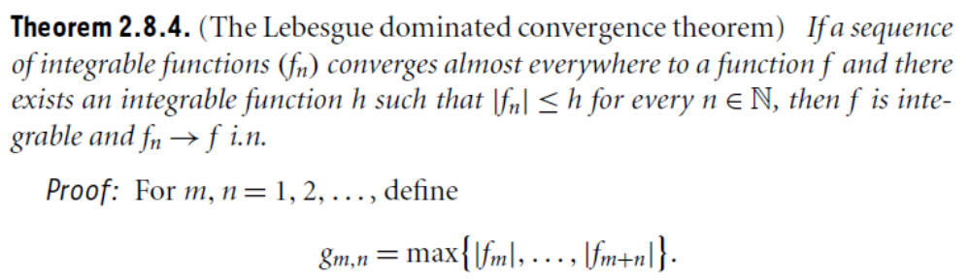
A,
2,
1.
Theorem 12

Slide 15
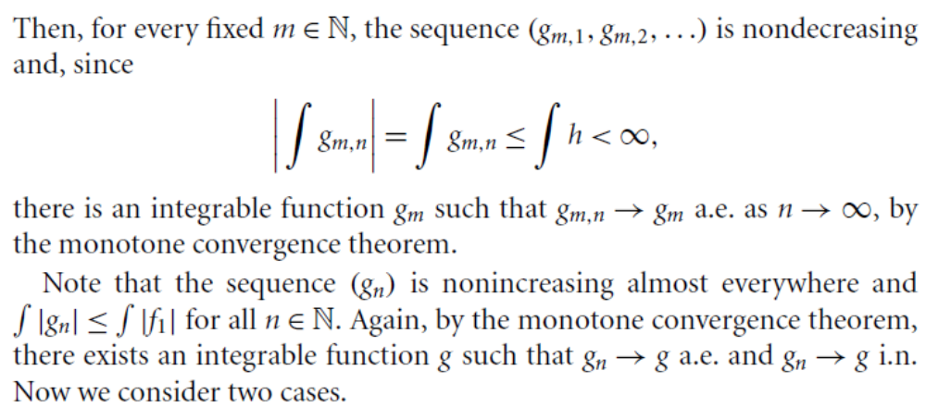

Slide 16
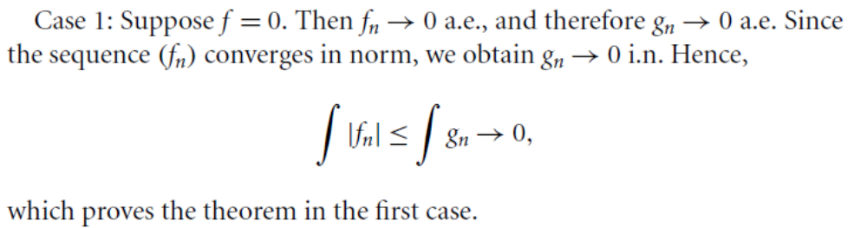

Slide 17
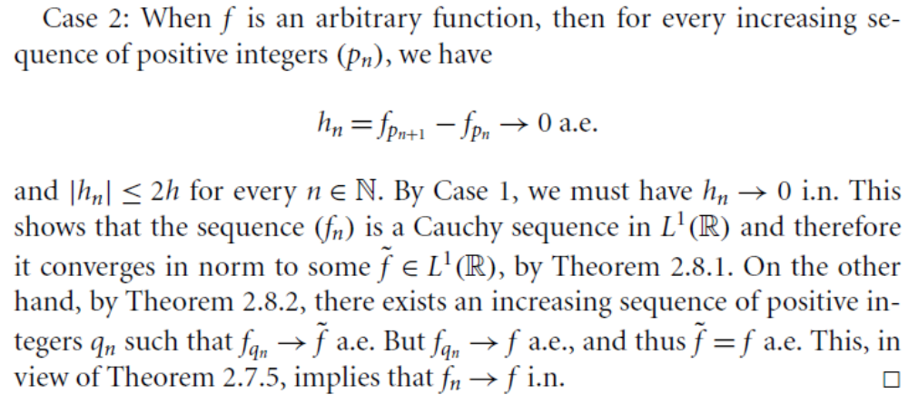
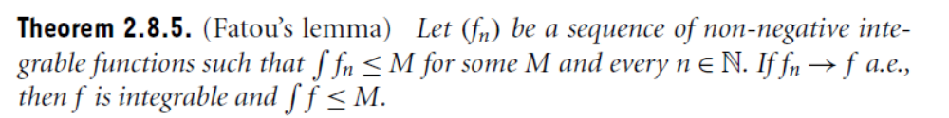
9.
10,
5,
Theorem 13

Slide 18
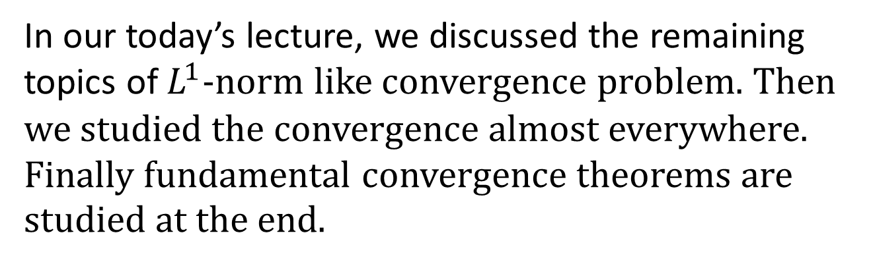
Summary of the today’s Lecture
In our today’s lecture, we discussed the remaining topics of $L^{1}$-norm like convergence problem. Then we studied the convergence almost everywhere. Finally fundamental convergence theorems are studied at the end.

