Slide 1
Introduction To Hilbert Spaces
Lokenath Debnath and Piotr Mikusinski
Course Teacher: Dr. Amjad Hussain

Slide 2
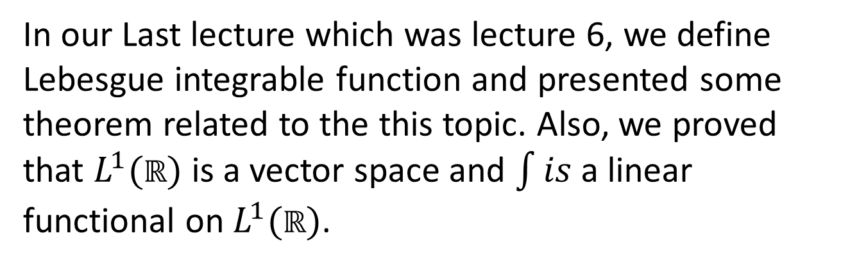
Summary of the Last Lecture
In our Last lecture which was lecture 6, we define Lebesgue integrable function and presented some theorem related to the this topic. Also, we proved that $L^{1}(ℝ)$is a vector space and $\int{is}$ a linear functional on $L^{1}(ℝ)$.

Slide 3
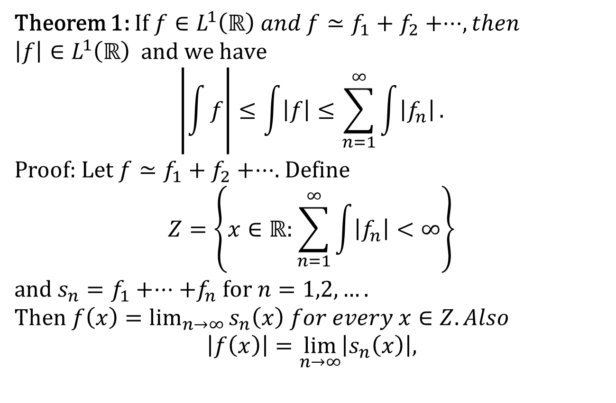
Absolute Value of an Integrable Function
Theorem 1: If $f∈L^{1}\left(ℝ\right) and f≃f_{1}+f_{2}+⋅⋅⋅, then$
$$\left|f\right|∈L^{1}\left(ℝ\right) and we have$$
$$\left|\int{f}\right|≤\int{\left|f\right|}≤\sum_{n=1}^{∞}{\int{\left|f_{n}\right|}}.$$
Proof: Let $f≃f_{1}+f_{2}+⋅⋅⋅$. Define
$$Z=\left\{x∈ℝ:\sum_{n=1}^{∞}{\int{\left|f_{n}\right|}}<∞\right\}$$
and $s_{n}=f_{1}+⋅⋅⋅+f_{n} for n=1,2,….$
Then $f\left(x\right)=\lim_{n→∞}{s_{n}\left(x\right) for every x∈Z. Also}$
$$\left|f\left(x\right)\right|=\lim_{n→∞}\left|s_{n}\left(x\right)\right|,$$

Slide 4
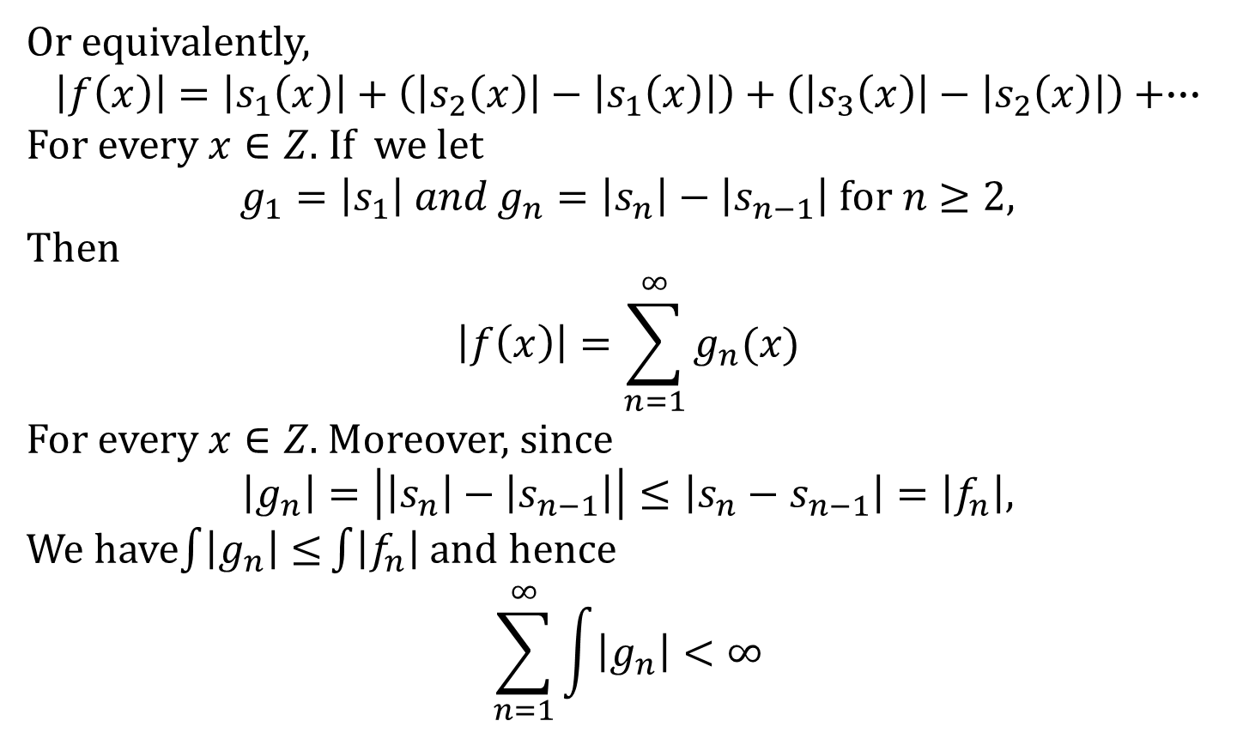
Or equivalently,
$$\left|f\left(x\right)\right|=\left|s_{1}\left(x\right)\right|+\left(\left|s_{2}\left(x\right)\right|−\left|s_{1}\left(x\right)\right|\right)+\left(\left|s_{3}\left(x\right)\right|−\left|s_{2}\left(x\right)\right|\right)+∙∙∙$$
For every $x∈Z$. If we let
$g_{1}=\left|s_{1}\right| and g_{n}=\left|s_{n}\right|−\left|s_{n−1}\right| for n≥2$,
Then
$$\left|f\left(x\right)\right|=\sum_{n=1}^{∞}{g_{n}(x)}$$
For every $x∈Z.$ Moreover, since
$$\left|g_{n}\right|=\left|\left|s_{n}\right|−\left|s_{n−1}\right|\right|≤\left|s_{n}−s_{n−1}\right|=\left|f_{n}\right|,$$
We have$\int{\left|g_{n}\right|≤}\int{\left|f_{n}\right|}$ and hence
$$\sum_{n=1}^{∞}{\int{\left|g_{n}\right|}}<∞$$

Slide 6
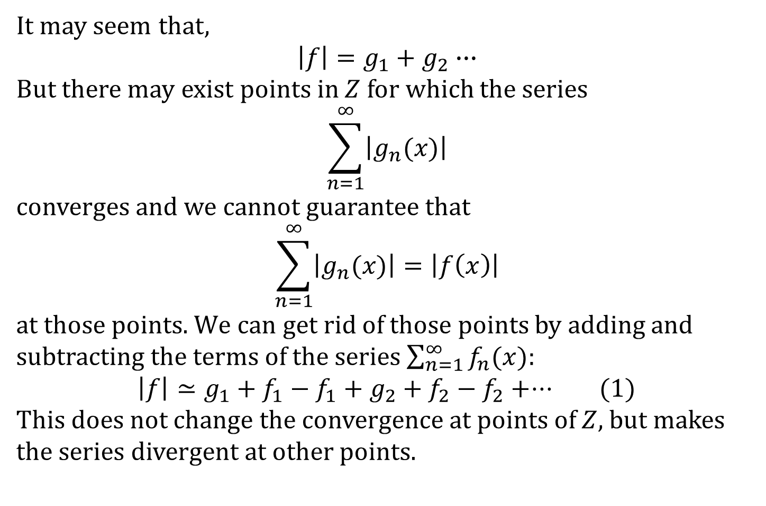
It may seem that,
$$\left|f\right|=g_{1}+g_{2}∙∙∙$$
But there may exist points in $Z$ for which the series
$$\sum_{n=1}^{∞}{\left|g_{n}(x)\right|}$$
converges and we cannot guarantee that
$$\sum_{n=1}^{∞}{\left|g_{n}(x)\right|}=\left|f\left(x\right)\right|$$
at those points. $We$ can get rid of those points by adding and subtracting the terms of the series$\sum_{n=1}^{∞}{f_{n}(x)}$:
$\left|f\right|≃g_{1}+f_{1}−f_{1}+g_{2}+f_{2}−f_{2}+⋅⋅⋅$ (1)
This does not change the convergence at points of $Z$, but makes the series divergent at other points.

Slide 7
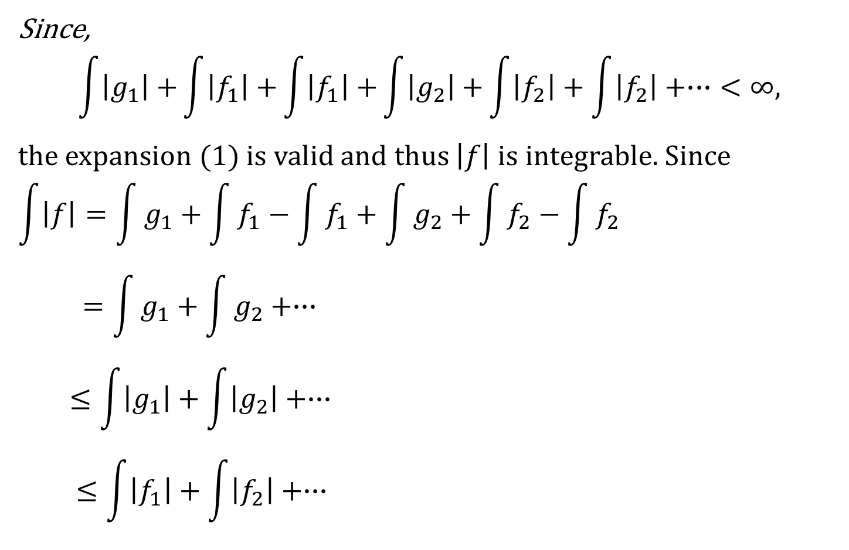
Since,
$$\int{\left|g_{1}\right|+}\int{\left|f_{1}\right|+}\int{\left|f_{1}\right|+}\int{\left|g_{2}\right|+}\int{\left|f_{2}\right|+\int{\left|f_{2}\right|+∙∙∙}}<∞,$$
the expansion (1) is valid and thus $\left|f\right|$ is integrable.Since
$$\int{\left|f\right|}=\int{g_{1}}+\int{f_{1}}−\int{f_{1}}+\int{g_{2}}+\int{f_{2}}−\int{f_{2}}$$
$$=\int{g_{1}}+\int{g_{2}}+∙∙∙$$
$$≤\int{\left|g_{1}\right|}+\int{\left|g_{2}\right|}+∙∙∙$$
$$≤\int{\left|f_{1}\right|}+\int{\left|f_{2}\right|}+∙∙∙$$

Slide 8
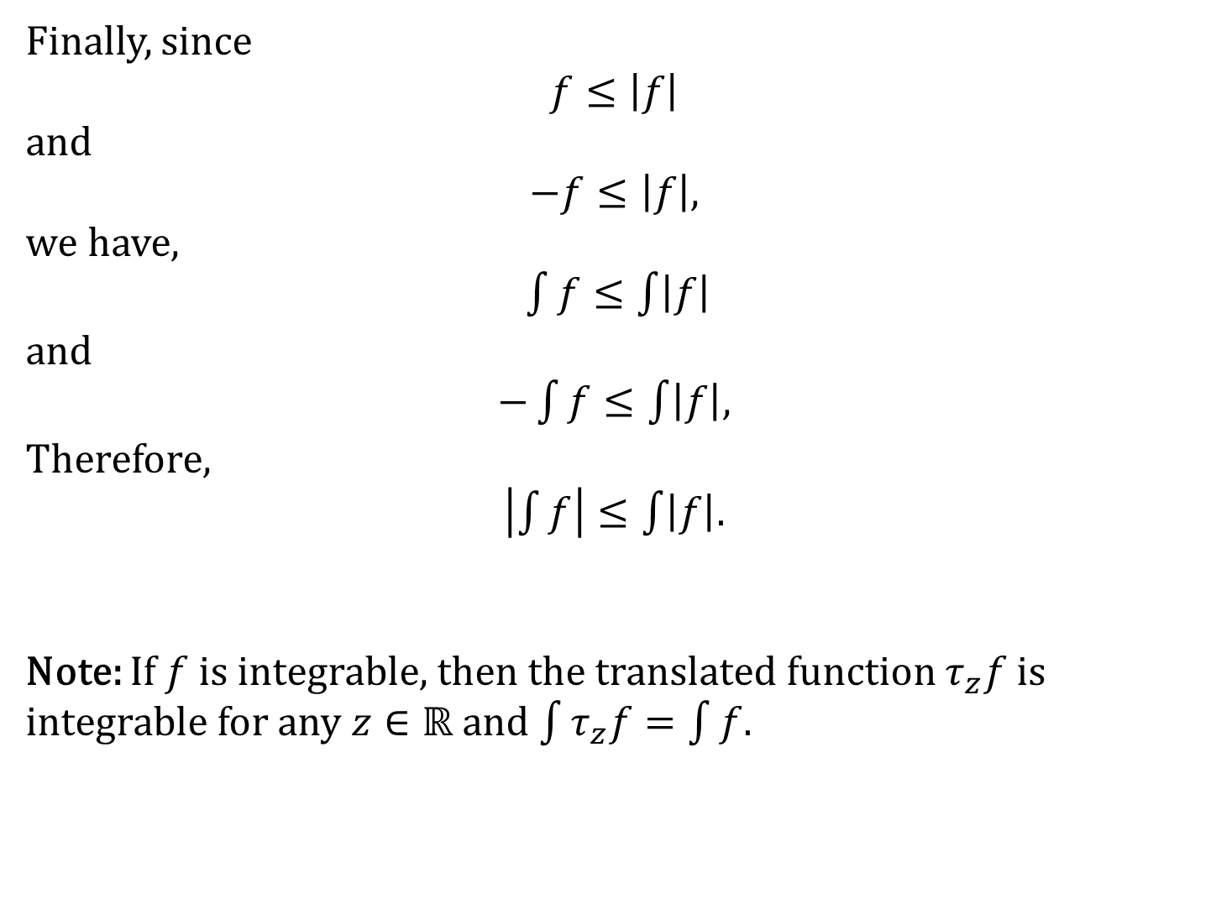
Finally, since
$$f≤\left|f\right|$$
and
$−f≤\left|f\right|$,
we have,
$\int{f≤\int{\left|f\right|}}$
and
$−\int{f≤\int{\left|f\right|}}$,
Therefore,
$\left|\int{f}\right|≤\int{\left|f\right|}$.
Note: If $f$ is integrable, then the translated function $τ_{z}f$ is integrable for any $z∈ℝ$ and $\int{τ_{z}f=\int{f}}$.

Slide 9
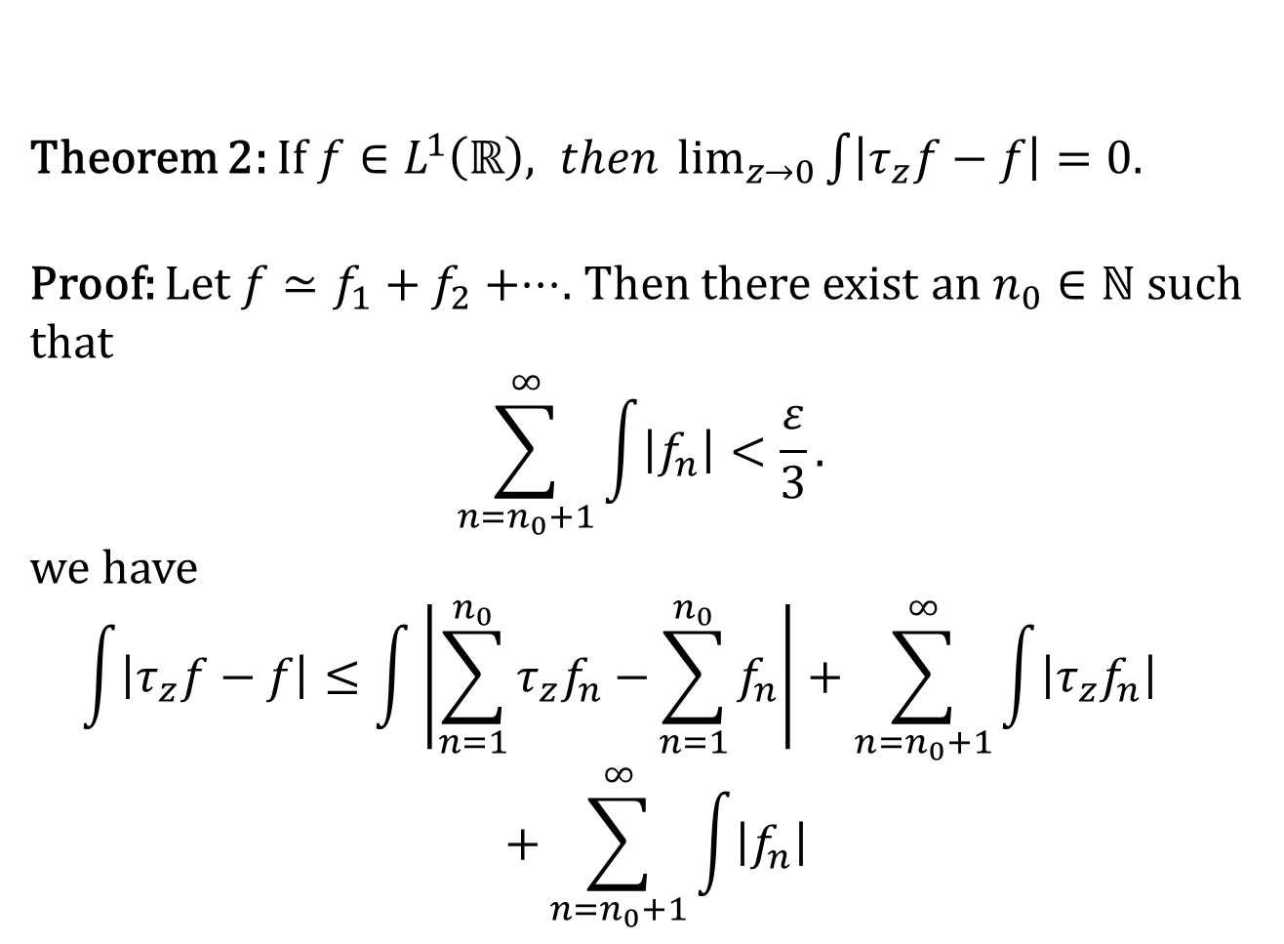
Theorem 2: If $f∈L^{1}\left(ℝ\right), then \lim_{z→0}{\int{\left|τ_{z}f−f\right|=0.}}$
Proof: Let $f≃f_{1}+f_{2}+⋅⋅⋅$. Then there exist an $n_{0}∈ℕ$ such that
$$\sum_{n=n_{0}+1}^{∞}{\int{\left|f_{n}\right|}}<\frac{ε}{3}.$$
we have
$$\int{\left|τ_{z}f−f\right|≤\int{\left|\sum_{n=1}^{n_{0}}{τ_{z}f_{n}−}\sum_{n=1}^{n_{0}}{f_{n}}\right|}}+\sum_{n=n_{0}+1}^{∞}{\int{\left|τ_{z}f_{n}\right|}}$$
$$+\sum_{n=n_{0}+1}^{∞}{\int{\left|f_{n}\right|}}$$

Slide 12
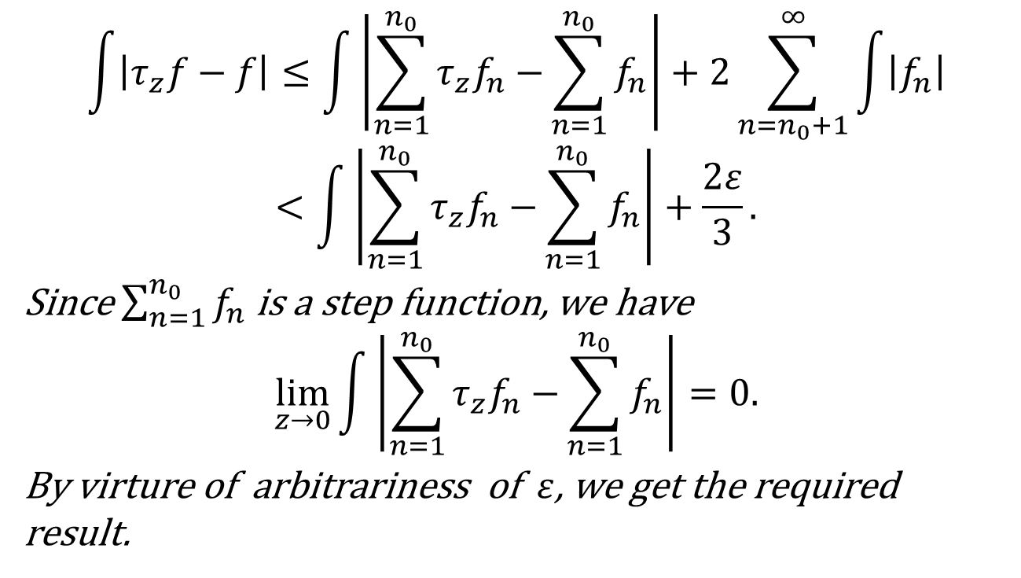
$$\int{\left|τ_{z}f−f\right|≤\int{\left|\sum_{n=1}^{n_{0}}{τ_{z}f_{n}−}\sum_{n=1}^{n_{0}}{f_{n}}\right|}}+2\sum_{n=n_{0}+1}^{∞}{\int{\left|f_{n}\right|}}$$
$$<\int{\left|\sum_{n=1}^{n_{0}}{τ_{z}f_{n}−}\sum_{n=1}^{n_{0}}{f_{n}}\right|}+\frac{2ε}{3}.$$
Since $\sum_{n=1}^{n_{0}}{f_{n}}$ is a step function, we have
$$\lim_{z→0}{\int{\left|\sum_{n=1}^{n_{0}}{τ_{z}f_{n}−}\sum_{n=1}^{n_{0}}{f_{n}}\right|=0.}}$$
By virture of arbitrariness of $ε$, we get the required result.

Slide 13
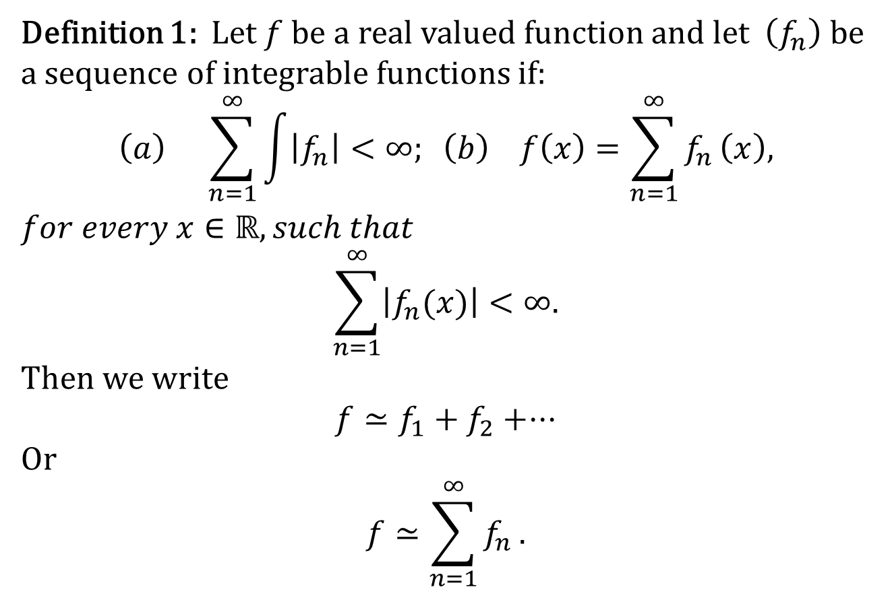
Series of Integrable Functions
Definition 1: Let $f$be a real valued function and let $\left(f_{n}\right)$ be a sequence of integrable functions if:
$$\left(a\right) \sum_{n=1}^{∞}{\int{\left|f_{n}\right|}}<∞; \left(b\right) f\left(x\right)=\sum_{n=1}^{∞}{f_{n}}\left(x\right),$$
$$for every x∈ℝ, such that$$
$$\sum_{n=1}^{∞}{\left|f_{n}(x)\right|}<∞.$$
Then we write
$$f≃f_{1}+f_{2}+⋅⋅⋅$$
Or
$$f≃\sum_{n=1}^{∞}{f_{n}}.$$

Slide 14
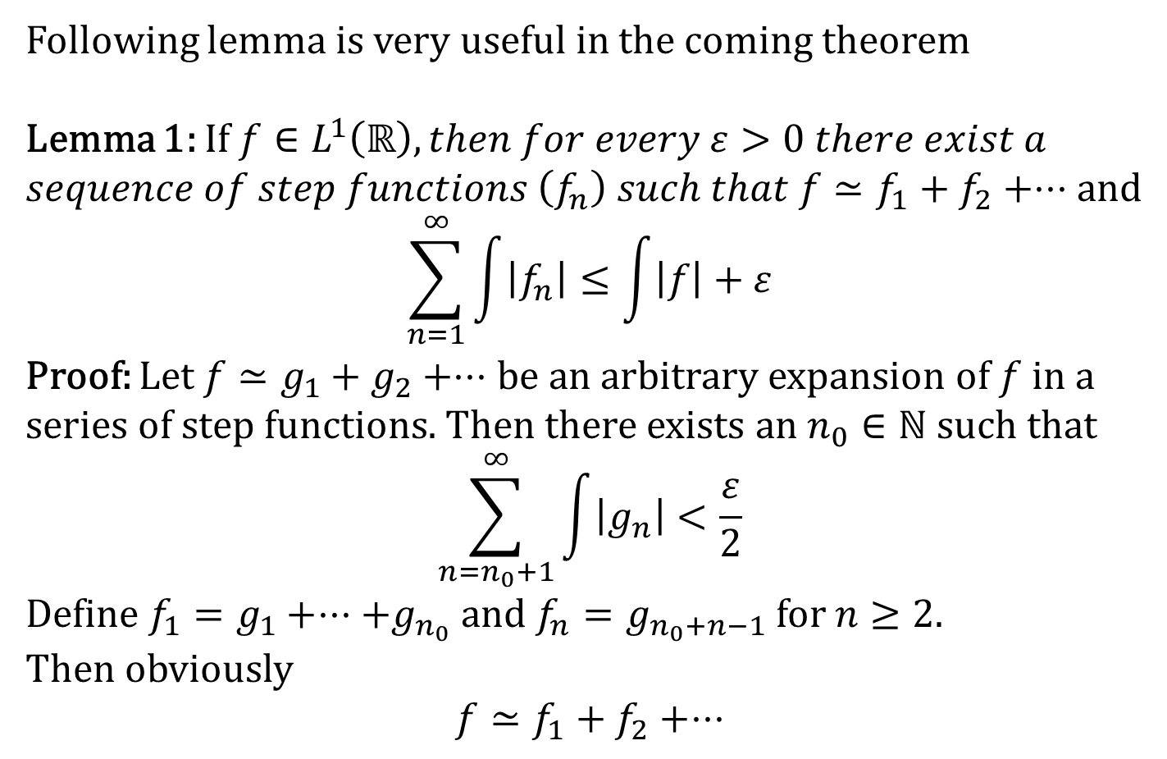
Following lemma is very useful in the coming theorem
Lemma 1: If $f∈L^{1}\left(ℝ\right), then for every ε>0 there exist a$
$sequence of step functions \left(f_{n}\right) such that f≃f_{1}+f_{2}+⋅⋅⋅$ and
$$\sum_{n=1}^{∞}{\int{\left|f_{n}\right|}}≤\int{\left|f\right|}+ε$$
Proof: Let $f≃g_{1}+g_{2}+⋅⋅⋅$ be an arbitrary expansion of $f$in a series of step functions. Then there exists an $n_{0}∈ℕ$such that
$$\sum_{n=n_{0}+1}^{∞}{\int{\left|g_{n}\right|}<\frac{ε}{2}}$$
Define $f_{1}=g_{1}+⋅⋅⋅+g_{n_{0}}$ and $f_{n}=g_{n_{0}+n−1}$ for $n≥2.$
Then obviously
$$f≃f_{1}+f_{2}+⋅⋅⋅$$

Slide 15
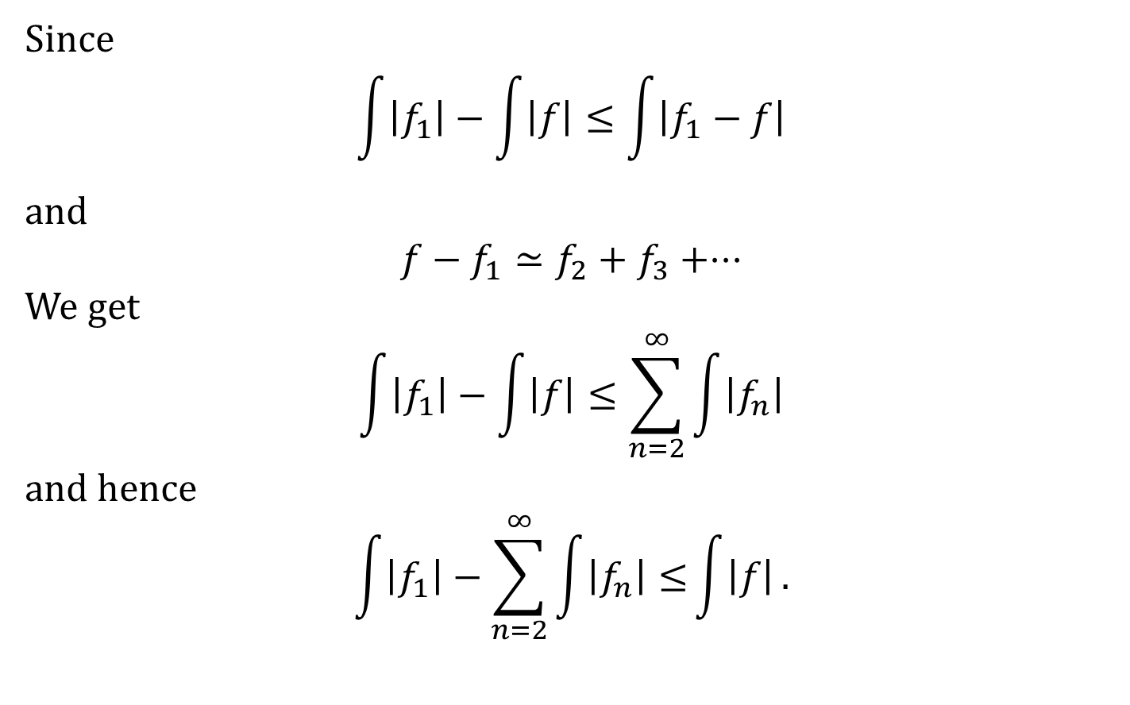
Since
$$\int{\left|f_{1}\right|−\int{\left|f\right|}≤\int{\left|f_{1}−f\right|}}$$
and
$$f−f_{1}≃f_{2}+f_{3}+⋅⋅⋅$$
We get
$$\int{\left|f_{1}\right|−\int{\left|f\right|}≤\sum_{n=2}^{∞}{\int{\left|f_{n}\right|}}}$$
and hence
$$\int{\left|f_{1}\right|−\sum_{n=2}^{∞}{\int{\left|f_{n}\right|}}≤}\int{\left|f\right|}.$$

Slide 16
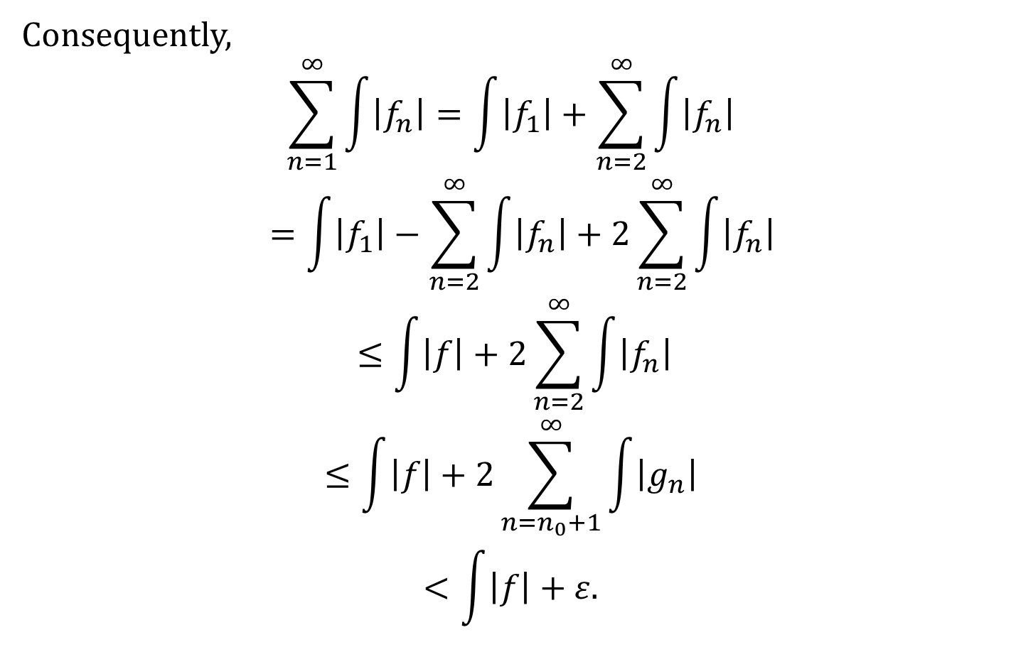
Consequently,
$$\sum_{n=1}^{∞}{\int{\left|f_{n}\right|}}=\int{\left|f_{1}\right|+\sum_{n=2}^{∞}{\int{\left|f_{n}\right|}}}$$
$$=\int{\left|f_{1}\right|−\sum_{n=2}^{∞}{\int{\left|f_{n}\right|}}}+2\sum_{n=2}^{∞}{\int{\left|f_{n}\right|}}$$
$$≤\int{\left|f\right|}+2\sum_{n=2}^{∞}{\int{\left|f_{n}\right|}}$$
$$≤\int{\left|f\right|}+2\sum_{n=n_{0}+1}^{∞}{\int{\left|g_{n}\right|}}$$
$$<\int{\left|f\right|}+ε.$$

Slide 17
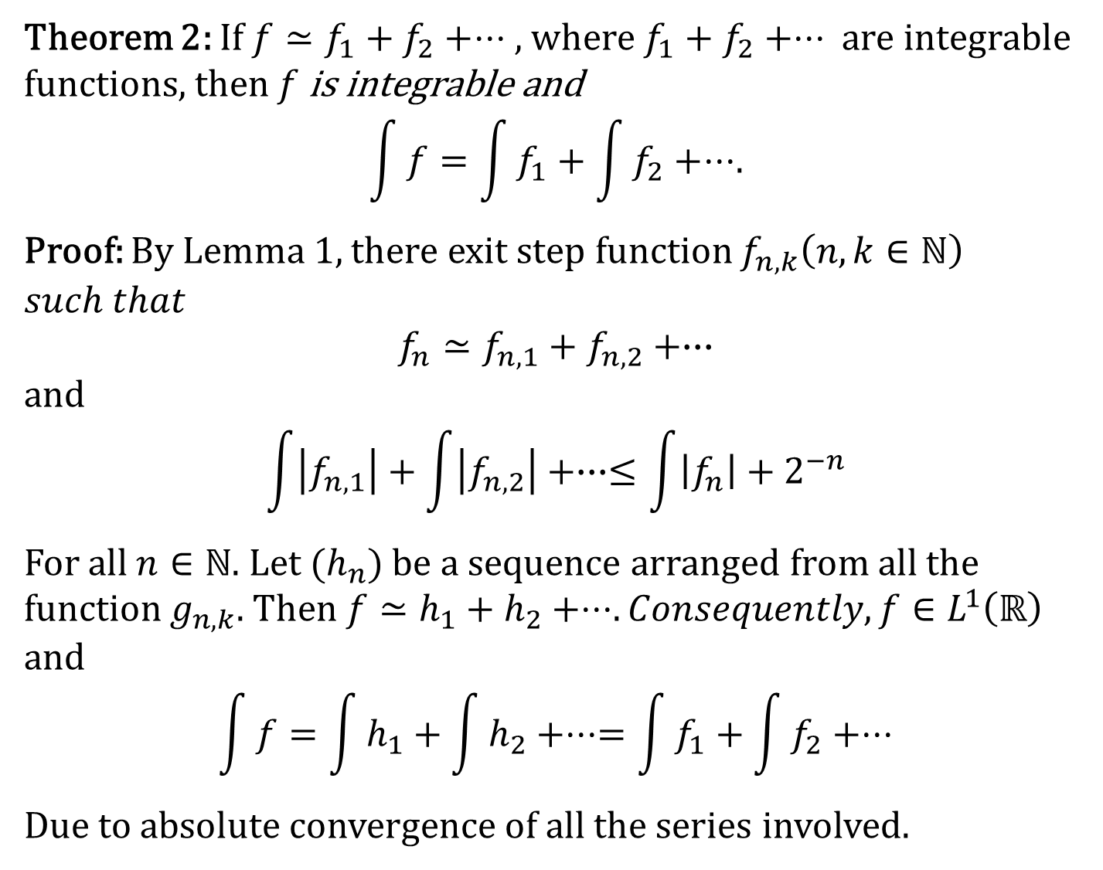
Theorem 2: If $f≃f_{1}+f_{2}+⋅⋅⋅$ , where $f_{1}+f_{2}+⋅⋅⋅$ are integrable functions, then $f$ is integrable and
$$\int{f}=\int{f_{1}}+\int{f_{2}}+⋅⋅⋅.$$
Proof: By Lemma 1, there exit step function $f_{n,k}\left(n,k∈ℕ\right)$$such that$
$f_{n}≃f_{n,1}+f_{n,2}+∙∙∙$
and
$$\int{\left|f_{n,1}\right|}+\int{\left|f_{n,2}\right|}+∙∙∙≤\int{\left|f_{n}\right|}+2^{−n}$$
For all $n∈ℕ$. Let ($h_{n}$) be a sequence arranged from all the function $g_{n,k}$. Then$f≃h_{1}+h_{2}+⋅⋅⋅. Consequently, f∈L^{1}\left(ℝ\right)$
and
$$\int{f}=\int{h_{1}}+\int{h_{2}}+⋅⋅⋅=\int{f_{1}}+\int{f_{2}}+⋅⋅⋅$$
Due to absolute convergence of all the series involved.

Slide 18
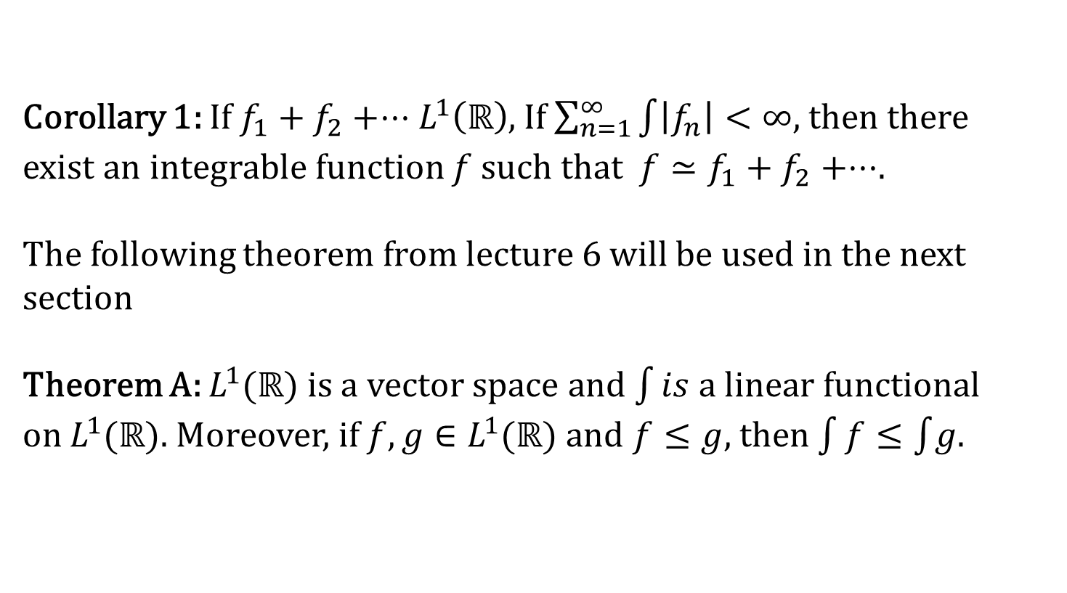
Corollary 1: If $f_{1}+f_{2}+⋅⋅⋅L^{1}\left(ℝ\right)$, If $\sum_{n=1}^{∞}{\int{\left|f_{n}\right|}}<∞$, then there exist an integrable function $f$ such that ${f≃f}_{1}+f_{2}+⋅⋅⋅$.
The following theorem from lecture 6 will be used in the next section
Theorem A:$L^{1}(ℝ)$ is a vector space and $\int{is}$ a linear functional on $L^{1}(ℝ)$. Moreover, if $f,g∈L^{1}(ℝ)$ and $f≤g$, then $\int{f}≤\int{g}$.

Slide 19
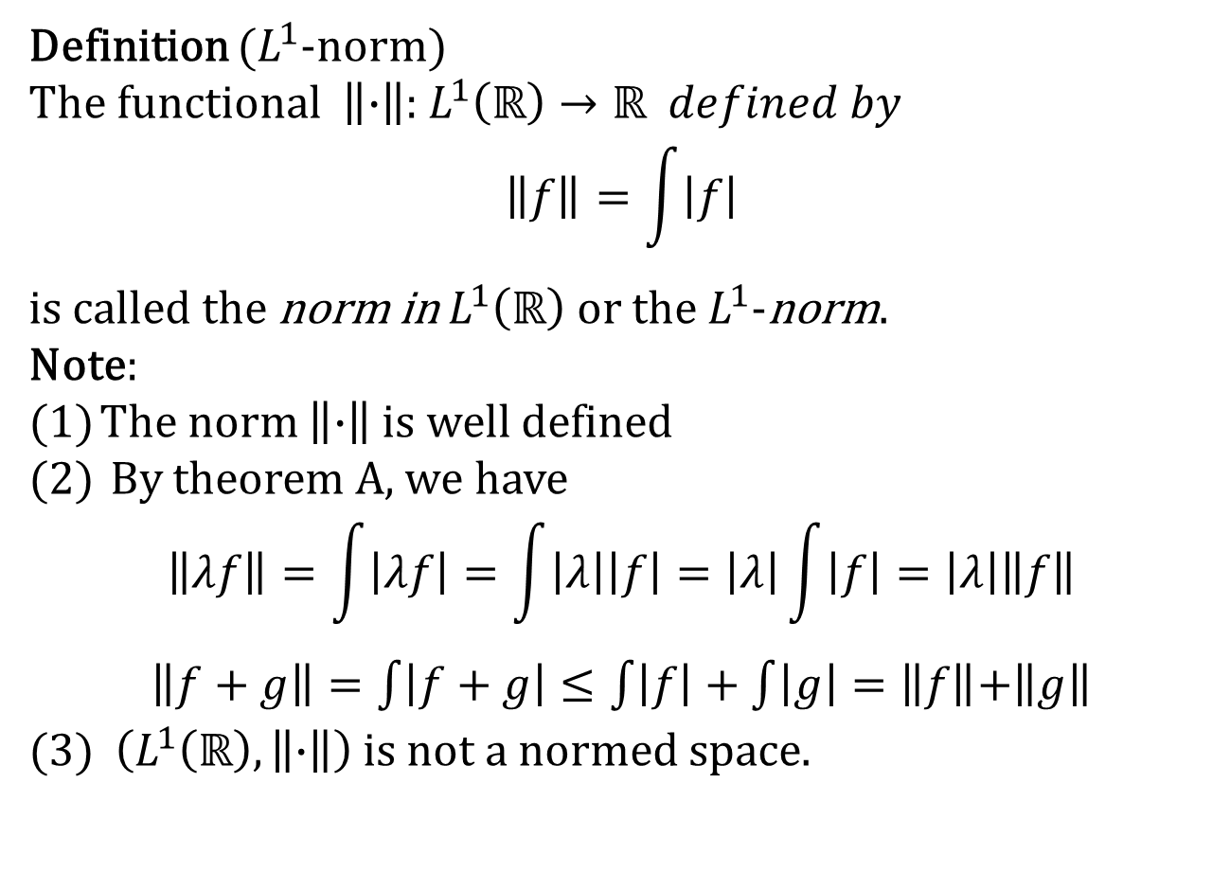

Norm in $L^{1}(ℝ)$
Definition ($L^{1}$-norm)
The functional $\left\|∙\right\|$: $L^{1}\left(ℝ\right)→ℝ defined by$
$$\left\|f\right\|=\int{\left|f\right|}$$
is called the norm in $L^{1}\left(ℝ\right)$ or the $L^{1}$-norm.
Note:
The norm $\left\|∙\right\|$ is well defined
By theorem A, we have
$$\left\|λf\right\|=\int{\left|λf\right|}=\int{\left|λ\right|\left|f\right|}=\left|λ\right|\int{\left|f\right|}=\left|λ\right|\left\|f\right\|$$
$\left\|f+g\right\|=\int{\left|f+g\right|}≤\int{\left|f\right|}+\int{\left|g\right|}=\left\|f\right\|$+$\left\|g\right\|$
(3) $\left(L^{1}\left(ℝ\right),\left\|∙\right\|\right)$ is not a normed space.

Slide 20
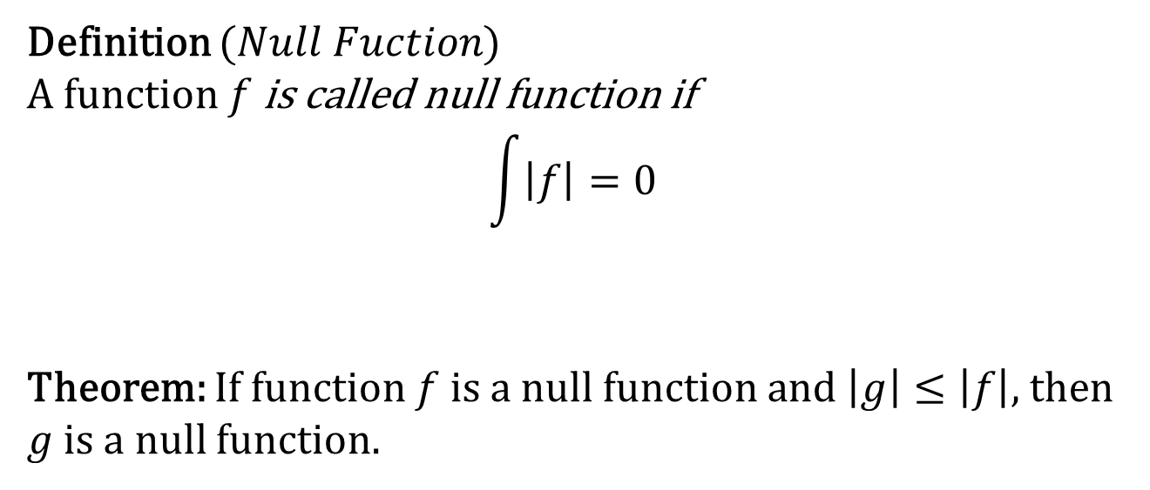
Norm in $L^{1}(ℝ)$
Definition ($Null Fuction$)
A function $f$ is called null function if
$$\int{\left|f\right|}=0$$
Theorem: If function $f$ is a null function and $\left|g\right|≤\left|f\right|$, then
$g$ is a null function.

Slide 21
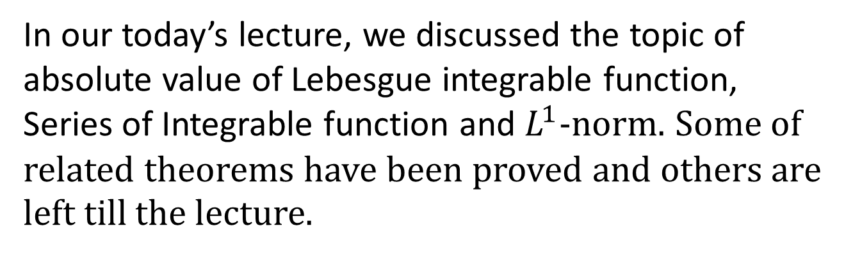
Summary of the today’s Lecture
In our today’s lecture, we discussed the topic of absolute value of Lebesgue integrable function, Series of Integrable function and $L^{1}$-norm. Some of related theorems have been proved and others are left till the lecture.

