Slide 1
Introduction To Hilbert Spaces
Lokenath Debnath and Piotr Mikusinski
Course Instructor: Dr. Amjad Hussain

Slide 2
Summary of the Last Lecture
In our last lecture, we presented a theorem related to Linear mapping and then define the Contraction mapping. Fixed point theorem was proved and applied to solve an algebraic equation.
Then we switched to a new chapter named “ The Lebesgue Integral” and define some terminologies.
In this lecture we further elaborate the concept of Lebesgue integrable function.

Slide 3
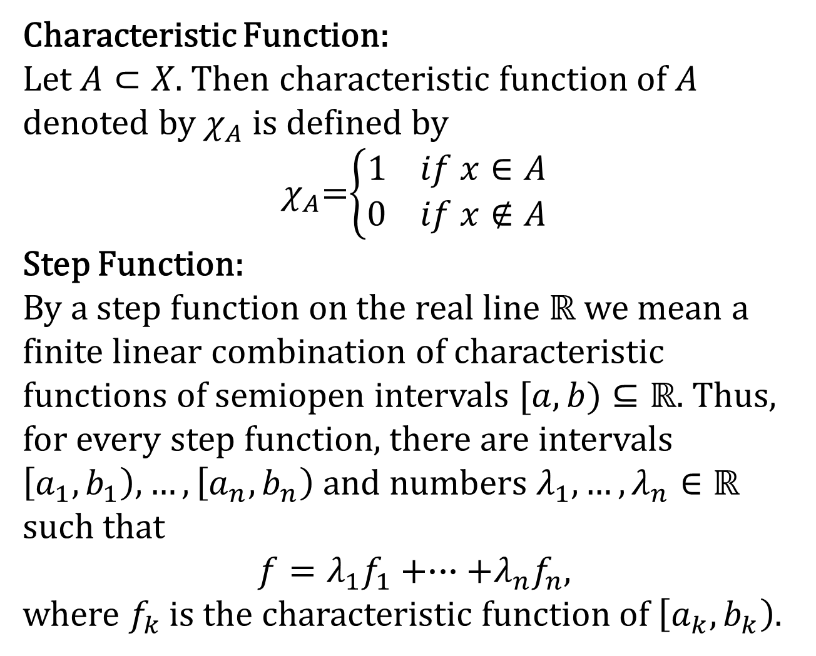
Characteristic Function:
Let $A⊂X$. Then characteristic function of $A$ denoted by $χ_{A}$ is defined by
$χ_{A}$=$\left\{\begin{aligned}1 if x∈A \\ 0 if x∉A\end{aligned}\right.$
Step Function:
By a step function on the real line $ℝ$ we mean a finite linear combination of characteristic functions of semiopen intervals $[a,b)⊆ℝ$. Thus, for every step function, there are intervals $\left[a_{1},b_{1}\right),…,\left[a_{n},b_{n}\right)$ and numbers $λ_{1},…,λ_{n}∈ℝ$
such that
$$f=λ_{1}f_{1}+∙∙∙+λ_{n}f_{n},$$
where $f_{k}$is the characteristic function of $\left[a_{k},b_{k}\right)$.

Slide 4
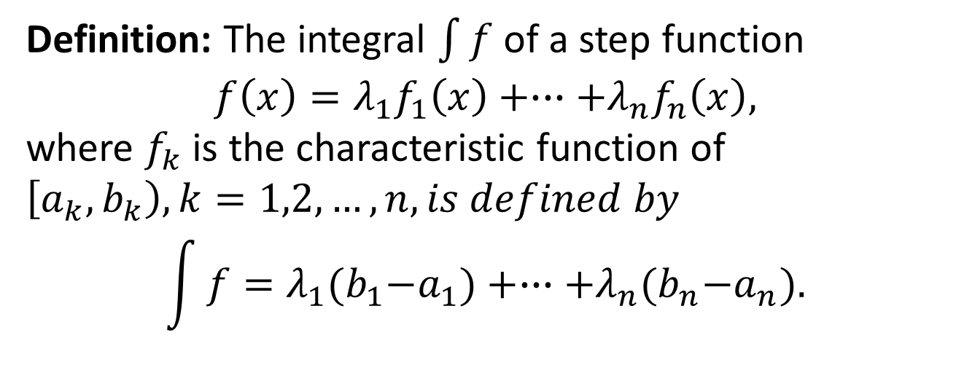
Integral of a Function
Definition: The integral $\int{f}$ of a step function
$$f\left(x\right)=λ_{1}f_{1}\left(x\right)+∙∙∙+λ_{n}f_{n}\left(x\right),$$
where $f_{k}$ is the characteristic function of $\left[a_{k},b_{k}\right), k=1,2,…,n, is defined by$
$$\int{f}=λ_{1}{(b}_{1}−a_{1})+∙∙∙+λ_{n}{(b}_{n}−a_{n}).$$

Slide 5
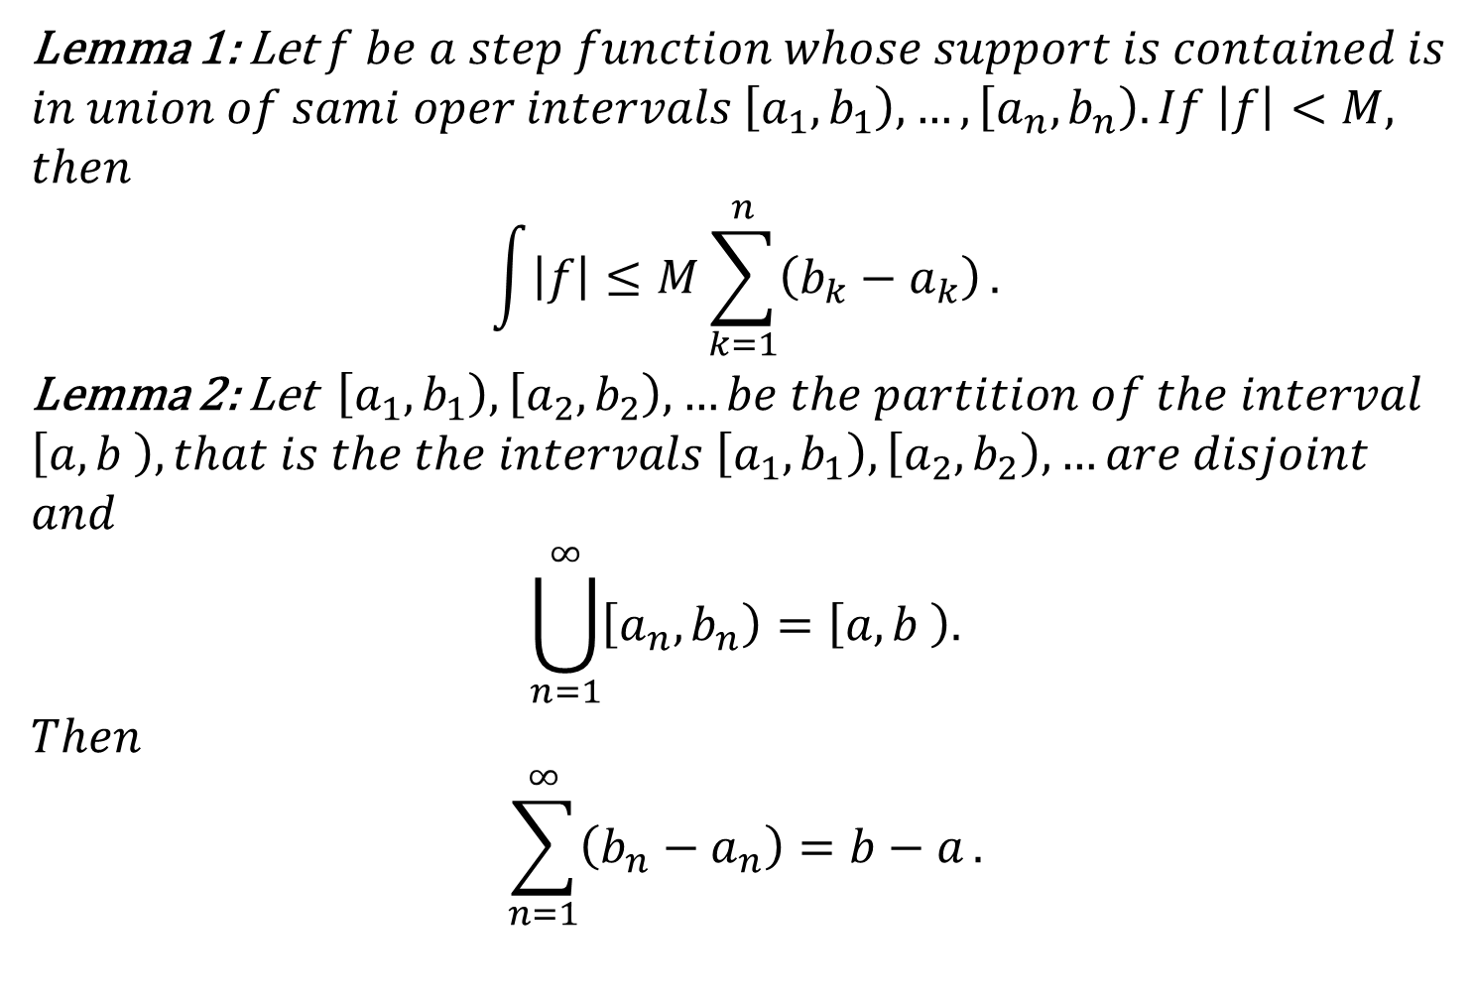
Lemma 1: Let $f be a step function whose support is contained is$
$$in union of sami oper intervals \left[a_{1},b_{1}\right),…,\left[a_{n},b_{n}\right). If \left|f\right|<M,$$
$$then$$
$$\int{\left|f\right|≤M\sum_{k=1}^{n}{\left(b_{k}−a_{k}\right)}}.$$
Lemma 2:Let $\left[a_{1},b_{1}\right),\left[a_{2},b_{2}\right), …be the partition of the interval$
$$\left[a,b \right), that is the the intervals \left[a_{1},b_{1}\right),\left[a_{2},b_{2}\right), …are disjoint$$
$$and$$
$$\bigcup_{n=1}^{∞}{\left[a_{n},b_{n}\right)=\left[a,b \right).}$$
$$Then$$
$$\sum_{n=1}^{∞}{\left(b_{n}−a_{n}\right)=b−a}.$$

Slide 6
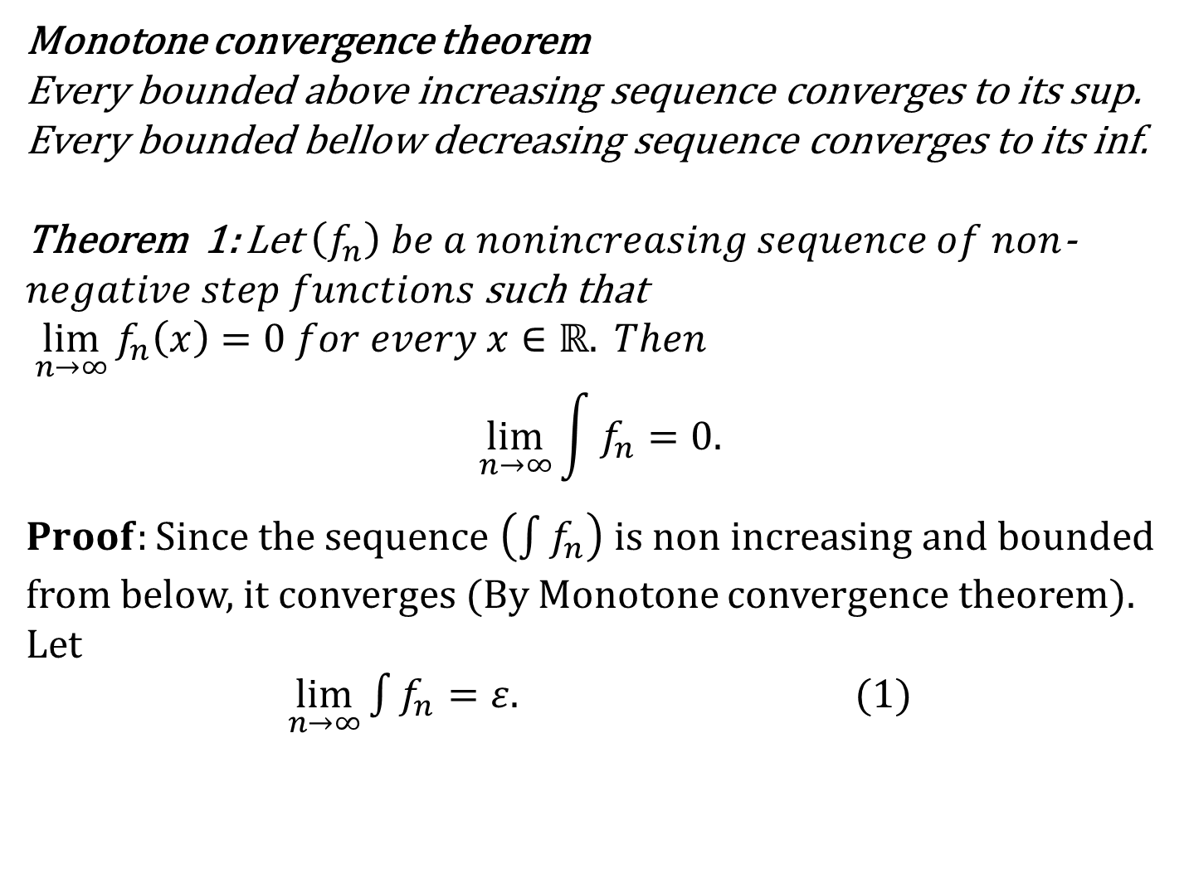
Monotone convergence theorem
Every bounded above increasing sequence converges to its sup.
Every bounded bellow decreasing sequence converges to its inf.
Theorem 1: Let $\left(f_{n}\right) be a nonincreasing sequence of non$-
$negative step functions$ such that
$\lim_{n→∞}{f_{n}\left(x\right)=0 for every x∈ℝ. Then}$
$$\lim_{n→∞}{\int{f_{n}}=0.}$$
$Proof:Since the sequence \left(\int{f_{n}}\right)$ is non increasing and bounded
from below, it converges (By Monotone convergence theorem).
Let
$\lim_{n→∞}{\int{f_{n}}=ε.}$(1)

Slide 8
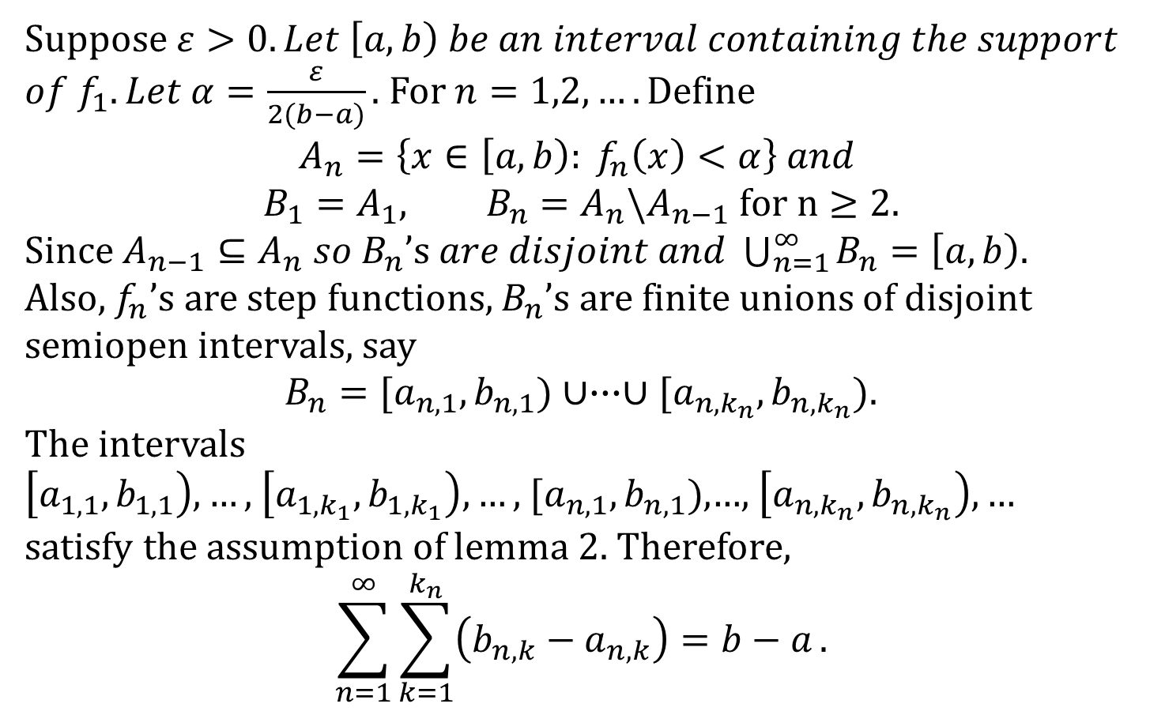
Suppose $ε>0. Let \left[a,b\right) be an interval containing the support$
$of f_{1}. Let α=\frac{ε}{2(b−a)}.$ For $n=1,2,….Define$
$$A_{n}=\left\{x∈\left[a,b\right): f_{n}\left(x\right)<α\right\} and$$
$$B_{1}=A_{1}, B_{n}=A_{n}\backslash A_{n−1} for n≥2.$$
Since $A_{n−1}⊆A_{n} so{ B}_{n}\text{’}\text{s} are disjoint and \bigcup_{n=1}^{∞}{B_{n}=\left[a,b\right). }$
Also, $f_{n}$’s are step functions, $B_{n}$’s are finite unions of disjoint
semiopen intervals, say
$B_{n}=[a_{n,1},b_{n,1})∪∙∙∙∪[a_{n,k_{n}},b_{n,k_{n}})$.
The intervals
$\left[a_{1,1},b_{1,1}\right),…,$$\left[a_{1,k_{1}},b_{1,k_{1}}\right),…,$$[a_{n,1},b_{n,1})$,…,$\left[a_{n,k_{n}},b_{n,k_{n}}\right),…$
satisfy the assumption of lemma 2. Therefore,
$$\sum_{n=1}^{∞}{\sum_{k=1}^{k_{n}}{\left(b_{n,k}−a_{n,k}\right)}=b−a}.$$

Slide 9
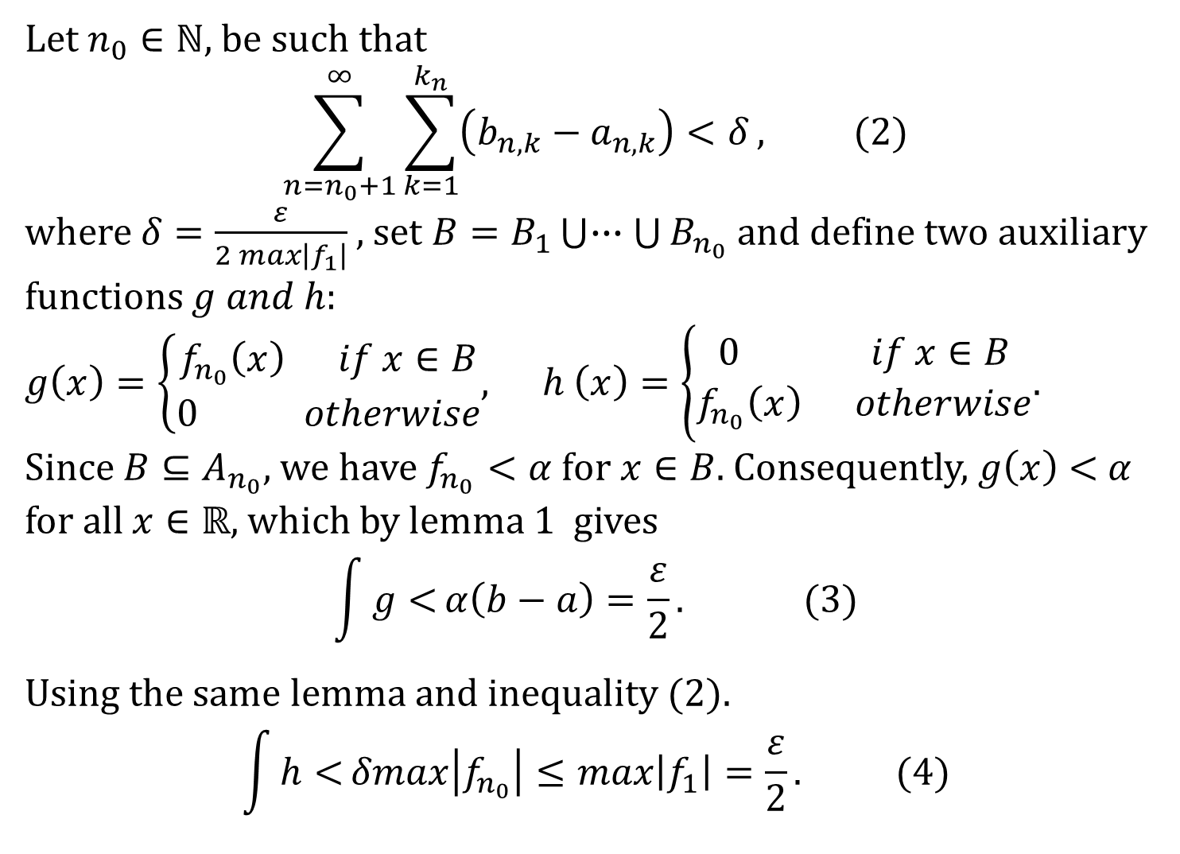
Let $n_{0}∈ℕ$, be such that
$$\sum_{n=n_{0}+1}^{∞}{\sum_{k=1}^{k_{n}}{\left(b_{n,k}−a_{n,k}\right)}<δ}, (2)$$
where $δ=\frac{ε}{2 max\left|f_{1}\right|}$ , set $B=B_{1}\bigcup{∙∙∙\bigcup{B_{n_{0}}}}$ and define two auxiliary
functions $g and h:$
$g\left(x\right)=\left\{\begin{aligned}f_{n_{0}}\left(x\right) if x∈B \\ 0 otherwise\end{aligned}\right.$,$h \left(x\right)=\left\{\begin{aligned}0 if x∈B \\ f_{n_{0}}\left(x\right) otherwise\end{aligned}\right.$.
Since $B⊆A_{n_{0}}$, we have $f_{n_{0}}<α for x∈B.$ Consequently, $g\left(x\right)<$$α$
for all $x∈ℝ$, which by lemma 1 gives
$$\int{g<}α\left(b−a\right)=\frac{ε}{2}. (3)$$
Using the same lemma and inequality (2).
$$\int{h<}δmax\left|f_{n_{0}}\right|≤max\left|f_{1}\right|=\frac{ε}{2}. (4)$$

Slide 10
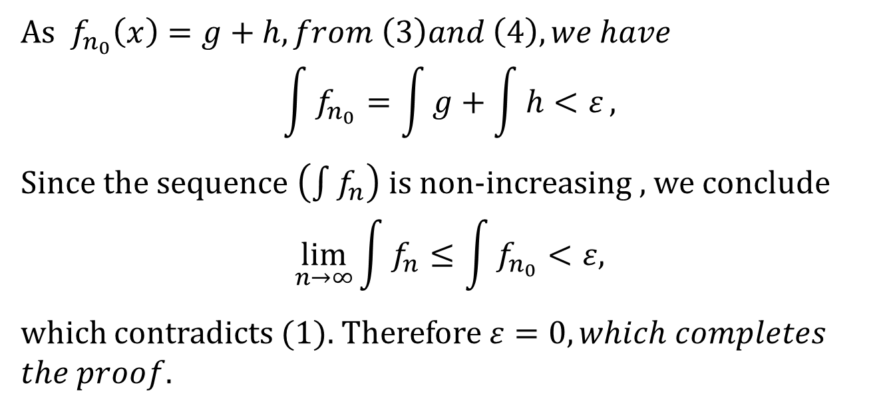
As $f_{n_{0}}\left(x\right)=g+h, from \left(3\right)and \left(4\right), we have$
$$\int{f_{n_{0}}}=\int{g+\int{h}<ε},$$
Since the sequence $\left(\int{f_{n}}\right)$is non-increasing , we conclude
$$\lim_{n→∞}{\int{f_{n}}}≤\int{f_{n_{0}}}<ε,$$
which contradicts (1). Therefore $ε=0, which completes$
$the proof$.

Slide 11
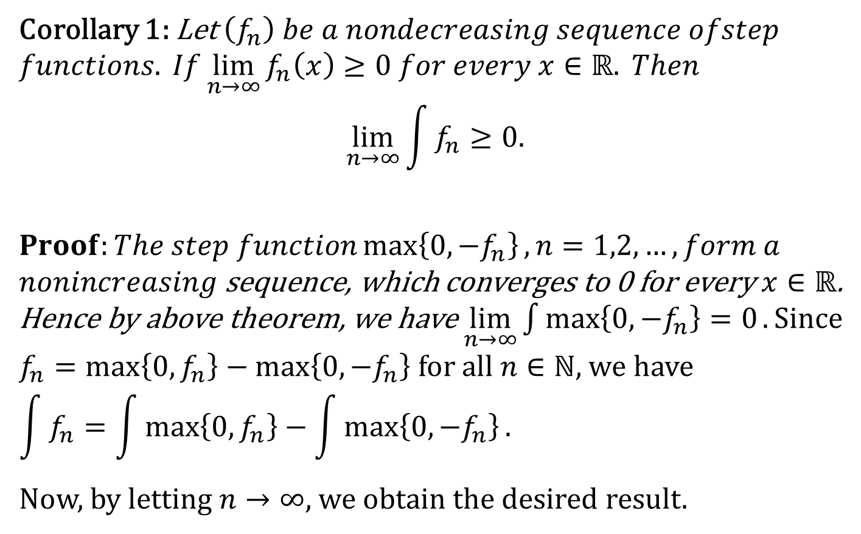
Corollary 1: Let $\left(f_{n}\right) be a nondecreasing sequence ofstep$
$$functions. If\lim_{n→∞}{f_{n}\left(x\right)≥0 for every x∈ℝ. Then}$$
$$\lim_{n→∞}{\int{f_{n}}≥0.}$$
$$Proof:The step function\max\left\{0,−f_{n}\right\}, n=1,2,…, form a$$
$nonincreasing$ sequence, which converges to 0 for every $x∈ℝ$.
Hence by above theorem, we have$\lim_{n→∞}{\int{\max\left\{0,−f_{n}\right\}=0}}. Since$
$f_{n}=\max\left\{0,f_{n}\right\}−\max\left\{0,−f_{n}\right\}$ for all $n∈ℕ$, we have
$$\int{f_{n}}=\int{\max\left\{0,f_{n}\right\}}−\int{\max\left\{0,−f_{n}\right\}.}$$
Now, by letting $n→∞$, we obtain the desired result.

Slide 13
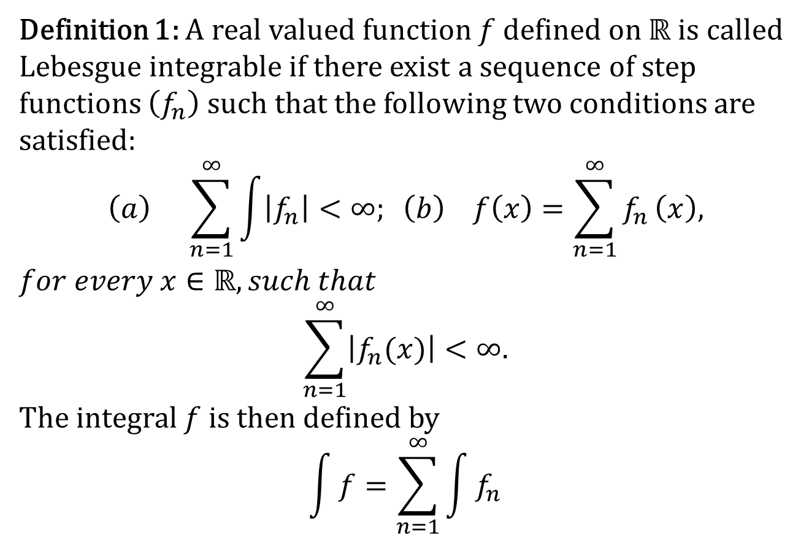
Lebesgue Integrable Functions
Definition 1: A real valued function $f$ defined on $ℝ$ is called Lebesgue integrable if there exist a sequence of step functions $\left(f_{n}\right)$ such that the following two conditions are satisfied:
$$\left(a\right) \sum_{n=1}^{∞}{\int{\left|f_{n}\right|}}<∞; \left(b\right) f\left(x\right)=\sum_{n=1}^{∞}{f_{n}}\left(x\right),$$
$$for every x∈ℝ, such that$$
$$\sum_{n=1}^{∞}{\left|f_{n}(x)\right|}<∞.$$
The integral $f$ is then defined by
$$\int{f}=\sum_{n=1}^{∞}{\int{f_{n}}}$$

Slide 14
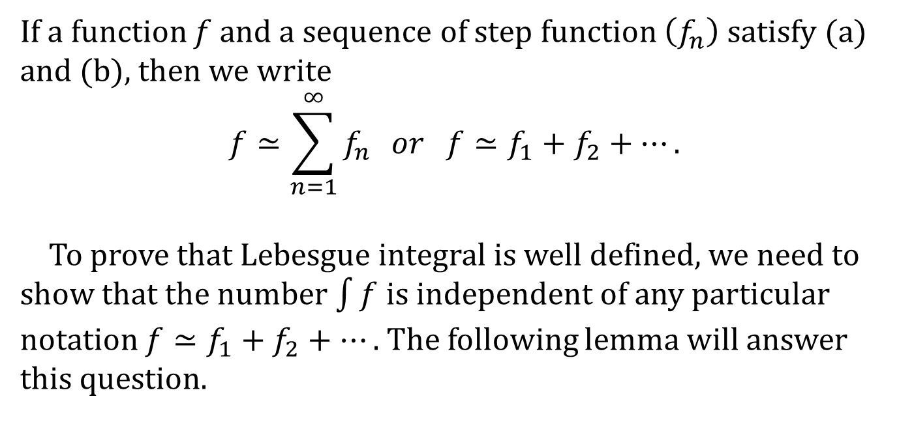
If a function $f$ and a sequence of step function $\left(f_{n}\right)$ satisfy (a)
and (b), then we write
$$f≃\sum_{n=1}^{∞}{f_{n}} or f≃f_{1}+f_{2}+….$$
To prove that Lebesgue integral is well defined, we need to show that the number $\int{f}$ is independent of any particular notation $f≃f_{1}+f_{2}+….$ The following lemma will answer this question.

Slide 15
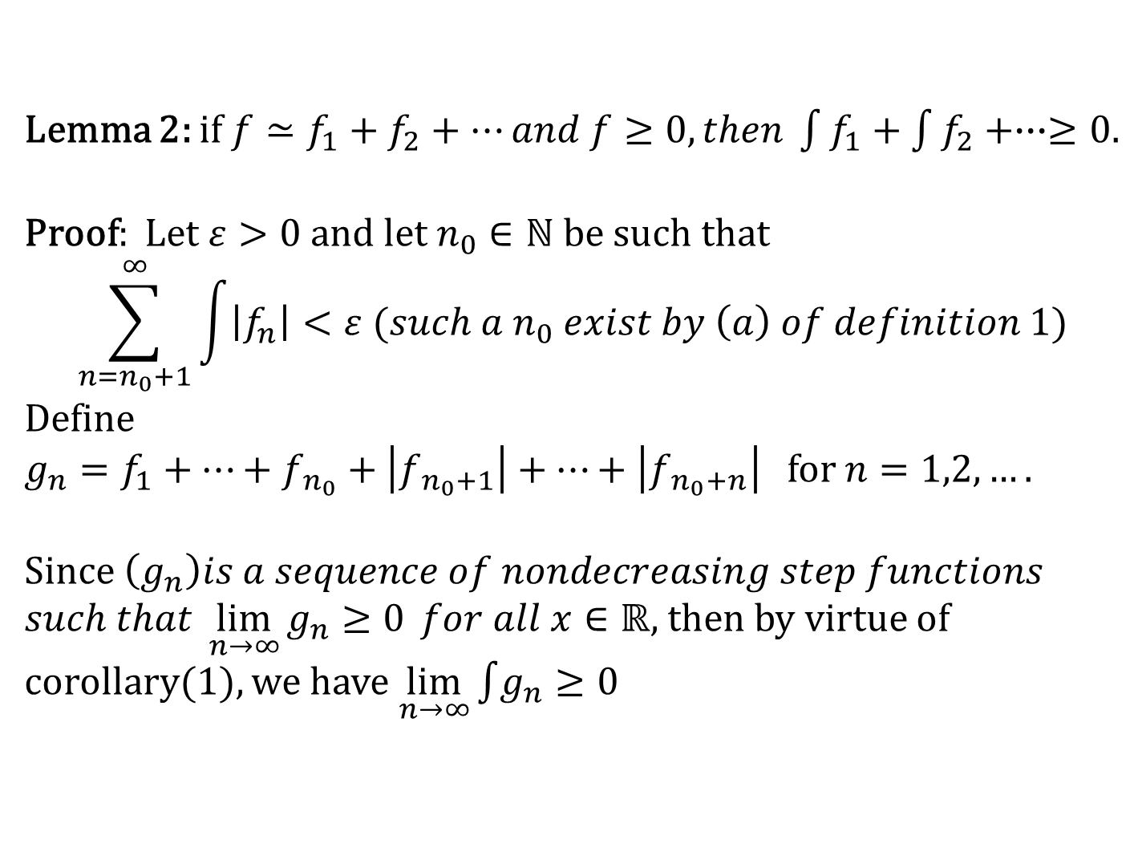
Lemma 2: if $f≃f_{1}+f_{2}+…and f≥0, then \int{f_{1}}+\int{f_{2}}+∙∙∙≥0.$
Proof: Let $ε>0$ and let $n_{0}∈ℕ$ be such that
$$\sum_{n=n_{0}+1}^{∞}{\int{\left|f_{n}\right|}}<ε (such a{ n}_{0} exist by \left(a\right) of definition 1)$$
Define
$g_{n}=f_{1}+…+f_{{ n}_{0}}+\left|f_{{ n}_{0}+1}\right|+…+\left|f_{{ n}_{0}+n}\right|$ for $n=1,2,….$
Since $\left(g_{n}\right)is a sequence of nondecreasing step functions$
$such that \lim_{n→∞}{g_{n}≥0} for all x∈ℝ$, then by virtue of corollary(1), we have $\lim_{n→∞}\int{g_{n}}{≥0}$

Slide 16
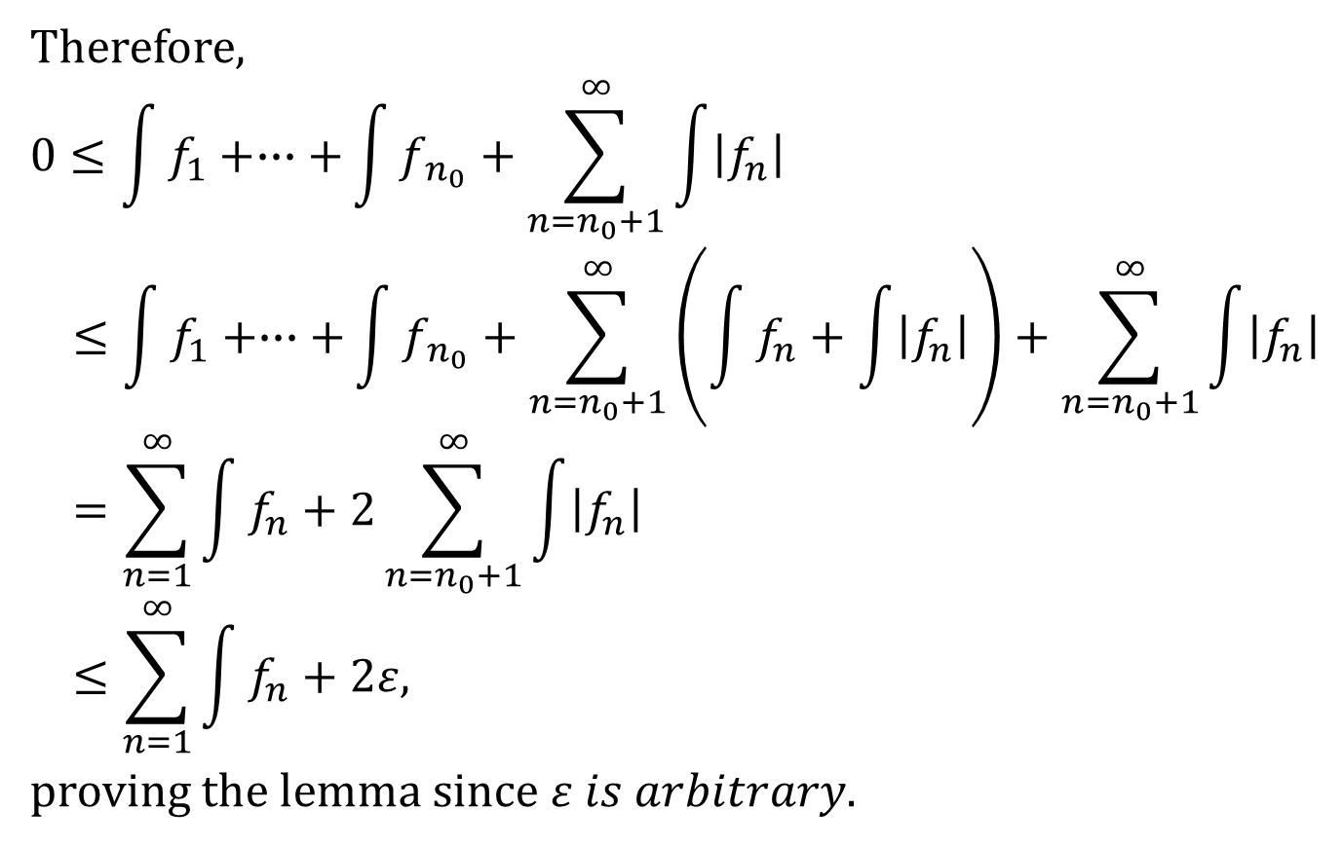
Therefore,
$$0≤\int{f_{1}}+∙∙∙+\int{f_{{ n}_{0}}}+\sum_{n=n_{0}+1}^{∞}{\int{\left|f_{n}\right|}}$$
$$≤\int{f_{1}}+∙∙∙+\int{f_{{ n}_{0}}}+\sum_{n=n_{0}+1}^{∞}{\left(\int{f_{n}}+\int{\left|f_{n}\right|}\right)}+\sum_{n=n_{0}+1}^{∞}{\int{\left|f_{n}\right|}}$$
$$=\sum_{n=1}^{∞}{\int{f_{n}}}+2\sum_{n=n_{0}+1}^{∞}{\int{\left|f_{n}\right|}}$$
$$≤\sum_{n=1}^{∞}{\int{f_{n}}}+2ε,$$
proving the lemma since $ε is arbitrary.$

Slide 17
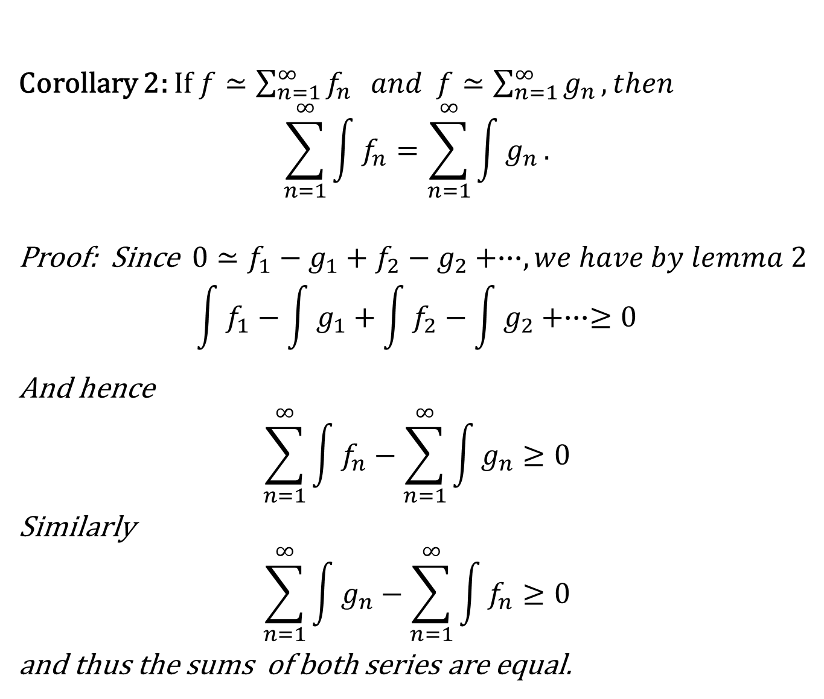
Corollary 2: If $f≃\sum_{n=1}^{∞}{f_{n}} and f≃\sum_{n=1}^{∞}{g_{n}}, then$
$$\sum_{n=1}^{∞}{\int{f_{n}}}=\sum_{n=1}^{∞}{\int{g_{n}}}.$$
Proof: Since $0≃f_{1}−g_{1}+f_{2}−g_{2}+∙∙∙, we have by lemma 2$
$$\int{f_{1}}−\int{g_{1}}+\int{f_{2}}−\int{g_{2}}+∙∙∙≥0$$
And hence
$$\sum_{n=1}^{∞}{\int{f_{n}}}−\sum_{n=1}^{∞}{\int{g_{n}}}≥0$$
Similarly
$$\sum_{n=1}^{∞}{\int{g_{n}}}−\sum_{n=1}^{∞}{\int{f_{n}}}≥0$$
and thus the sums of both series are equal.

Slide 18
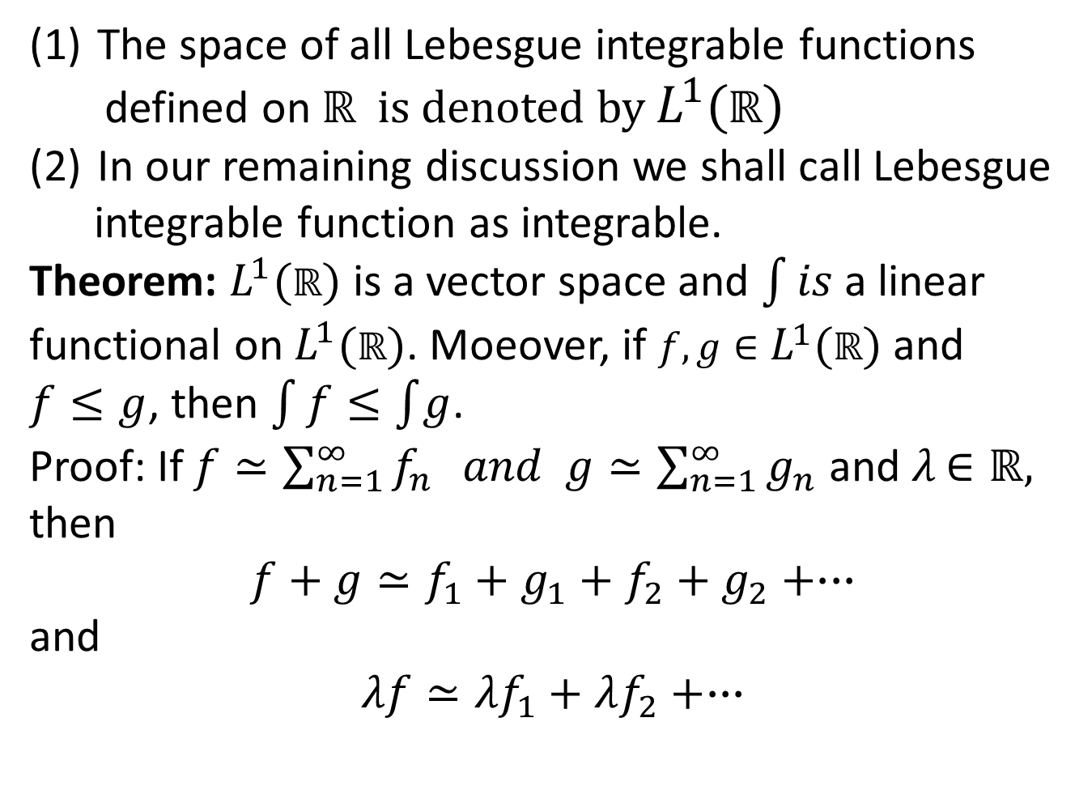
The space of all Lebesgue integrable functions
defined on $ℝ$ is denoted by $L^{1}(ℝ)$
In our remaining discussion we shall call Lebesgue
integrable function as integrable.
Theorem:$L^{1}(ℝ)$is a vector space and $\int{is}$ a linear functional on $L^{1}(ℝ)$. Moeover, if $f,g∈L^{1}(ℝ)$ and
$f≤g$, then $\int{f}≤\int{g}$.
Proof: If $f≃\sum_{n=1}^{∞}{f_{n}} and g≃\sum_{n=1}^{∞}{g_{n}}$ and $λ$$∈ℝ,$
then
$$f+g≃f_{1}+g_{1}+f_{2}+g_{2}+∙∙∙$$
and
$$λf≃{λf}_{1}+λf_{2}+∙∙∙$$

Slide 19
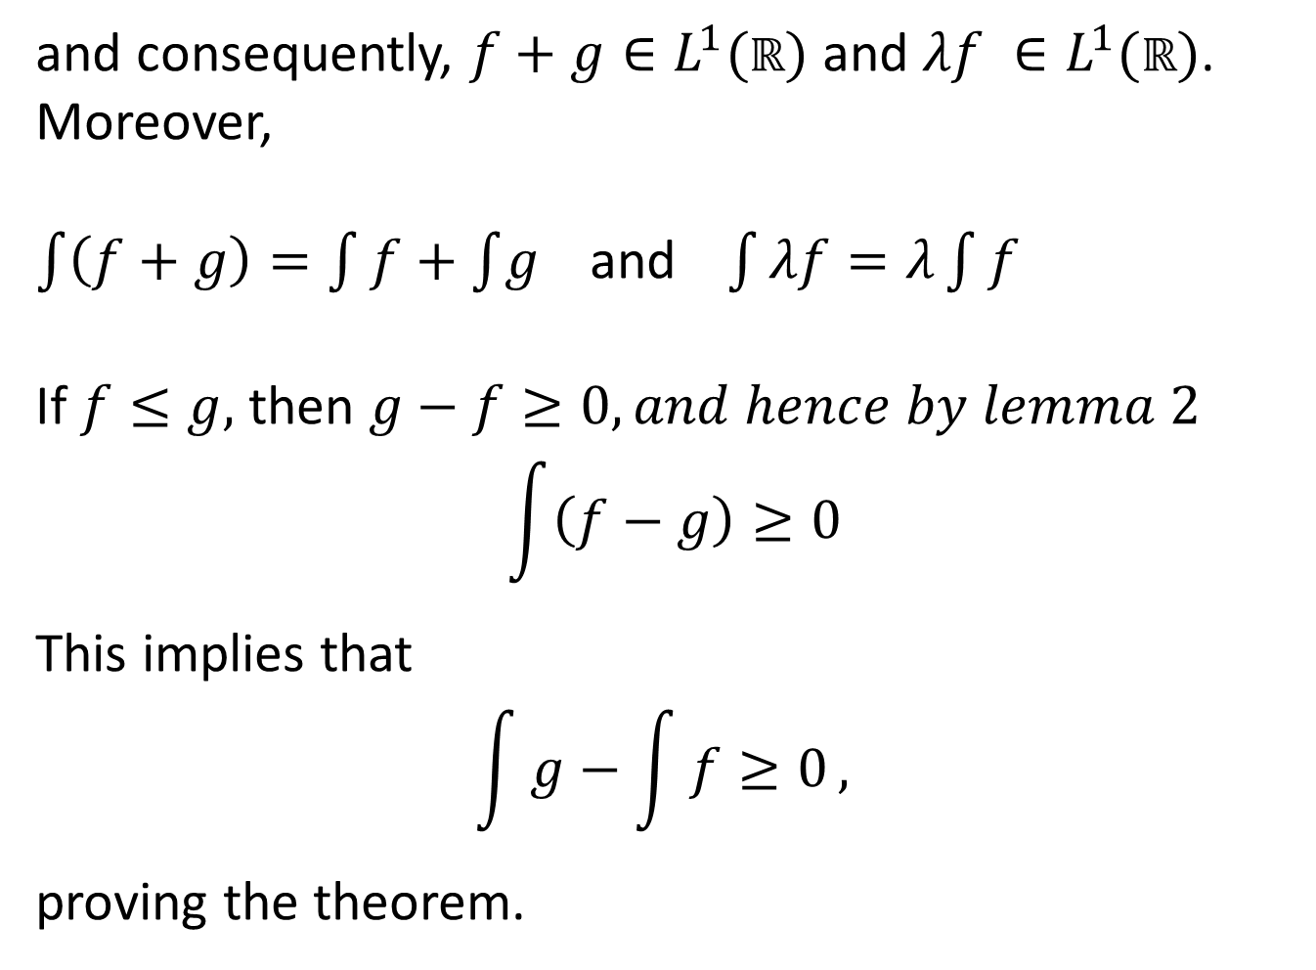
and consequently, $f+g∈L^{1}(ℝ)$and $λf ∈L^{1}(ℝ)$.
Moreover,
$\int{\left(f+g\right)}=\int{f}+\int{g}$and$\int{λf=λ\int{f}}$
If $f≤g,$ then $g−f≥0, and hence by lemma 2$
$$\int{\left(f−g\right)≥0}$$
This implies that
$$\int{g−\int{f≥0}, }$$
proving the theorem.

Slide 20
Summary of the Today’s Lecture
In our today’s lecture, we define Lebesgue integrable function and presented some theorem related to the Lebesgue Integral functions.

