Slide 1
Summary of the Last Lectures
In our last lecture we presented some result regarding Banach spaces and then define Linear mappings and proved some theorems on it.

Slide 2
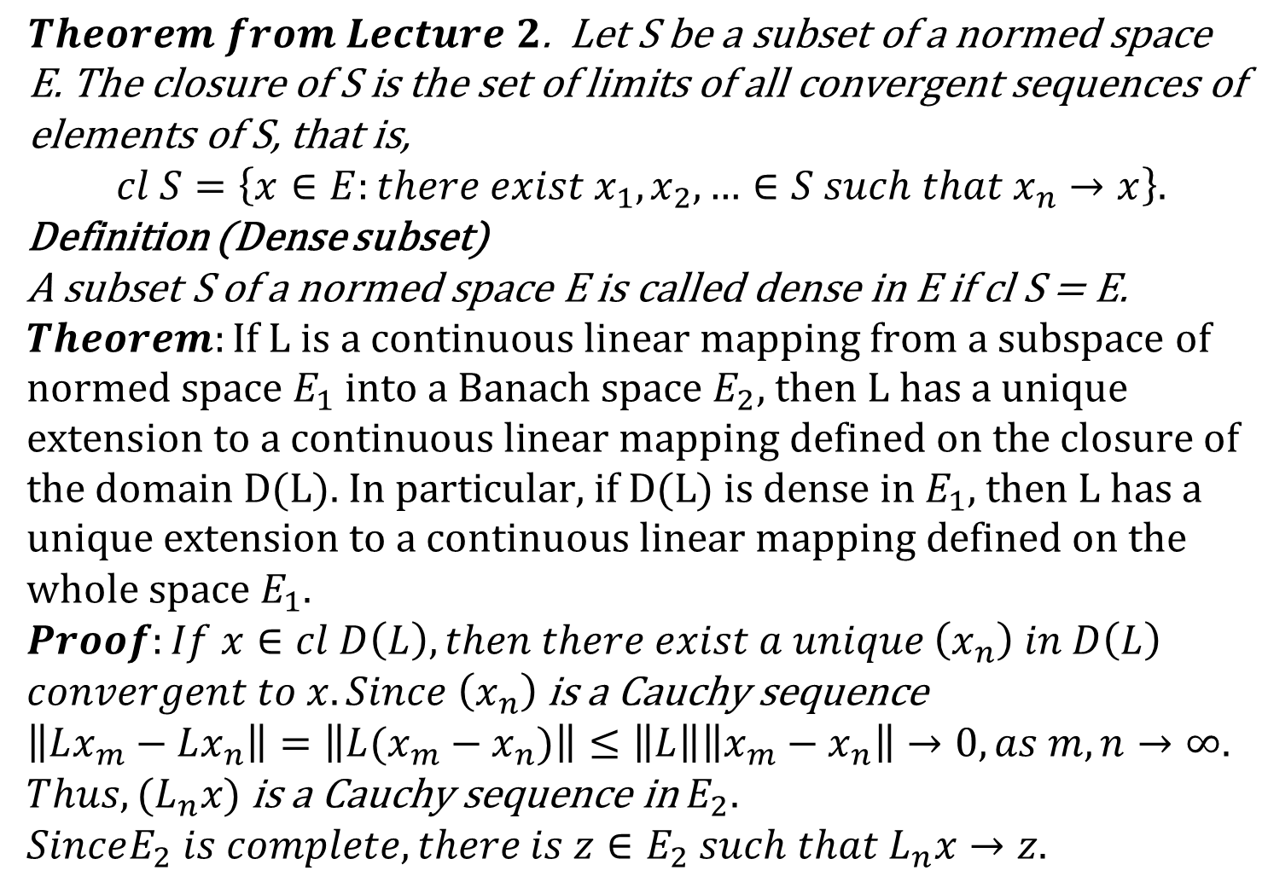
$$Theorem from Lecture 2\text{. }\text{Let} \text{S} \text{be} \text{a} \text{subset} \text{of} \text{a} \text{normed} \text{space} \text{E}\text{. }\text{The} \text{closure} \text{of} \text{S} \text{is} \text{the} \text{set} \text{of} \text{limits} \text{of} \text{all} \text{convergent} \text{sequences} \text{of} \text{elements} \text{of} \text{S}\text{, }\text{that} \text{is}\text{,}$$
$$cl S=\left\{x∈E:there exist x_{1},x_{2},…∈S such that x_{n}→x\right\}.$$
Definition (Dense subset)
A subset S of a normed space E is called dense in E if cl S = E.
$Theorem:\text{If} \text{L} \text{is} \text{a} \text{continuous} \text{linear} \text{mapping} \text{from} \text{a} \text{subspace} \text{of} \text{normed} \text{space} E_{1} \text{into} \text{a} \text{Banach} \text{space}{ E}_{2}\text{, }\text{then} \text{L} \text{has} \text{a} \text{unique} \text{extension} \text{to} \text{a} \text{continuous} \text{linear} \text{mapping} \text{defined} \text{on} \text{the} \text{closure} \text{of} \text{the} \text{domain} \text{D}\text{(}\text{L}\text{). }\text{In} \text{particular}\text{, }\text{if} \text{D}\text{(}\text{L}\text{) }\text{is} \text{dense} \text{in} E_{1}\text{, }\text{then} \text{L} \text{has} \text{a} \text{unique} \text{extension} \text{to} \text{a} \text{continuous} \text{linear} \text{mapping} \text{defined} \text{on} \text{the} \text{whole} \text{space}{ E}_{1}$.
$$Proof:If x∈cl D\left(L\right), then there exist a unique \left(x_{n}\right) in D\left(L\right)$$
$convergent to x. Since \left(x_{n}\right)$ is a Cauchy sequence
$$\left\|Lx_{m}−Lx_{n}\right\|=\left\|L(x_{m}−x_{n})\right\|≤\left\|L\right\|\left\|x_{m}−x_{n}\right\|→0, as m,n→∞.$$
$Thus, (L_{n}x)$ is a Cauchy sequence in $E_{2}.$
$$SinceE_{2} is complete, there is z∈E_{2} such that L_{n}x→z.$$

Slide 4
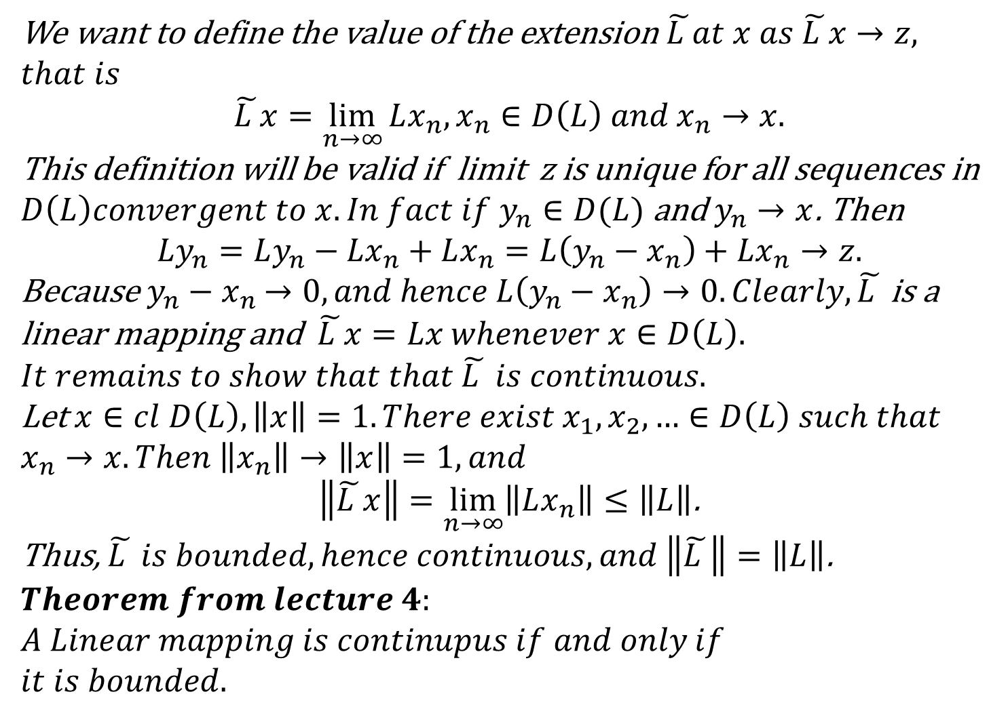
We want to define the value of the extension $\tilde{L }at x as \tilde{L }x→z,$
$$that is$$
$$\tilde{L }x=\lim_{n→∞}{Lx_{n}, x_{n}∈D\left(L\right) and x_{n}→x.}$$
This definition will be valid if limit z is unique for all sequences in
$D\left(L\right)convergent to x. In fact if y_{n}∈D(L)$ and $y_{n}→x$. Then
$$Ly_{n}=Ly_{n}−Lx_{n}+Lx_{n}=L\left(y_{n}−x_{n}\right)+Lx_{n}→z.$$
Because $y_{n}−x_{n}$ $→0, and hence L\left(y_{n}−x_{n}\right)→0. Clearly, \tilde{L }$ is a linear mapping and $\tilde{L }x=Lx whenever x∈D\left(L\right).$
$$It remains to show that that \tilde{L } is continuous.$$
Let $x∈cl D\left(L\right), \left\|x\right\|=1. There exist x_{1},x_{2},…∈D\left(L\right) such that$
$$x_{n}→x. Then \left\|x_{n}\right\|→\left\|x\right\|=1, and$$
$\left\|\tilde{L }x\right\|=\lim_{n→∞}\left\|Lx_{n}\right\|≤\left\|L\right\|$.
Thus, $\tilde{L } is bounded, hence continuous, and \left\|\tilde{L }\right\|=\left\|L\right\|$.
$$Theorem from lecture 4:$$
$$A Linear mapping is continupus if and only if$$
$$it is bounded.$$

Slide 6
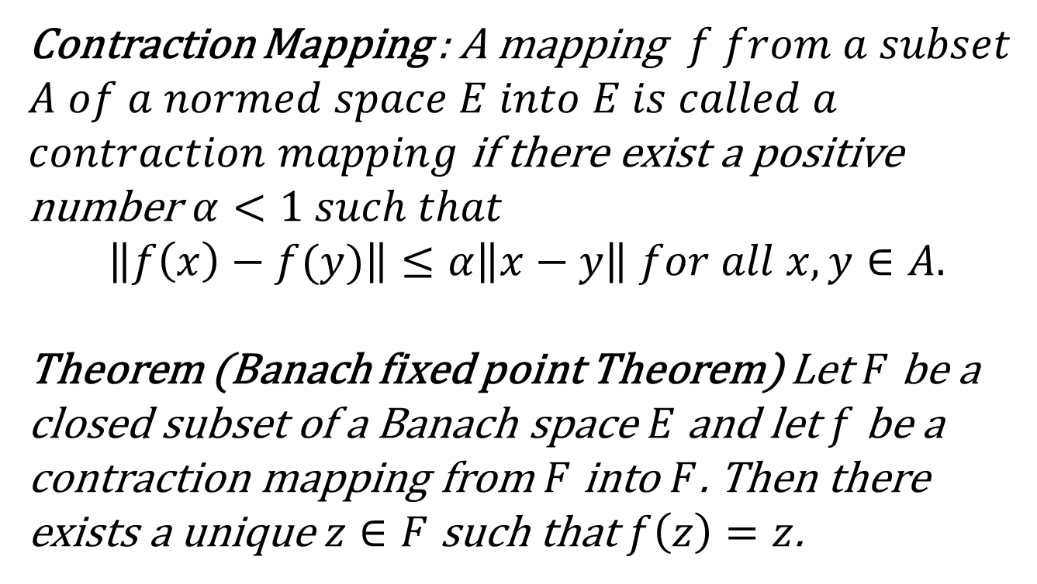
Contraction Mapping and Banach
Fixed Point Theorem
Contraction Mapping : A mapping $f from a subset$
$$A of a normed space E into E is called a$$
$contraction mapping$ if there exist a positive number $α<1 such that$
$$\left\|f\left(x\right)−f(y)\right\|≤α\left\|x−y\right\| for all x,y∈A.$$
Theorem (Banach fixed point Theorem) Let $F$ be a closed subset of a Banach space $E$ and let $f$ be a contraction mapping from $F$ into $F$. Then there
exists a unique $z∈F$ such that $f\left(z\right)=z$.

Slide 8
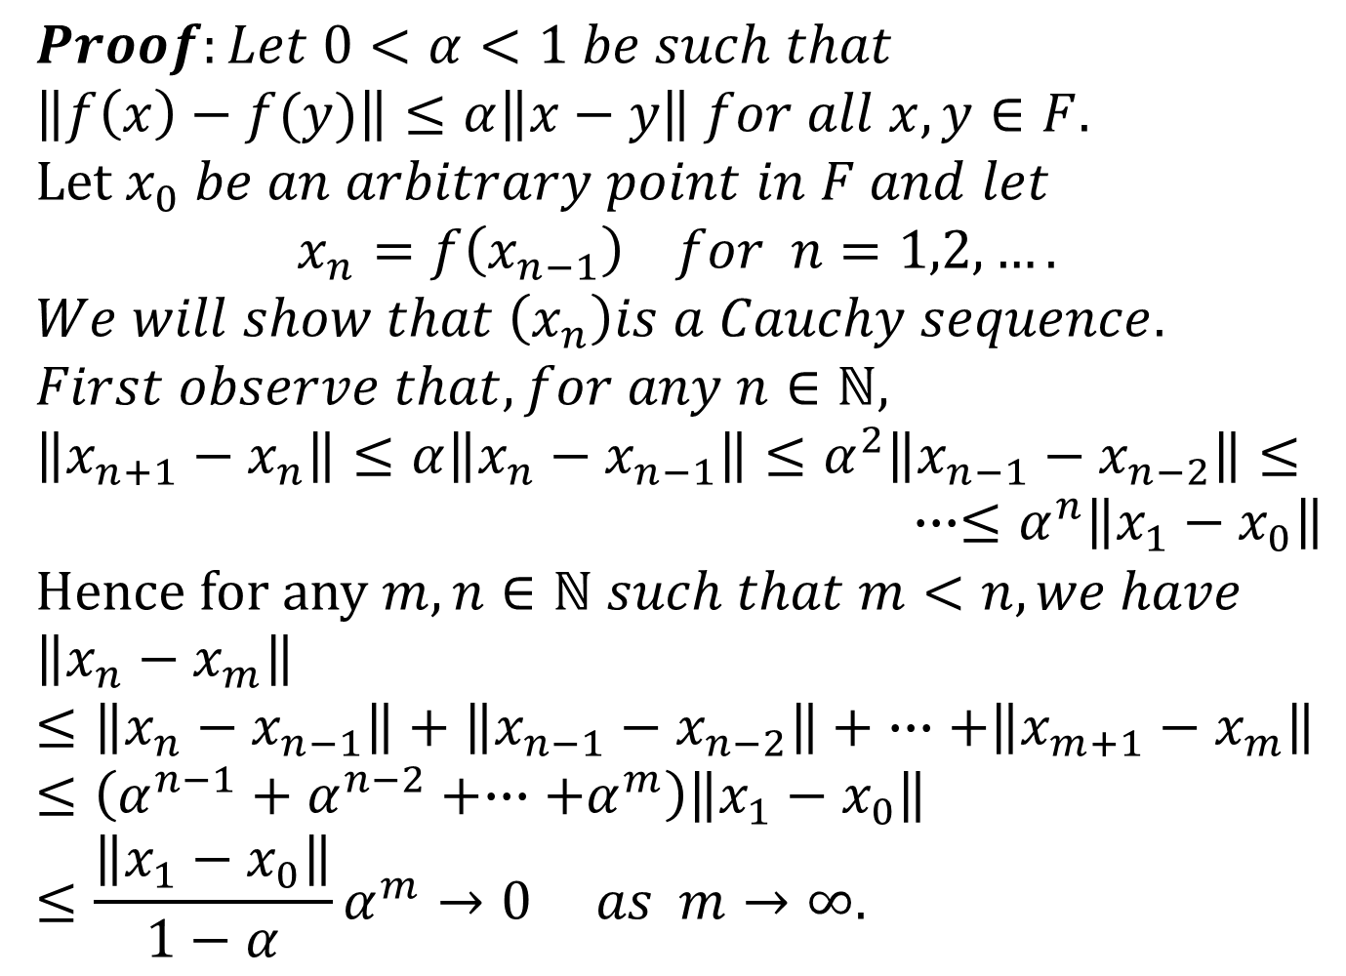
$$Proof:Let 0<α<1 be such that$$
$$\left\|f\left(x\right)−f(y)\right\|≤α\left\|x−y\right\| for all x,y∈F.$$
$$Let x_{0} be an arbitrary point in F and let$$
$$x_{n}=f\left(x_{n−1}\right) for n=1,2,….$$
$$We will show that \left(x_{n}\right)is a Cauchy sequence.$$
$$First observe that, for any n∈ℕ,$$
$$\left\|x_{n+1}−x_{n}\right\|≤α\left\|x_{n}−x_{n−1}\right\|≤α^{2}\left\|x_{n−1}−x_{n−2}\right\|≤$$
$∙∙∙≤α^{n}\left\|x_{1}−x_{0}\right\|$
Hence for any $m,n∈ℕ such that m<n, we have$
$$\left\|x_{n}−x_{m}\right\|≤\left\|x_{n}−x_{n−1}\right\|+\left\|x_{n−1}−x_{n−2}\right\|+ ∙∙∙+\left\|x_{m+1}−x_{m}\right\|$$
$$≤\left(α^{n−1}+α^{n−2}+∙∙∙+α^{m}\right)\left\|x_{1}−x_{0}\right\|$$
$$≤\frac{\left\|x_{1}−x_{0}\right\|}{1−α}α^{m}→0 as m→∞.$$

Slide 10
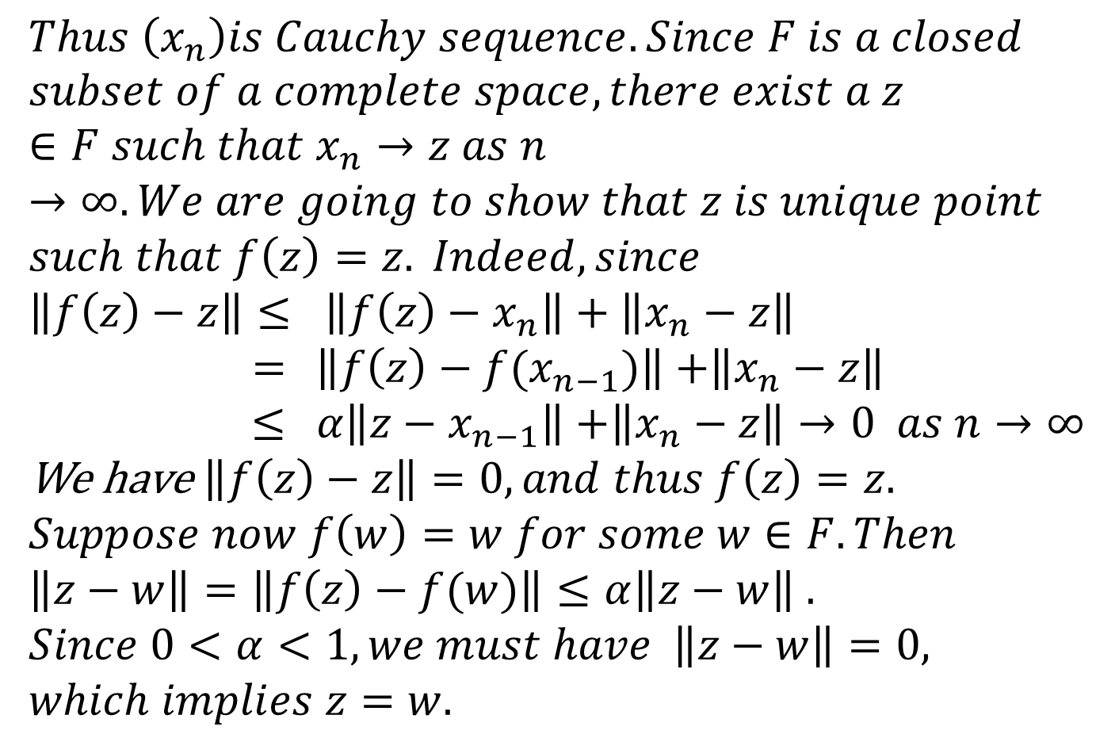
$$Thus \left(x_{n}\right)is Cauchy sequence. Since F is a closed$$
$$subset of a complete space, there exist a z∈F such that x_{n}→z as n→∞. We are going to show that z is unique point$$
$$such that f\left(z\right)=z. Indeed, since$$
$$\left\|f\left(z\right)−z\right\|≤ \left\|f\left(z\right)−x_{n}\right\|+\left\|x_{n}−z\right\|$$
$=$ $\left\|f\left(z\right)−{f(x}_{n−1})\right\|$ $+\left\|x_{n}−z\right\|$
$≤$ $α\left\|z−x_{n−1}\right\|$ $+\left\|x_{n}−z\right\|→0 as n→∞$
We have $\left\|f\left(z\right)−z\right\|=0, and thus f\left(z\right)=z.$
$$Suppose now f\left(w\right)=w for some w∈F. Then$$
$$\left\|z−w\right\|=\left\|f\left(z\right)−f(w)\right\|≤α\left\|z−w\right\| .$$
$Since 0<α<1, we must have$ $\left\|z−w\right\|=0,$
$which implies z=w.$

Slide 12
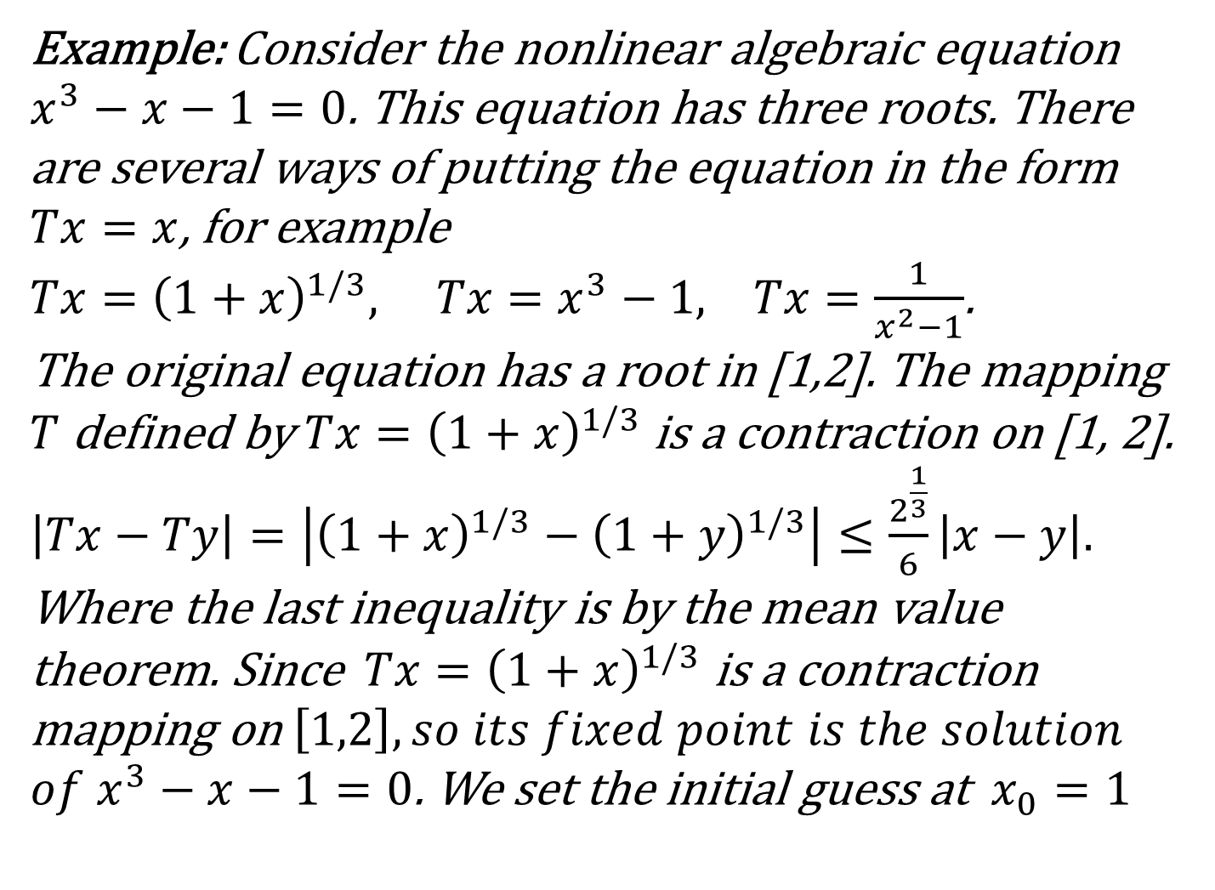
Example: Consider the nonlinear algebraic equation $x^{3}−x−1=0$. This equation has three roots. There are several ways of putting the equation in the form $Tx=x$, for example
$Tx={\left(1+x\right)}^{1/3}, Tx=x^{3}−1, Tx=\frac{1}{x^{2}−1}$.
The original equation has a root in [1,2]. The mapping $T$ defined by $Tx={\left(1+x\right)}^{1/3}$ is a contraction on [1, 2]. $\left|Tx−Ty\right|=\left|{\left(1+x\right)}^{1/3}−{\left(1+y\right)}^{1/3}\right|≤\frac{2^{\frac{1}{3}}}{6}\left|x−y\right|.$
Where the last inequality is by the mean value theorem. Since$Tx={\left(1+x\right)}^{1/3}$ is a contraction mapping on $\left[1,2\right], so its fixed point is the solution$
$of x^{3}−x−1=0$. We set the initial guess at $x_{0}=1$

Slide 14
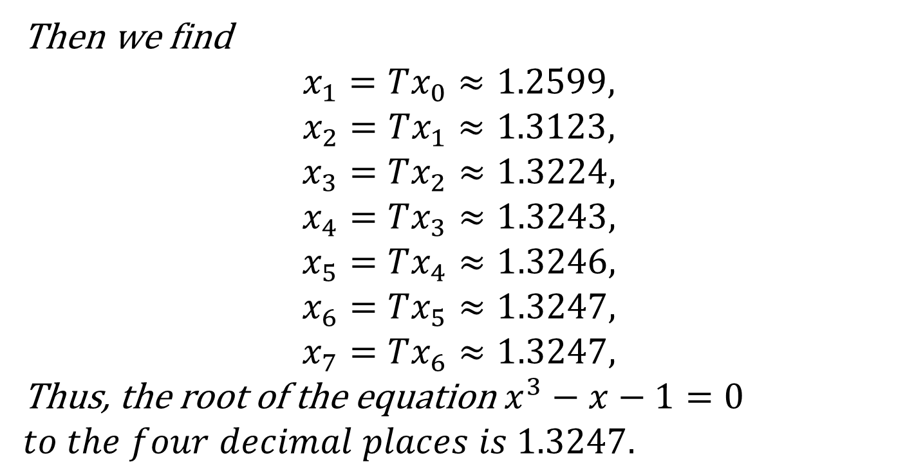
Then we find
$$x_{1}=Tx_{0}≈1.2599,$$
$$x_{2}=Tx_{1}≈1.3123,$$
$$x_{3}=Tx_{2}≈1.3224,$$
$$x_{4}=Tx_{3}≈1.3243,$$
$$x_{5}=Tx_{4}≈1.3246,$$
$$x_{6}=Tx_{5}≈1.3247,$$
$$x_{7}=Tx_{6}≈1.3247,$$
Thus, the root of the equation $x^{3}−x−1=0$
$$to the four decimal places is 1.3247.$$

Slide 15
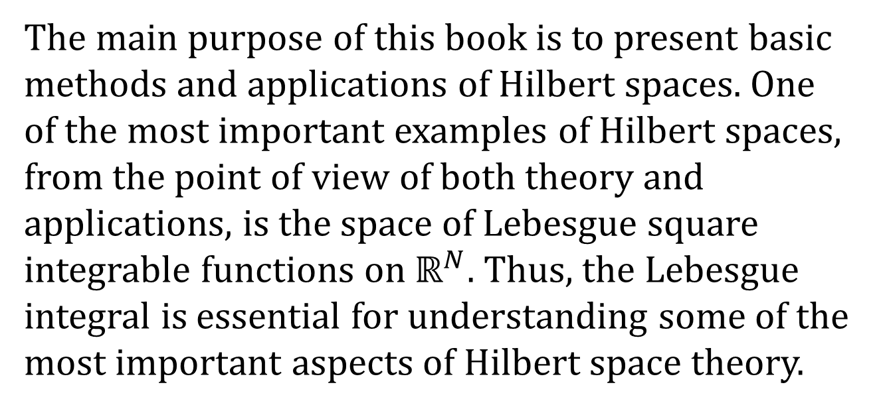
The Lebesgue Integral
The main purpose of this book is to present basic methods and applications of Hilbert spaces. One of the most important examples of Hilbert spaces, from the point of view of both theory and applications, is the space of Lebesgue square integrable functions on $ℝ^{N}$. Thus, the Lebesgue integral is essential for understanding some of the most important aspects of Hilbert space theory.

Slide 16
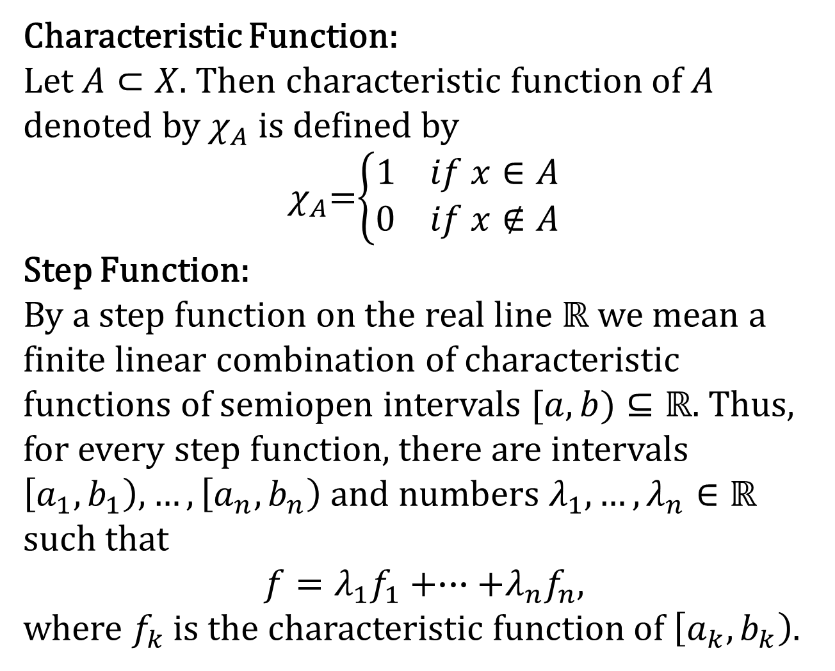
Characteristic Function:
Let $A⊂X$. Then characteristic function of $A$ denoted by $χ_{A}$ is defined by
$χ_{A}$=$\left\{\begin{aligned}1 if x∈A \\ 0 if x∉A\end{aligned}\right.$
Step Function:
By a step function on the real line $ℝ$ we mean a finite linear combination of characteristic functions of semiopen intervals $[a,b)⊆ℝ$. Thus, for every step function, there are intervals $\left[a_{1},b_{1}\right),…,\left[a_{n},b_{n}\right)$ and numbers $λ_{1},…,λ_{n}∈ℝ$
such that
$$f=λ_{1}f_{1}+∙∙∙+λ_{n}f_{n},$$
where $f_{k}$ is the characteristic function of $\left[a_{k},b_{k}\right)$.

Slide 17
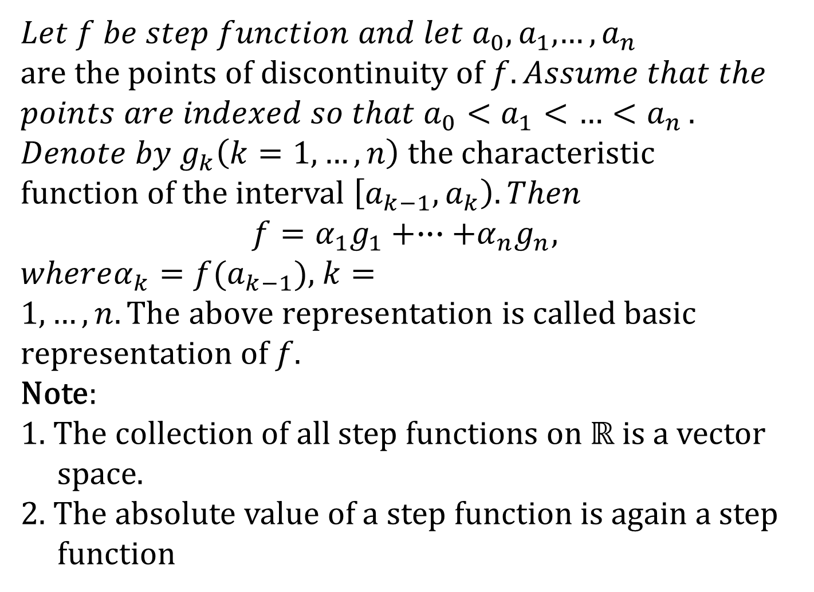
$Let f be step function and let a_{0},a_{1}$,${…,a}_{n}$
$$are the points of discontinuity of f. Assume that the$$
$$points are indexed so that a_{0}<a_{1}<{…<a}_{n}.$$
$$Denote by g_{k}\left(k=1,…,n\right) the characteristic$$
$function of$the interval $\left[a_{k−1},a_{k}\right). Then$
$$f=α_{1}g_{1}+∙∙∙+α_{n}g_{n},$$
$whereα_{k}=f(a_{k−1})$, $k=1,…,n. The above representation is called basic$
$representation$of $f.$
Note:
1. The collection of all step functions on $ℝ$ is a vector
space.
2. The absolute value of a step function is again a step
function

Slide 18
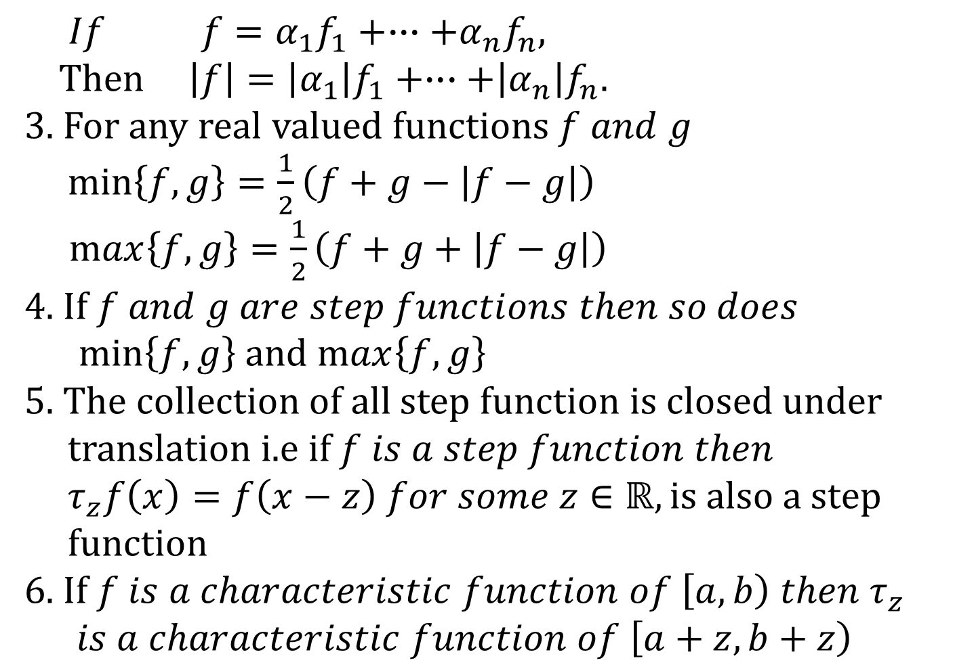
$$If f=α_{1}f_{1}+∙∙∙+α_{n}f_{n},$$
Then$\left|f\right|=\left|α_{1}\right|f_{1}+∙∙∙+\left|α_{n}\right|f_{n}.$
3. For any real valued functions $f and g$
$\min\left\{f,g\right\}=\frac{1}{2}\left(f+g−\left|f−g\right|\right)$
$\max\left\{f,g\right\}=\frac{1}{2}\left(f+g+\left|f−g\right|\right)$
4. If $f and g are step functions then so does$
$\min\left\{f,g\right\}$ and $\max\left\{f,g\right\}$
5. The collection of all step function is closed under
translation i.e if $f is a step function then$
$τ_{z}f\left(x\right)=f\left(x−z\right) for some z∈ℝ, is also a step$
$function$
6. If $f is a characteristic function of \left[a,b\right) then τ_{z}$
$is a characteristic function of \left[a+z,b+z\right)$

Slide 19
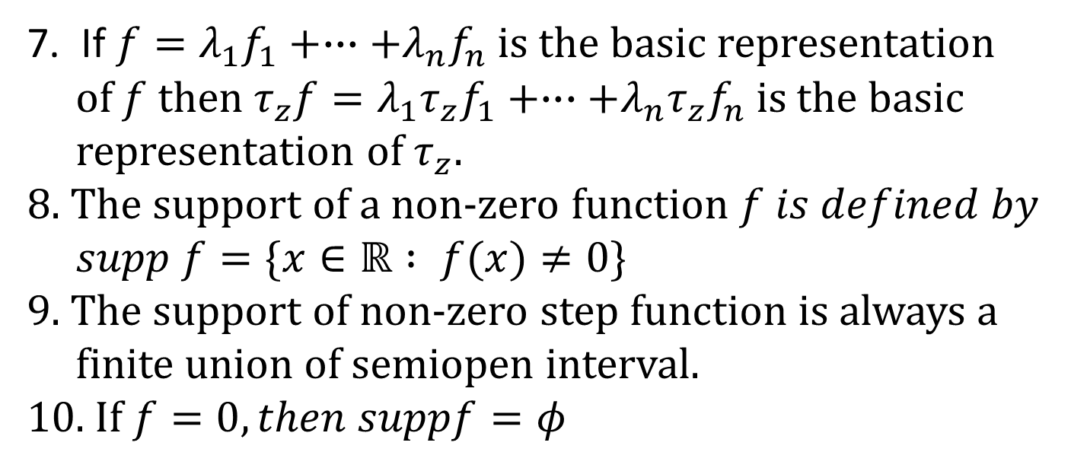
7. If $f=λ_{1}f_{1}+∙∙∙+λ_{n}f_{n}$ is the basic representation
of $f$ then $τ_{z}f=λ_{1}τ_{z}f_{1}+∙∙∙+λ_{n}τ_{z}f_{n}$ is the basic
representation of $τ_{z}$.
8. The support of a non-zero function $f is defined by$
$supp f=\{x∈ℝ : f(x)≠0\}$
9. The support of non-zero step function is always a
finite union of semiopen interval.
10. If $f=0, then suppf=φ$

Slide 20
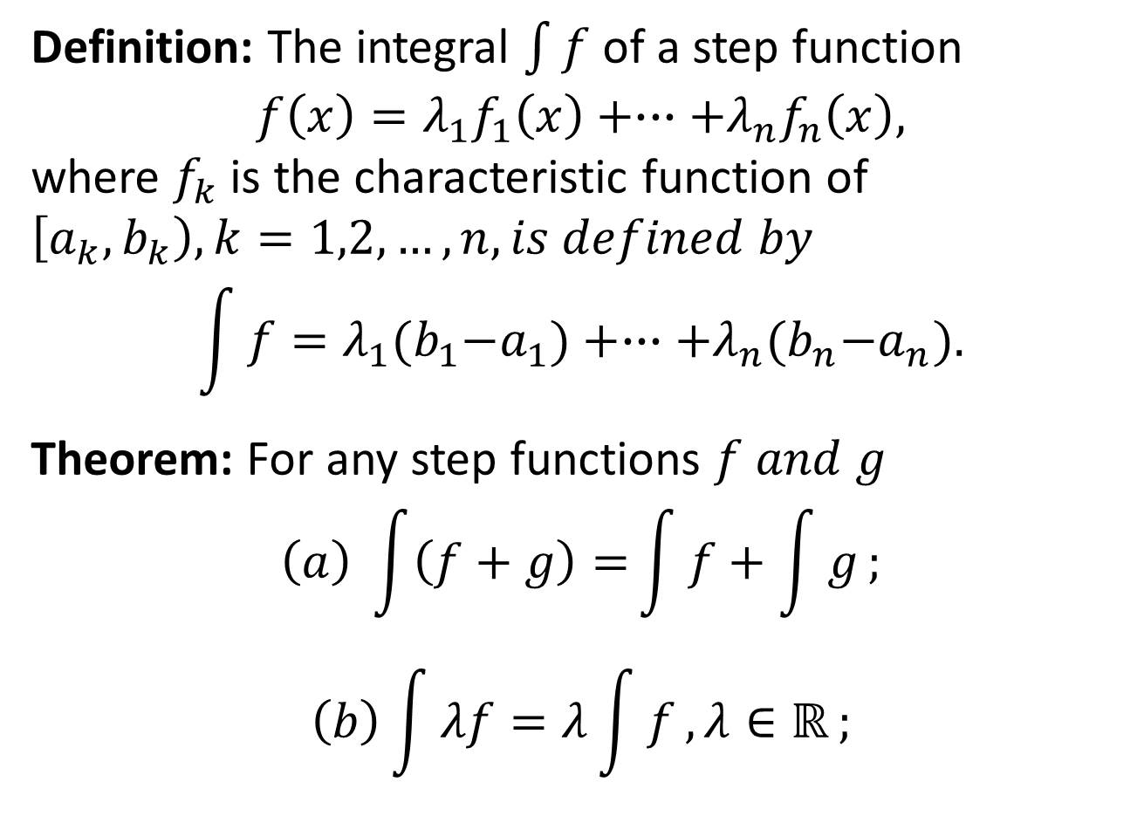
Integral of a Function
Definition: The integral $\int{f}$ of a step function
$$f\left(x\right)=λ_{1}f_{1}\left(x\right)+∙∙∙+λ_{n}f_{n}\left(x\right),$$
where $f_{k}$ is the characteristic function of $\left[a_{k},b_{k}\right), k=1,2,…,n, is defined by$
$$\int{f}=λ_{1}{(b}_{1}−a_{1})+∙∙∙+λ_{n}{(b}_{n}−a_{n}).$$
Theorem: For any step functions $f and g$
$$\left(a\right) \int{\left(f+g\right)=}\int{f+\int{g}};$$
$$\left(b\right)\int{λf=λ\int{f},λ∈ℝ};$$

Slide 21
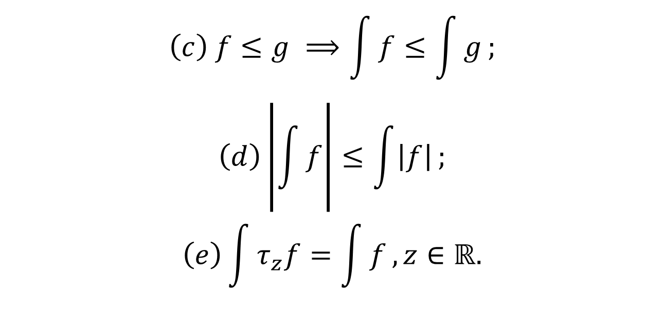
Integral of a Function
$$\left(c\right) f≤g ⟹\int{f≤\int{g}};$$
$$\left(d\right)\left|\int{f}\right|≤\int{\left|f\right|};$$
$$\left(e\right)\int{τ_{z}f=\int{f}, }z∈ℝ.$$

Slide 22
Summary of the Today’s Lectures
In our today’s lecture, we presented a theorem related to Linear mapping and then define the Contraction mapping. A very important result regarding this topic that is fixed point theorem is proved and applied to solve an algebraic equation.
With this we finish chapter one and switched to a new chapter named “ The Lebesgue Integral”.

