Slide 1
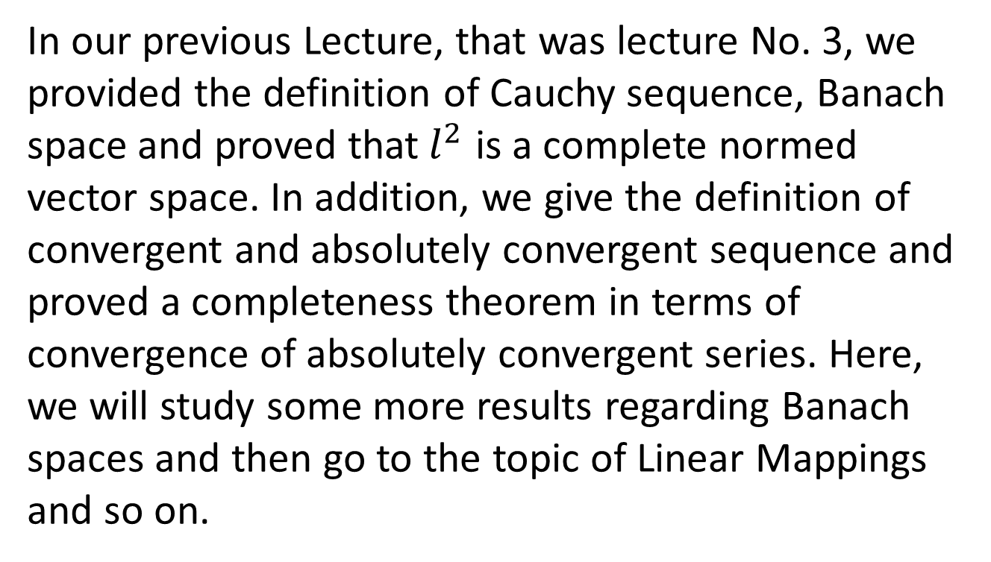
Summary of the Last Lectures
In our previous Lecture, that was lecture No. 3, we provided the definition of Cauchy sequence, Banach space and proved that${ l}^{2}$ is a complete normed vector space. In addition, we give the definition of convergent and absolutely convergent sequence and proved a completeness theorem in terms of convergence of absolutely convergent series. Here, we will study some more results regarding Banach spaces and then go to the topic of Linear Mappings and so on.

Slide 2
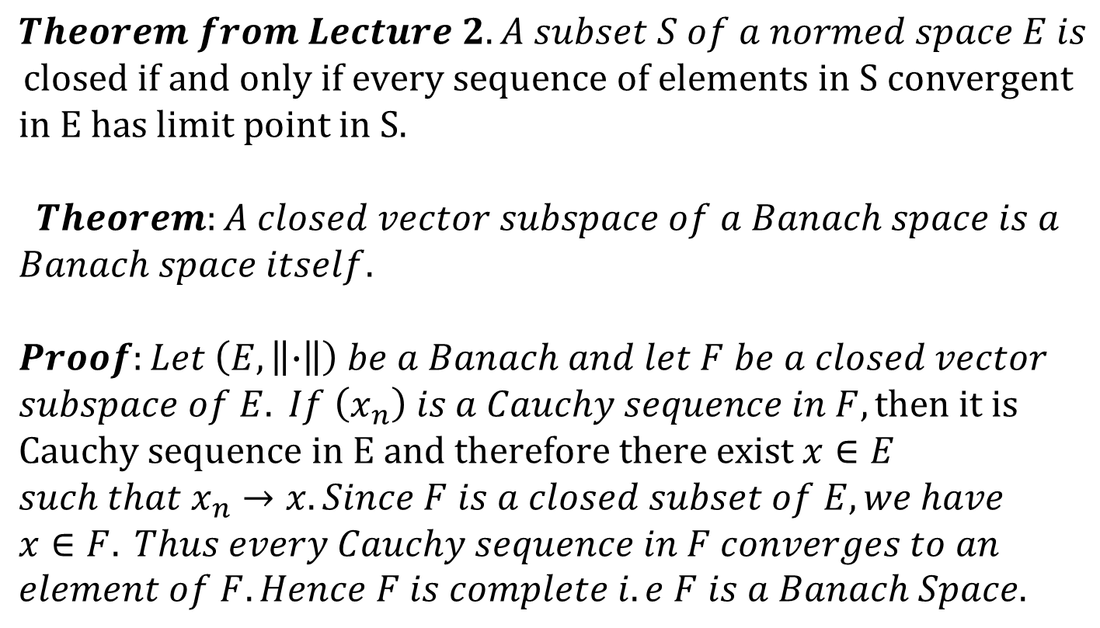
$$Theorem from Lecture 2. A subset S of a normed space E is$$
$$closed if and only if every sequence of elements in S convergent$$
$$in E has limit point in S.$$
$$Theorem:A closed vector subspace of a Banach space is a$$
$$Banach space itself.$$
$$Proof:Let \left(E,\left\|∙\right\|\right) be a Banach and let F be a closed vector$$
$$subspace of E. If \left(x_{n}\right) is a Cauchy sequence in F, then it is$$
$$Cauchy sequence in E and therefore there exist x∈E$$
$$such that x_{n}→x. Since F is a closed subset of E, we have$$
$$x∈F. Thus every Cauchy sequence in F converges to an$$
$$element of F. Hence F is complete i.e F is a Banach Space.$$

Slide 3
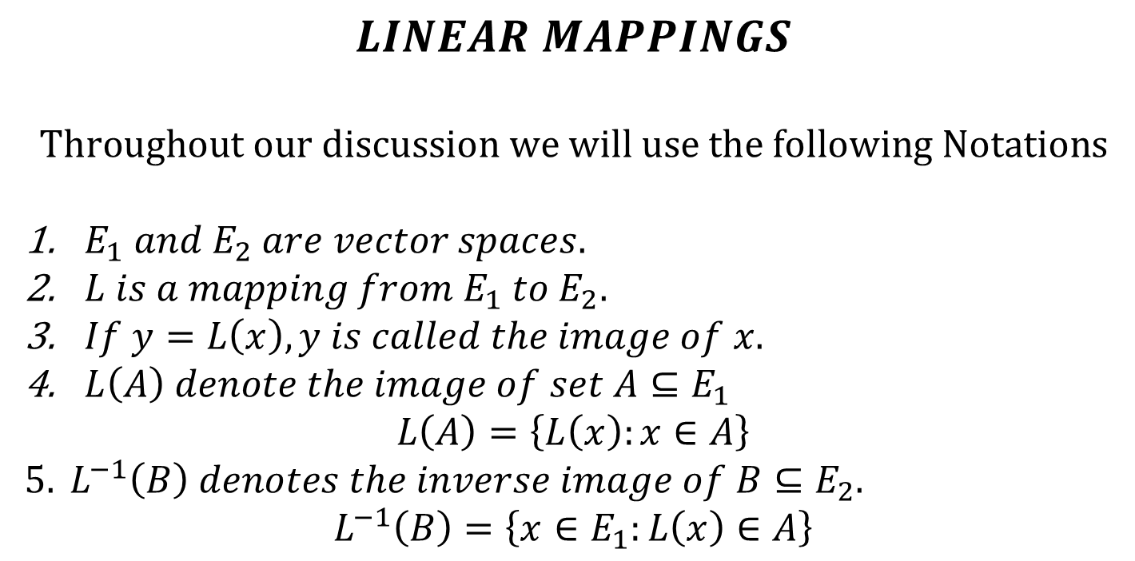
$$LINEAR MAPPINGS$$
$$Throughout our discussion we will use the following Notations$$
$E_{1} and{ E}_{2} are vector spaces$.
$L is a mapping from E_{1} to{ E}_{2}$.
$If y=L\left(x\right), y is called the image of x.$
$L\left(A\right) denote the image of set A⊆E_{1}$
$$L\left(A\right)=\left\{L\left(x\right):x∈A\right\}$$
$$5. L^{−1}\left(B\right) denotes the inverse image of B⊆E_{2}.$$
$$L^{−1}\left(B\right)=\left\{x∈E_{1}:L\left(x\right)∈A\right\}$$

Slide 4
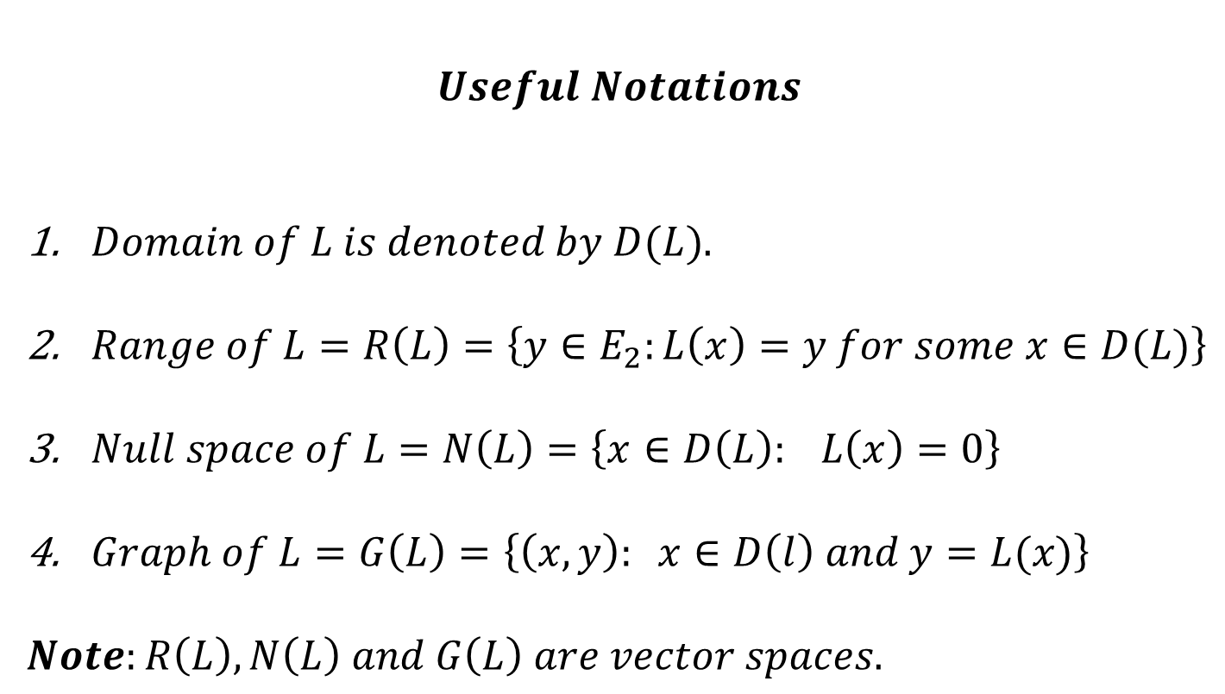
$$Useful Notations$$
$Domain of L is denoted by D(L)$.
$Range of L=R\left(L\right)=\left\{y∈E_{2}:L\left(x\right)=y for some x∈D(L)\right\}$
$Null space of L=N\left(L\right)=\left\{x∈D\left(L\right): L\left(x\right)=0\right\}$
$Graph of L=G\left(L\right)=\left\{\left(x,y\right): x∈D\left(l\right) and y=L(x)\right\}$
$$Note:R\left(L\right), N\left(L\right) and G\left(L\right) are vector spaces.$$

Slide 5
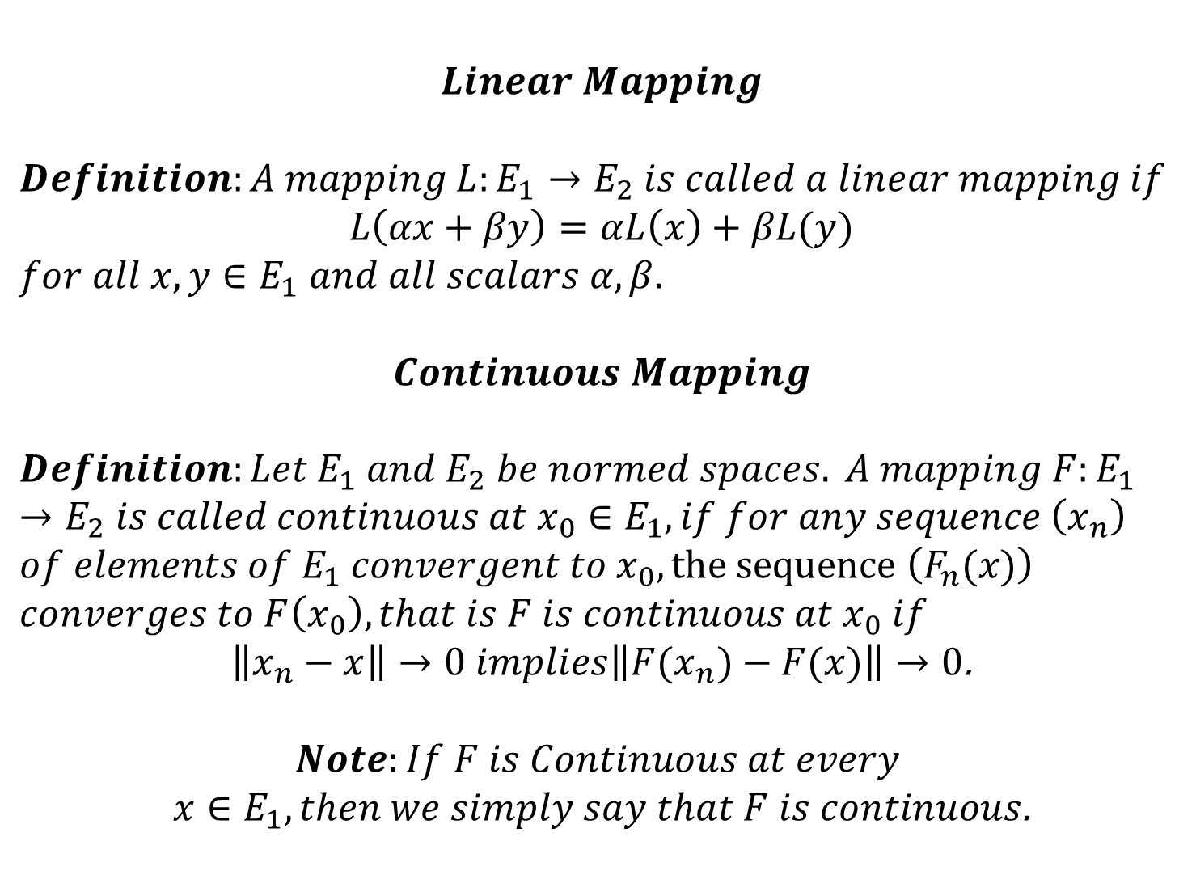
$$Linear Mapping$$
$$Definition:A mapping L:E_{1}→E_{2} is called a linear mapping if$$
$$L\left(αx+βy\right)=αL\left(x\right)+βL(y)$$
$$for all x,y∈E_{1} and all scalars α,β.$$
$$Continuous Mapping$$
$$Definition:Let E_{1} and E_{2} be normed spaces. A mapping F:E_{1}→E_{2} is called continuous at x_{0}∈E_{1}, if for any sequence \left(x_{n}\right)$$
$$of elements of E_{1} convergent to x_{0}, the sequence \left(F_{n}(x)\right)$$
$$converges to F\left(x_{0}\right), that is F is continuous at x_{0} if$$
$\left\|x_{n}−x\right\|→0 implies\left\|{F(x}_{n})−F(x)\right\|→0$.
$$Note:If F is Continuous at every$$
$x∈E_{1}, then we simply say that F is continuous$.

Slide 6
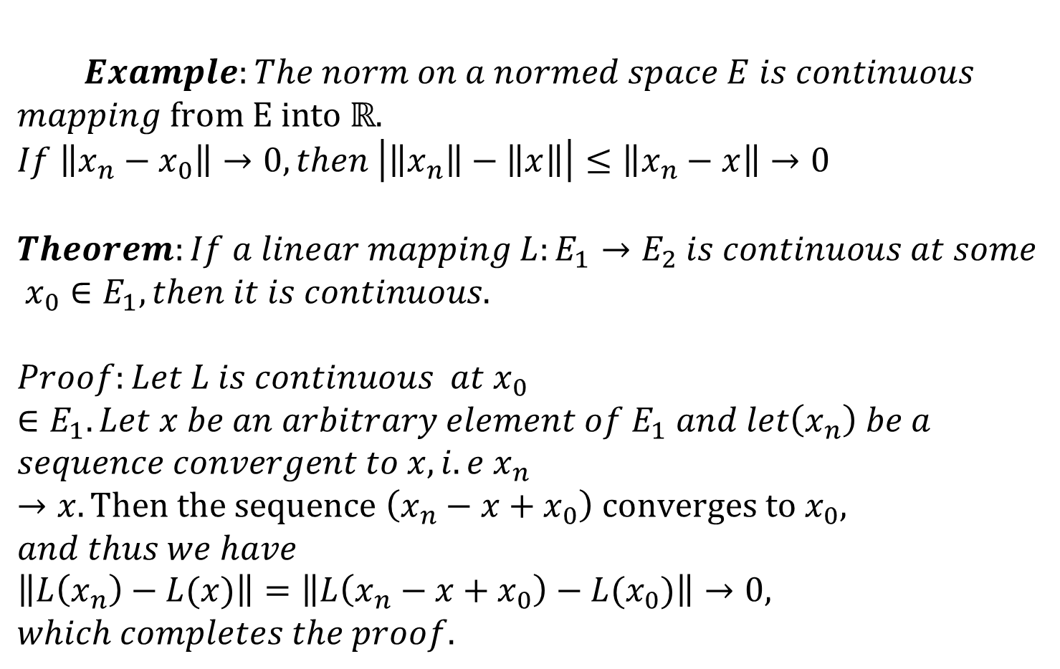
$$Example:The norm on a normed space E is continuous$$
$mapping from E into ℝ$.
$$If \left\|x_{n}−x_{0}\right\|→0, then \left|\left\|x_{n}\right\|−\left\|x\right\|\right|≤\left\|x_{n}−x\right\|→0$$
$$Theorem:If a linear mapping L:E_{1}→E_{2} is continuous at some$$
$$x_{0}∈E_{1}, then it is continuous.$$
$$Proof:Let L is continuous at x_{0}∈E_{1}. Let x be an arbitrary element of E_{1} and let\left(x_{n}\right) be a$$
$$sequence convergent to x, i.e x_{n}→x. Then the sequence \left(x_{n}−x+x_{0}\right) converges to{ x}_{0},$$
$$and thus we have$$
$$\left\|L\left(x_{n}\right)−L(x)\right\|=\left\|L\left(x_{n}−x+x_{0}\right)−L(x_{0})\right\|→0, which completes the proof.$$

Slide 7
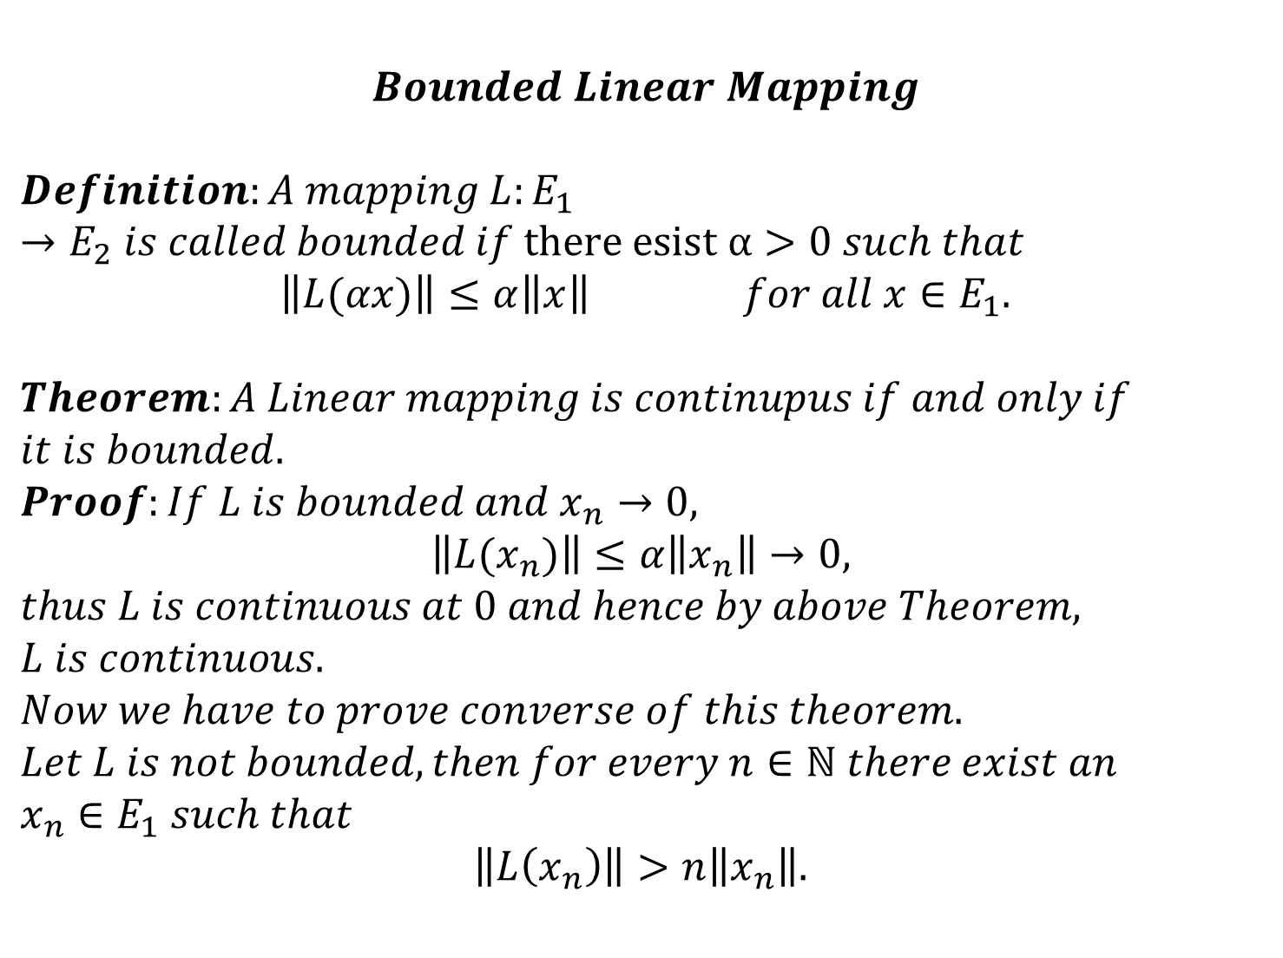
$$Bounded Linear Mapping$$
$$Definition:A mapping L:E_{1}→E_{2} is called bounded if there esist α>0 such that$$
$$\left\|L(αx)\right\|≤α\left\|x\right\| for all x∈E_{1}.$$
$$Theorem:A Linear mapping is continupus if and only if$$
$$it is bounded.$$
$$Proof:If L is bounded and x_{n}→0,$$
$$\left\|L(x_{n})\right\|≤α\left\|x_{n}\right\|→0,$$
$$thus L is continuous at 0 and hence by above Theorem,$$
$$L is continuous.$$
$$Now we have to prove converse of this theorem.$$
$$Let L is not bounded, then for every n∈ℕ there exist an$$
$$x_{n}∈E_{1} such that$$
$$\left\|L\left(x_{n}\right)\right\|>n\left\|x_{n}\right\|.$$

Slide 8
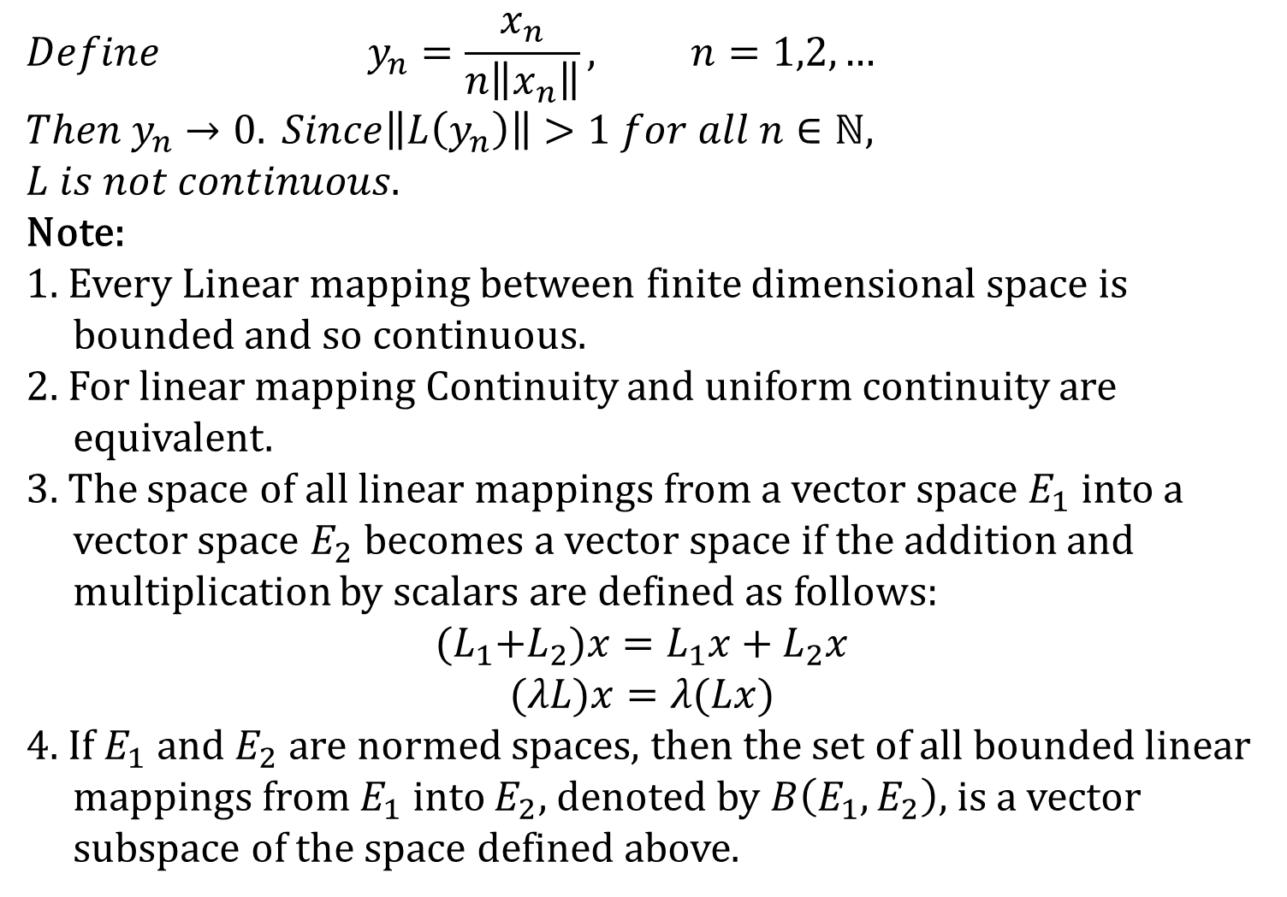
$$Define y_{n}=\frac{x_{n}}{n\left\|x_{n}\right\|}, n=1,2,…$$
$${Then y}_{n}→0. Since\left\|L\left(y_{n}\right)\right\|>1 for all n∈ℕ, L is not continuous.$$
Note:
1. Every Linear mapping between finite dimensional space is
bounded and so continuous.
2. For linear mapping Continuity and uniform continuity are
equivalent.
3. The space of all linear mappings from a vector space $E_{1}$ into a
vector space $E_{2}$becomes a vector space if the addition and
multiplication by scalars are defined as follows:
$${(L}_{1}+L_{2})x=L_{1}x+L_{2}x$$
$$(λL)x=λ(Lx)$$
4. If $E_{1}$and $E_{2}$are normed spaces, then the set of all bounded linear
mappings from $E_{1}$into $E_{2}$, denoted by $B\left(E_{1},E_{2}\right),$is a vector
subspace of the space defined above.

Slide 9
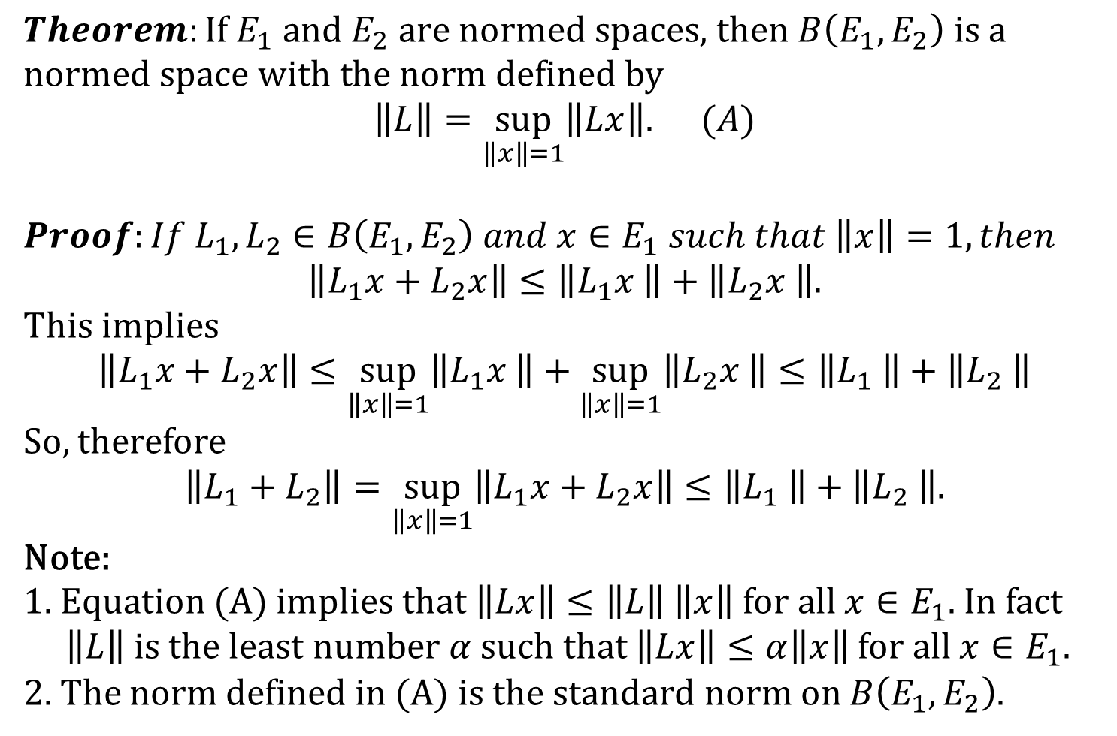
$$Theorem:\text{If} E_{1} \text{and} E_{2} \text{are} \text{normed} \text{spaces}\text{, }\text{then} B\left(E_{1},E_{2}\right) \text{is} \text{a} \text{normed} \text{space} \text{with} \text{the} \text{norm} \text{defined} \text{by}$$
$$\left\|L\right\|=\sup_{\left\|x\right\|=1}\left\|Lx\right\|. (A)$$
$$Proof:If L_{1},L_{2}∈B\left(E_{1},E_{2}\right) and x∈E_{1} such that \left\|x\right\|=1, then$$
$$\left\|L_{1}x+L_{2}x\right\|≤\left\|L_{1}x \right\|+\left\|L_{2}x \right\|.$$
This implies
$$\left\|L_{1}x+L_{2}x\right\|≤\sup_{\left\|x\right\|=1}\left\|L_{1}x \right\|+\sup_{\left\|x\right\|=1}\left\|L_{2}x \right\|≤\left\|L_{1} \right\|+\left\|L_{2} \right\|$$
So, therefore
$\left\|L_{1}+L_{2}\right\|=\sup_{\left\|x\right\|=1}\left\|L_{1}x+L_{2}x\right\|≤\left\|L_{1} \right\|+\left\|L_{2} \right\|$.
Note:
1. Equation (A) implies that$\left\|Lx\right\|≤\left\|L\right\|$$\left\|x\right\|$ for all $x∈E_{1}$. In fact
$\left\|L\right\|$ is the least number $α$ such that $\left\|Lx\right\|≤α\left\|x\right\|$ for all $x∈E_{1}$.
2. The norm defined in (A) is the standard norm on $B\left(E_{1},E_{2}\right)$.

Slide 10
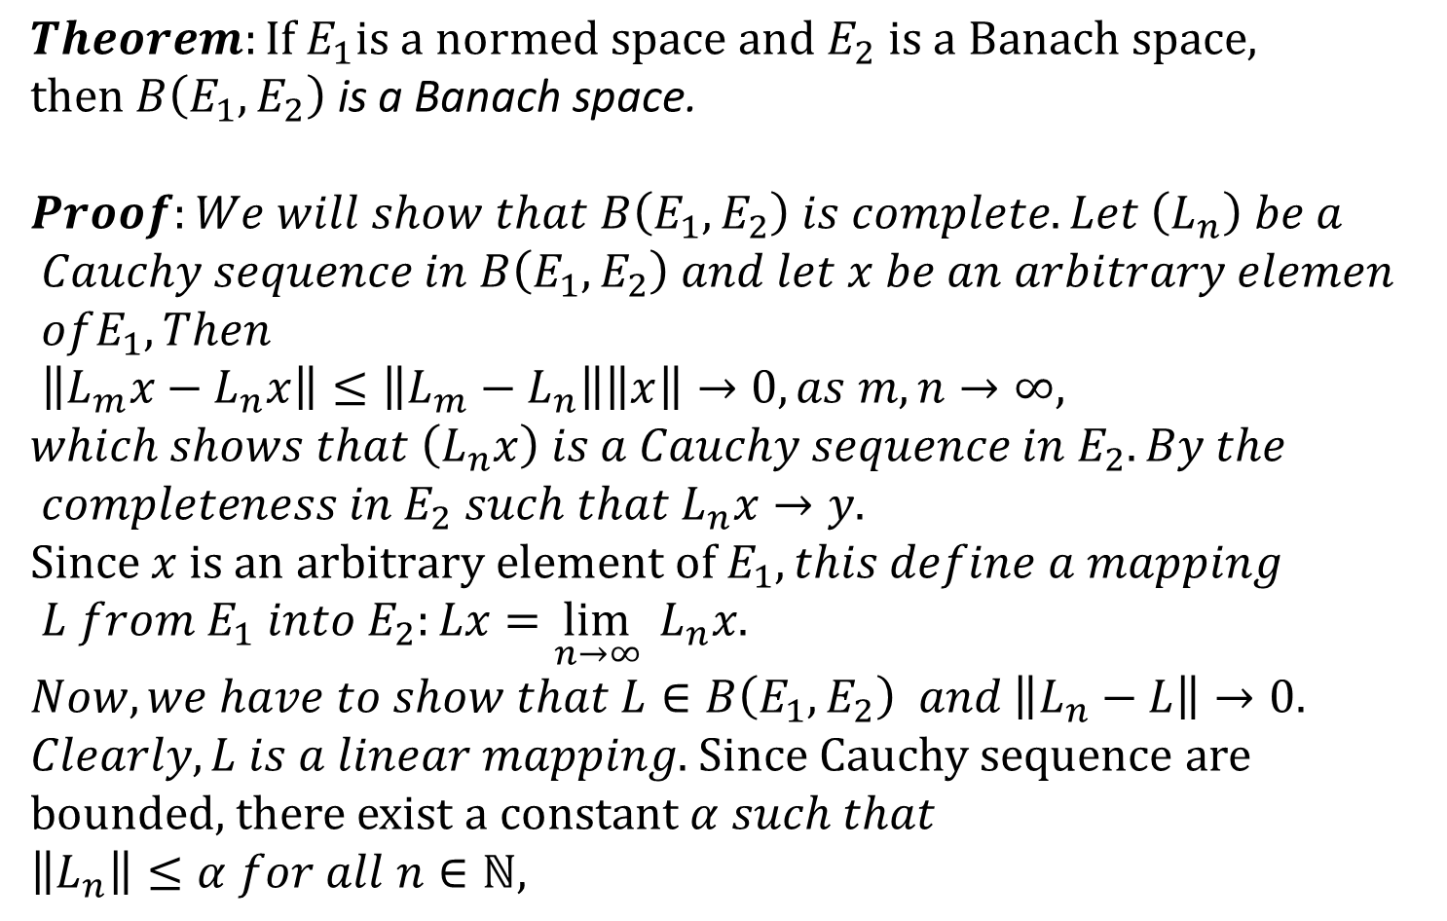
$$Theorem:\text{If} E_{1}\text{is} \text{a} \text{normed} \text{space} \text{and} E_{2} \text{is} \text{a} \text{Banach} \text{space}\text{, }\text{then} B\left(E_{1},E_{2}\right) \text{is} \text{a} \text{Banach} \text{space}\text{.}$$
$$Proof:We will show that B\left(E_{1},E_{2}\right) is complete. Let \left(L_{n}\right) be a$$
$$Cauchy sequence in B\left(E_{1},E_{2}\right) and let x be an arbitrary elemen$$
$$ofE_{1}, Then$$
$$\left\|L_{m}x−L_{n}x\right\|≤\left\|L_{m}−L_{n}\right\|\left\|x\right\|→0, as m,n→∞, which shows that \left(L_{n}x\right) is a Cauchy sequence in{ E}_{2}. By the$$
$$completeness in{ E}_{2} such that{ L}_{n}x→y.$$
$$Since x is an arbitrary element of{ E}_{1}, this define a mapping$$
$$L from{ E}_{1} into{ E}_{2}:Lx=\lim_{n→∞}{{ L}_{n}x. }$$
$$Now, we have to show that L∈B\left(E_{1},E_{2}\right) and \left\|L_{n}−L\right\|→0.$$
$Clearly, L is a linear mapping$. Since Cauchy sequence are bounded, there exist a constant $α such that$
$$\left\|L_{n}\right\|≤α for all n∈ℕ,$$

Slide 11
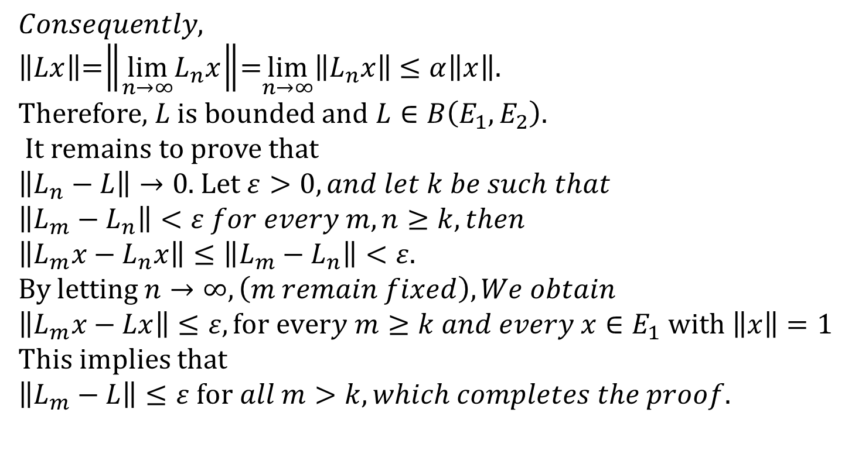
$Consequently,$
$\left\|Lx\right\|$=$\left\|{\lim_{n→∞}L}_{n}x\right\|$=$\lim_{n→∞}\left\|L_{n}x\right\|$$≤α\left\|x\right\|$.
Therefore, $L$ is bounded and $L∈B\left(E_{1},E_{2}\right)$.
It remains to prove that
$\left\|L_{n}−L\right\|→0$. Let $ε>0, and let k be such that$
$$\left\|L_{m}−L_{n}\right\|<ε for every m,n≥k, then$$
$\left\|L_{m}x−L_{n}x\right\|≤\left\|L_{m}−L_{n}\right\|<ε$.
By letting $n→∞, \left(m remain fixed\right), We obtain$
$$\left\|L_{m}x−Lx\right\|≤ε, for every m≥k and every x∈E_{1} with \left\|x\right\|=1$$
This implies that
$\left\|L_{m}−L\right\|≤ε$$for all m>k, which completes the proof.$

Slide 12
Summary of the Today’s Lectures
In this lecture we presented some result regarding Banach spaces and then define Linear mappings and proved some theorems on it.

