Slide 1
Introduction To Hilbert Spaces with Applications
Lokenath Debnath and Piotr Mikusinski
Course Teacher: Dr. Amjad Hussain

Slide 2
Summary of the Last Lecture
In our last lecture, we mainly concerned with two very important sections of Chapter 5, namely the method of solution for separable kernel and differential equations and differential operators. The first section was ended with some theorems with related examples. However, the second one was still under discussion and will be completed in this lecture.

Slide 3
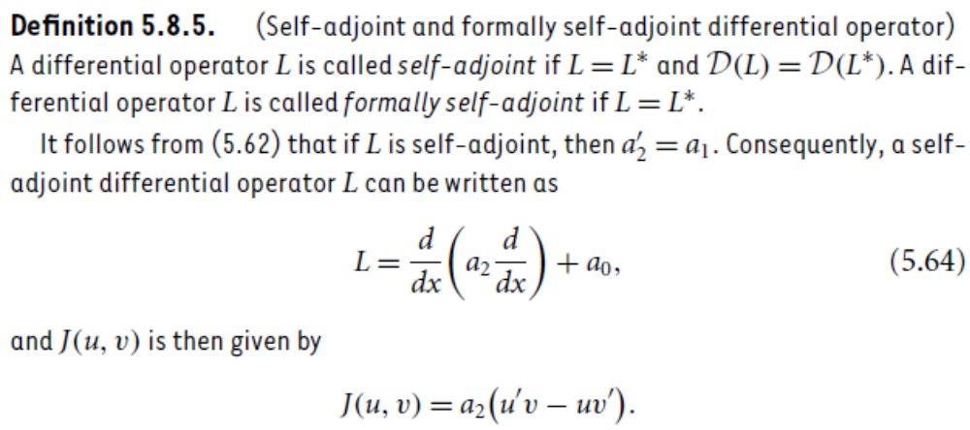

Slide 4
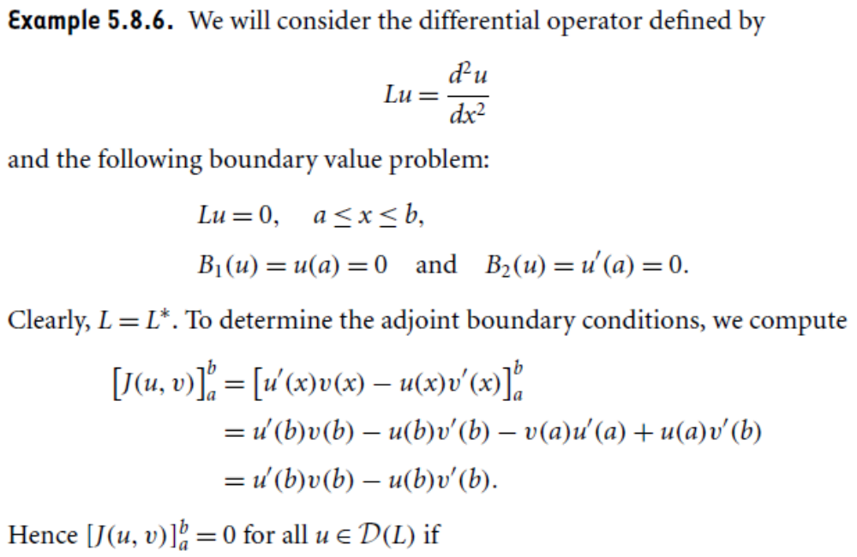

Slide 5
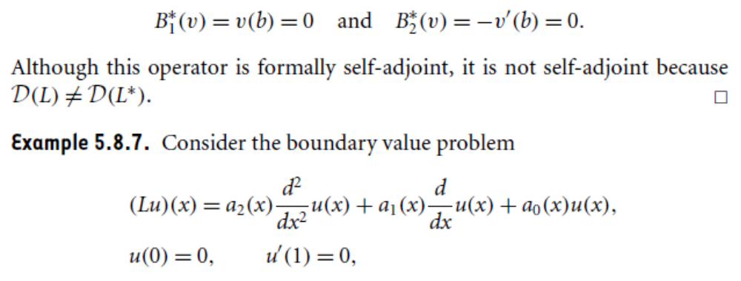
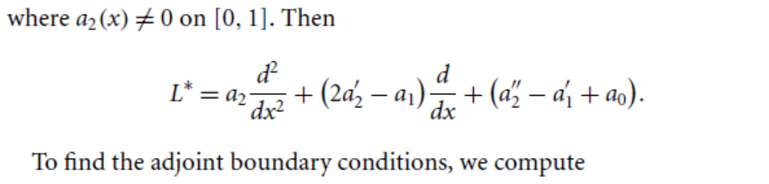

Slide 6
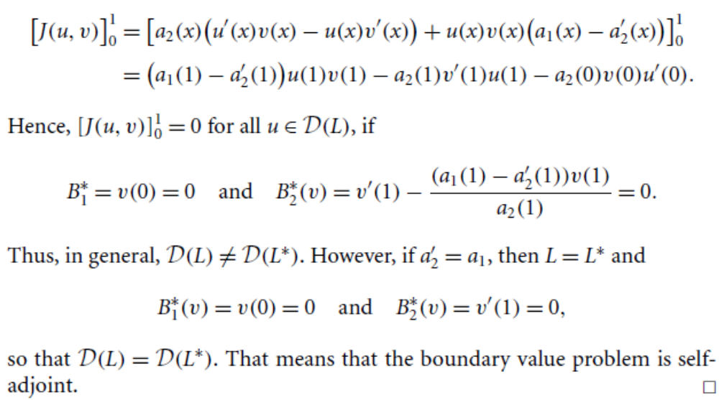

Slide 7
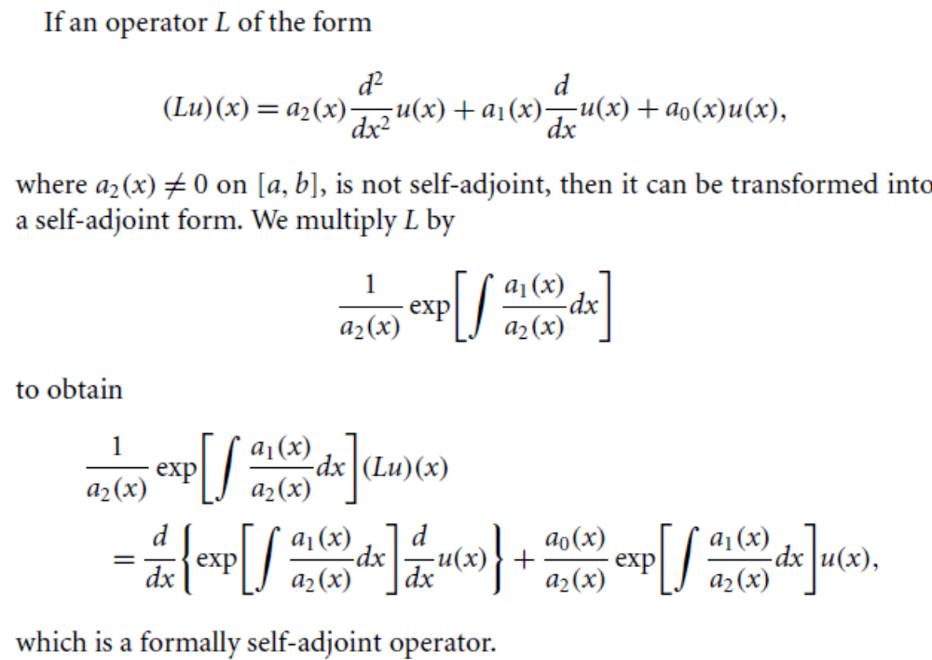

Slide 8
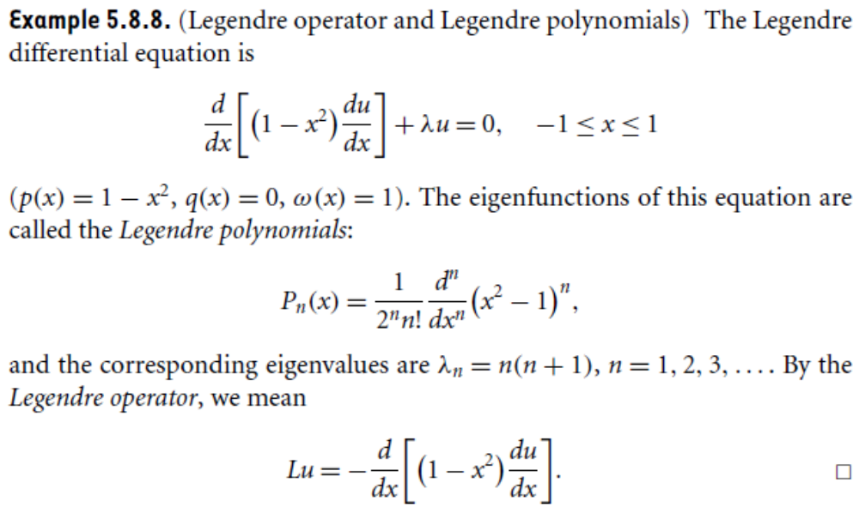

Slide 9
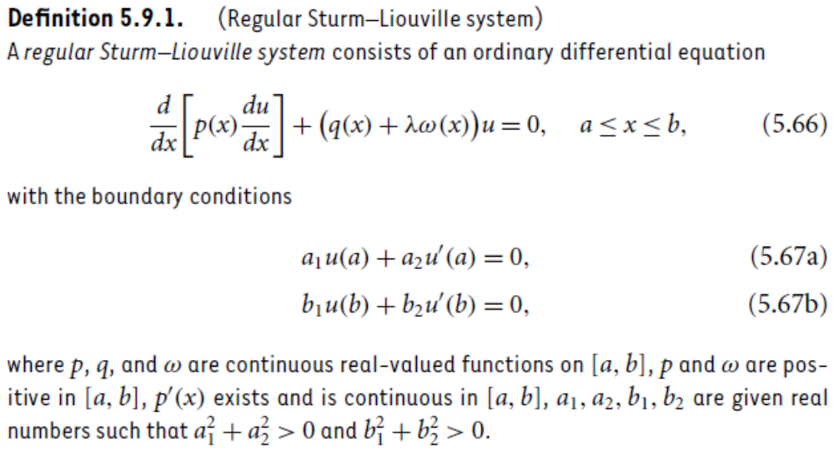
Sturn-Liouville System

Slide 10
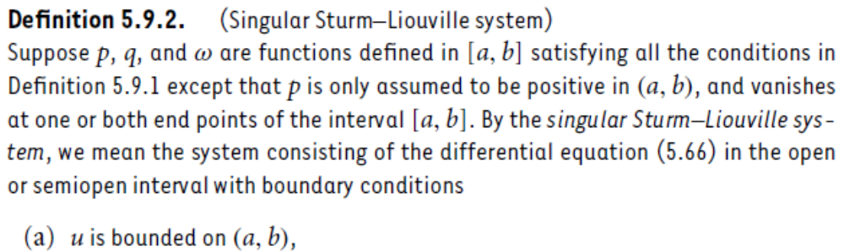

Slide 11
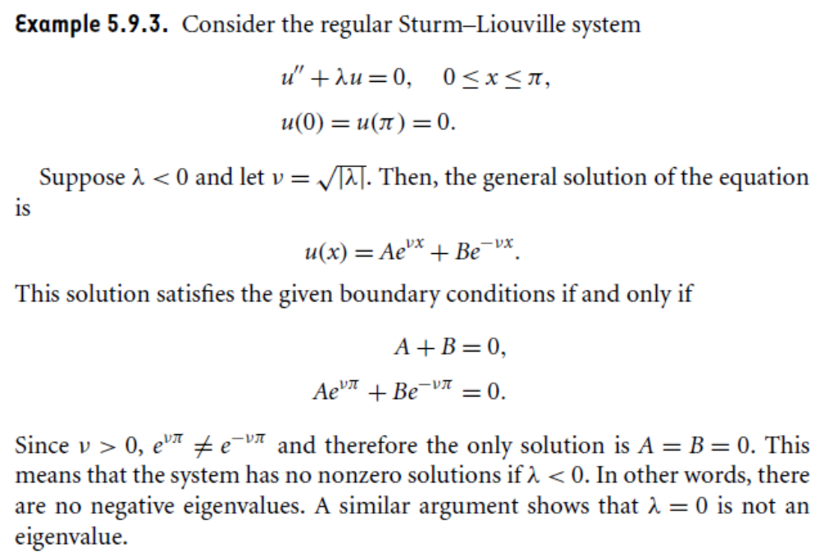

Slide 12
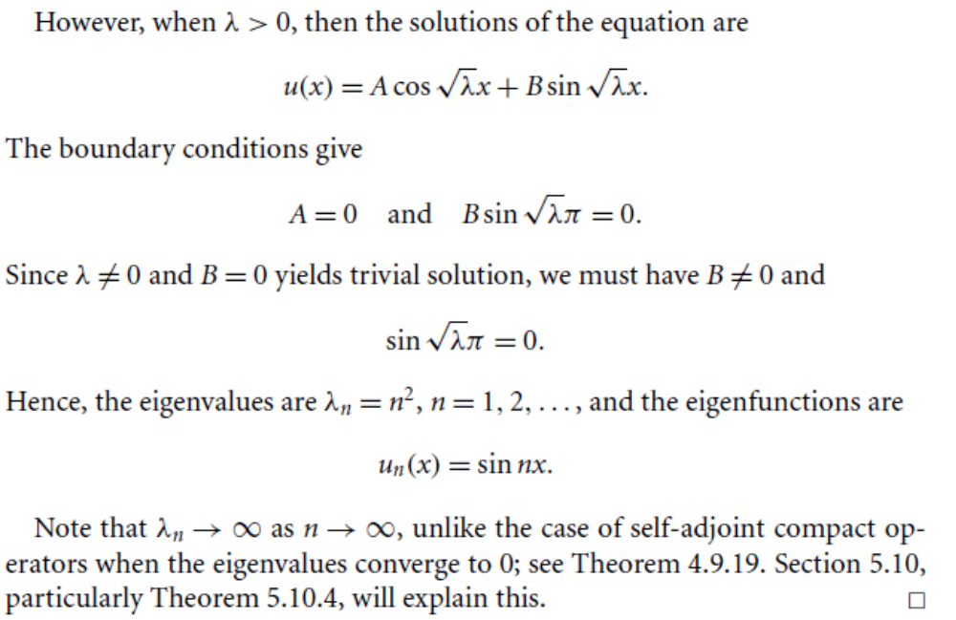

Slide 13
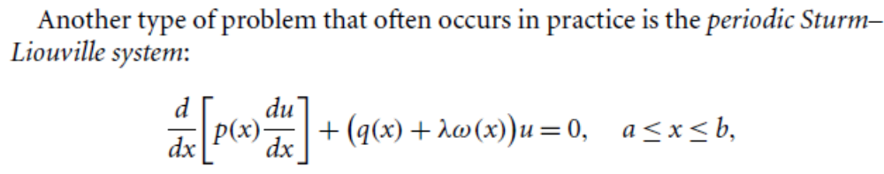
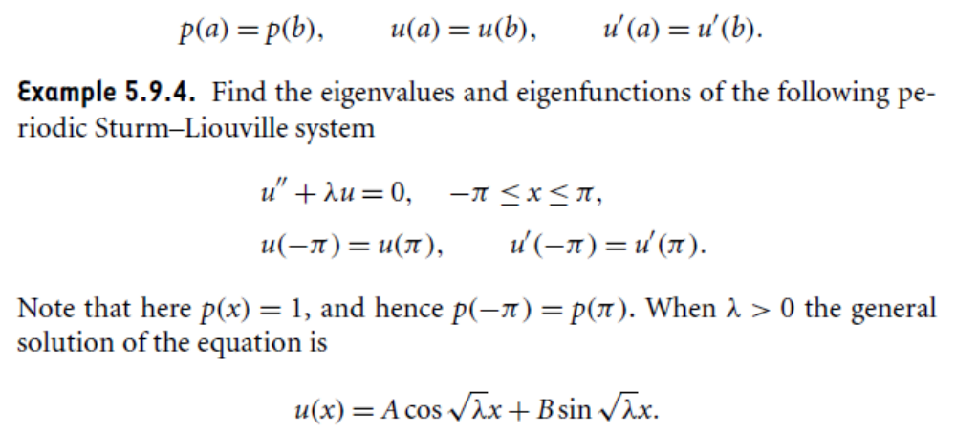

Slide 14
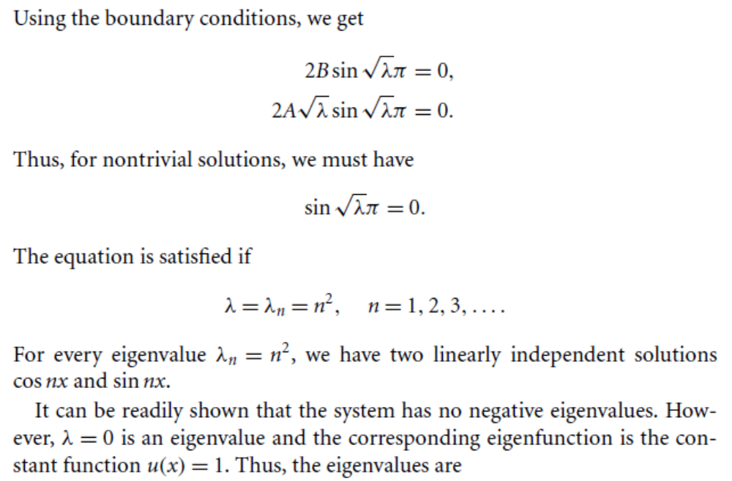

Slide 15
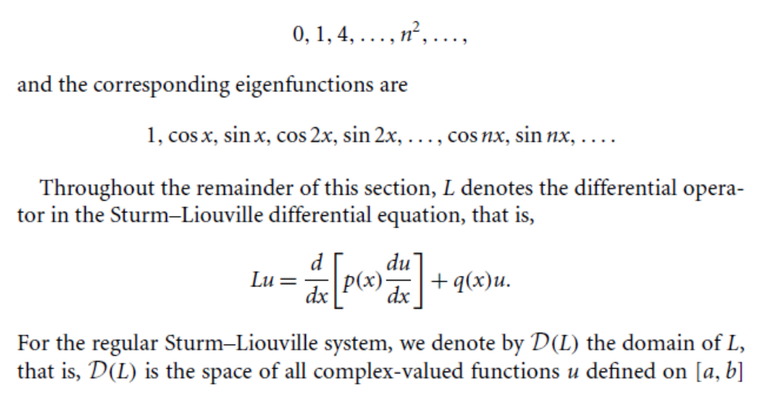

Slide 16
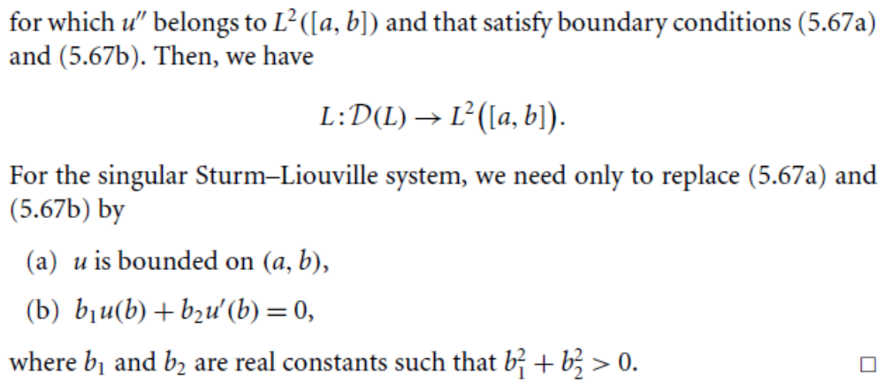

Slide 17
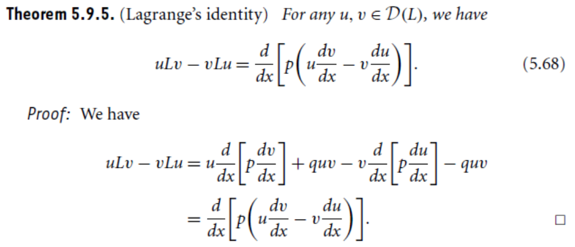

Slide 18
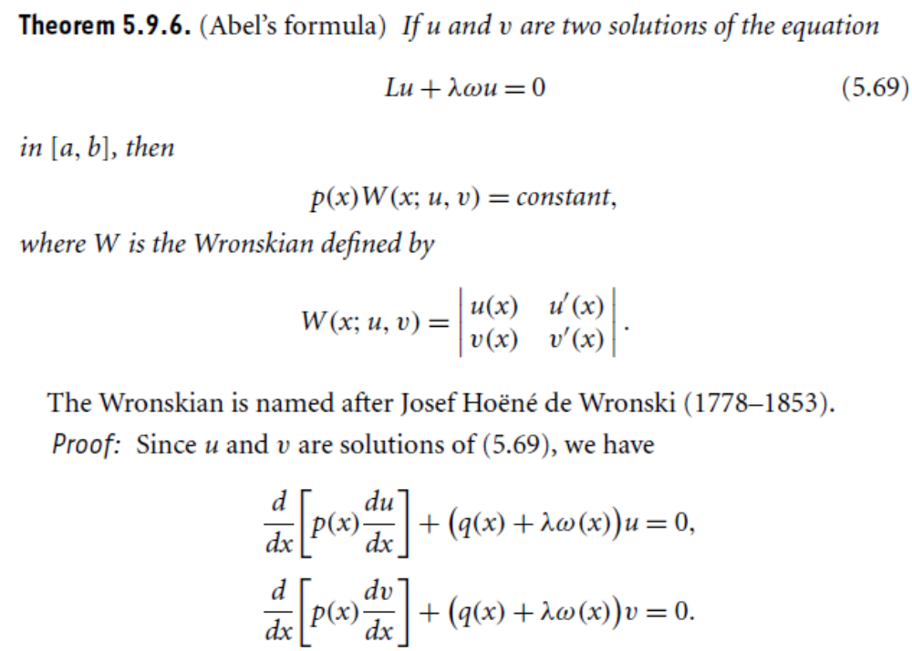

Slide 19
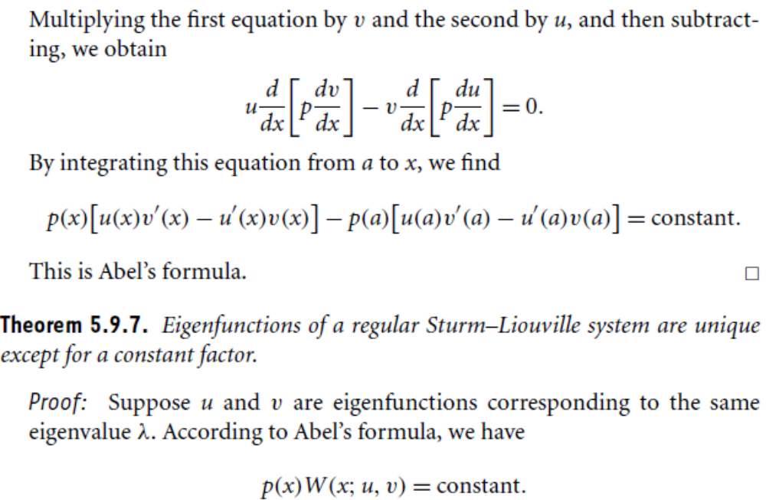

Slide 20
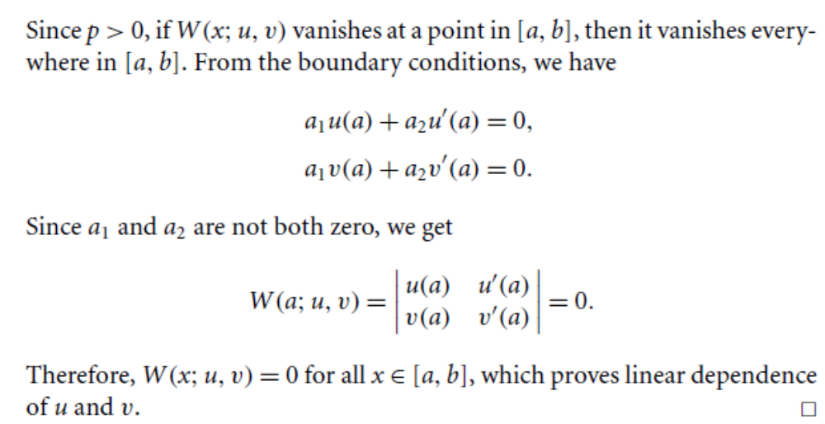

Slide 21
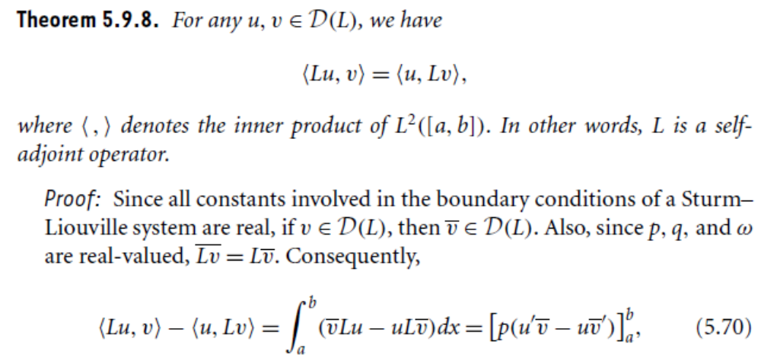

Slide 23
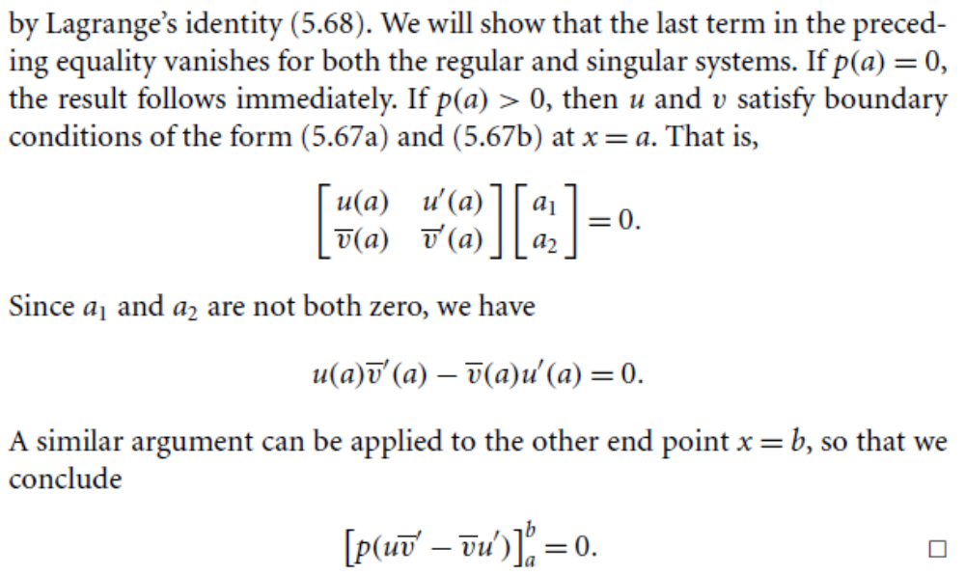

Slide 24
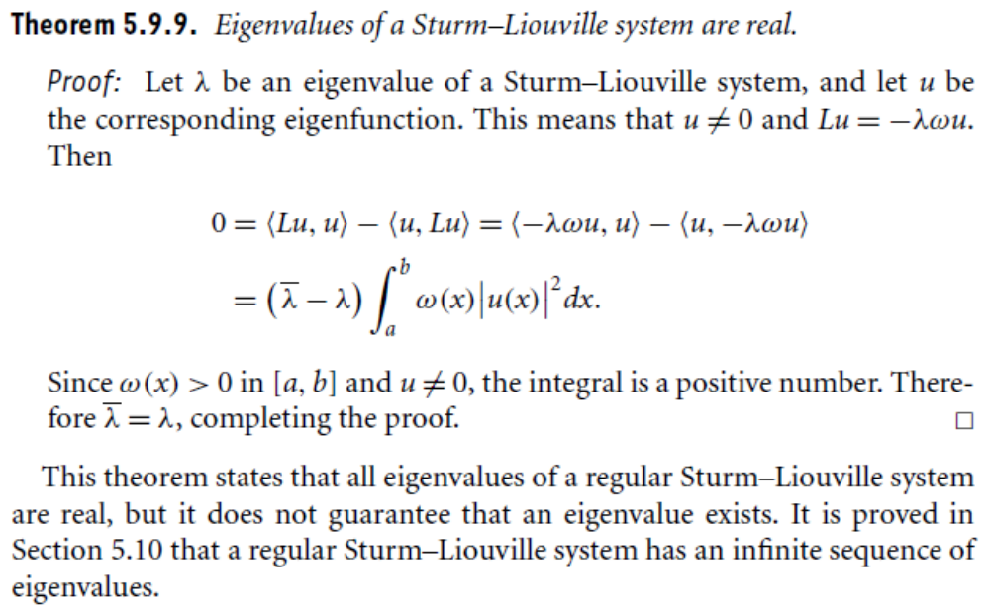

Slide 26
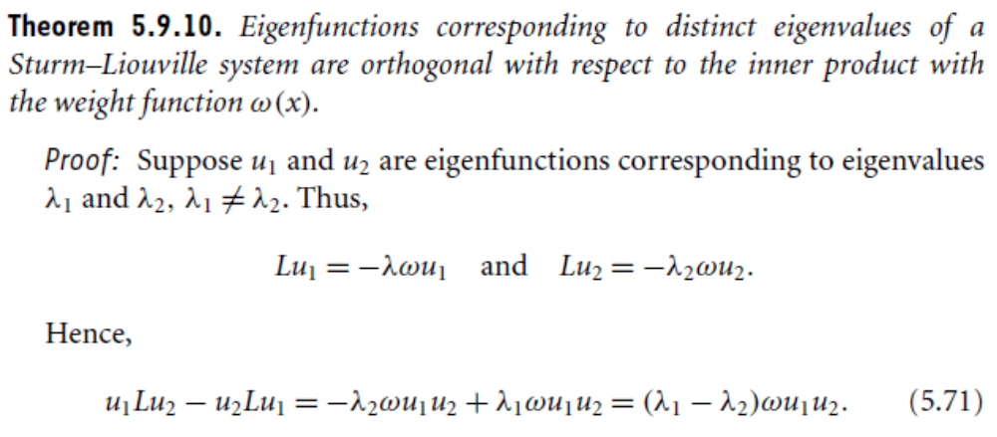
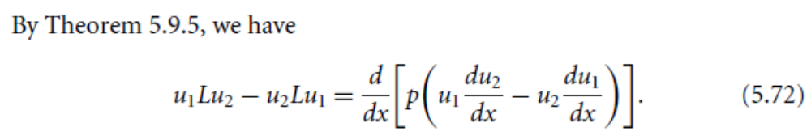

Slide 27
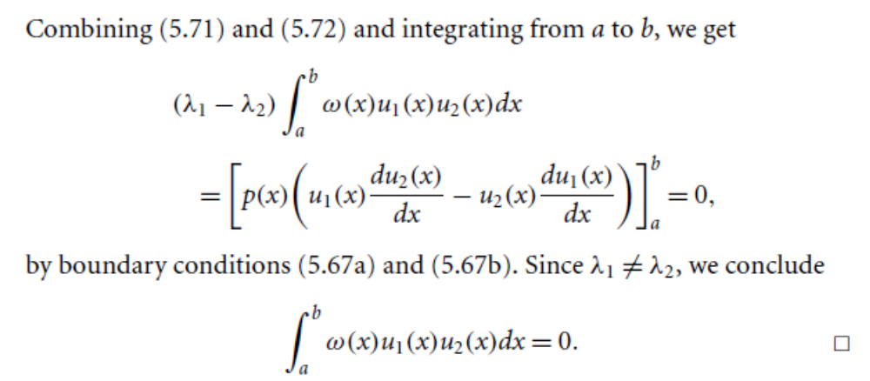

Slide 28
Summary of the today’s Lecture
In our today’s lecture, we finish the remainder of the uncompleted section of differential operators. We then started a new section, namely, Sturn-Liouville system and proved many theorem regarding this topic. Some examples are also provided for thorough understanding of the topic.

