Slide 1
Introduction To Hilbert Spaces with Applications
Lokenath Debnath and Piotr Mikusinski
Course Teacher: Dr. Amjad Hussain

Slide 2
Summary of the Last Lecture
In our last lecture, we developed the method of so called successive approximations to tackle with the integral equations of general kind and same for the Volterra homogeneous and non-homogeneous integral equations.

Slide 3
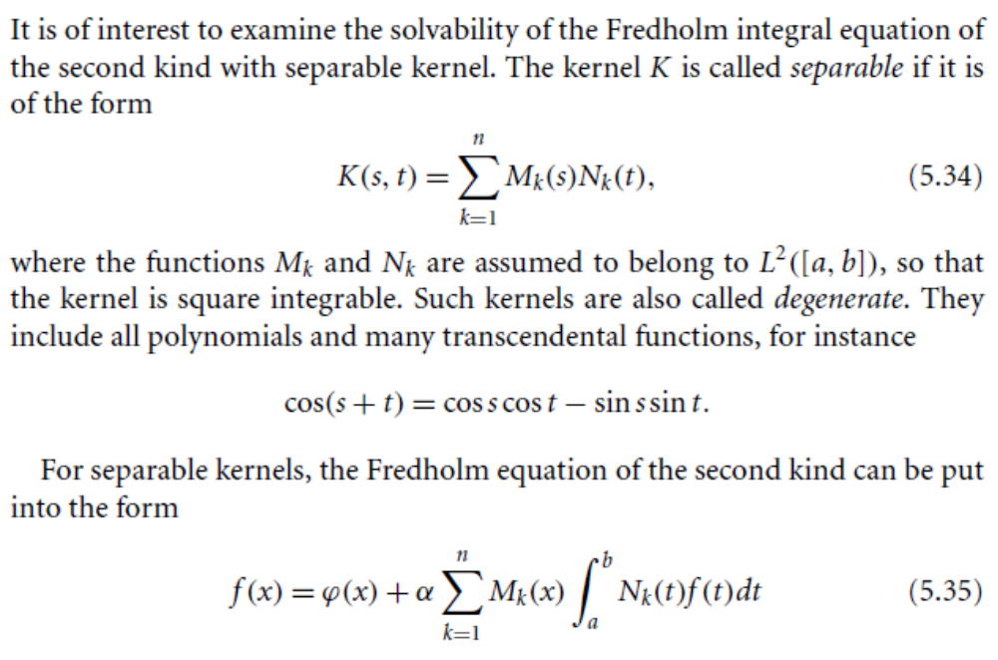
Method of Solution for a Separable Kernel

Slide 4
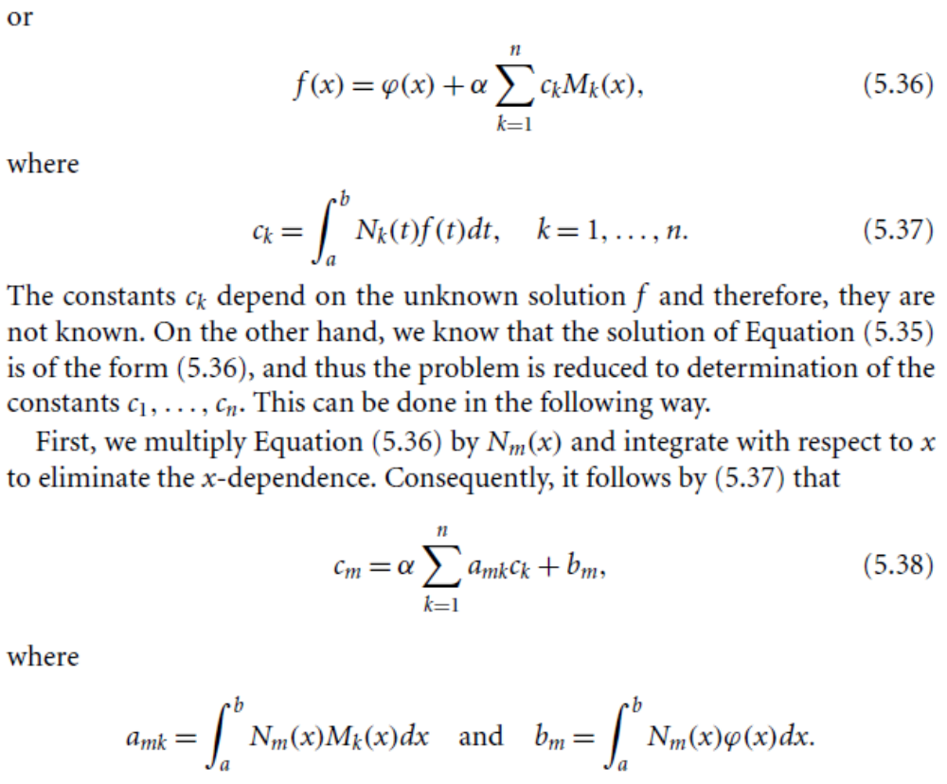

Slide 6
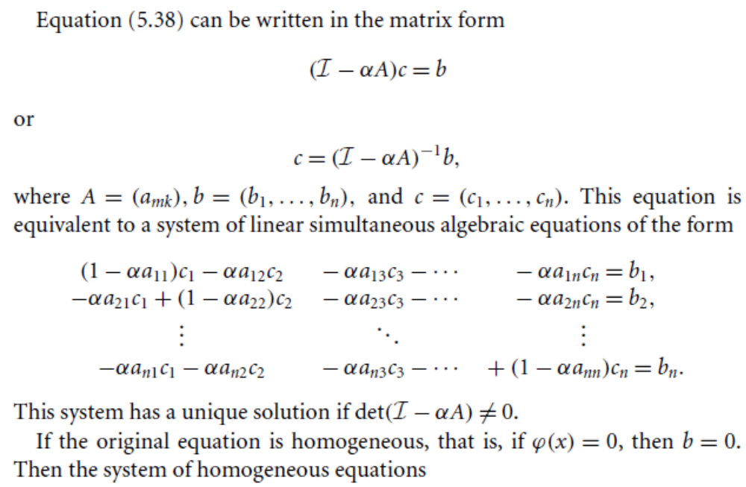

Slide 7
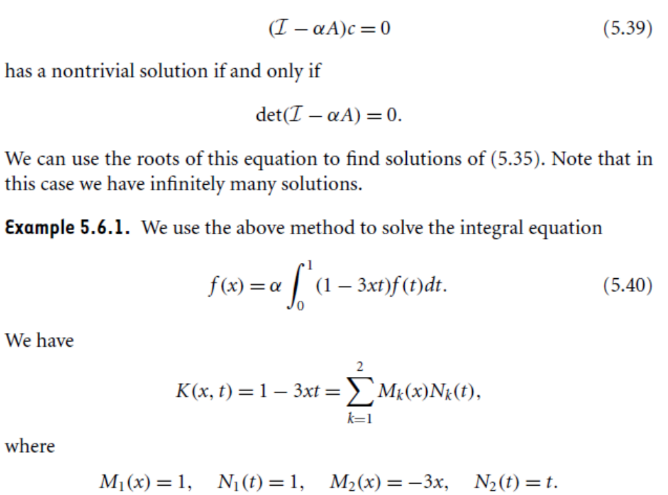

Slide 8
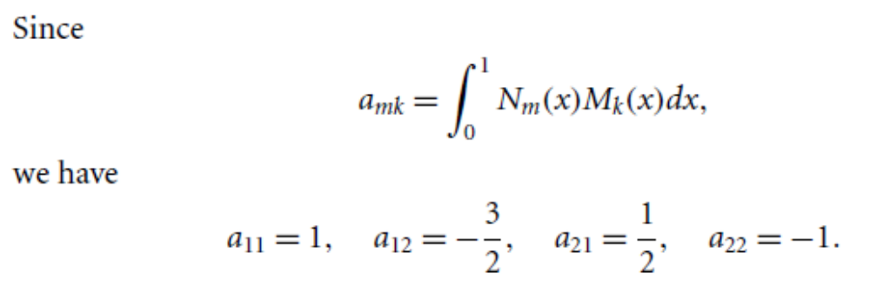
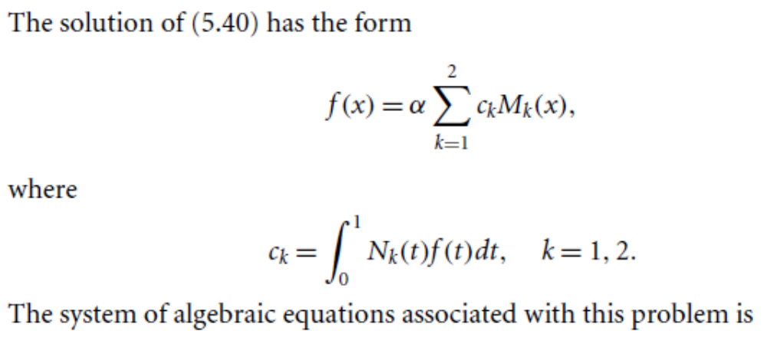

Slide 9
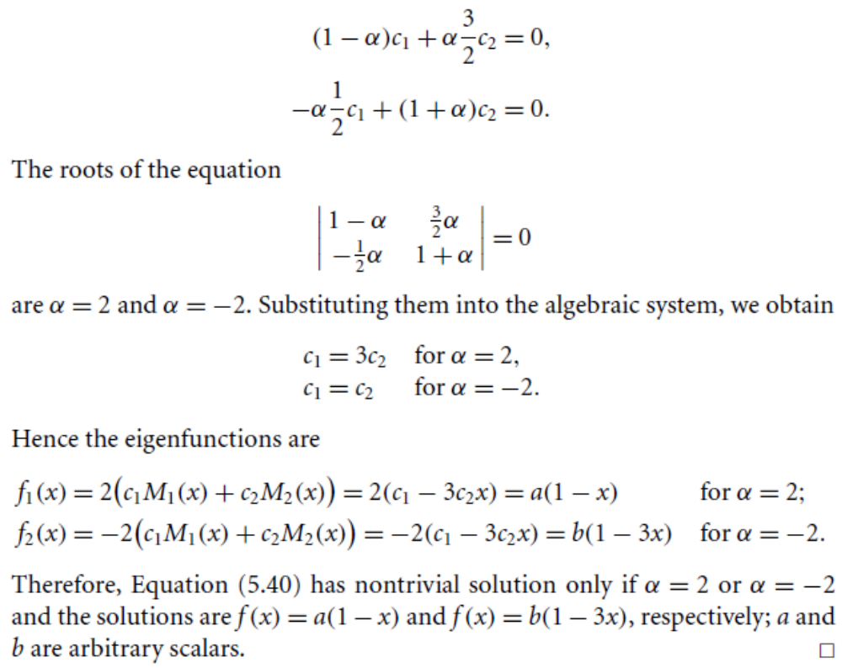

Slide 11
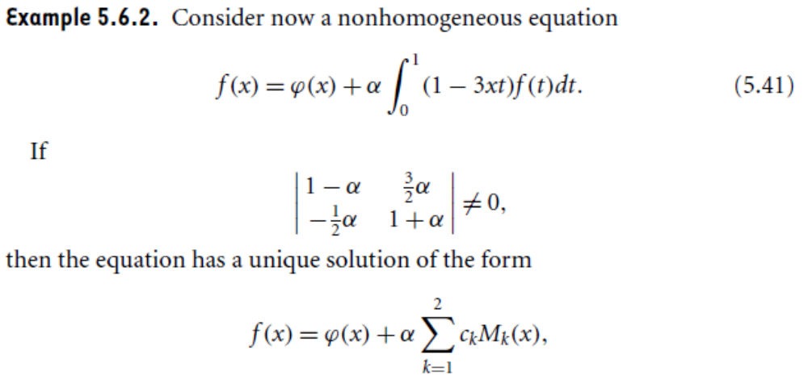

Slide 12
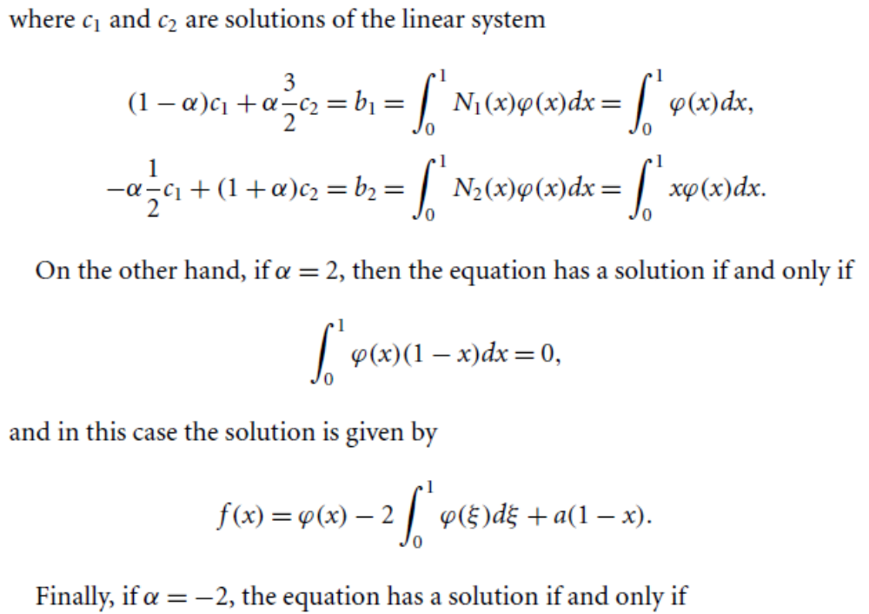

Slide 13
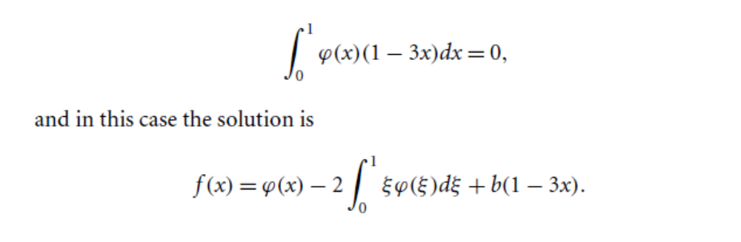

Slide 14
Ordinary Differential Equations
and
Differential Operators

Slide 15
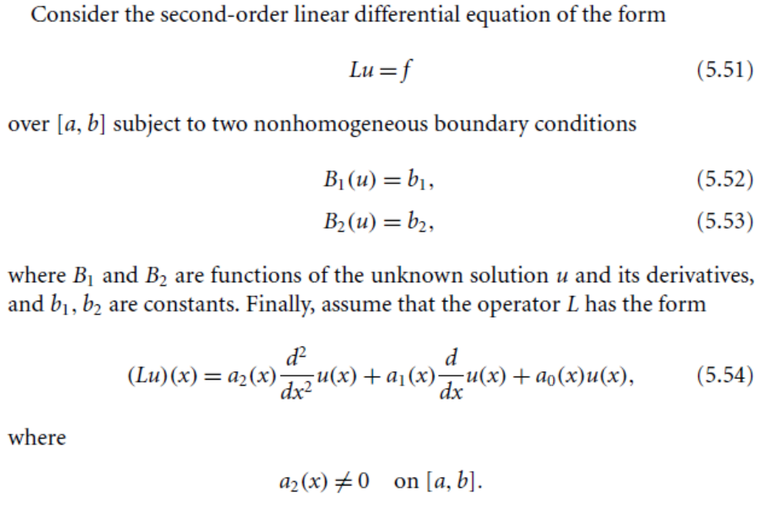

Slide 16
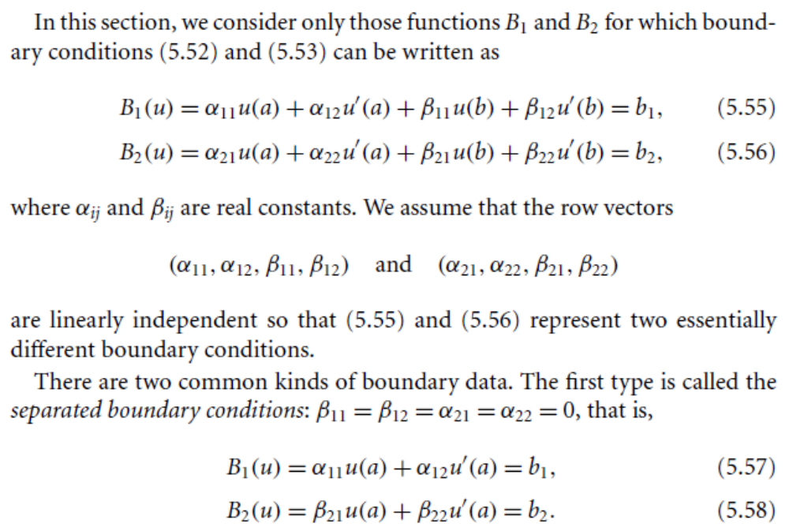

Slide 17
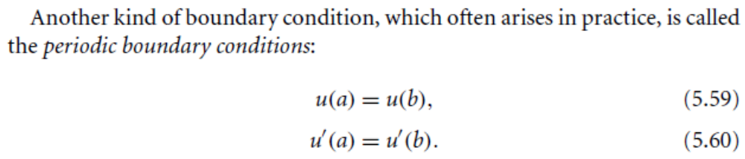
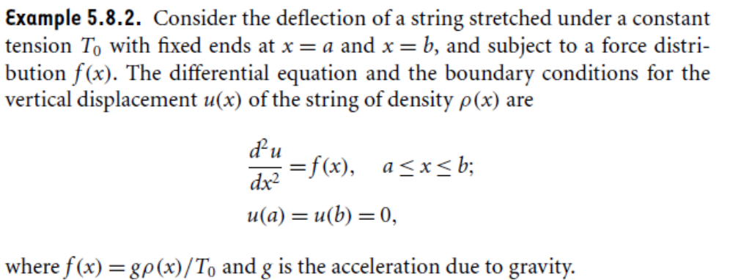

Slide 18
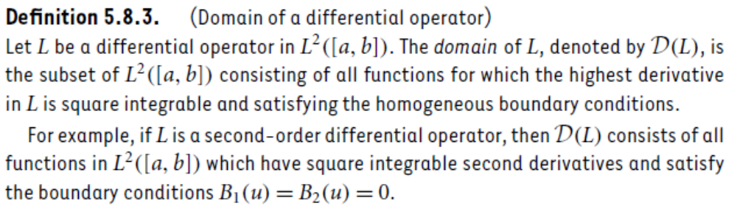
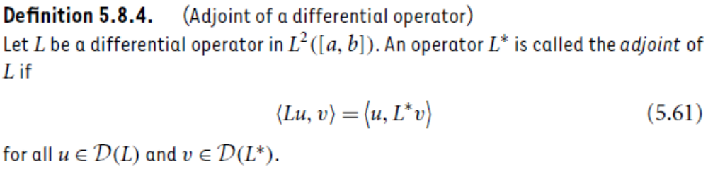

Slide 19
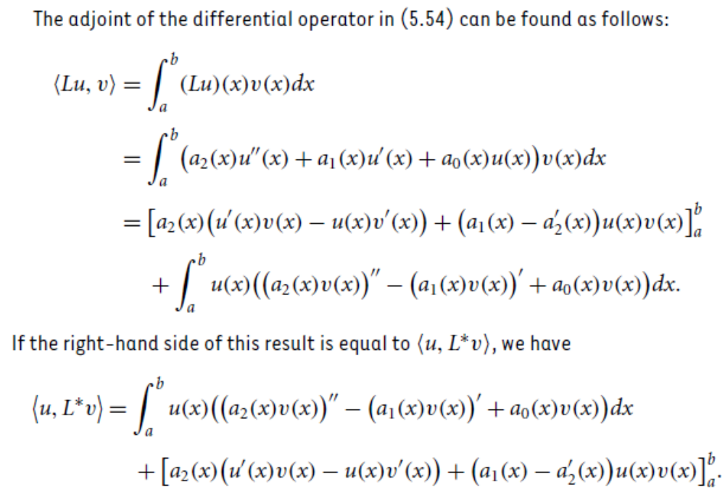

Slide 20
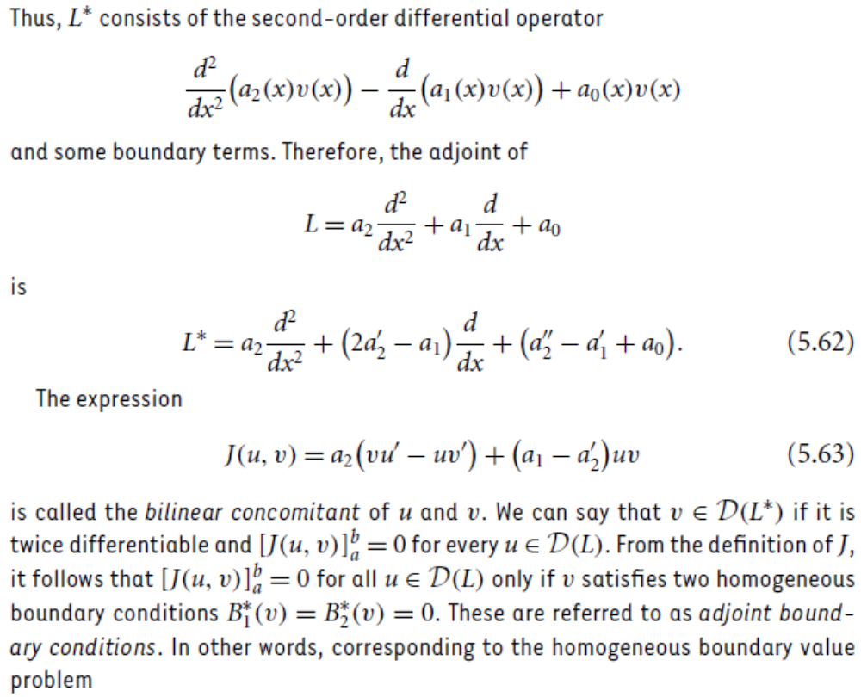

Slide 21
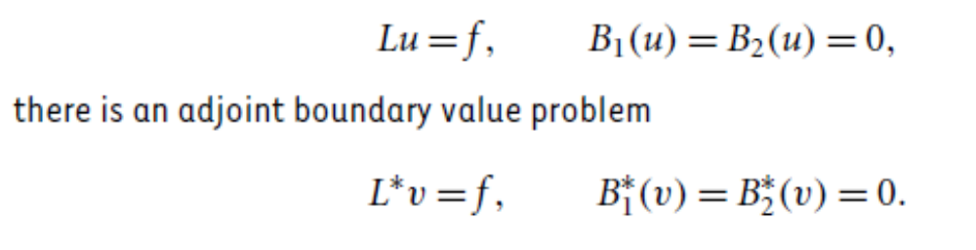

Slide 22
Summary of the today’s Lecture
In our today’s lecture, we mainly concerned with two very important sections of this chapter, namely the method of solution for separable kernel and differential equations and differential operators. The first section is ended with some theorems with related examples. However, the second one is still under discussion and will be completed in next lecture.

