Slide 1
Introduction To Hilbert Spaces with Applications
Lokenath Debnath and Piotr Mikusinski
Course Teacher: Dr. Amjad Hussain

Slide 2
Summary of the Last Lecture
In our last lecture, we considered Picard existence and uniqueness theorem, Fredholm alternative for self-adjoint compact operator, Existance and uniqueness of nonlinear Fredholm integral equations.

Slide 3
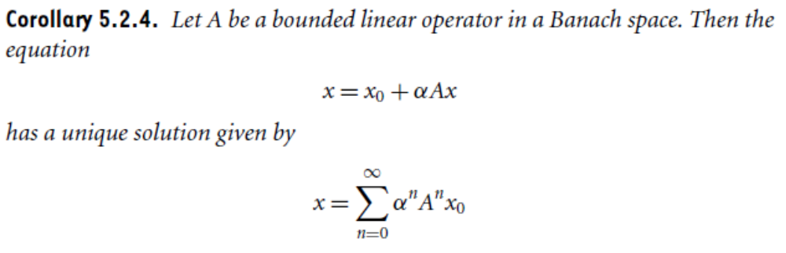
Previous Results

Slide 4
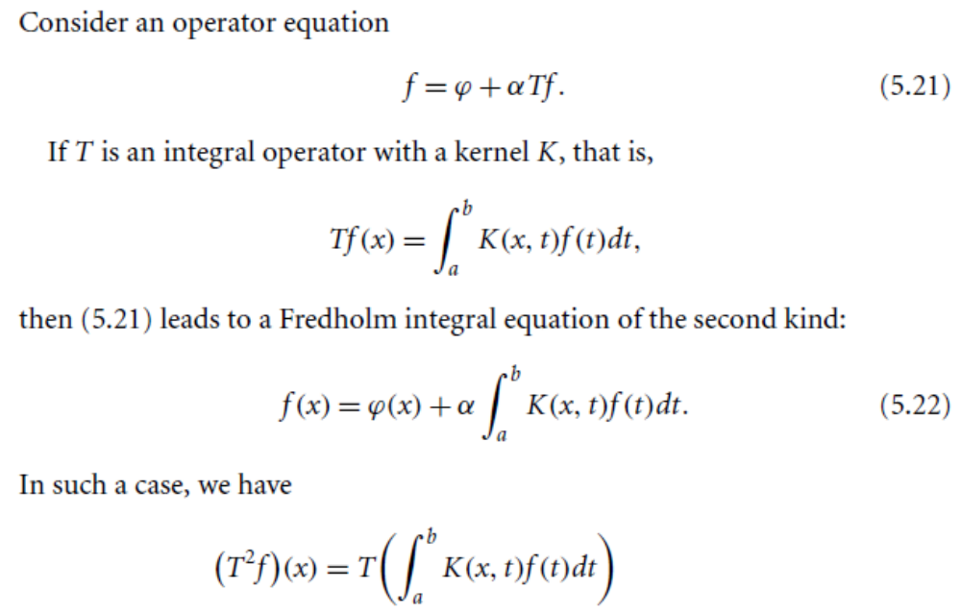
Method of Successive Approximation

Slide 5
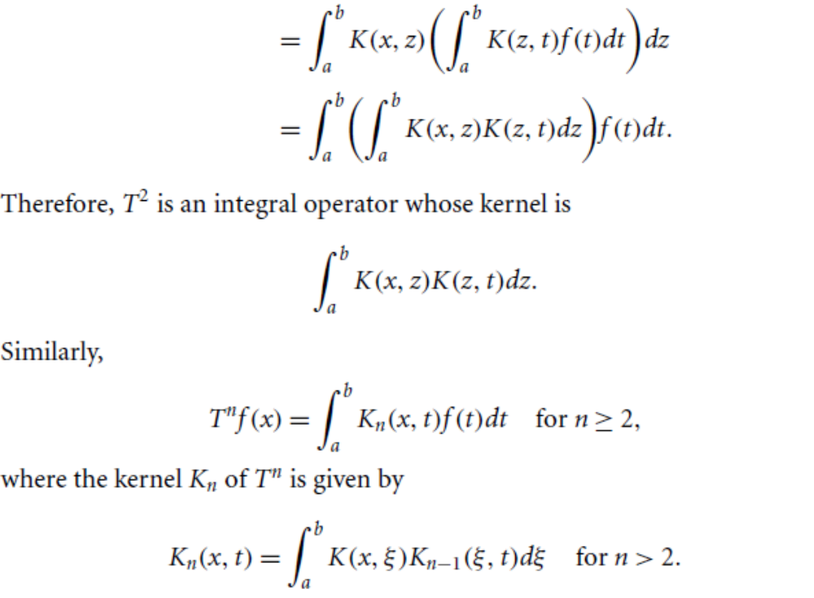

Slide 6
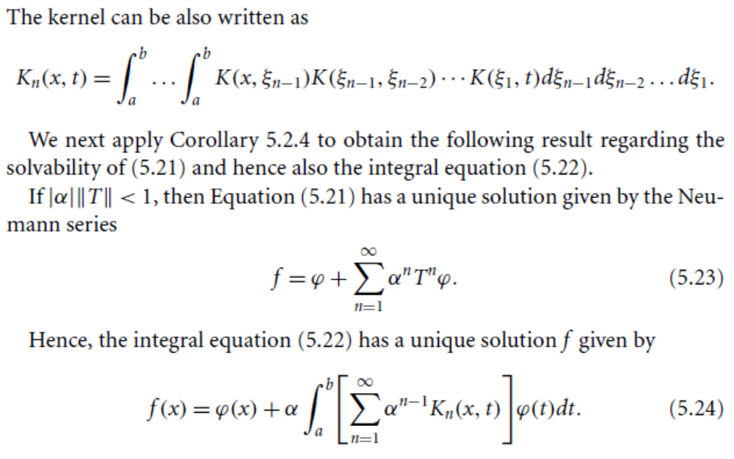

Slide 7
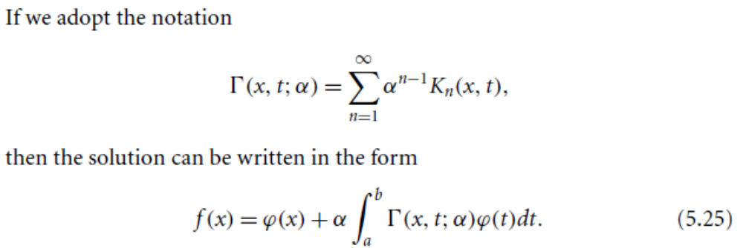
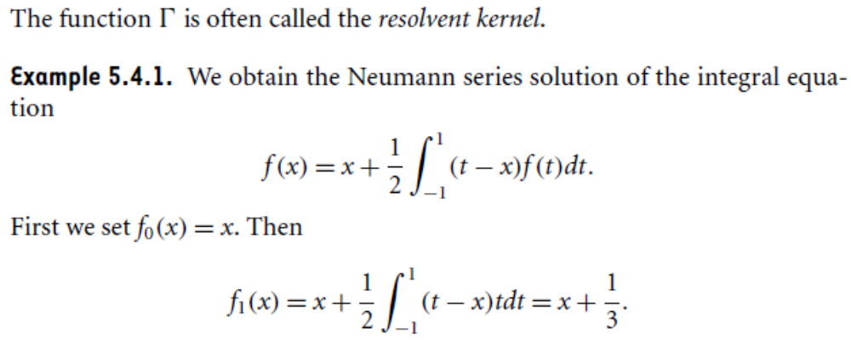

Slide 8
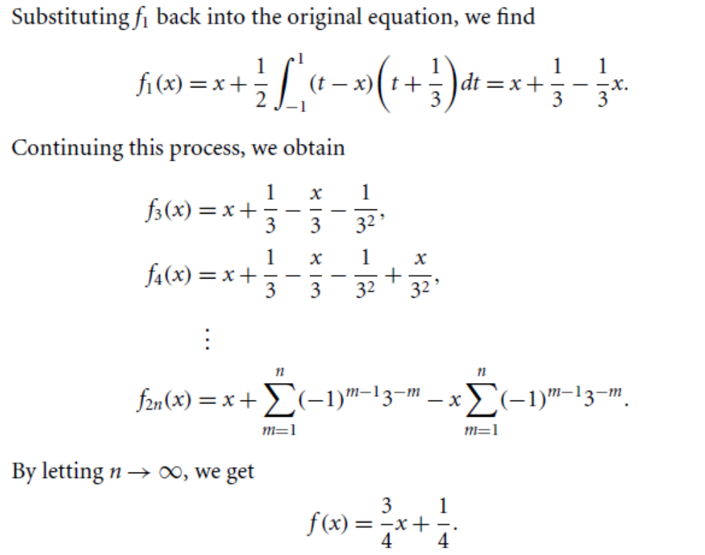

Slide 10
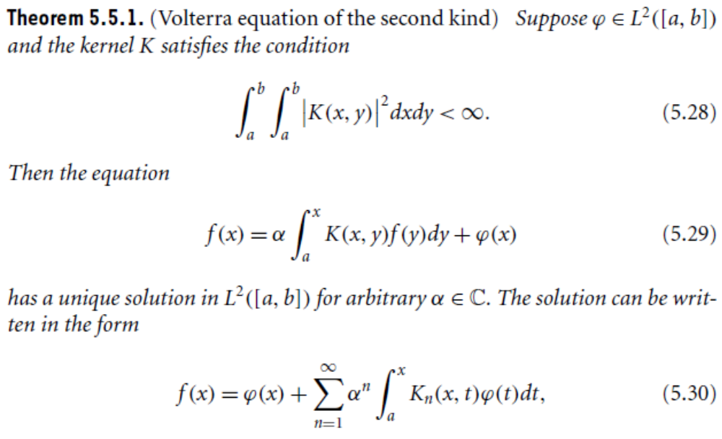
Volterra Integral Equations

Slide 11
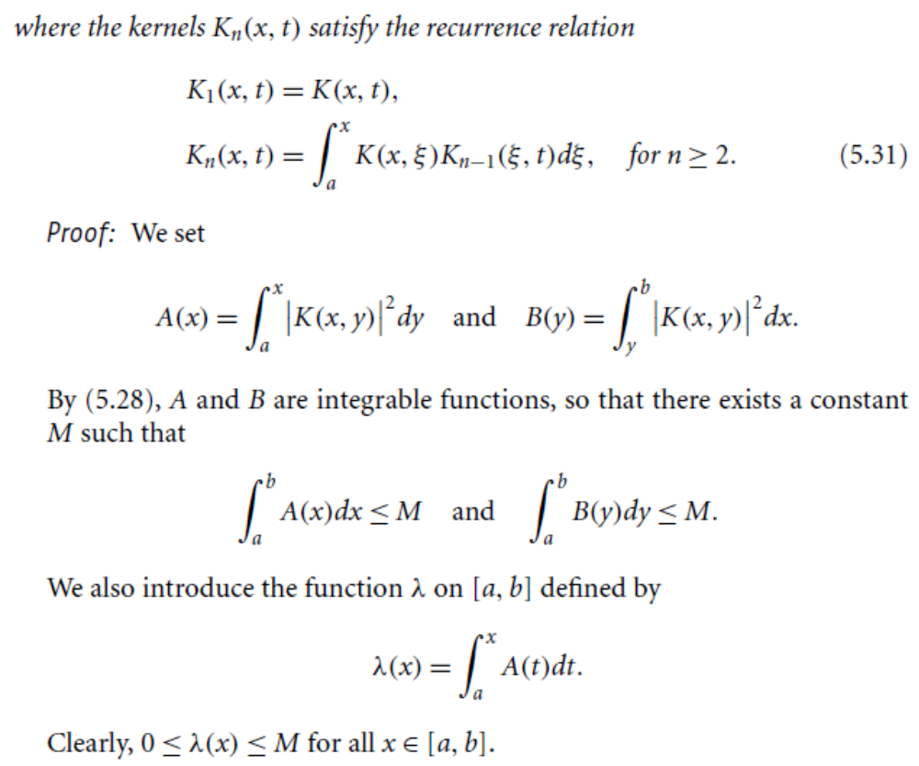

Slide 12
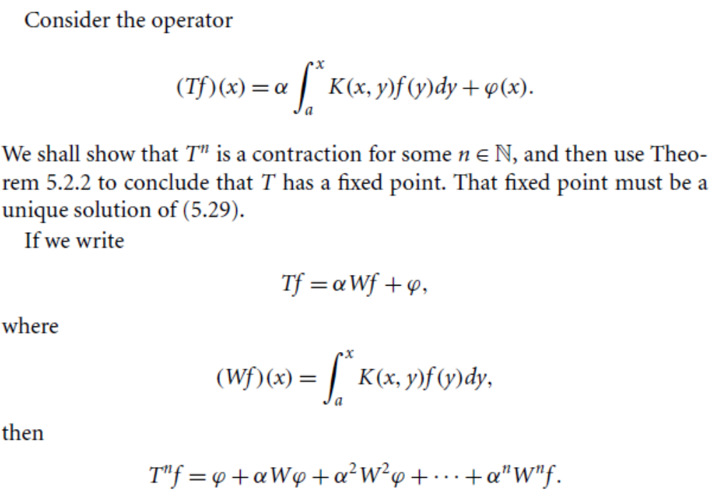

Slide 14
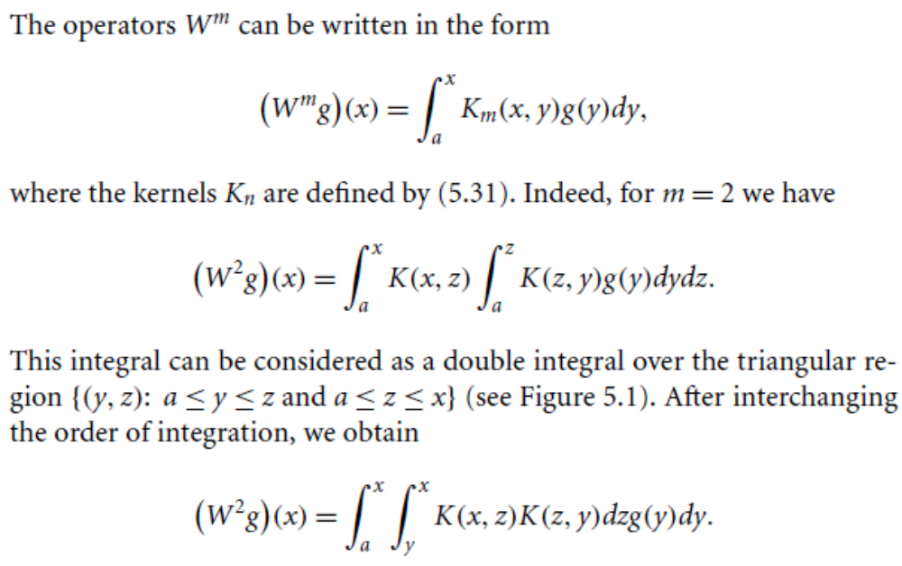

Slide 15
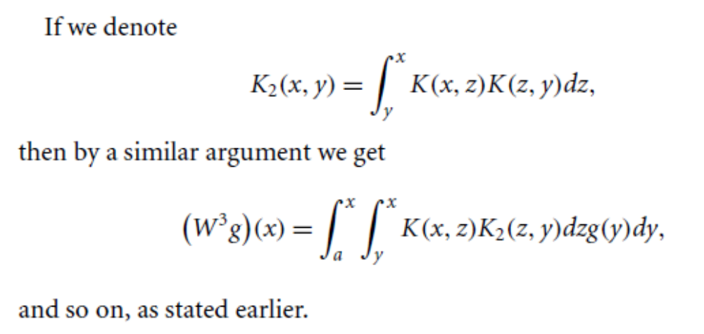
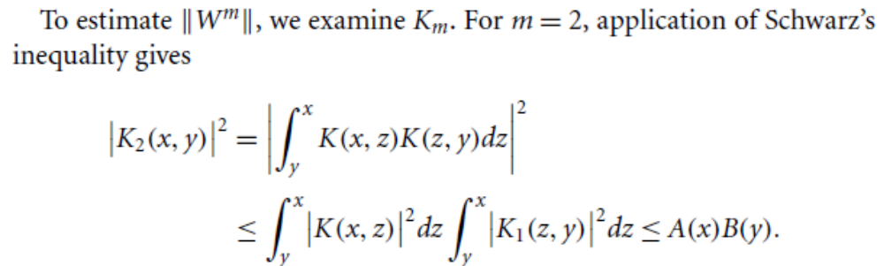

Slide 17
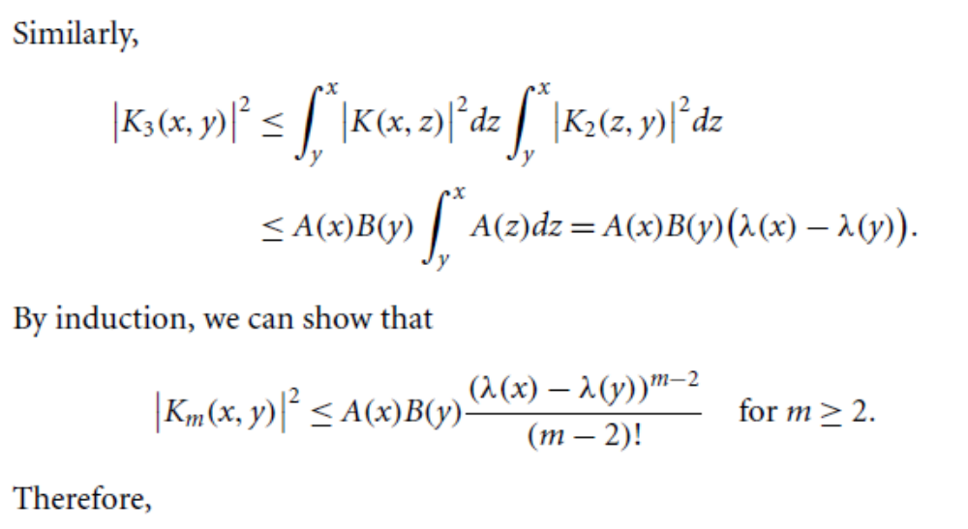

Slide 18
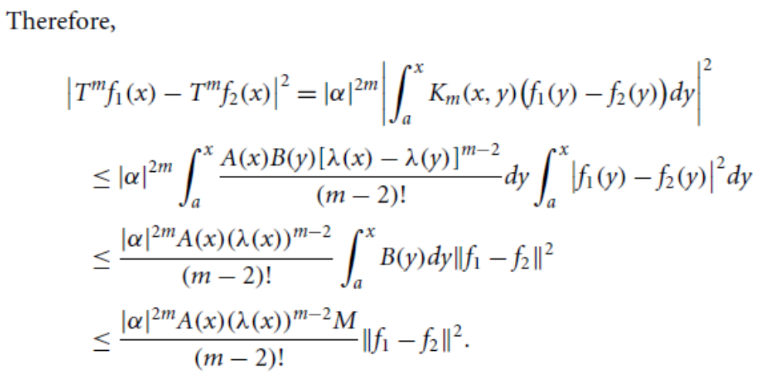

Slide 19
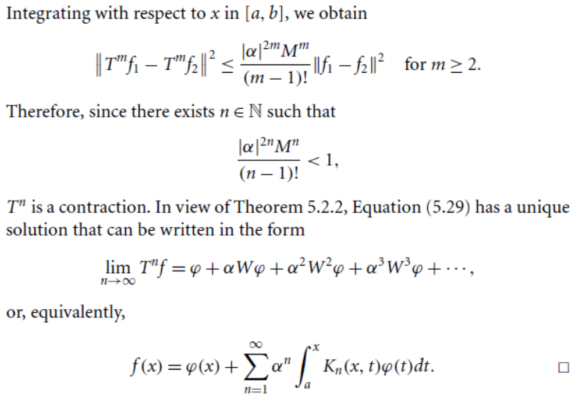

Slide 20
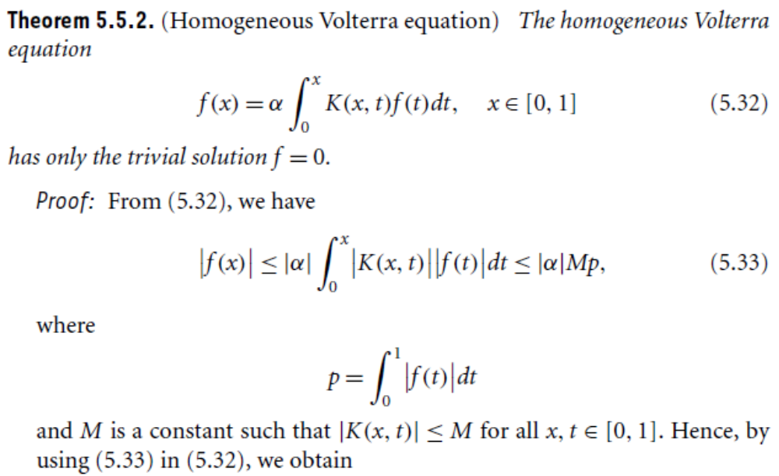

Slide 21
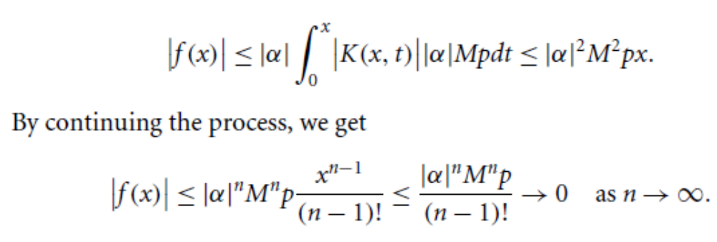

Slide 22
Summary of the today’s Lecture
In our today’s lecture,

