Slide 1
Summary of the Last Lectures
This is our Third lecture. In our second lecture, we studied the Normed vector space and some topological properties of Normed spaces. However, our first lecture is about Vector spaces and related results.

Slide 2
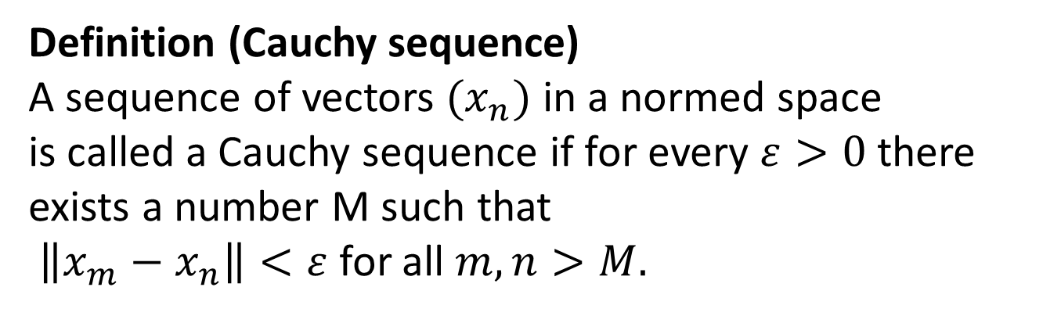
Banach Space
Definition (Cauchy sequence)
A sequence of vectors $(x_{n})$in a normed space
is called a Cauchy sequence if for every $ε>0$ there exists a number M such that
$\left\|x_{m}−x_{n}\right\|<ε$ for all $m,n>M.$

Slide 3
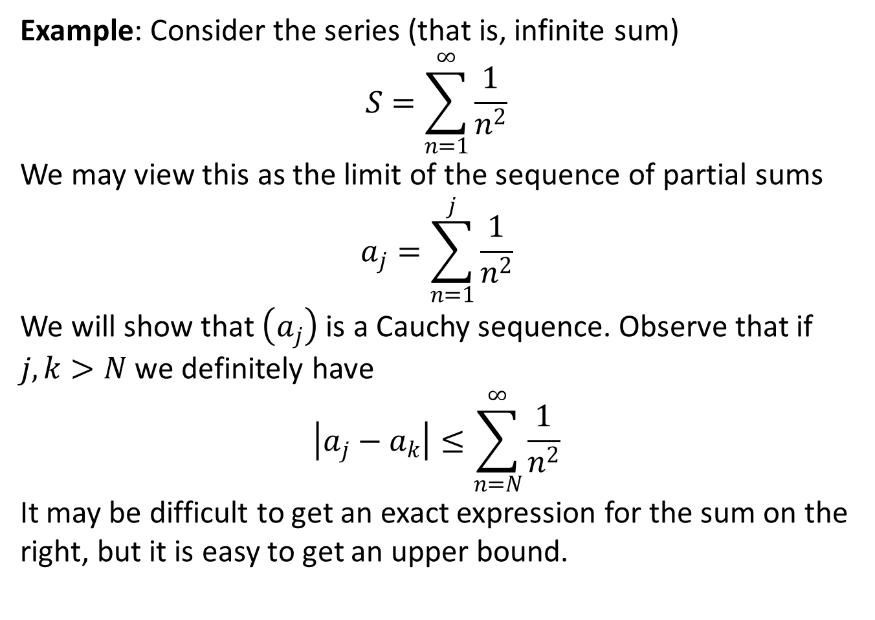
Example: Consider the series (that is, infinite sum)
$$S=\sum_{n=1}^{∞}{\frac{1}{n^{2}}}$$
We may view this as the limit of the sequence of partial sums
$$a_{j}=\sum_{n=1}^{j}{\frac{1}{n^{2}}}$$
We will show that $\left(a_{j}\right)$is a Cauchy sequence. Observe that if
$j,k>N$we definitely have
$$\left|a_{j}−a_{k}\right|≤\sum_{n=N}^{∞}{\frac{1}{n^{2}}}$$
It may be difficult to get an exact expression for the sum on the right, but it is easy to get an upper bound.

Slide 4
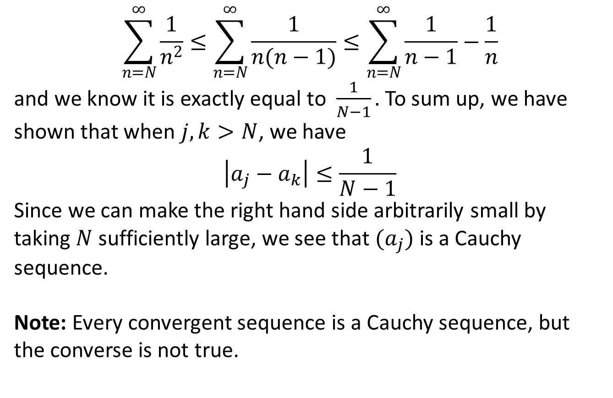
$$\sum_{n=N}^{∞}{\frac{1}{n^{2}}}≤\sum_{n=N}^{∞}{\frac{1}{n(n−1)}}≤\sum_{n=N}^{∞}{\frac{1}{n−1}−\frac{1}{n}}$$
and we know it is exactly equal to $\frac{1}{N−1}.$ To sum up, we have
shown that when $j,k>N$, we have
$$\left|a_{j}−a_{k}\right|≤\frac{1}{N−1}$$
Since we can make the right hand side arbitrarily small by taking $N$ sufficiently large, we see that $(a_{j})$ is a Cauchy sequence.
Note:Every convergent sequence is a Cauchy sequence, but the converse is not true.

Slide 7
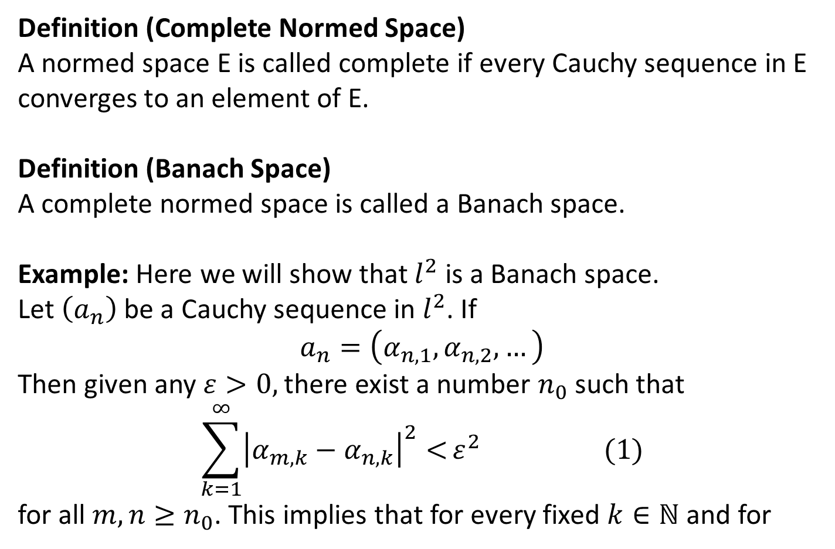
Definition (Complete Normed Space)
A normed space E is called complete if every Cauchy sequence in E converges to an element of E.
Definition (Banach Space)
A complete normed space is called a Banach space.
Example: Here we will show that $l^{2}$ is a Banach space.
Let $\left(a_{n}\right)$ be a Cauchy sequence in $l^{2}$. If
$$a_{n}=\left(α_{n,1},α_{n,2},…\right)$$
Then given any $ε>0,$ there exist a number $n_{0}$ such that
$$\sum_{k=1}^{∞}{{\left|α_{m,k}−α_{n,k}\right|}^{2}<}ε^{2} (1)$$
for all $m,n≥n_{0}$. This implies that for every fixed $k∈ℕ$ and for

Slide 9
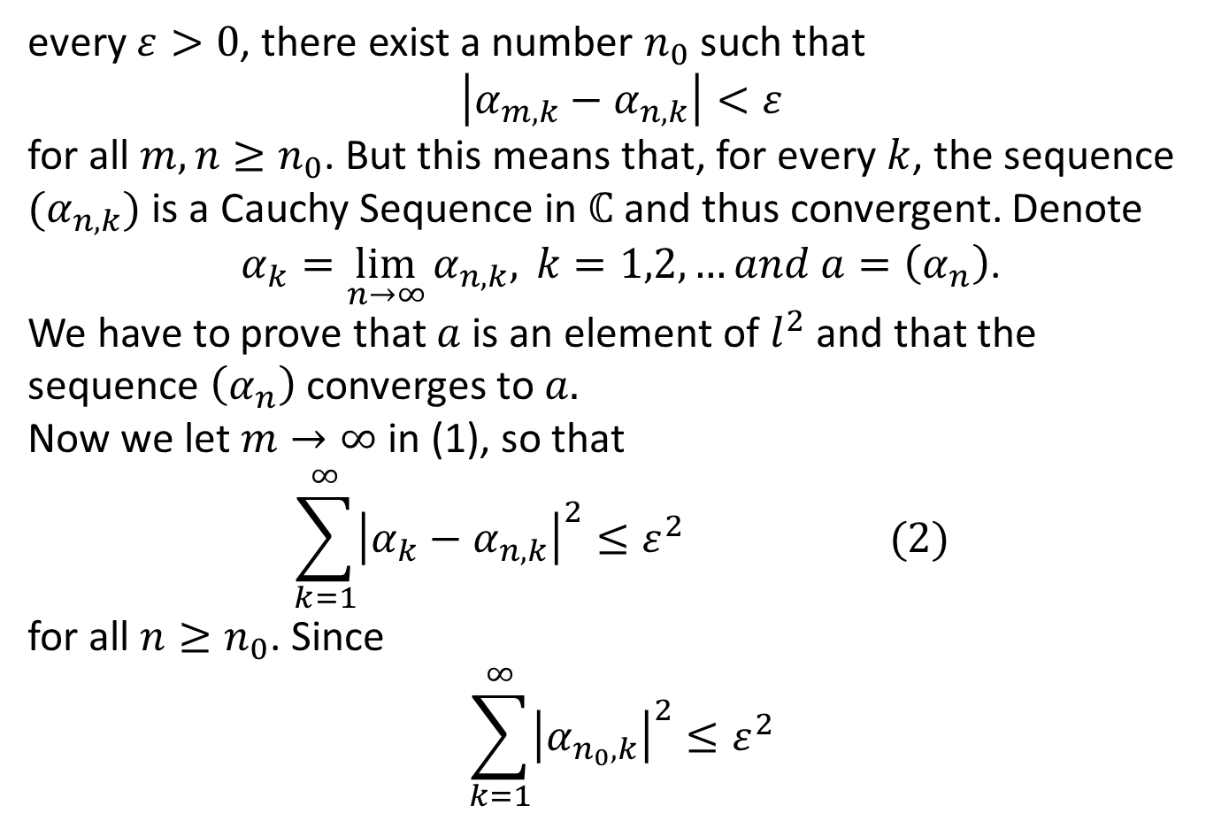
every $ε>0$, there exist a number $n_{0}$ such that
$$\left|α_{m,k}−α_{n,k}\right|<ε$$
for all $m,n≥n_{0}$. But this means that, for every $k$, the sequence$(α_{n,k})$ is a Cauchy Sequence in $ℂ$ and thus convergent. Denote
$α_{k}=\lim_{n→∞}{α_{n,k},} k=1,2,…and a=\left(α_{n}\right)$.
We have to prove that $a$ is an element of $l^{2}$ and that the sequence $\left(α_{n}\right)$ converges to $a.$
Now we let $m→∞$ in (1), so that
$${\sum_{k=1}^{∞}{{\left|α_{k}−α_{n,k}\right|}^{2}}≤ε}^{2} (2)$$
for all $n≥n_{0}$. Since
$${\sum_{k=1}^{∞}{{\left|α_{n_{0},k}\right|}^{2}}≤ε}^{2}$$

Slide 11
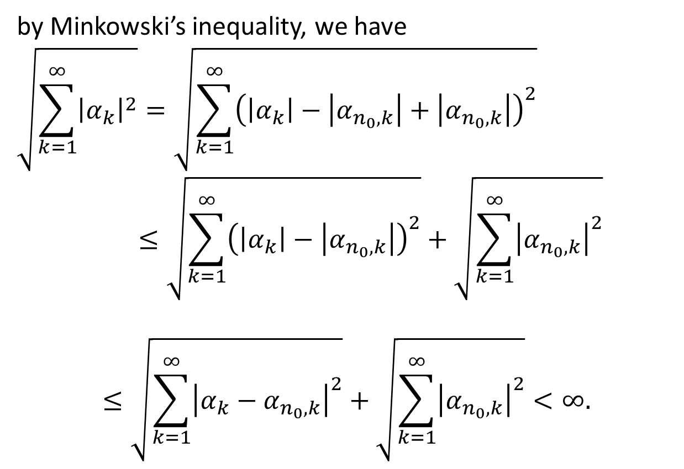
by Minkowski’s inequality, we have
$$\sqrt{\sum_{k=1}^{∞}{{\left|α_{k}\right|}^{2}}}=\sqrt{\sum_{k=1}^{∞}{{\left(\left|α_{k}\right|−\left|α_{n_{0},k}\right|+\left|α_{n_{0},k}\right|\right)}^{2}}}$$
$$≤\sqrt{\sum_{k=1}^{∞}{{\left(\left|α_{k}\right|−\left|α_{n_{0},k}\right|\right)}^{2}}}+\sqrt{\sum_{k=1}^{∞}{{\left|α_{n_{0},k}\right|}^{2}}}$$
$$≤\sqrt{\sum_{k=1}^{∞}{{\left|{α_{k}−α}_{n_{0},k}\right|}^{2}}}+\sqrt{\sum_{k=1}^{∞}{{\left|α_{n_{0},k}\right|}^{2}}}<∞.$$

Slide 13
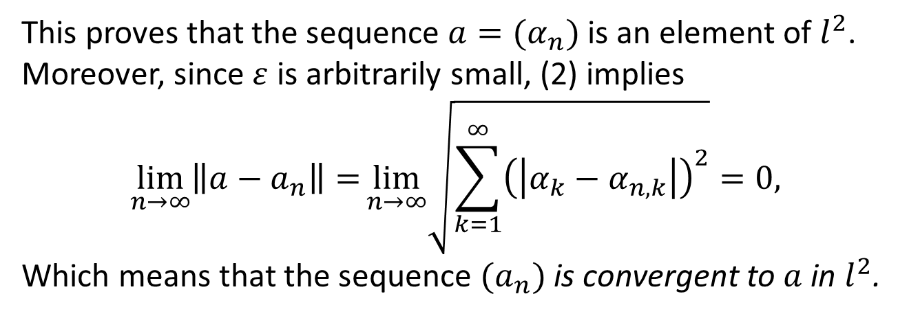
This proves that the sequence $a=(α_{n})$is an element of $l^{2}$. Moreover, since $ε$is arbitrarily small, (2) implies
$$\lim_{n→∞}\left\|a−a_{n}\right\|=\lim_{n→∞}\sqrt{\sum_{k=1}^{∞}{{\left(\left|α_{k}−α_{n,k}\right|\right)}^{2}}}=0,$$
Which means that the sequence $(a_{n})$is convergent to $a$ in $l^{2}$.

Slide 14
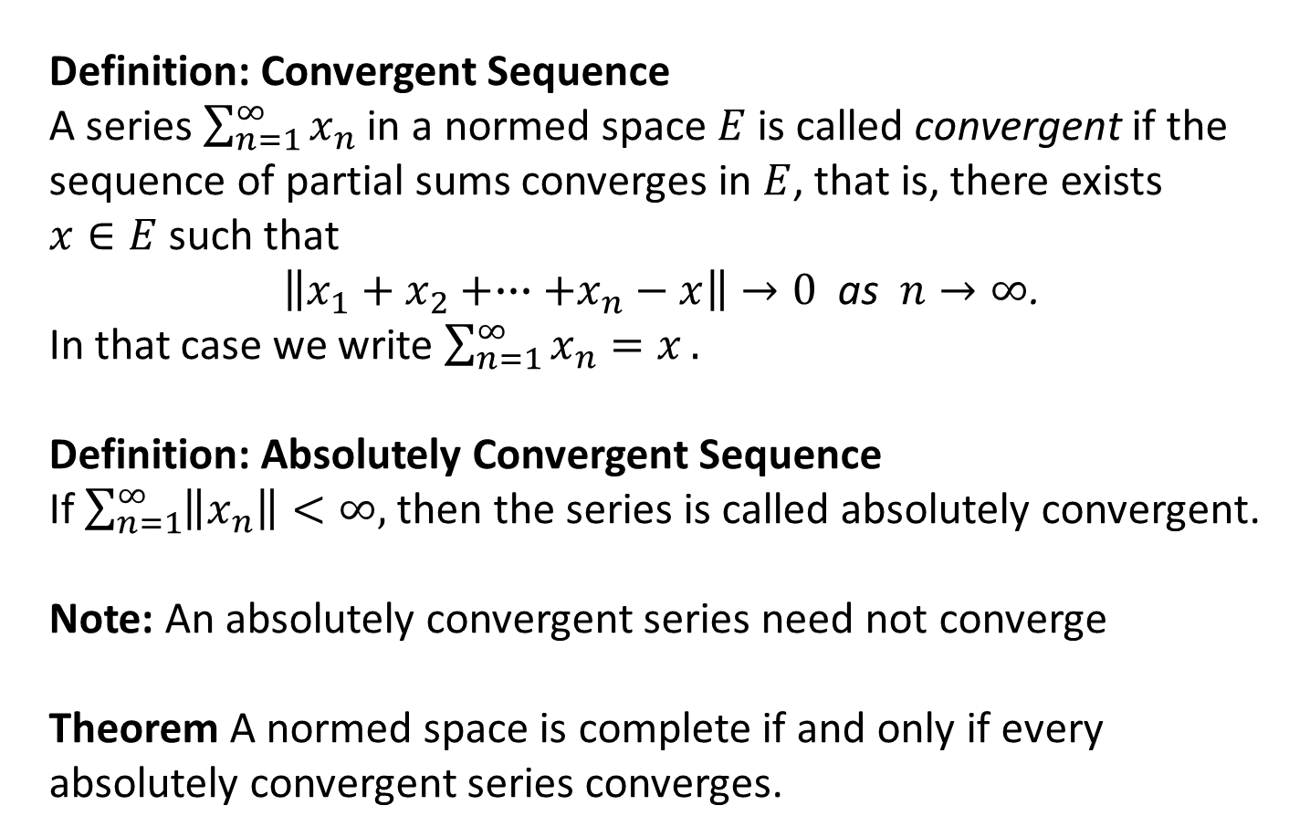
Definition: Convergent Sequence
A series $\sum_{n=1}^{∞}{x_{n}}$in a normed space $E$is called convergent if the sequence of partial sums converges in $E$, that is, there exists
such that
$\left\|x_{1}+x_{2}+∙∙∙+x_{n}−x\right\|→0$ as $n→∞$.
In that case we write $\sum_{n=1}^{∞}{x_{n}=x}.$
Definition: Absolutely Convergent Sequence
If $\sum_{n=1}^{∞}{\left\|x_{n}\right\|<∞,}$ then the series is called absolutely convergent.
Note: An absolutely convergent series need not converge
Theorem A normed space is complete if and only if every absolutely convergent series converges.

Slide 15
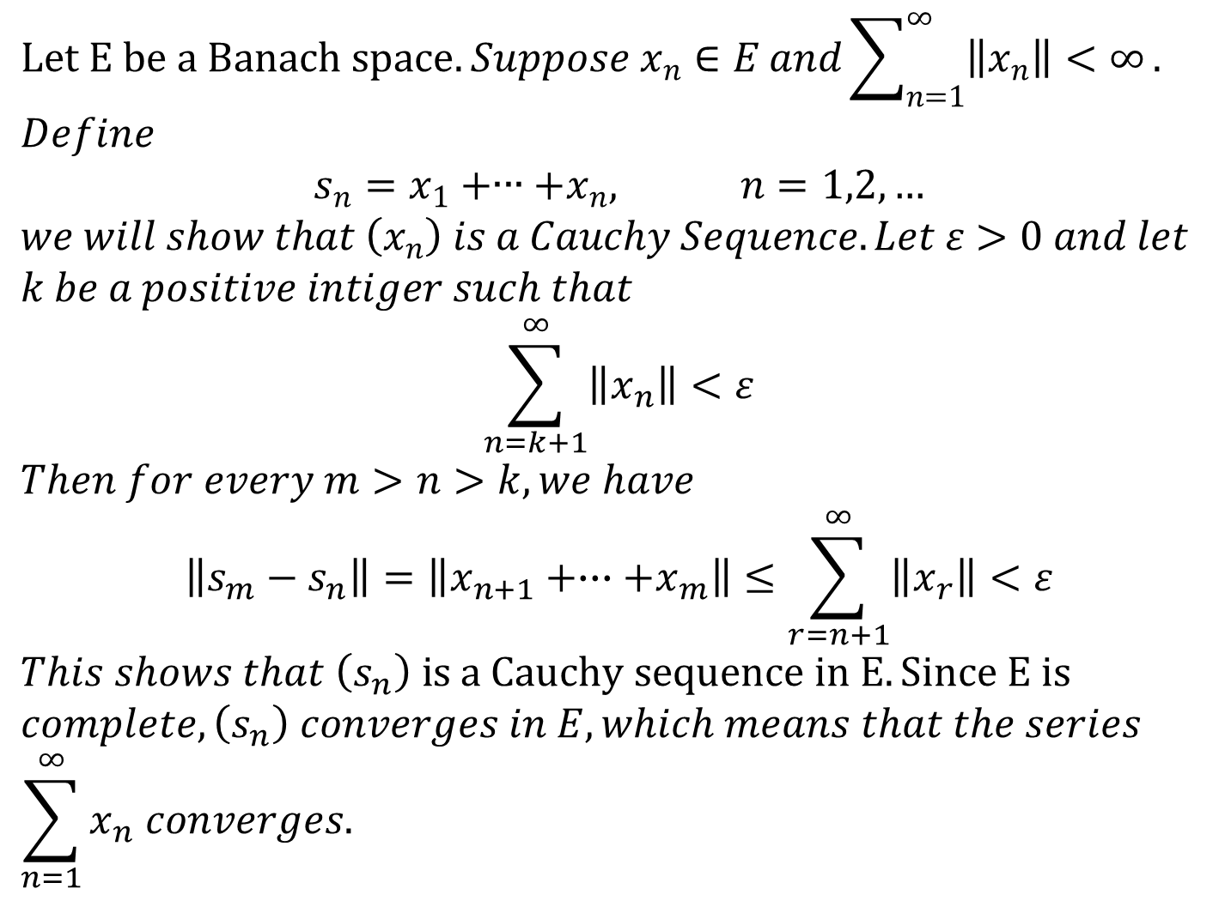
$$Let E be a Banach space. Suppose x_{n}∈E and\sum_{n=1}^{∞}{\left\|x_{n}\right\|<∞}.$$
$$Define$$
$$s_{n}=x_{1}+∙∙∙+x_{n}, n=1,2,…$$
$$we will show that \left(x_{n}\right) is a Cauchy Sequence. Let ε>0 and let$$
$$k be a positive intiger such that$$
$$\sum_{n=k+1}^{∞}{\left\|x_{n}\right\|<ε}$$
$$Then for every m>n>k, we have$$
$$\left\|s_{m}−s_{n}\right\|=\left\|x_{n+1}+∙∙∙+x_{m}\right\|≤\sum_{r=n+1}^{∞}{\left\|x_{r}\right\|<ε}$$
$$This shows that \left(s_{n}\right) is a Cauchy sequence in E. Since E is$$
$$complete, \left(s_{n}\right) converges in E, which means that the series$$
$$\sum_{n=1}^{∞}{x_{n} converges.}$$

Slide 16
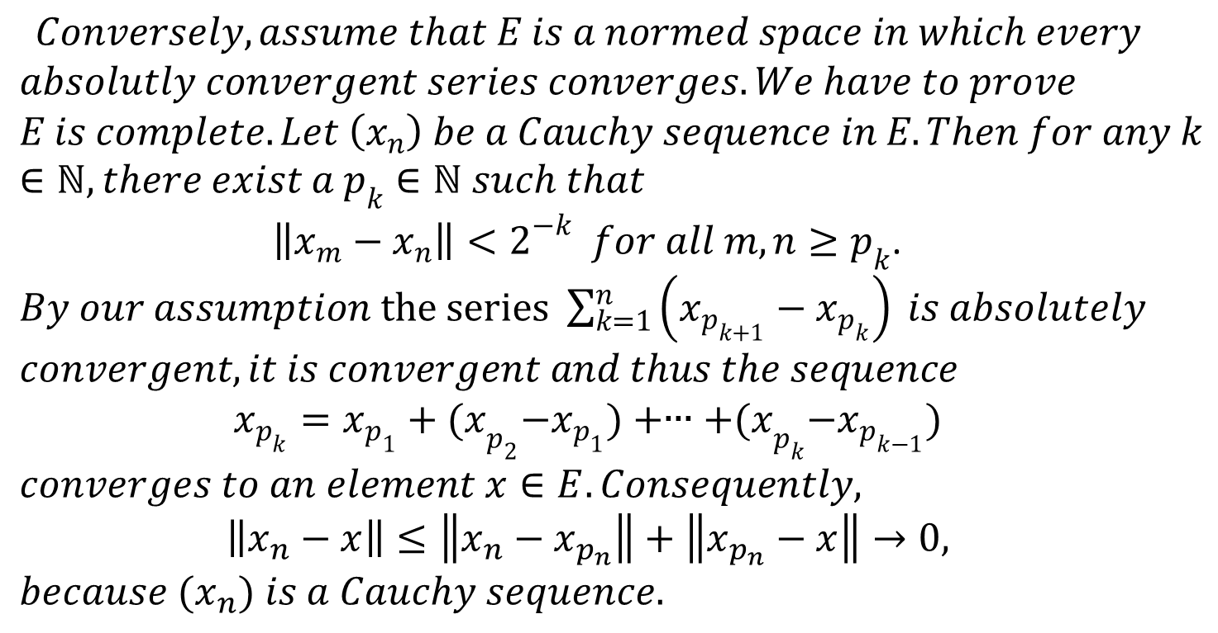
$$Conversely, assume that E is a normed space in which every$$
$$absolutly convergent series converges. We have to prove$$
$$E is complete. Let \left(x_{n}\right) be a Cauchy sequence in E. Then for any k∈ℕ, there exist a p_{k}∈ℕ such that$$
$\left\|x_{m}−x_{n}\right\|<2^{−k} for all m,n≥p_{k}$.
$By our assumption the series \sum_{k=1}^{n}{\left(x_{p_{k+1}}−x_{p_{k}}\right) is absolutely}$
$$convergent, it is convergent and thus the sequence$$
$$x_{p_{k}}=x_{p_{1}}+{(x}_{p_{2}}−x_{p_{1}})+∙∙∙+{(x}_{p_{k}}−x_{p_{k−1}})$$
$$converges to an element x∈E. Consequently,$$
$$\left\|x_{n}−x\right\|≤\left\|x_{n}−x_{p_{n}}\right\|+\left\|x_{p_{n}}−x\right\|→0,$$
$$because {(x}_{n}) is a Cauchy sequence.$$

Slide 17
Summary of Today’s Lectures
In this we have defined Cauchy sequence, give an example of the same. Then we define the Banach space and proved that is a complete normed space. Finally, we give the definition of convergent and absolutely convergent series. Lastly, we prove the theorem that states that
A normed space is complete if and only if every absolutely convergent sequence converges.

