Slide 1
Introduction To Hilbert Spaces with Applications
Lokenath Debnath and Piotr Mikusinski
Course Teacher: Dr. Amjad Hussain

Slide 2
Summary of the Last Lecture
In our last lecture, we considered the definitions of extension of an operator, densely defined operator, adjoint of densely defined operator, densely defined self-adjoint operator, symmetric operator, and closed operator. Several theorems were then stated to characterize such kind of operators.

Slide 3
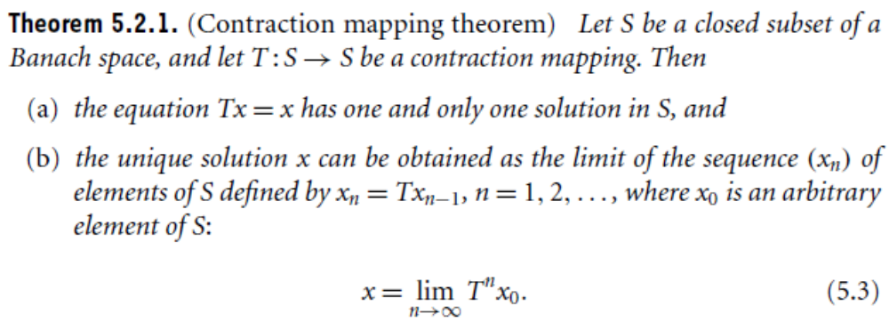

Slide 4
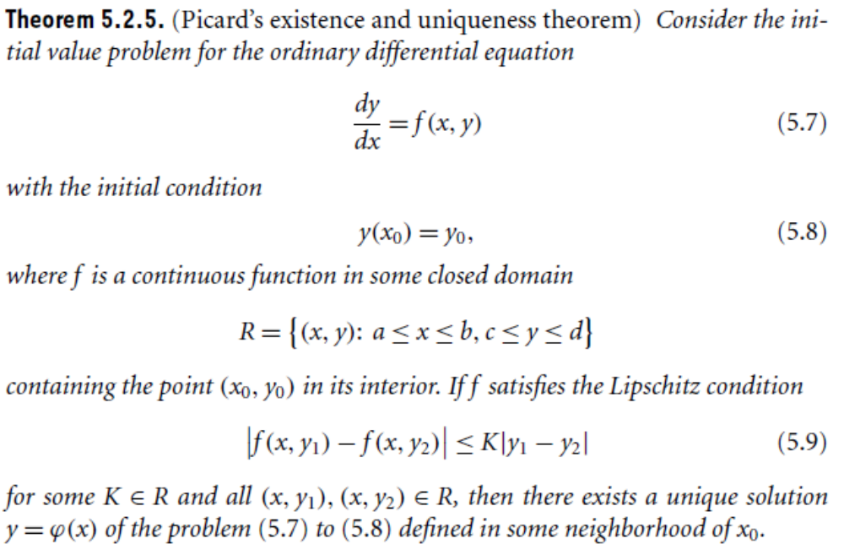

Slide 5
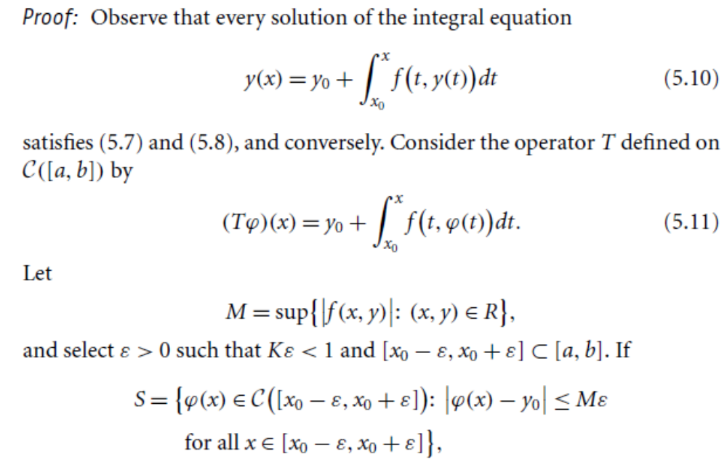

Slide 6
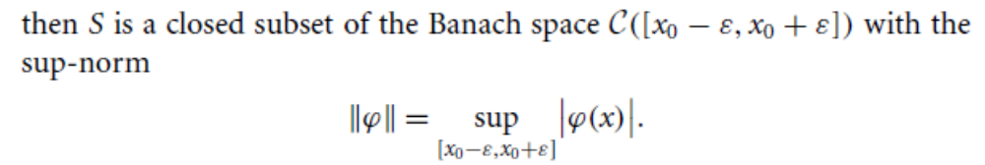
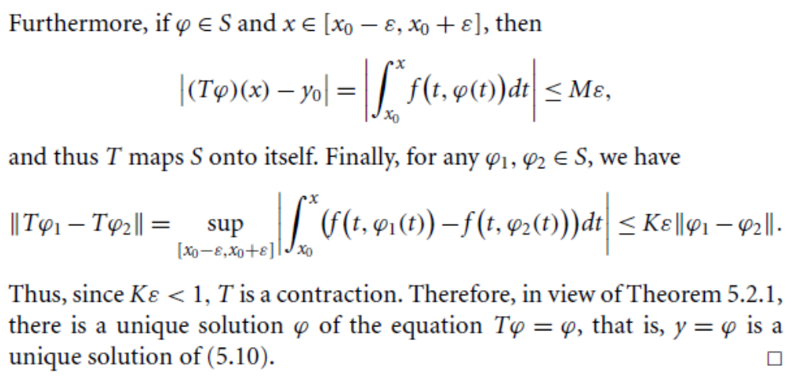

Slide 8
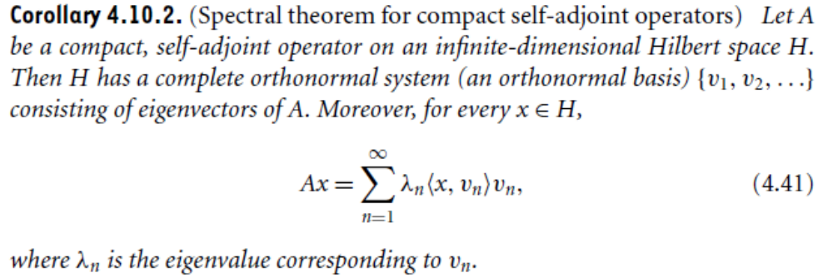
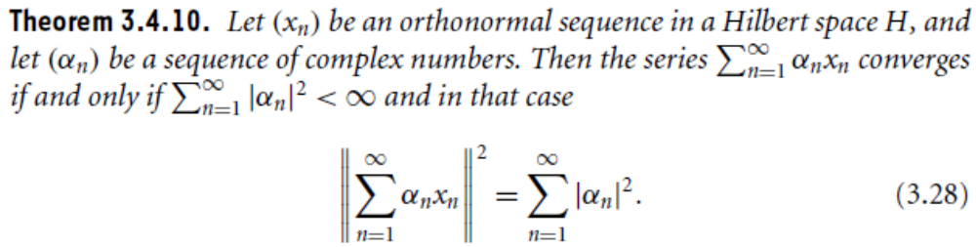

Slide 9
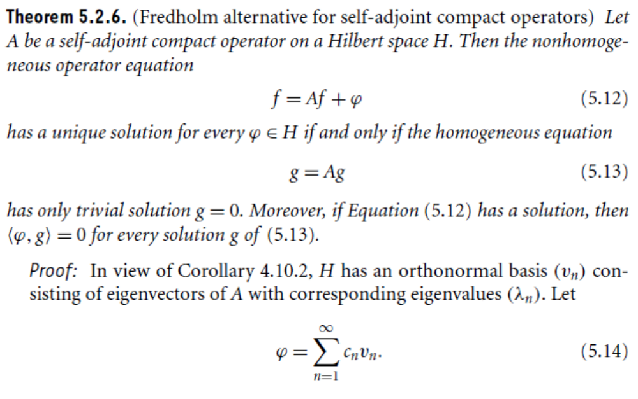

Slide 10
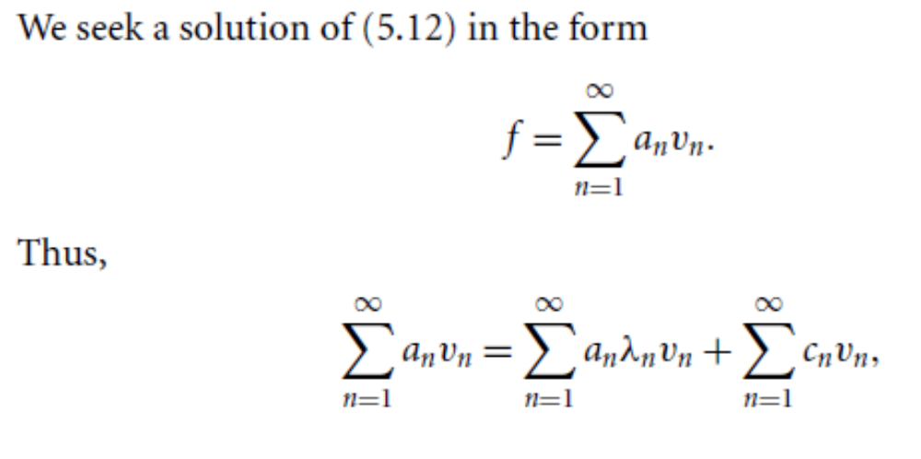
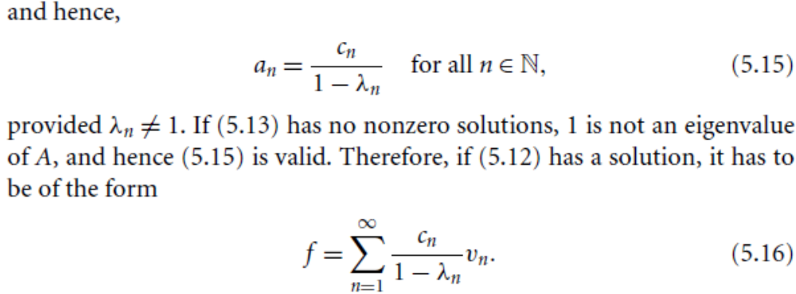

Slide 11
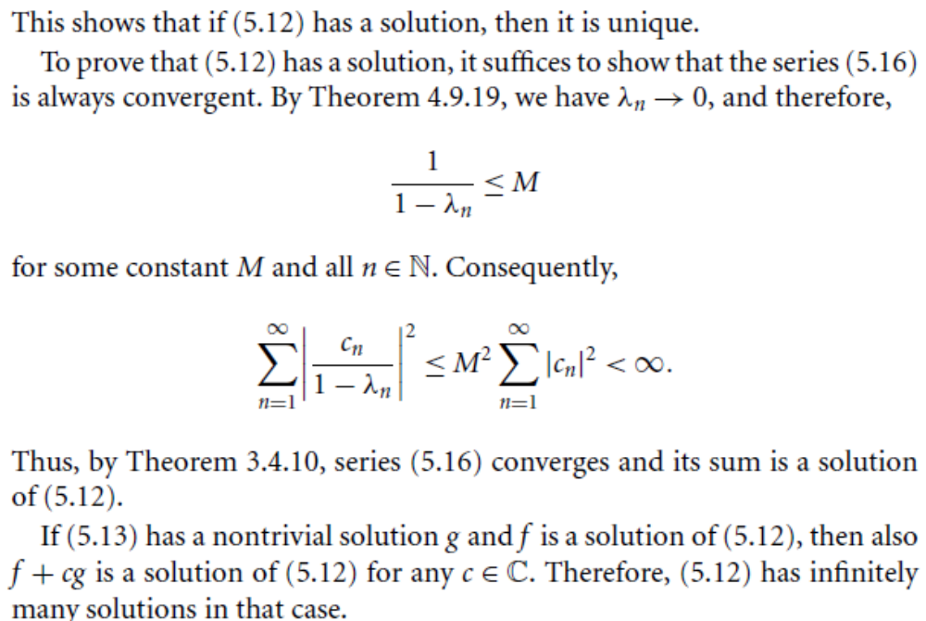

Slide 12
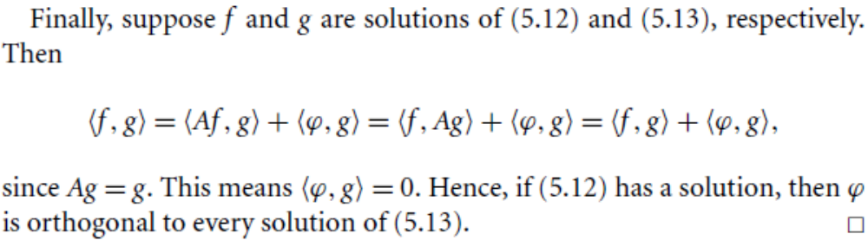
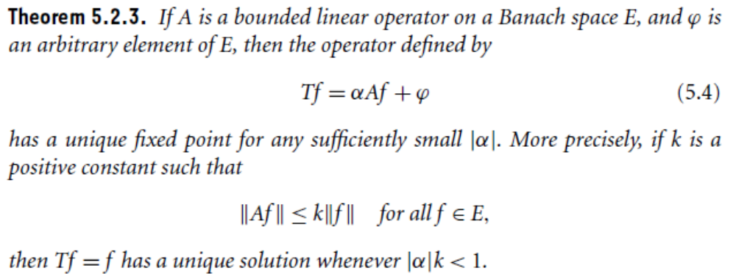

Slide 13
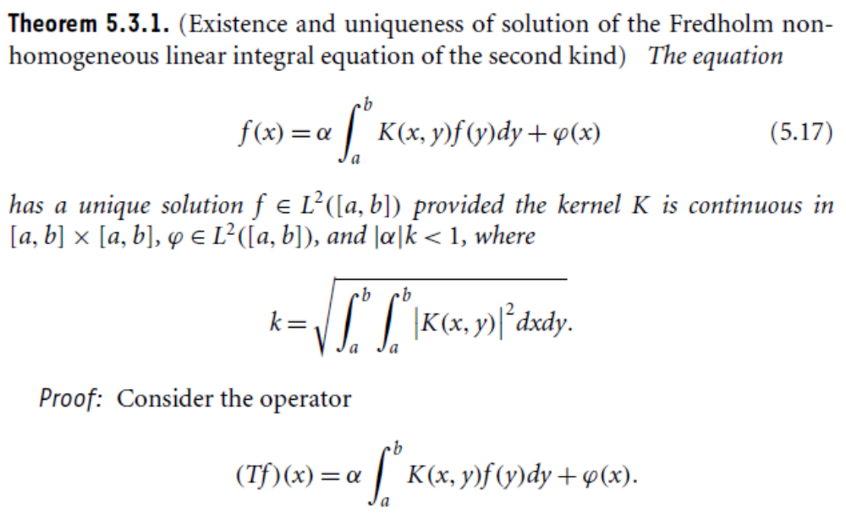
Fredholm Integral Equations

Slide 14
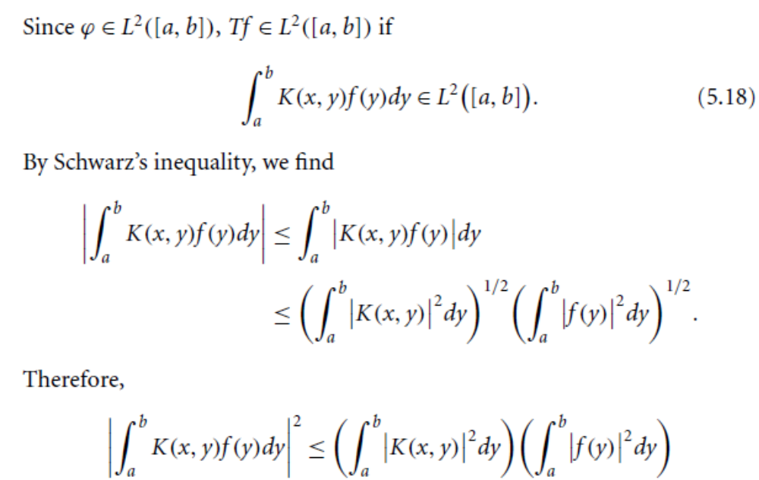

Slide 15
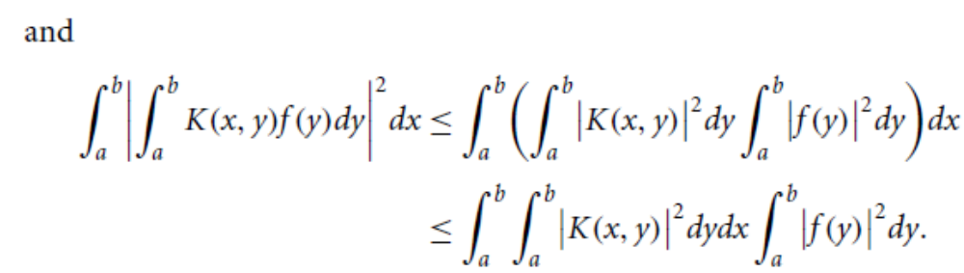
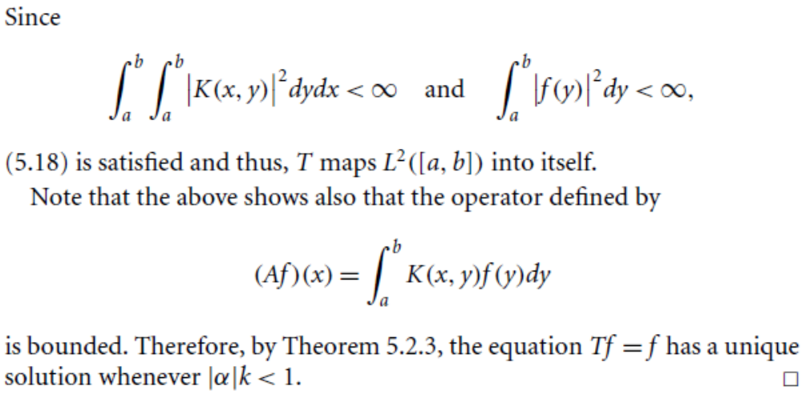

Slide 16
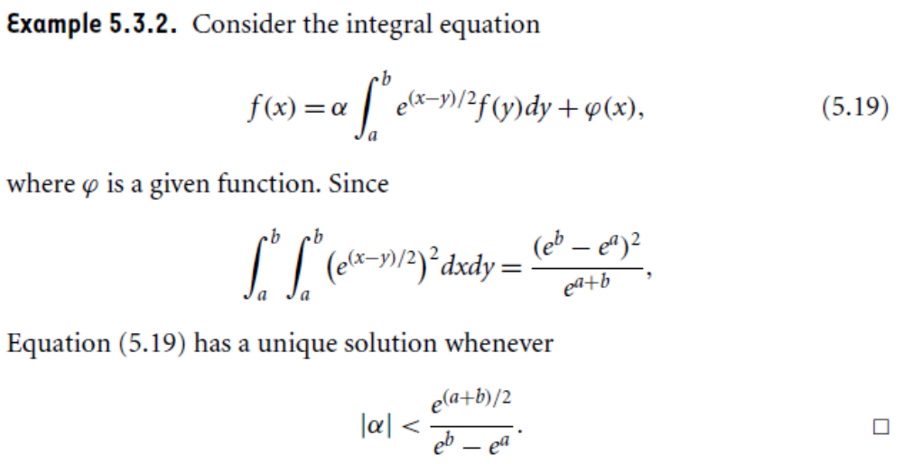

Slide 17
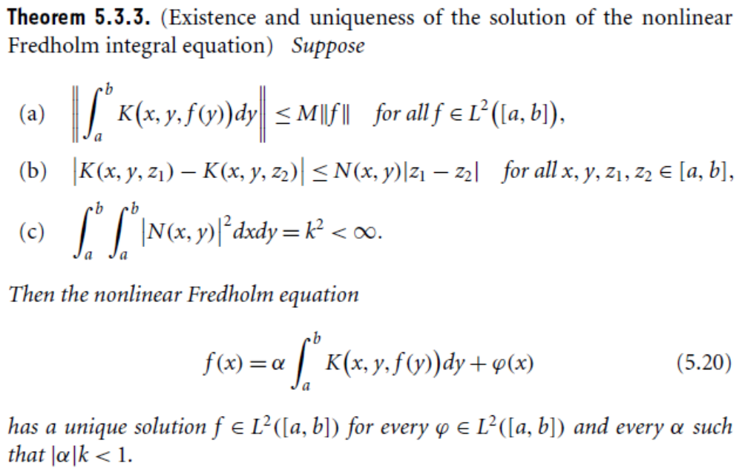

Slide 18
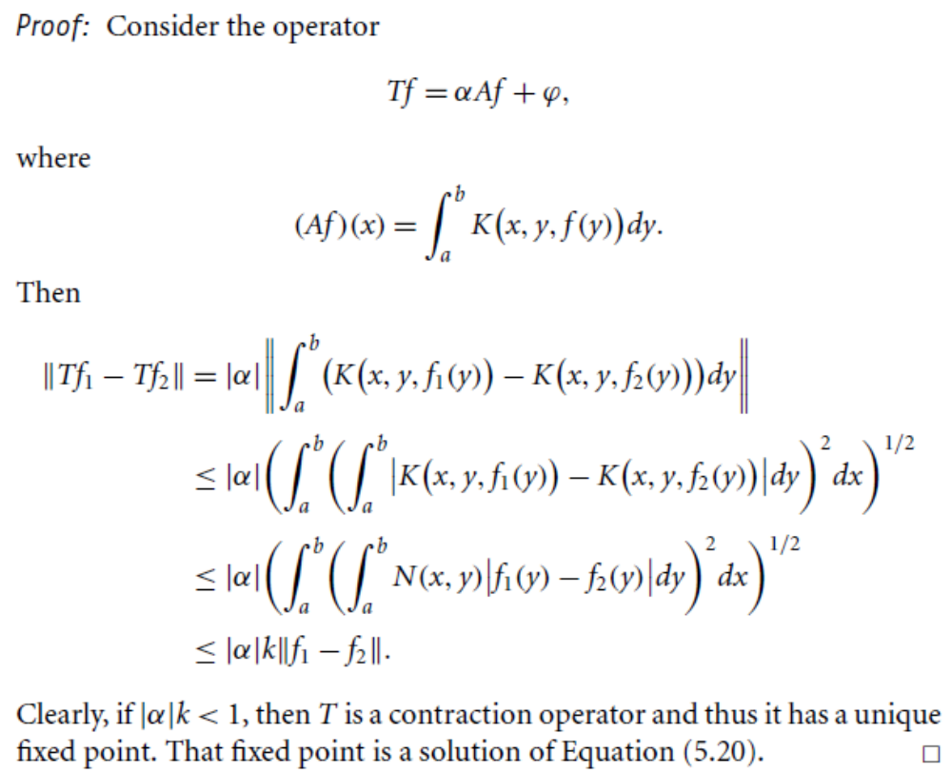

Slide 19
Summary of the today’s Lecture
In our today’s lecture, we consider Picard existence and uniqueness theorem, Fredholm alternative for self-adjoint compact operator, Existance and uniqueness of nonlinear Fredholm integral equations.

