Slide 1
Introduction To Hilbert Spaces with Applications
Lokenath Debnath and Piotr Mikusinski
Course Teacher: Dr. Amjad Hussain

Slide 2
Summary of the Last Lecture
In our last lecture, we considered the definitions of extension of an operator, densely defined operator, adjoint of densely defined operator, Self-adjoint operator, symmetric operator, and closed operator. Several theorems were then stated to characterize such kind of operators.

Slide 3
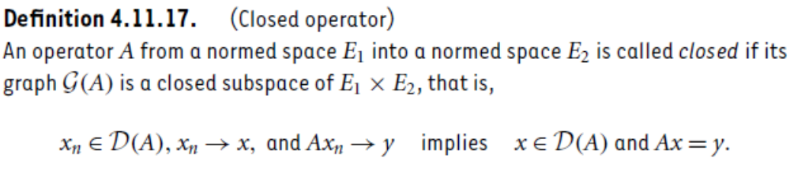

Slide 4
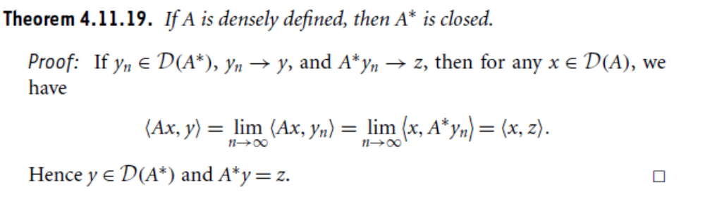
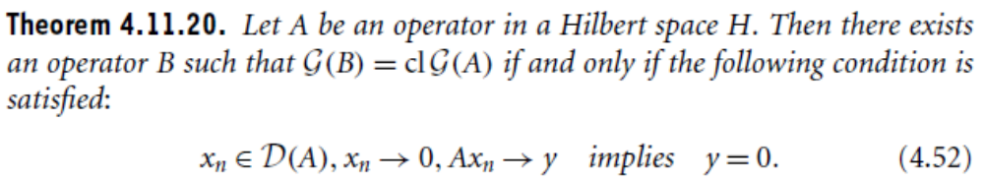
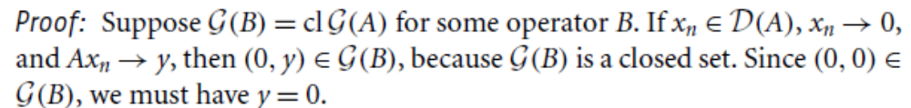

Slide 5
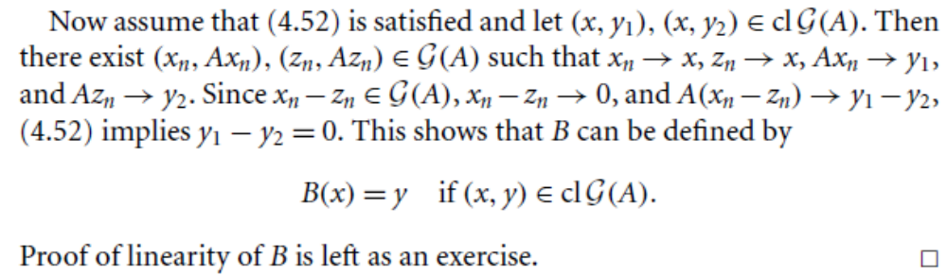
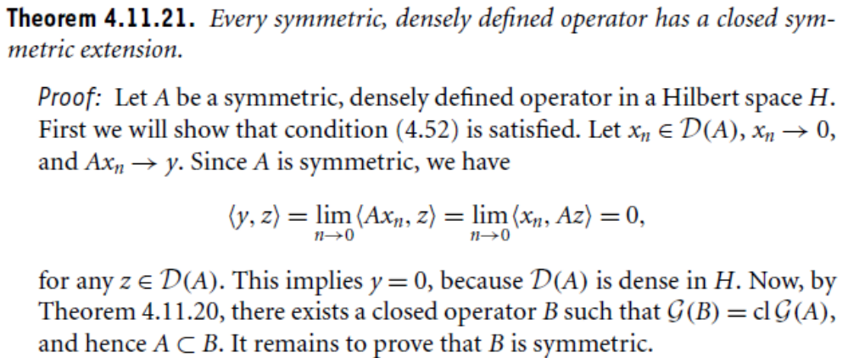

Slide 6
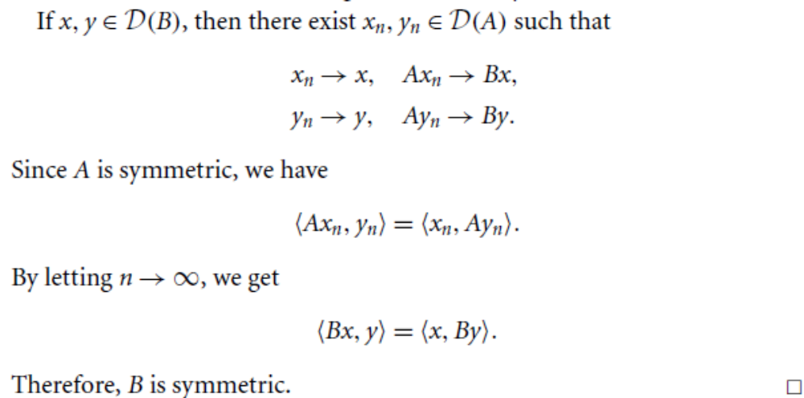
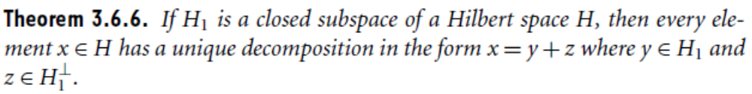

Slide 7
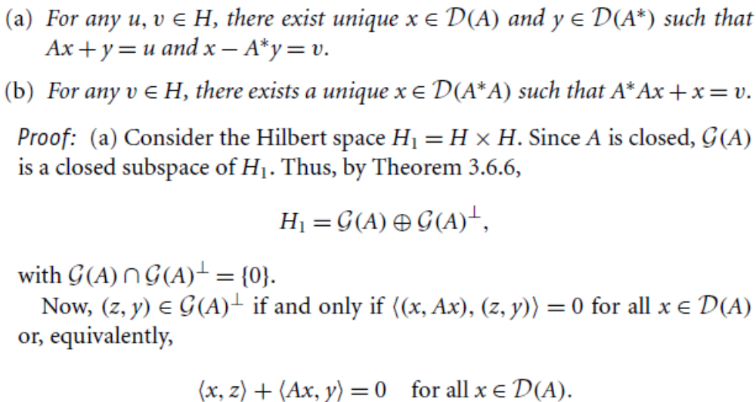

Slide 23
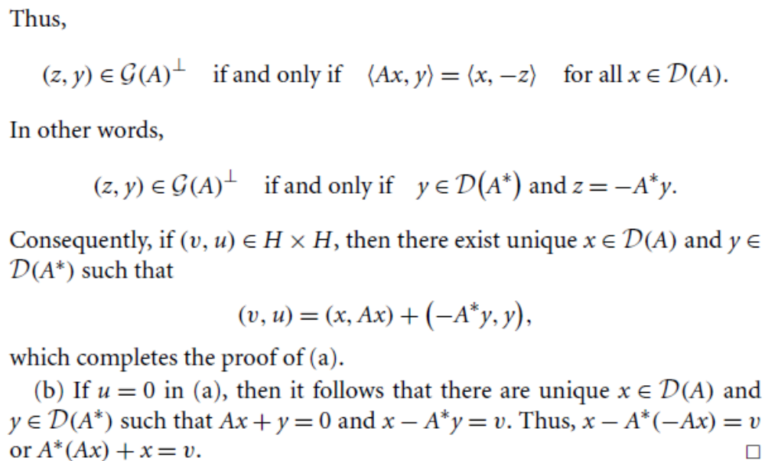

Slide 24
Linear Operators on Hilbert Space
Bilinear Functionals and quadratic form
Adjoint and self-Adjoint operators
Invertible Normal, Isometric, and Unitary Operators
Positive Operators
Projection Operators
Compact Operators
Eigenvalues and Eigenvectors
Spectral decomposition
Unbounded Operators

Slide 25
Application to Integral and Differential Equations

Slide 26
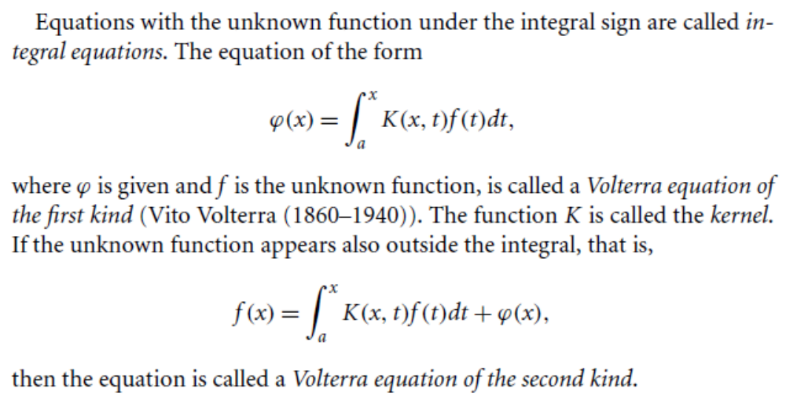
Integral Equations

Slide 27
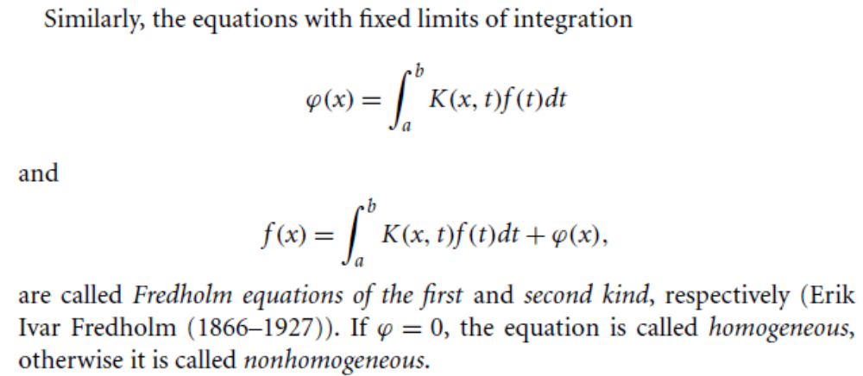

Slide 28
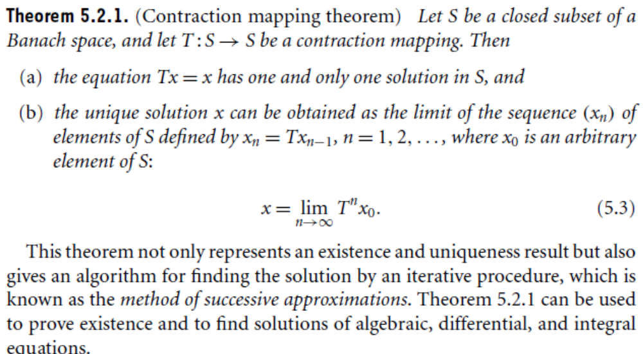
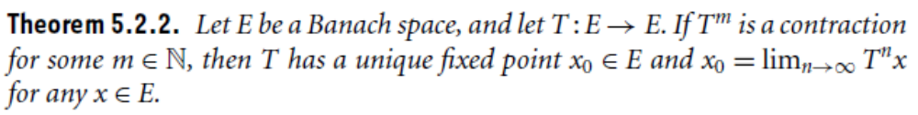
Basic Existence Theorem

Slide 29
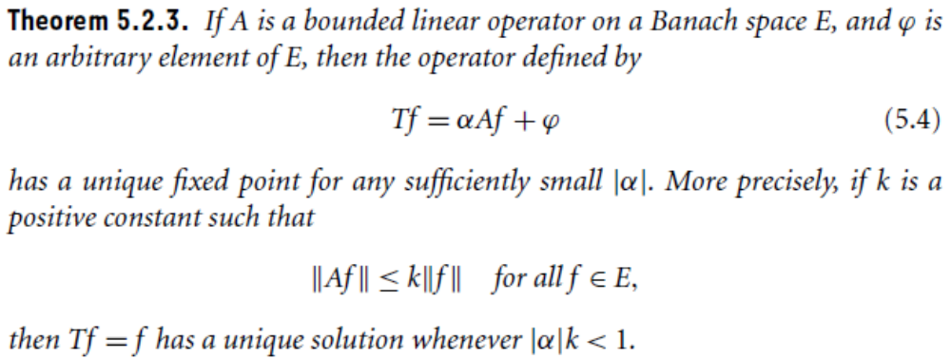
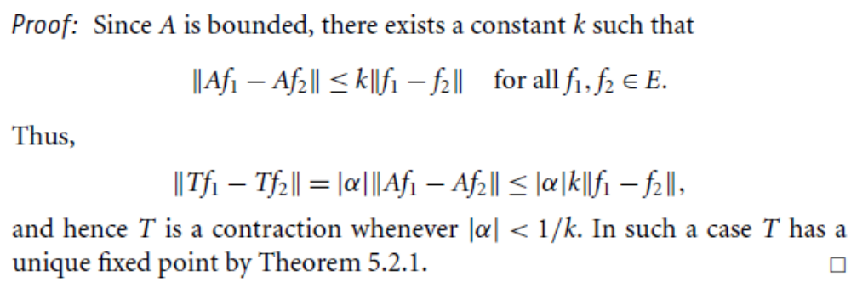

Slide 31
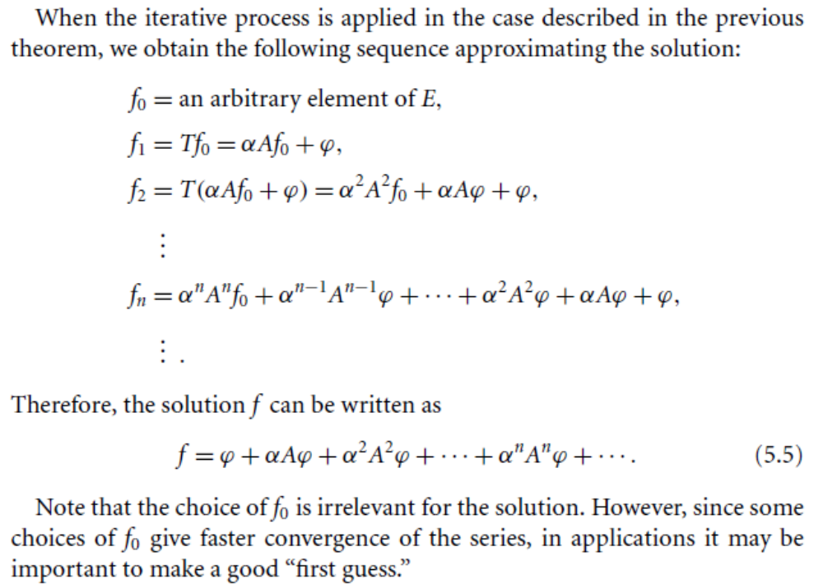

Slide 32
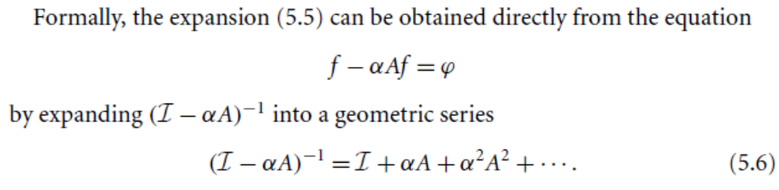
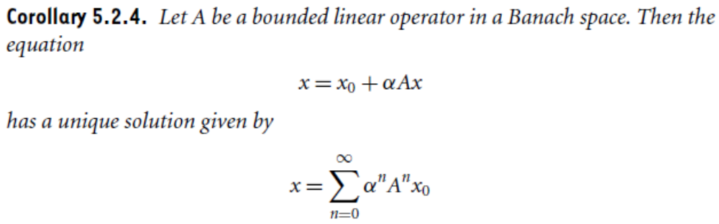


Slide 33
Summary of the today’s Lecture
In our today’s lecture, we considered the remaning part of Chapter 3 and then started Chapter 4. Thus, we consider some application of Hilbert space to the integral and differential equations.

