Slide 1
Introduction To Hilbert Spaces with Applications
Lokenath Debnath and Piotr Mikusinski
Course Teacher: Dr. Amjad Hussain

Slide 2
Summary of the Last Lecture
In our last lecture, we completed spectral decomposition section. We proved Hibert Schmidt theorem and spectral theorem for compact self-adjoint operators there. Also, we defined function of operators and furnished many examples to explain this definition.

Slide 3
Unbounded Operators
Chapter 4 and boundedness
Methods of this Chapter
What if we consider unbounded operators
What is unbounded operator?
Example
Difference between Operators on Hilbert space and
operator in Hilbert space.

Slide 4
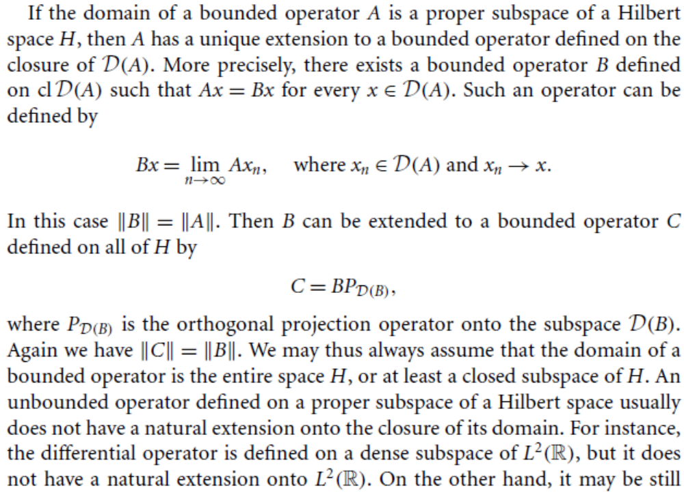

Slide 5
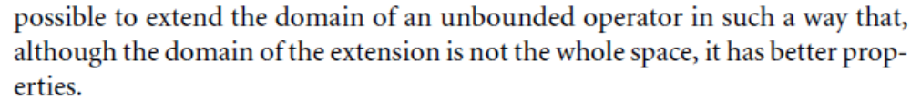
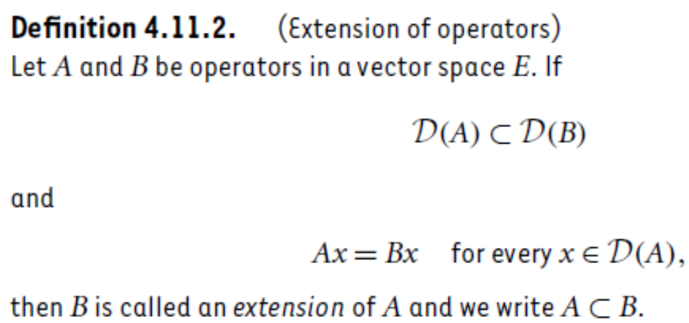
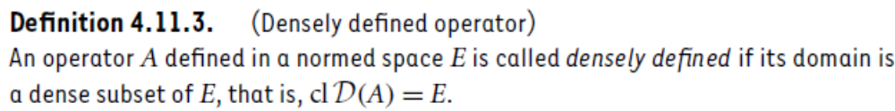

Slide 6
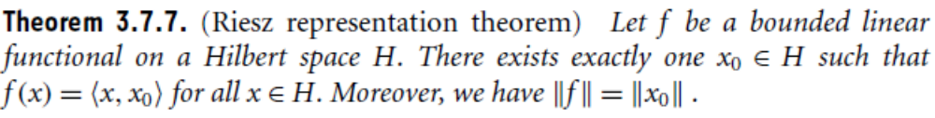
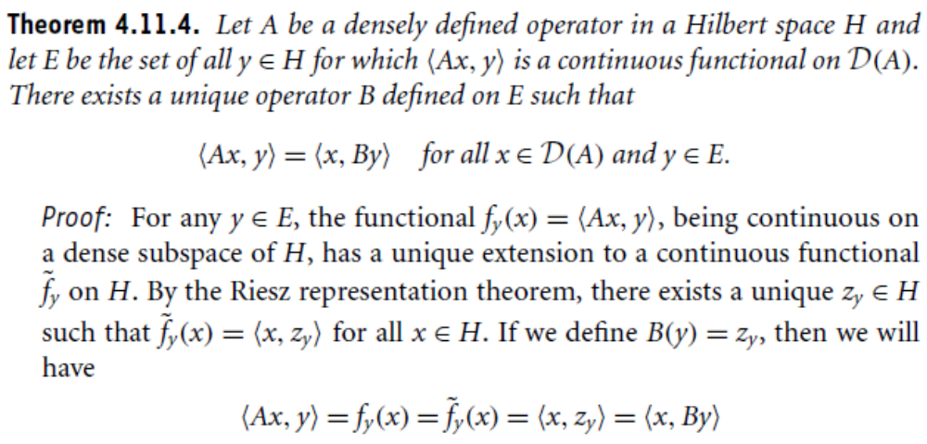

Slide 7
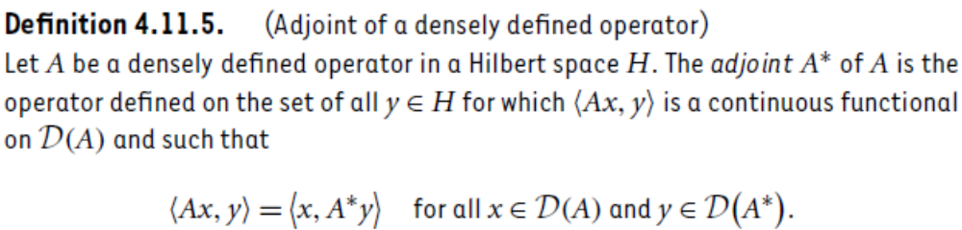
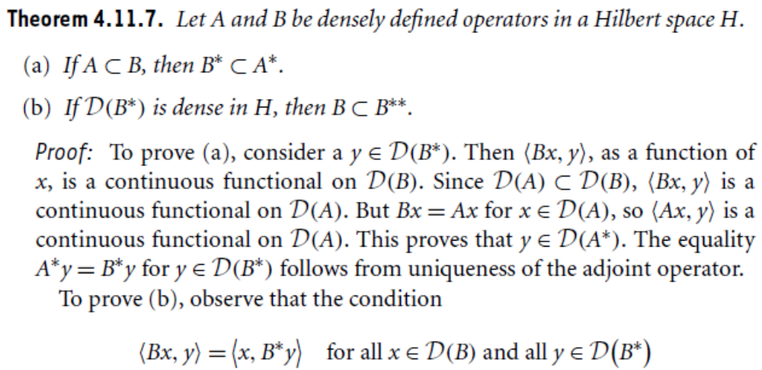

Slide 8
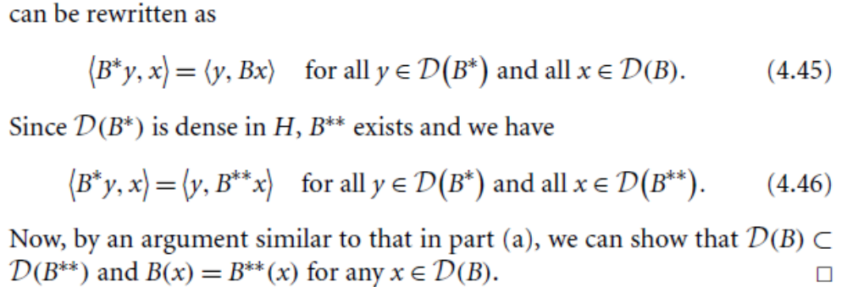
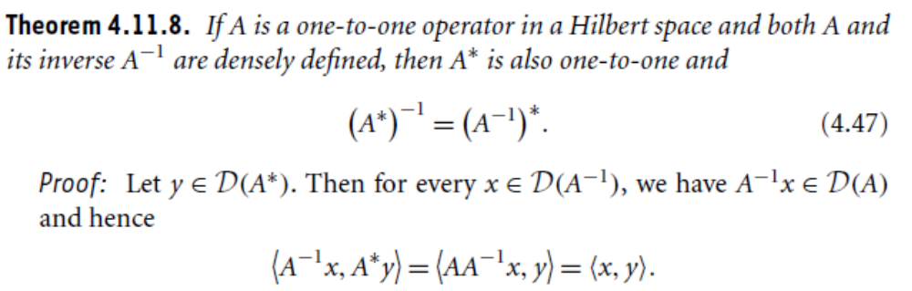

Slide 9
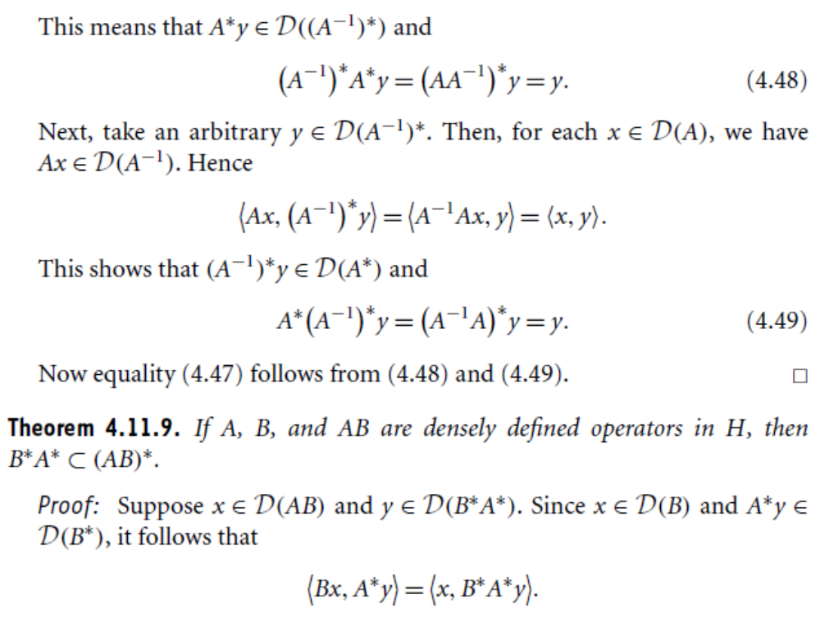

Slide 10
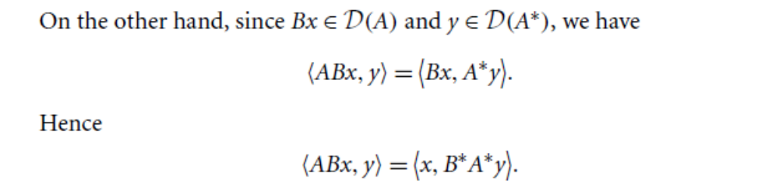
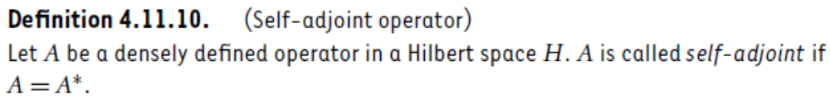
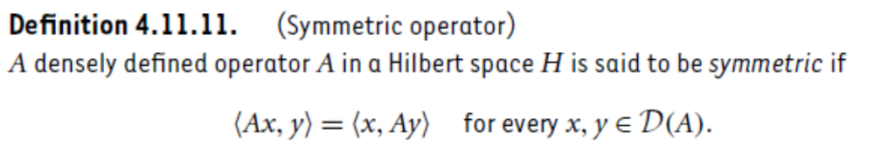

Slide 11
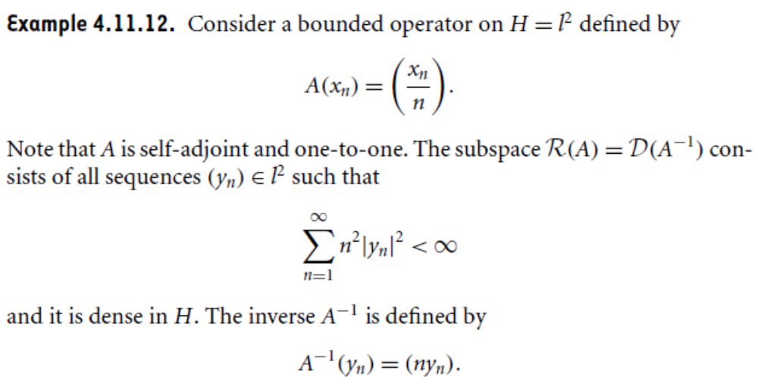
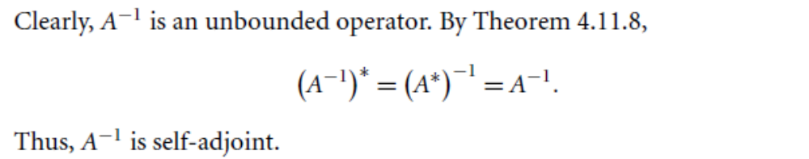

Slide 12
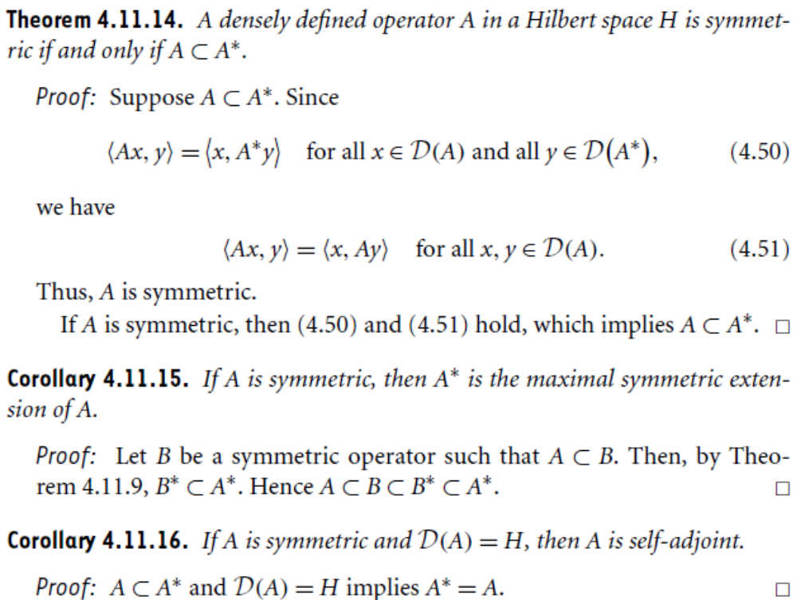

Slide 13
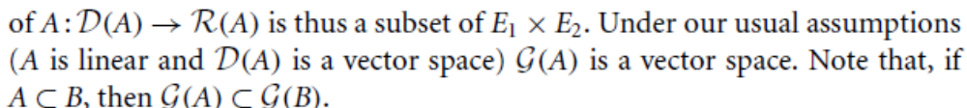
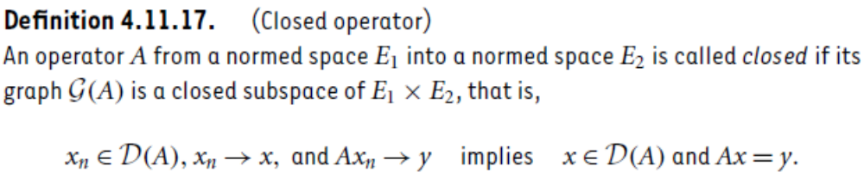
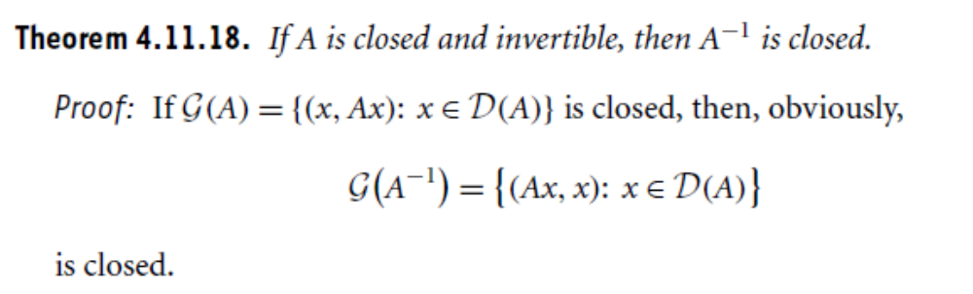

Slide 14
Summary of the today’s Lecture
In our today’s lecture, we consider the definitions of extension of an operator, densely defined operator, adjoint of densely defined operator, adjoint operator, symmetric operator, and closed operator. Several theorems are then stated to characterize such kind of operators

