Slide 1
Introduction To Hilbert Spaces with Applications
Lokenath Debnath and Piotr Mikusinski
Course Teacher: Dr. Amjad Hussain

Slide 2
Summary of the Last Lecture
In our last lecture, we considered further results regarding eigenvalues and eigenvectors corresponding to the self-adjoint, compact and orthogonal operators. Finally, we defined approximate eigenvalue and proved related theorems.

Slide 3
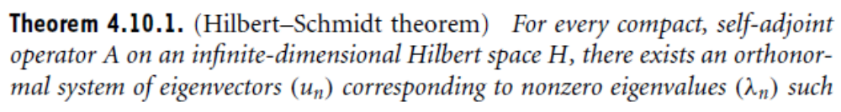
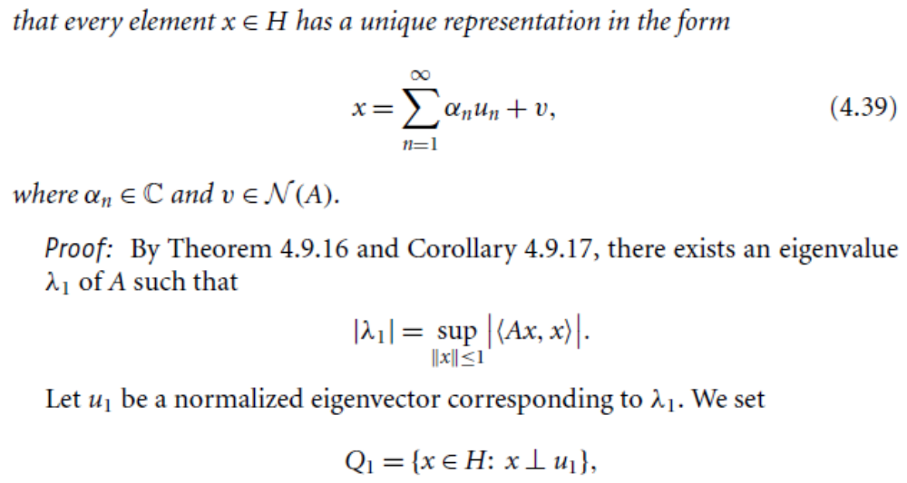
Spectral Decomposition

Slide 4
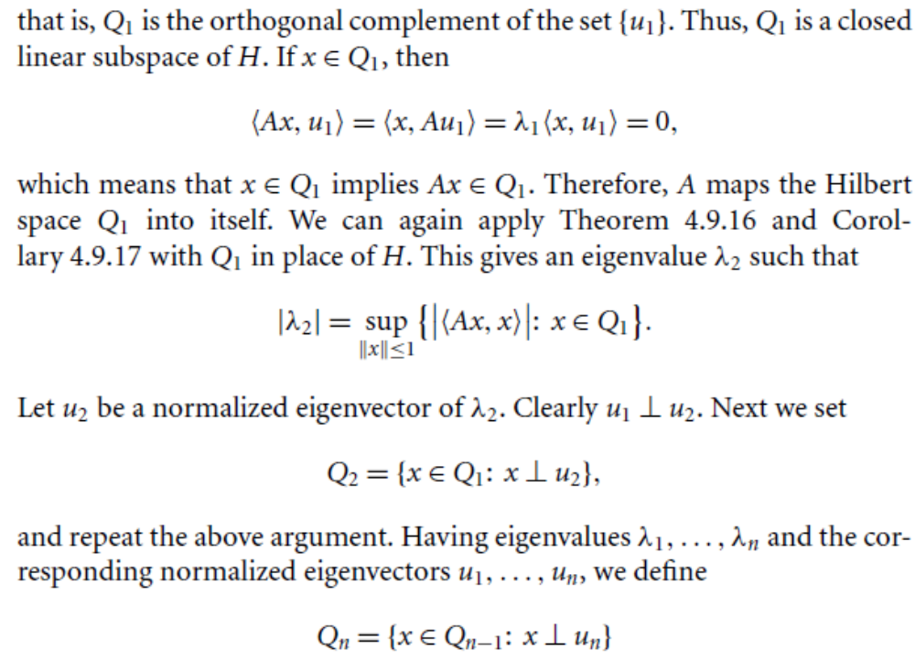

Slide 5
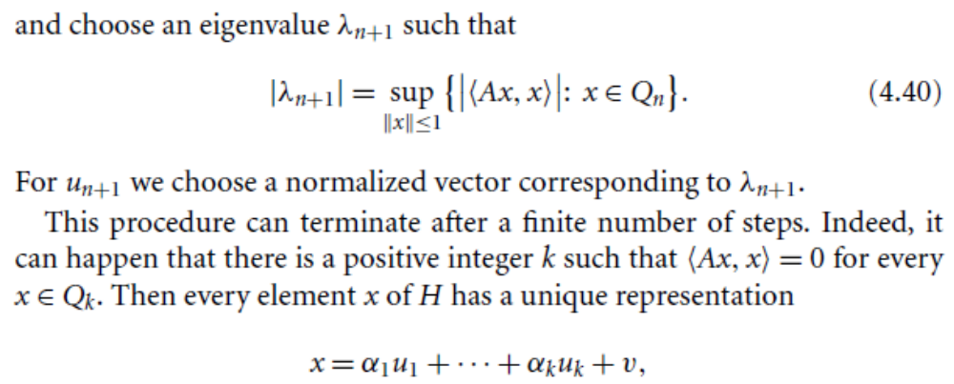
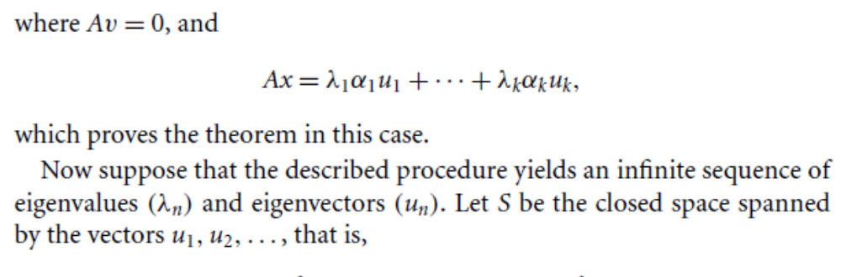

Slide 6
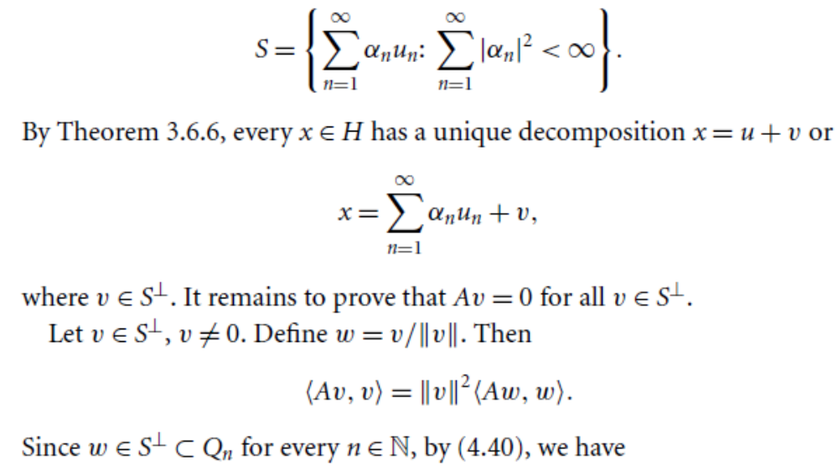

Slide 7
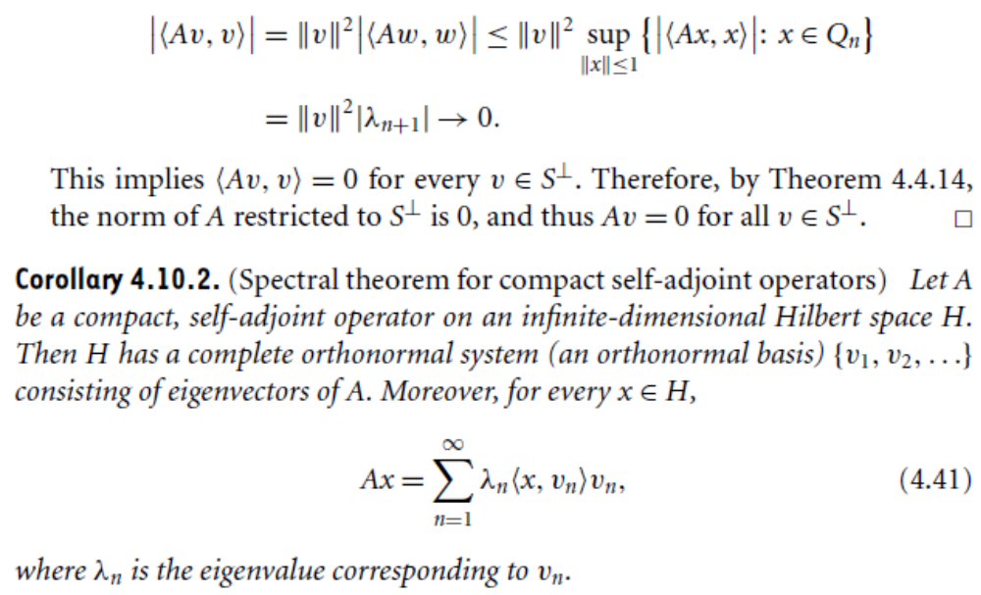

Slide 8
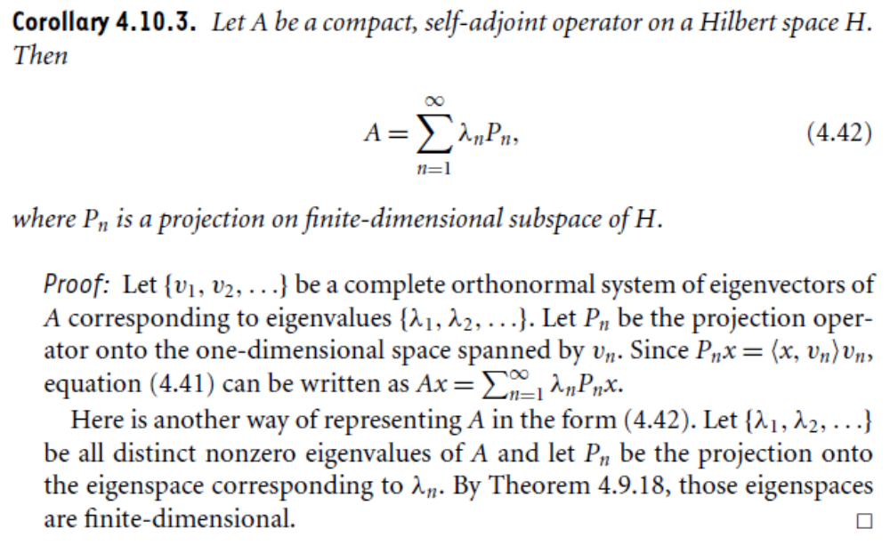

Slide 9
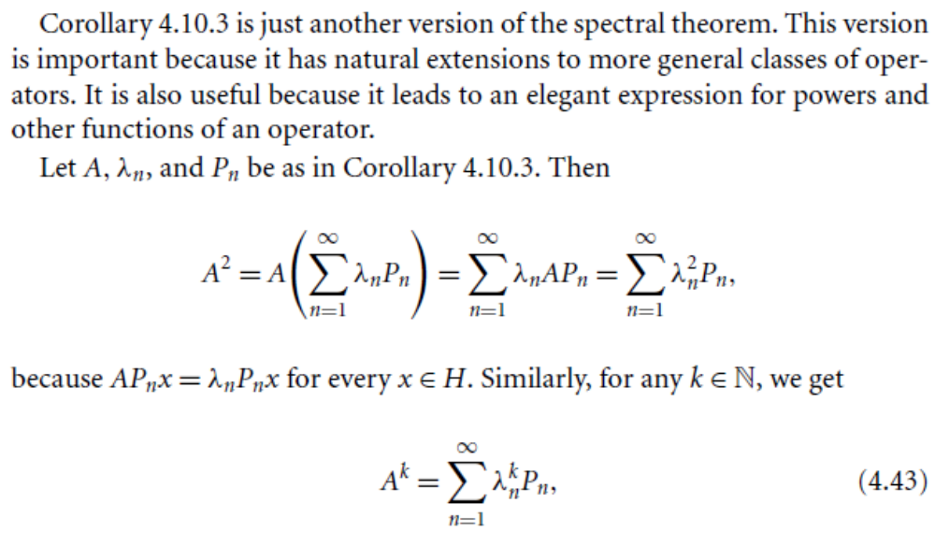

Slide 10
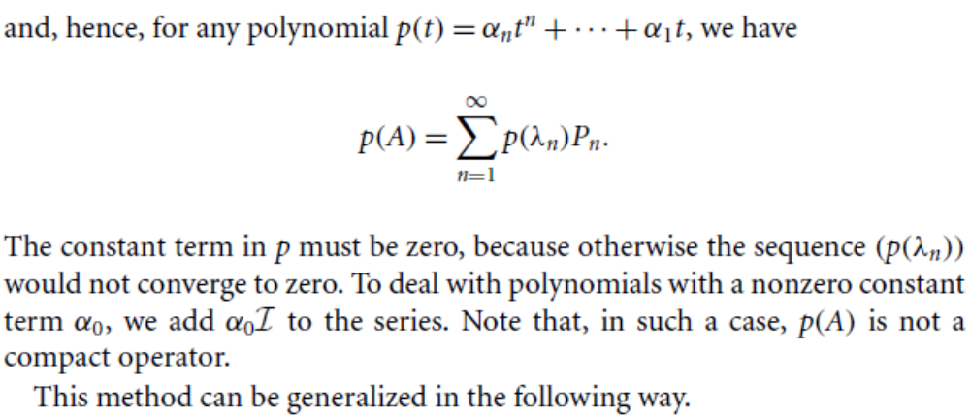

Slide 11
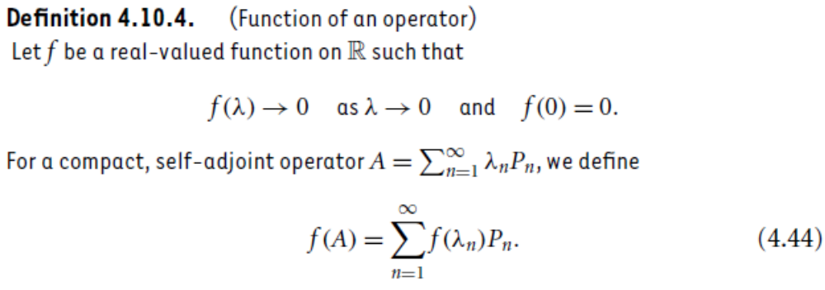

Slide 12
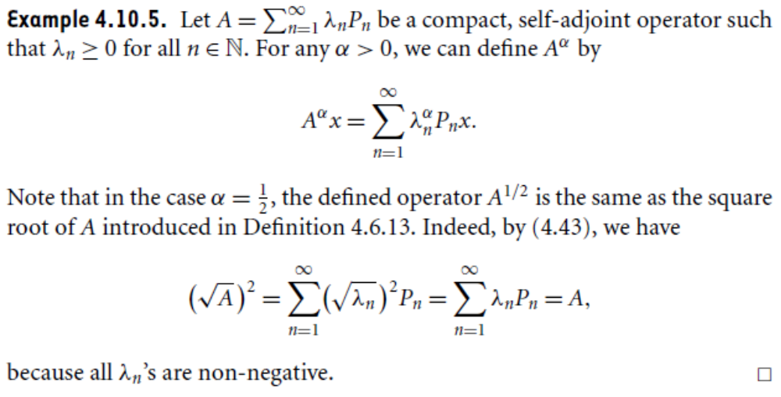

Slide 13
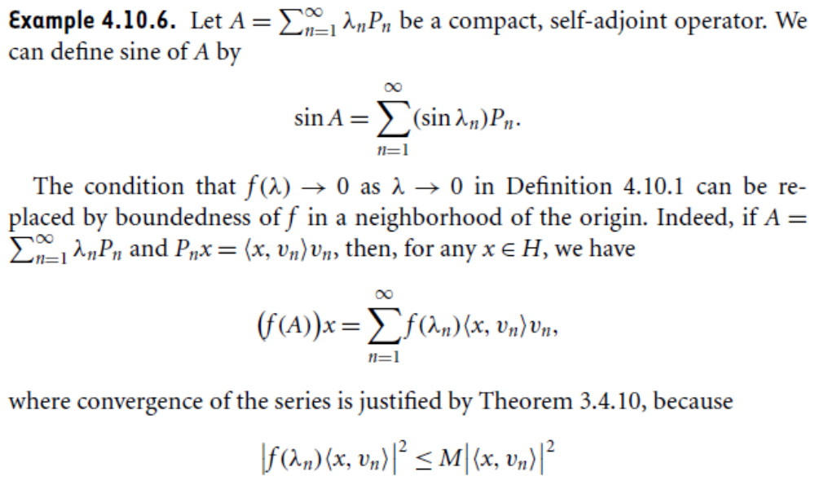

Slide 14
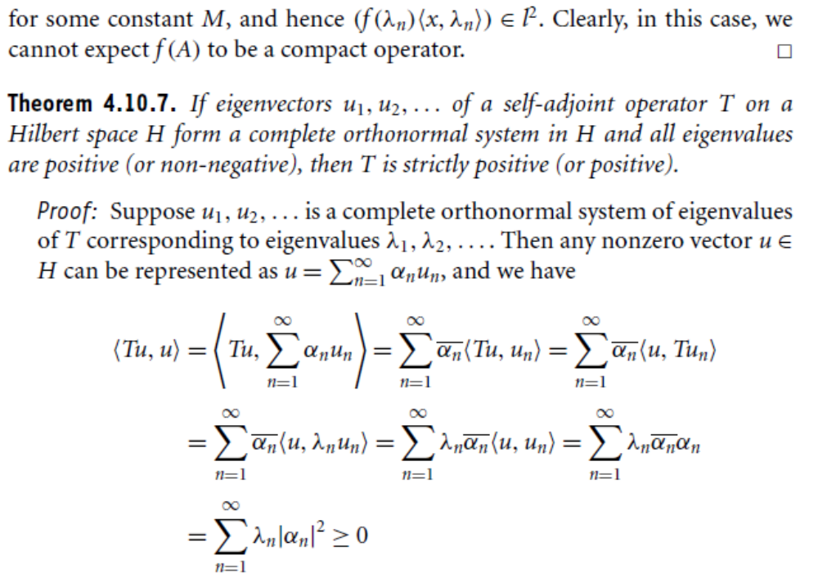

Slide 16
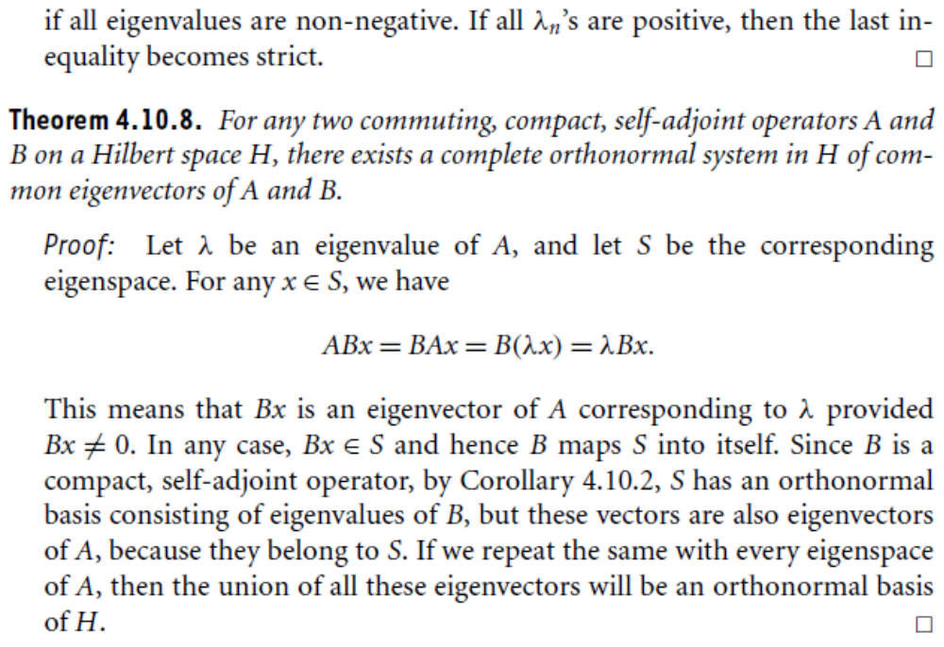

Slide 17
Summary of the today’s Lecture
In our today’s lecture, we started a new section which is spectral decomposition. We proved Hibert Schmidt theorem and spectral theorem for compact self-adjoint operators. At the end we define function of operators and furnished many examples to explain this definition.

