Slide 1
Introduction To Hilbert Spaces with Applications
Lokenath Debnath and Piotr Mikusinski
Course Teacher: Dr. Amjad Hussain

Slide 2
Summary of the Last Lecture
In our last lecture, we introduced the concepts of eigenvalues and eigenvectors which were very useful in many fields of pure and applied mathematics. Terms like Resolvent and spectrum are also defined and related theorems were proved at the end.

Slide 3
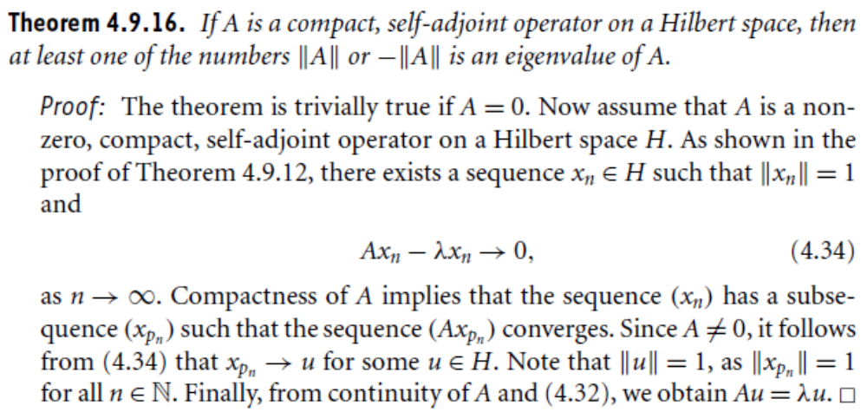

Slide 4
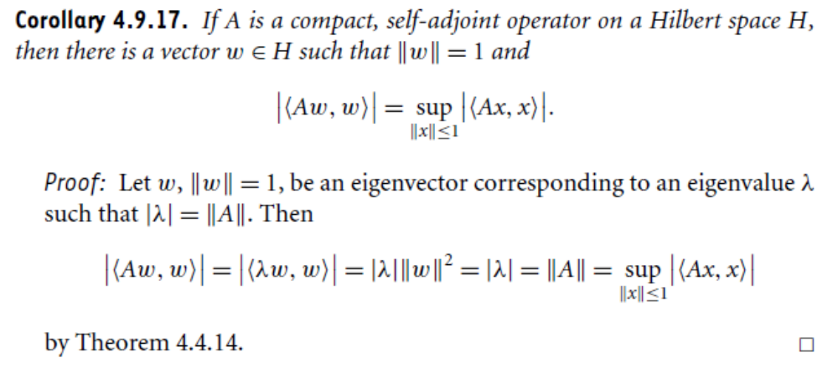

Slide 5
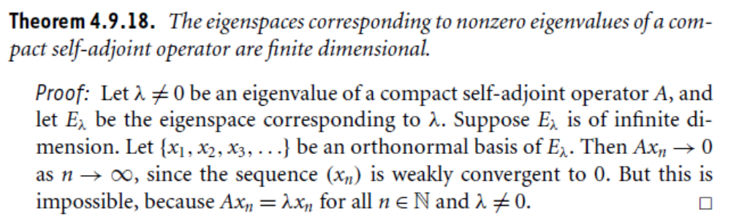
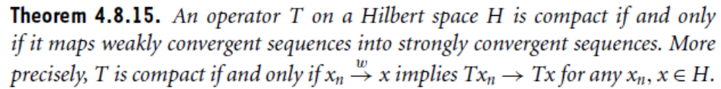
Theorems from Previous Lectures

Slide 6
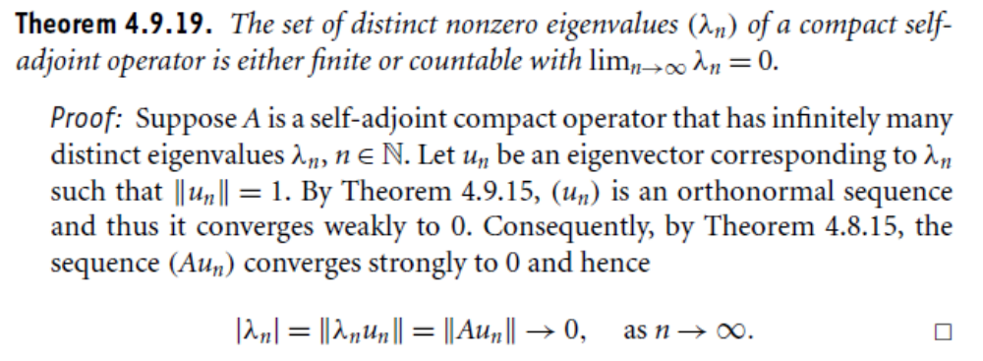

Slide 7
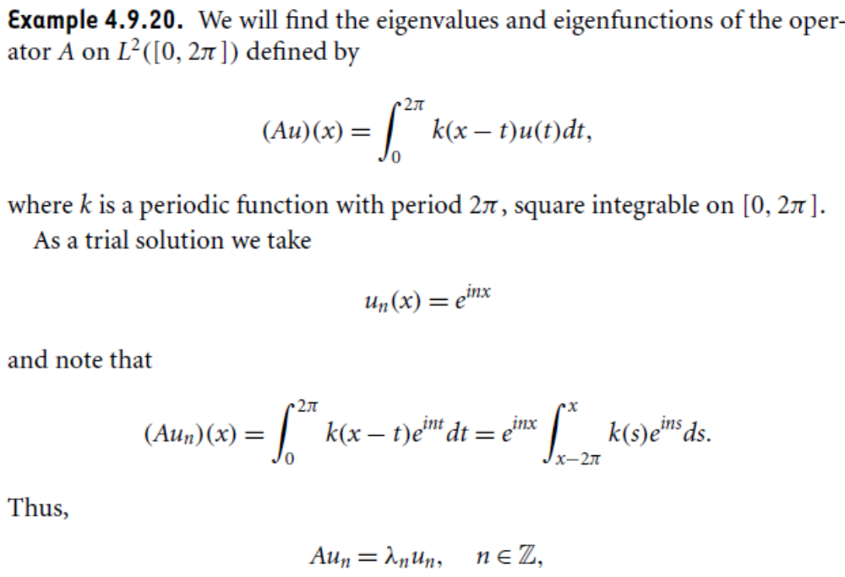

Slide 8
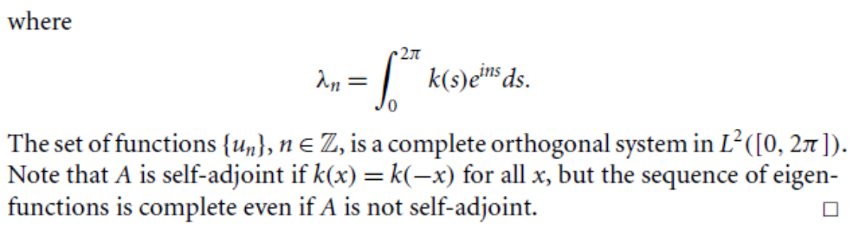
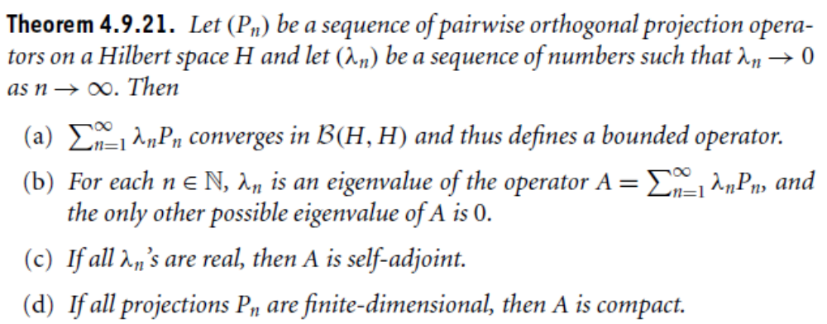

Slide 9
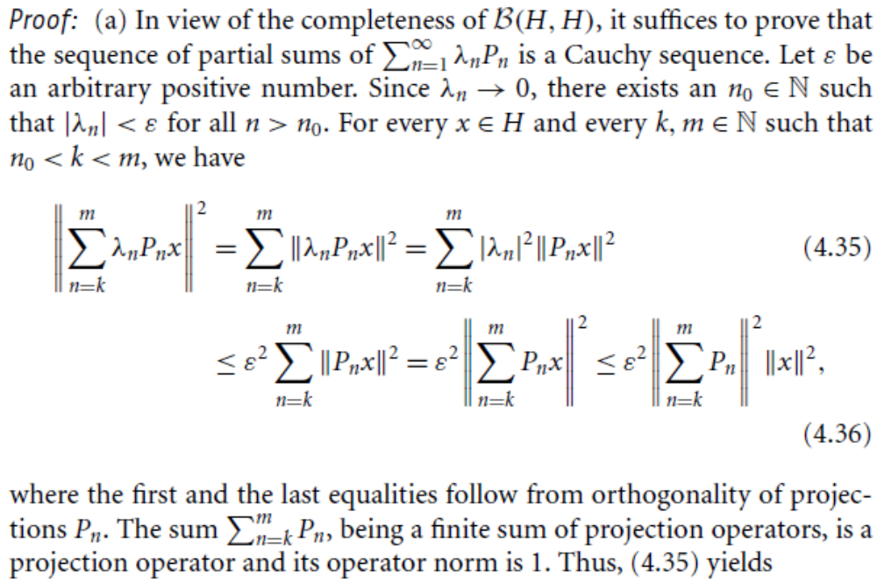

Slide 10
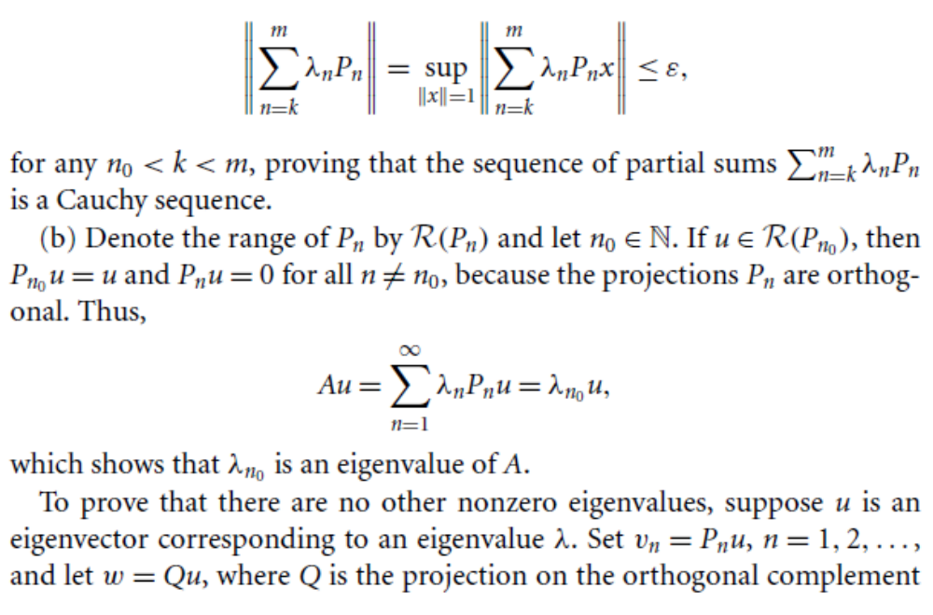

Slide 11
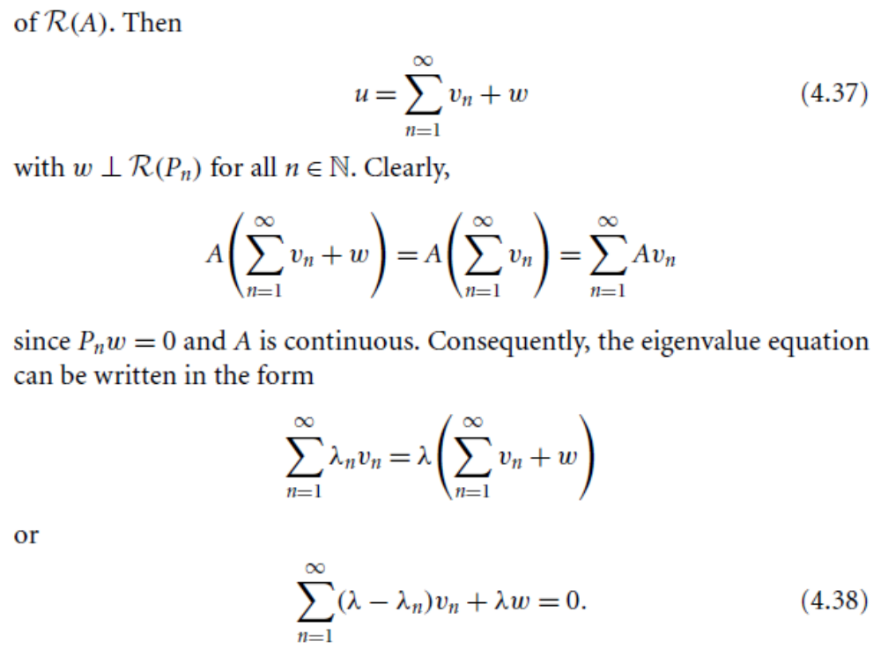

Slide 12
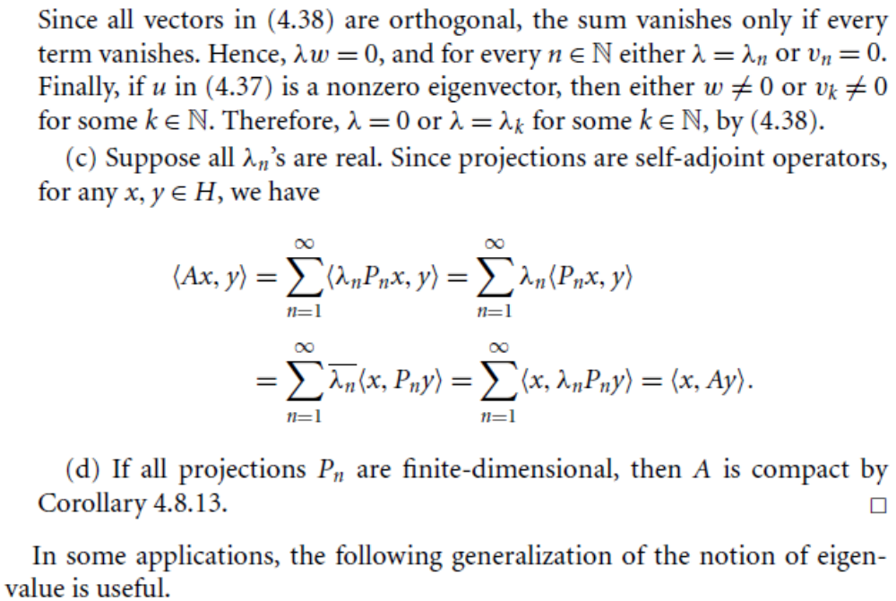

Slide 13
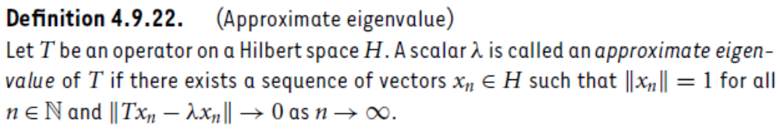
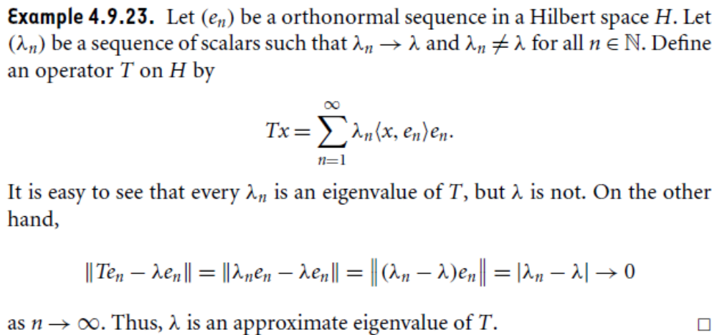

Slide 14
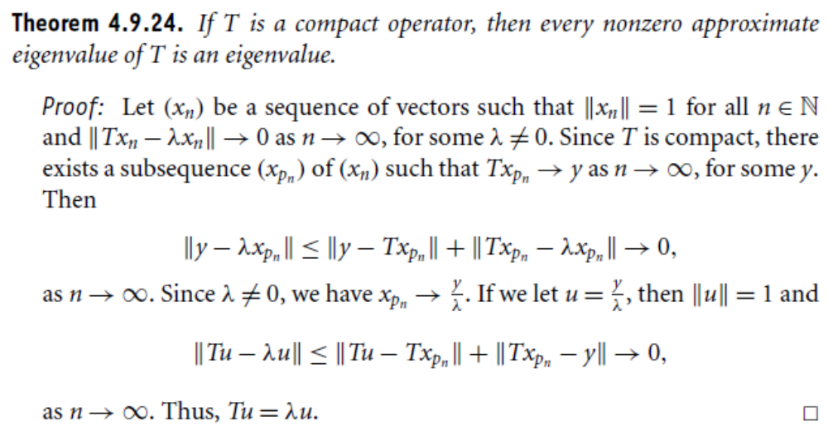

Slide 15
Summary of the today’s Lecture
In our today’s lecture, we consider further results regarding eigenvalues and eigenvectors corresponding to the self-adjoint, compact and orthogonal operators. Finally, we define approximate eigenvalue and proved related theorems.

