Slide 1
Introduction To Hilbert Spaces with Applications
Lokenath Debnath and Piotr Mikusinski
Course Teacher: Dr. Amjad Hussain

Slide 2
Summary of the Last Lecture
In our last lecture, we considered compact operators and finite dimensional operators. Several theorems were presented in order to characterize the compactness of operators. Finally, it was concluded that compactness is stronger condition then boundedness.

Slide 3
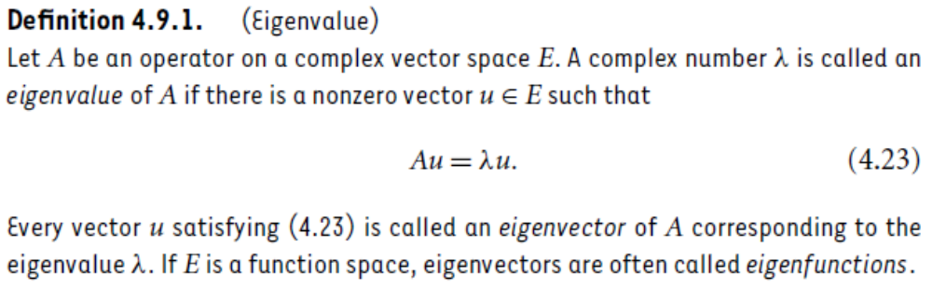
Eigenvalues and Eigenvectors

Slide 4
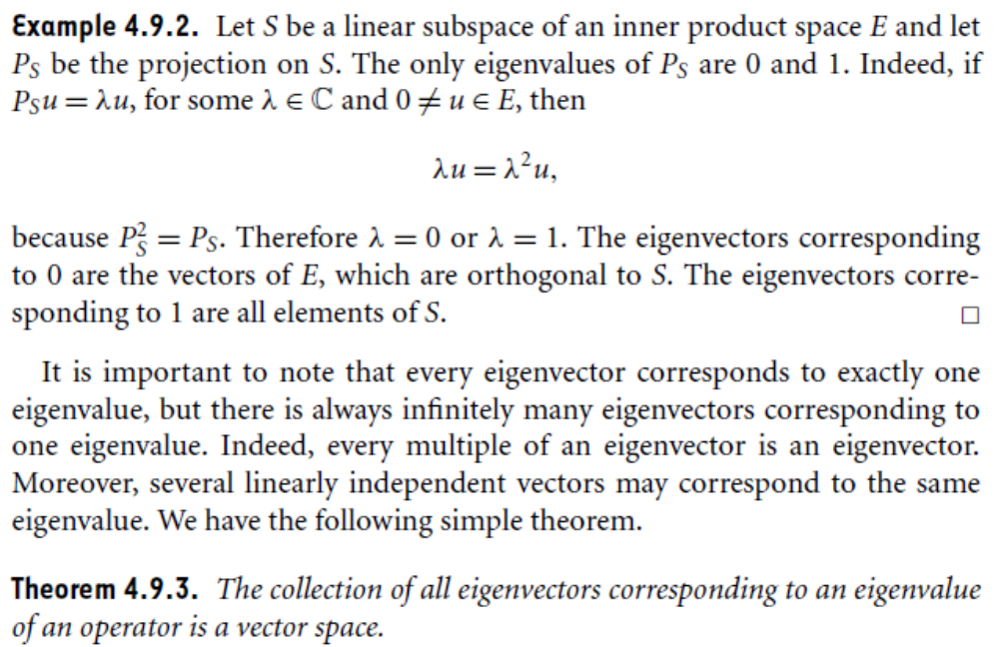

Slide 5
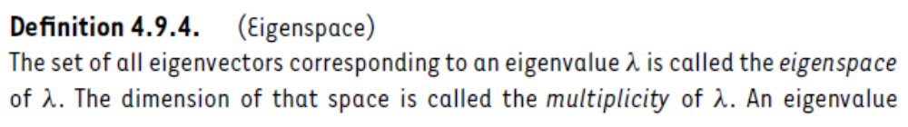
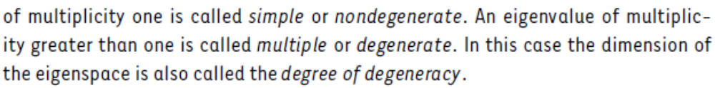
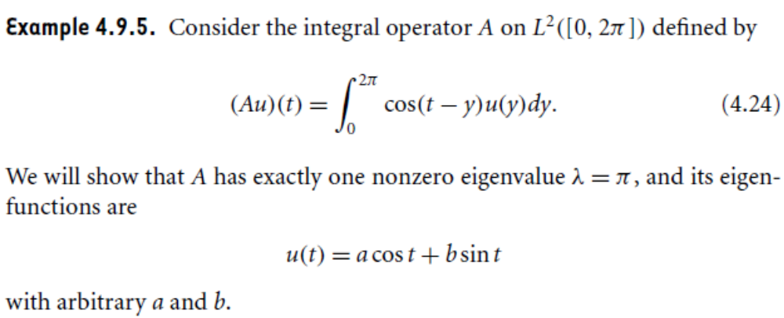

Slide 6
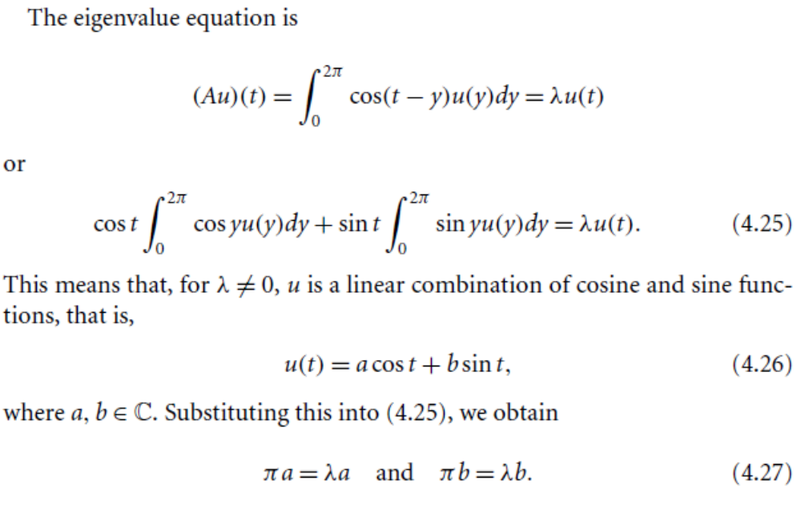

Slide 7
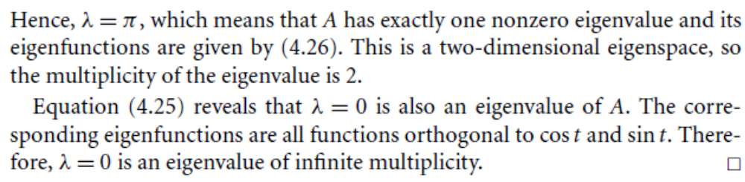
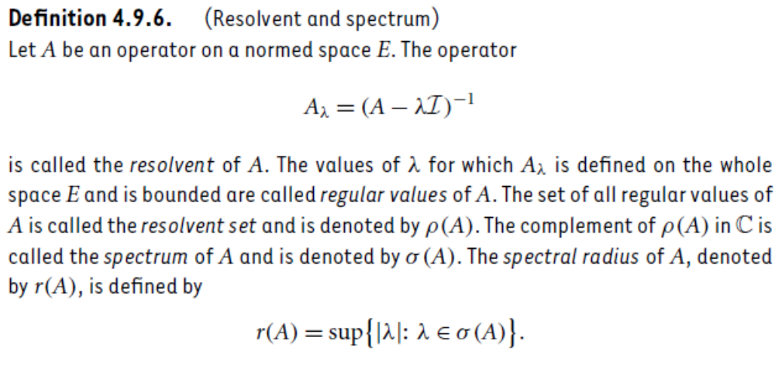

Slide 8
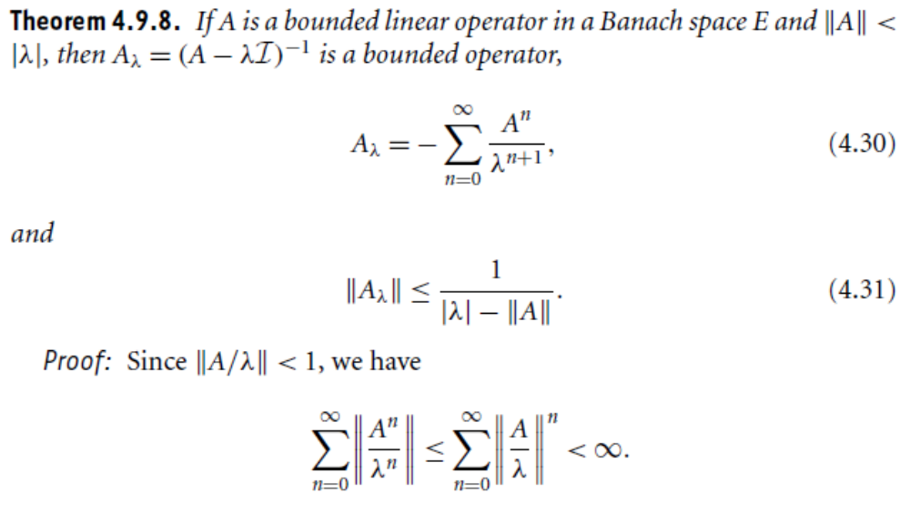

Slide 9
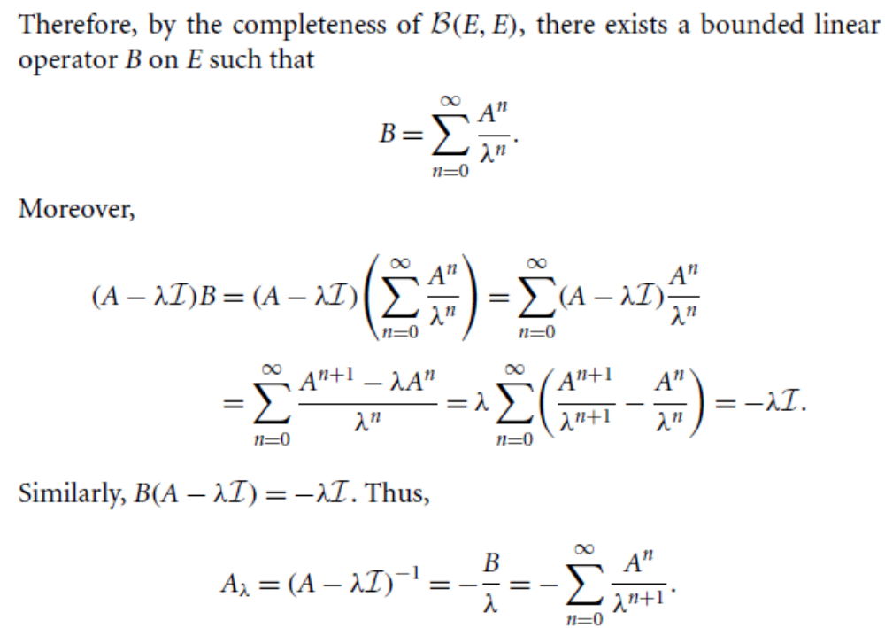

Slide 10
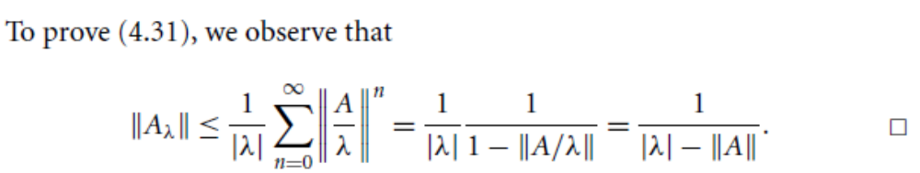
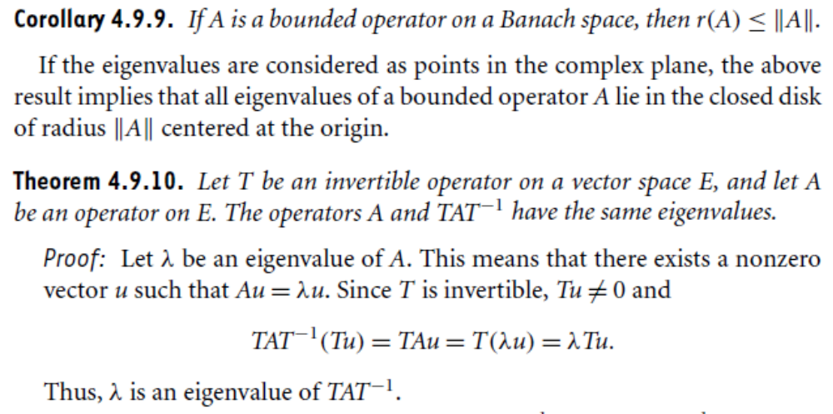

Slide 12
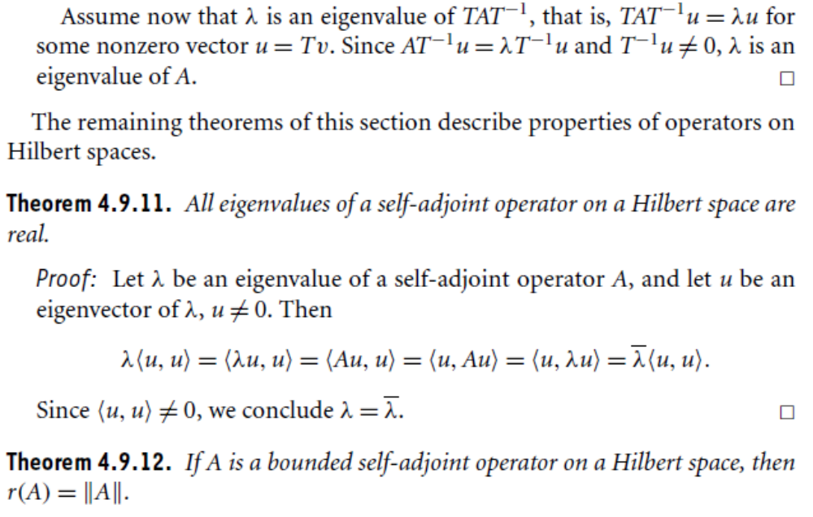

Slide 13
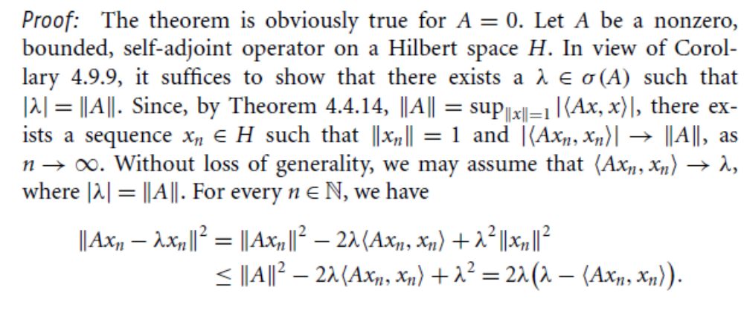
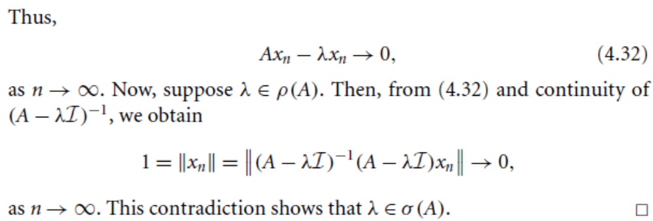

Slide 15
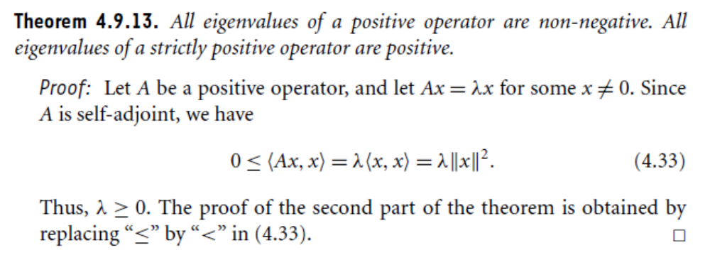

Slide 16
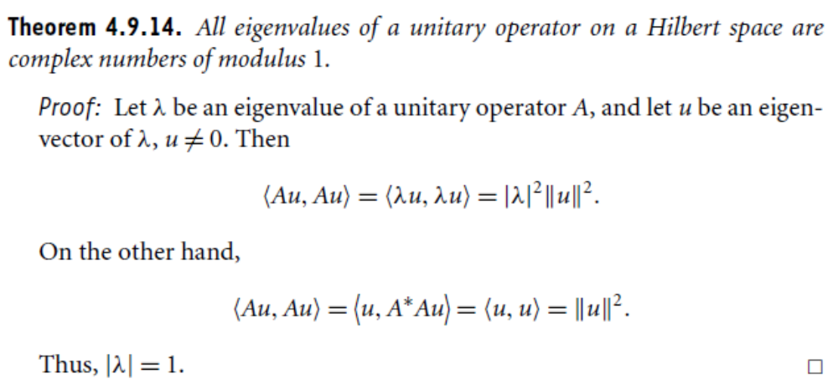

Slide 17
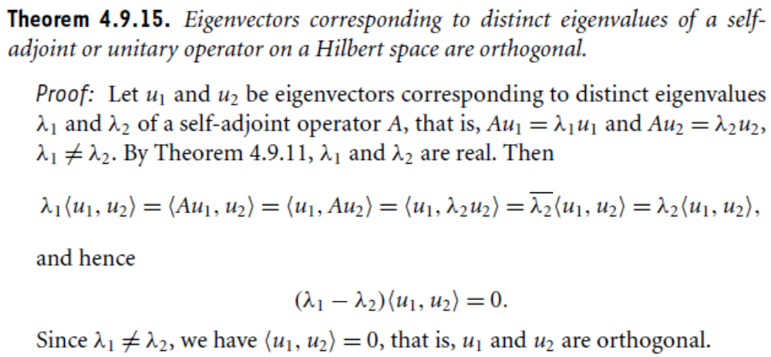

Slide 18
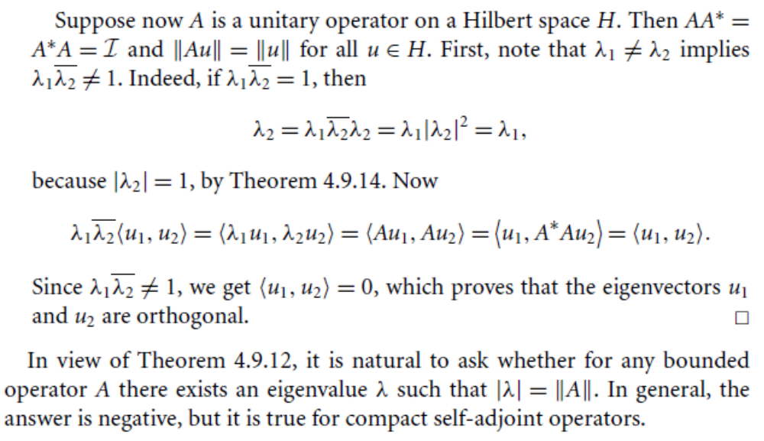

Slide 19
Summary of the today’s Lecture
In our today’s lecture, we introduce the concepts of eigenvalues and eigenvectors which are very useful in many fields of pure and applied mathematics. Terms like Resolvent and spectrum are also defined and related theorems are proved at the end.

