Slide 1
Introduction To Hilbert Spaces with Applications
Lokenath Debnath and Piotr Mikusinski
Course Teacher: Dr. Amjad Hussain

Slide 2
Summary of the Last Lecture
In our last lecture, we considered square root of positive operators and defined strictly positive operators. We started new section of projection operators and defined orthogonal projection operators, idempotent operators and orthogonality of projection operators. Several theorem were then furnished to complete this section.

Slide 3
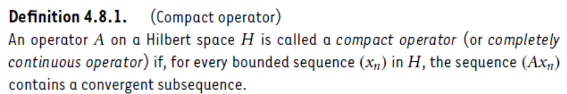
Compact Operators

Slide 4
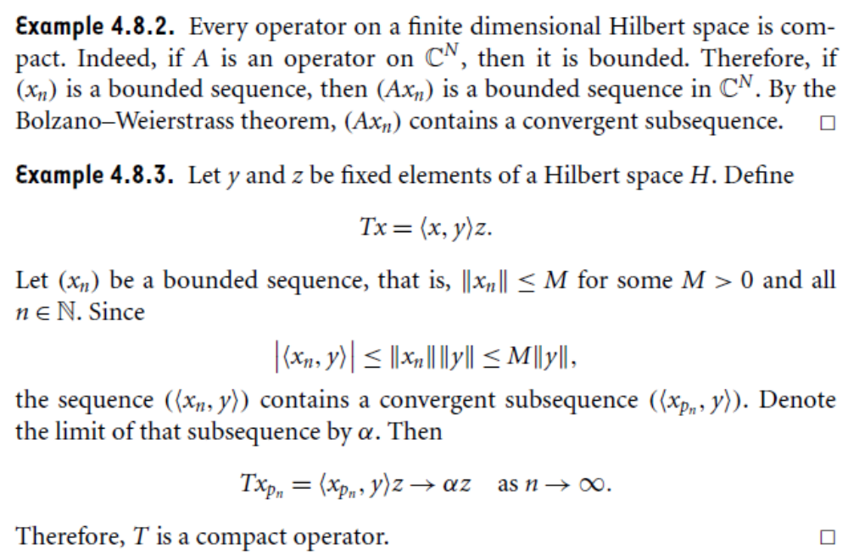

Slide 5
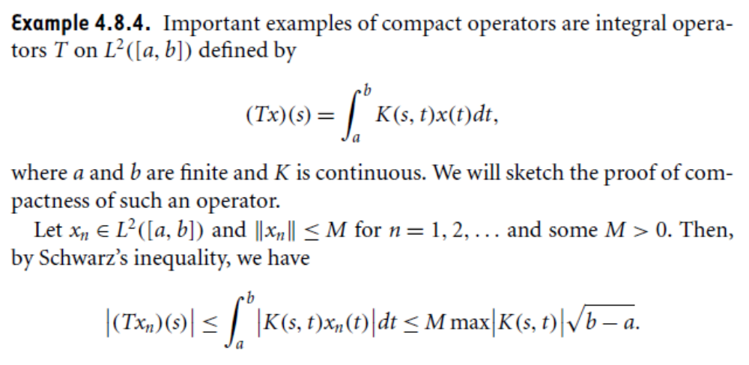

Slide 7
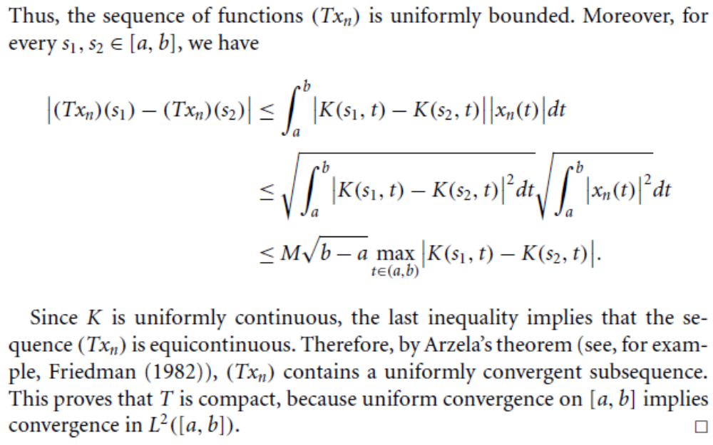

Slide 8
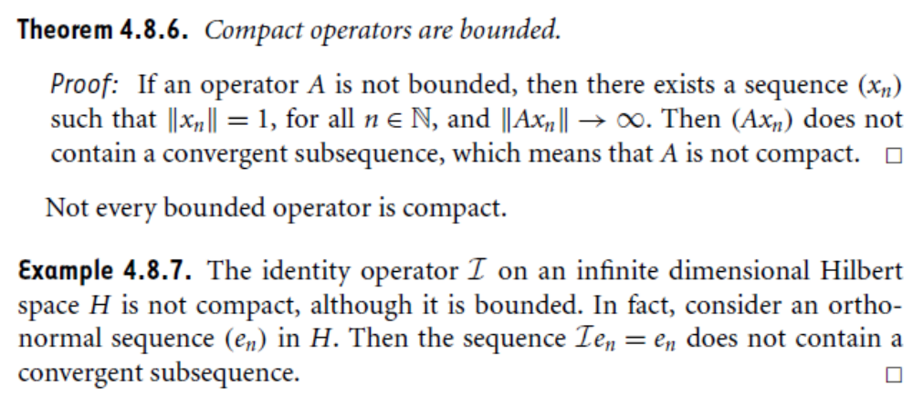
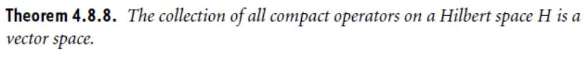

Slide 9
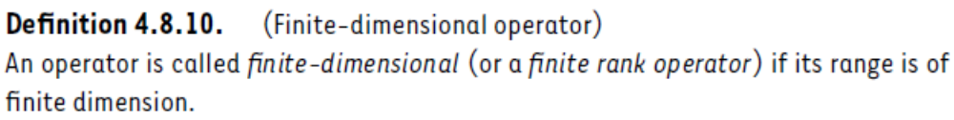
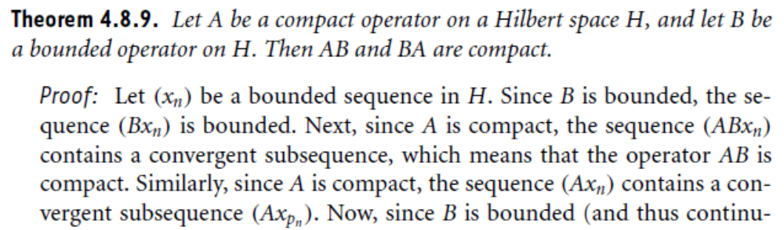

Slide 10
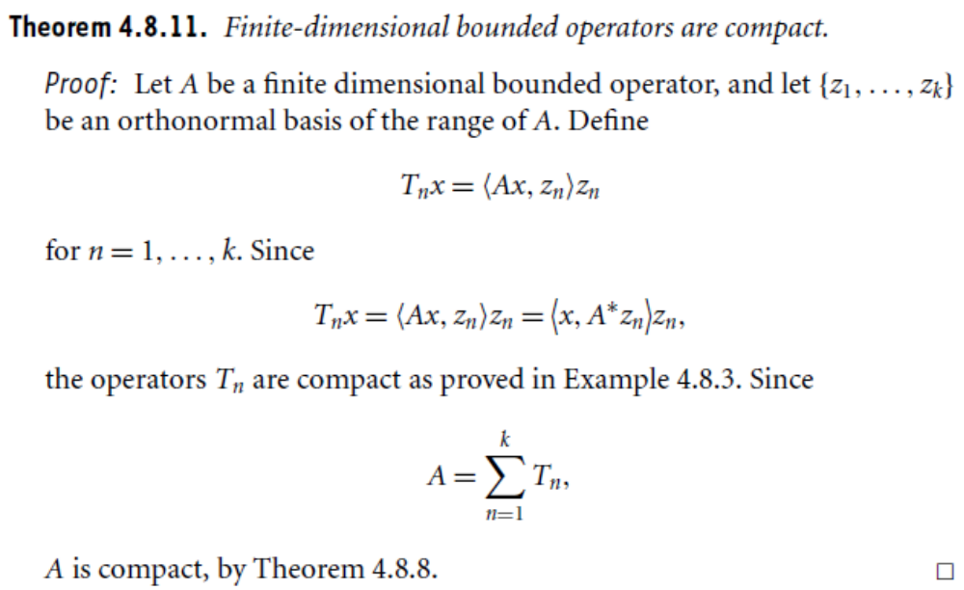

Slide 11
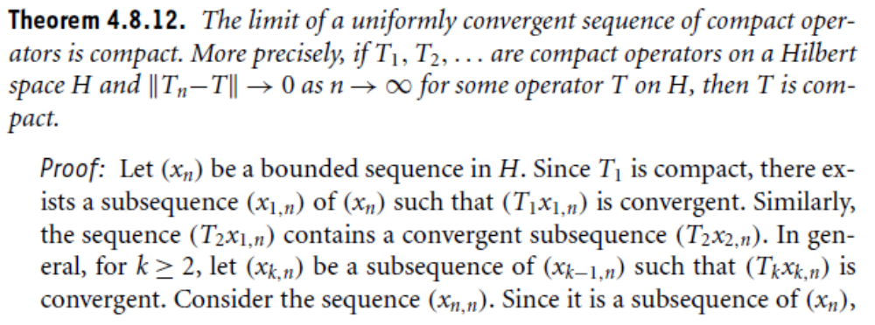
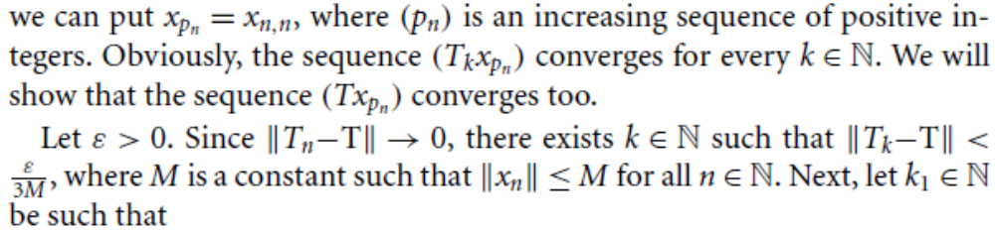

Slide 12
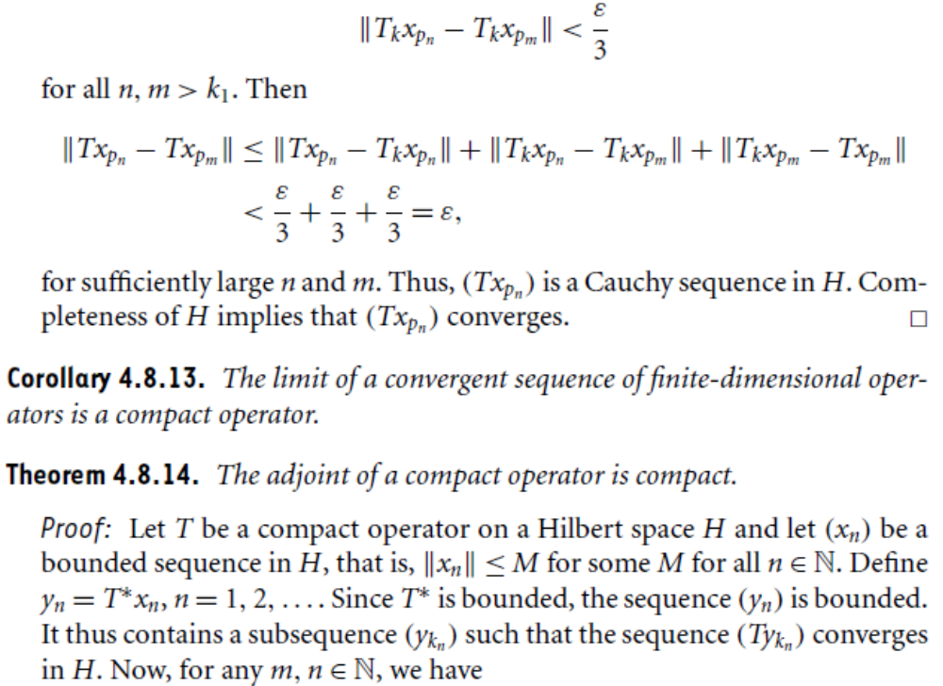

Slide 14
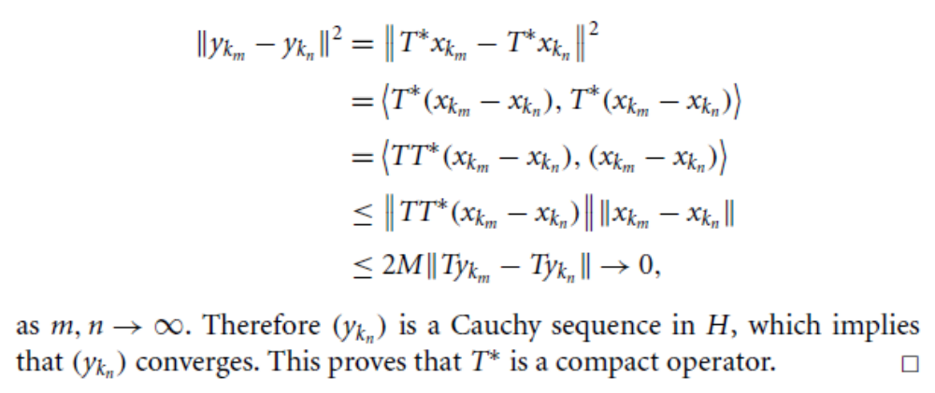
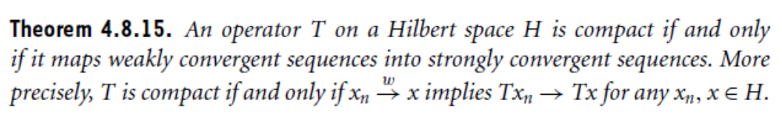

Slide 15
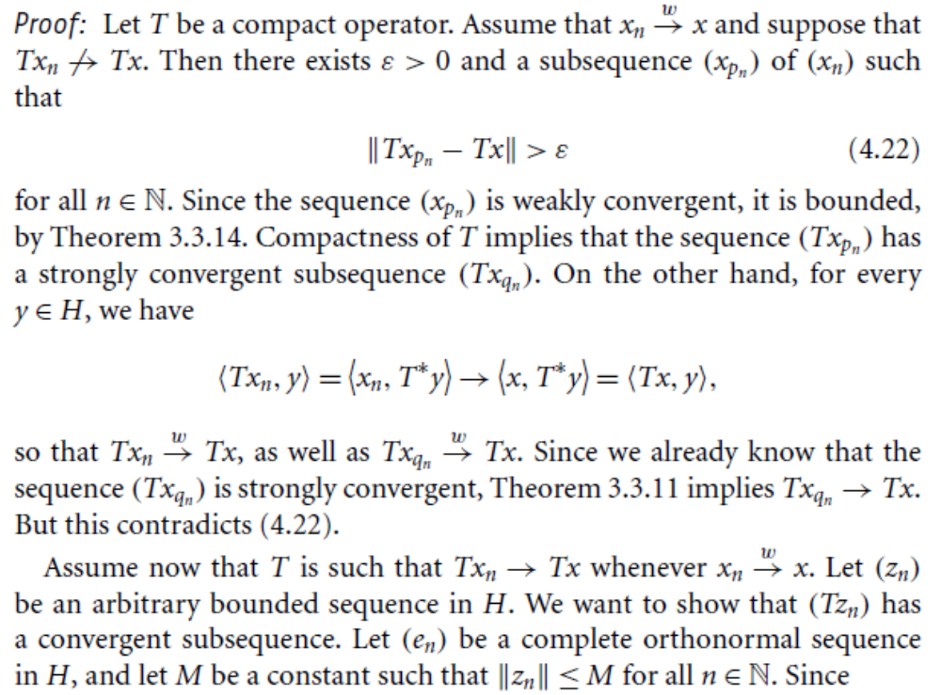

Slide 16
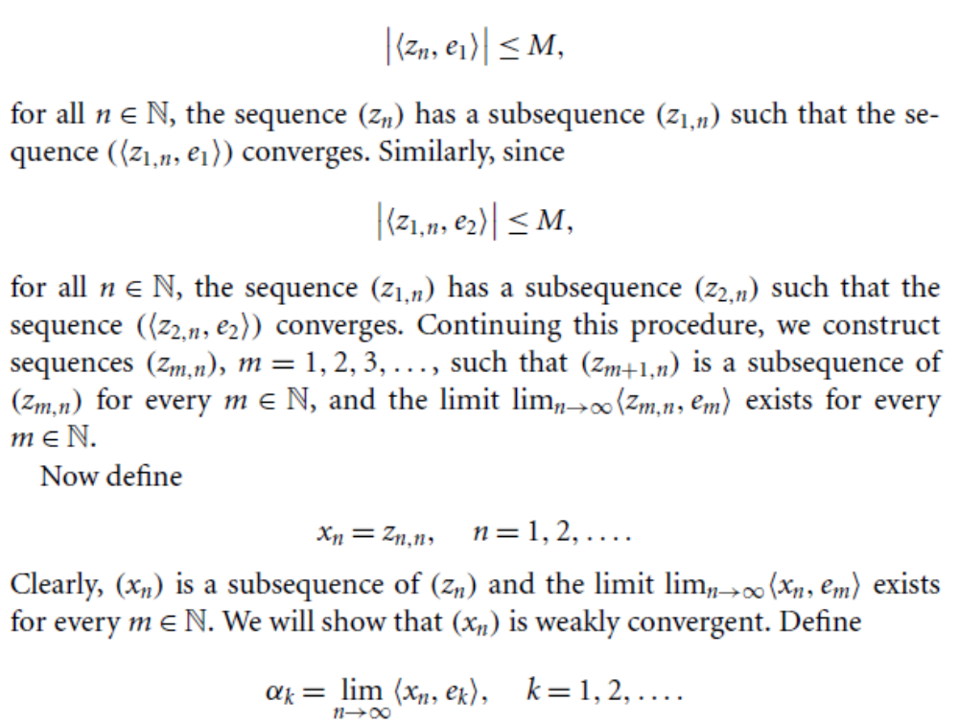

Slide 17
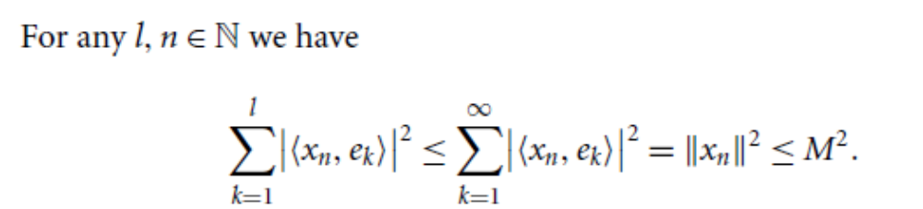
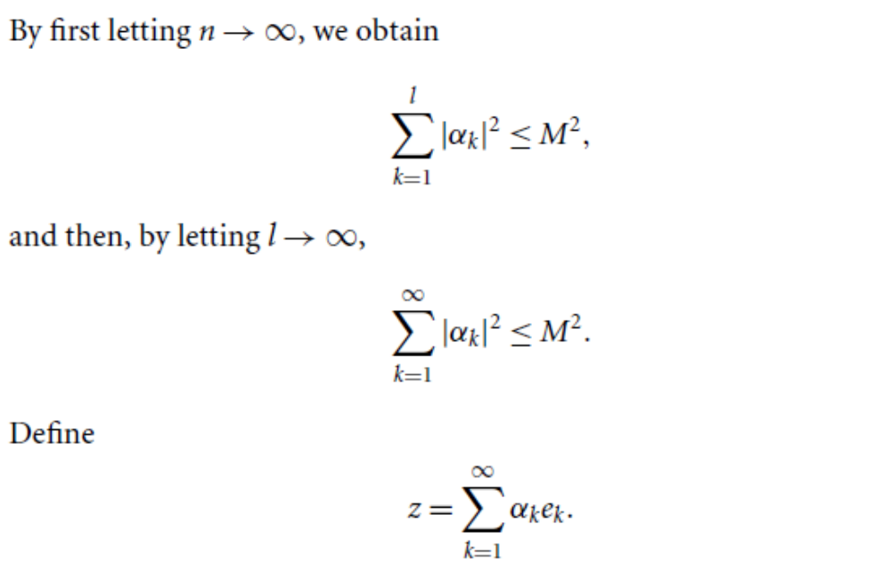

Slide 18
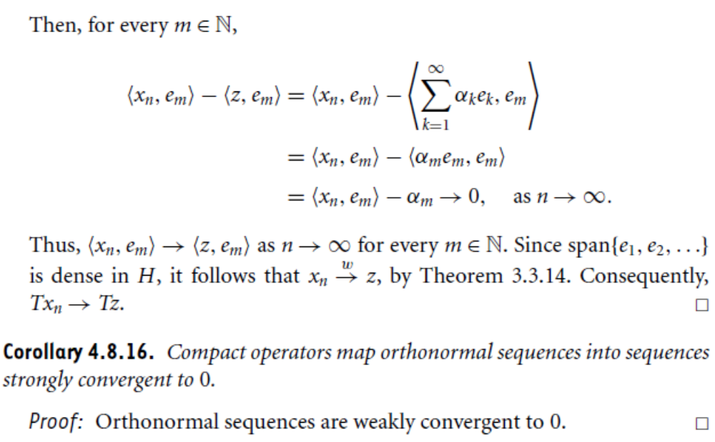

Slide 19
Is compactness is stronger condition then Boundedness?

Slide 20
Summary of the today’s Lecture
In our today’s lecture, we consider compact operators and finite dimensional operators. Several theorems are presented in order to characterize the compactness of operators. Finally, it is concluded that compactness is stronger condition then boundedness.

