Slide 1
Introduction To Hilbert Spaces with Applications
Lokenath Debnath and Piotr Mikusinski
Course Teacher: Dr. Amjad Hussain

Slide 2
Summary of the Last Lecture
In our last lecture, we complete the remainder of the self-adjoint operators. We than switched to the new section of invertible, normal, isometric and unitary operators and proved many theorem by first defining these terms.

Slide 3
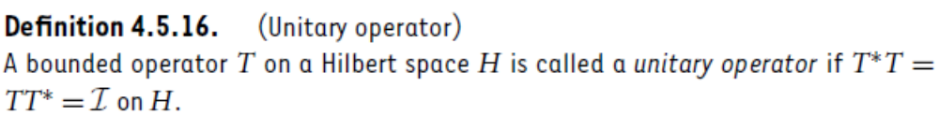
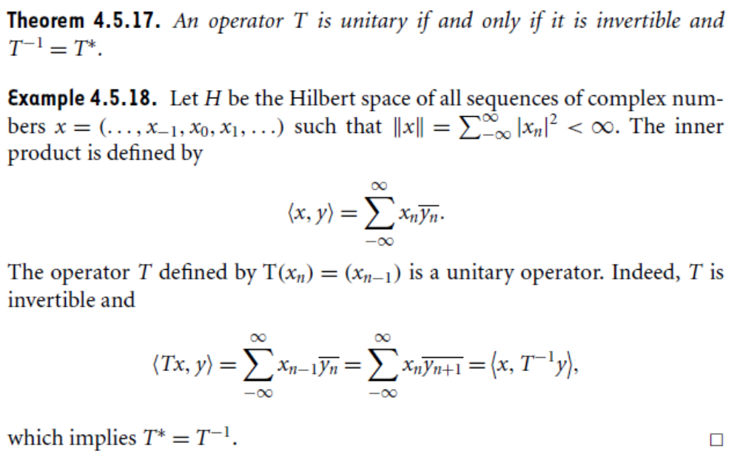

Slide 4
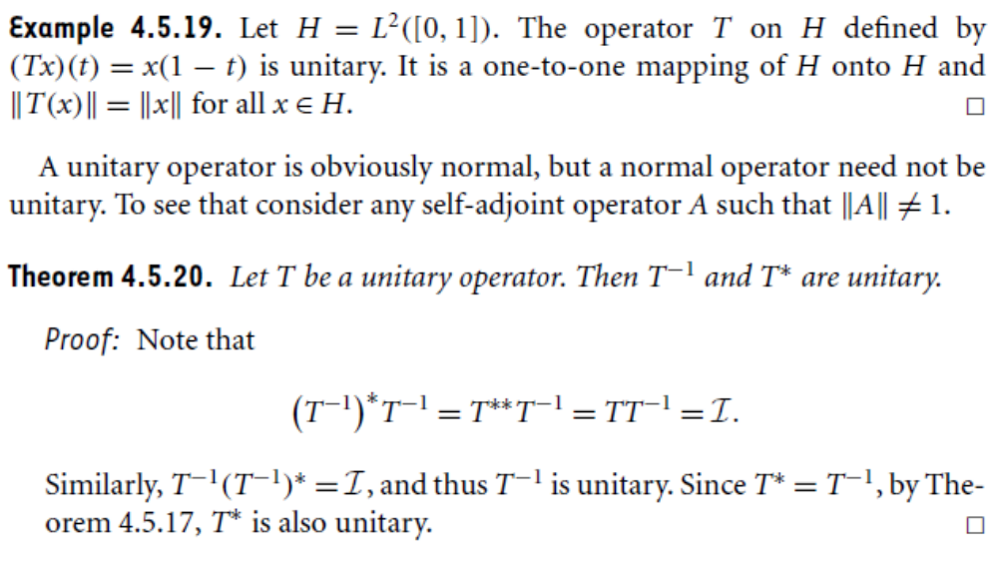

Slide 5
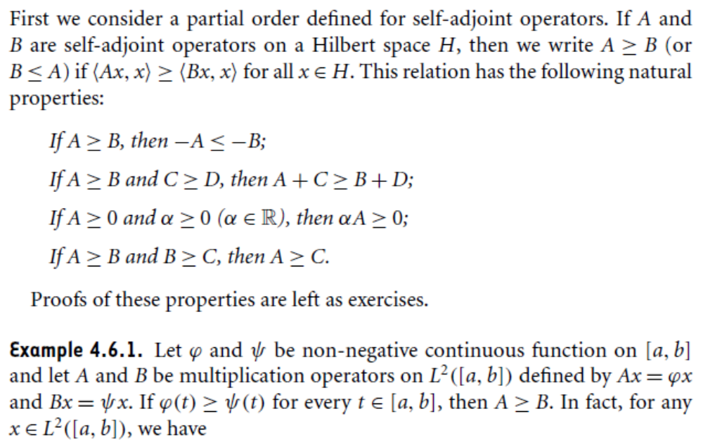
Positive Operator

Slide 6
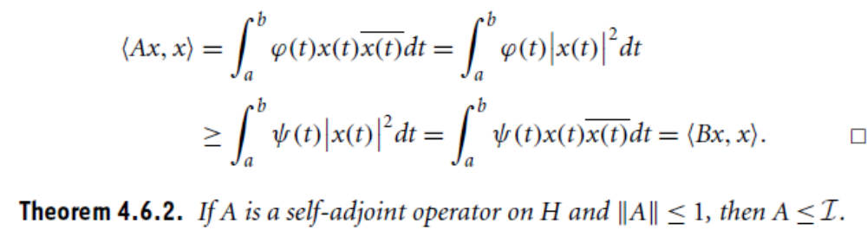
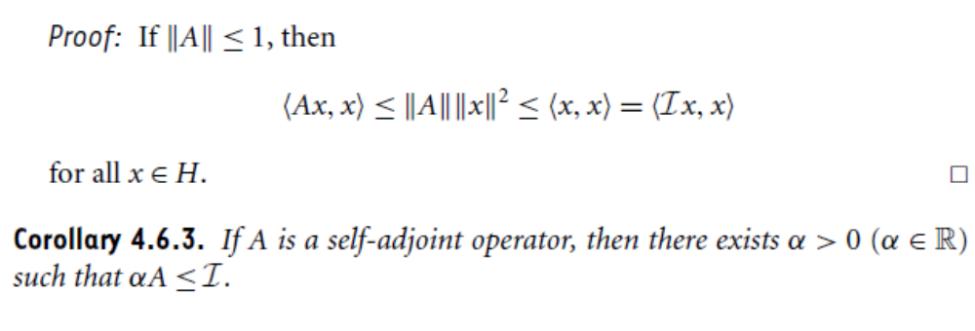

Slide 7
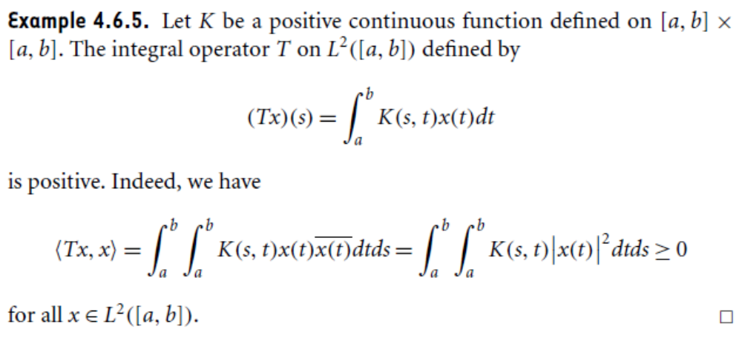

Slide 8
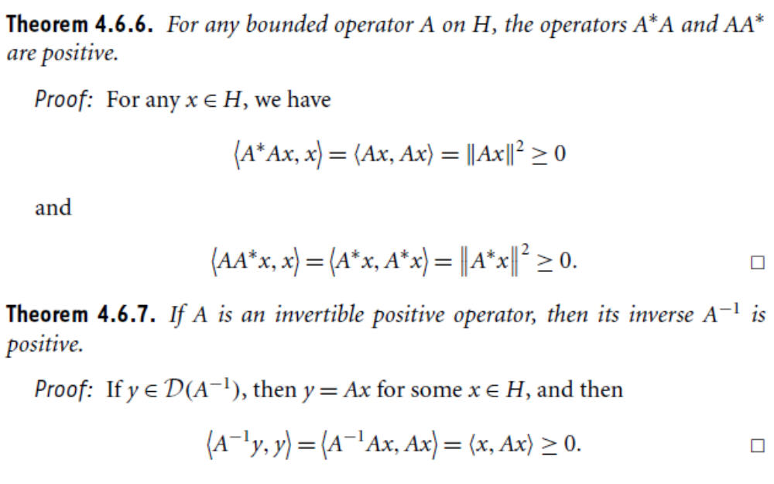

Slide 9
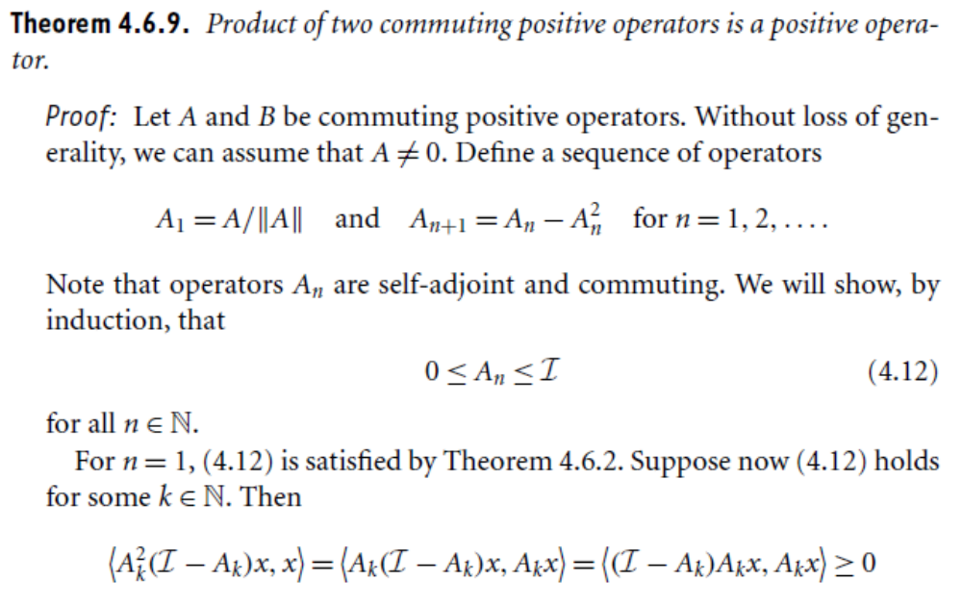

Slide 10
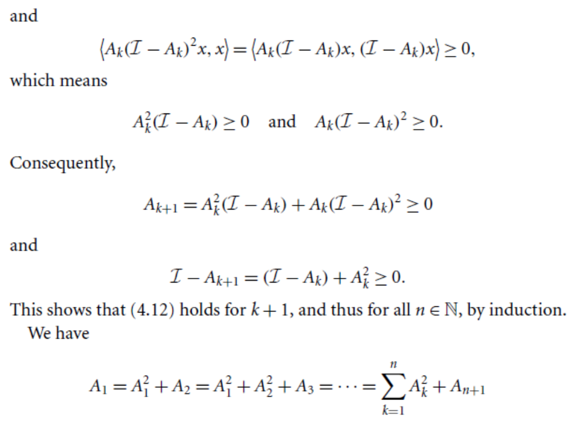

Slide 11
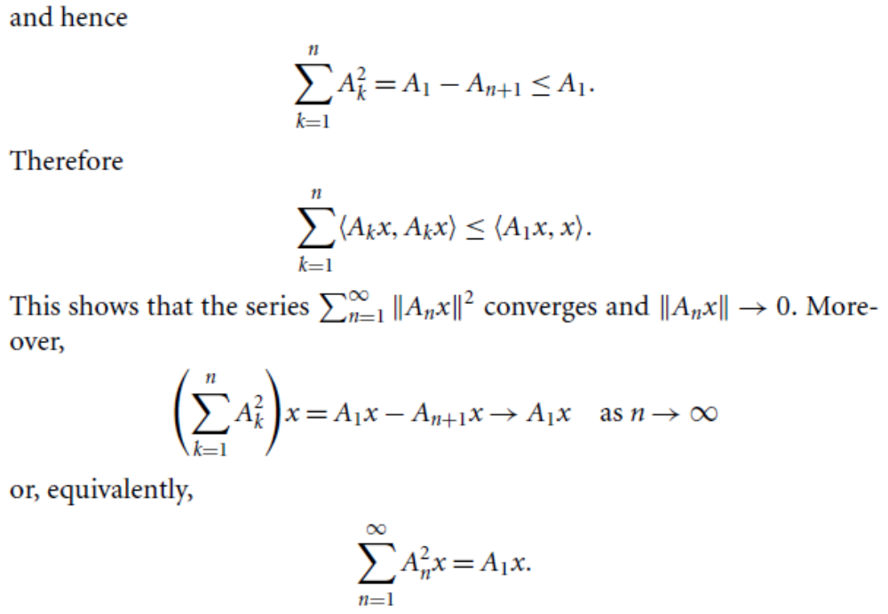

Slide 12
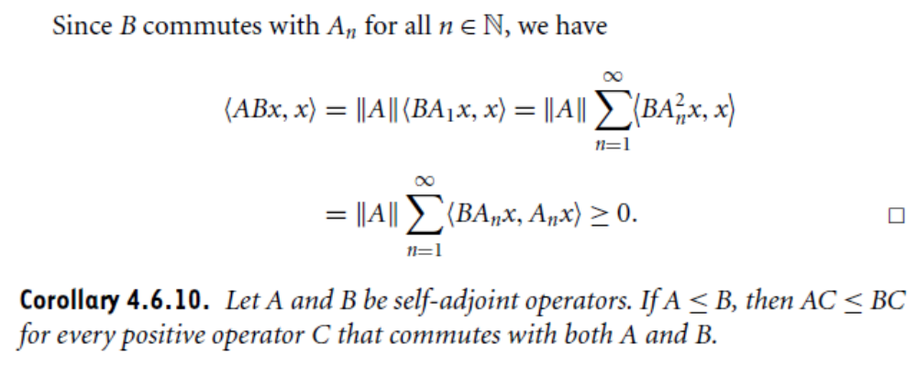

Slide 13
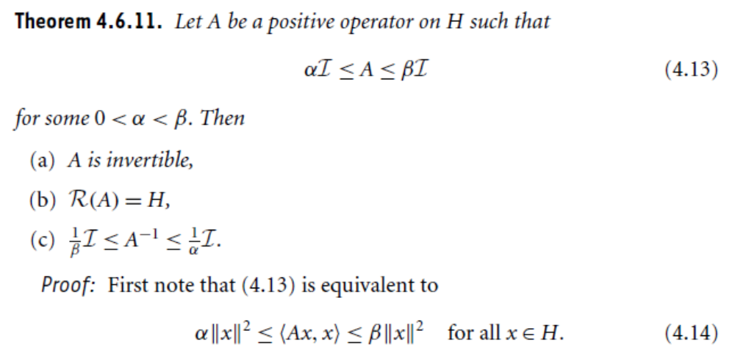

Slide 14
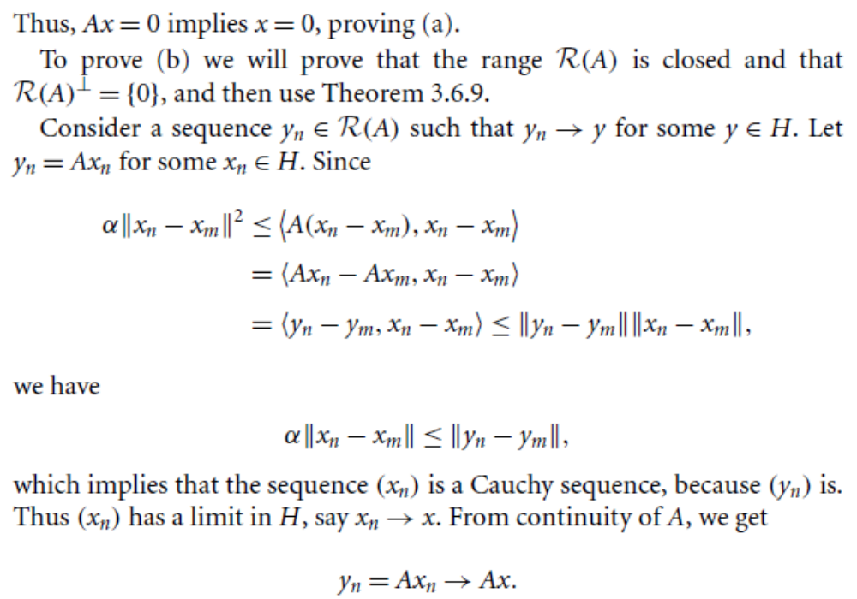

Slide 15
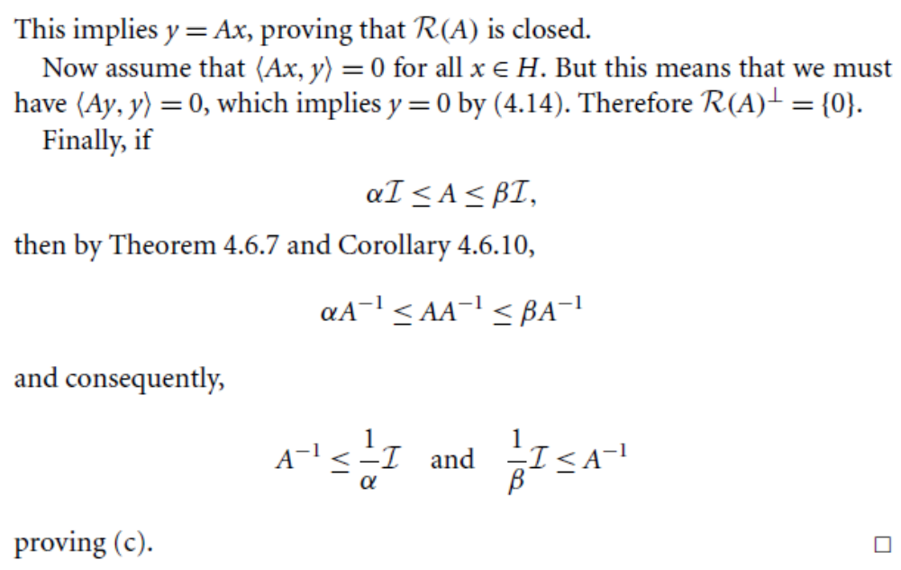

Slide 16
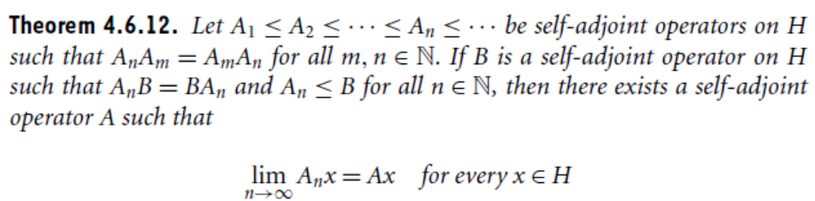
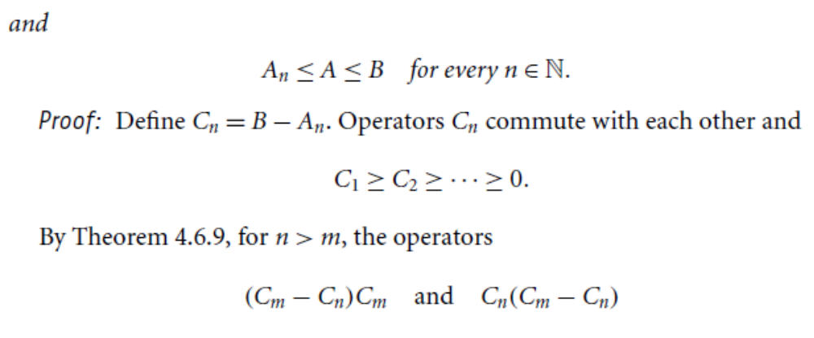

Slide 17
Summary of the today’s Lecture
In our today’s lecture, we consider the remaining part of the previous section and proved some theorems on unitary operators. Finally, we end this lecture by introducing the term positive operator and proving related theorem.

