Slide 1
Introduction To Hilbert Spaces with Applications
Lokenath Debnath and Piotr Mikusinski
Course Teacher: Dr. Amjad Hussain

Slide 2
Summary of the Last Lecture
In our last lecture, we considered coercive functionals with Lax Miligram theorem. We then turned into adjoint operators and gave some examples and related theorems. Finally self adjoint operators were discussed at the end.

Slide 3
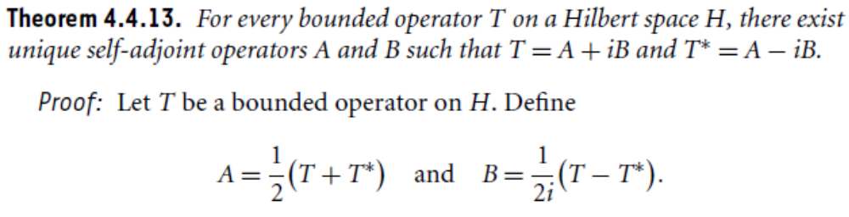
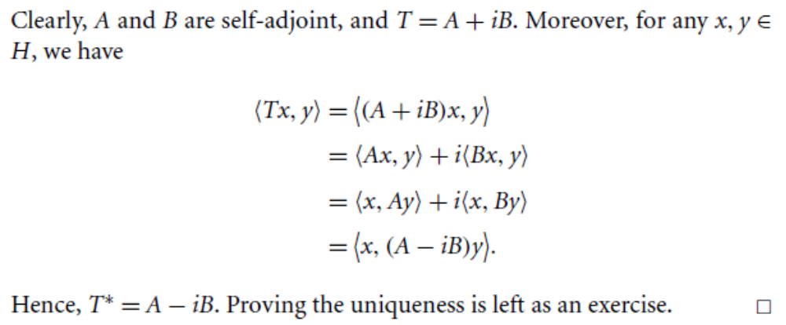

Slide 4
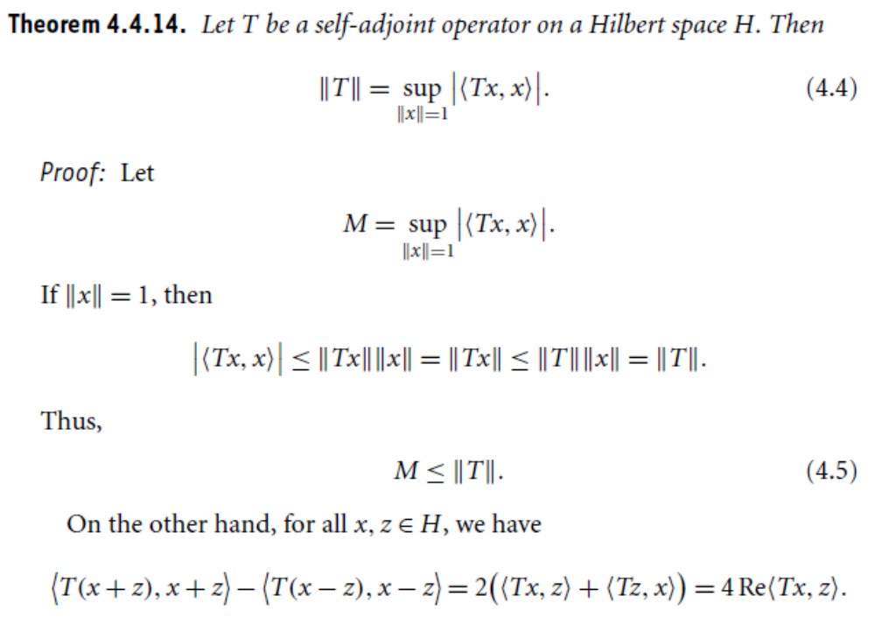

Slide 6
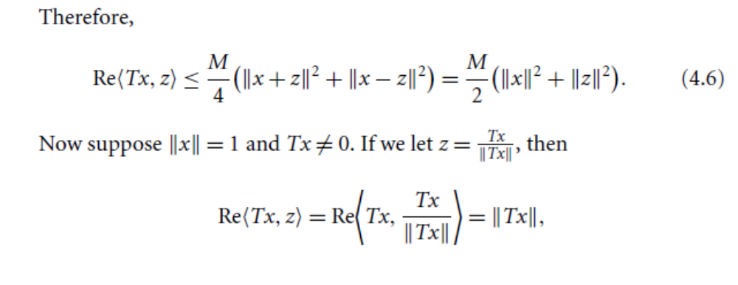
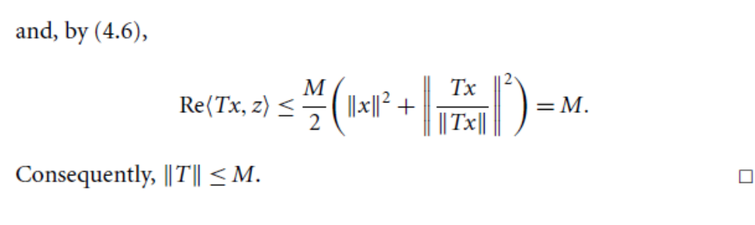

Slide 7
Invertible, Normal, isometric and Unitary Operators

Slide 8
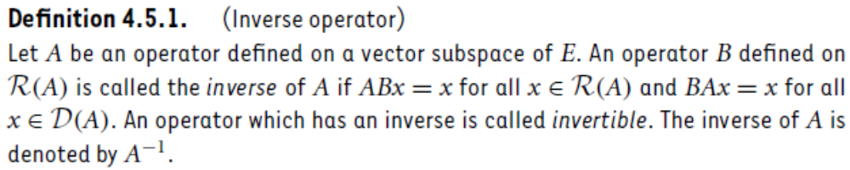
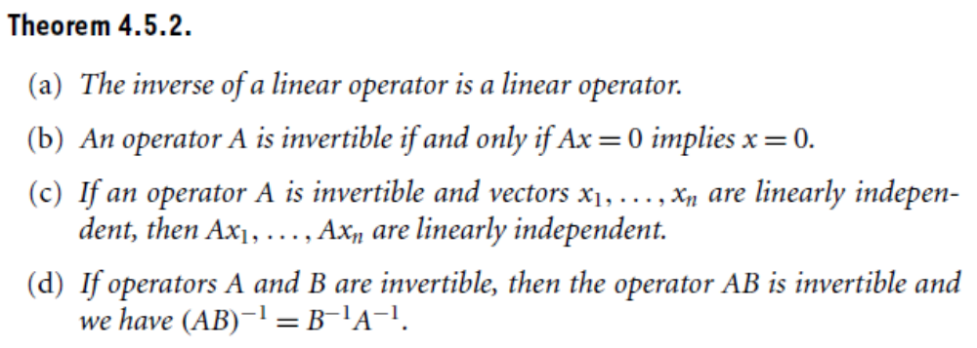
Algebraic Properties of invertible operators

Slide 9
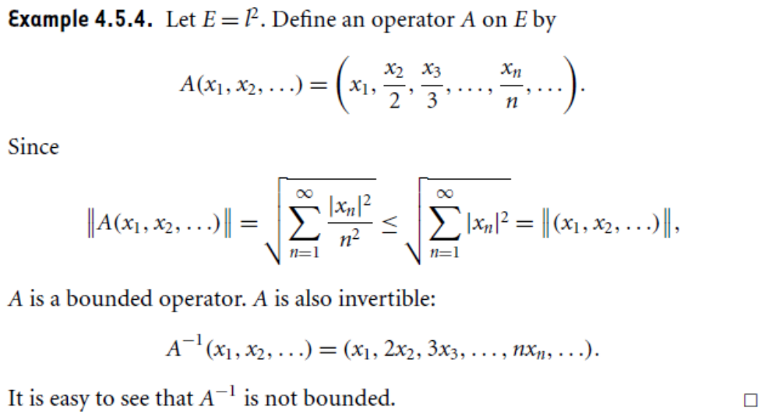

Slide 10
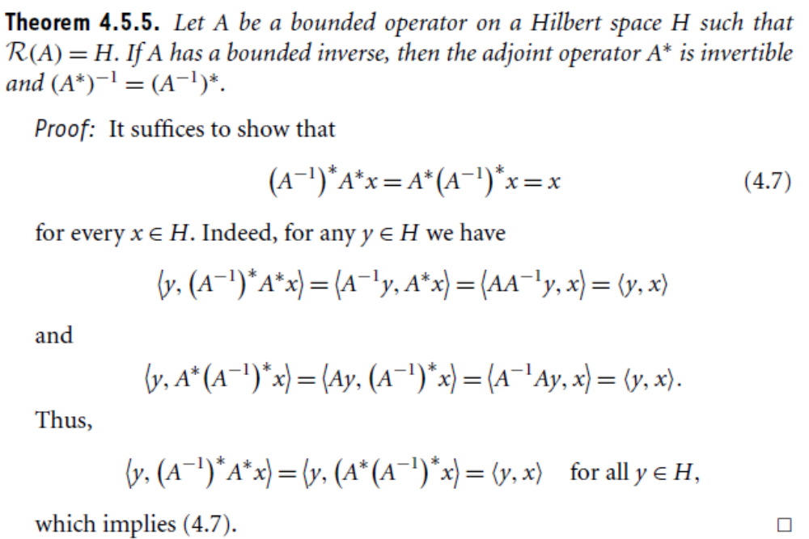

Slide 11
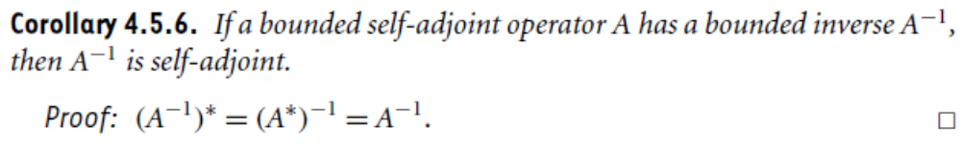
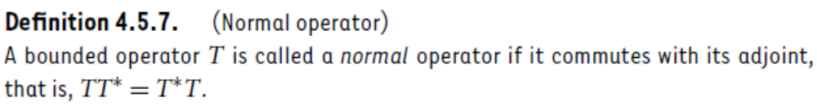

Slide 12
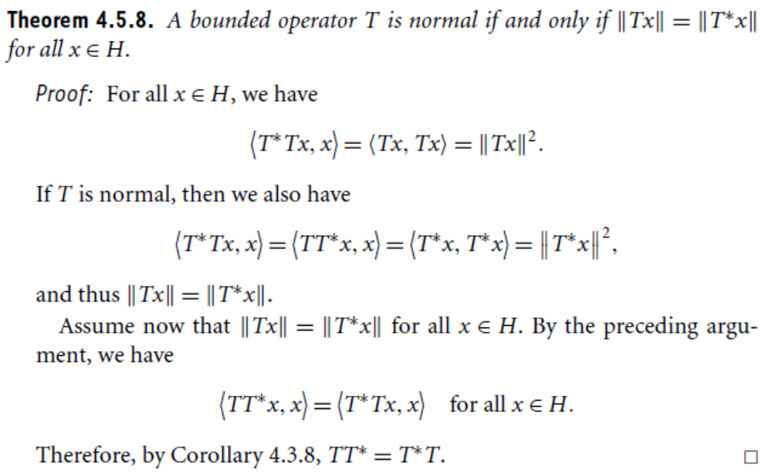

Slide 13
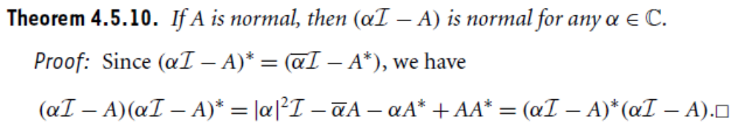
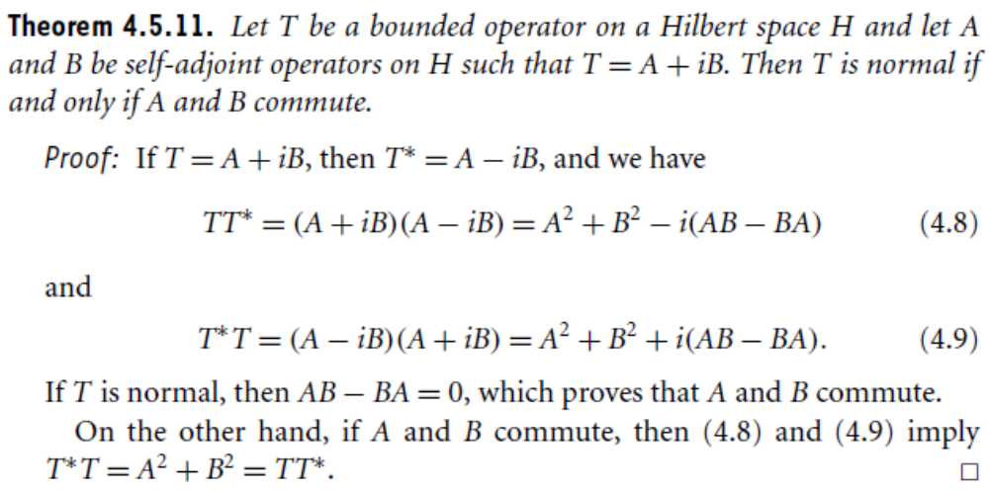

Slide 14
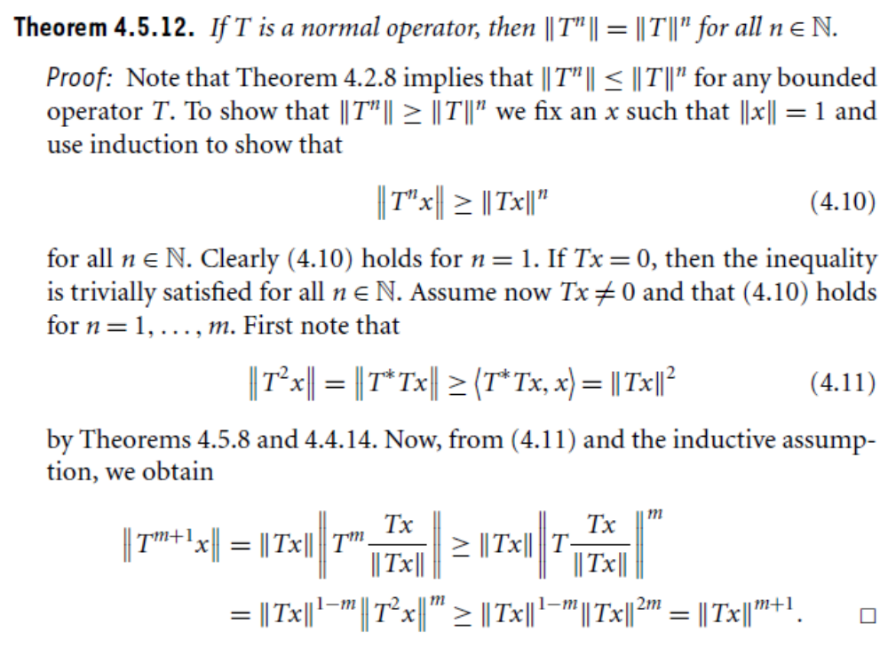

Slide 15
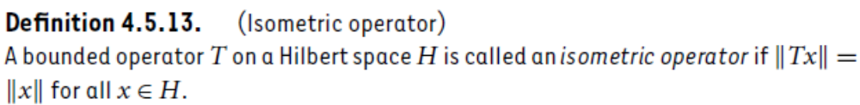
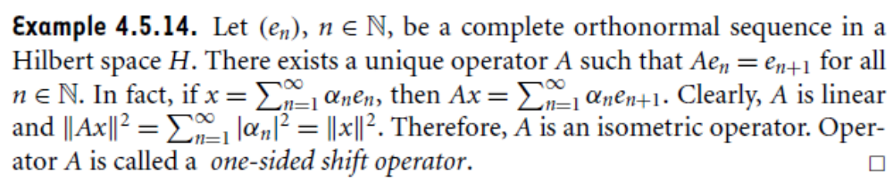

Slide 16
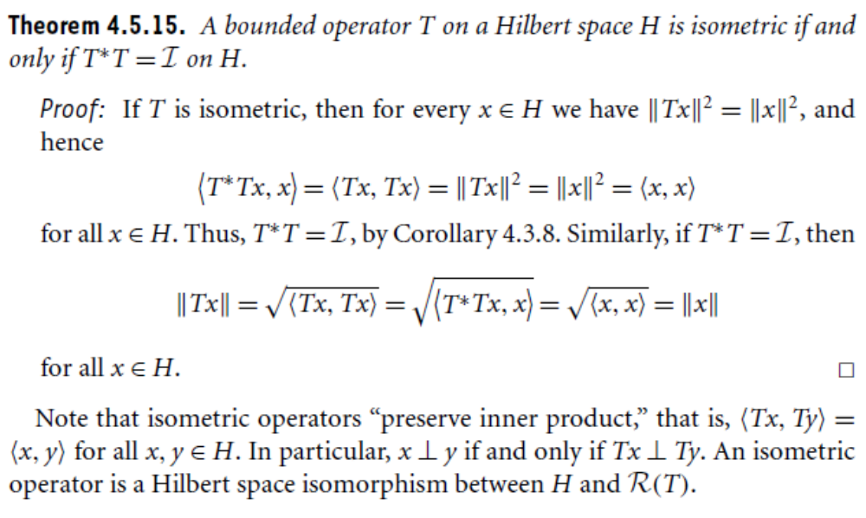

Slide 17
Summary of the today’s Lecture
In our today’s lecture, we consider some more result regarding self adjoint operators. The new section, that is section 4.5 is started in which we study the definitions of invertible, normal, isometric and unit operators. We then proved some theorems on these topics.

